Slide 1
Predicting Depression in Older Adults
Early prediction from 4 years out using ELSA longitudinal data
Akeeb Lawel • Fiyin Akano • Zannat Chowdhury Sagar
Giridhar Nampally • Pushkar Jadav • Poorna Golla
MSc Artificial Intelligence • AI and Healthcare • 2025/26

Slide 2
The Problem
Late-life depression: prevalent, disabling, and largely invisible
The clinical reality
The ML opportunity
WHO ~7% of adults 60+ globally have depression
• Most never receive a diagnosis or treatment
• Drivers: stigma, somatic presentation, comorbidity, time-poor primary care
• Linked to worse outcomes in CVD, dementia, all-cause mortality
• Universal screening is impractical at population scale
• Routine survey or health-record data is already collected
• ML can flag the highest-risk for clinician follow-up
• Saves clinician time — better than untargeted screening
Most beneficial when prediction is early enough to act on
Project goal
Goal — Predict depression onset 2 to 4 years ahead from data already in routine collection.
ELSA Depression Prediction | AI & Healthcare | University of Surrey 2025/26
2 / 14

Slide 3
Research Questions
Three questions, locked before any modelling began
RQ1
RQ2
RQ3
Can ML predict depression onset 2 to 4 years ahead from ELSA survey data alone?
Does combining two waves of data improve over single-wave models?
Which feature domains carry independent predictive signal beyond prior depression history?
How we answer them
Mapping — RQ2 answered by the three prediction arms; RQ3 answered by SHAP and the leakage sensitivity analysis.
ELSA Depression Prediction | AI & Healthcare | University of Surrey 2025/26
3 / 14

Slide 4
ELSA: The Dataset
Representative panel of English adults 50+, biennial since 2002
What's in the data
Why Waves 6, 7, 8? (Akeeb's audit)
• Same individuals followed every 2 years (Waves 1 to 11)
• Health, cognition, social, economic, lifestyle
8-item CES-D depression scale at every wave
• UK Data Service deposit 5050 (Stata format)
93–97% valid CES-D in every wave
>90% participant overlap across consecutive waves
• 13,920 unique variables, but only 2,656 common to all waves
• Waves 6–7–8 = strongest consecutive longitudinal block
10,601
9,666
8,445
7,535
7,211
▶
▶
▶
▶
Wave 6 IFS respondents
Wave 7 IFS respondents
Wave 8 IFS respondents
Inner-join W6∩W7∩W8
After valid CES-D filter
ELSA Depression Prediction | AI & Healthcare | University of Surrey 2025/26
4 / 14

Slide 5
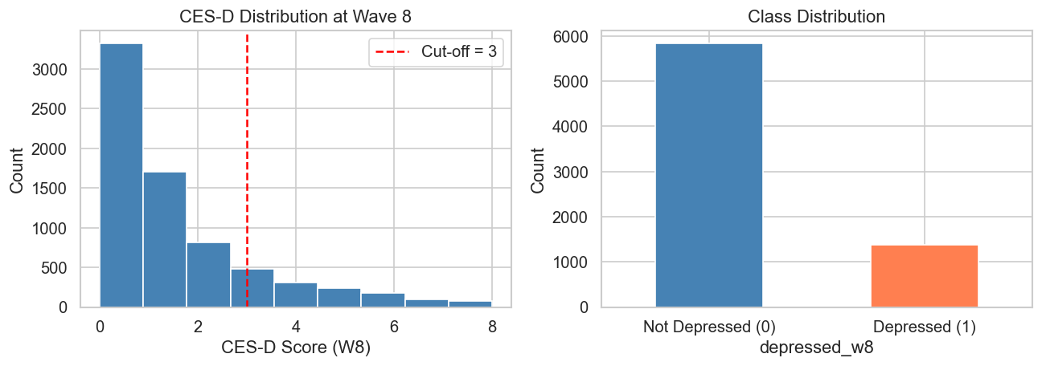
The Outcome Variable
Binary depression label — CES-D ≥ 3 at Wave 8
Why CES-D ≥ 3
• Validated 8-item depression screen
• Steffick (2000) cutoff
~19% observed prevalence — matches literature
The CES-D fix
Earlier bug: raw items on a 0-3 scale → prevalence ~74%
Fix: switched to IFS-validated cesd_sc
• Range corrected to 0-8; prevalence drops to 19%
• Lesson: always validate against published prevalence
Imbalance handling
Class imbalance handled via class_weight='balanced' (LR, RF) and scale_pos_weight=4 (XGB).
ELSA Depression Prediction | AI & Healthcare | University of Surrey 2025/26
5 / 14

Slide 6
The Pipeline
End-to-end reproducible Colab notebook
1. Load + merge
2. Preprocess
3. Engineer
4. Split
5. Train + tune
6. Evaluate
IFS / Core / Financial files Inner join on idauniq
Recode -1/-8/-9 → NaN Drop >40% missing (train-only)
10 derived features incl. CES-D change
75/25 stratified test 5-fold stratified CV
LR, RF, XGB, LGBM RandomizedSearchCV
AUC, F1, recall Calibration SHAP
10 engineered features capture longitudinal dynamics
cesd_change (W7-W6)
mobility_count W6/W7
adl_count W6/W7
iadl_count W6/W7
functional_burden W6/W7
mobility_change (W7-W6)
Methodology
All preprocessing fit on training data only — zero test-set leakage. Median imputation and scaling inside sklearn Pipelines.
ELSA Depression Prediction | AI & Healthcare | University of Surrey 2025/26
6 / 14

Slide 7
Experimental Design
Three prediction arms × five feature configurations × four models
W6 only
W7 only
W6 + W7
~4-year horizon
~2-year horizon
Combined longitudinal
68 features
68 features
138 features + change features
Five feature configurations per arm (RQ3 design)
full
no_cesd
health_only
function_cog
socioeconomic
All predictors
Drop prior CES-D
SRH + chronic
Mobility + ADL + cognition
Wealth + employ + social
Total experiments
3 arms × 5 configs × 4 models = 60 baseline experiments. Best config per arm then tuned via RandomizedSearchCV (30 iter, 5-fold).
ELSA Depression Prediction | AI & Healthcare | University of Surrey 2025/26
7 / 14

Slide 8
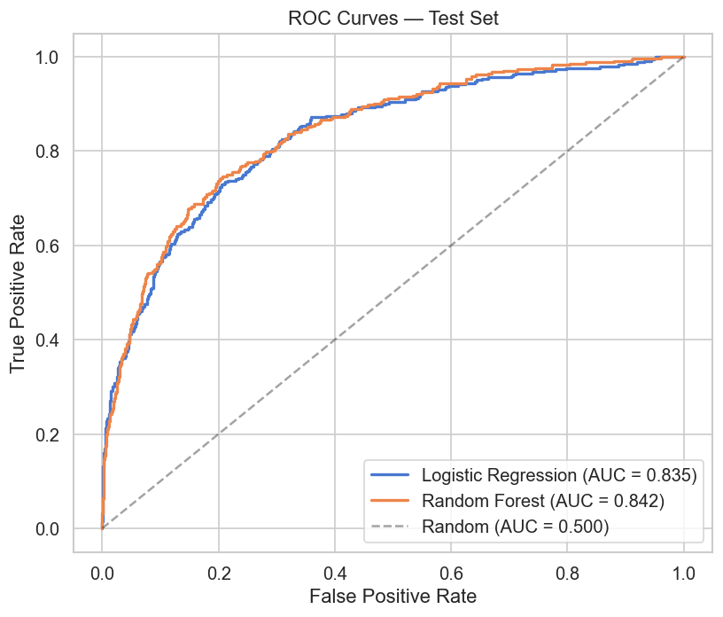
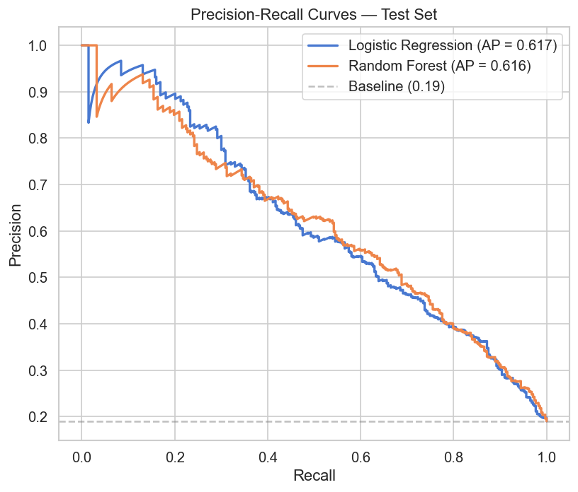
Headline Results
Tuned Random Forest combining W6+W7 — AUC 0.85 on held-out test set
Best tuned model per arm (test set)
W6 only (~4 yr)
W7 only (~2 yr)
W6+W7 combined
AUC 0.819
AUC 0.824
AUC 0.848
F1 0.532 Recall 0.732
F1 0.545 Recall 0.668
F1 0.582 Recall 0.714
Stacking ensemble — RF + LGBM + LR meta — AUC 0.841, Recall 0.773 (highest of any model)
ELSA Depression Prediction | AI & Healthcare | University of Surrey 2025/26
8 / 14

Slide 9
Clinical Deployment Readiness
Threshold tuning, calibrated probabilities, and stacking for screening
Threshold optimisation
Calibration
Stacking ensemble
• Default t = 0.50 → F1 0.580
Optimal t ≈ 0.58 → F1 0.611 (+5%)
• Lower t → more recall, more false +ve
Tune t to clinic capacity, not 0.5
• Tree models under-confident at low p
Isotonic regression on RF preserves AUC 0.848
• Probabilities now reliable in p∈[0.2, 0.6]
• LR is naturally well-calibrated
• RF + LGBM base, LR meta-learner
AUC 0.841, Recall 0.773 (highest)
• Soft-vote: correlated errors → no AUC gain
For maximum case detection: stacking
Choosing the right model for the right use case
Three deployment options match three clinical needs: best discrimination → RF tuned; reliable probability → calibrated RF; maximum recall → stacking ensemble.
ELSA Depression Prediction | AI & Healthcare | University of Surrey 2025/26
9 / 14

Slide 10
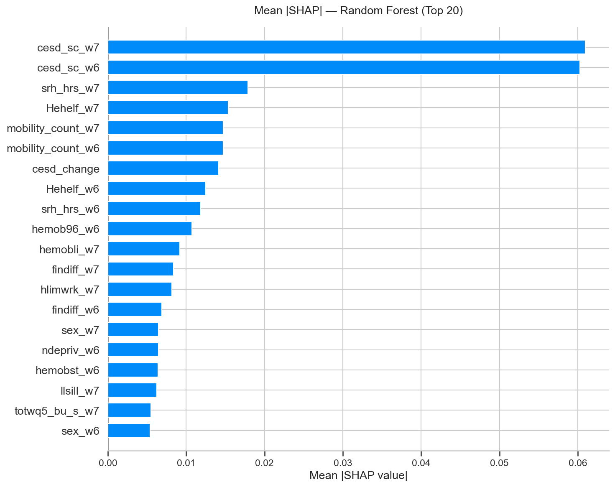
What Drives the Predictions?
SHAP feature importance — Random Forest, W6+W7 full model
Top predictors (full model)
Prior CES-D state dependence dominates
Self-rated health subjective vitality
Mobility count physical function decline
CES-D change worsening trajectory matters
Financial difficulty socioeconomic strain
What this shows
Late-life depression has a biopsychosocial signature
• Physical, mental, and social signals all visible 2-4 yrs ahead
• Aligns with established gerontological depression literature
ELSA Depression Prediction | AI & Healthcare | University of Surrey 2025/26
10 / 14

Slide 11
Robustness: Three Methods Agree
SHAP, LR coefficients, and LGBM gain converge on the same predictors
Convergent feature ranking (W6+W7)
Leave-one-domain-out AUC drop
Feature
SHAP rank
LR coeff
LGBM gain
Prior depression
−0.077
cesd_sc W7/W6
#1, #2
+0.89 / +0.70
Dominant
Self-rated health
−0.005
Chronic conditions
≈0.000
Self-rated health
#3 – #5
+ve
Top 5
Mobility / function
≈0.000
Mobility count
#4 – #6
−ve
Top 5
Cognition
≈0.000
Financial diff.
#6 – #8
+0.32
Mid-tier
Socioeconomic
≈0.000
Wealth (totwq5)
#8
−0.34
Mid-tier
Lifestyle / digital
≈0.000
Sex (female)
#9 – #10
+0.27
Mid-tier
Why near-zero for everything else?
Health, mobility, finance share |r| ≈ 0.4–0.5
• Remove one domain → model reconstructs from neighbours
Signal is robust, not redundant
Three independent methods. Same ranking.
RQ3 holds: the same biopsychosocial predictors emerge under SHAP, LR coefficients, LGBM gain, and ablation — the finding is not a SHAP artefact.
ELSA Depression Prediction | AI & Healthcare | University of Surrey 2025/26
11 / 14

Slide 12
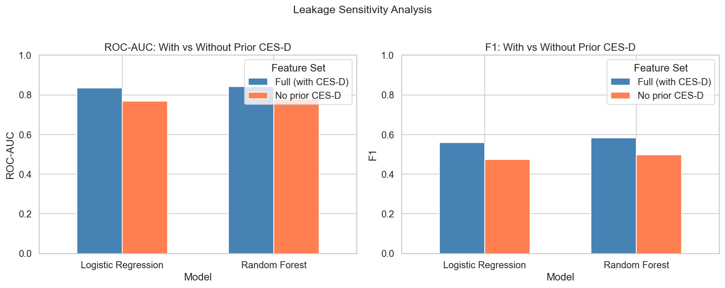
Beyond Depression History
Even without prior CES-D, the model still predicts well
The leakage test
• Strip every CES-D-related feature; refit
• Tests: is the model just "depressed people stay depressed"?
What we found
AUC 0.848 → 0.773 (drop of 0.075)
• Drop is real — prior depression matters
• But 0.77 is still a clinically usable screening signal
Achieved with no mental health features at all
Headline scientific finding
Depression risk leaves a measurable footprint in physical, functional, and economic data 2–4 years before symptoms emerge.
ELSA Depression Prediction | AI & Healthcare | University of Surrey 2025/26
12 / 14

Slide 13
Limitations
Where the model can and cannot be trusted
Methodological
Generalisability
Screening, not diagnosis CES-D ≥ 3 flags symptoms, not MDD
Observational associations, not causal claims
Attrition bias ~30% of W6 sample dropped (likely sicker)
State dependence prior CES-D dominates the full model
Imbalance precision ≈ 49%; ~half of flagged are false +ve
Validated only on English population aged 50+
• Excludes institutionalised and care-home residents
• ELSA cohort effects (e.g. 1950s-born ≠ today's 50-year-olds)
Fairness not yet evaluated across sex, ethnicity, SES
• Threshold of 0.5 is naive — deployment must tune to capacity
Transparency
These limitations were noted explicitly in the GitHub PR review process and accepted as documented constraints, not silent gaps.
ELSA Depression Prediction | AI & Healthcare | University of Surrey 2025/26
13 / 14

Slide 14
Future Directions and Conclusion
From a coursework prototype to a clinical research roadmap
Future directions
Take-home messages
Incident-only model exclude already-depressed at baseline
External validation HRS (US), SHARE (EU), TILDA (Ireland)
Biomarkers add ELSA nurse-visit blood data
Trajectory models RNNs across many waves
Fairness audit calibration across subgroups
Cost-effectiveness QALY analysis with intervention data
RQ1 AUC 0.85 = clinically useful early prediction
RQ2 Two waves > one, but recent snapshot ≈ combined
RQ3 Non-mental-health features carry independent signal
• Routine over-50 health-check data could feed this model today
In one sentence
Routine survey data can flag future depression with clinically useful accuracy 2–4 years in advance — even without using depression history at all.
ELSA Depression Prediction | AI & Healthcare | University of Surrey 2025/26
14 / 14

