Slide 1
AI & HEALTHCARE
SURREY 2025/26
Group Project — AI and Healthcare
ELSA
Depression Prediction
Early prediction of depression onset in older English adults using machine learning on longitudinal survey data
English Longitudinal Study of Ageing
UKDS Study 5050
Banks et al. 2006
Team
At a glance
Akeeb Lawel
Fiyin Akano
Zannat Chowdhury Sagar
Giridhar Nampally
Pushkar Jadav
Poorna Golla
7,211 participants (W6/W7/W8)
19% depression prevalence
3 prediction arms
60 base model combinations
Best AUC 0.848

Slide 2
Motivation and research questions
Why early depression screening matters
Clinical context
Research questions
Depression affects 10–15% of English adults aged 50+ (Banks et al. 2006)
Diagnosis typically occurs after symptoms become severe, delaying intervention
No existing population-level early-warning tool based on routine survey data
ELSA captures health, function, cognition, socioeconomic and lifestyle variables at two-year intervals
RQ1
Can ML models trained on ELSA survey data predict depression onset 2 to 4 years in advance in adults aged 50 and over?
RQ2
Does longitudinal data across two waves improve prediction over single-wave models, and does prediction horizon length affect accuracy?
Our approach
RQ3
Which feature domains carry independent predictive signal beyond prior depression history, and does the model retain meaningful accuracy without prior depression scores?
Train ML models on non-clinical ELSA survey variables at Waves 6 and 7 to predict CES-D depression status at Wave 8 — 2 to 4 years in advance.
2 / 13

Slide 3
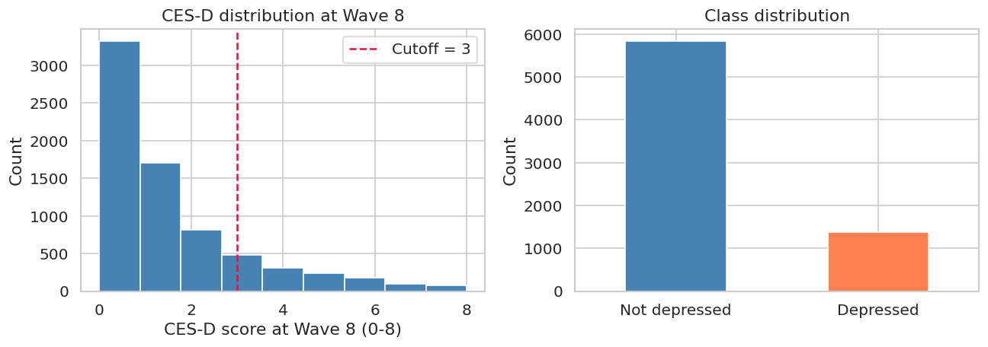
Data — ELSA and wave selection
Building on a robust longitudinal cohort
Wave selection rationale
Outcome: CES-D at Wave 8
CES-D scoring fix
Waves 6, 7, 8 have the highest 3-wave consecutive retention in ELSA — over 90%
CES-D available in >93% of cases across all three waves
2-year gaps give a meaningful 2–4 year prediction horizon
Inner join: 7,211 participants retained
Survivorship note: inner join retains healthier, wealthier participants — acknowledged limitation
8 binary items (yes/no), summed to 0–8 scale
Threshold ≥3 = depressed (Steffick 2000)
IFS-validated cesd_sc variable used
Earlier pipeline used 0–3 per-item scale → range 8–16 and 74% prevalence (clinically impossible)
Fix: IFS-derived cesd_sc directly (0–8, binary scoring)
Corrected: 19% — consistent with literature
7,211
participants
19%
prevalence
Class imbalance handling
1,372
depressed (W8)
1:4.3
class ratio
LR/RF: class_weight='balanced' · XGB: scale_pos_weight=4 · LGBM: class_weight='balanced'
Result: recall 0.67–0.73 across models
Key dataset characteristics
ELSA = English Longitudinal Study of Ageing
Nationally representative cohort of English adults aged 50+
Run by Institute for Fiscal Studies (IFS)
Accessible via UK Data Service (Study 5050)
Each wave collects:
Health status, chronic conditions
Mobility and functional ability
Cognitive tests
Socioeconomic circumstances
Social engagement, lifestyle, demographics
Key clinical instrument: CES-D (Center for Epidemiologic Studies Depression Scale)
Fig. 1: CES-D distribution at Wave 8 and class distribution
3 / 13

Slide 4
Experimental design
60 combinations — three arms, five configs, four models
ARM 1 — BASELINE
ARM 2 — BASELINE
ARM 3 — LONGITUDINAL
W6 only
W7 only
W6 + W7
68 features · ~4-year horizon to W8
Cross-sectional · Earlier snapshot
68 features · ~2-year horizon to W8
Cross-sectional · Closer to outcome
138 features + trajectories · 2–4 year horizon
cesd_change · mobility_change
Five feature configurations per arm
Full
All features
No CES-D
Remove depression history
Health only
SRH + chronic
Func / Cog
Mobility + cognition
Socioeconomic
Financial + social
Four models per arm per config
Tuning strategy
LR
Interpretable baseline, no tuning
Random Forest
Tuned · class balanced
Best config per arm selected by mean AUC across all models
RandomizedSearchCV: 30 iterations × 5-fold stratified CV
Scoring: roc_auc (not accuracy — avoids majority-class bias)
LR excluded from tuning — stable interpretable reference
Total: 3 × 5 × 4 = 60 base combinations
XGBoost
Tuned · scale_pos_weight
LightGBM
Tuned · literature benchmark
4 / 13

Slide 5
Feature domains and configuration motivation
Nine domains grounded in clinical literature
Prior depression cesd_sc W6/W7, cesd_change
Wave symmetry enforcement
Self-rated health srh_hrs, hehelf, llsill · Ohrnberger 2017
ndepriv dropped from both waves — W7 version had 56% missing data in training split
Rule: if a stem fails missingness at one wave, both waves are removed
Prevents longitudinal model using asymmetrically available predictors
Chronic conditions BP, diabetes, arthritis, heart
Mobility / function 10 items summed → ADL/IADL count
Cognition memtotb (memory), execnn (exec fn)
Feature engineering
25 individual item-level variables compressed to 4 composite scores
mobility_count, adl_count, iadl_count, functional_burden
cesd_change, mobility_change: W7−W6 trajectory (W6+W7 arm only)
Socioeconomic findiff, totwq5, ndepriv · Zaninotto 2019
Social / housing famtype, tenure, internet use
Lifestyle / digital heacta/b/c (physical activity), scint
Missingness handling
Demographics age, sex, marstat, ethnicity
Survey missing codes −1, −2, −8, −9 → NaN throughout
Columns with >40% missing dropped — estimated on training split only
Median imputation within sklearn Pipeline per arm
5 / 13

Slide 6
Main results — answering RQ1 and RQ2
AUC 0.848 from non-clinical survey data alone
Best tuned model per arm
RQ1
Yes. AUC 0.848 is competitive with the ELSA literature benchmark. The model correctly ranks a depressed individual above a non-depressed one 84.8% of the time — from non-clinical survey variables only.
Arm | Model | AUC | F1 | Recall
W6 only (4yr) | LGBM | 0.819 | 0.532 | 0.732
W7 only (2yr) | RF tuned | 0.824 | 0.545 | 0.668
W6+W7 (longit.) | RF tuned | 0.848 | 0.582 | 0.714
RQ2 horizon
W7 only (2yr) beats W6 only (4yr) by only 0.005 AUC. A 4-year early prediction carries nearly equivalent information to a 2-year prediction — clinically significant for early intervention.
Benchmark: Zhao et al. 2025 — AUC 0.77–0.90 on ELSA (cross-sectional, larger sample)
All models — W6+W7 arm
RQ2 longit.
Adding both waves gives +0.024 AUC over the best single-wave model. Trajectory features contribute, but single-wave screening is already viable.
Model | AUC | F1 bin | F1 mac | Recall | Prec
LR baseline | 0.835 | 0.559 | 0.711 | 0.697 | 0.467
RF tuned | 0.848 | 0.582 | 0.727 | 0.714 | 0.491
XGB tuned | 0.844 | 0.585 | 0.734 | 0.676 | 0.516
LGBM tuned | 0.843 | 0.577 | 0.718 | 0.758 | 0.466
Soft-vote ens. | 0.847 | 0.582 | 0.728 | 0.709 | 0.494
Metric note
AUC-ROC: primary discrimination metric — threshold-independent
Binary F1: measures depression detection only, not majority-class accuracy
LR gap vs best RF: only 0.013 AUC — interpretable model is defensible
6 / 13

Slide 7
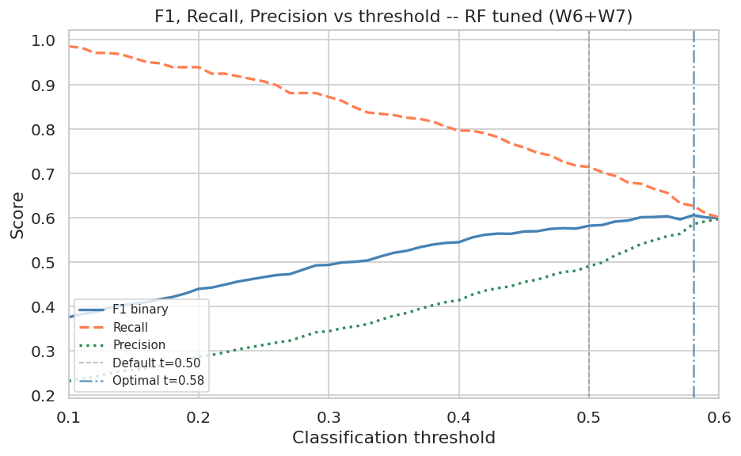
Feature config comparison and threshold optimisation
Health alone captures 88% of full model performance
AUC by feature config — W6+W7 arm
Threshold optimisation — RF tuned (W6+W7)
Model | Default t=0.50 | Optimal t | F1 @ opt | Recall
RF tuned | 0.582 | 0.58 | 0.606 | 0.627
XGB tuned | 0.585 | 0.55 | 0.593 | —
LGBM tuned | 0.577 | 0.58 | 0.592 | —
LR baseline | 0.559 | 0.60 | 0.570 | —
Why is optimal threshold above 0.50?
class_weight='balanced' already shifts the model toward positive predictions during training. Raising threshold to 0.58 filters low-confidence positives, improving precision enough to lift F1 by +0.024.
Health only at 24 features achieves 88% of full model AUC
Socioeconomic features weakest in isolation — signal correlated with health
No CES-D retains 91% of AUC — model is not just tracking persistence
Fig. 2: F1, Recall, Precision vs threshold — RF tuned (W6+W7)
7 / 13

Slide 8
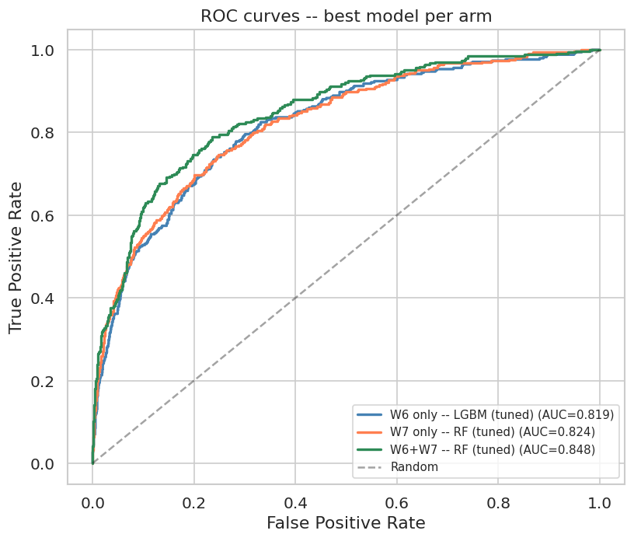
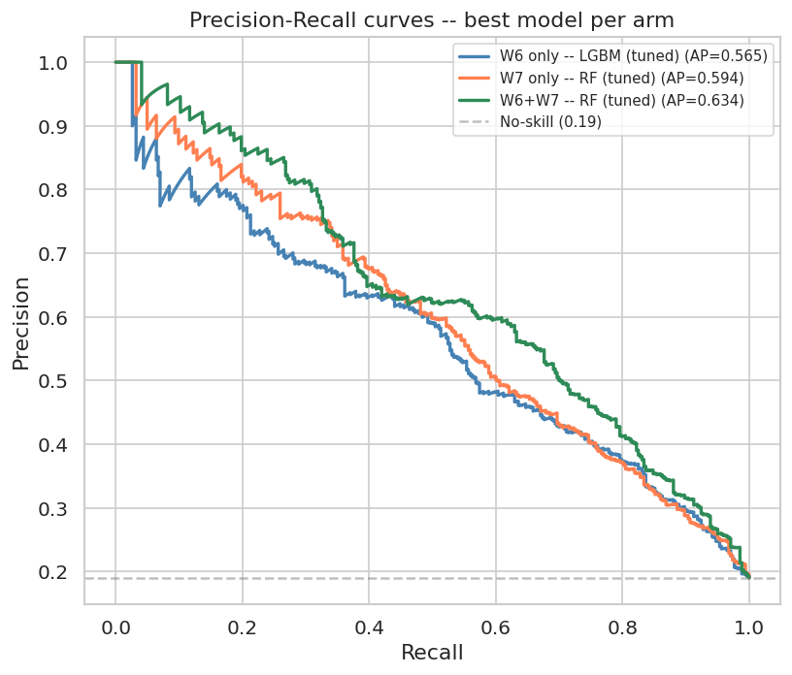
ROC and Precision-Recall curves — W6+W7 arm
LR sacrifices only 0.013 AUC for full interpretability
ROC curve findings
Model | AUC-ROC | Avg Prec | Gap vs RF
RF tuned | 0.848 | 0.635 | —
XGB tuned | 0.844 | 0.627 | 0.004
LR baseline | 0.835 | 0.617 | 0.013
No-skill baseline | 0.500 | 0.190 | —
Tree models diverge from LR at FPR 0.20–0.40 — the non-linear interaction zone
All models substantially above 0.19 no-skill baseline
Precision-Recall — 19% prevalence context
PR curves are more informative than ROC at low prevalence
Curves fall steeply beyond recall 0.60 — catching more than 60% of cases comes at significant precision cost
RF Average Precision 0.635 vs no-skill 0.190 — 3.3× improvement
Fig. 3: ROC curves — best model per arm
Fig. 4: Precision-Recall curves — best model per arm
8 / 13

Slide 9
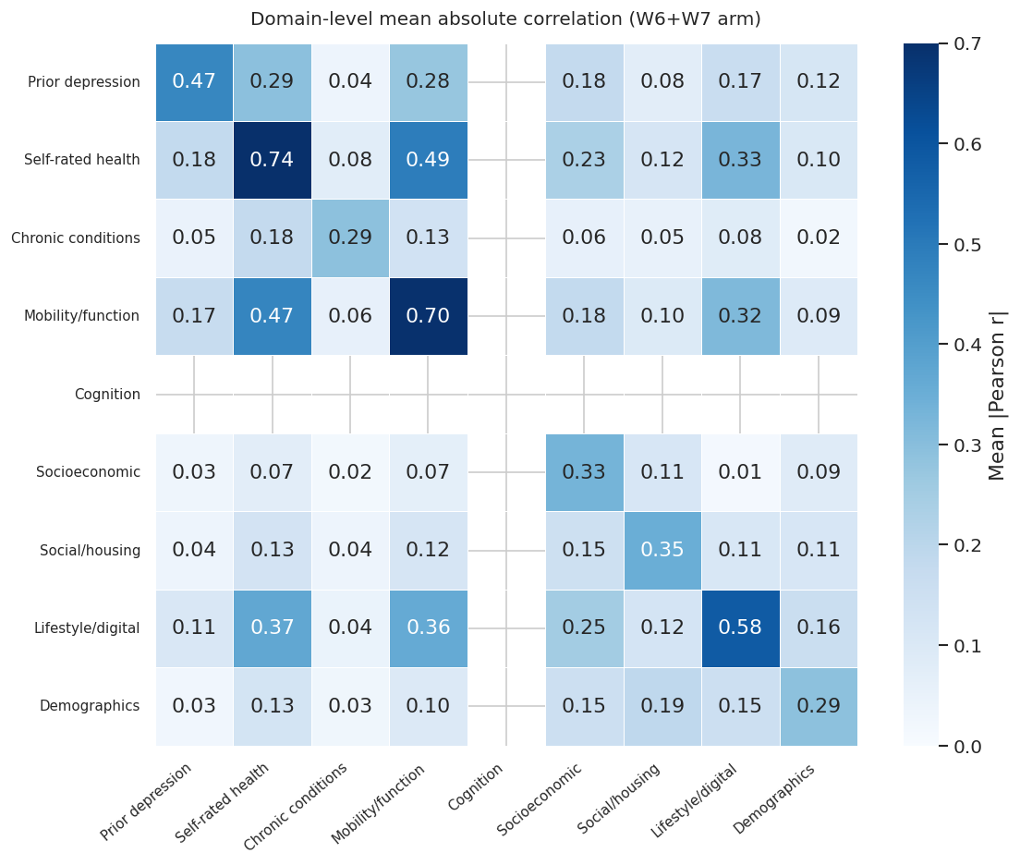
Domain ablation and feature correlation — RQ3 setup
Near-zero ablation drops reflect feature correlation, not irrelevance
Leave-one-domain-out AUC drop (W6+W7, RF, baseline 0.848)
Why near-zero for most domains?
Fig. 5: Domain correlation heatmap
Domain correlation: mobility/function ↔ self-rated health share mean |r| ≈ 0.45. When one domain is removed, the model reconstructs signal from correlated neighbours. Ablation = unique contribution only.
Top 25 features by correlation with depressed_w8
cesd_sc_w7, cesd_sc_w6: highest positive correlation — expected
hemob96_w6 (no mobility difficulties): strong negative — protective
findiff_w6/w7 (financial difficulty): positive — socioeconomic signal
totwq5_bu_s (wealth quintile): negative — higher wealth protective
sex: positive — women at higher risk (Kessler 2003)
Key insight
The no_cesd configuration (AUC 0.773) gives the cleanest RQ3 answer — forcibly removing CES-D, not just testing one domain at a time.
9 / 13

Slide 10
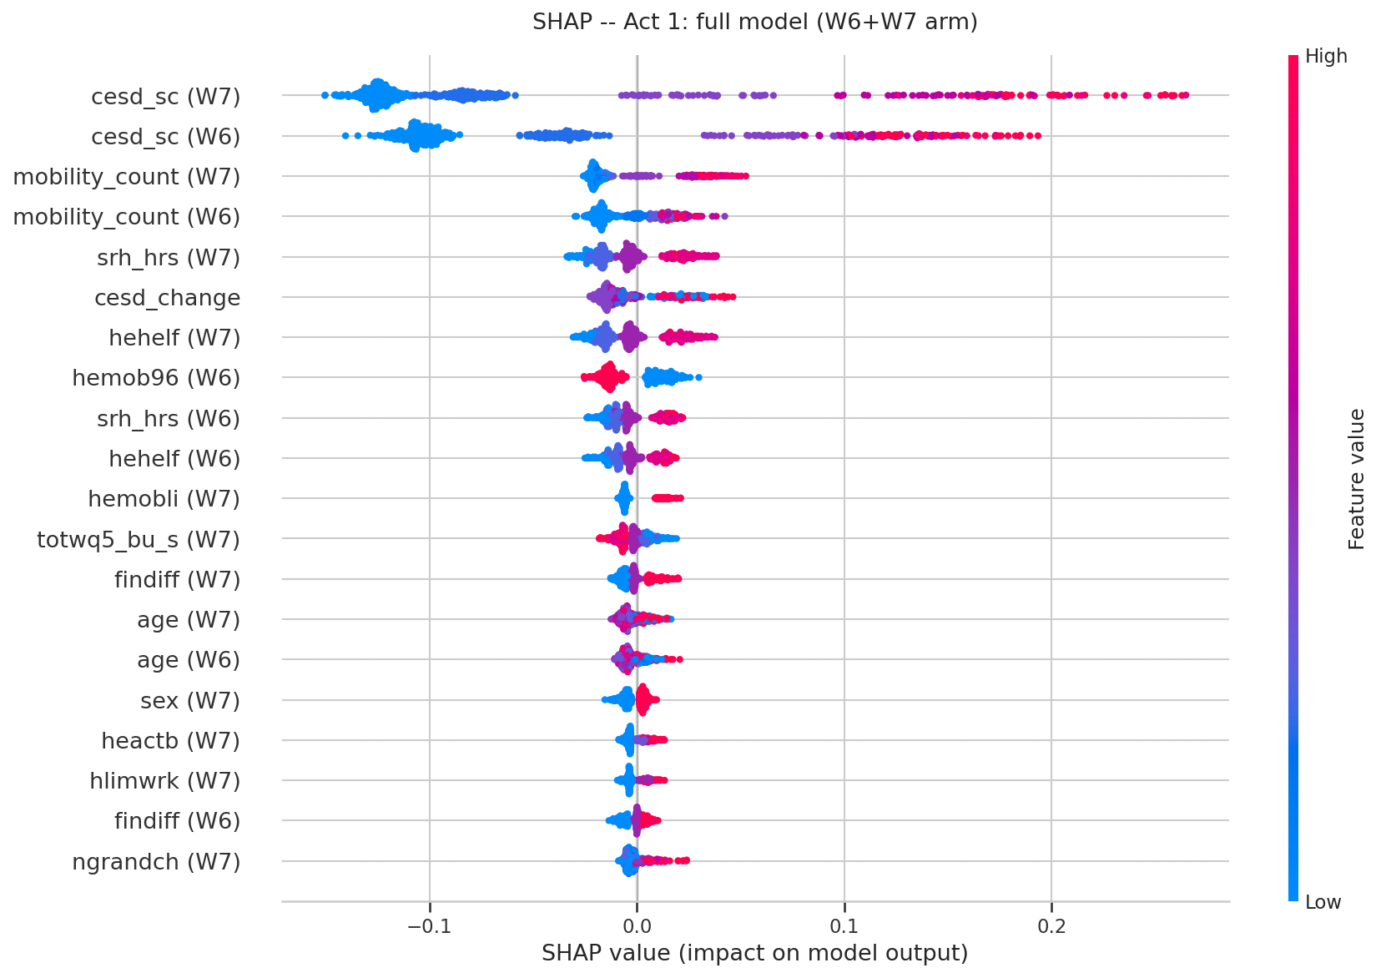
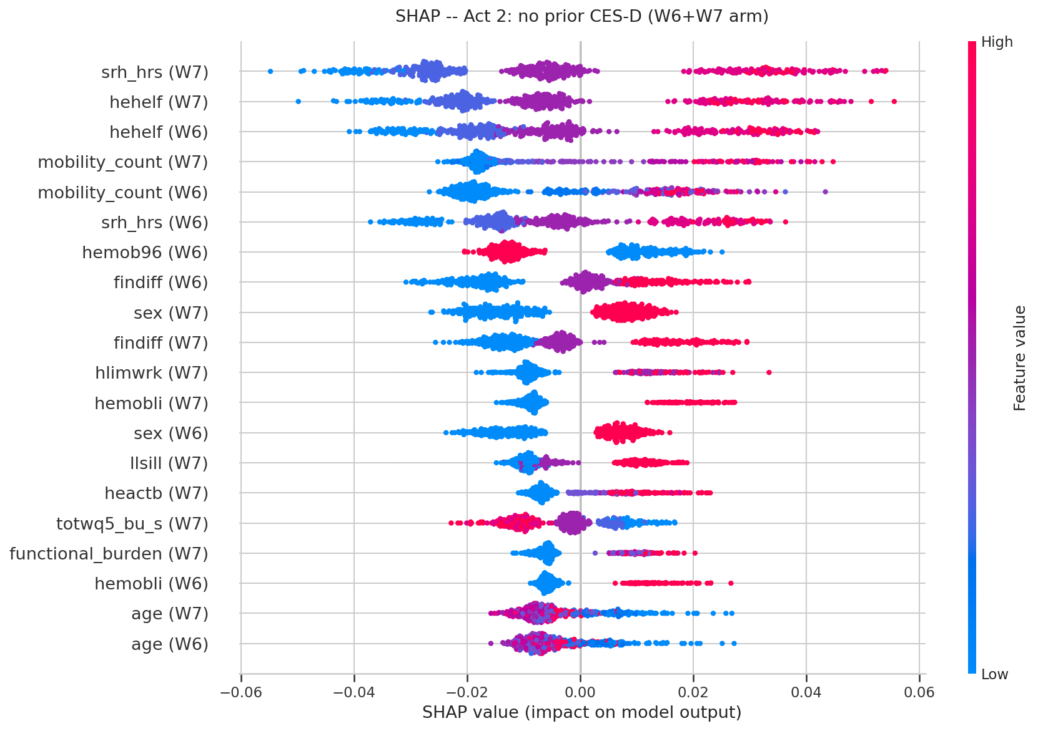
Leakage sensitivity and SHAP — answering RQ3
91% of AUC retained without any depression history
Model is NOT just tracking depression persistence
SHAP narrative — two-act story
ACT 1 — FULL MODEL
ACT 2 — NO CES-D
W6 only: 90% retained
W7 only: 93% retained
W6+W7: 91% retained
RQ3
Independent risk factors: self-rated health, mobility, financial strain, sex — consistent with Ohrnberger et al. 2017 and Zaninotto et al. 2019.
CES-D dominates · range −0.15 to +0.25
Model finds shortcut through prior scores
SRH rises to #1 · range −0.06 to +0.06
Model learns genuine risk factors
The contrast between Act 1 and Act 2 IS the RQ3 answer. The ranking shift from CES-D-dominated to self-rated-health-dominated proves the model learns genuine onset predictors, not just persistence.
10 / 13

Slide 11
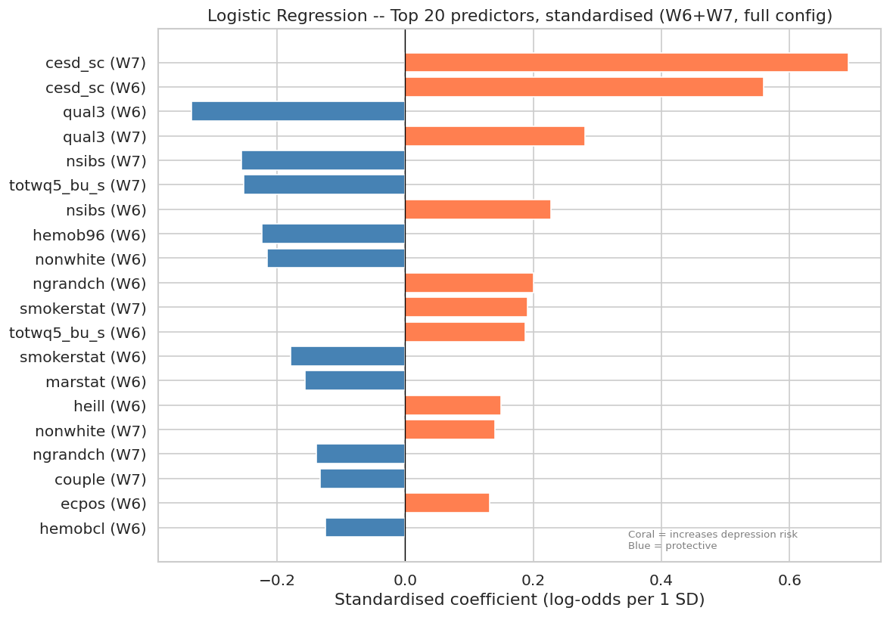
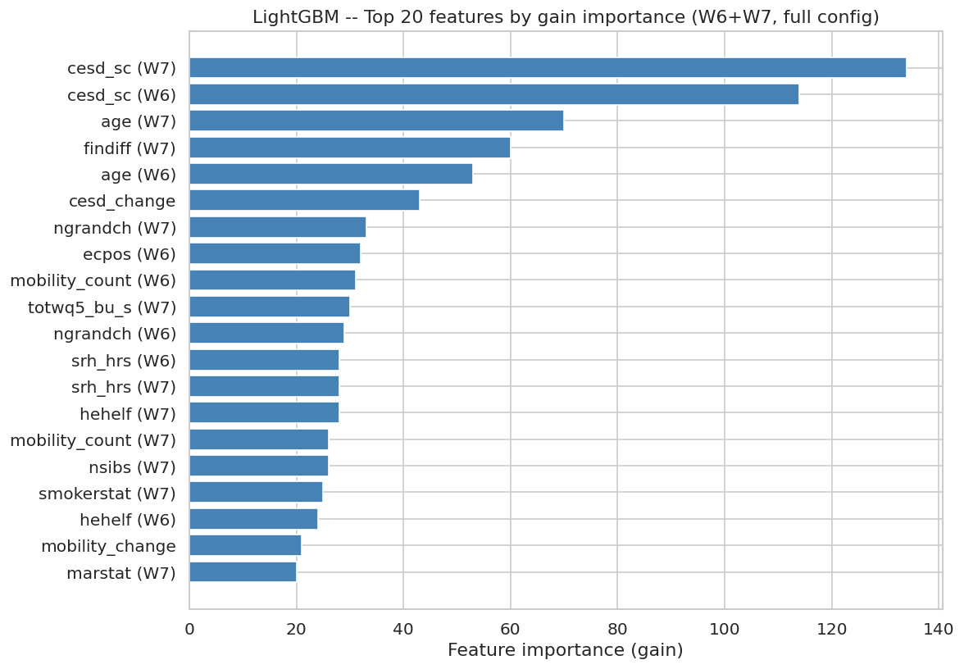
Clinical interpretability — LR coefficients and LGBM importance
Three independent methods tell the same story
LR standardised coefficients (log-odds per 1 SD, W6+W7)
Convergent evidence across three methods
Feature | SHAP rank | LR coeff | LGBM gain
cesd_sc W7/W6 | #1, #2 | +0.89/+0.70 | Dominant
Self-rated health | #5–7 | +ve | Top 5
mobility_count | #3–4 | −ve | Top 5
financial diff. | #8–10 | +0.32 | Mid-tier
Three independent methods agree on ranking — confirms robustness of findings
LGBM vs literature gap
LGBM AUC 0.843 vs RF 0.848 — gap of only 0.005
LGBM achieves best recall 0.758 — preferred for screening
Zhao et al. 2025 used cross-sectional setup, ~30% larger sample
Moderate sample size (~5,400 train) suits RF's bagging stability
Fig. 6: LR standardised coefficients
Fig. 7: LightGBM — Top 20 features by gain importance (W6+W7, full config)
11 / 13

Slide 12
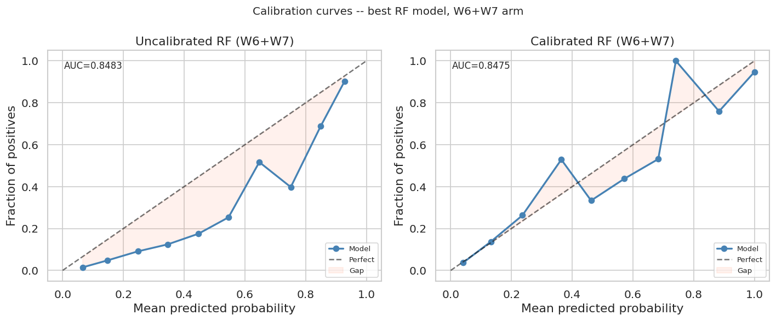
Ensemble methods and calibration
Stacking achieves highest recall — best for screening
Model comparison — W6+W7 arm
Model | AUC | F1b | F1mac | Recall | Precision
LR baseline | 0.835 | 0.559 | 0.711 | 0.697 | 0.467
RF tuned | 0.848 | 0.582 | 0.727 | 0.714 | 0.491
XGB tuned | 0.844 | 0.585 | 0.734 | 0.676 | 0.516
LGBM tuned | 0.843 | 0.577 | 0.718 | 0.758 | 0.466
Soft-vote ens. | 0.847 | 0.582 | 0.728 | 0.709 | 0.494
Stack RF+LGBM+LR | 0.841 | 0.563 | 0.718 | 0.773 | 0.434
Why soft-vote didn't improve AUC
RF, XGB, LGBM trained on same data → correlated errors
Averaging correlated predictions regresses toward mean — no diversity benefit
Ensemble helps most with diverse model families (LR + tree + neural net)
Fig. 8: Calibration curves — best RF model, W6+W7 arm
Calibration — are probabilities reliable?
All tree models: underconfident at low probabilities
LR is best calibrated — known property of logistic regression
Isotonic regression on RF: AUC maintained at 0.848, probability reliability improved in p=0.2–0.6 range
Stacking outcome
AUC 0.841 — below best individual RF
Recall 0.773 — highest of any configuration tested
LR meta-learner weights LGBM more heavily → sensitivity focus
Deployment recommendation: Calibrated RF for risk scoring where probability matters · Uncalibrated RF for binary screening · LR for clinical explainability
12 / 13

Slide 13
Conclusions and limitations
Three questions. Three answers.
RQ1
Yes. AUC 0.848 from non-clinical survey data. Competitive with Zhao et al. 2025 benchmark.
RQ2
4-year (AUC 0.819) nearly as effective as 2-year (0.824). Adding second wave: +0.024 AUC. Single-wave screening is viable.
RQ3
91% of AUC retained without depression history. Predictors: self-rated health, mobility, financial difficulty, sex.
Deployment recommendations
Maximum case detection
Stacking ensemble or LGBM — recall 0.758–0.773
Best discrimination
RF tuned — AUC 0.848
Clinical explainability
Logistic Regression — AUC 0.835
Risk scoring (probabilities)
Calibrated RF — AUC preserved at 0.848
Limitations
Future work
Survivorship bias — inner join retains healthier, wealthier participants
CES-D binary threshold loses spectrum information
Generalisation limited to English adults aged 50+
ndepriv dropped — area-level deprivation excluded
30-iteration tuning may under-explore LGBM's space
Continuous CES-D regression instead of binary threshold
Wave 9 outcome prediction extending the horizon
Clinical deployment trial with per-context threshold optimisation
Larger ensemble diversity (LR + tree + neural net)
Explainability tools beyond SHAP for clinical communication
Dataset: ELSA UKDS Study 5050 · Banks et al. 2006 · Steffick 2000 · Zhao et al. 2025 · Ohrnberger et al. 2017 · Zaninotto et al. 2019 · Kessler 2003 · Bergstra and Bengio 2012 · Alexopoulos 2005
Thank you. Questions?
Akeeb Lawel · Fiyin Akano · Zannat Chowdhury Sagar · Giridhar Nampally · Pushkar Jadav · Poorna Golla
University of Surrey — AI and Healthcare Module 2025/26
13 / 13

