Slide 1
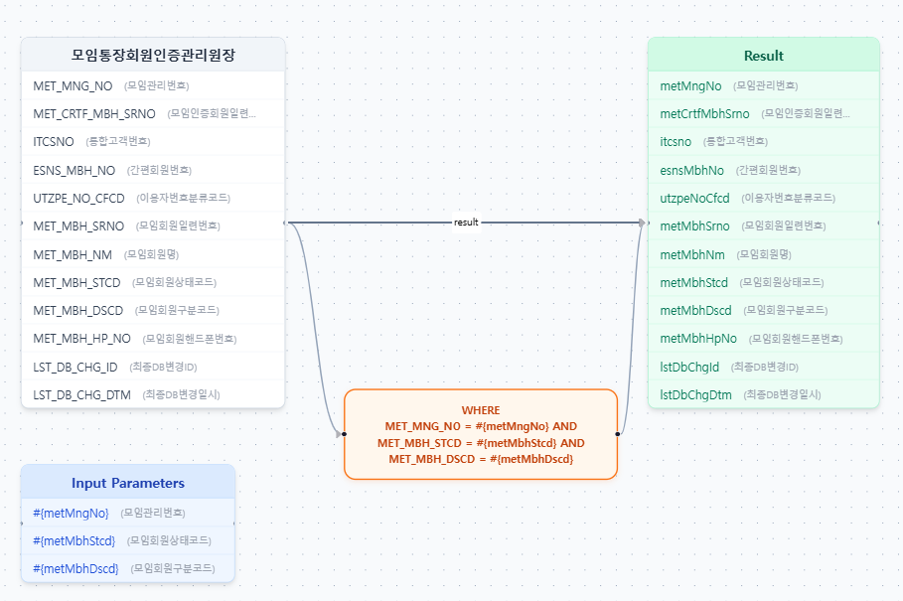

Slide 2
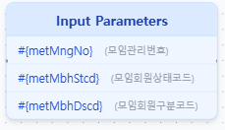
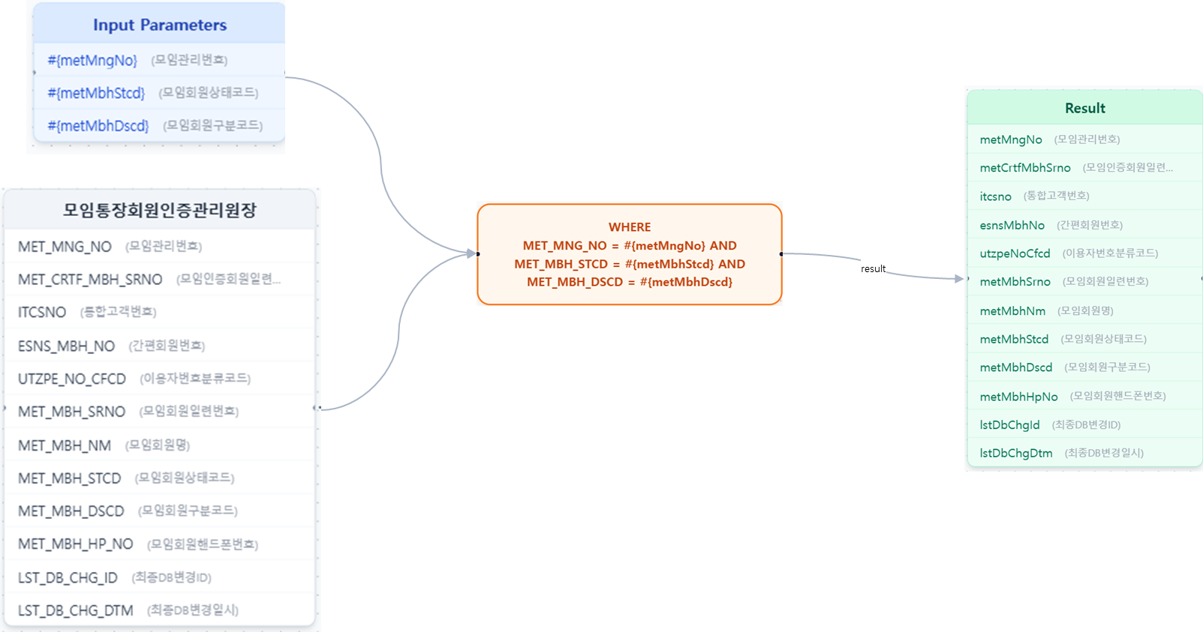
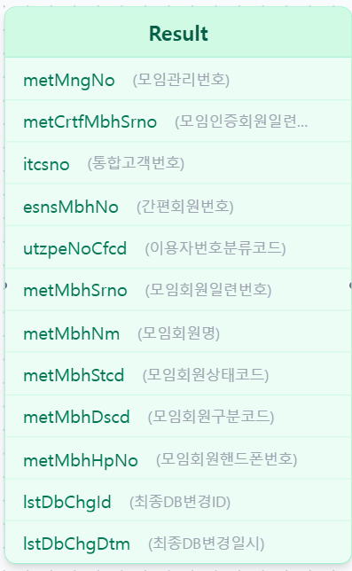
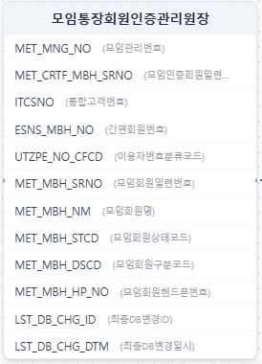
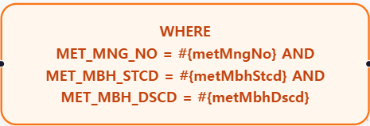
result

Slide 3
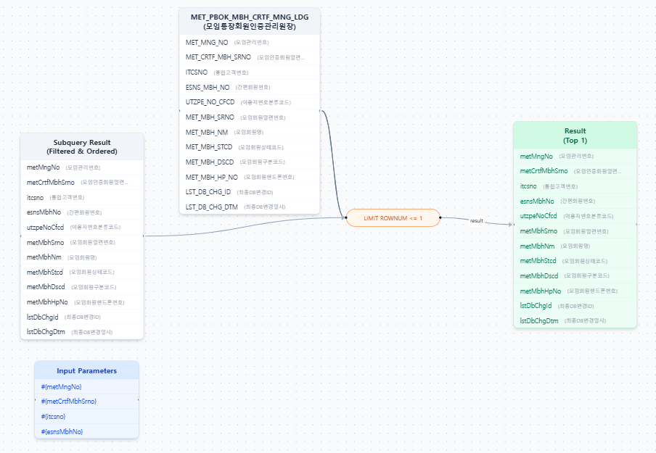

Slide 4
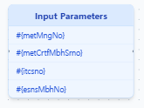
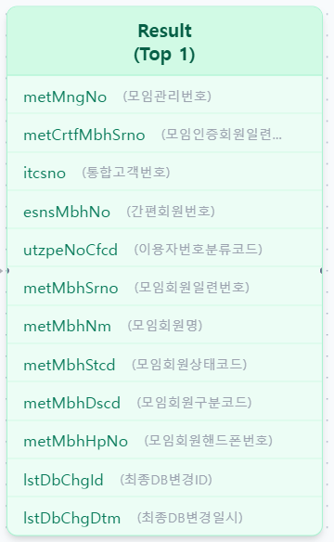
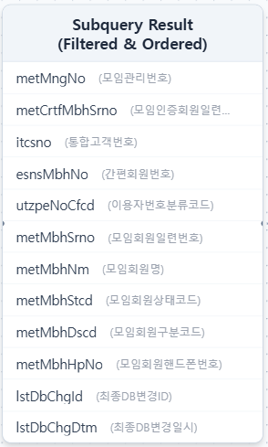
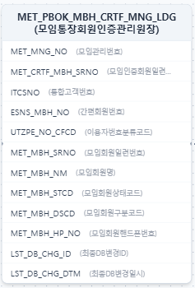
WHERE MET_MNG_NO = #{metMngNo}
AND (MET_CRTF_MBH_SRNO = #{metCrtfMbhSrno} OR ITCSNO = #{itcsno} OR ESNS_MBH_NO = #{esnsMbhNo})
ORDER BY
MET_CRTF_MBH_SRNO DESC
LIMIT ROWNUM <= 1
result

Slide 5
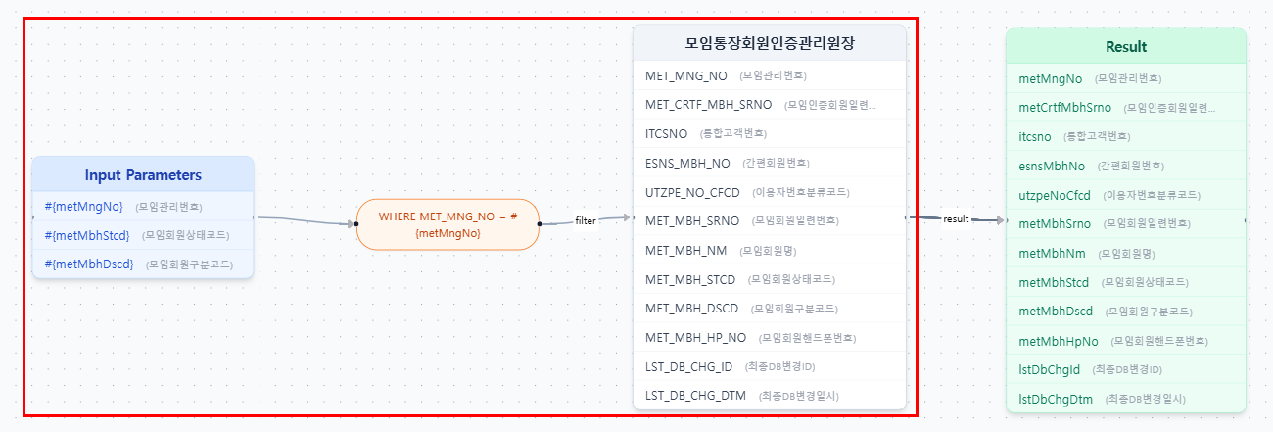
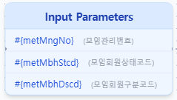
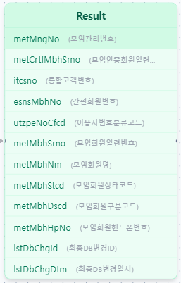
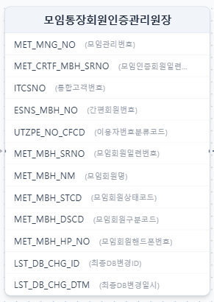

filter
result

Slide 6


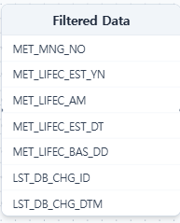
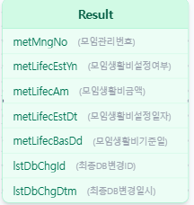
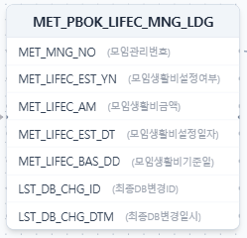


Slide 7


Slide 8


Slide 9
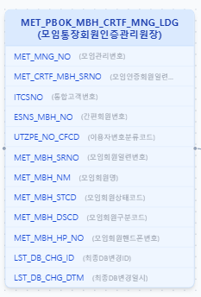
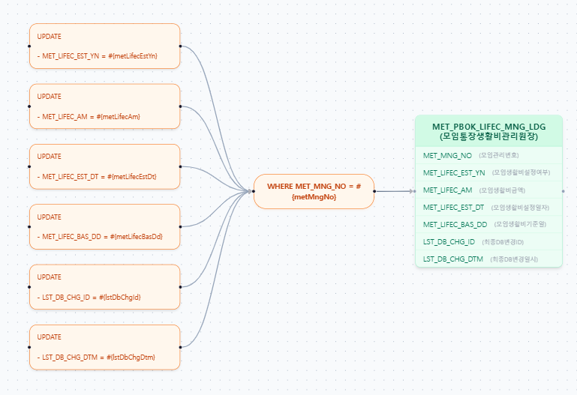
Input Parameters
#{metLifecEstYn} (모임생활비설정여부)
#{metLifecAm} (모임생활비금액)
#{metLifecEstDt} (모임생활비설정일자)
#{metLifecBasDd} (모임생활비기준일)
#{metLifecEstYn} (모임관리번호)
#{lstDbChgId} (최종DB변경ID)
#{lstDbChgDtm} (최종DB변경일시)
#{metMngNo} (모임관리번호)

Slide 10
