Slide 1
CVPR2020 GhostNet: More Features from Cheap Operations
7109053123 周子玄

Slide 2
Abstract
motivate
CNNs spend a lot of computation resources
CNNs will produce redundant feature
Proposes
Ghost module to generate more feature maps from cheap operations
Method
intrinsic feature maps -> linear transformation -> ghost feature maps
Result
GhostNet can achieve higher recognition performance

Slide 3
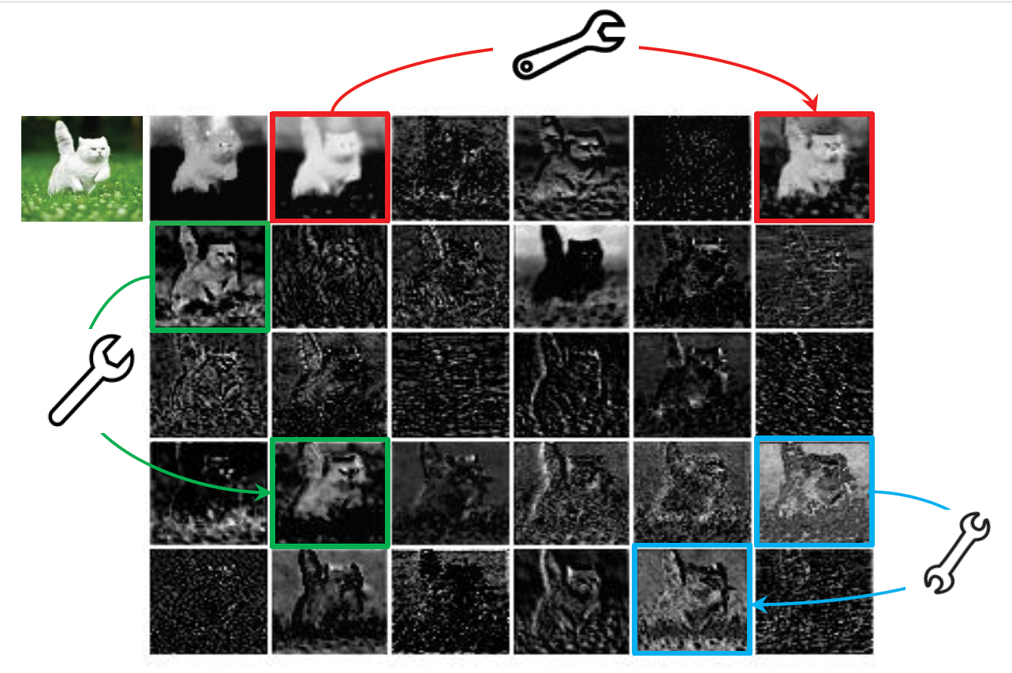
Features generated by the first residual group

Slide 4
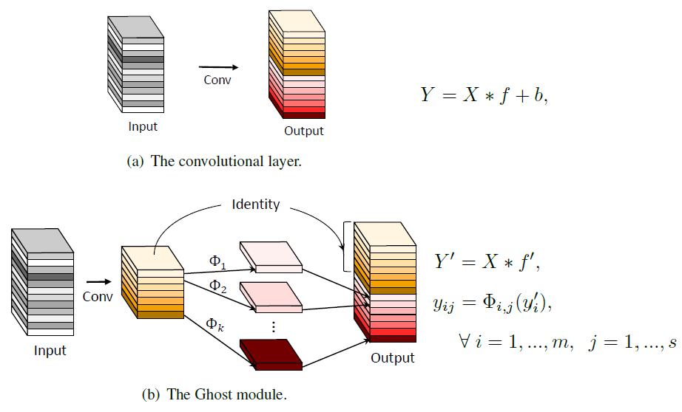
Method

Slide 5
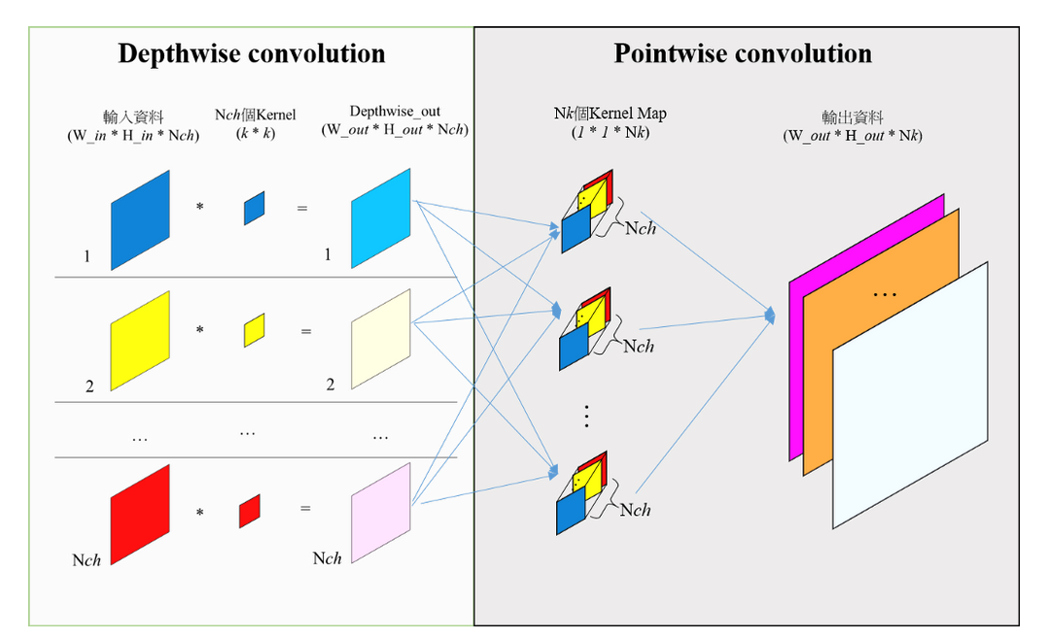
How Φ work
Notes:
N個feature就有N個kernel
每個feature都被其對應的kernel掃過產生f’
輸出要幾層決定於1x1 conv的個數

Slide 6
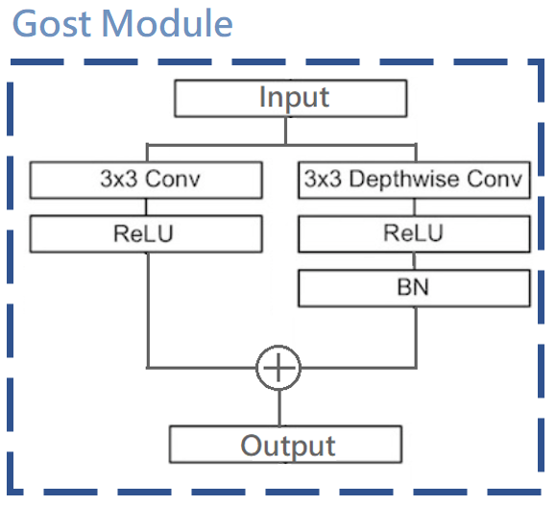
Gost Module

Slide 7
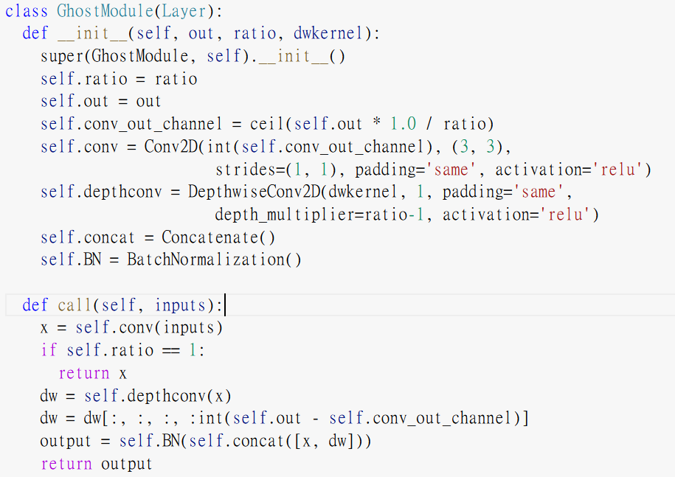
Gost Module

Slide 8
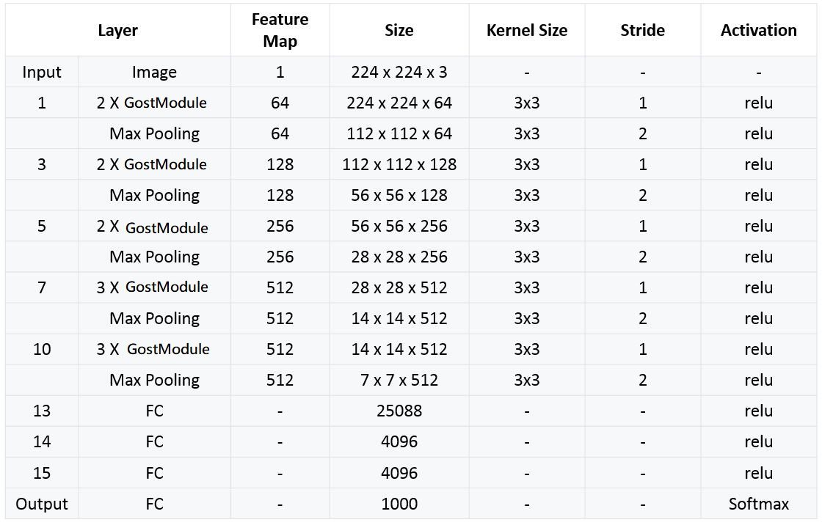

Gost-VGG16

Slide 9
Gost-VGG16

Slide 10
Perfermance
Model name | VGG16 | GVGG16-r2 | GVGG16-r4 | GVGG16-r8 | GVGG16-r16 | GVGG16-r16
Train Epoch | 50 | 50 | 50 | 50 | 50 | 70
Parameters | 33.6M | 26.3 | 22.6M | 20.8M | 19.8M | 19.8M
Train acc | 0.9921 | 0.9833 | 0.9486 | 0.8861 | 0.8045 | 0.8493
Val_acc | 0.8648 | 0.8633 | 0.8433 | 0.8067 | 0.7553 | 0.7755
M = Million
實驗結果：
https://drive.google.com/drive/folders/16Eyeanj7ZhzdlAwQqxdMO83sHmWvSUlo?usp=sharing

Slide 11
Reference
https://arxiv.org/abs/1911.11907
https://ithelp.ithome.com.tw/articles/10192162
https://blog.yeshuanova.com/2018/02/depthwise-separable-convolution/?fbclid=IwAR1lnpT51BWzTKMkwblvf7293778SeXlUlKrhZqfs-f2RHiBL0CIY9ss55Q
https://chih-sheng-huang821.medium.com/%E6%B7%B1%E5%BA%A6%E5%AD%B8%E7%BF%92-mobilenet-depthwise-separable-convolution-f1ed016b3467

