Slide 1
Introduction to R Spring 2021
Wim Cardoen & Brett Milash
Center for High-Performance Computing (CHPC)
University of Utah

Slide 2
Overview
What is R?
Why R?
R language basics, in casu:
Basic Data Types
Vector, Matrix & Array
List, Data Frame
Functions
Loops, Conditionals,..
IO
R @ CHPC
Interesting sites/Links
NO Stats will be covered here. => MATH Dept.

Slide 3
What is R?
Implementation of S (stat. prog. lang. developed @ Bell Labs by John Chambers)
Original authors: Ross Ihaka & Robert Gentleman (Auckland, NZ) around 1992.
Two facets:
Scripting language (vs. compiled language)
Data Analysis environment
R-code can run on different OS’s (Linux, Windows, MacOs)
Under the hood: relies on C/C++, Fortran for comp. expensive tasks
(e.g. linear algebra,…)
Free & Open-Source

Slide 4
Why R?
Scripting language -> rapid proto-typing
Most diverse set of statistical tools
A lot of pre-canned packages (libraries)
Relatively easy to add new packages
Large Community
Free
Job “security”?

Slide 5
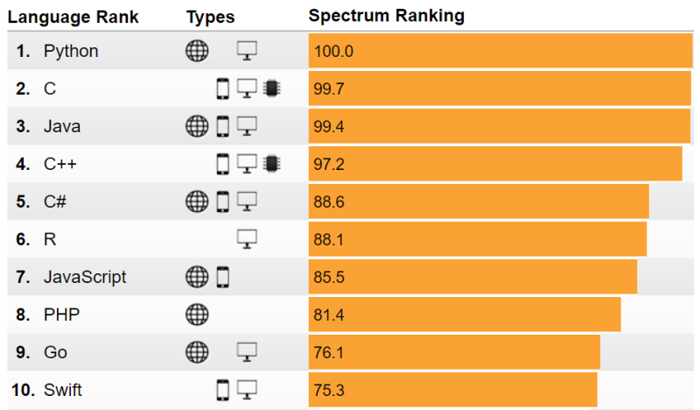
IEEE: The Top 10 Prog. Languages (2017)

Slide 6
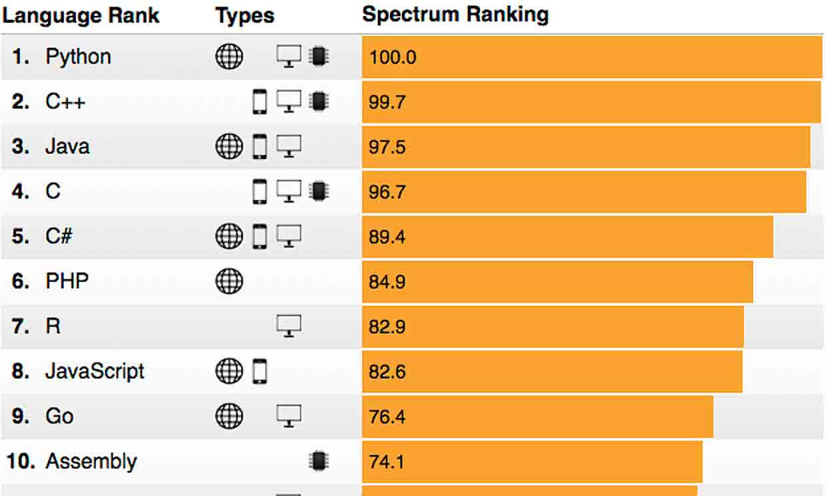
IEEE: The Top 10 Prog. Languages (2018)

Slide 7
Using R @ CHPC
# Simple Approach (to start)
module avail
module load R/4.0.2 # Centos 7
# Invoke Command Line Interpreter (CLI)
R
R>
# If you want to use an IDE (e.g. Rstudio)
module load RStudio
rstudio # Load IDE

Slide 8
R @ CHPC cont’d
Using an R Batch script (CMD Line -> Testing)
Options:
Rscript yourfile.R # Redirects output to stdout
R CMD BATCH yourfile.R # Redirects output to yourfile.Rout
R –no-save < yourfile.R
./yourfile2.R # Add ‘#!/usr/bin/env Rscript’ as top line

Slide 9
R @ CHPC cont’d
)
Submit an R Batch script on the cluster (using SLURM):
Example SLURM scripts to be found in:
https://www.chpc.utah.edu/documentation/software/r-language.php

Slide 10
R @ CHPC cont’d
R library:= A location where R packages are installed
R package := Fundamental Unit of Reproducible R code
=> R packages are installed in R libraries (vs. C/C++/Fortran,..)
Different libraries:
R-Core installation
R>.Library / echo $R_HOME
Libraries installed by the CHPC
echo $R_LIBS_SITE
User Libraries (if the user decides to do this – default: absent)
echo $R_LIBS_USER
Check existing libraries: R>.libPaths()

Slide 11
R @ CHPC cont’d
Installation of packages:
install.packages() (high level)
Example: (maRketSim package)
install.packages(c(“maRketSim”),
lib=c(“$YOUR_LIBRARY”),
repos=c(http://cran.us.r-project.org),verbose=TRUE)
R CMD INSTALL (low level)
Example: (RNetCDF package)
export PATH=/uufs/chpc.utah.edu/sys/installdir/netcdf-c/4.3.2i/bin:$PATH export PATH=/uufs/chpc.utah.edu/sys/installdir/udunits/2.2.20/bin:$PATH

Slide 12
R @ CHPC cont’d
R CMD INSTALL \
--library=/uufs/chpc.utah.edu/common/home/$USER/RLibs/3.5.2i \ --configure-args="CPPFLAGS='-I/uufs/chpc.utah.edu/sys/installdir/udunits/2.2.20/include'\ LDFLAGS='-Wl,-rpath=/uufs/chpc.utah.edu/sys/installdir/netcdf-c/4.3.2i/lib \ -L/uufs/chpc.utah.edu/sys/installdir/netcdf-c/4.3.2i/lib -lnetcdf \ -Wl,-rpath=/uufs/chpc.utah.edu/sys/installdir/udunits/2.2.20/lib\ -L/uufs/chpc.utah.edu/sys/installdir/udunits/2.2.20/lib -ludunits2 ' \ --with-nc-config=/uufs/chpc.utah.edu/sys/installdir/netcdf-c/4.3.2i/bin/nc-config " \ RNetCDF_1.8-2.tar.gz
Note:
R CMD install calls ./configure under the hood

Slide 13
Questions?

Slide 14
Links
https://www.r-project.org/
https://cran.r-project.org/ (Comprehensive R Archive Network)
https://www.r-bloggers.com/
The Art of R Programming (Norman Matloff)
Hadley Wickham
R mailing-list
Stack Overflow (R Channel)

