Slide 1
Workflow Managers
Brett Milash
Center for High Performance Computing
University of Utah

Slide 2
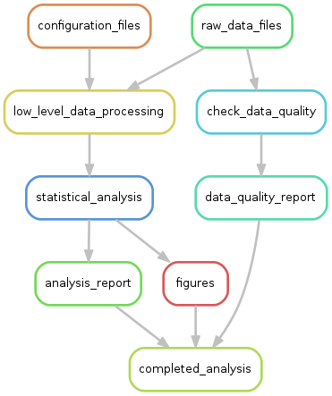
Workflow managers – what are they?
Tools to “orchestrate” complex analyses
Track dependancies from analysis results back to raw data files
Statements to carry out analysis step-by-step
Configurable for local, cluster, remote execution
Common in bioinformatics, not (necessarily) bioinformatics-specific
Numerous! Over 100 in existence
https://github.com/pditommaso/awesome-pipeline

Slide 3
Why use them?
Reproducibility
Portability between clusters, institutions
Modularity – divide and conquer!
Convenience

Slide 4
(My) Criteria for selection
Actively used and developed
Native SLURM support
No significant system administration support required
General purpose (i.e. not just for bioinformatics)
Significant functionality bang for your learning buck

Slide 5
Snakemake and Nextflow
Snakemake
Nextflow
Python (3)
Rules
Files
Execution:
Local (shell, python)
SLURM
LSF
Other interesting bits:
Wildcards
Graphical output
Modular workflows
Python API
Common Workflow Language
Groovy (java 1.8)
Processes
Channels (files, values, pipes, sets of these … )
Execution:
Local (shell, groovy, python, R, perl, … )
SLURM
LSF
HTCondor (Open Science Grid)
Sun Grid Engine
PBS/Torque
Kubernetes
AWS Batch
Other interesting bits:
Common Workflow Language (in alpha)
Process definitions part of workflow

Slide 6
Snakemake: a better make
Classical makefile:
Rule
Dependancies (input)
hello_world: hello_world.o
gcc -o hello_world hello_world.o
hello_world.o: hello_world.c hello_world.h
gcc -c hello_world.c
Target (output)
Action

Slide 7
Simple snakefile example
Rules have:
inputs
outputs
actions (shell or python)
names
Rules are:
linked implicitly
(or explicitly)
executed in parallel if possible
executed locally or on a cluster
rule link:
input: "hello_world.o"
output: "hello_world"
shell: """
module load gcc/4.9.2
gcc -o {output} {input}
"""
rule compile:
input: source="hello_world.c",headers=["hello_world.h",]
output: "hello_world.o"
shell: """
module load gcc/4.9.2
gcc -c {input.source}
"""

Slide 8
Snakemake exercise 1
In the “data” directory, manually run “fastqc --noextract” on one of the .fastq.gz files, to see what output files are created.
Create a snakefile with a single rule that runs “fastqc --noextract” on just one fastq file. Choose any one file, and hard-code its name into your snakefile as the input. Also hard-code the output file names. Hint: multiple output files expressed as comma-separated list of quoted file names.
Run “snakemake –s your_snakefile”
rule fastqc:
input: "SRR5934916.fastq.gz"
output: "SRR5934916_fastqc.zip", "SRR5934916_fastqc.html"
# Here's an optional message, printed to standard output:
message: "Running Fastqc on input file {input}."
shell: "fastqc --noextract {input}"

Slide 9
Snakemake wildcards
Wildcards: filename patterns enable generalizable rules
These make workflows reusable
Parallelization!
The trick:
Create one rule that handles a single input -> output action. This acts as a template.
Create a second rule whose input lists all the required output files using snakemake’s expand() function. This acts as a gatekeeper.
The catch: you can’t execute the template rule directly, only the gatekeeper rule.

Slide 10
Snakemake wildcard example
# Calculate the number of lines and MD5 checksum for every .fastq.gz file.
# First, generate a list of the sample names embedded in the file names:
import os
samples=[f.split('.')[0] for f in os.listdir('.') if f.endswith('.fastq.gz’)]
rule all_sizes_and_checksums:
input: expand("{sample}.{format}", sample=samples, format=["linecount","md5"])
output: touch("sizes_and_checksums.done") # Creates empty output file
rule one_size_and_checksum:
input: "{sample}.fastq.gz"
output: linecount="{sample}.linecount", checksum="{sample}.md5"
shell: """
gunzip -c {input} | wc -l > {output.linecount}
md5sum {input} > {output.checksum}
"""

Slide 11
Snakemake exercise 2
Alter your snakefile ( or use solutions/exercise1.snakefile ) to:
Process all fastq files with fastqc using a wildcard.
Once fastqc has been run on all fastq files, run the command “multiqc .” to summarize all the fastqc output files. This will produce multiqc_report.html and multiqc_data.
You can do this with 2 rules (one template, one “gatekeeper”), or 3 rules (one template, one gatekeeper, and a third to run multiqc).

Slide 12
Snakemake exercise 2 solution ( 2 rules )
# Generate a list of the sample names embedded in the file names.
import os
samples=[f.split('.')[0] for f in os.listdir('.') if f.endswith('.fastq.gz')]
rule run_multiqc:
input: expand("{sample}_fastqc.{format}", sample=samples, format=["zip","html"])
output: "multiqc_report.html", "multiqc_data"
shell: """
module load multiqc
multiqc .
"""
rule fastqc_one_sample:
input: "{sample}.fastq.gz"
output: "{sample}_fastqc.zip", "{sample}_fastqc.html"
shell: """
module load fastqc
fastqc --noextract {input}
"""

Slide 13
Snakemake on a cluster
Any snakemake task can run on a cluster:
snakemake -s snakefile --cluster-config cluster.yaml --jobs 20
Cluster configuration file:
# cluster.yaml - cluster configuration for my snakemake job.
__default__:
partition: slurm_parition
account: slurm_account
time: 3:00:00
nodes: 1
Configuration can be in JSON or YAML format
Can provide default and rule-specific configurations
Can specify ”local” rules:
localrules: run_multiqc

Slide 14
Snakemake exercise 3
Create a cluster configuration file cluster.yaml:
# cluster.yaml - cluster configuration for my snakemake job.
__default__:
partition: slurm_parition
account: slurm_account
time: 3:00:00
nodes: 1
Run your snakefile (or use solutions/exercise2-2.snakefile) using your cluster configuration file:
snakemake -s ../solutions/exercise2-2.snakefile --cluster-config \ ../examples/cluster.yaml --jobs 20

Slide 15
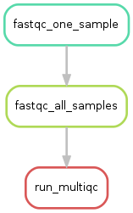
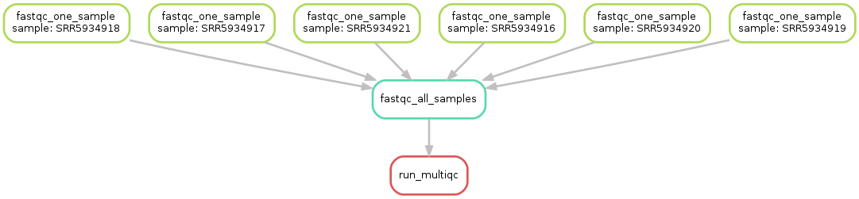
Snakemake wrap-up
Modular workflows
include: "path/to/other/snakefile"
Graphical output
snakemake –s snakefile --rulegraph | dot –Tpng > rulegraph.png
snakemake –s snakefile --dag | dot –Tpng > dag.png

Slide 16
Simple Nextflow Example

Slide 17
Nextflow Exercise 1

Slide 18
Advanced Nextflow Example

Slide 19
Nextflow Exercise 2

Slide 20
Documentation
Snakemake
https://snakemake.readthedocs.io/en/stable/
Nextflow
https://www.nextflow.io/

Slide 21
Logging in to Summit using XSEDE Credentials
ssh –l your_xsede_login login.xsede.org
(enter your password, then 2FA using DUO)
gsissh rmacc-summit
This gets you onto a login node on Summit
ssh scompile
to get onto a compile node.

Slide 22
Install Instructions

Slide 23
Thank you!

