Slide 1
Workflow Managers Snakemake and Nextflow
Brett Milash
Center for High Performance Computing
University of Utah

Slide 2
Logging in to Summit
Using XSEDE Credentials
ssh –l your_xsede_login login.xsede.org
(enter your password, then 2FA using DUO)
gsissh rmacc-summit
This gets you onto a login node on Summit
ssh scompile
to get onto a compile node.
Using a temporary account:
ssh user0040@tlogin1.rc.colorado.edu
ssh scompile

Slide 3
Install instructions
$ source ~bmilash@xsede.org/rmacc-setup
Loading modules.
Altering PATH.
Testing that nextflow is on path:
~/bin/nextflow
Testing snakemake version.
5.2.2
Cloning github repository.
Cloning into 'rmacc-workflows'...
remote: Counting objects: 38, done.
remote: Compressing objects: 100% (29/29), done.
Unpacking objects: 7% (3/38)
$ cd rmacc-workflows

Slide 4
Documentation
Snakemake
https://snakemake.readthedocs.io/en/stable/
Nextflow
https://www.nextflow.io/

Slide 5
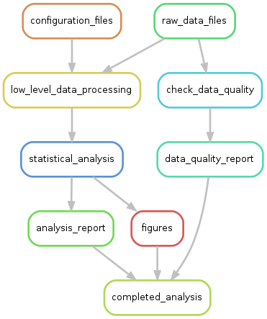
Workflow managers – what are they?
Tools that conduct complex analyses
Track dependancies from analysis results back to raw data files
Statements to carry out analysis step-by-step
Can be configured for local, cluster, remote execution
Common in bioinformatics, not (necessarily) bioinformatics-specific
Numerous! Over 100 in existence
https://github.com/pditommaso/awesome-pipeline

Slide 6
Why use them?
Reproducibility
Portability between clusters, institutions
Modularity – divide and conquer!
Re-use
Convenience

Slide 7
(My) Criteria for selection
Actively used and developed
Native SLURM support
No significant system administration support required
General purpose (i.e. not just for bioinformatics)
Significant functionality bang for your learning buck

Slide 8
Snakemake and Nextflow
Snakemake
Nextflow
Similar to “make”
Python
Rules
Files
Execution:
Local (shell, python)
SLURM
LSF
Other interesting bits:
Wildcards
Graphical output
Modular workflows
Python API
Common Workflow Language
Dataflow programming model
Groovy (java 1.8)
Processes
Channels (files, values, pipes, sets of these … )
Execution:
Local (shell, groovy, python, R, perl, … )
SLURM
LSF
HTCondor (Open Science Grid)
Sun Grid Engine
Kubernetes
AWS Batch
Other interesting bits:
Common Workflow Language (in alpha)
Process definitions part of workflow

Slide 9
Snakemake: a better make
Classical makefile:
Rule
Dependancies (input)
hello_world: hello_world.o
gcc -o hello_world hello_world.o
hello_world.o: hello_world.c hello_world.h
gcc -c hello_world.c
Target (output)
Action

Slide 10
Simple snakefile example
Rules have:
inputs
outputs
actions (shell or python)
names
Rules are:
linked implicitly
(or explicitly)
executed in parallel if possible
executed locally or on a cluster
rule link:
input: "hello_world.o"
output: "hello_world"
shell: """
module load gcc/6.1.0
gcc -o {output} {input}
"""
rule compile:
input: source="hello_world.c",headers=["hello_world.h",]
output: "hello_world.o"
shell: """
module load gcc/6.1.0
gcc -c {input.source}
"""

Slide 11
Snakemake exercise 1
In the “data” directory, manually run “fastqc --noextract” on one of the .fastq.gz files, to see what output files are created.
Create a snakefile with a single rule that runs “fastqc --noextract” on just one fastq file. Choose any one file, and hard-code its name into your snakefile as the input. Also hard-code the output file names. Hint: output file names are quoted, and multiple output files are comma-separated.
Run “snakemake –s your_snakefile”
rule fastqc:
input: "SRR5934916.fastq.gz"
output: "SRR5934916_fastqc.zip", "SRR5934916_fastqc.html"
# Here's an optional message, printed to standard output:
message: "Running Fastqc on input file {input}."
shell: "fastqc --noextract {input}"

Slide 12
Snakemake wildcards
Wildcards: filename patterns enable generalizable rules
These make workflows reusable
Parallelization!
The trick:
Create one rule that handles a single input -> output action. This acts as a template.
Create a second rule whose input lists all the required output files using snakemake’s expand() function. This acts as a gatekeeper.
The catch: you can’t execute the template rule directly, only the gatekeeper rule.

Slide 13
Snakemake wildcard example
# Calculate the number of lines and MD5 checksum for every .fastq.gz file.
# First, generate a list of the sample names embedded in the file names:
import os
samples=[f.split('.')[0] for f in os.listdir('.') if f.endswith('.fastq.gz’)]
rule all_sizes_and_checksums:
input: expand("{sample}.{format}", sample=samples, format=["linecount","md5"])
output: touch("sizes_and_checksums.done") # Creates empty output file
rule one_size_and_checksum:
input: "{sample}.fastq.gz"
output: linecount="{sample}.linecount", checksum="{sample}.md5"
shell: """
gunzip -c {input} | wc -l > {output.linecount}
md5sum {input} > {output.checksum}
"""

Slide 14
Snakemake exercise 2
Alter your snakefile ( or use solutions/exercise1.snakefile ) to:
Process all fastq files with fastqc using a wildcard.
Once fastqc has been run on all fastq files, run the command “multiqc .” to summarize all the fastqc output files. This will produce multiqc_report.html and multiqc_data.
You can do this with 2 rules (one template, one “gatekeeper”), or 3 rules (one template, one gatekeeper, and a third to run multiqc).

Slide 15
Snakemake exercise 2 solution ( 2 rules )
# Generate a list of the sample names embedded in the file names.
import os
samples=[f.split('.')[0] for f in os.listdir('.') if f.endswith('.fastq.gz')]
rule run_multiqc:
input: expand("{sample}_fastqc.{format}", sample=samples, format=["zip","html"])
output: "multiqc_report.html", "multiqc_data"
shell: """
module load multiqc
multiqc .
"""
rule fastqc_one_sample:
input: "{sample}.fastq.gz"
output: "{sample}_fastqc.zip", "{sample}_fastqc.html"
shell: """
module load fastqc
fastqc --noextract {input}
"""

Slide 16
Snakemake on a cluster
Any snakemake task can run on a cluster:
snakemake -s snakefile --cluster-config cluster.yaml --jobs 20
Cluster configuration file:
# cluster.yaml - cluster configuration for my snakemake job.
__default__:
partition: slurm_parition
account: slurm_account
time: 3:00:00
nodes: 1
Configuration can be in JSON or YAML format
Can provide default and rule-specific configurations
Can specify ”local” rules:
localrules: run_multiqc

Slide 17
Snakemake exercise 3
Create a cluster configuration file cluster.yaml:
# cluster.yaml - cluster configuration for my snakemake job.
__default__:
partition: shas
qos: debug
time: 0:10:00
nodes: 1
Run your snakefile (or use solutions/exercise2-2.snakefile) using your cluster configuration file:
snakemake -s your_snakefile --cluster-config cluster.yaml --cluster sbatch --jobs 5

Slide 18
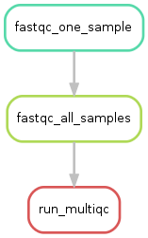
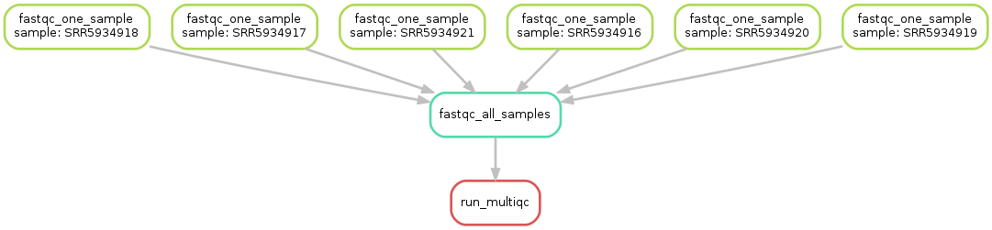
Snakemake wrap-up
Modular workflows
include: "path/to/other/snakefile"
Graphical output
snakemake –s snakefile --rulegraph | dot –Tpng > rulegraph.png
snakemake –s snakefile --dag | dot –Tpng > dag.png

Slide 19
Nextflow basics
Nextflow is based on the dataflow programming model.
Imagine your workflow as an assembly line built from:
Channels
Carry data around
Not just files – also values, streaming data (pipes), “sets” of items -> data types
“Operators” allow channel filtering, forking, combining, transforming, …
Processes
Input from channel(s)
Output to channel(s)
Scripts: shell, also python, perl, R, …
Executors
“Plug-ins” that control where the work is done
Local (by default), also SLURM, Open Science Grid , SGE, LSF, PBS, etc …

Slide 20
More nextflow basics
Work directory
Each process invocation happens in its own directory
Input files linked there
Result files left there unless you explicitly “publish” them elsewhere
Nextflow scripts written in groovy
// one-line comments
/* multi-line comments */
Start with “#!/usr/bin/env nextflow” for an executable nextflow script
http://docs.groovy-lang.org/docs/latest/html/documentation/

Slide 21
Nextflow compile example
$ ls
a.c b.c main.c compile1.nf
$ cat compile1.nf
#!/usr/bin/env nextflow
c_files_channel = Channel.fromPath( "*.c" )
c_files_channel.subscribe { println "$it" }
$ nextflow run compile1.nf
N E X T F L O W ~ version 0.29.1
Launching `./compile1.nf` [distraught_shockley] - revision: 1115256fab
.../examples/nextflow_ex1/a.c
.../examples/nextflow_ex1/b.c
.../examples/nextflow_ex1/main.c

Slide 22
Nextflow compile example (2)
$ cat compile2.nf
#!/usr/bin/env nextflow
c_files_channel = Channel.fromPath( "*.c" )
process compile {
module 'gcc/4.9.2'
input: file c_file from c_files_channel
output: file '*.o' into result
script: "gcc -c -g ${c_file}"
}
result.subscribe { println "Compiled $it" }

Slide 23
Nextflow compile example (2)
$ nextflow run compile2.nf
N E X T F L O W ~ version 0.29.1
Launching `./compile2.nf` [angry_legentil] - revision: 922ae15375
[warm up] executor > local
[ea/588755] Submitted process > compile (3)
[d7/6bbcd1] Submitted process > compile (2)
[06/c5c40b] Submitted process > compile (1)
Compiled .../work/ea/5887555a65533fdccd0065a0673efa/main.o
Compiled .../work/d7/6bbcd194c33fe0a590c937eeb11ee3/b.o
Compiled .../work/06/c5c40b31665ca2eebba39acf0319bb/a.o

Slide 24
Nextflow compile example (3)
$ cat compile2.nf
#!/usr/bin/env nextflow
c_files_channel = Channel.fromPath( "*.c" )
process compile {
module 'gcc/6.1.0'
input: file c_file from c_files_channel
output: file '*.o' into result
script: "gcc -c -g ${c_file}"
}
result.subscribe { println "Compiled $it" }

Slide 25
Nextflow exercise 1
In the data directory, create a nextflow script that:
Creates a channel that lists the .fastq.gz files
Subscribes to that channel, and print the values from it.
Add to your nextflow script a process that:
Runs “fastqc --noextract” on each .fastq.gz file from the channel
Sends the name of the .zip and .html files generated to a result channel. You will need to use a set to do this:
set file('*.html'), file('*.zip') into result_channel
Run your script with “nextflow run your_script_name –resume” .
Re-run the script, and observe how the output changes.

Slide 26
Nextflow Exercise 2
Alter your nextflow file from exercise 1 to publish the FastQC files to a directory named QcFiles, and then run ”multiqc QcFiles” on that directory.
Multiqc will produce “multiqc_report.html” and “multi_data”. Publish those files to the QcFiles directory.

Slide 27
Thank you!

