Slide 1




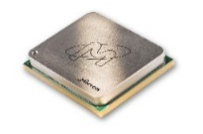




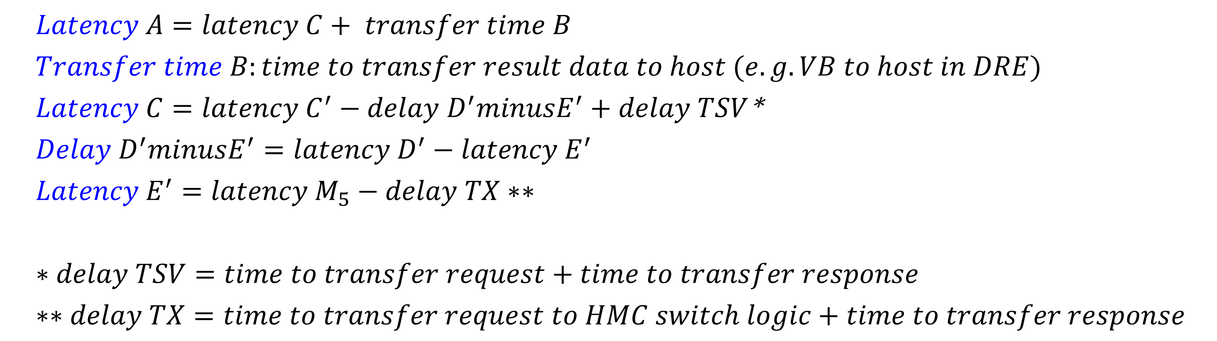
Custom Memory Cube
Yu Zou, Vinayak Deshpande, Herman Lam, Alan George
F3
MOTIVATION & GOAL
APPROACH
Motivation
Memory bottleneck – critical for memory-intensive Big Data apps
Promise of CMC for computational ram & processor-in-memory processing
Goal: Create flexible research platform for design space exploration of CMC apps & arch. before existence of CMC
Merlin board
Phase 1: Prototype Platform
Create CMC emulation platform using Convey’s FPGA-HMC platform (Merlin board)
Phase 2: Case Study
Select model of CMC
Develop mapping from measured parameters to model parameters
Perform design space exploration of CMC arch & CMC operations/apps
DRAM
DRAM
Layers
HMC
Layers
CMC
Case study: model of a notional CMC
CPU
Logic Layer
CPU
Processor
Custom
Logic Layer
PHASE 1: Prototype Platform
PHASE 2: Case Study
Observability
Instrument Merlin infrastructure with hardware performance monitors (C’, D’, M1, M2, M3, M4, M5, and E’)
Usability & Flexibility
Implemented & measured kernels and apps using HT (Convey’s tool & language)
Vector Addition (emulates DRE* fill operation)
DRE app: SpMV
CMC platform on Merlin board
Model of notional CMC
CMC platform on Merlin board
Selected notional CMC model from published work
Identified hardware parameters required by performance model
Mapped measurement points to model parameters as required
*DRE: Data Reordering/Rearrangement Engine from LLNL
PHASE1: Initial Results
PHASE2: Initial Results
Measured performance: simple read/write (µs)
(Averaged over 100,000 iterations)
Measured performance: Vector Addition in ms (100,000 iterations of 2 reads & 1 write)
A’ (ms) | C’ | D’ | M1 | M2 | M3 | M4 | M5 | E’
282.55 | 281.72 | 278.72 | 258.96 | 199.68 | 151.31 | - | - | -
Model of notional CMC
CMC platform on Merlin board
Oper. | A’ (µs) | C’ | D’ | M1 | M2 | M3 | M4 | M5 | E’
Read | 1095.6 | 1.03 | 1.006 | 0.923 | 0.725 | 0.519 | - | - | -
Write | 1104.0 | 1.071 | 1.011 | 0.991 | 0.793 | 0.577 | - | - | -
Measured performance: SpMV – DRE app in seconds (2²⁴ X 2²⁴ matrix)
A’ (s) | C’ | D’ | M1 | M2 | M3 | M4 | M5 | E’
1658.67 | 1580.14 | 1559.65 | 1460.57 | 1122.42 | 839.84 | - | - | -
PLANS FOR 2017
Task 1: Platform development
Develop library for customization of notional CMC architecture under study
Explore CMC apps using HT
Task 2: Case studies to explore
Notional CMC architectures
CMC apps: DRE, Sorting, Bloom filter
Characteristics of CMC-amenable apps
$Latency A=latency C+ transfer time B$
$Transfer time B:time to transfer result data to host (e.g. VB to host in DRE)$
$Latency C=latency C^{′}−delay D^{′}minusE^{′}+delay TSV$*
$Delay D^{′}minusE^{′}=latency D^{′}−latency E^{′}$
$Latency E^{′}=latency M_{5}−delay TX∗∗$
$∗delay TSV=time to transfer request+time to transfer response$
$∗∗delay TX=time to transfer request to HMC switch logic+time to transfer response$
Members e.g.,

