Slide 1
F3-16: FPGA & HMC Tools & Architectures for RSC
Kenneth Hill
Abhijeet Lawande
Vinayak Deshpande
A. Jyothishwara
Siddharth Sharma
Yiheng Xia
Yu Zou
Research Students
Dr. Herman Lam
Assoc. Professor of ECE
University of Florida
Dr. Alan George
Professor of ECE
University of Florida
Number of supporting memberships = 5.3

Slide 2



Project Goals, Motivations, & Challenges
F3
Motivation
Convergence of RSC* needs and opportunities
Demands from big-data & data-center applications
Demands from extreme-scale computation (towards Exascale)
Emerging RSC players, innovations, & applications (e.g., IBM, Microsoft, Intel, Micron)
Goal
Explore and advance key technologies for RSC
High-level synthesis (HLS) tool studies
Role of HMC** & CMC*** for RSC
Multi-device architecture & tool exploration
Challenges
Achieve performance gain while maintaining productivity
Study CMC before existence of CMC
Productively exploit architectural advancements
*RSC – Reconfigurable supercomputing
** HMC – Hybrid memory cube
*** CMC – Custom memory cube

Slide 3




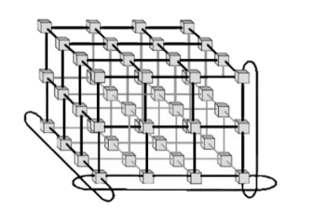


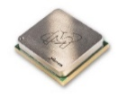



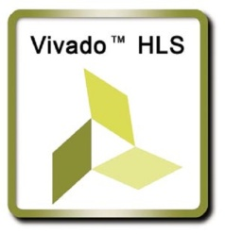

F3-16: Approach
F3
P1: App & HLS Studies
Evaluate OpenCL HLS tools for impactful RSC apps
Explore interconnect topologies for CAPI*-enabled accelerators
P2: Reconfigurable Interconnects for Novo-G#
Novo-G#: reconfigurable interconnect, w/ OpenCL integration
Evaluate performance & productivity tradeoffs
P3: Custom Memory Cube (CMC) Research Platform
Build foundation for CMC research by studying HMC
Create research platform and explore potential of CMC
P4: CMS** Endcap L-1 Muon Trigger
Explore HLS tools for CMS firmware development in Large Hadron Collider (LHC) at CERN
Evaluate optimization & productivity tradeoffs for HLS
*CAPI: Coherent Accelerator Processor Interface
**CMS: Compact Muon Solenoid

Slide 4


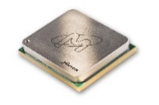

F3-16: Highlights
F3
P1: App & HLS Studies
PSLSE* simulator support for Xilinx and Altera OpenCL
Performance projection of STAC-A2 benchmark for Stratix10
P2: Reconfigurable Interconnects for Novo-G#
Multi-FPGA HLS development with Altera OpenCL
Accelerated apps 2-3x with reconfigurable topology & protocol
P3: Custom Memory Cube (CMC)
Prototype CMC research platform on Convey Merlin board
Case study of notional CMC** & CMC app (DRE***)
P4: CMS Endcap L-1 Muon Trigger
CMS firmware redeveloped & verified using Vivado HLS
Stringent perf., resource, & consistency constraints achieved
* PSLSE: Power Service Layer Simulation Engine from IBM
** Nair, R., et al. "Active Memory Cube: A processing-in-memory architecture for exascale systems.“ IBM Journal of Res. & Development 59.2/3 (2015): 17-1.
*** DRE: Data Reordering/Rearrangement Engine from Lawrence Livermore National Lab

Slide 5
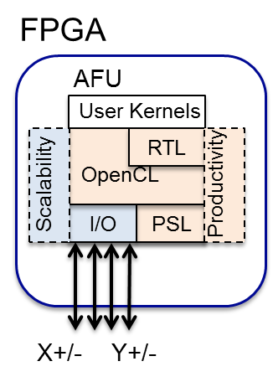
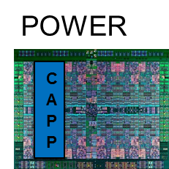

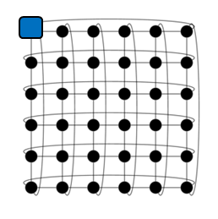
P1: App & HLS Studies: CAPI Accelerators
F3
Motivation
Goal
Large-scale, heterogeneous systems,
Becoming a necessity for big data & extreme-scale computing (toward Exascale)
Develop
Framework = Architecture + Tools
for FPGA accelerators
that is scalable and productive
Approach
Architecture
Directly interconnected FPGAs
Provides performance & scalability through OpenCL pipes
Memory coherency
AFU uses CAPI to directly access host process memory
Tools
Hybrid programming model
Use high-level OpenCL language to increase designer productivity
Leverage optimized RTL cores (libraries)
DSE of large-scale heterog. systems
using system simulation tools (e.g., PSL Simulation Engine)
CAPI
AFU: Accelerator Functional Unit
CAPI: Coherent Accelerator Processor Interface from IBM
CAPP: Coherent Accelerator Processor Proxy
PSL: POWER Service Layer
DSE: design space exploration

Slide 6

P1: App & HLS Studies: CAPI Accelerators
F3
Achievements
Architecture
Evaluated new Xilinx SDAccel tool on POWER8 w/ CAPI
Initial support uses AXI to PSL bridge to transfer data to/from accelerator
OpenCL kernel uses virtual address from host process
Explored CAPI accelerator network for Xilinx and Altera OpenCL
Use OpenCL pipes for point-to-point connection between kernels
CAPI

Slide 7

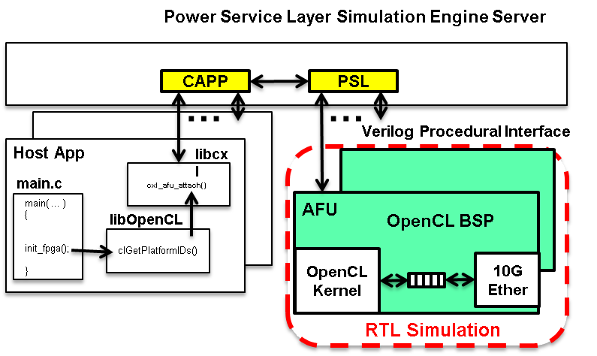
P1: App & HLS Studies: CAPI Accelerators
F3
Achievements
Tools
Investigated RTL kernel support for Xilinx SDAccel
RTL logic encapsulated by AXI interface
Case Studies: vector ops, FFT (spiral.net)
Developed PSLSE simulator support for Altera OpenCL and Xilinx SDAccel
HW simulation for PSL to AFU interface w/ xsim
SW debugging for OpenCL Hardware Abstraction Layer
CAPI

Slide 8
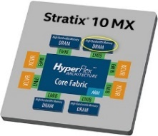

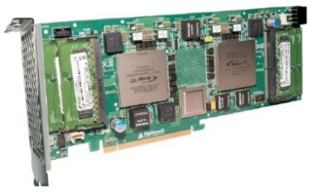

P1: App & HLS Studies: FPGA Acceleration of STAC-A2
F3
Goal
FPGA-based acceleration of STAC-A2* benchmark suite on Stratix-10 (S-10) SoC
STAC-A2 is a standard-based, financial technology benchmark on risk analysis
Memory and computation intensive
Motivation
Approach
(For 2016)
Before existence of Stratix-10 SoC
Develop & verify STAC-A2 functions in OpenCL
Verify implementations in Altera OpenCL emulator
Implement verified STAC-A2 functions on dual Arria-10 (A-10) FPGAs
Measure performance on dual A-10s
Project single S-10 performance from dual A-10 measurements
*STAC: Securities technology analysis center

Slide 9
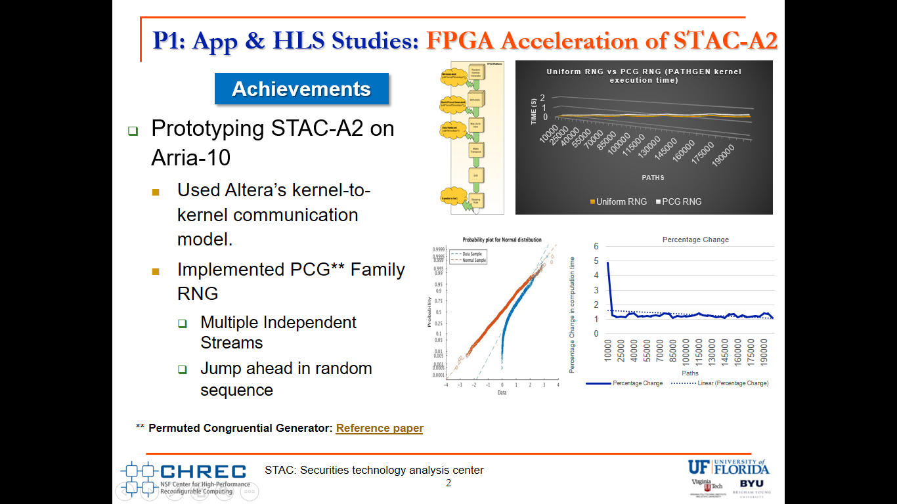
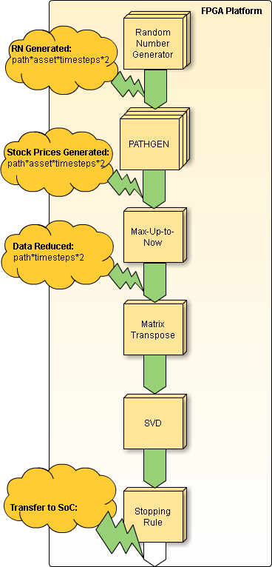
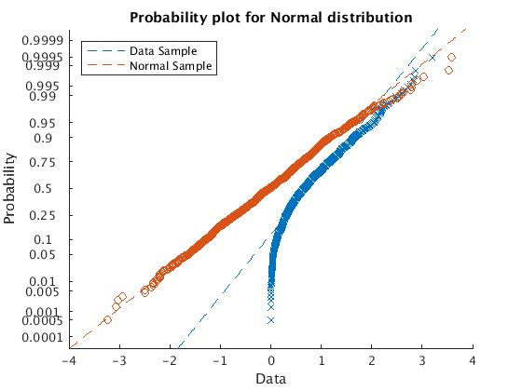
P1: App & HLS Studies: FPGA Acceleration of STAC-A2
F3
Achievements
Prototyping STAC-A2 on Arria-10
Used Altera’s kernel-to-kernel communication model.
Implemented PCG** family RNG
Multiple independent streams
Jump ahead in random sequence
Permuted Congruential Generator: http://www.pcg-random.org/pdf/toms-oneill-pcg-family-v1.02.pdf
STAC: Securities technology analysis center

Slide 10
P1: App & HLS Studies: FPGA Acceleration of STAC-A2
F3
Achievements
Prototyping STAC-A2 on Arria-10
Optimized: Monte-Carlo datapath for future scaling
Vectorization of datapath: SIMD lanes to increase throughput
Added: Payoff Option (Max-Up-To-Now)
Data transfer reduction: Factor of 5
Transfer A
Transfer B
Paths | Transfer A | Transfer B | Communication Reduced
25000 | 0.0210 | 0.0044 | 4.772
50000 | 0.0425 | 0.0089 | 4.740
75000 | 0.0658 | 0.0134 | 4.914
150000 | 0.1345 | 0.0266 | 5.045

Slide 11
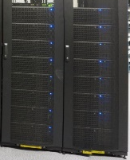
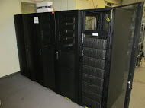
P2: Reconfigurable Interconnects for Novo-G#
F3
Goal
Improve performance & usability of multi-FPGA systems
through HLS integration & flexible interconnect strategies
App Formulation
Motivation
VisualSim model
Design entry
Effective large-scale RSC app acceleration on Novo-G# requires:
Rapid DSE & performance estimation
Reduced barrier-to-entry with HLS support
Fast & efficient networking framework with reconfigurable network support
DSE
OpenCL app
Reconfig. protocol
Reconfig. topology
Novo-G# system
Reconfig. layer
Execution
Approach
DSE through simulation of Novo-G# VisualSim model
Rapid prototyping via multi-FPGA OpenCL
Explore reconfigurable aspects of Novo-G# interconnect
Novo-G#

Slide 12
P2: Reconfigurable Interconnects for Novo-G#
F3
Achievements
Explored reconfigurable aspects of Novo-G# interconnect
Novo-G# RIF* encapsulates tools, methods, and h/w support for reconfigurable networks
Improved multi-FPGA app design flow with DSE through simulation
Scalable and accurate VisualSim model with reconfigurable network support
Models verified to less than 9% error against Novo-G# implementation
App Formulation
VisualSim model
VisualSim model
Design entry
Design entry
DSE
DSE
OpenCL app
Reconfig. protocol
Reconfig. topology
OpenCL app
Novo-G# system
Reconfig. layer
Execution
Execution
Reconfigurable Network Aspects
Network topology
Network behavior
Point-to-point protocol

Slide 13
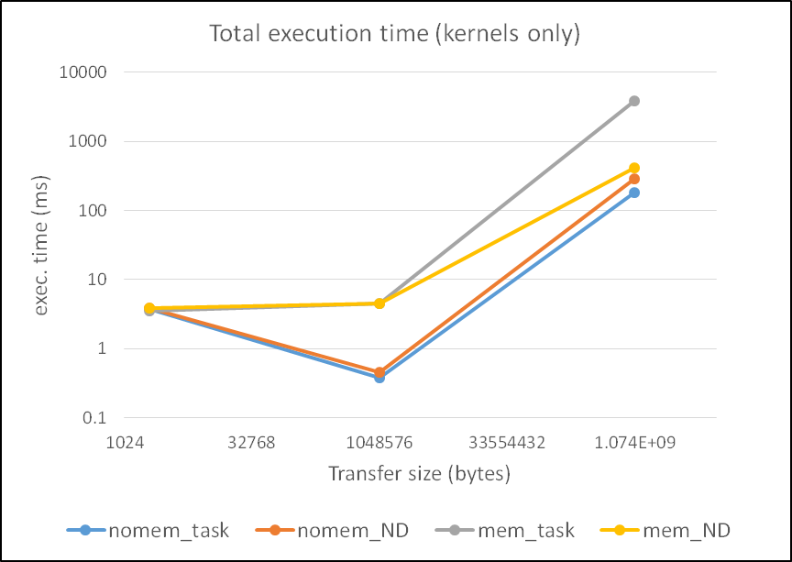
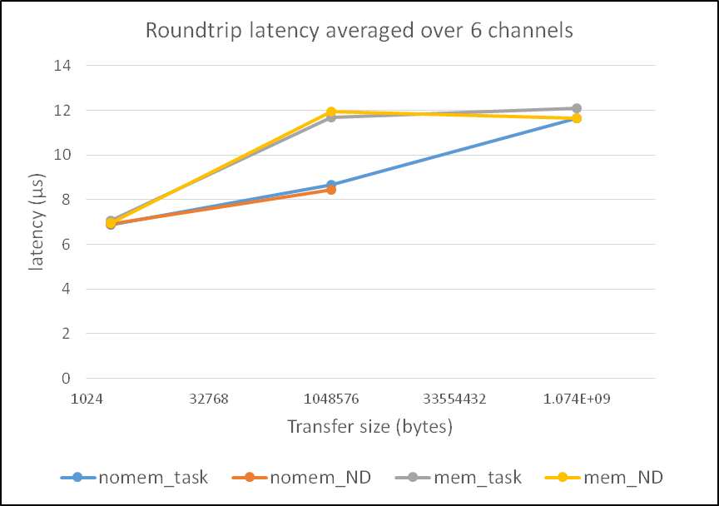
P2: Reconfigurable Interconnects for Novo-G#
F3
Reconfigurable point-to-point protocols
Support for multiple link-layer protocols through use of Native PHY and AOCL
Reconfigured at runtime to match app requirements
Reconfigurable network topology
Reconfigurable topology without change to physical network
Small overhead (3-8%) for large perf. gain
Achievements
App Formulation
VisualSim model
VisualSim model
Design entry
DSE
DSE
Reconfig. protocol
Reconfig. protocol
Reconfig. topology
OpenCL app
Reconfig. topology
Reconfig. layer
Novo-G# system
Reconfig. layer
Execution
Execution
Case studies using reconfigurable interconnect 3D FFT: 3.3x speedup ; LBM: 2.2x speedup
More
results on poster
End-to-end support for multi-FPGA reconf. networks

Slide 14
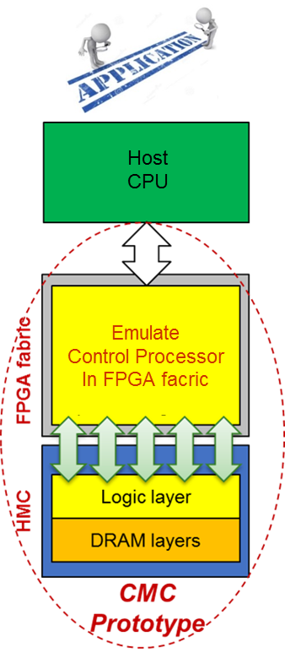
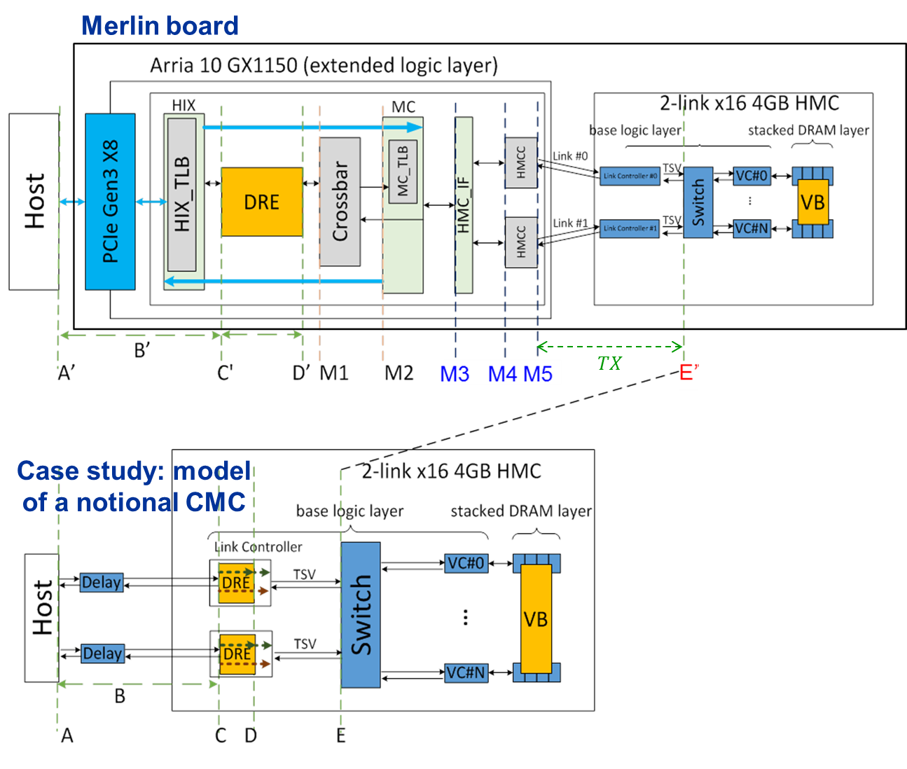
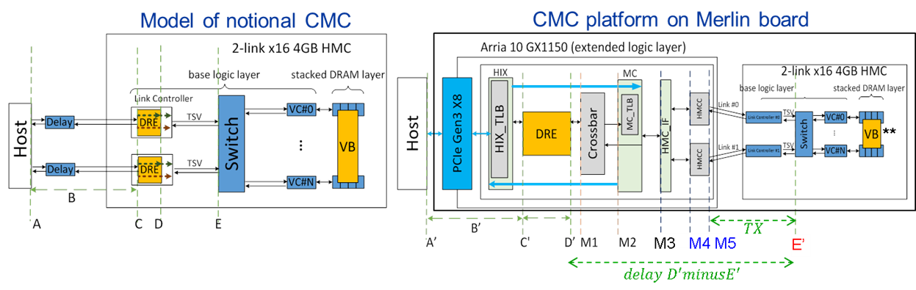
P3: Custom Memory Cube Research Platform
F3
Motivation
Memory bottleneck - critical for memory-intensive Big Data apps
Promise of CMC for C-RAM* & PIM** processing
Goal
Create flexible research platform for design space exploration of CMC apps & arch. before existence of CMC
Approach
Prototype platform:
FPGA + HMC = emulation of CMC
Case study:
Select model of CMC
Develop mapping from measured parameters to model parameters
Perform design space exploration of CMC arch & CMC operations/apps
*C-RAM: Computational RAM
**PIM: Processor In Memory
Notes:
OK

Slide 15
P3: Custom Memory Cube Research Platform
F3
Prototype platform:
FPGA + HMC = Emulation of CMC
Achievement
Implemented on Convey Merlin board from Micron
Observability: instrumented Merlin infrastructure with hardware performance monitors
(C’, D’, M1, M2, M3, M4, M5, and E’ )
Progress (measurements)
Able to measure all listed parameters except:
M4, M5: Exploring with help from Convey
E’: Exploring with help with Micron under NDA
Measured performance: simple read/write (µs)
(Averaged over 100,000 iterations)
Oper. | A’ (µs) | C’ | D’ | M1 | M2 | M3 | M4 | M5 | E’
Read | 1095.6 | 1.03 | 1.006 | 0.923 | 0.725 | 0.519 | - | - | -
Write | 1104.0 | 1.071 | 1.011 | 0.991 | 0.793 | 0.577 | - | - | -
*Hybrid Threading (HT) language & tool from Micron/Convey
Notes:
Need summary bullets:
able to read everything except M4, M5, E’
M4 and M5: Convey; E’: Micron

Slide 16
P3: Custom Memory Cube Research Platform
F3
Prototype platform:
FPGA + HMC = Emulation of CMC
Achievement
Usability & flexibility: Implemented & measured kernels and apps using HT
Vector Addition (emulates DRE* “fill” op)
DRE app: SpMV**
Measured performance: Vector Addition in ms (100,000 iterations of 2 reads & 1 write)
A’ (ms) | C’ | D’ | M1 | M2 | M3 | M4 | M5 | E’
282.55 | 281.72 | 278.72 | 258.96 | 199.68 | 151.31 | - | - | -
Measured performance: SpMV – DRE app in seconds (2²⁴ X 2²⁴ matrix)
A’ (s) | C’ | D’ | M1 | M2 | M3 | M4 | M5 | E’
1658.67 | 1580.14 | 1559.65 | 1460.57 | 1122.42 | 839.84 | - | - | -
* DRE: Data Reordering/Rearrangement Engine from Lawrence Livermore National Lab (LLNL)
** SpMV: sparse matrix-vector multiplication
Notes:
Make this into a “platform result slide” also
replace with platform figure (from previous slide)
bullet summarizing we also have different design options for DRE
able to measure for DRC ops (hopefully add another row for non-blocking ops)

Slide 17
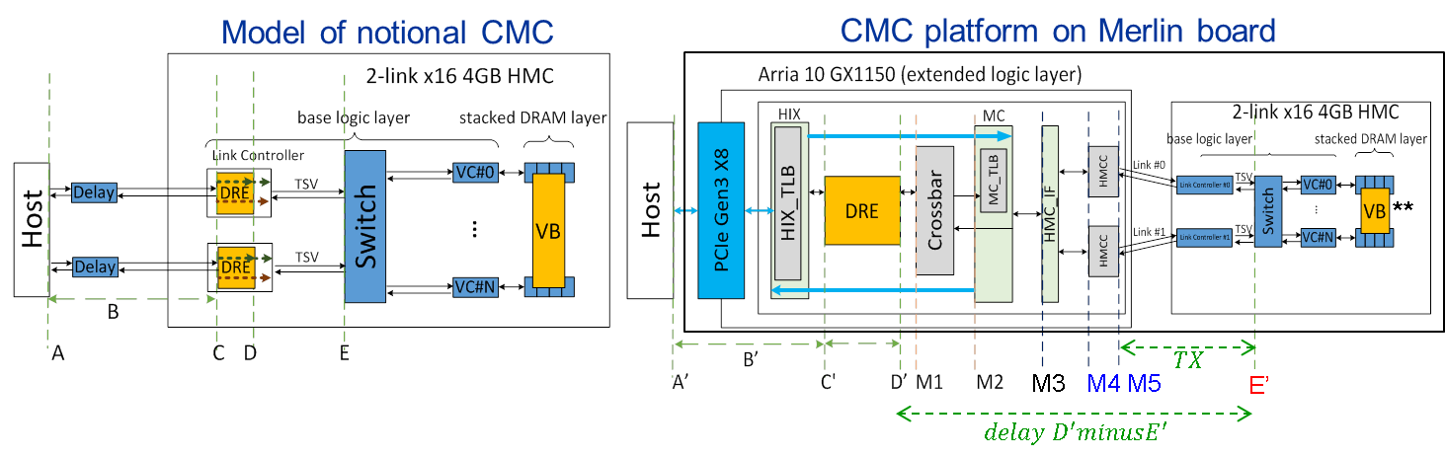
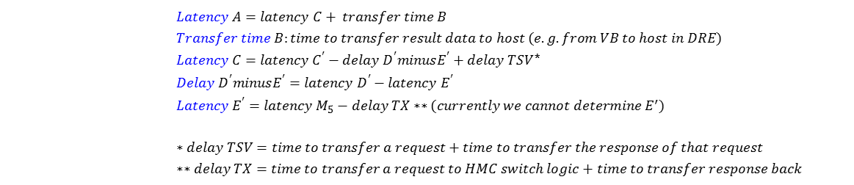
P3: Custom Memory Cube Research Platform
F3
Notional CMC architecture*
Performance modelling
Achievement
Going forward
Able to measure all identified parameters in CMC platform
Map measured values to model values of notional CMC architecture
Selected notional CMC model from published work
Identified hardware parameters required by performance model
Mapped measurement points to model parameters as required
Measured to model parameter mapping
$Latency A=latency C+ transfer time B$
$$Transfer time B:time to transfer result data to host (e.g. from VB to host in DRE)$$
$Latency C=latency C^{′}−delay D^{′}minusE^{′}+delay TSV$*
$$Delay D^{′}minusE^{′}=latency D^{′}−latency E^{′}$$
$$Latency E^{′}=latency M_{5}−delay TX∗∗(currently we cannot determine E^{′})$$
$$∗delay TSV=time to transfer a request+time to transfer the response of that request$$
$$∗∗delay TX=time to transfer a request to HMC switch logic+time to transfer response back$$
* Nair, R., et al. "Active Memory Cube: A processing-in-memory architecture for exascale systems.“ IBM Journal of Res. & Development 59.2/3 (2015): 17-1.
** VB: view buffer in DRE logic

Slide 18
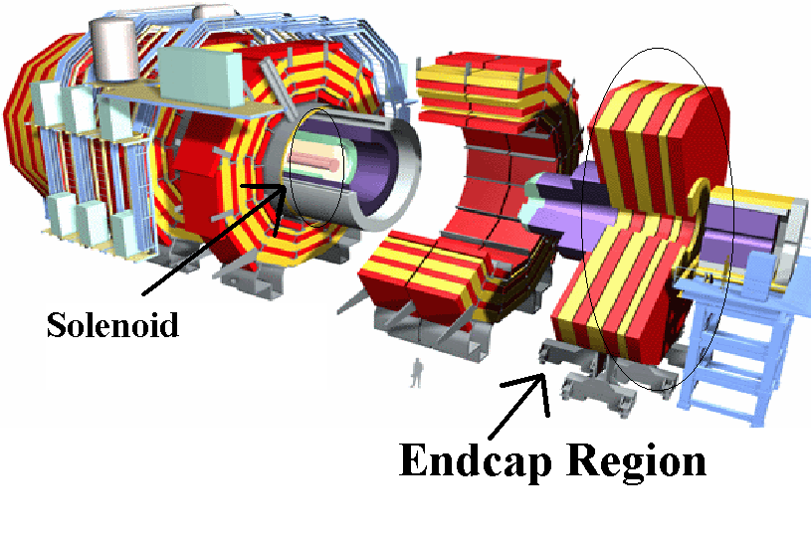
P4: CMS* Endcap L-1 Muon Trigger
F3
Motivation
Code-development time
several years and >4000 lines of Verilog implementation required originally
Code complexity
Development and maintenance complexity rapidly increasing with every version
Verification for physicists (in C++)
Increasingly difficult to maintain consistency b/w C++ & RTL models
Goal
Use Vivado HLS for development of next-generation CMS code to ensure:
Parallel development of firmware & C++ model
Increased flexibility, reduced development time
Consistent high-level (C++) verification
* CMS: Compact Muon Solenoid, Large Hadron Collider (LHC) @ CERN

Slide 19
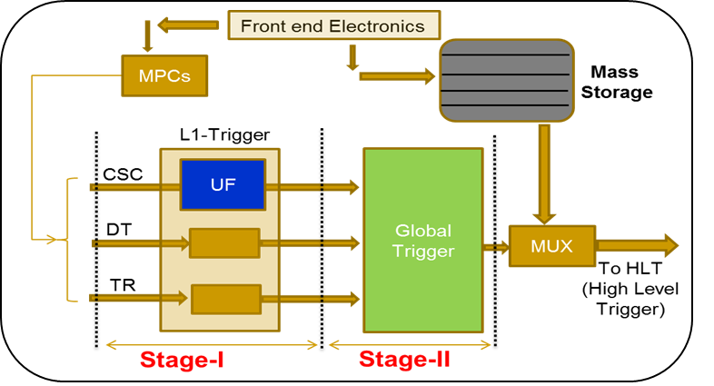
P4: CMS Endcap L-1 Muon Trigger
F3
Achievements
All 9 modules of CSC* Track-finder** redeveloped & verified
HLS & RTL consistency achieved through simulation
Marked productivity improvement
Firmware verification completed on FPGA for 5 out of 9 modules
HLS-generated outputs consistent with baseline Verilog outputs
Performance constraints satisfied & resource usage comparable
Resource statistics better than Verilog implementation for majority of cases
RTL optimizations using high-level constructs
Consistency between C++ & RTL achieved
HLS code compatible with g++ compiler
Deployment in LHC at CERN expected early 2017
* CSC: Cathode Strip Chamber
** CSC Track-finder: Sub-system which identifies muon tracks from CSC

Slide 20
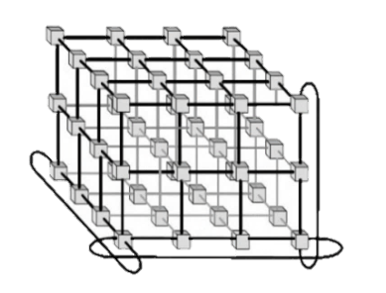


F3-16: Conclusions
F3
P1: App & HLS Studies
Explored Xilinx and Altera OpenCL for CAPI architecture
Developed STAC-A2 design for Stratix10 SoC
P2: Reconfigurable Interconnects for Novo-G#
Novo-G# RIF: end-to-end reconfigurable network app support
Explored reconfigurability through protocols and topology
P3: Custom Memory Cube (CMC)
Developed hardware-in-the-loop CMC research platform
Performance measurement and modeling of notional CMC arch.
P4: CMS Endcap L-1 Muon Trigger
Redeveloped CMS firmware using Vivado HLS
Achieved all performance, resource & consistency constraints

Slide 21
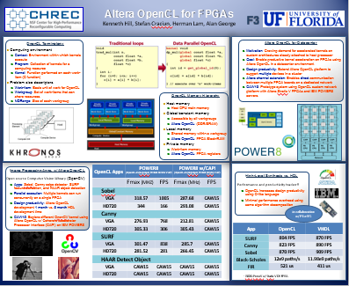
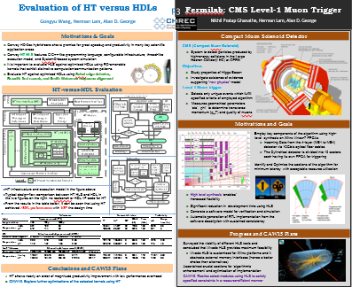
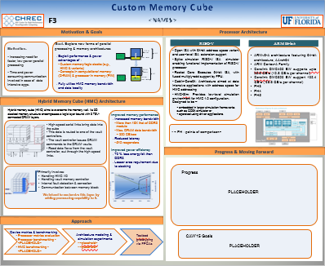
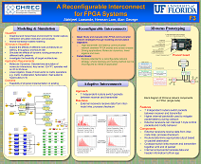
Questions, Posters, & Demos
F3
Posters & Demos
OpenCL for FPGAs on IBM POWER
HLS for CMS Level-1 Endcap Muon Trigger
Custom Memory Cube
A Reconfigurable 3D Interconnect for Novo-G
Publications
G. Wang, H. Lam, A. George, “Comparative Debugging for Reconfigurable Computing”, 2016 International Conf. on Computer Aided Design (ICCAD’16), Austin, TX, 7-10 Nov. 2016, submitted
G. Wang, H. Lam, Y. Zou, R. Xavier, S. Gundecha, A. George. “A Research Platform for Custom Memory Cube”, Workshop on Modeling & Simulation of Systems and Applications (ModSim). University of Seattle, Seattle, WA, Aug. 2016.
A. George, M. Herbordt, H. Lam, A. Lawande, J. Sheng, C. Yang, “Novo-G#: A Community Resource for Exploring Large-Scale Reconfigurable Computing with Direct and Programmable Interconnects”, IEEE High Performance Extreme Computing Conf. (HPEC’15), Waltham, MA, 13-15 Sept. 2016, invited
A. Lawande, A. George, and H. Lam. "An OpenCL framework for distributed apps on a multidimensional network of FPGAs." Proceedings of the Sixth Workshop on Irregular Applications: Architectures and Algorithms. Salt Lake City, UT, 13 Nov. 2016.

