Slide 1
F3-16: FPGA & HMC Tools & Architectures for RSC
Kenneth Hill
Abhijeet Lawande
Nikhil Ghanathe
Shefali Gundecha
Gongyu Wang
Riju John Xavier
Yu Zou
Research Students
Dr. Herman Lam
Assoc. Professor of ECE
University of Florida
Dr. Alan George
Professor of ECE
University of Florida
Number of supporting memberships = 5.3

Slide 2



Project Goals, Motivations, & Challenges
F3
Motivation
Convergence of RSC* needs and opportunities
Demands from big-data & data-center applications
Demands from extreme-scale computation (towards Exascale)
Emerging RSC players, innovations, & applications (e.g., IBM, Microsoft, Intel, Micron)
Goal
Explore and advance key technologies for RSC
High-level synthesis (HLS) tool studies
Role of HMC** & CMC*** for RSC
Multi-device architecture & tool exploration
Challenges
Achieve performance gain while maintaining productivity
Study CMC before existence of CMC
Productively exploit architectural advancements
*RSC – Reconfigurable supercomputing
** HMC – Hybrid memory cube
*** CMC – Custom memory cube

Slide 3




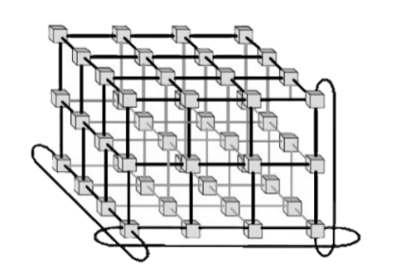


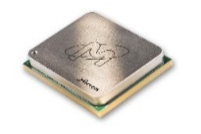





F3-16: Approach
F3
P1: Multi-device Acceleration on POWER Arch.
Evaluate HLS tools on POWER architecture (e.g., OpenCL+CAPI*) for impactful RSC applications
Explore interconnect topologies for CAPI-enabled accelerators
P2: Reconfigurable Interconnects for Novo-G#
Novo-G#: reconfigurable interconnect, w/ OpenCL integration
Evaluate performance & productivity tradeoffs
P3: Custom Memory Cube (CMC)
Build foundation for CMC research by studying HMC
Create research platform and study benefits of CMC
P4: CMS** Endcap L-1 Muon Trigger
Explore HLS tools for CMS firmware development in Large Hadron Collider (LHC) at CERN
Evaluate optimization & productivity tradeoffs for HLS
*CAPI: Coherent Accelerator Processor Interface
**CMS: Compact Muon Solenoid

Slide 4
F3-16: Highlights
F3
P1: Multi-device Acceleration on POWER Arch.
1
2
P2: Reconfigurable Interconnects for Novo-G#
Fast, efficient, and flexible protocol stack for inter-FPGA comm.
Multi-FPGA HLS development with Altera OpenCL
P3: Custom Memory Cube (CMC)
Developed CMC research platform on Convey Merlin board
Applied to case study: DRE***
P4: CMS Endcap L-1 Muon Trigger
Redeveloped & verified CMS firmware using Vivado HLS
Achieved all performance, resource & consistency constraints
* DSE: Design space exploration
** PSLSE: Power Service Layer Simulation Engine from IBM
*** DRE: Data Reordering/Rearrangement Engine from Lawrence Livermore National Lab (LLNL)

Slide 5
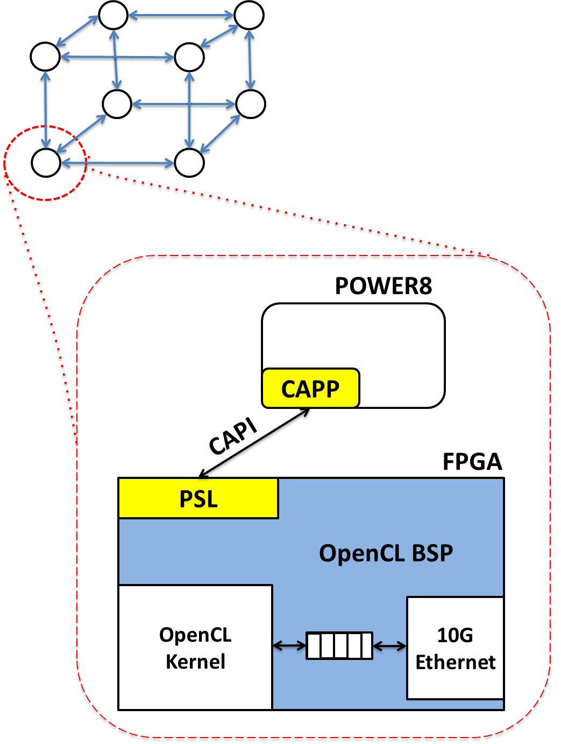

P1: Multi-device Acceleration on POWER Architecture
F3
Goal
Provide productive & scalable framework for coherent FPGA systems
OpenCL integration w/ CAPI and back-end network
Motivation
Emerging big data & data-center demands require:
Tightly integrated processors & co-processors
Ability to scale out with problem size
Approach
Examine CAPI support for Altera/Xilinx OpenCL
Leverage OpenCL pipes for streaming network
Explore multi-FPGA designs using PSLSE* simulation environment
* PSLSE: Power Service Layer Simulation Engine from IBM

Slide 6
P1: Multi-device Acceleration on POWER Arch.
F3
Achievements
Explored new Xilinx OpenCL tools on POWER8 w/ CAPI
Designed custom Altera OpenCL BSP for CAPI accelerator network
Prepared PSLSE simulator for DSE of multi-FPGA OpenCL
OpenCL Kernels | Stratix V (POWER8 host w/ CAPI) |  | Virtex 7 (POWER8 host w/ CAPI)
 | Fmax (MHZ) | FPS | Fmax (MHz) | FPS
Sobel | 294.98 | 98.52 | 250 | 107.97
Canny | 300.48 | 91.68 | 250 | CAW16
SURF | 275.63 | 91.98 | CAW16 | CAW16
Power Service Layer Simulation Engine Server
CAPP
PSL
…
…
Verilog Procedural Interface
Host App
libcxl
main.c
cxl_afu_attach()
main( … )
{
init_fpga();
}
libOpenCL
AFU
OpenCL BSP
More results
on poster
clGetPlatformIDs()
OpenCL Kernel
10G
Ether
CAW16 Plans
RTL Simulation
Use PSLSE environment for DSE of multi-FPGA OpenCL system
Deploy hardware prototype w/ Altera or Xilinx FPGAs

Slide 7
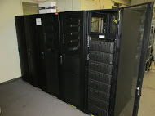
P2: Reconfigurable Interconnects for Novo-G#
F3
Goal
Improve performance & usability of multi-FPGA systems
through HLS integration & flexible interconnect strategies
Motivation
Design Entry
Effective large-scale RSC app acceleration on Novo-G# requires:
Rapid DSE & performance estimation
Reduced barrier-to-entry with HLS support
Fast & efficient networking framework with reconfigurable network support
VisualSim
(DSE)
HDL
Reconfigure
Prototype
Approach
DSE through simulation of Novo-G# VisualSim model
Rapid prototyping via multi-FPGA OpenCL
Explore reconfigurable aspects of Novo-G# interconnect
Novo-G#

Slide 8
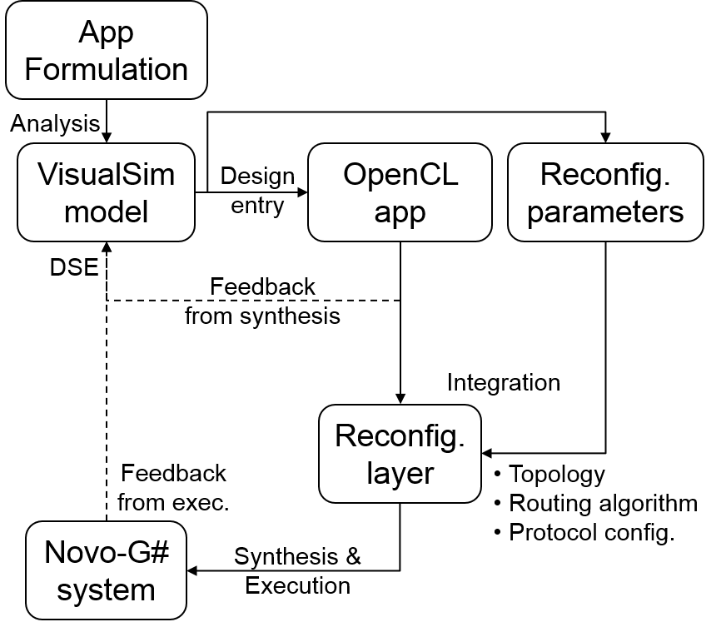
P2: Reconfigurable Interconnects for Novo-G#
F3
Achievements
Reconfigurable Network Aspects
Network topology
Network behavior
Point-to-point protocol
Explored reconfigurable aspects of Novo-G# interconnect
Through simulation and hardware experiments
Novo-G# RIF* encapsulates tools, methods, and h/w & s/w support for reconfigurable networks
Improved multi-FPGA app design flow with emphasis on DSE through simulation
Highly scalable and accurate VisualSim model with support for reconfigurable networks
Fed by real-world parameters from synthesis and hardware execution
Models verified to less than 9% error against Novo-G# implementation

Slide 9
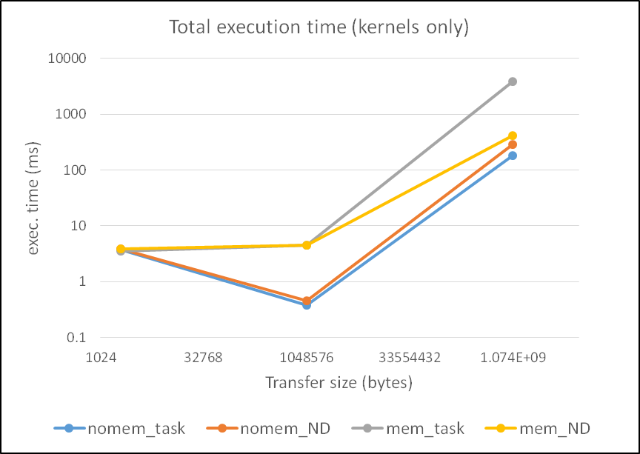
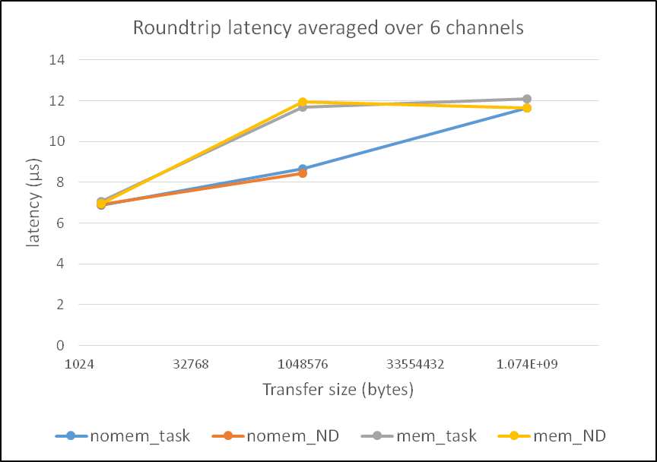
P2: Reconfigurable Interconnects for Novo-G#
F3
Achievements
Reconfigurable point-to-point protocols
Support for multiple link-layer protocols through use of Native PHY and AOCL
Reconfigured at runtime to match app requirements
Reconfigurable network topology
Reconfigurable topology without change to physical network through Novo-G# RIF
Relatively small overhead (3-8%) for large perf. gain
3D FFT: 3.3x perf. through use of “long” links to improve connectivity & reduce packet latency
LBM: 2.2x perf. with “corner” links to improve dimensionality and eliminate routing entirely
placeholder
More
results on poster
End-to-end support for multi-FPGA reconf. networks

Slide 10


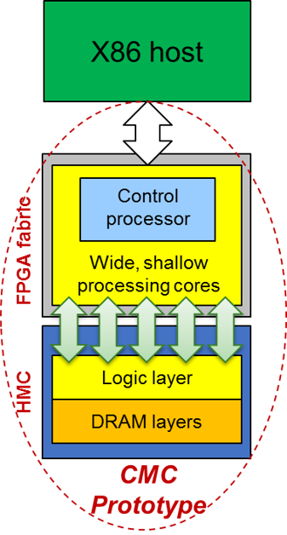
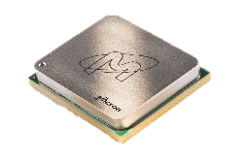

P3: Custom Memory Cube (CMC)
F3
Goal
Create research platform for design-space exploration CMC apps & arch (C-RAM* & PIM**)
Motivation
Memory-intensive apps: memory bottleneck & high energy consumption
HMC: higher B/W & lower power than current memories
Potential for C-RAM* & PIM** processing (CMC)
Approach
Create initial prototype of CMC arch using FPGA+HMC
Explore perf. measurement methods for CMC platform
Research perf. modelling for notional CMC architecture
Initial case study CMC app: DRE*** of LLNL
*C-RAM: Computational RAM
**PIM: Processor In Memory
***DRE: Data-Reordering Engine

Slide 11
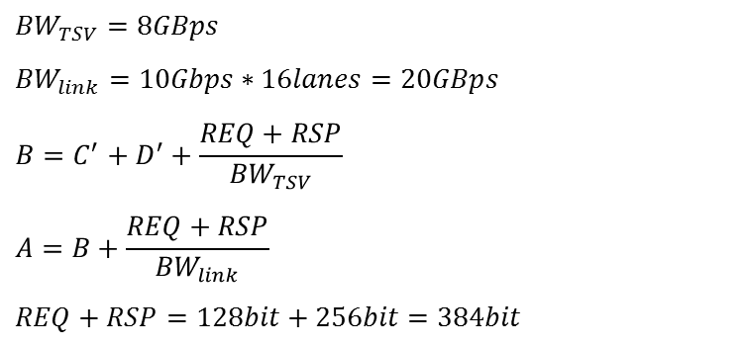
P3: Custom Memory Cube (CMC)
F3
Initial prototype of CMC research platform on Convey Merlin* board (FPGA + HMC)
Achievement
Model of notional CMC**
Explore perf. measurement methods for CMC platform
Research perf. modelling for notional CMC architecture
$${BW}_{TSV}=8GBps$$
$${BW}_{link}=10Gbps∗16lanes=20GBps$$
$$B=C^{′}+D^{′}+\frac{REQ+RSP}{{BW}_{TSV}}$$
$$A=B+\frac{REQ+RSP}{{BW}_{link}}$$
$REQ+RSP=128bit+256bit=384bit$
Merlin board
*Merlin board from Convey Computer, Inc. (now part of Micron)
**Nair, R., et al. "Active Memory Cube: A processing-in-memory architecture for exascale systems.“
IBM Journal of Research and Development 59.2/3 (2015): 17-1.

Slide 12
P3: Custom Memory Cube (CMC)
F3
Perf. measurements on CMC research platform
Case study: Data Reordering/Rearrangement Engine
Achievements
Measurement on Merlin* platform
Performance of single memory operations (wr/rd)
Performance of DRE operations
Performance of DRE applications: PageRank, SpMV, Random Access, Image Differencing
Placeholder: to insert a result table
Placeholder: to insert a result table

Slide 13
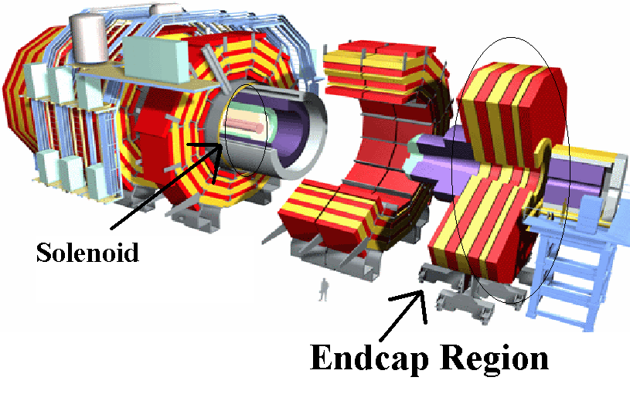
P4: CMS* Endcap L-1 Muon Trigger
F3
Motivation
Code-development time
Verilog implementation required several years and >4000 lines of code
Code complexity
Development and maintenance complexity rapidly increasing
Verification for physicists
Increasingly difficult to maintain consistency b/w C++ & RTL models
Goal
Explore HLS languages & tools for next-generation CMS code for
Parallel development of firmware & C++ model
Increased flexibility, reduced development time
Consistent high-level (C++) verification
Design Tool: Vivado HLS Xilinx Virtex-7 XC7VX690T
* CMS: Compact Muon Solenoid, Large Hadron Collider (LHC) @ CERN

Slide 14
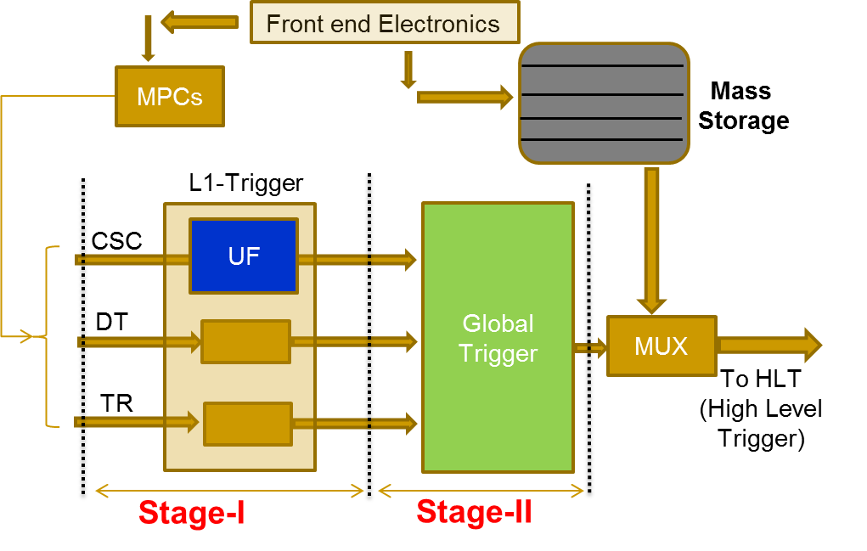
P4: CMS Endcap L-1 Muon Trigger
F3
Achievements
All 9 modules of CSC* Track-finder** redeveloped & verified
HLS & RTL consistency achieved through simulation
Marked productivity improvement
Firmware verification completed on FPGA X out of 9 modules
HLS-generated outputs consistent with baseline Verilog outputs
Performance constraints satisfied & resource usage comparable
Resource statistics better than Verilog implementation for majority of cases
RTL optimizations using high-level constructs
Deployment in LHC at CERN expected XXX
* CSC: Cathode Strip Chamber
** CSC Track-finder: Sub-system which identifies muon tracks from CSC

Slide 15
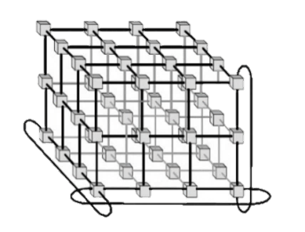
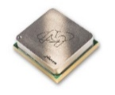

F3-16: Conclusions
F3
P1: Multi-device Acceleration on POWER Arch.
1
2
P2: Reconfigurable Interconnects for Novo-G#
Novo-G# RIF: end-to-end reconfigurable network app support
Explored reconfigurability through network protocols and topology
P3: Custom Memory Cube (CMC)
Developed hardware-in-the-loop CMC research platform
Performance measurement and modeling of notional CMC arch.
P4: CMS Endcap L-1 Muon Trigger
Redeveloped CMS firmware using Vivado HLS
Achieved all performance, resource & consistency constraints

Slide 16
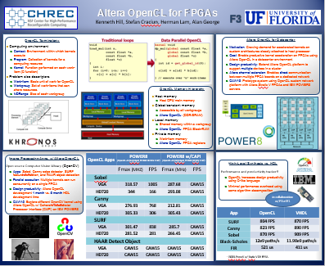
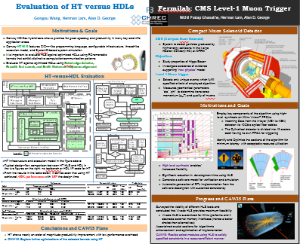
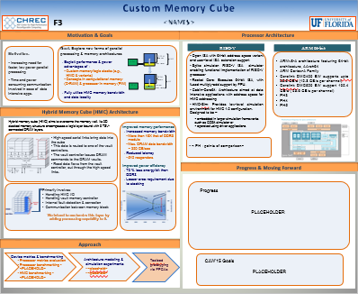
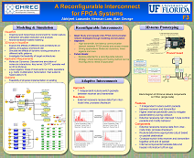
Questions, Posters, & Demos
F3
Posters & Demos
OpenCL for FPGAs on IBM POWER
HLS for CMS Level-1 Endcap Muon Trigger
Custom Memory Cube
A Reconfigurable 3D Interconnect for Novo-G
Publications
G. Wang, H. Lam, A. George, “Comparative Debugging for Reconfigurable Computing”, 2016 International Conf. on Computer Aided Design (ICCAD’16), Austin, TX, 7-10 Nov. 2016, submitted
G. Wang, H. Lam, Y. Zou, R. Xavier, S. Gundecha, A. George. “A Research Platform for Custom Memory Cube”, Workshop on Modeling & Simulation of Systems and Applications (ModSim). University of Seattle, Seattle, WA, Aug. 2016.
A. George, M. Herbordt, H. Lam, A. Lawande, J. Sheng, C. Yang, “Novo-G#: A Community Resource for Exploring Large-Scale Reconfigurable Computing with Direct and Programmable Interconnects”, IEEE High Performance Extreme Computing Conf. (HPEC’15), Waltham, MA, 13-15 Sept. 2015, invited

