Slide 1
F3-15: App and Architecture Studies in Reconfigurable Supercomputing
Dr. Herman Lam
Assoc. Professor of ECE
University of Florida
Dr. Alan George
Professor of ECE
University of Florida
Kenneth Hill
Abhijeet Lawande
Nikhil Ghanathe
Shefali Gundecha
Nalini Kumar
Carlo Pascoe
Gongyu Wang
Riju John Xavier
Research Students
University of Florida
Number of supporting memberships = 6

Slide 2


Project Goals, Motivations, & Challenges
Motivation: Resurgence in reconfigurable supercomputing (RSC)
Demands from Big Data applications
Demands from Extreme-scale Computation (towards Exascale)
Emerging RSC players, innovations, & applications (IBM, Microsoft, Intel, Baidu, Google, Oracle, …)
Goal: Explore and advance key technologies for RSC
App & productivity studies in reconfigurable computing
Exploration of future-gen devices & systems
Reconfigurable interconnect for acceleration of communication-intensive RSC apps
Challenges
Achieve performance gain while maintaining productivity
Balance tradeoff b/w uncertainty, accuracy, scalability, & speed
Design min architectural changes with max impact
Notes:
The motivation for the F3 group for next year is the topic of a birds-of-a-feature (BOF) at the Supercomputing Conference SC14 in New Orleans last month, the resurgence in reconfigurable supercomputing, as a result from:
Demands from Big Data applications
Demands from Extreme-scale Computation (towards Exascale)
Emerging RSC players and innovations from major companies like IBM, Microsoft, Google, and Oracle & new RSC applications
The goal is to explore and advance some key technologies for reconfigurable computing.
For demands from big data, …app and productivity studies
For demands from extreme-scale computing, … BE
Also for demands from big data, … reconfig interconnect
The challenges are:
For app and productiviity studies ..
For BE …
For rec interconnect …

Slide 3
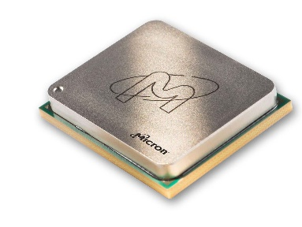


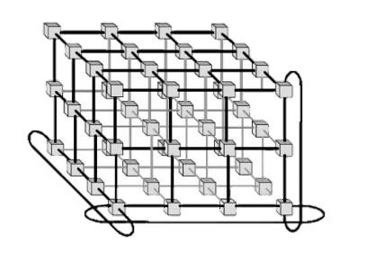



Approach
P1: App & HLS Studies
Explore use of HLS¹ languages & tools for productive development
Acceleration of impactful apps
OpenCV kernels using POWER8/CAPI
CMS² L1 trigger on Virtex-7
Experiments on multiple platforms
OpenCL on IBM POWER8 with Nallatech PCIe385n
HT³ on Convey HC-2ex
P2: Exploration of Future-gen Devices & Systems
Study behavior of large-scale, future-gen applications& architectures
Custom memory cube (CMC) with custom logic layer for C-RAM⁴ or PIM⁵
Multi-scale coarse-grained simulation for design space exploration
Apps
RSC
RSC
Tools
P3: Reconfigurable Interconnectivity for Novo-G#
Improve performance and usability
Novel interconnects explored through Novo-G# simulation model and testbed
Improved usability through OpenCL and efficiency through intelligent network design
Arch.
¹ HLS: High-Level Synthesis
² CMS: Compact Muon Solenoid
³ HT: Hybrid Threading
⁴ C-RAM: Computational RAM
⁵ PIM: Processor-in-Memory

Slide 4
Highlights
P2: Exploration of Future-gen Devices & Systems
P1: App & HLS Studies
Performance / productivity tradeoff
Apps
Custom Memory Cube (CMC)
Candidate simulators identified for ARM64, RISC-V, and HMC
ARM64 mem. B/W measured (ext.: 12.8GB/s)
Altera OpenCL vs. HDL
Improved productivity with comparable perform.
Application portability across different FPGA board vendors featuring Altera FPGAs
Behavioral Emulation (BE)
ArchBEOs for Tile-Gx36, XeonPhi, 64-bit ARM, IBM Power7 cores
AppBEOs for 2D/3D matrix multiply, Sobel
Convey HT vs. HDL
Improved productivity with low perf. overhead
1/8th dev. time to achieve >80% performance of optimized HDL apps
RSC
Tools
P3: Reconfigurable Interconnectivity for Novo-G#
Arch.
Modeling & Simulation
Novo-G# model & predictions updated
Validated with h/w experiments and measurements on 2x2x2 system
10-20x BlueGene/Q (CPU cluster) perf.
Network Design
Working 3D torus network stack (based on custom RTL & Interlaken)
40 Gbps inter-FPGA links with 10⁻¹³ BER¹
Supports variety of protocols & features
¹ BER: Bit Error Rate
Notes:
P2 - BE section:
- Could change it to Model, Validate, & Predict
- ArchBEOs for various many-core processors
- Under ~10% error for device-level studies

Slide 5
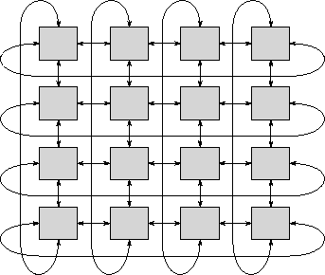


P1: App Studies & Altera OpenCL
Goal: Compare HLS vs. HDL
Apps: Sobel, Canny edge detector, and SURF feature extraction (in collaboration w/ P3 of F1)
Progress:
Performance: OpenCL shows similar performance with VHDL and across different vendor platforms
Design Productivity: Altera OpenCL development 1 month vs. 6 months for HDL development
Design Portability: Altera OpenCL project run on three different RC platforms with no code modifications
Fmax for OpenCL w/ CAPI (MHz)
 | CAPI | PCIe
SURF | 286 | 301
Canny | 213 | 277
Sobel | 288 | 319
CAPI
CAPI
CAPI
CAPI
P8 CPU
P8 CPU
P8 CPU
P8 CPU
Network
CAW15 Plans
OpenCL Cluster for Datacenter
Extend Altera OpenCL platform to support multiple device in a cluster
Showcase directly connected kernels using 10 Gigabit Ethernet
Application Studies
Explore OpenCV image-processing kernels using Power8 w/ CAPI
Apps. | Nallatech PCIe385 | Bittware S5PHQ-D8 | GiDEL ProceV (OpenCL | GiDEL ProceV (VHDL)
SURF | 776 FPS @ VGA | 765 FPS @ VGA | 720 FPS @ VGA | 778 FPS @ VGA
Canny | 821 FPS @ VGA | 861 FPS @ VGA | 769 FPS @ VGA | 807 FPS @ VGA
Sobel | 935 FPS @ VGA | 896 FPS @ VGA | 814 FPS @ VGA | 795 FPS @ VGA
More apps. and info. at poster

Slide 6
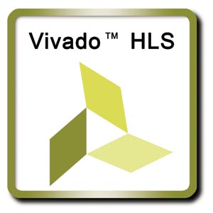
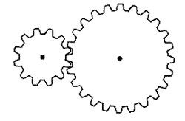

P1: App & HLS Studies
HT-vs-HDL study goals
Evaluate HT in terms of performance and productivity
Compare against optimized HDL designs of three distinctive kernels
Progress
HT designs achieve >80% performance of optimized HDLs
Nearly an order of magnitude productivity improvement
CAW15 plans
Explore further optimizations of the kernels using HT toolset
CMS Level-1 Muon trigger
Compact Muon Solenoid
System for measuring & detecting muons created from proton collisions
Goals
Accelerate L1 trigger algorithm on Virtex 7 FPGA
Real-time data rate reduction algorithm for Large Hadron Collider at CERN
Develop HLS model for simulation and corresponding RTL implementation
Progress
Exploring OpenCL & Vivado HLS for high-level synthesis & verification
CAW15 plans
Identify & implement key modules of the algorithm efficaciously using HLS
Productivity
Performance
More info. and results at poster session

Slide 7



P2: Custom Memory Cube (CMC)
Progress
Conducted initial survey & identified promising simulators with HMC & processor support
HMC-Sim with GC64 simulator for RISC-V support
Gem5 simulator for ARM64 support
SST with support from Gem5
Device-metrics & benchmarking evaluation of Juno ARM dev. platform
Ext. mem. BW: 12.8 GB/s
Int. mem. BW: L1-96 GB/s, L2-28.8 GB/s
CoreMark benchmark score: 4176.8
Goal: Explore new forms of parallel processing & memory architectures
Exploit perf.& power advantages of:
Custom memory/logic stacks (e.g., HMC¹ & variants)
Concepts in computational memory, C-RAM² & PIM³
Approach
Research involves studies with:
Device metrics & benchmarking
Architecture modeling & simulation experiments
Testbed prototyping via FPGAs
CAW15 plans
Benchmark on ARM64 (e.g., GUPS, STREAM) and HMC
Explore co-simulation of HMC and RISC-V/ARM64 based on device metrics
¹ HMC: hybrid-memory cube
² C-RAM: computational memory
³ PIM: processor in memory
Notes:
3Dinterconnection technology
HMC Gen 2: 8 DRAMs * 16 slices * 2 banks = 256 responders/ Acc to HMC 2.0 Documentation : 4GB has 256 banks, 8GB has 512 banks
Only challenge being system implementation may not be able to utilize the high BW it can provide – as can be seen comparing device metric and HMC BW of 320 GB/s
Hence this project which aims to add PIM technology to HMC
The project summary from Dr. George:
This project focuses upon new forms of parallel processing and memory architectures to achieve an optimal combination of performance, power, and scalability for selected apps in computational science. We are exploring new ideas and technologies in hybrid memory cubes featuring an on-chip stack of memory and logic, such as technology from Micron and custom variants. The goal is to exploit performance and power advantages of custom memory/logic stacks, and of concepts in computational memory (C-RAM) or processor in memory (PIM) with them, and doing so by connecting and/or integrating processors such as 64-bit ARM and RISC-V. Research involves studies with device metrics and benchmarks, architecture modeling and simulation experiments, and testbed prototyping (via FPGAs) and evaluation. The project is being conducted in close collaboration with CHREC members at the Laboratory for Physical Sciences (LPS) in Maryland.

Slide 8

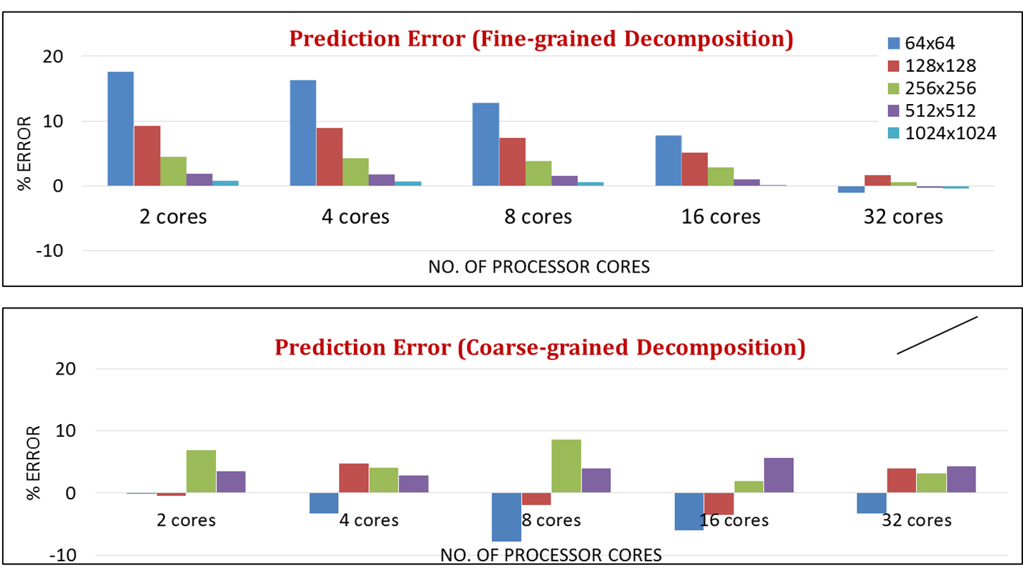
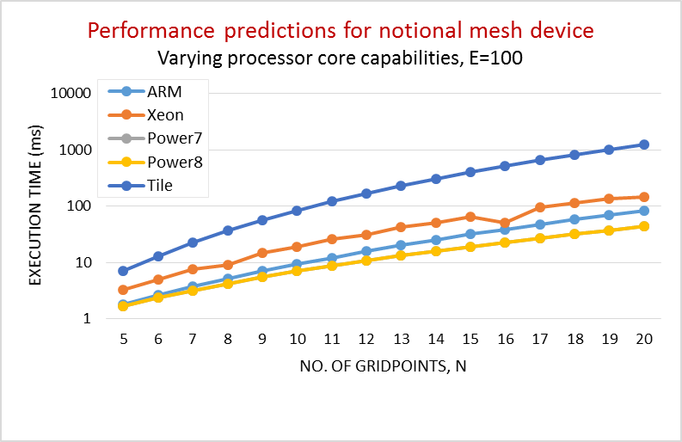
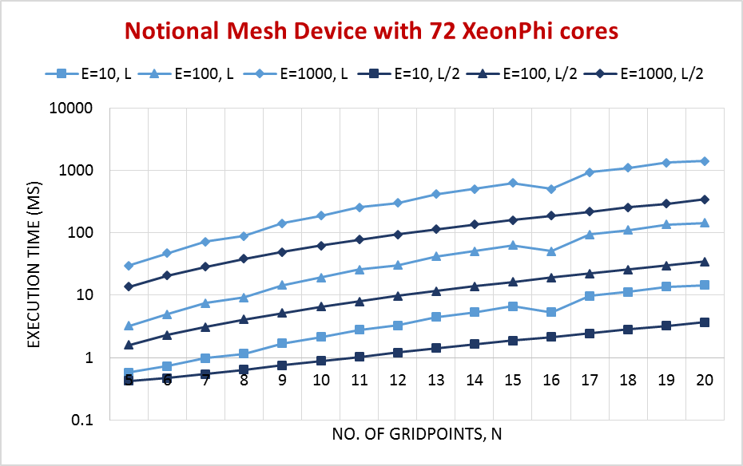
P2: Behavioral Emulation of Future-gen Devices & Systems
Behavioral Emulation (BE) methodology & framework* to advance:
Large-scale science simulations on present & near- future platforms
Hardware/software co-design for exascale systems
Progress:
Designed and calibrated BEO models for several devices
Tile-Gx36, Intel XeonPhi, 64-bit ARM, IBM Power 7 etc.
Validated simulations for select app kernels (~10% error)
Demonstrated use of BE for algorithm and architecture DSE
Notional mesh devices with Xeon Phi, 64-bit ARM, Power7 cores
Notional mesh devices with different network properties (eg. latencies)
Goal
Leverage BE foundation to model apps on next-gen devices & systems
DSE²
Switching delay
Hybrid arch.
No. of cores
Network topology
Network latency
Please visit our poster for detailed results
CAW15 Plans
Extend BE framework for system network modeling and simulation
Leverage and integrate with SST for fast Partial Discrete Event Simulator
* DOE funded PSAAP-II Center for Compressible Multiphase Turbulence
BEO: Behavioral Emulation Object
DSE: Design Space Exploration
SST: Structural Simulation Toolkit
Notes:
(footnote: Structural Simulation Toolkit)

Slide 9

P3: Reconfigurable Interconnects for Novo-G#
Goal: Enable large-scale app acceleration with a reconfigurable 3D-torus network
Turn communication-bound problems into computation-bound problems
Approach:
Novo-G# network design to support multi-FPGA apps efficiently
Modeling & simulation of novel topologies, architectures, and protocols
OpenCL support to improve productivity and usability
Novo-G# network design
Three-layer network stack based on Interlaken protocol
CRC32, 64/67 encoding, multi-lane sync.
Configurable no. of routers to handle app bandwidth requirements
Tradeoff bandwidth for resource util.
Less than 10% memory & logic util. @ 200 MHz (3 routers)
ProceV board
Novo-G#
32 GiDEL ProceV (soon 64) (Stratix V D8)
3D torus or 5/6D hypercube
6 Rx-Tx links per FPGA
4x 10 Gbps per link
3D torus network stack
2x4x4 torus

Slide 10
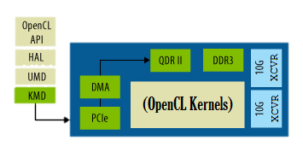
P3: Novo-G# Modeling & OpenCL Support
Modeling & Simulation
Novo-G# perf. model (F3-14) optimized and updated with h/w data
Kernel and network stack tested on 2x2x2 Novo-G# system
Performance measurements used to validate VisualSim model predictions
Updated model predicts 20x speedup over IBM BlueGene/Q for 3D FFT
OpenCL support
Enable productive use of Novo-G# by integrating into Altera OpenCL
Inter-FPGA links map to Altera OpenCL channels
Preliminary support for inter-FPGA channels completed & tested with synthetic kernels
ProceV board
Predicted Novo-G# speedup over BG/Q for 3D FFT
FFT size | 64 nodes |  | 128 nodes |  | 256 nodes |  | 512 nodes
 | BG/Q (µs) | Speedup | BG/Q (µs) | Speedup | BG/Q (µs) | Speedup | BG/Q (µs) | Speedup
32^3 | 142 | 19.03 | 127 | 18.94 | 110 | 15.86 | 93 | 11.26
64^3 | 507 | 12.92 | 459 | 17.99 | 268 | 16.64 | 229 | 18.12
128^3 | 1826 | 6.13 | 1426 | 8.20 | 944 | 8.69 | 677 | 10.40
Inter-FPGA channel
CAW15 Plans
Explore reconfigurable interconnects in simulation & hardware
Improve Novo-G# OpenCL support & evaluate using meaningful apps
Please visit our poster for details
ProceV board

Slide 11

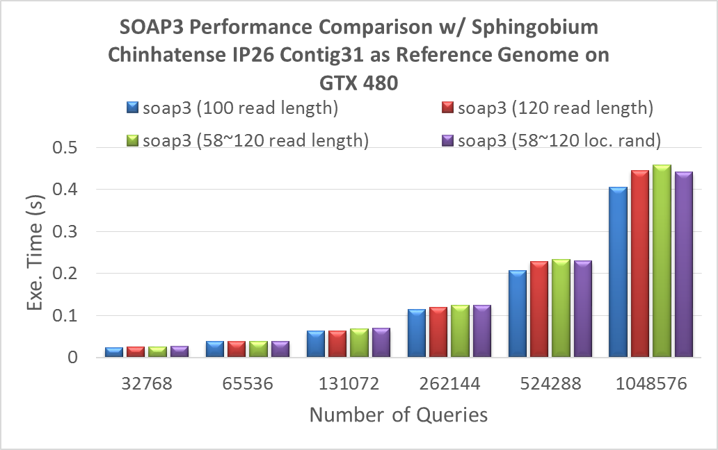

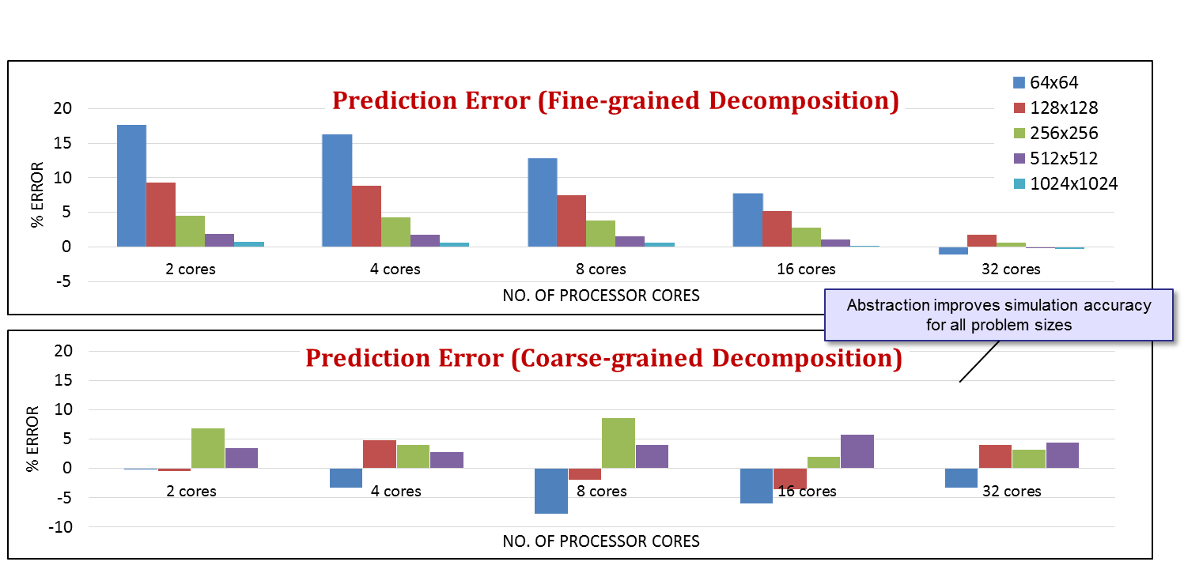
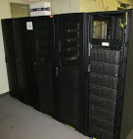
Conclusions
P1: App and HLS Studies
OpenCL & HT offer productive app development environment for FPGAs while maintaining comparable performance
Evaluated HLS tools on various platforms to identify tradeoff between performance & productivity
P2: Exploration of Future-gen Devices & Systems
Custom memory cube (CMC) with custom logic layer to provide computational memory or processor in memory
Behavioral Emulation provides foundation to study large-scale, future-gen apps & architectures
P3: Reconfigurable Interconnectivity for Novo-G#
Novo-G# provides a high-bandwidth, low-latency, and multi-dimensional platform for multi-FPGA applications
Design of protocol stack driven by lessons learned from exploration and evaluation in VisualSim
Novo-G#

Slide 12
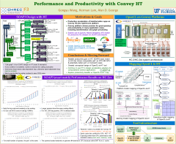
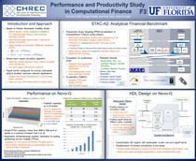
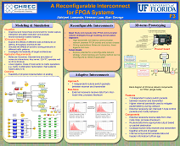
Questions, Posters, & Demos
Posters & Demos
Altera OpenCL for FPGAs
Evaluation of Convey HT versus HDL & CMS L1 Trigger on Virtex-7
Behavioral Emulation of Future-Gen Devices & Systems
Custom Memory Cube
A Reconfigurable 3D Interconnect for Novo-G
Publications
A. Lawande, A. George, and H. Lam, “Novo-G#: A multidimensional Torus-based Reconfigurable Cluster for Molecular Dynamics” Concurrency & Computation: Practice & Experience, 2015, to appear.
K. Hill, S. Craciun, A. George, and H. Lam, “Comparative Analysis of OpenCL vs. HDL with Image-Processing Kernels on Stratix-V FPGA,” 2015 IEEE Application-Specific Systems, Architectures and Processors, to appear.
G. Wang, H. Lam, A. George, and G. Edwards, “Performance and Productivity Evaluation of Hybrid-Threading HLS versus HDLs,” 2015 IEEE High Performance Extreme Computing Conference (HPEC’15), submitted

