Slide 1
F3-16: FPGA & HMC Tools & Architectures for RSC
Kenneth Hill
Nikhil Ghanathe
Shefali Gundecha
Abhijeet Lawande
Gongyu Wang
Riju John Xavier
Yu Zou
Research Students
Dr. Herman Lam
Assoc. Professor of ECE
University of Florida
Dr. Alan George
Professor of ECE
University of Florida
Number of supporting memberships = 5.3

Slide 2

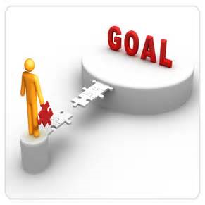

Project Goals, Motivations, & Challenges
Motivation
Breakout year for reconfigurable supercomputing (RSC)
Derek Chiou, Microsoft “Catapult”, 1632 nodes; TACC added 384-node system
Mike Paolini, IBM, “Acceleration is the New Norm, Now Get to Work!”
Mike Strickland, Altera, “2015 is the Year of the FPGA!”
Intel to purchase Altera for $16.7B cash
BOF*
Goal
Explore and advance key technologies for RSC
HLS tool studies for reconfigurable computing
Role of Custom Memory Cube (CMC) for RSC
Multi-device architecture and tool studies
Challenges
Achieve performance gain while maintaining productivity
Study CMC before existence of CMC
Again, achieve performance gain while maintaining productivity
*BOF: Birds-of-a-Feather event

Slide 3




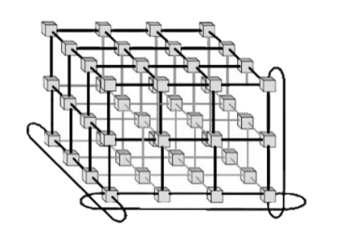


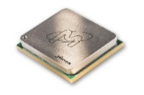





F3-16: Approach
P1: Multi-device Acceleration on POWER Arch.
Evaluate HLS tools on POWER architecture (e.g., OpenCL+CAPI*) for impactful RSC applications
Explore interconnect topologies for CAPI-enabled accelerators
P2: Reconfigurable Interconnects for Novo-G#
Novo-G#: reconfigurable interconnect, w/ OpenCL integration
Evaluate performance & productivity tradeoffs
P3: Custom Memory Cube (CMC)
Build foundation of CMC research by studying HMC
Create research vehicle and study benefits of CMC
P4: CMS** Endcap L-1 Muon Trigger
Explore HLS tools for CMS firmware development at Large Hadron Collider in CERN
Evaluate optimization & productivity issues using HLS
*CAPI: Coherent Accelerator Processor Interface
**CMS- Compact Muon Solenoid

Slide 4
F3-16: Highlights
P1: Multi-device Acceleration on POWER Arch.
Initial development using Xilinx OpenCL w/ CAPI
PSLSE† simulation environment for multi-FPGA w/ OpenCL
P2: Reconfigurable Interconnects for Novo-G#
Fast, efficient, and flexible protocol stack for inter-FPGA comm.
Multi-FPGA HLS development with Altera OpenCL
P3: Custom Memory Cube (CMC)
Initial prototype CMC platform with DRE*
Performance measurements on CMC platform
P4: CMS Endcap L-1 Muon Trigger
Increased flexibility and code productivity using HLS**
Tight latency control & optimal resource usage with Vivado HLS
*DRE: Data reordering engine
**HLS-High-level Synthesis
†PSLSE: Power Service Layer Simulation Engine

Slide 5

P1: Multi-device Acceleration on POWER Arch.
Goal
Provide productive & scalable framework for coherent FPGA systems
add dedicated network integration w/ OpenCL
Motivation
Enable scalable designs for coherent
FPGA systems :
Productive design with OpenCL
Large scale processing pipelines with streaming network support
Approach
Design entry using OpenCL or RTL for higher customization
Leverage OpenCL pipes for streaming network support
Multi-FPGA modeling via Power Service Layer Simulation Engine

Slide 6
P1: Multi-device Acceleration on POWER Arch.
Achievements
Explored Xilinx OpenCL w/ CAPI using image-processing kernels
Power Service Layer Simulation Engine support for Altera OpenCL BSP
Simulate custom CAPI OpenCL BSP for accelerator network
CAW16 Plans
Explore & evaluate scalability of FPGA kernels using dedicated network
Network modeling with PSLSE and hardware prototyping

Slide 7
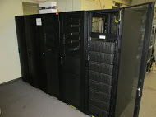
P2: Reconfigurable Interconnects for Novo-G#
Goal
Improve performance & usability of multi-FPGA systems
through HLS integration & flexible interconnect strategies
Motivation
Design Entry
Effective large-scale RSC app acceleration on Novo-G# requires:
Rapid DSE & performance estimation
Reduced barrier-to-entry with HLS support
Fast & efficient networking framework with reconfigurable network support
VisualSim
(DSE)
HDL
Reconfigure
Prototype
Approach
DSE* through simulation of Novo-G# VisualSim model
Rapid prototyping via multi-FPGA OpenCL
Explore reconfigurable aspects of Novo-G# interconnect
Novo-G#
*DSE: design-space exploration

Slide 8
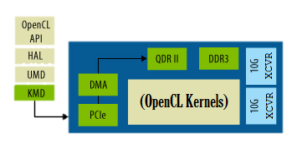
P2: Reconfigurable Interconnects for Novo-G#
Achievements
Reconfigurable Network Aspects
Network topology
Network behavior
Point-to-point protocol
Novo-G# protocol stack now supports multiple link-layer protocols
Interlaken, Custom, and Low-latency PHYs supported
Improved OpenCL support for productive multi-FPGA development
Developed OpenCL BSP w/ channels& case studies
Lessons learned for efficient inter-FPGA channel use in OpenCL
ProceV board
Inter-FPGA channel
Placeholder for graphs
CAW16 Plans
ProceV board
Explore & evaluate reconfigurable aspects of network topology and network behavior
Through simulation and prototyping
More
results on poster

Slide 9
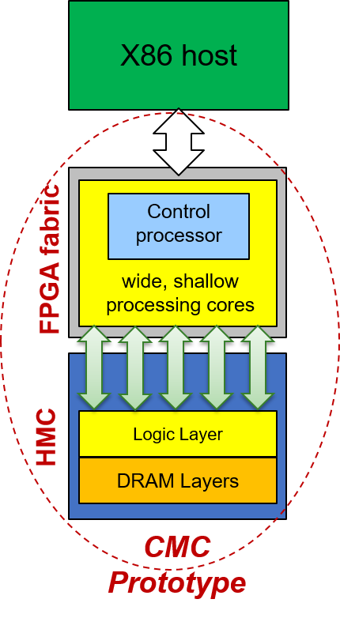
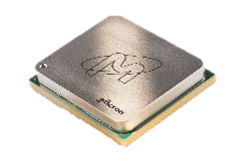

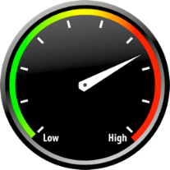

P3: Custom Memory Cube (CMC)
Goal
Create research platform to explore potential of custom logic layer for HMC (C-RAM* & PIM**)
Motivation
Memory accesses of data-intensive applications consume considerable amount of time and energy
HMC has higher B/W & lower power than current memories
Lack of fully functional CMC research platform
Approach
Phase 1
Develop test apps on FPGA-HMC platform (e.g., Merlin board)
Enable perf. measurement on FPGA & study HMC w/ test apps
Create initial prototype of CMC arch. using DRE† of LLNL
Study more elaborate CMC designs using select apps
Phase 2
*C-RAM: Computational RAM
**PIM: Processor in Memory
†DRE: Data reordering engine
Notes:
“make the bullets shorter like commercial slogans!”

Slide 10
P3: Custom Memory Cube (CMC)
Achievements
Phase 1
Developed and enabled multi-level performance measurement methods
Evaluated HMC bandwidth using GUPS and STREAM benchmarks
Up to 0.164 GUPS and XXX GB/s
More results on poster
CAW16 Plans
Enable performance monitor for DRE applications and validate results
Enable power measurement of HMC device
*DRE: Data reordering engine
Notes:
Give me more information on your graphs. For example if it is a performance graph, you should have a mockup with the x and y axes labeled and an explanation of the takeaway points.

Slide 11
P3: Custom Memory Cube (CMC)
Achievements
Phase 2
Developed initial prototype of CMC research platform
DRE with view buffer in HMC upon LPS’s feedback
Validated DRE functionality on Merlin using page rank app.
PLACEHOLDER FOR MINI GRAPHS WHICH SERVE AS CLIPARTS
More results on poster
CAW16 Plans
Explore DRE designs w/ memory-mapped view buffer in FPGA
Continue study of DRE on Merlin and LPS-suggested CMC apps
*DRE: Data reordering engine
Notes:
Add concept diagram of DRE on Merlin board and sort-of swap phase 1 and phase 2 (but do not call them phase 1 & 2 anymore → it is our term used with LPS).
Give me more information on your graphs. For example if it is a performance graph, you should have a mockup with the x and y axes labeled and an explanation of the takeaway points.

Slide 12
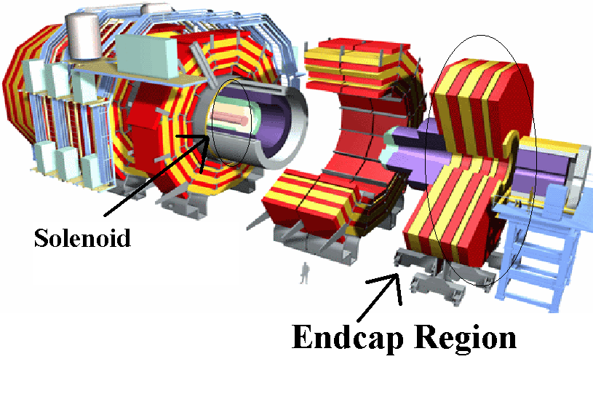
P4: CMS Endcap L-1 Muon Trigger
Motivation
Code development time
Verilog Implementation took several years and >4000 lines of code
Development and Maintenance
Code and development complexity rapidly increasing
Verification for Physicists
Increasingly difficult to obtain consistency between C++ & RTL model
Goal
Explore High-level Synthesis languages & tools for next-generation CMS code for
Parallel development of firmware & C++ model
Increase flexibility, reduce development time
Consistent high-level (C++) verification
Design Tool: Vivado HLS Xilinx Virtex-7 XC7VX690T

Slide 13
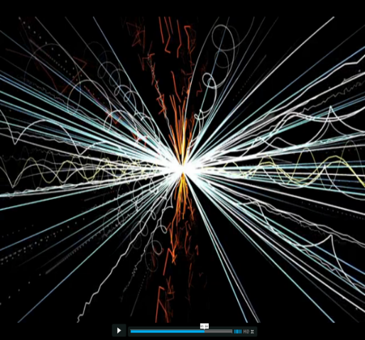
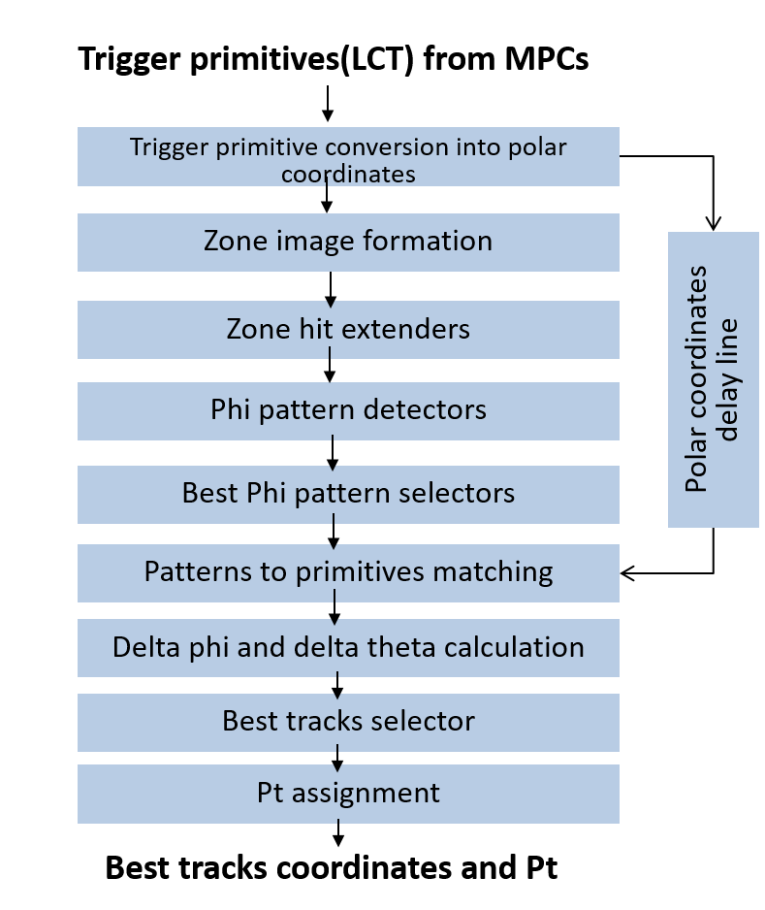
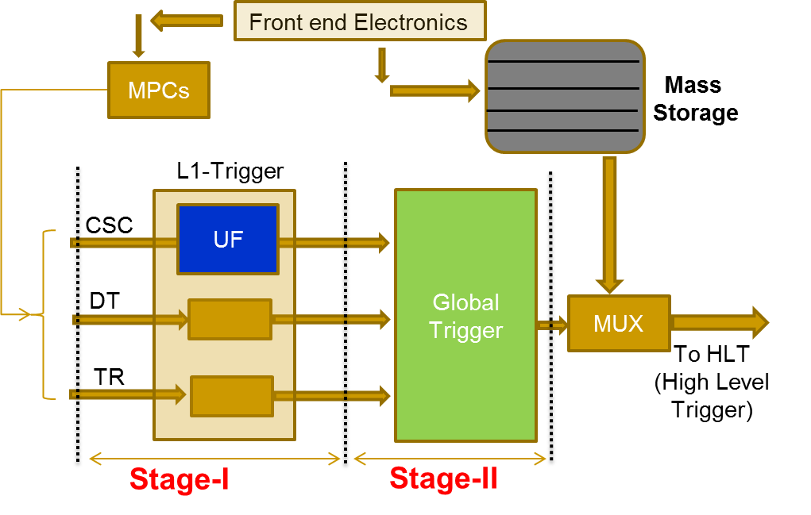
P4: CMS Endcap L-1 Muon Trigger
Achievements
Translated and verified 8 out of 9 modules of CSC Track-finder
Marked productivity improvement
Performance constraints satisfied & resource usage comparable
Resource statistics better than Verilog impl. for majority of cases
RTL optimizations using high-level constructs
Consistency between C++ & RTL achieved
HLS code compatible with g++ compiler
CAW16 Plans
Complete code development of CSC Track Finder
Test & Integrate code and implement on FPGA

Slide 14
F3-16: Conclusions
P1: Multi-device Acceleration on POWER Arch.
Summary & Conclusions
P2: Reconfigurable Interconnects for Novo-G#
Developed a BSP & methodology for Multi-FPGA OpenCL
Explored reconfigurability through link protocols, more in CAW16
P3: Custom Memory Cube (CMC)
Enabled performance measurements on Merlin board
Developed initial prototype CMC platform with DRE
P4: CMS Endcap L-1 Muon Trigger
CSC Track-finder firmware redeveloped using Vivado-HLS
Performance and resource constraints satisfied for all modules

Slide 15
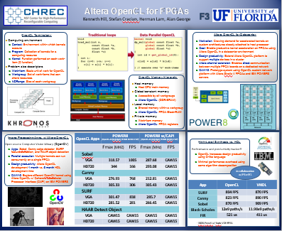
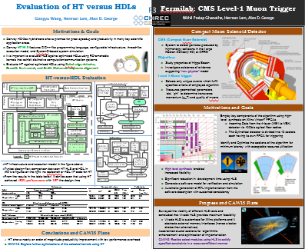
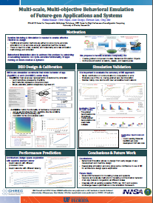
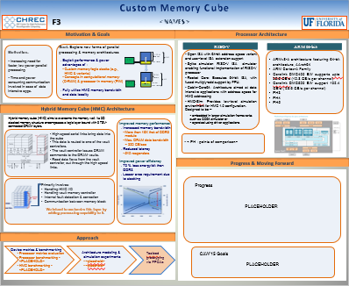
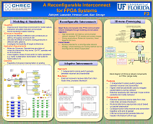
Questions, Posters, & Demos
Posters & Demos
Altera OpenCL for FPGAs
HLS for CMS Level-1 Endcap Muon Trigger
Behavioral Emulation of Future-gen Devices & Systems
Custom Memory Cube
A Reconfigurable 3D Interconnect for Novo-G
Publications
A. Lawande, A. George, and H. Lam, “Novo-G#: A multidimensional Torus-based Reconfigurable Cluster for Molecular Dynamics,” Concurrency & Computation: Practice & Experience, 2015, doi:10.1002/cpe.3565
K. Hill, S. Craciun, A. George, and H. Lam, “Comparative Analysis of OpenCL vs. HDL with Image-Processing Kernels on Stratix-V FPGA,” 2015 IEEE Application-Specific Systems, Architectures and Processors (ASAP’15), Toronto, Canada, 27-29 July 2015
G. Wang, H. Lam, A. George, and G. Edwards, “Performance and Productivity Evaluation of Hybrid-Threading HLS versus HDLs,” IEEE High Performance Extreme Computing Conference (HPEC’15), Waltham, MA, 15-17 Sept. 2015
N. Kumar, M. Sringarpure, T. Banerjee, J. Hackl, S. Balachandar, H. Lam, A. George, and S. Ranka, "CMT-bone: A mini-app for Compressible Multiphase Turbulence Simulation Software,“ Cluster Computing (CLUSTER), IEEE International Conference on , vol., no., pp.785-792, 8-11 Sept. 2015, doi: 10.1109/CLUSTER.2015.134
Placeholder
Placeholder

Slide 16
Outline
Note: each project presentation is allocated 10 minutes, plus 5 minutes of Q&A, for a total of 15 minutes
Goals, Motivations, & Challenges (1 slide)
Refresh IAB on where we have been going with this project and why
Approach (1 slide)
Refresh IAB on how we are getting there (methods, tasks)
Results & Analysis (5-7 slides)
Start with single attention-grabber slide on major progress & achievements
Then, for each major task, highlight key developments, experiments, results, analyses, and insight (“elevator pitch” style) – avoid overly dense
Reminder: details should be saved for posters & appendix
Conclusions (1-2 slides)
Brief summary of work, progress, achievement, and benefit
Listing of any publications from project
Listing of poster & demo titles
Appendix: Additional Materials (≤ 5 slides) – optional
For off-line study by IAB, but NOT presented at workshop

Slide 17
REMINDER
Faculty, please send final draft of presentation (both .pptx and .pdf files, please) to Alan & Darlene by 5pm ET on Monday, May 30th for posting and IAB preview
Please remember to include poster titles and demo titles in your closing slide, so we can make a list and send it to the IAB as well

