Slide 1


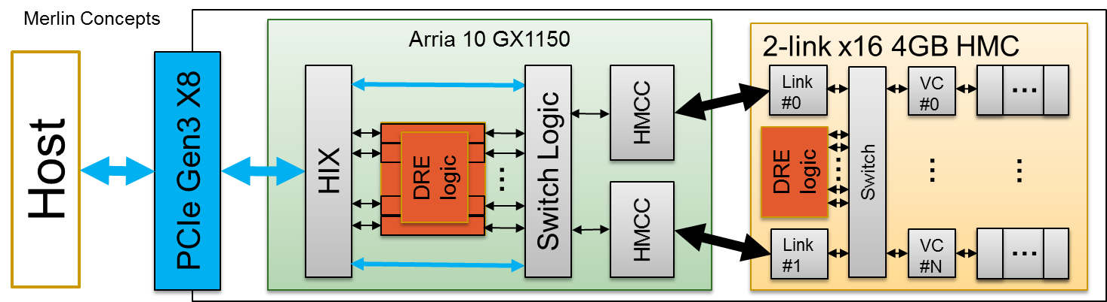
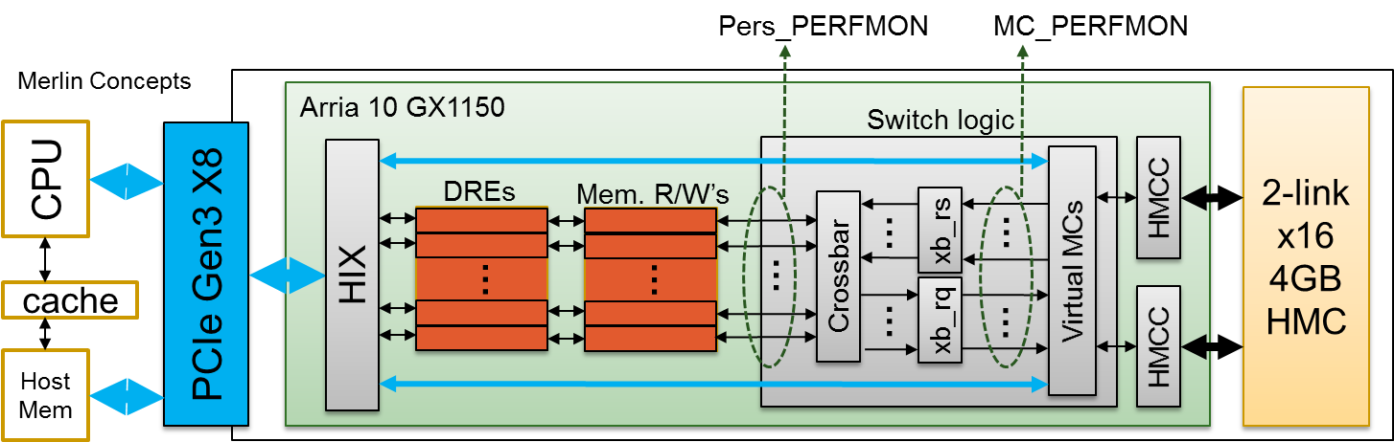
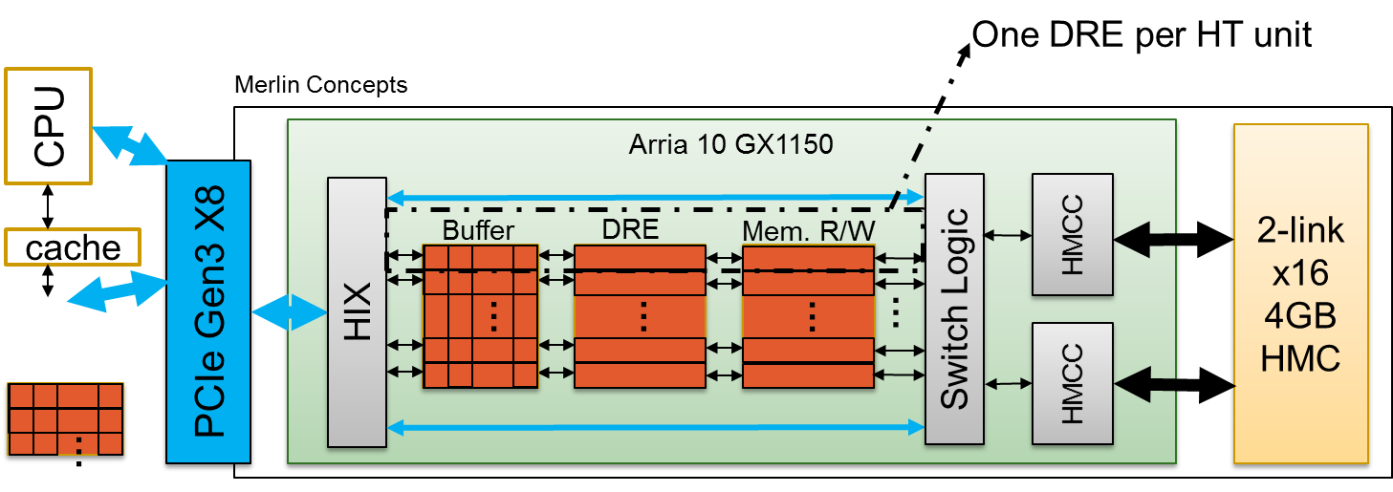
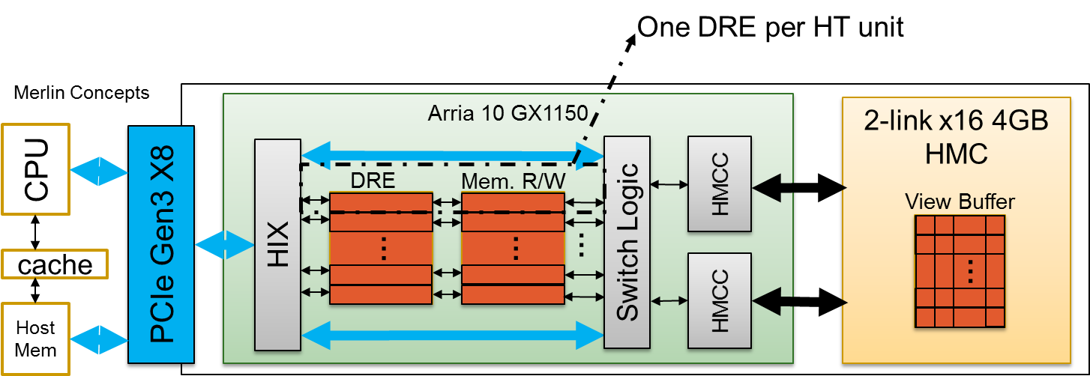
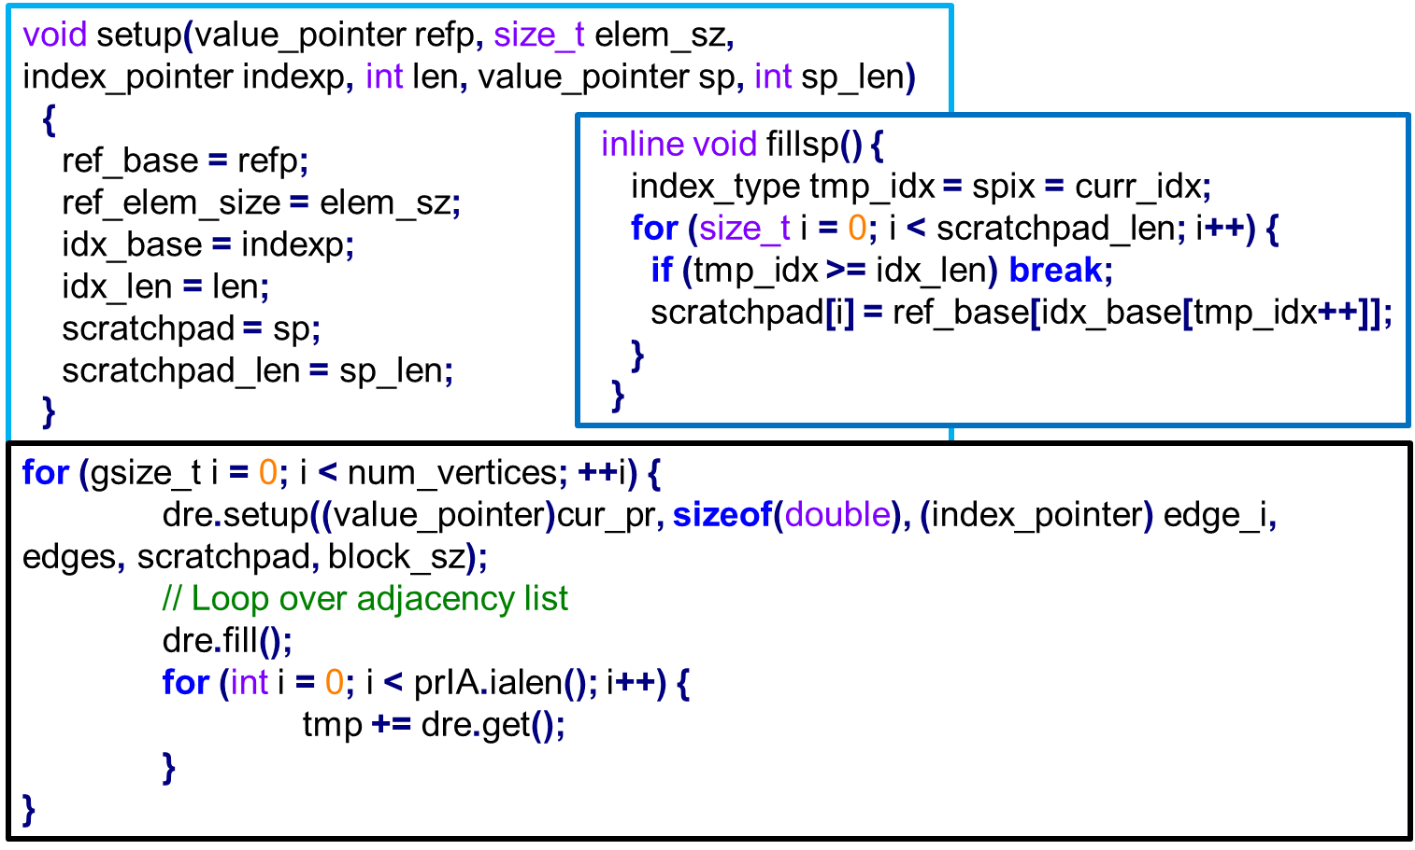
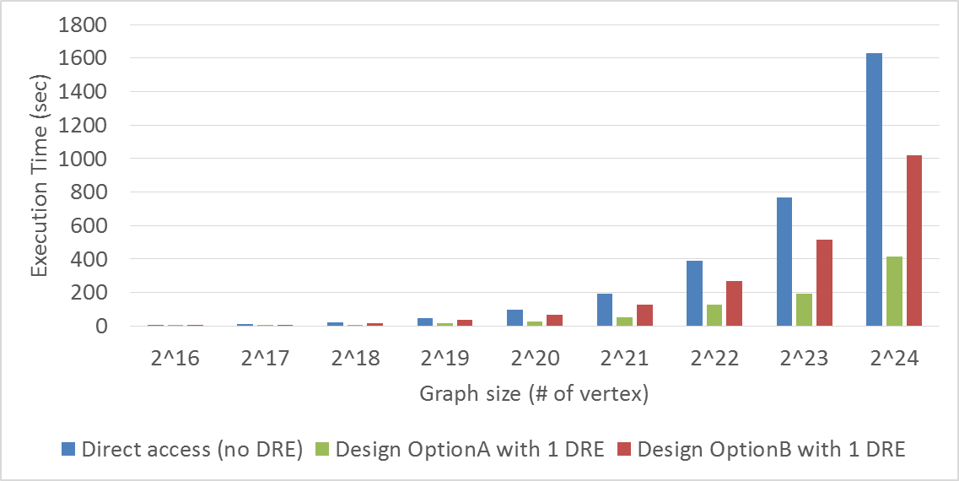
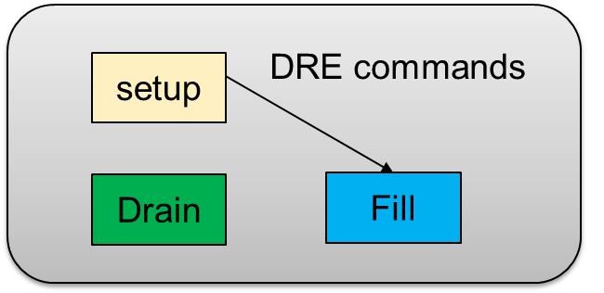


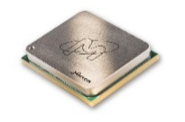




Custom Memory Cube
Gongyu Wang, Yu Zou, Herman Lam, Alan George
F3
MOTIVATION & GOAL
APPROACH
Motivation
Communication involved with data-intensive apps. consumes considerable time
HMC has higher B/W than current memories
Lack of fully functional CMC research platform
Goal: Create research platform to explore potential of custom logic layer for HMC
Exploit performance advantage of :
Custom logic/memory stacks (e.g., HMC and variants)
Computational memory (C-RAM) and processor in memory (PIM)
Fully utilize HMC memory bandwidth and data locality
Task 1: CMC Prototype
Create initial prototype of CMC architecture using data reorder/rearrangement engine (DRE) of LLNL
Study elaborate CMC designs using select apps
Task 2: Measurement on HMC
Develop test apps on FPGA-HMC platform (e.g., Merlin board)
Enable perf. measurement on FPGA & study HMC w/ test apps
DRAM
CPU
Layers
HMC
Logic Layer
DRAM
Layers
CMC
CPU
Processor
Custom
Logic Layer
TASK 1: CMC Prototypes
TASK 2: Measurement on HMC
Design optionA: view buffer in host memory
DRE’s view buffer is located in host memory
Read/write to DRE through HT’s host data interfaces
Design optionB: view buffer in HMC
Allocate DRE’s view buffer in HMC
Read/write to DRE’s view buffer through HIX directly
Two measurement methods
CPU measurement from view of host application
FPGA measurement using PERFMON logic of Convey PDK
Two running modes
Host only
CPU code directly accessing HMC
CMC
CMC computation on FPGA accessing HMC in highly parallel fashion
Initial Results
Developed and enabled multi-level performance measurement methods
Evaluated HMC bandwidth using GUPS and STREAM benchmarks
Initial Results
Test app – PageRank
Parameters
Test size: 2¹⁶ ~ 2²⁴ , 8-byte words
Performance
Performance with DRE is better than without
Design optionA shows better performance than design optionB
PLANS FOR CAW16
Task 1: CMC Prototype
Explore DRE designs w/ memory-mapped view buffer in FPGA
Continue study of DRE on Merlin and LPS-suggested CMC apps
Task 2: Measurement on HMC
Enable performance monitor for DRE applications and validate results
Enable power measurement of HMC device
Testbed
Convey Merlin board (MA-100)
Benchmarks
GUPS
STREAM
Parameters
Table size: 2¹⁶ ~ 2²⁹ , 8-byte words
GUPS Performance
CMC shows speedup if host-only is baseline
PERFMON outputs average latencies
STREAM Performance
PERFMON outputs average latencies
Nearly constant difference between Pers & MC PERFMON measurements
Members e.g.,

