Slide 1
F3-16: FPGA & HMC Tools & Architectures for RSC
Kenneth Hill
Nikhil Ghanathe
Shefali Gundecha
Abhijeet Lawande
Gongyu Wang
Riju John Xavier
Yu Zou
Research Students
Dr. Herman Lam
Assoc. Professor of ECE
University of Florida
Dr. Alan George
Professor of ECE
University of Florida
Number of supporting memberships = #

Slide 2



Project Goals, Motivations, & Challenges
Motivation
Breakout year for reconfigurable supercomputing (RSC)
Derek Chiou, Microsoft (not Microsoft Research), “Catapult”
Mike Paolini, IBM, “Acceleration is the New Norm, Now Get to Work!”
Mike Strickland, Altera, “2015 is the Year of the FPGA!”
Intel to purchase Altera for $16.7B cash
BOF*
Goal
Explore and advance key technologies for RSC
HLS tool studies for reconfigurable computing
Role of Custom Memory Cube (CMC) for RSC
Multi-device architecture and tool studies
Challenges
Achieve performance gain while maintaining productivity
Study CMC before existence of CMC
Again, achieve performance gain while maintaining productivity
*BOF: Birds-of-a-Feather event

Slide 3




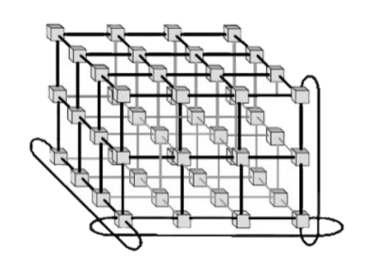




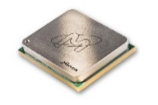



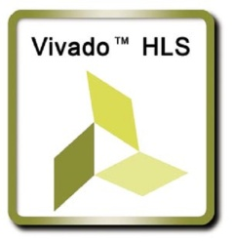

F3-16: Approach
P1: Multi-device Acceleration on POWER Arch.
Evaluate HLS tools on POWER architecture (e.g., OpenCL+CAPI*) for impactful RSC applications
Explore interconnect topologies for CAPI-enabled accelerators
P2: Reconfigurable Interconnects for Novo-G#
Novo-G#: reconfigurable interconnect, w/ OpenCL integration
Evaluate performance & productivity tradeoffs
P3: Custom Memory Cube (CMC)
Build foundation of CMC research by studying HMC
Create research vehicle and study benefits of CMC
P4: CMS** Endcap L-1 Muon Trigger
Explore HLS tools for CMS firmware development at Large Hadron Collider in CERN
Evaluate optimization & productivity issues using HLS
*CAPI: Coherent Accelerator Processor Interface
**CMS- Compact Muon Solenoid

Slide 4
F3-16: Highlights
P1: Multi-device Acceleration on POWER Arch.
Highlight 1
Highlight 2
P2: Reconfigurable Interconnects for Novo-G#
Fast, efficient, and flexible protocol stack for inter-FPGA comm.
Multi-FPGA HLS development with Altera OpenCL
P3: Custom Memory Cube (CMC)
STREAM shows ~10x B/W than GUPS on HMC
Initial prototype of CMC (DRE) shows >2x speedup
P4: CMS Endcap L-1 Muon Trigger
Highlight 1
Highlight 2
*DRE: Data reordering engine

Slide 5
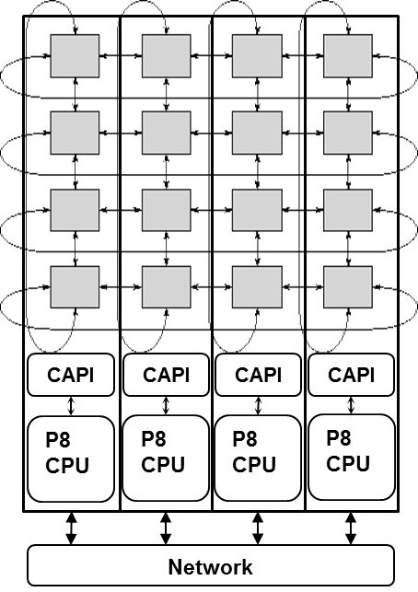
P1: Multi-device Acceleration on POWER Arch.
Task 2: Direct accelerator network w/ OpenCL+CAPI
Improve application scalability for multi-FPGA designs
Goal
F3-15
Leverage from Novo-G# technology
Three-layer protocol stack for inter-FPGA networking
Multi-FPGA OpenCL
F3-16
Explore interconnect topologies and scalability for CAPI-enabled accelerators
Via system simulation studies
Experiment via POWER8 testbed
Leverage OpenCL for user productivity
Four-node POWER8 cluster

Slide 6

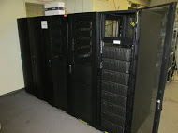
P2: Reconfigurable Interconnects for Novo-G#
Goal
Improve performance & usability of multi-FPGA systems
through HLS integration & flexible interconnect strategies
Design Entry
Motivation
VisualSim
(DSE)
Acceleration of large-scale RSC apps on Novo-G# with:
Perf. estimation model for rapid DSE
HLS integration to reduce barrier-to-entry
Framework to support reconfigurable networks
HDL
Reconfigure
Prototype
Approach
Explore reconfigurable aspects of Novo-G# interconnect
DSE* through simulation of Novo-G# VisualSim model
Rapid prototyping via multi-FPGA OpenCL
Novo-G#
*DSE: design-space exploration

Slide 7
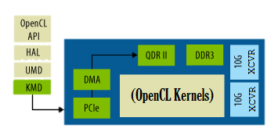
P2: Reconfigurable Interconnects for Novo-G#
Achievements
Reconfigurable Network Aspects
Network topology
Network behavior
Point-to-point protocol
Novo-G# protocol stack now supports multiple link-layer prototcols
Interlaken, Custom, and Low-latency PHYs supported
OpenCL support for productive multi-FPGA development
OpenCL BSP w/ channels + basic kernels
Lessons learned for efficient inter-FPGA channel usage in OpenCL
ProceV board
Inter-FPGA channel
CAW16 Plans
ProceV board
Explore & evaluate reconfigurable aspects of network topology and network behavior
Through simulation and prototyping

Slide 8
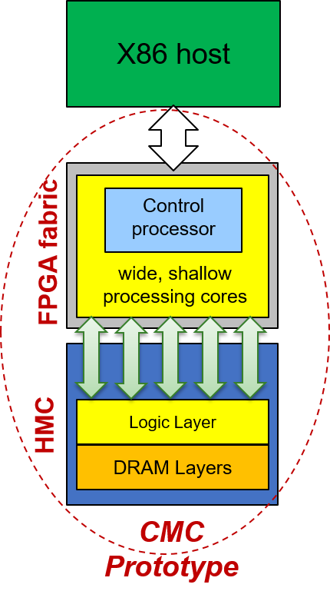


P3: Custom Memory Cube (CMC)
Goal
Explore potential of custom logic layer for HMC
C-RAM* & PIM** (e.g., control & SIMD in logic layer)
Motivation
Memory accesses of data-intensive applications consumes considerable amount of time and energy
HMC has higher B/W & lower power than current memories
Lack of fully functional CMC research platform
Approach
Phase 1
Develop test apps on FPGA-HMC platform (e.g., Merlin board)
Enable perf. measurement on FPGA & study HMC w/ test apps
HMC has higher B/W & lower power than current memories
Lack of fully functional CMC research platform
Design-space exploration using software simulation & Task-A testbeds
Develop CMC prototypes & explore CMC processing capabilities
Phase 2
*C-RAM: Computational RAM
**PIM: Processor in Memory

Slide 9
P3: Custom Memory Cube (CMC)
Phase 1
Achievements
Phase 2
Memory accesses of data-intensive applications consumes considerable amount of time and energy
HMC has higher B/W & lower power than current memories
Lack of fully functional CMC research platform
Develop test apps on FPGA-HMC platform (e.g., Merlin board)
Enable perf. measurement on FPGA & study HMC w/ test apps
HMC has higher B/W & lower power than current memories
Lack of fully functional CMC research platform
CAW16 Plans
Enable support of tunable parameters of HMC (e.g., packet size, tag size)
Study LPS-suggested CMC apps to define set of amenable operations in the logic layer
*C-RAM: Computational RAM
**PIM: Processor in Memory

Slide 10
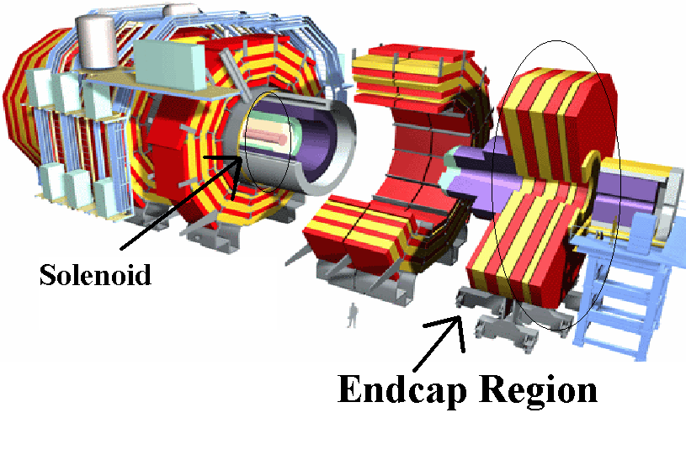
P4: CMS Endcap L-1 Muon Trigger
Motivation
Code development time
Verilog Implementation took several years and >4000 lines of code
Development and Maintenance
Code and development complexity rapidly increasing
Verification for Physicists
Increasingly difficult to obtain consistency between C++ & RTL model
Goal
Explore High-level Synthesis languages & tools for next-generation CMS code for
Parallel development of firmware & C++ model
Increase Flexibility, reduce development time
Enable consistent high-level (C++) verification

Slide 11
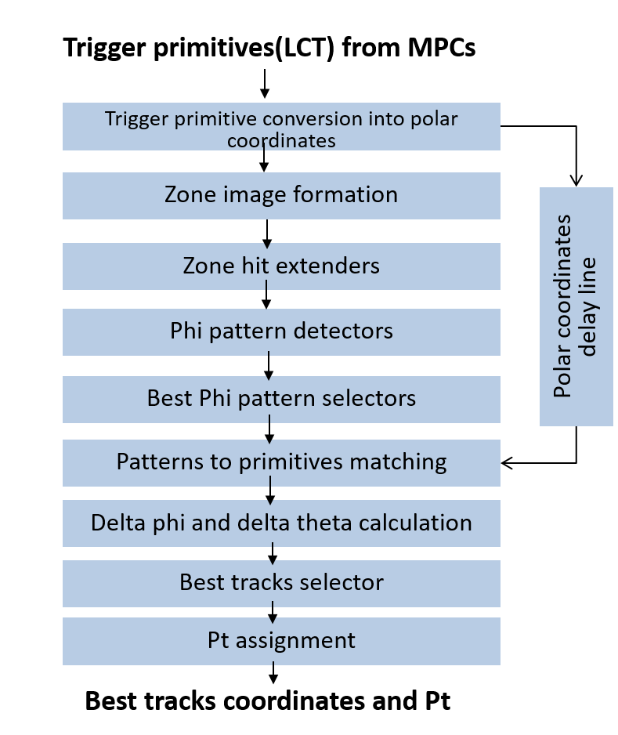
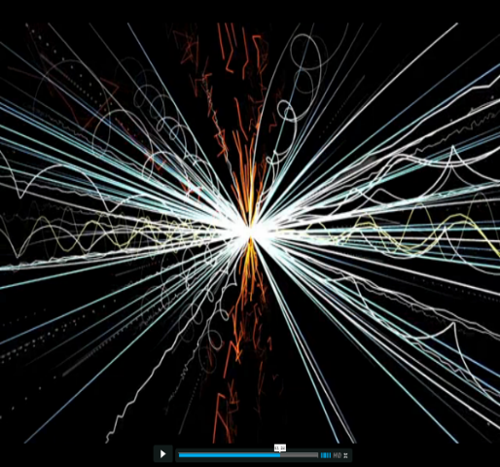
P4: CMS Endcap L-1 Muon Trigger
Achievements
Translated and verified 8 out of 9 modules of CSC Track-finder using HLS
Marked improvement in productivity
Performance constraints met for all modules
RTL optimizations using high-level constructs
Resource usage comparable
Observed to be better than Verilog impl. for majority of cases
Consistency between C++ & RTL achieved
HLS code compatible with g++ compiler enabling reliable high-level verification
Design tool: Vivado HLS FPGA: Xilinx Virtex-7 XC7VX690T

Slide 12

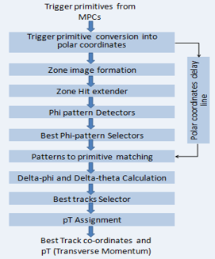
P4: CMS Endcap L-1 Muon Trigger
Further exploration of HLS languages & tools
for next-gen CMS code
Goal
F3-15
Converted 4 out of 9 modules of Track-finder algorithm
Promising outcomes
Improved productivity using Vivado HLS
Lessons learned for h/w optimization via Vivado HLS
HLS (C++) code used automatically for verification
F3-16
Complete & optimize sub-modules in Track Finder Module
Integrate submodules
Study integration issues in Vivado HLS
Integrate HLS code into CMSSW**
**CMSSW- CMS software

Slide 13
F3-16: Conclusions
P1: Multi-device Acceleration on POWER Arch.
Summary & Conclusions
P2: Reconfigurable Interconnects for Novo-G#
Developed a BSP & methodology for Multi-FPGA OpenCL
Explored reconfigurability through link protocols, more in CAW16
P3: Custom Memory Cube (CMC)
Summary & Conclusions
P4: CMS Endcap L-1 Muon Trigger
Summary & Conclusions

Slide 14
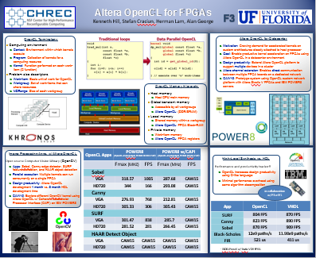
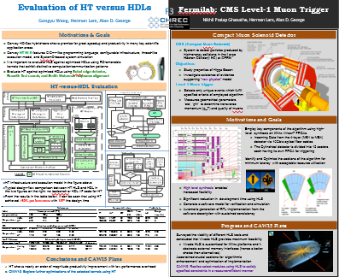
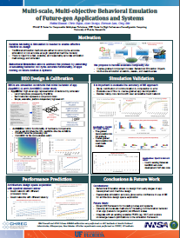
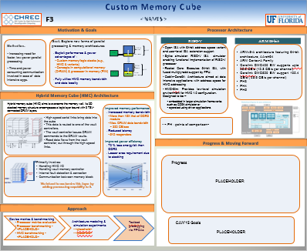
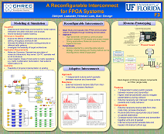
Questions, Posters, & Demos
Posters & Demos
Altera OpenCL for FPGAs
HLS for CMS Level-1 Endcap Muon Trigger
Behavioral Emulation of Future-gen Devices & Systems
Custom Memory Cube
A Reconfigurable 3D Interconnect for Novo-G
Publications
A. Lawande, A. George, and H. Lam, “Novo-G#: A multidimensional Torus-based Reconfigurable Cluster for Molecular Dynamics,” Concurrency & Computation: Practice & Experience, 2015, doi:10.1002/cpe.3565
K. Hill, S. Craciun, A. George, and H. Lam, “Comparative Analysis of OpenCL vs. HDL with Image-Processing Kernels on Stratix-V FPGA,” 2015 IEEE Application-Specific Systems, Architectures and Processors (ASAP’15), Toronto, Canada, 27-29 July 2015
G. Wang, H. Lam, A. George, and G. Edwards, “Performance and Productivity Evaluation of Hybrid-Threading HLS versus HDLs,” IEEE High Performance Extreme Computing Conference (HPEC’15), Waltham, MA, 15-17 Sept. 2015
N. Kumar, M. Sringarpure, T. Banerjee, J. Hackl, S. Balachandar, H. Lam, A. George, and S. Ranka, "CMT-bone: A mini-app for Compressible Multiphase Turbulence Simulation Software,“ Cluster Computing (CLUSTER), IEEE International Conference on , vol., no., pp.785-792, 8-11 Sept. 2015, doi: 10.1109/CLUSTER.2015.134
Placeholder
Placeholder

Slide 15
Outline
Note: each project presentation is allocated 10 minutes, plus 5 minutes of Q&A, for a total of 15 minutes
Goals, Motivations, & Challenges (1 slide)
Refresh IAB on where we have been going with this project and why
Approach (1 slide)
Refresh IAB on how we are getting there (methods, tasks)
Results & Analysis (5-7 slides)
Start with single attention-grabber slide on major progress & achievements
Then, for each major task, highlight key developments, experiments, results, analyses, and insight (“elevator pitch” style) – avoid overly dense
Reminder: details should be saved for posters & appendix
Conclusions (1-2 slides)
Brief summary of work, progress, achievement, and benefit
Listing of any publications from project
Listing of poster & demo titles
Appendix: Additional Materials (≤ 5 slides) – optional
For off-line study by IAB, but NOT presented at workshop

Slide 16
REMINDER
Faculty, please send final draft of presentation (both .pptx and .pdf files, please) to Alan & Darlene by 5pm ET on Monday, May 30th for posting and IAB preview
Please remember to include poster titles and demo titles in your closing slide, so we can make a list and send it to the IAB as well

