Slide 1
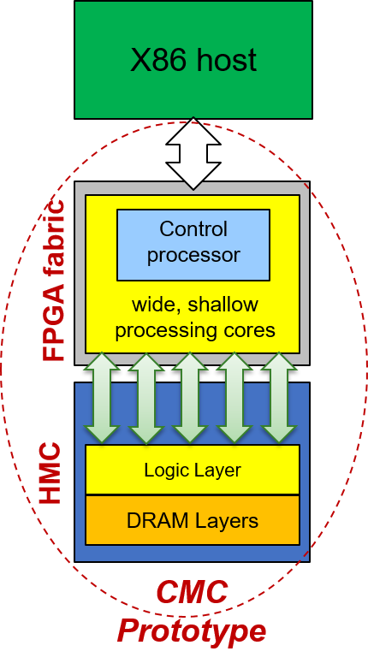
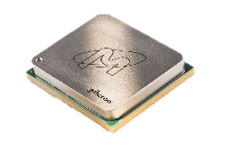

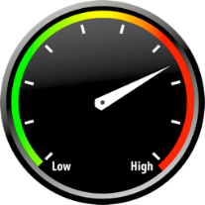


P3: Custom Memory Cube (CMC)
Goal
Explore potential of custom logic layer for HMC
C-RAM* & PIM** (e.g., control & SIMD in logic layer)
Motivation
Memory accesses of data-intensive applications consumes considerable amount of time and energy
HMC has higher B/W & lower power than current memories
Lack of fully functional CMC research platform
Approach
Phase 1
Develop test apps on FPGA-HMC platform (e.g., Merlin board)
Enable perf. measurement on FPGA & study HMC w/ test apps
Create initial prototype of CMC arch. using DRE† of LLNL
Validate and evaluate DRE designs using select apps
Phase 2
*C-RAM: Computational RAM
**PIM: Processor in Memory
†DRE: Data reordering engine

Slide 2
P3: Custom Memory Cube (CMC)
Phase 1
Achievements
Phase 2
Developed STREAM memory benchmark & bucket sort test application on Merlin board
Developed and enabled multi-level performance measurement methods
Evaluated HMC bandwidth using GUPS and STREAM benchmarks
Up to 0.164 GUPS
Discussed five potential design options for developing DRE on Merlin
Developed DRE with view buffer in HMC upon LPS’s feedback
Tested DRE on Merlin using page rank app. showing >2x speedup
Developed and tested DRE on Merlin with view buffer in host memory
PLACEHOLDER FOR MINI GRAPHS WHICH SERVE AS CLIPARTS
More results on poster
PLACEHOLDER FOR MINI GRAPHS WHICH SERVE AS CLIPARTS
CAW16 Plans
Enable support of tunable parameters of HMC (e.g., packet size, tag size)
Continue study of CMC using DRE
Study LPS-suggested CMC apps
*DRE: Data reordering engine

