Slide 1

Geospatial Data Management and analysis
Creating an interactive earthquakes map using Python
ANTOINE Simon, CHRISTIAENS Louis, master students : civil engineering, mining and geology – January 2019

Slide 2
What we did :
Python code that creates interactives map of earthquakes
Documentation : https://geospatialanalysis.readthedocs.io/en/latest/

Slide 3
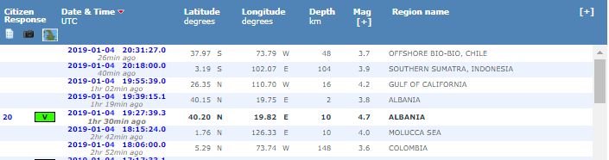
Who provides the Data ?
EMSC : Euro-Mediterranean seismological center
https://www.emsc-csem.org/
Gather informations about earthquakes and share it publicly

Slide 4
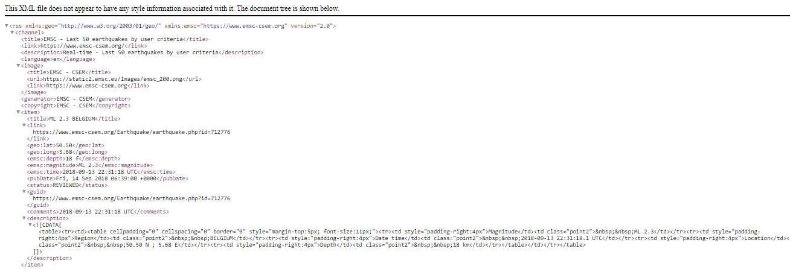
Who provides the Data ?
Customized RSS feed option :
https://www.emsc-csem.org/service/rss/rss.php?filter=yes&region=BELGIUM&min_intens=0&max_intens=8
Parameter = Flinn–Engdahl regions

Slide 5
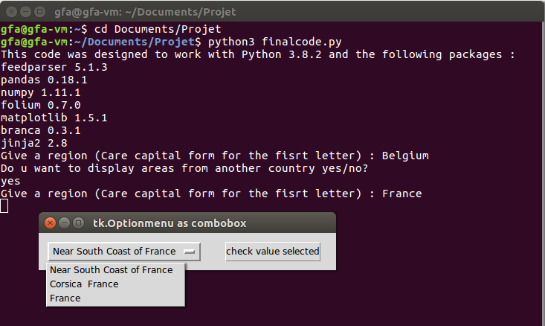
Code flows
When the code is compiled :
1) First precision on the area
2) Drop down list
3) Reselect areas ?
4) Retrieving data with RSS
5) Create/Save/Display the map

Slide 6
Python/Packages used
Pandas/Numpy
Feedparser
Folium/Branca
Tkinter / Datetime
Jinja2 (To use javascript with python)

Slide 7
Code structure
Area Selection
Data frame creation
Map creation

Slide 8
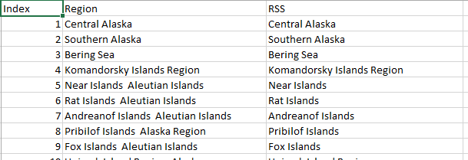
Selecting areas
Importing the Flinn-Engdahl regions

Slide 9
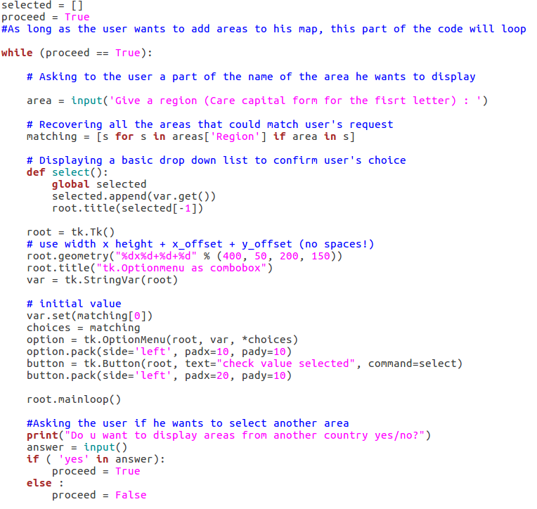
Selecting areas

Slide 10
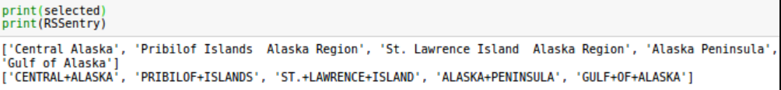
Selecting areas
Format the list of regions in an understandable form for RSS feed

Slide 11
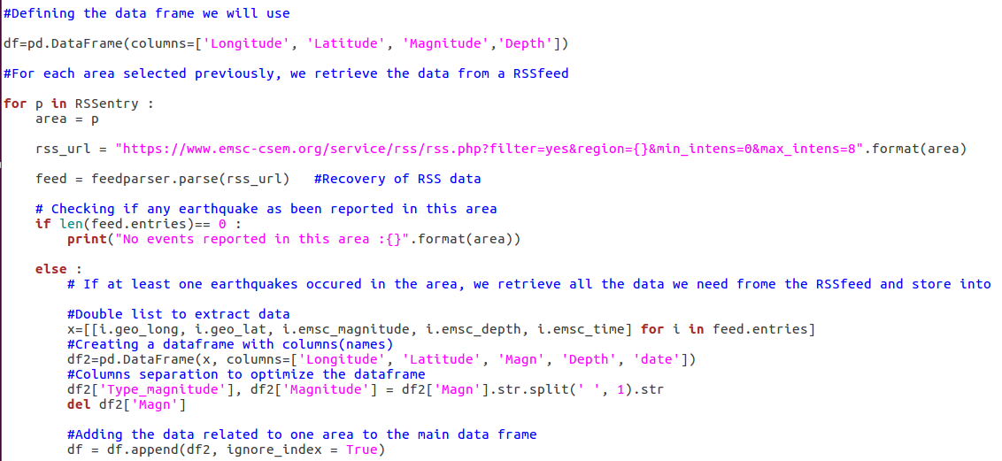
Data frame creation

Slide 12
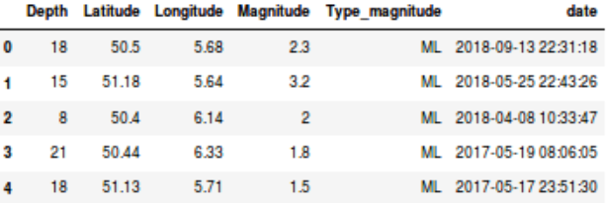
Data frame creation
After recovering/processing raw data :

Slide 13
Map creation
Final map is composed of four layers :
Main layer : default empty world map
Magnitude layer : displays earthquakes ranked by magnitude
Depth layer : displays earthquakes ranked by depth
Date layer : displays earthquakes ranked by date

Slide 14
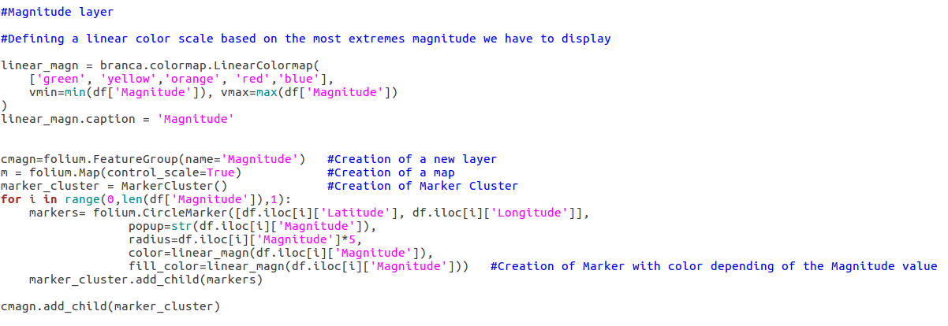
Map creation
Magnitude and depth layers => Linear color scale

Slide 15
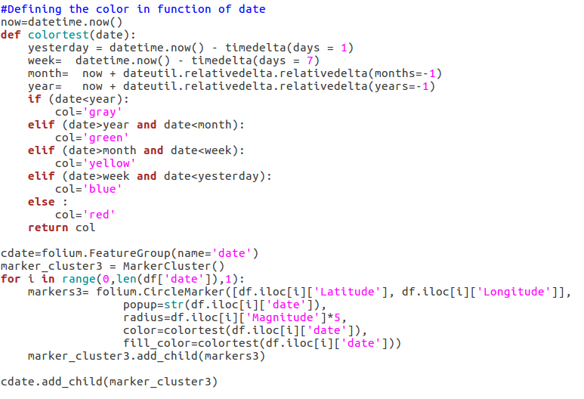
Map creation
Date layer => Non linear color scale

Slide 16
Map creation
Displaying/Binding a color scale to a layer = problem
Linear scale
Javascript : http://nbviewer.jupyter.org/gist/BibMartin/f153aa957ddc5fadc64929abdee9ff2e 07/12/2018
Non linear scale :
Html : https://nbviewer.jupyter.org/gist/BibMartin/f153aa957ddc5fadc64929abdee9ff2e

Slide 17
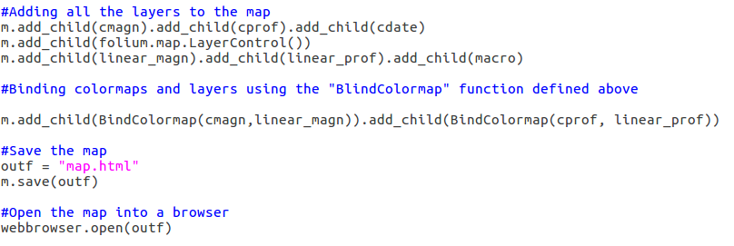
Map creation

Slide 18
Improvements
Checking if the area the user request exists
Binding the date legend to the date layer
Retrieving the list of Flinn–Engdahl regions from a website instead of a static file
Adding the date of creation to each map
.py file => Standalone application

