Slide 1


Admin
Username
Password
Sign In
All rights reserved © 2024 Pyat 7

Slide 2
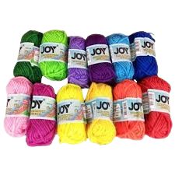
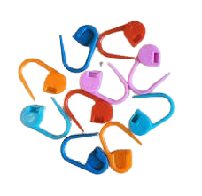
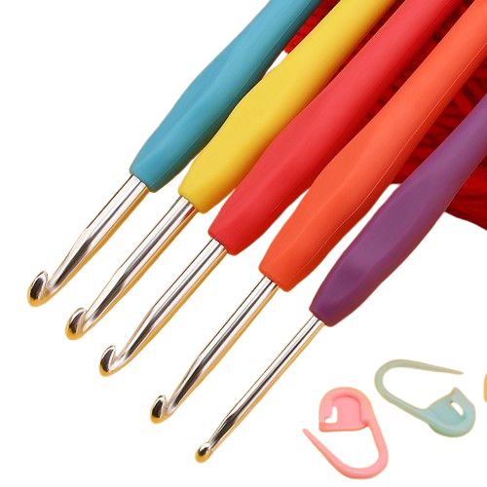





Admin
Category
Products
Yarns
Markers
Hooks
View All
Delete
View All
Delete
View All
Delete
All rights reserved © 2024 Pyat 7
Terms and Policy
About

Slide 3
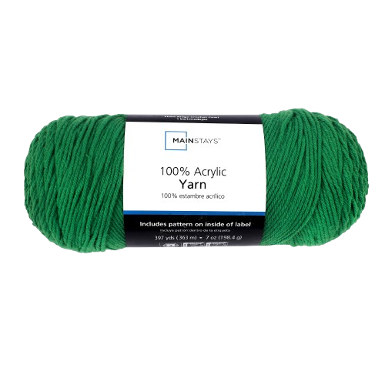
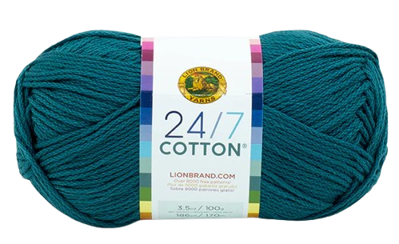
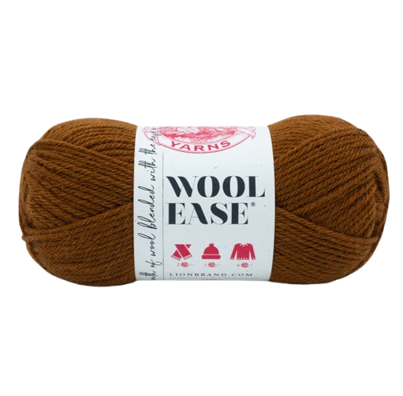

Admin
Category
Yarns
X
Are You Sure You Want To Delete This Category?
No
Yes
Acrylic Yarn
Cotton Yarn
Wool Yarn
Mark234 and 1.3k others
Mark234 and 1.3k others
Mark234 and 1.3k others
Description
Description
Description
Delete
Edit
Delete
Edit
Delete
Edit
All rights reserved © 2024 Pyat 7
Terms and Policy
About

Slide 4

Admin
Category
Yarns
X
Yarn Category Successfully Deleted
Ok
Acrylic Yarn
Cotton Yarn
Wool Yarn
Mark234 and 1.3k others
Mark234 and 1.3k others
Mark234 and 1.3k others
Description
Description
Description
Delete
Edit
Delete
Edit
Delete
Edit
All rights reserved © 2024 Pyat 7
Terms and Policy
About

Slide 5
Admin
Category
Products
Markers
Hooks
View All
Delete
View All
Delete
All rights reserved © 2024 Pyat 7
Terms and Policy
About

Slide 6
Admin
Category
Yarns
Acrylic Yarn
Cotton Yarn
Wool Yarn
Mark234 and 1.3k others
Mark234 and 1.3k others
Mark234 and 1.3k others
Description
Description
Description
Delete
Edit
Delete
Edit
Delete
Edit
All rights reserved © 2024 Pyat 7
Terms and Policy
About

Slide 7
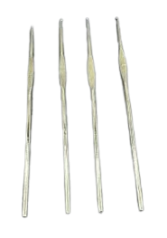
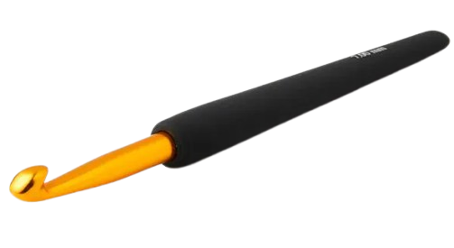
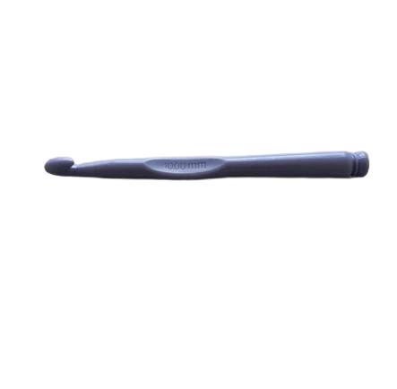
Admin
Category
Hooks
Steel
Plastic
Aluminum
Mark234 and 1.3k others
Mark234 and 1.3k others
Mark234 and 1.3k others
Description
Description
Description
Delete
Edit
Delete
Edit
Delete
Edit
All rights reserved © 2024 Pyat 7
Terms and Policy
About

Slide 8
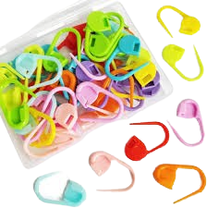
Admin
Category
Marker
Plastic
Mark234 and 1.3k others
Description
Delete
Edit
All rights reserved © 2024 Pyat 7
Terms and Policy
About

Slide 9
Admin
Category
Yarns
X
Are You Sure You Want To Delete This Product?
No
Yes
Acrylic Yarn
Cotton Yarn
Wool Yarn
Mark234 and 1.3k others
Mark234 and 1.3k others
Mark234 and 1.3k others
Description
Description
Description
Delete
Edit
Delete
Edit
Delete
Edit
All rights reserved © 2024 Pyat 7
Terms and Policy
About

Slide 10
Admin
Category
Yarns
X
Product Successfully Deleted
Ok
Acrylic Yarn
Cotton Yarn
Wool Yarn
Mark234 and 1.3k others
Mark234 and 1.3k others
Mark234 and 1.3k others
Description
Description
Description
Delete
Edit
Delete
Edit
Delete
Edit
All rights reserved © 2024 Pyat 7
Terms and Policy
About

Slide 11
Admin
Category
Yarns
Cotton Yarn
Wool Yarn
Mark234 and 1.3k others
Mark234 and 1.3k others
Description
Description
Delete
Edit
Delete
Edit
All rights reserved © 2024 Pyat 7
Terms and Policy
About

Slide 12


Admin
Category
Comments
mark234
4.7
Thank You seller
Acrylic Yarn
Edit
12-01-2024
All rights reserved © 2024 Pyat 7
Terms and Policy
About

Slide 13
Yarn Description

Slide 14
Admin
Category
Yarn Description
Categories:
Yarn
Markers
Hooks
Acrylic
Cotton
Wool
Stich Markers
Aluminum
Plastic
Steel
Description
Acrylic yarn is a synthetic fiber yarn made from polyacrylonitrile or polyacrylic. It's a versatile, affordable, and widely used yarn in crochet, knitting, and textile applications.
Hook Sizes
Upload Image
3.5mm to 10mm
Properties
Durable Material, Rust-Resistant, Sleek Design, Easy Installation, Versatile Usage
Save
All rights reserved © 2024 Pyat 7
Terms and Policy
About

Slide 15
Admin
Category
Yarn Description
Categories:
Yarn
Markers
Hooks
Acrylic
Cotton
Wool
Stich Markers
Aluminum
Plastic
Steel
Description
Cotton Yarn is a synthetic fiber yarn made from polyacrylonitrile or polyacrylic. It's a versatile, affordable, and widely used yarn in crochet, knitting, and textile applications.
Hook Sizes
Upload Image
3.5mm to 10mm
Properties
Durable Material, Rust-Resistant, Sleek Design, Easy Installation, Versatile Usage
Save
All rights reserved © 2024 Pyat 7
Terms and Policy
About

Slide 16
Admin
Category
Yarn Description
Categories:
Yarn
Markers
Hooks
Acrylic
Cotton
Wool
Stich Markers
Aluminum
Plastic
Steel
Description
Wool Yarn is a synthetic fiber yarn made from polyacrylonitrile or polyacrylic. It's a versatile, affordable, and widely used yarn in crochet, knitting, and textile applications.
Hook Sizes
Upload Image
3.5mm to 10mm
Properties
Durable Material, Rust-Resistant, Sleek Design, Easy Installation, Versatile Usage
Save
All rights reserved © 2024 Pyat 7
Terms and Policy
About

Slide 17
Markers Description

Slide 18
Admin
Category
Markers Description
Categories:
Yarn
Markers
Hooks
Acrylic
Cotton
Wool
Stich Markers
Aluminum
Plastic
Steel
Description
A stitch marker is a small tool used in knitting and crocheting to help keep track of specific points in a project. These markers can be placed directly onto your yarn or slipped onto the knitting needle.
Color
Upload Image
Red, Orange, Green, Blue, Black, Violet
Save
All rights reserved © 2024 Pyat 7
Terms and Policy
About

Slide 19
Hooks Description

Slide 20
Admin
Category
Hooks Description
Categories:
Yarn
Markers
Hooks
Acrylic
Cotton
Wool
Stich Markers
Aluminum
Plastic
Steel
Description
Crafted for durability and versatility, our aluminum hooks are the perfect solution for all your hanging and storage needs. Made from high-quality, lightweight aluminum, these hooks are rust-resistant, sturdy, and designed to last.
Sizes
Upload Image
3.5mm to 10mm
Properties
Durable Material, Rust-Resistant, Sleek Design, Easy Installation, Versatile Usage
Save
All rights reserved © 2024 Pyat 7
Terms and Policy
About

Slide 21
Admin
Category
Hooks Description
Categories:
Yarn
Markers
Hooks
Acrylic
Cotton
Wool
Stich Markers
Aluminum
Plastic
Steel
Description
Plastic hooks are versatile fastening tools or accessories designed to hold, hang, or secure objects. They are typically made from durable plastic materials such as polypropylene, polyethylene, or ABS, making them lightweight, rustproof, and resistant to wear and moisture.
Sizes
Upload Image
3.5mm to 10mm
Properties
Durable Material, Rust-Resistant, Sleek Design, Easy Installation, Versatile Usage
Save
All rights reserved © 2024 Pyat 7
Terms and Policy
About

Slide 22
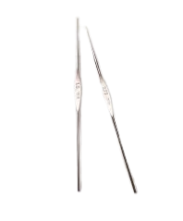
Admin
Category
Hooks Description
Categories:
Yarn
Markers
Hooks
Acrylic
Cotton
Wool
Stich Markers
Aluminum
Plastic
Steel
Description
Steel hooks are versatile tools made from high-strength steel, known for their durability and resistance to wear and corrosion.
Sizes
Upload Image
3.5mm to 10mm
Properties
Durable Material, Rust-Resistant, Sleek Design, Easy Installation, Versatile Usage
Save
All rights reserved © 2024 Pyat 7
Terms and Policy
About

Slide 23
Admin
Category
Hooks Description
X
Categories:
Yarn
Markers
Hooks
Done
Acrylic
Cotton
Wool
Stich Markers
Aluminum
Plastic
Steel
Description
Steel hooks are versatile tools made from high-strength steel, known for their durability and resistance to wear and corrosion.
Ok
Sizes
Upload Image
3.5mm to 10mm
Properties
Durable Material, Rust-Resistant, Sleek Design, Easy Installation, Versatile Usage
Save
All rights reserved © 2024 Pyat 7
Terms and Policy
About

