Slide 1
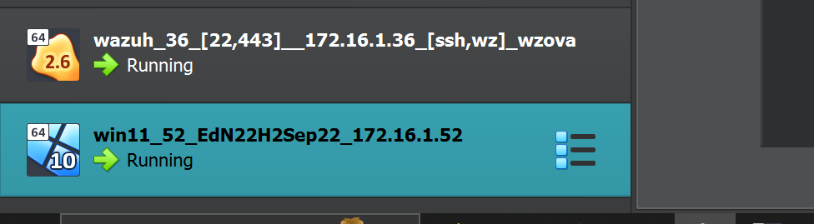
Topic 1 Implement CIS 12.8 Restrict Admin Internet
Your boss uses the DC virtual machine. Download the DC virtual machine from the unit website and
import it into Virtualbox. Setup a shared folder on DC for your scripts.

Slide 2
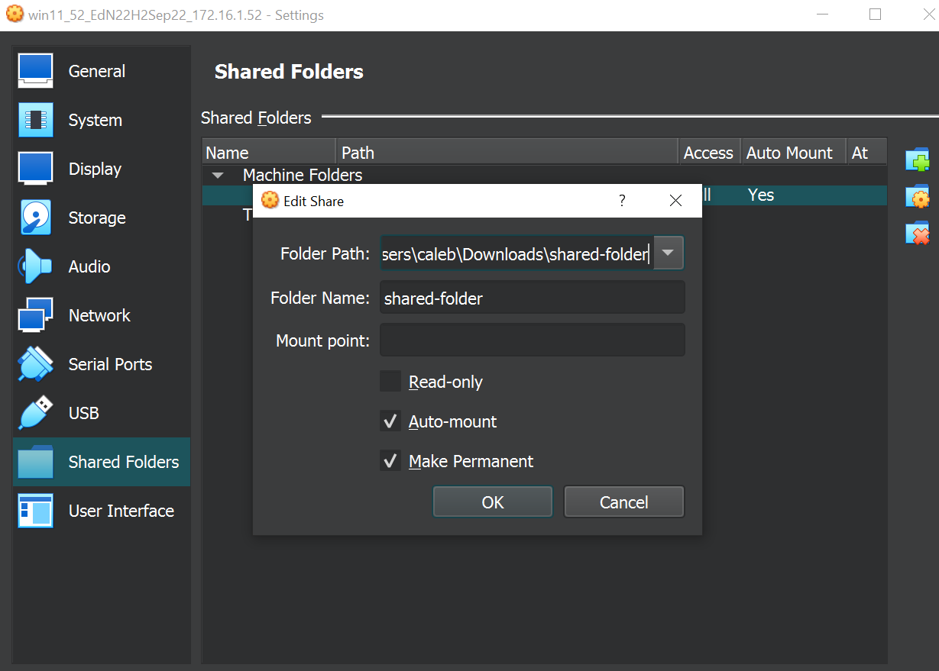
Setup a shared folder on Win11 for your scripts.

Slide 3
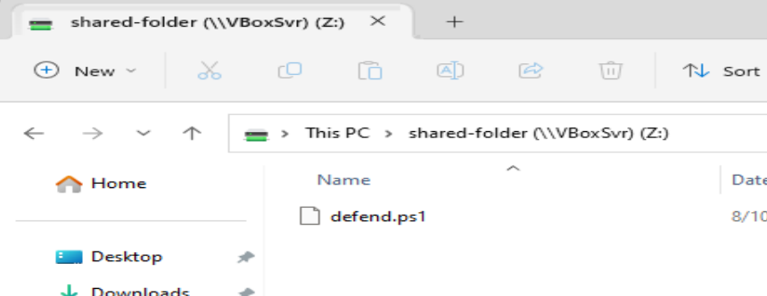
1. Create a PowerShell script called defend.ps1.

Slide 4
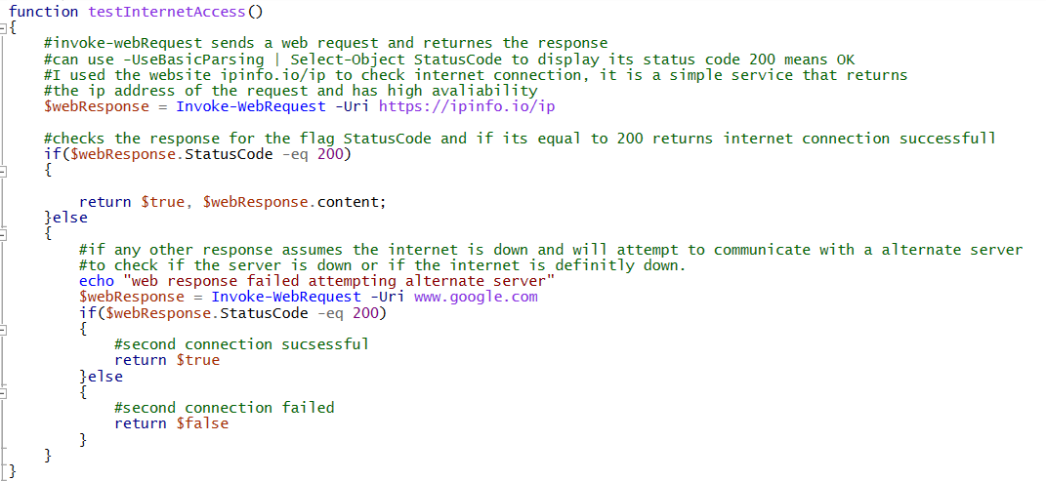
Pre-test: write a function testInternetAccess():
a. Use Invoke-WebRequest to check for Internet access by downloading a webpage. An HTTP status code of 200 means that a webpage was successfully obtained. You might need to use the option -UseBasicParsing.

Slide 5
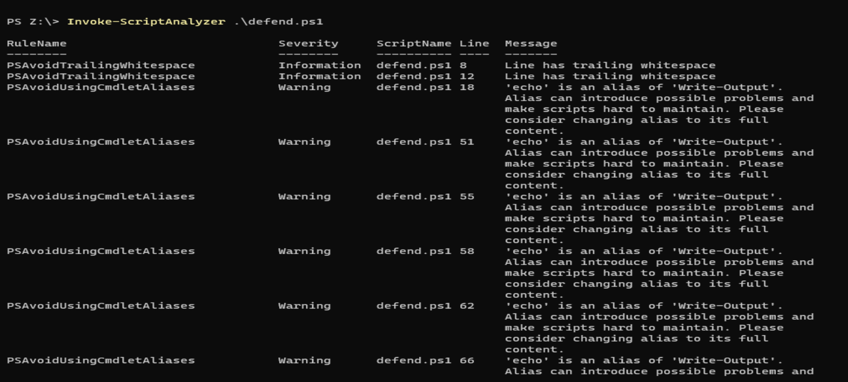
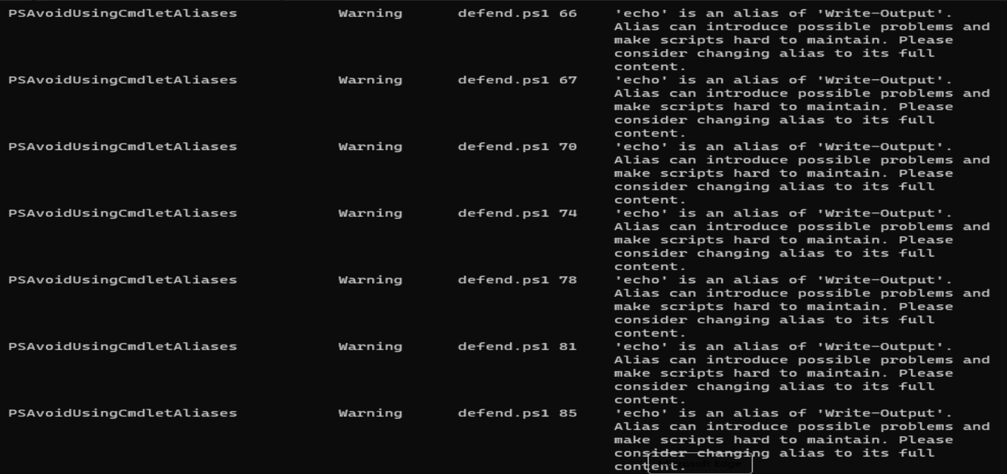
Clean up your code using PSScriptAnalzyer

