Slide 1
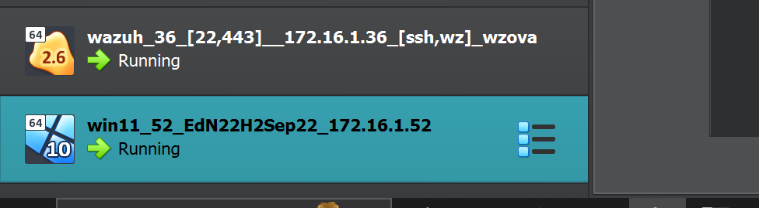
Topic 1 Implement CIS 12.8 Restrict Admin Internet
Your boss uses the DC virtual machine. Download the DC virtual machine from the unit website and
import it into Virtualbox. Setup a shared folder on DC for your scripts.

Slide 2
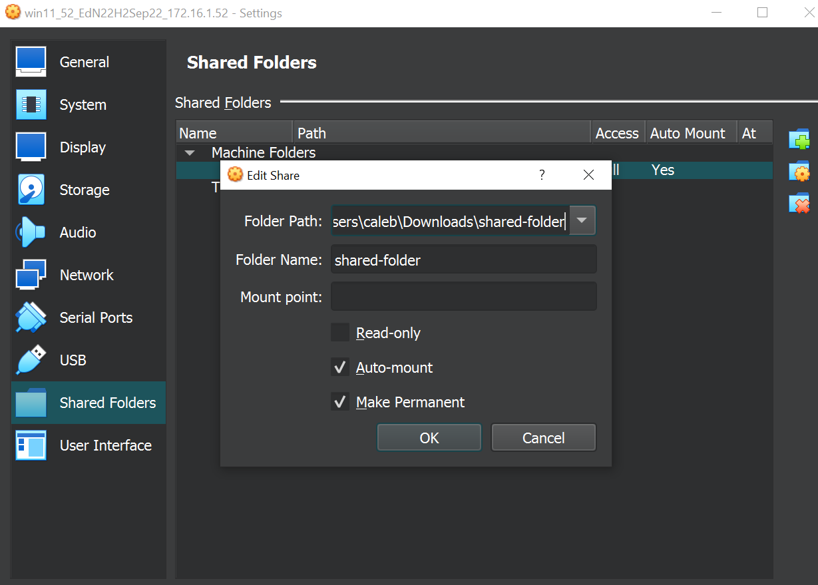
Setup a shared folder on Win11 for your scripts.

Slide 3
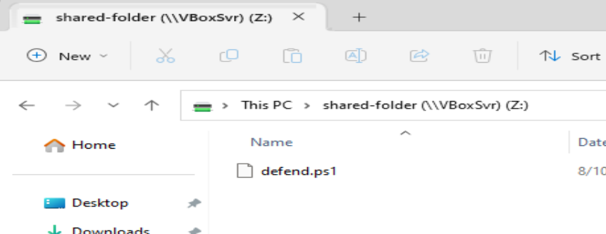
1. Create a PowerShell script called defend.ps1.

Slide 4
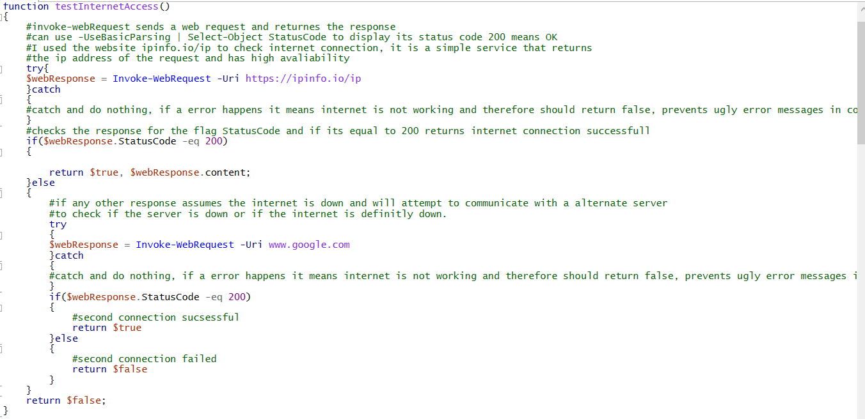
Pre-test: write a function testInternetAccess():
a. Use Invoke-WebRequest to check for Internet access by downloading a webpage. An HTTP status code of 200 means that a webpage was successfully obtained. You might need to use the option -UseBasicParsing.

Slide 5
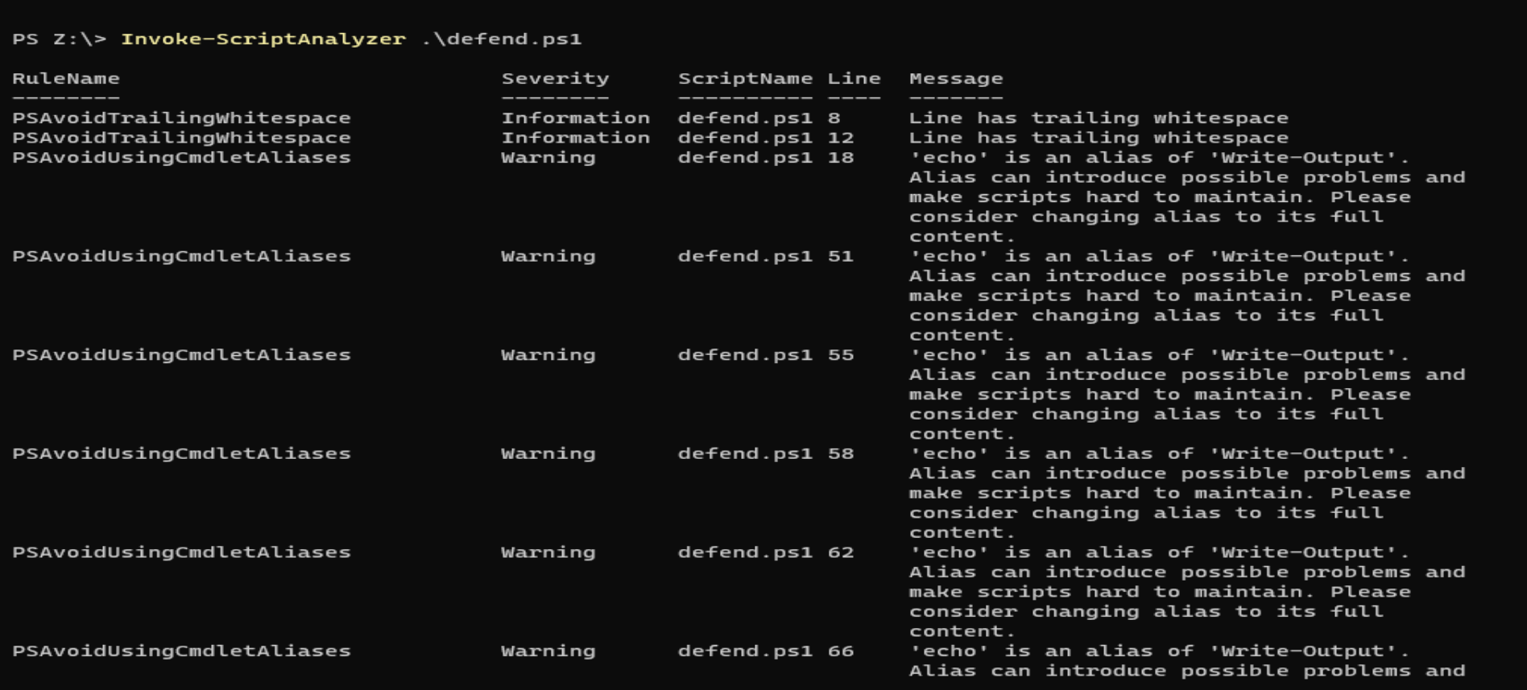
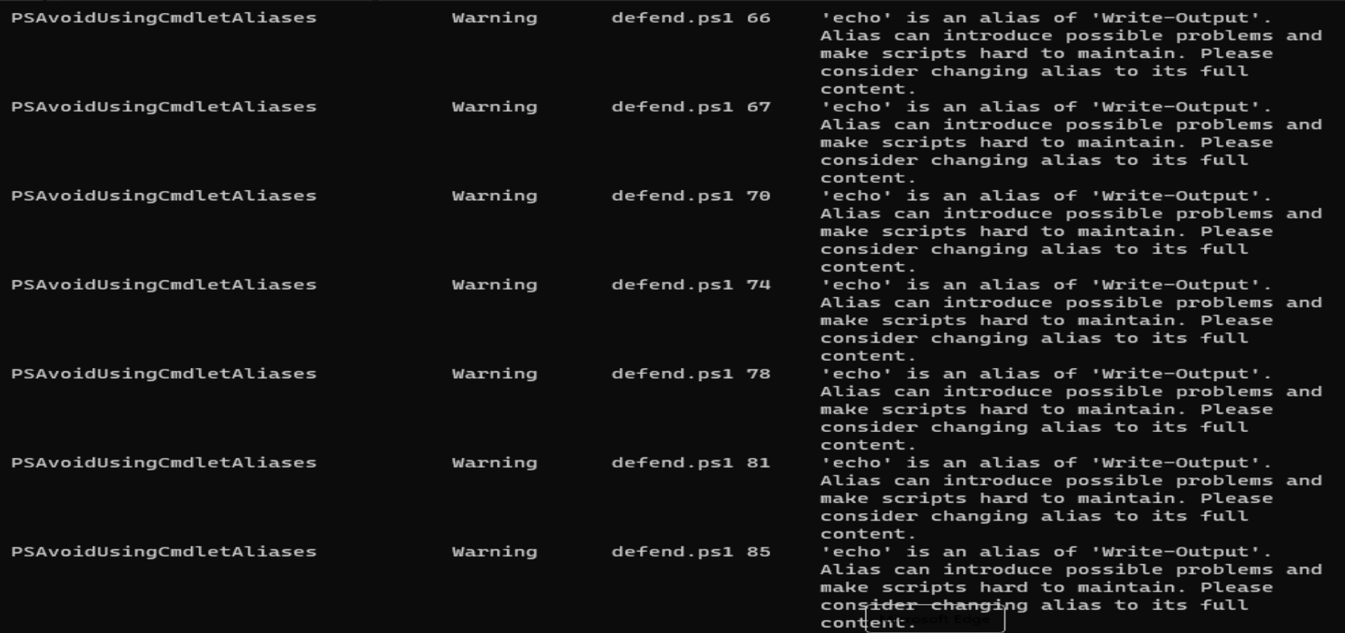
Clean up your code using PSScriptAnalzyer

Slide 6
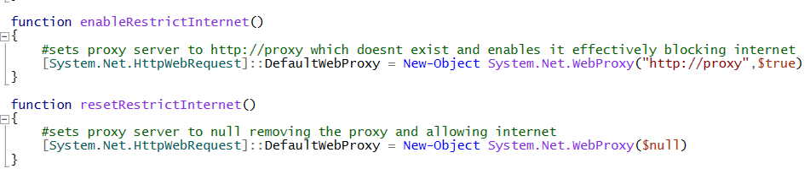
Create a function enableRestrictInternet() that removes Internet access by setting the proxy to a fake, non-existent server “proxy”:
Add a resetRestrictInternet() function to your script that re-enables Internet access by removing the fake proxy

Slide 7
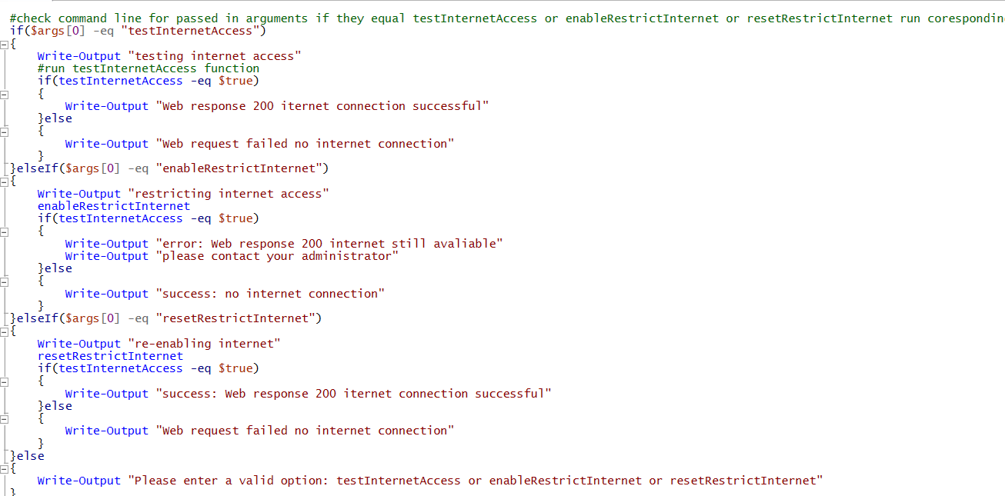
Add code to your script that checks the first argument of the command line: If the first argument is testInternetAccess, call the testInternetAccess() function. For example, the following command line would call testInternetAccess(): defend.ps1 testInternetAccess
Improve your code to call the other functions in your script based on the command line argument.

Slide 8
Testing

Slide 9
No valid command line option given

Slide 10
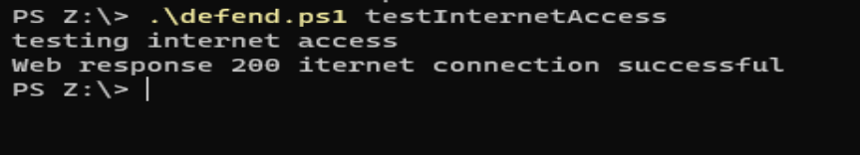
Test Internet access

Slide 11

Disable internet

Slide 12
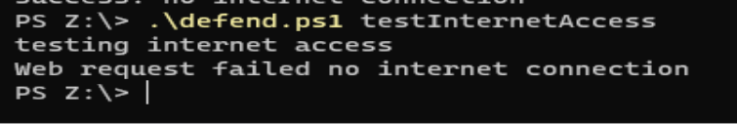
Test internet after internet restrict

Slide 13
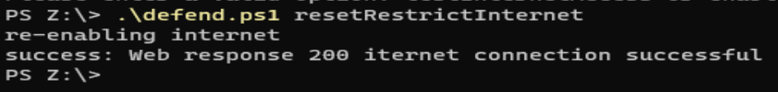
Re-enabling internet

