Slide 1
Peer Programming
Github Link https://github.com/CHROME-PLATED-METRO-WOLF/Coit11241-peer-programming
Partnered with Callan (received no communication from him)

Slide 2
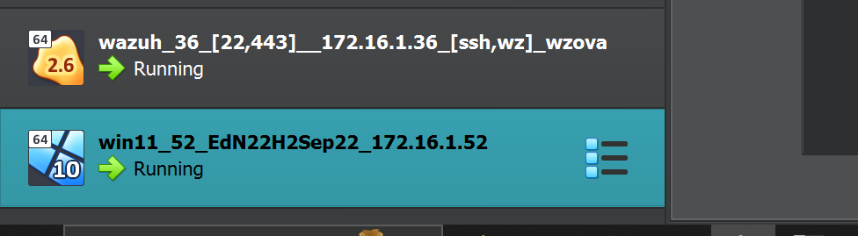
Topic 1 Implement CIS 12.8 Restrict Admin Internet
Your boss uses the DC virtual machine. Download the DC virtual machine from the unit website and
import it into Virtualbox. Setup a shared folder on DC for your scripts.

Slide 3
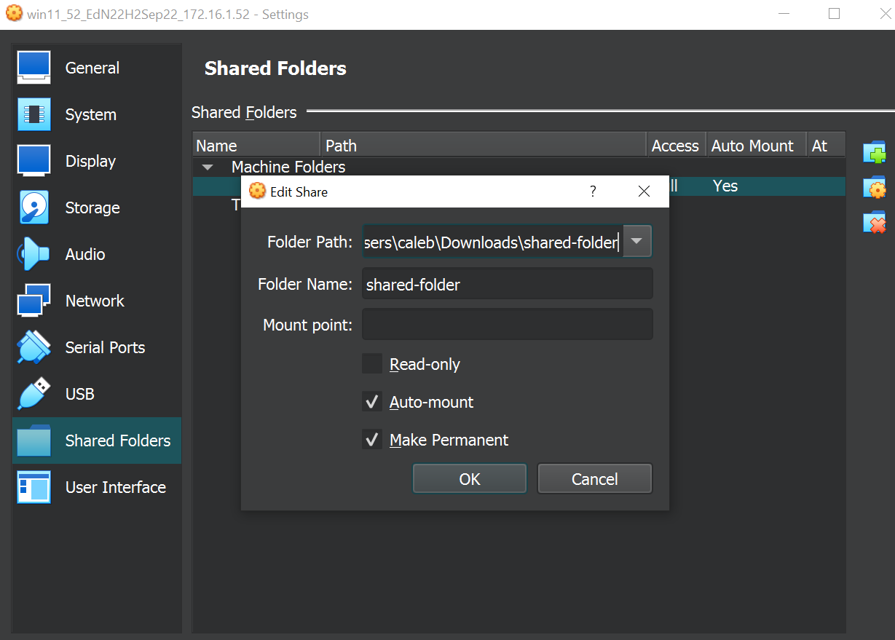
Setup a shared folder on Win11 for your scripts.

Slide 4
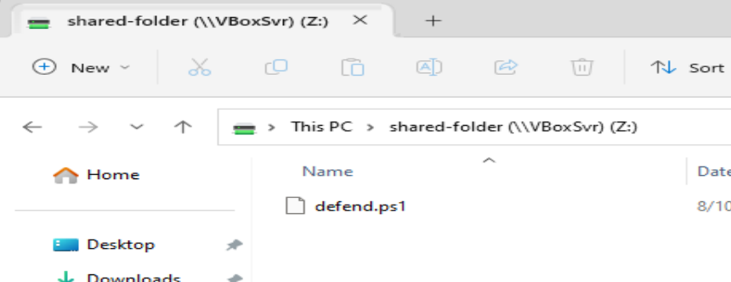
1. Create a PowerShell script called defend.ps1.

Slide 5
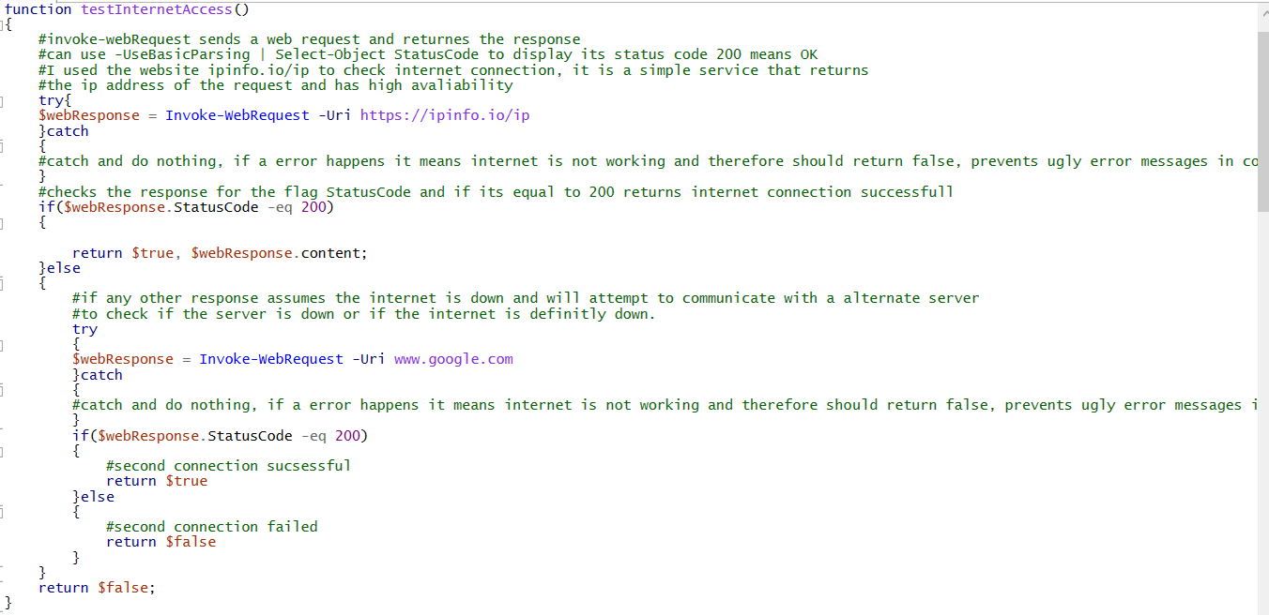
Pre-test: write a function testInternetAccess():
a. Use Invoke-WebRequest to check for Internet access by downloading a webpage. An HTTP status code of 200 means that a webpage was successfully obtained. You might need to use the option -UseBasicParsing.

Slide 6
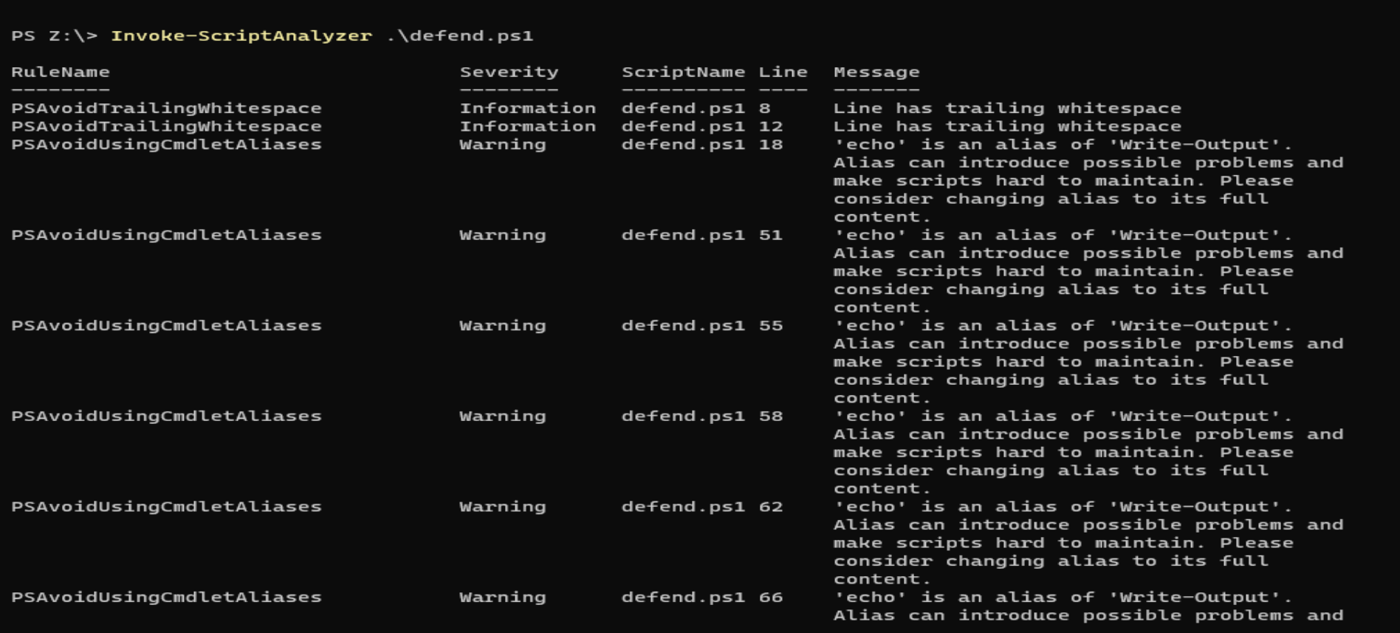
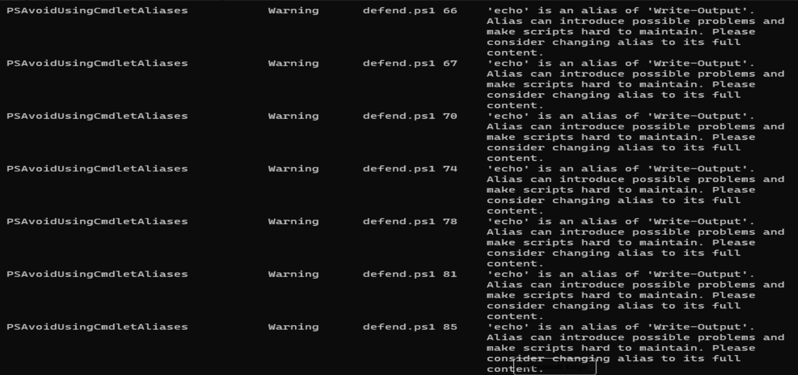
Clean up your code using PSScriptAnalzyer

Slide 7
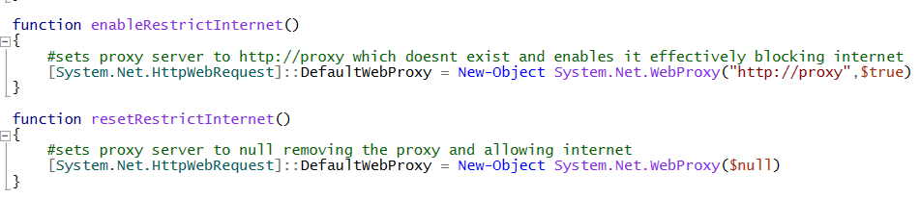
Create a function enableRestrictInternet() that removes Internet access by setting the proxy to a fake, non-existent server “proxy”:
Add a resetRestrictInternet() function to your script that re-enables Internet access by removing the fake proxy

Slide 8
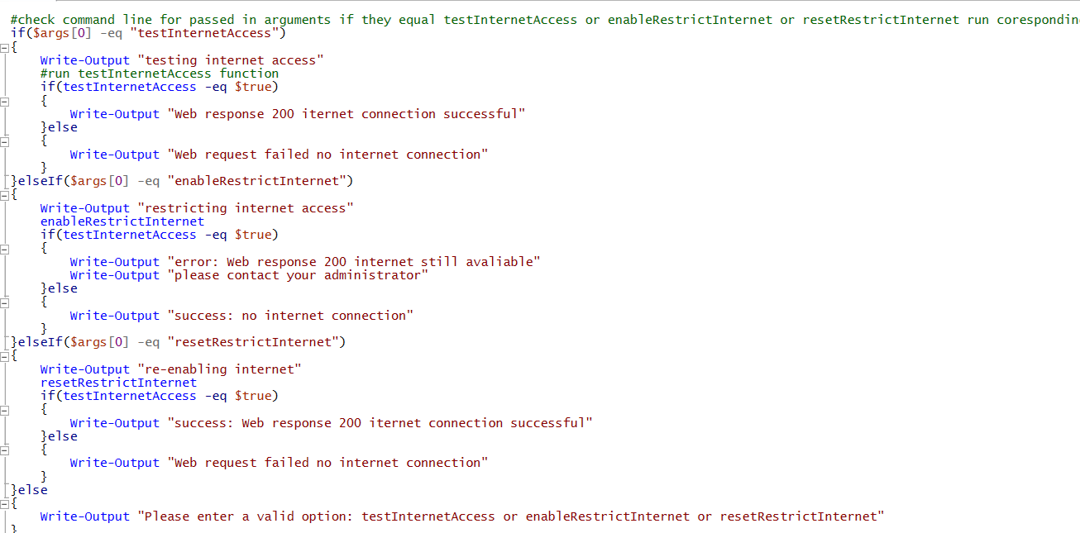
Add code to your script that checks the first argument of the command line: If the first argument is testInternetAccess, call the testInternetAccess() function. For example, the following command line would call testInternetAccess(): defend.ps1 testInternetAccess
Improve your code to call the other functions in your script based on the command line argument.

Slide 9
Testing

Slide 10
No valid command line option given

Slide 11
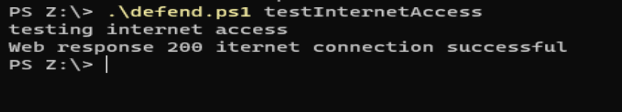
Test Internet access

Slide 12

Disable internet

Slide 13
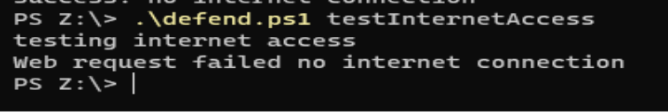
Test internet after internet restrict

Slide 14
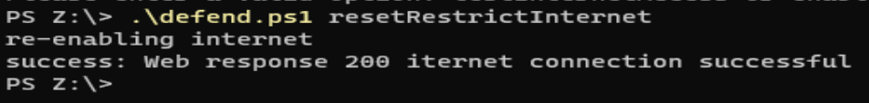
Re-enabling internet

Slide 15
Issues/Bugs encountered
turns out powershell has some really “interesting” behavior and any text you echo in a function will be added to the start of the return data from function. This means you cant put debugging echos in functions that return data otherwise your comparisons to those functions returned data will be wrong.
I do not understand how any programmer making a function like the one below where it clearly is returning a Boolean value if something is true wants and echo or Write-Output to be appended to the return data.
Function test()
{
echo "checking if internet has exploded"
return $true
}
This function will return "checking if internet has exploded true" rather than returning just true therefore making any boolean checks come back as true. Example if(test) which should check if the function is true or false will return true no matter what, even that doesnt make sense how does a function returning a bunch of text equal $true it does not equal $true.

