Slide 1
Caleb Davidson
https://github.com/CHROME-PLATED-METRO-WOLF/attack

Slide 2
BlackCat commands
Category | Category Description | Description
T1033 | System Owner/User Discovery | Net Use to connect to other computers (Microsoft Threat Intelligence, 2022)
T1570 | Lateral Tool Transfer | PsExec to deploy payloads to computer (Bouchrika, 2023)
T1070.001 | Indicator Removal: Clear Windows Event Logs | Can use wevtutil.exe to remove event logs to hide blackcats presence. (Microsoft Threat Intelligence, 2022)
T1490 | Inhibit System Recovery | can delete shadow copies using vssadmin.exe and wmic.exe it can also modify the boot loader using bcdedit (Clark et al., 2019)
All command categories came from attack.mitre.org group. Specifically BlackCats att&ck page https://attack.mitre.org/software/S1068/

Slide 3
Detailed commands
Name | Detailed command
T1033 Net Use | net use \\[computer name] /user:[domain]\[user] [password] /persistent:no (Microsoft Threat Intelligence, 2022)
T1570 PsExec | psexec.exe -accepteula \\<TARGET_HOST> -u <USERNAME> -p <PASSWORD> -s -d -f -c <ALPHV_EXECUTABLE> [FLAGS] [OPTIONS] --access-token <ACCESS_TOKEN> [SUBCOMMAND] (Bouchrika, 2023)
T1070.001 wevtutil.exe | for /F \”tokens=*\” %1 in (‘wevtutil.exe el’) DO wevtutil.exe cl \”%1\” (Microsoft Threat Intelligence, 2022)
T1490 vssadmin.exe | vssadmin.exe delete shadows /all /quiet wmic.exe Shadowcopy Delete bcdedit /set {default} recoveryenabled No (Clark et al., 2019)

Slide 4
T1033 Net Use
net use \\[computer name] /user:[domain]\[user] [password] /persistent:no
BlackCat uses the net use command to connect to remote drives, this command is slightly more likely to be used by legitimate process or users so there may be some false positives. To reduce false positives the wazuh rule will look for net use and /persistent:no it is unlikely for a user adding a network drive to specifically turn persistence off. If that’s the case its still worth raising an alert.
In order to reduce the possibility of command being formatted in a way that prevents detection our wazuh rule will look for a command that has “net use”, “persistent” and “no” in the command.

Slide 5
T1570 PsExec
BlackCat will have PsExec bundled into the executable however PsExec can be download from here .
T1570 – PsExec is unlikely to be run via the command line on normal machines especially with the –accepteula argument therefore all events of PsExec being run from the command line with –accepteula argument are suspicious.
Wazuh can catch PsExec events by looking at the commandLine section of event logs for PsExec and accepteula

Slide 6
T1070.001 wevtutil.exe
for /F \”tokens=*\” %1 in (‘wevtutil.exe el’) DO wevtutil.exe cl \”%1\”
This command doesn’t work in the testing environment however in powershell you can achieve the same outcome using wevtutil with this command.
wevtutil el | Foreach-Object {wevtutil cl "$_"}
Despite it clearing logs Sysmon will still catch it until it fully clears the logs allowing Wazuh to generate a alert.
You can prevent the logs from being cleared either by group policy from the domain controller. This can be circumvented sometimes if the user or BlackCat can edit the registry they could undo the domain controller action then quickly remove logs before the group policy is updated again.
A better solution would be some kind of remote logging server where logs are forwarded to. In this case the logs are forwarded to Wazuh and an event is triggered.

Slide 7
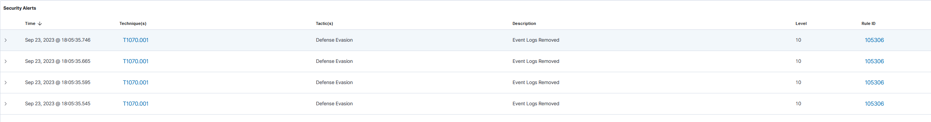
T1070.001 wevtutil.exe
Manual log clearing through event viewer does not trigger these alerts.

Slide 8
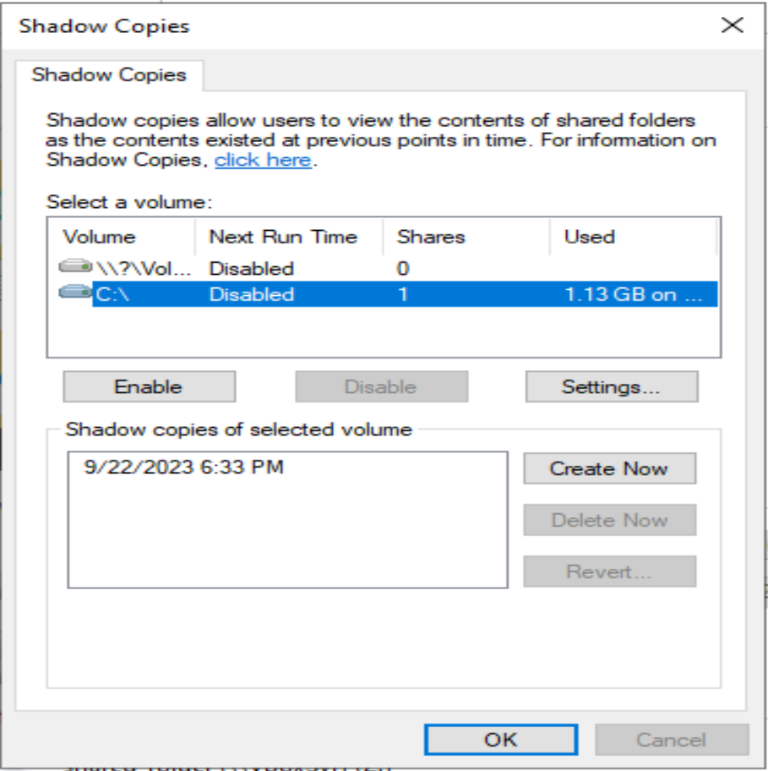
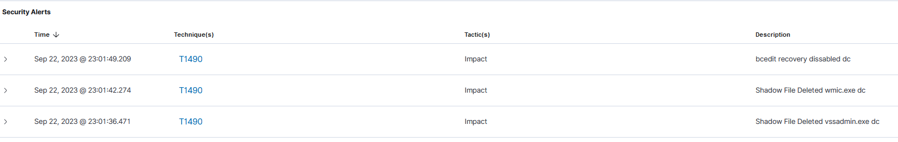
T1490 Inhibit System Recovery
Had to enable shadow copies first for the attack to be successful
vssadmin.exe delete shadows /all /quiet wmic.exe Shadowcopy Delete
bcdedit /set {default} recoveryenabled No
Each command will trigger a event in wazuh under these conditions
1. if vssadmin.exe and delete are called in the same command.
2. If wmic.exe, shadowcopy and delete are called in the same command.
3. If bcdedit, recoveryenabled and no are called in same command.

Slide 9
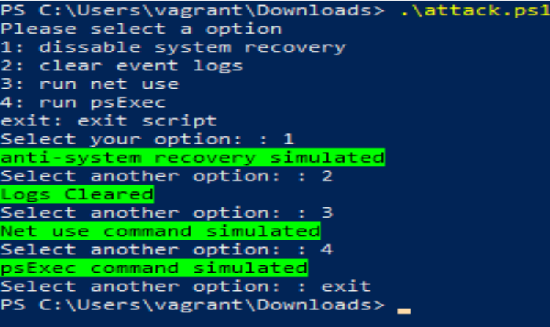
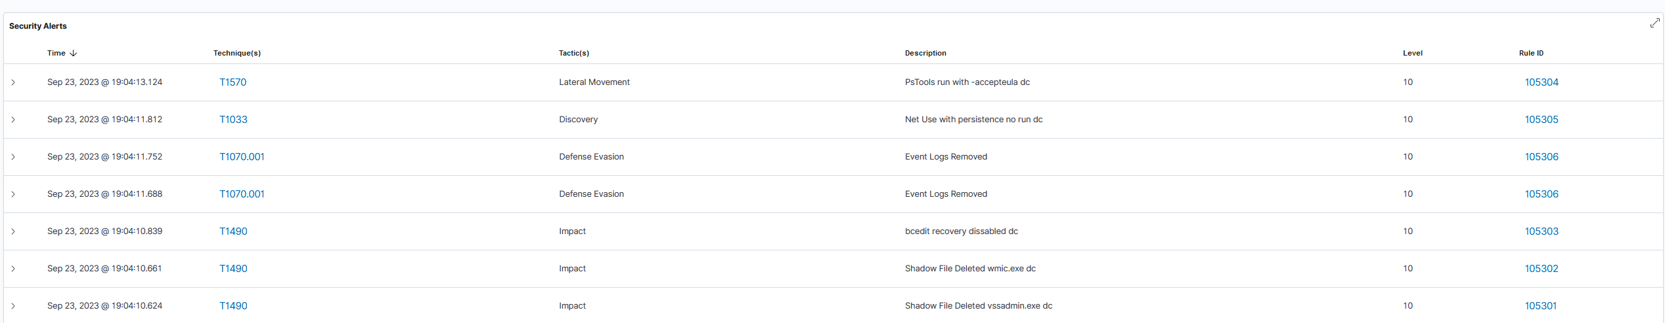
Testing attack script

Slide 10
References
ALPHV/BlackCat Ransomware, A.D.D.I. (2023) A deep dive into ALPHV/BlackCat ransomware, SecurityScorecard. Available at: https://securityscorecard.com/research/deep-dive-into-alphv-blackcat-ransomware/ (Accessed: 22 September 2023).
Bouchrika, I. (2023) BlackCat ransomware (ALPHV), Varonis. Available at: https://www.varonis.com/blog/blackcat-ransomware (Accessed: 22 September 2023).
Clark, A., Sivakumaran, P. and Gotlib, Y. (2019) Inhibit system recovery, Inhibit System Recovery, Technique T1490 - Enterprise | MITRE ATT&CK®. Available at: https://attack.mitre.org/techniques/T1490/ (Accessed: 22 September 2023).
Intelligence, M.T. (2022) The many lives of BlackCat ransomware, Microsoft Security Blog. Available at: https://www.microsoft.com/en-us/security/blog/2022/06/13/the-many-lives-of-blackcat-ransomware/ (Accessed: 22 September 2023).
Nagahama, H. et al. (2023) Blackcat, BlackCat, Software S1068 | MITRE ATT&CK®. Available at: https://attack.mitre.org/software/S1068/ (Accessed: 22 September 2023).
T1033, A.R. (2023) T1033, Explore Atomic Red Team. Available at: https://atomicredteam.io/discovery/T1033/ (Accessed: 22 September 2023).
T1083, A. (2023) T1083, Explore Atomic Red Team. Available at: https://atomicredteam.io/discovery/T1083/ (Accessed: 22 September 2023).

