Slide 1
Caleb Davidson
Github https://github.com/CHROME-PLATED-METRO-WOLF/coit11241-Cyber-Threat-Intelligence
All scan reports are in “shared-folder”

Slide 2
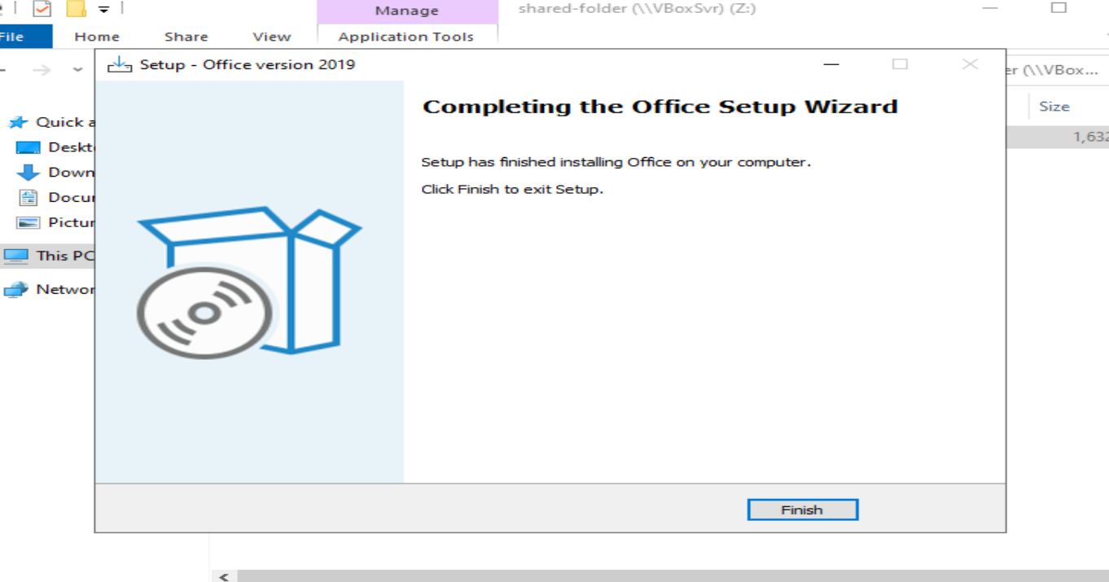
Install CQU_Office 2019 into DC

Slide 3
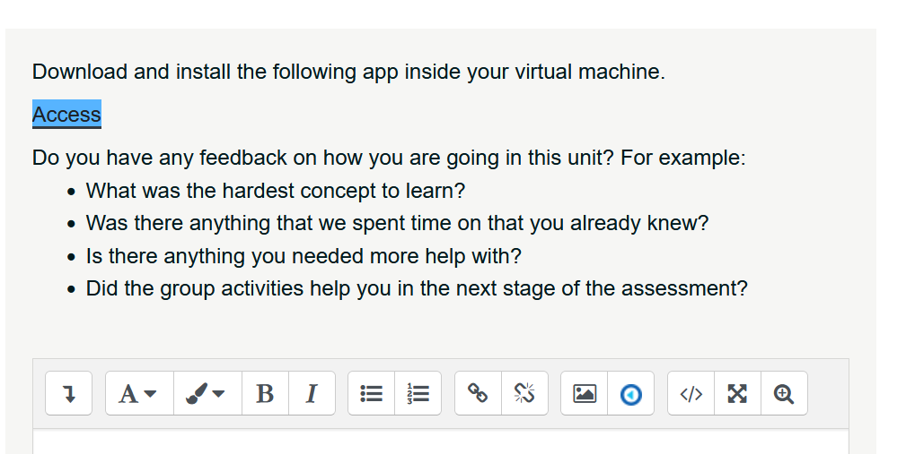
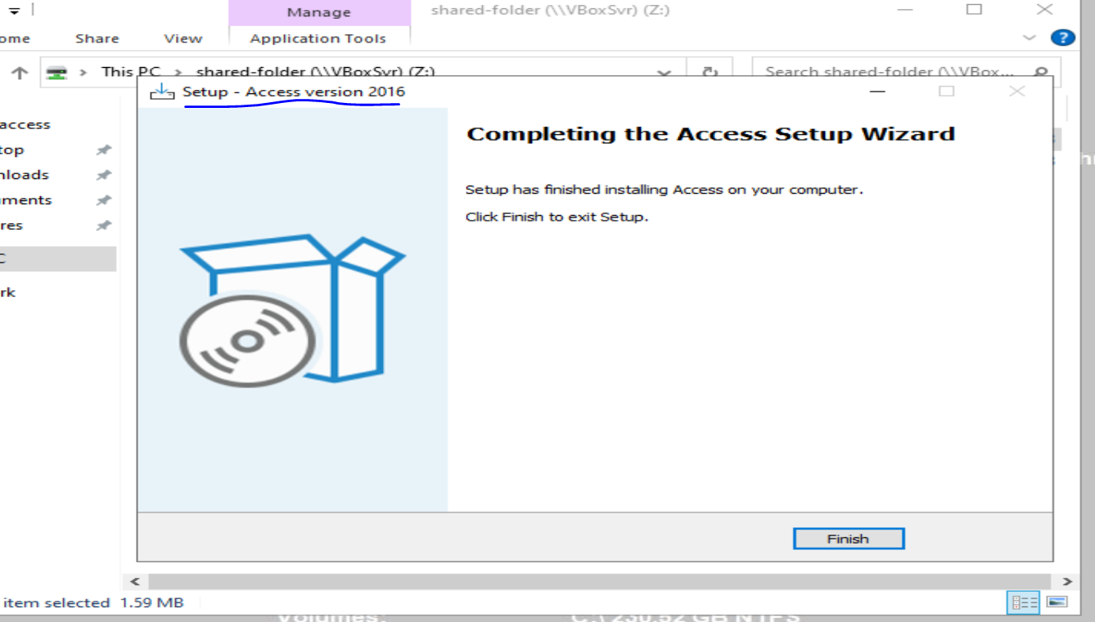
Install additional app(s) into DC

Slide 4
Search the Information System for Vulnerabilities without Wazuh
Nessus
Nikto
Legion
Nmap
Wafw00f

Slide 5
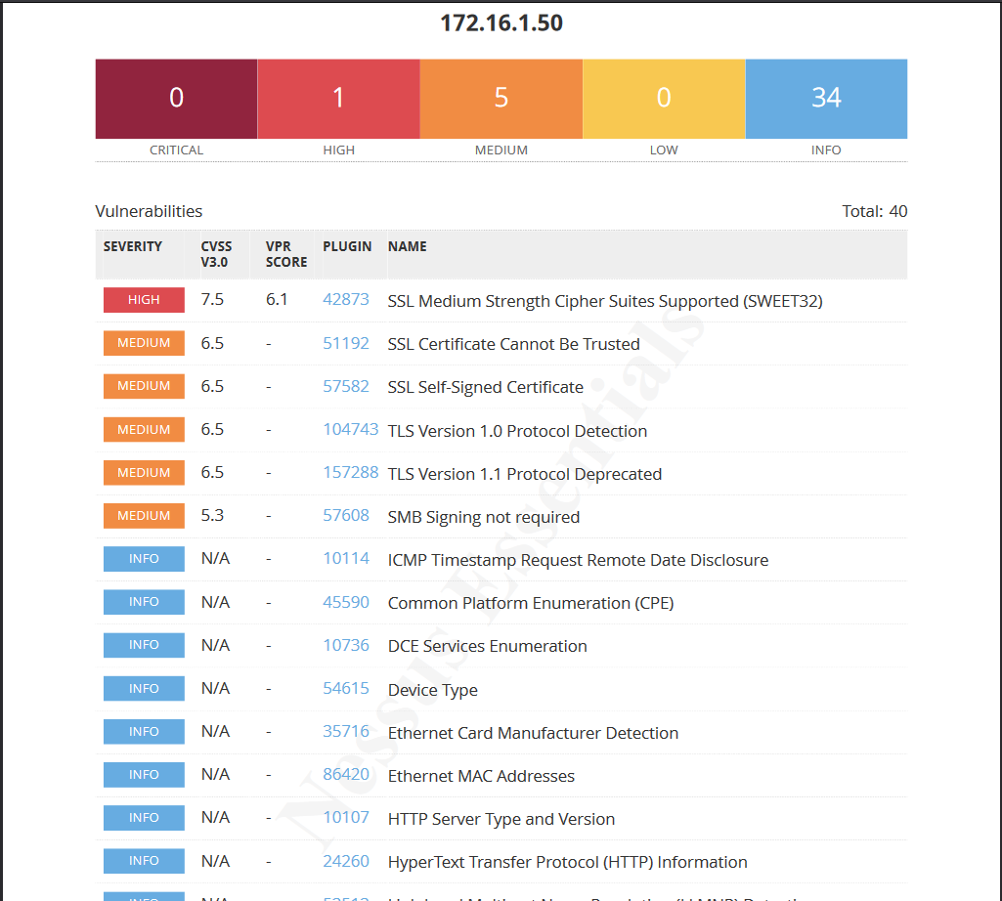
Nessus
DC machine

Slide 6
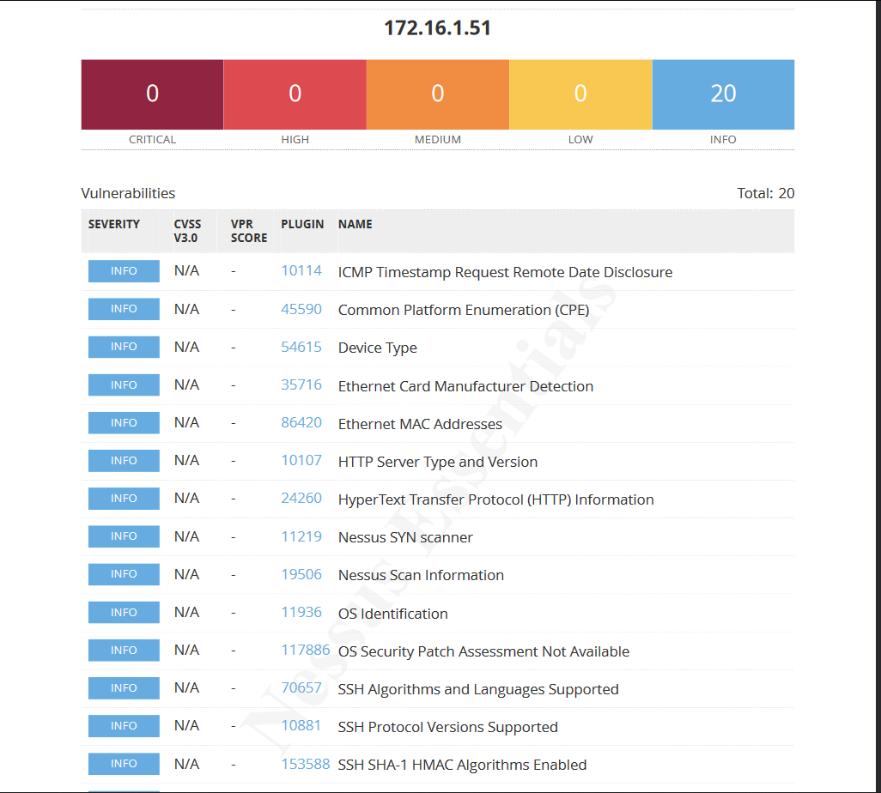
Nessus
Odoo machine

Slide 7
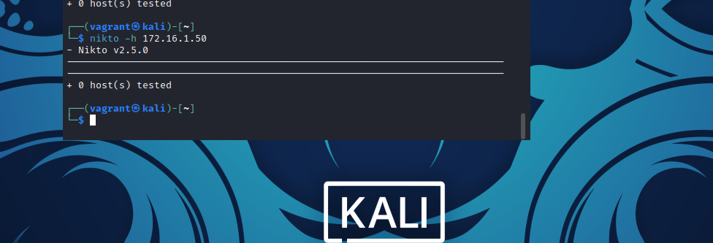
Nikto DC machine
No webserver running on DC machine so nikto has nothing to scan

Slide 8
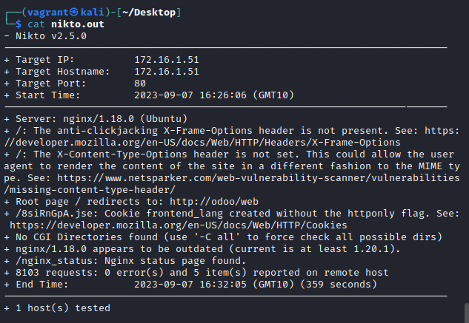
Nikto Odoo
No vulnerabilities found however web server is outdated and some configuration issues were found.

Slide 9
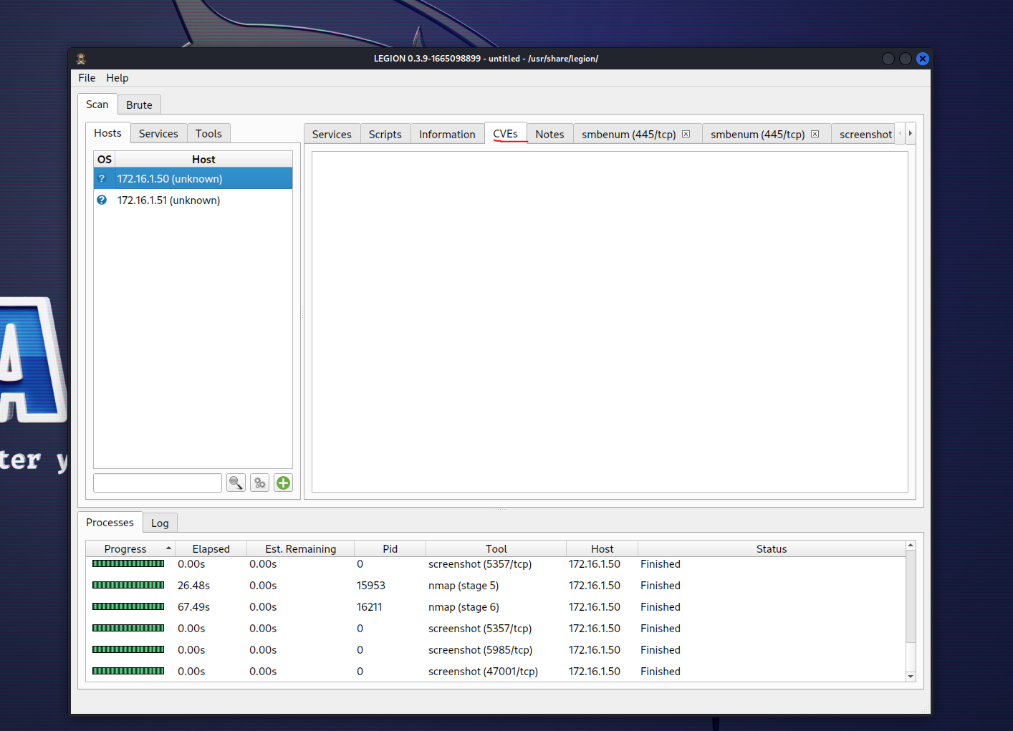
Legion
No CVEs detected for the DC machine.
Discovered some webservers on different ports, re scanned them with Nikto

Slide 10
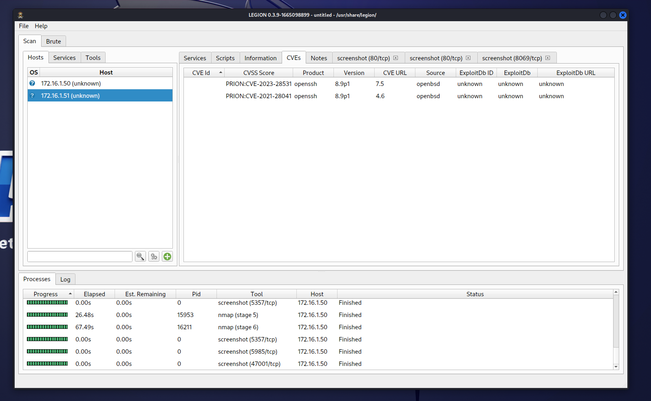
Legion
Legion scan of Odoo server 2 CVEs found

Slide 11
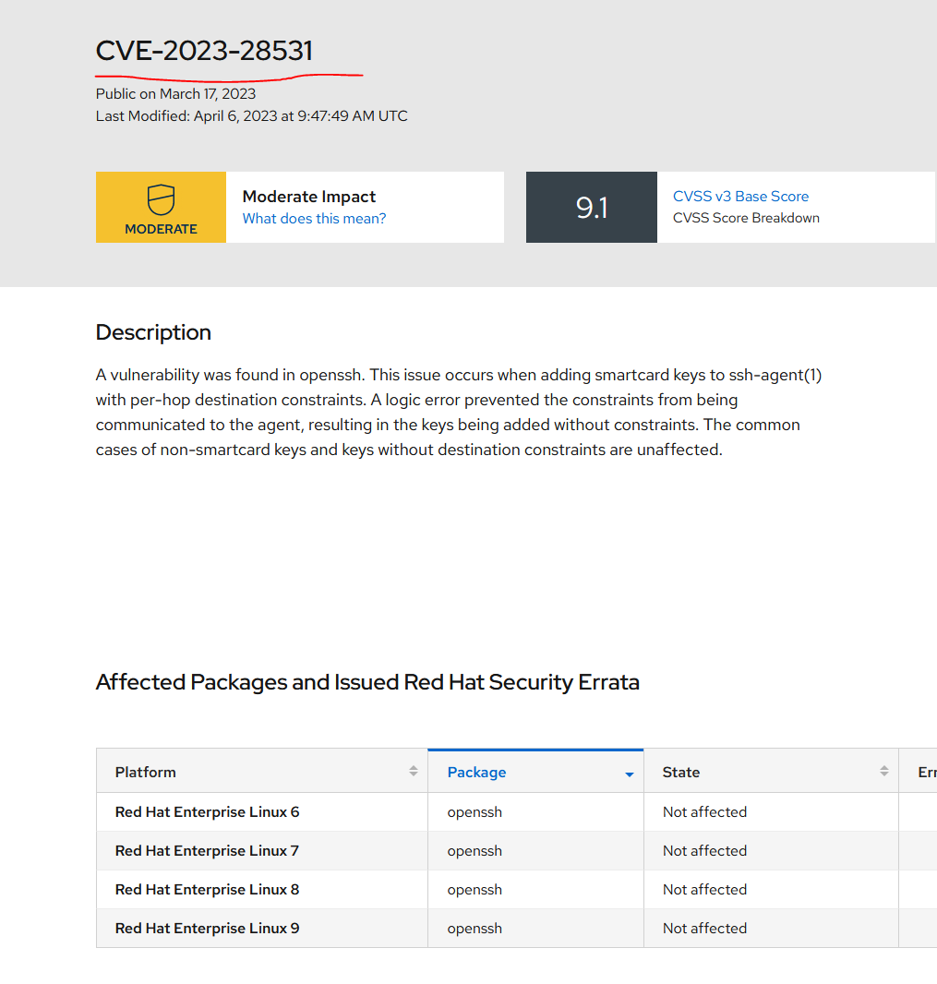
Odoo server CVE-2023-28531

Slide 12
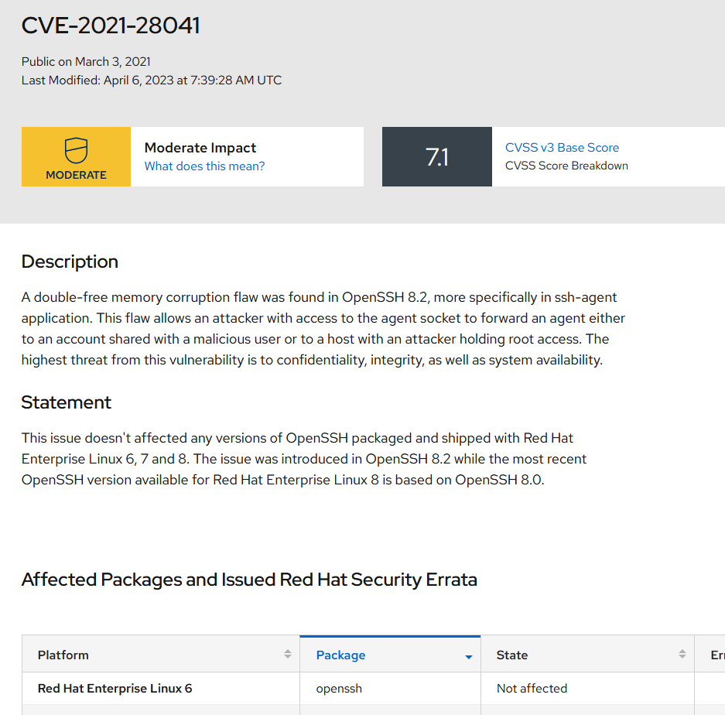
Odoo CVE-2021-28041

Slide 13
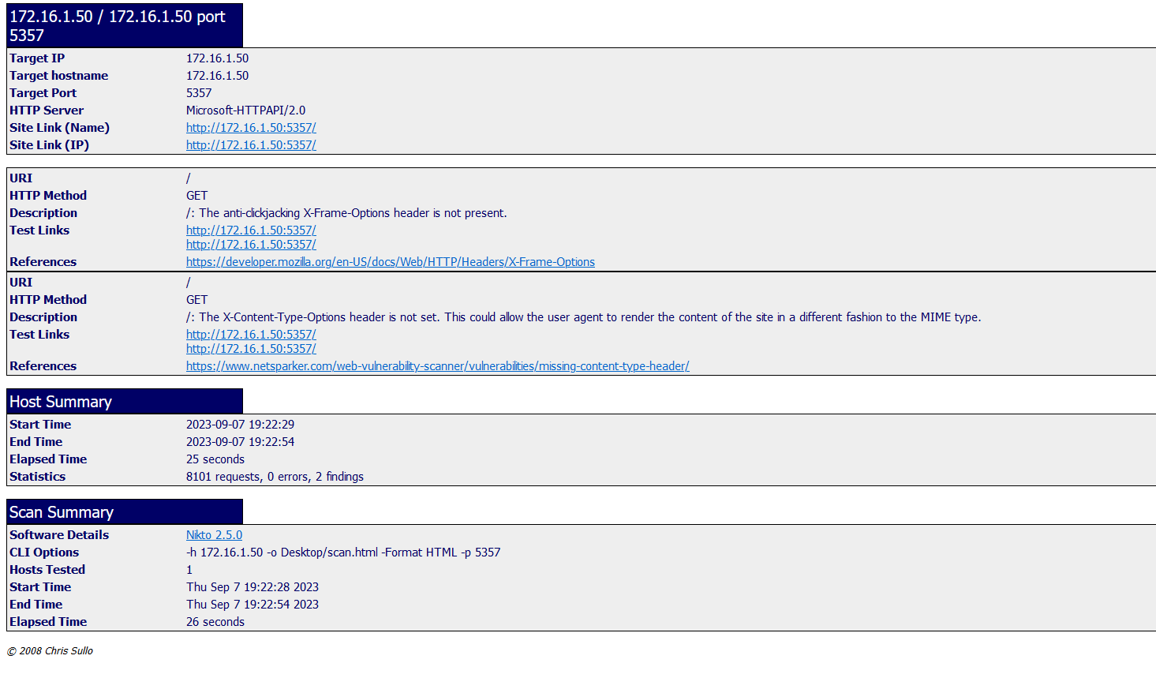
Nikto scan of DC port 5357

Slide 14
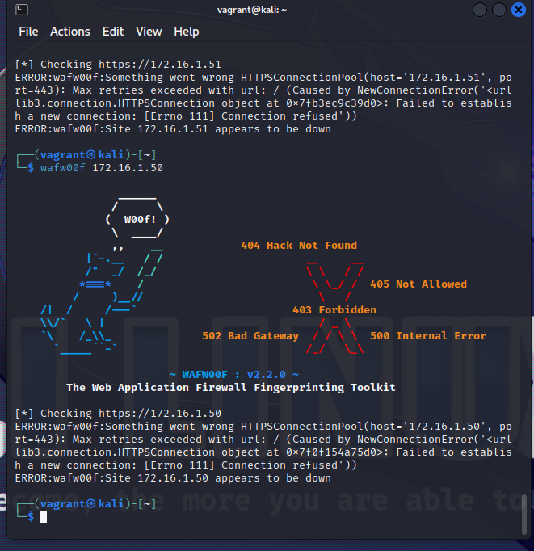
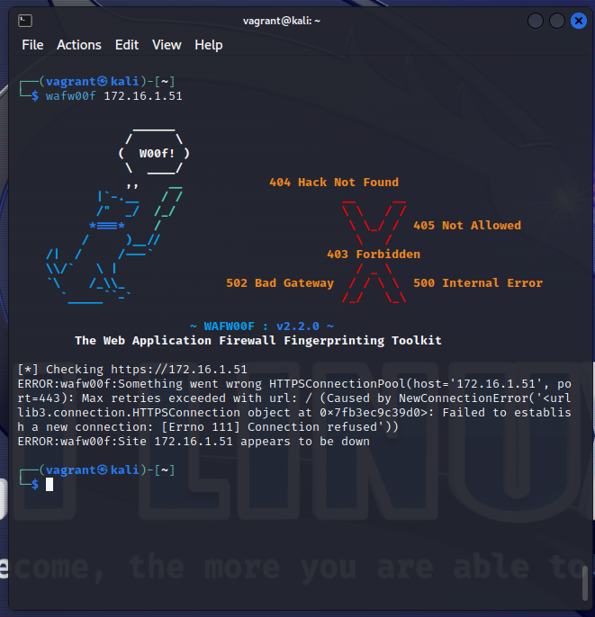
Wafwoof
DC
Odoo

Slide 15
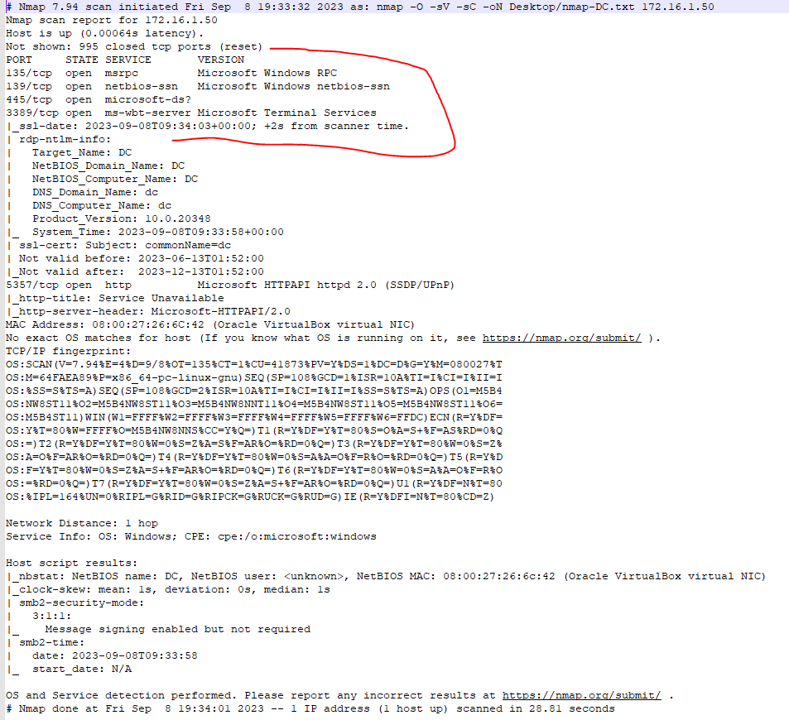
Nmap DC machine

Slide 16
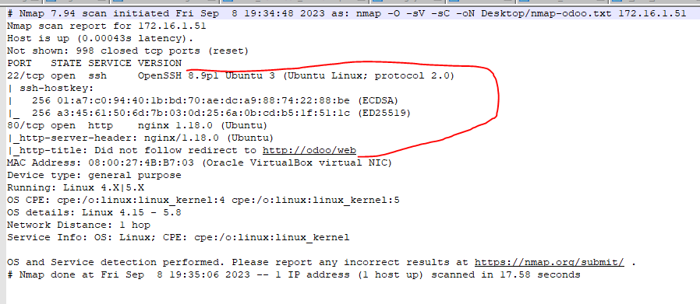
Nmap oDoo

Slide 17
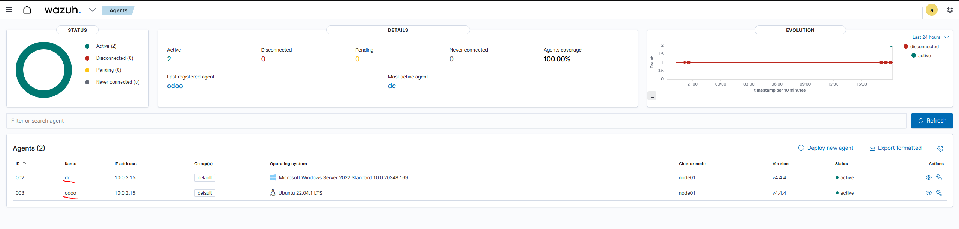
Wazuh

Slide 18
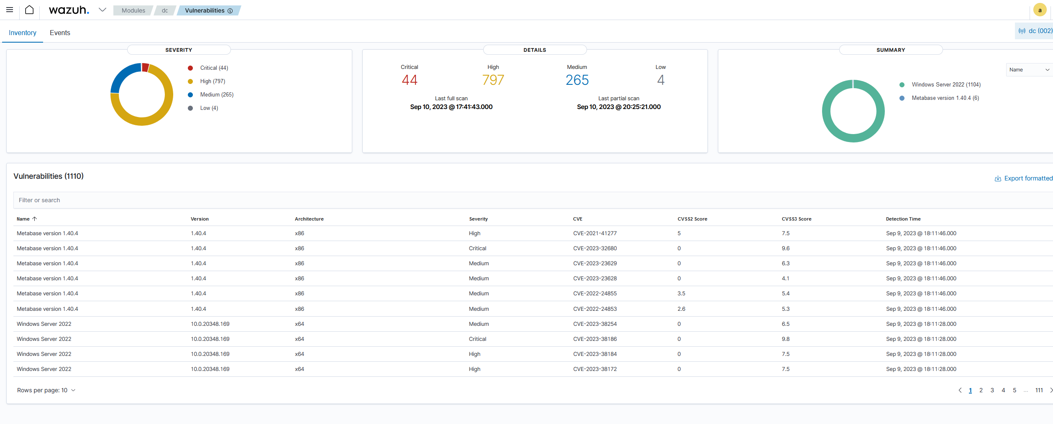
Wazuh

Slide 19
Black Cats Lifecycle
BlackCat infiltrates a network by using compromised credentials via the remote desktop protocol and virtual private networks. It also uses vulnerabilities in software to infect machines. Users can also be tricked by emails to download and execute BlackCat.
Once black cat has infected a machine and infiltrated a network it will attempt to infect other machines in the network using a variety of techniques. It will use compromised credentials and the remote desktop protocol to gain access to other machines and install itself. If BlackCat is able to compromise the domain controller it will use group policy objects to deploy itself on other computers. PsExec is also used with compromised account credentials to spread BlackCat. Software vulnerabilities are also used to spread BlackCat, public CVEs are known to be used to spread BlackCat
Once BlackCat has infected a system it opens a connection back to its command and control network and a malicious actor can execute attacks.
BlackCat typically will perform a triple-extortion attack where BlackCat will exfiltrate the users data and will threaten publishing their data if the fee is not paid. At the same time BlackCat will encrypt all of the users files and will not decrypt them if the fee is not paid and finally the user will be threatened of a denial of service attack if the fee is not paid.

Slide 20
BlackCat ATT&CK TTPs
T1190 BlackCat exploits unpatched or vulnerable public facing applications
T1112 BlackCat can use the registry to maintain persistence
T1548 BlackCat bypass user account control elevating privileges
T1003.001 Credential dumping can allow BlackCat to extract other users credentials
T1486 BlackCat will encrypt user data.
T1563.002 & T1570 RDP Hijacking and psexec for lateral movement

Slide 21
CVE | CWE | CAPEC | ATT&CK
CVE-2023-32680 | CWE-306 | CAPEC-62 | T1190
CVE-2016-2183 | CWE-200 | CAPEC-310 | None
CVE-2023-28531 | NVD-CWE-noinfo
CVE-2021-28041 | CWE-415 | None

Slide 22
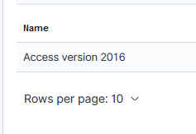
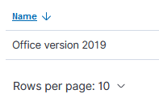
rationale
I cannot find any CVEs that trace back to ATT&CK for BlackCat im not sure if im doing something wrong but I installed all office and the additional program (access) and added all the packages to the cpe_helper.json including both of those. Restarted wazuh and it rescanned and yet no vulnerabilities related to BlackCat.
Nessus found no CVEs that can be tracked back to blackcat on DC the only high priority vulnerability CVE-2016-2183 has no CAPECs with ATT&ck assigned to them
Wazuh found CVE-2023-32680 and once again none of the CAPECs had any ATT&CK except for CAPEC-62 which has WASC-9 cross-site forgery which has nothing to do with BlackCat.
the rest of wazuhs vulnerabilities were all Microsoft server 2022 and every CVEs CAPECs did not have any ATT&CKs and none of them had anything to do with BlackCat. Most of them didn’t even have any CWEs associated with them
In the previous slide (BlackCat ATT&CK TTPs) I decided these ATTA&CKs were the most important since out of the other ones listed these are the most likely attacks to occur. Additionally these ATT&CKs are the most severe and have a greater chance of either spreading BlackCat or damaging a system.
I could not list the top 5 vulnerabilities properly because there were no vulnerabilities found that would aid BlackCat. For completeness after checking every single windows server CVE it looks like all of them would be fixed by updating to the latest windows version.

Slide 23
References
CIS (no date) Breaking down the BlackCat ransomware operation, Center for internet security. Available at: https://www.cisecurity.org/insights/blog/breaking-down-the-blackcat-ransomware-operation (Accessed: 09 September 2023).
Microsoft (2022) The many lives of BlackCat ransomware, Microsoft Security Blog. Available at: https://www.microsoft.com/en-us/security/blog/2022/06/13/the-many-lives-of-blackcat-ransomware/ (Accessed: 08 September 2023).
What is BlackCat malware? (no date) What Is BlackCat Malware? Available at: https://www.blackberry.com/us/en/solutions/endpoint-security/ransomware-protection/blackcat (Accessed: 09 September 2023).

