Slide 1
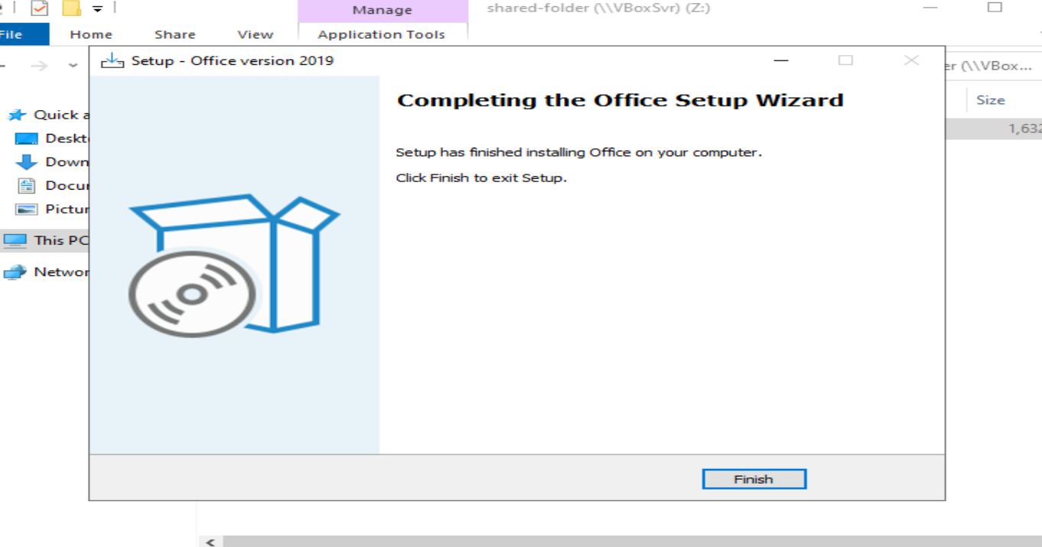
Install CQU_Office 2019 into DC

Slide 2
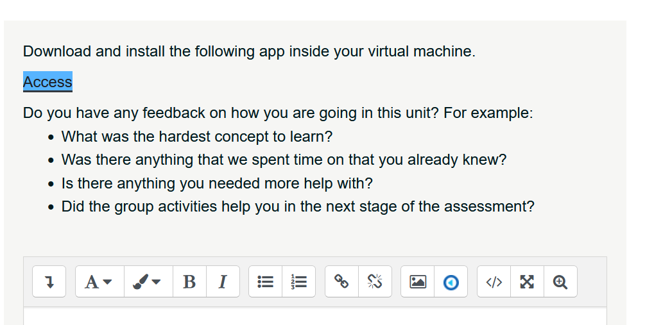
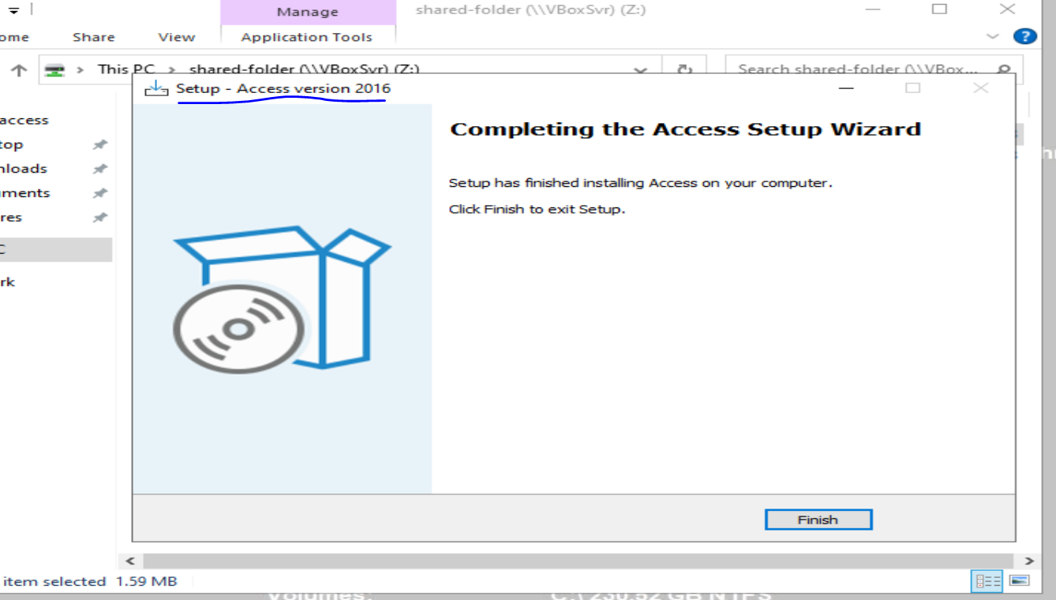
Install additional app(s) into DC

Slide 3
Search the Information System for Vulnerabilities without Wazuh
Nessus
Nikto
Legion
Nmap
Wafw00f

Slide 4
Nessus

Slide 5
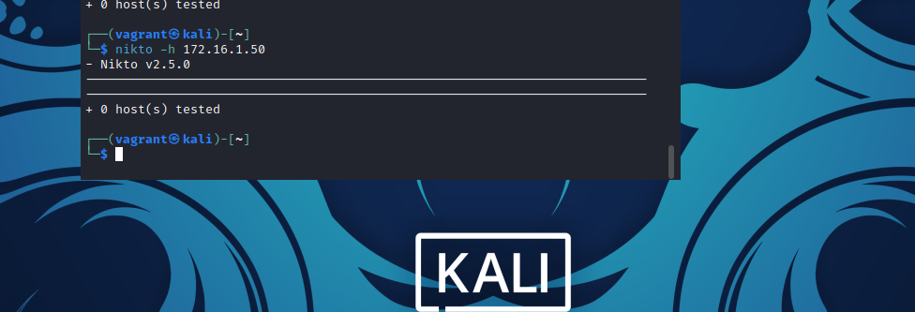
Nikto DC machine
No webserver running on DC machine so nikto has nothing to scan

Slide 6
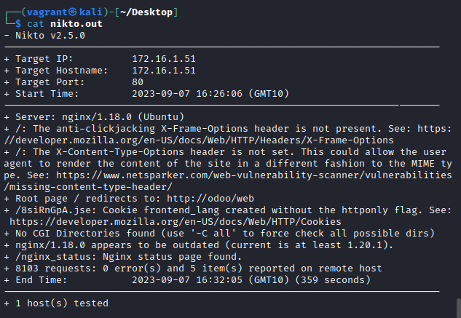
Nikto Odoo
No vulnerabilities found however web server is outdated and some configuration issues were found.

Slide 7
Legion

