Slide 1
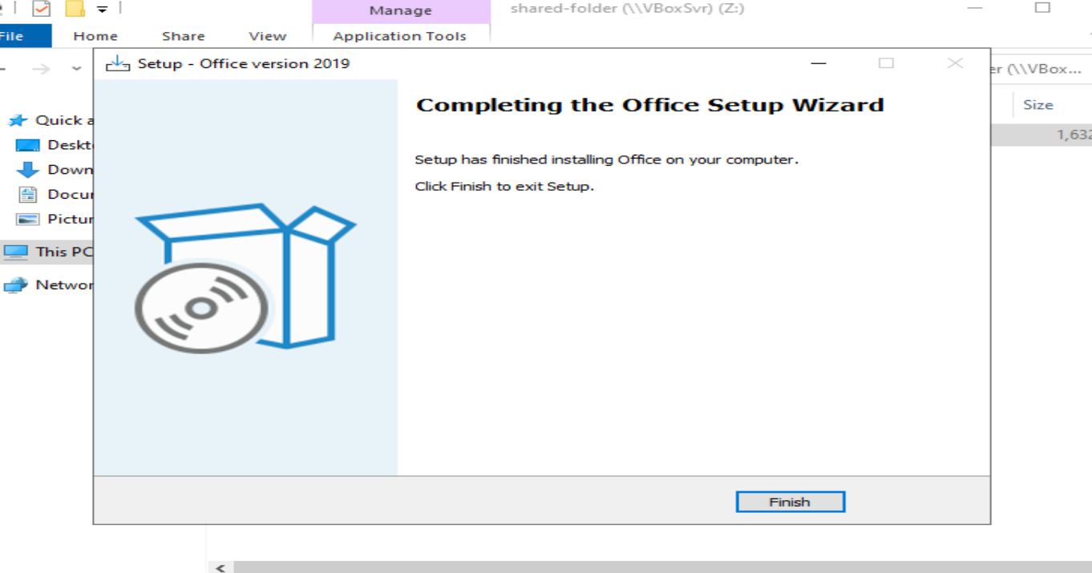
Install CQU_Office 2019 into DC

Slide 2
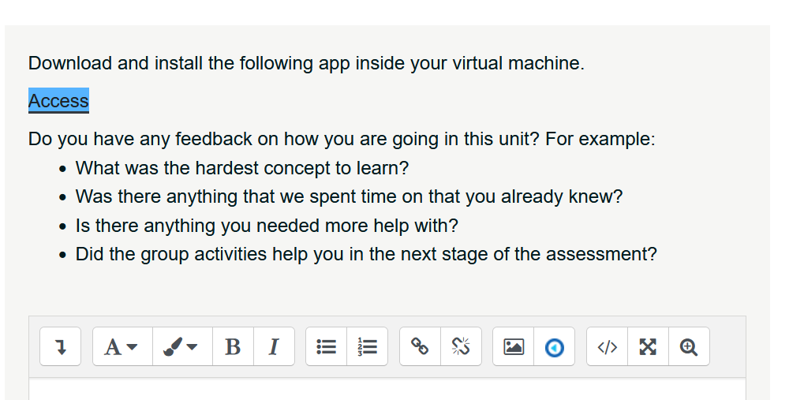
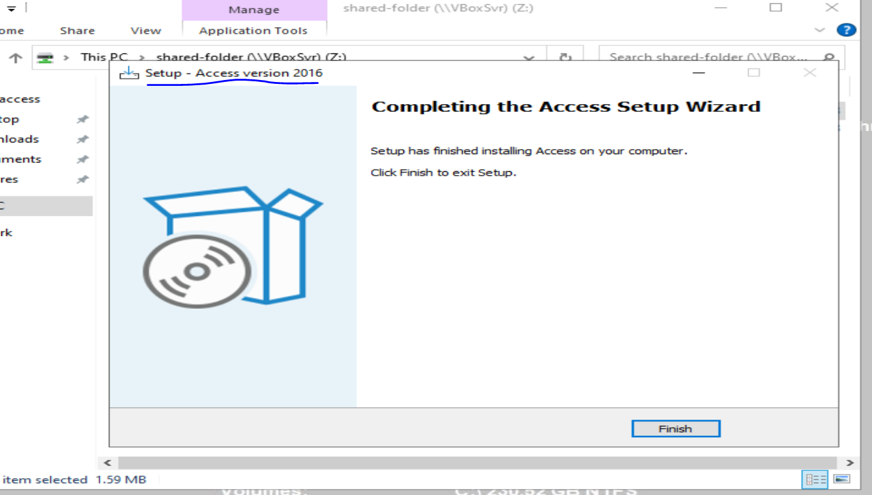
Install additional app(s) into DC

Slide 3
Search the Information System for Vulnerabilities without Wazuh
Nessus
Nikto
Legion
Nmap
Wafw00f

Slide 4
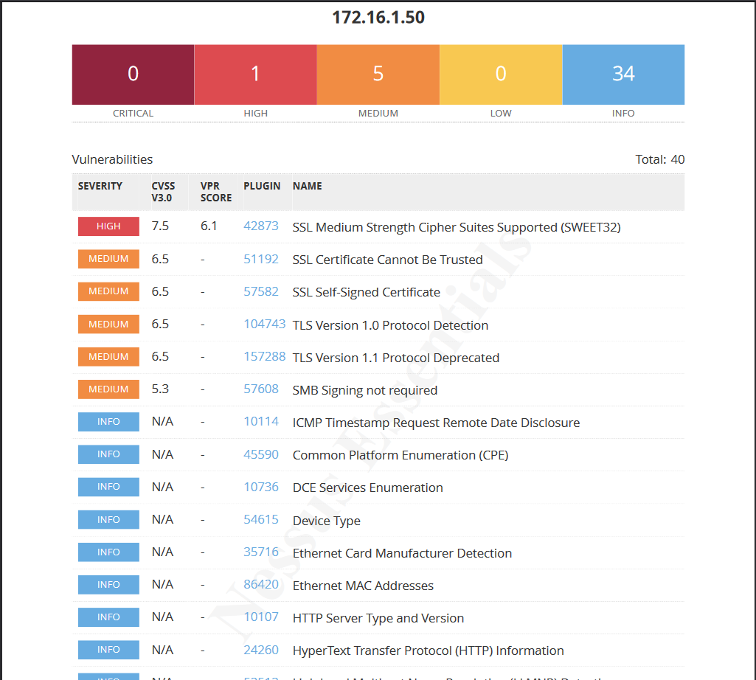
Nessus
DC machine

Slide 5
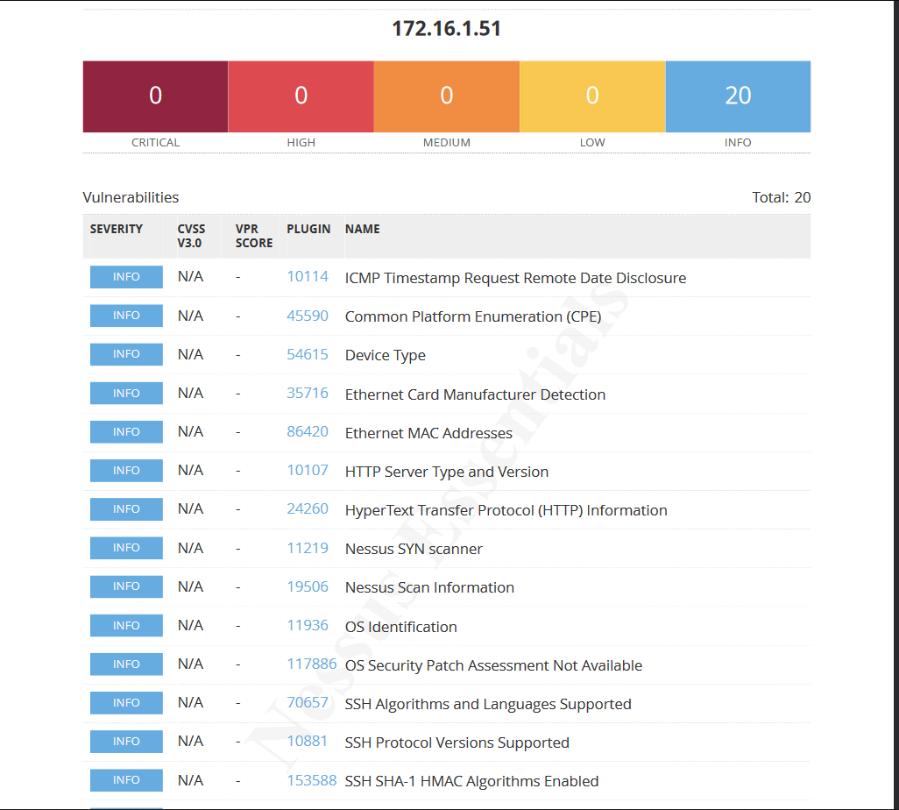
Nessus
Odoo machine

Slide 6
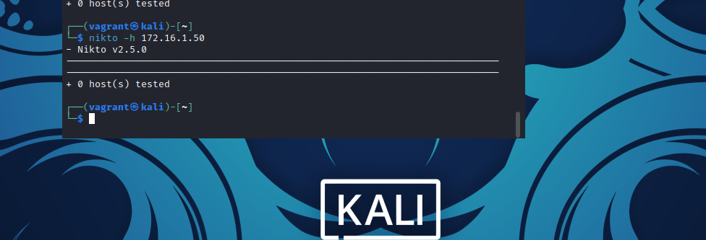
Nikto DC machine
No webserver running on DC machine so nikto has nothing to scan

Slide 7
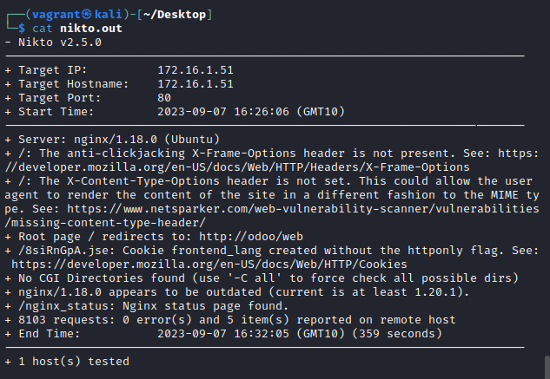
Nikto Odoo
No vulnerabilities found however web server is outdated and some configuration issues were found.

Slide 8
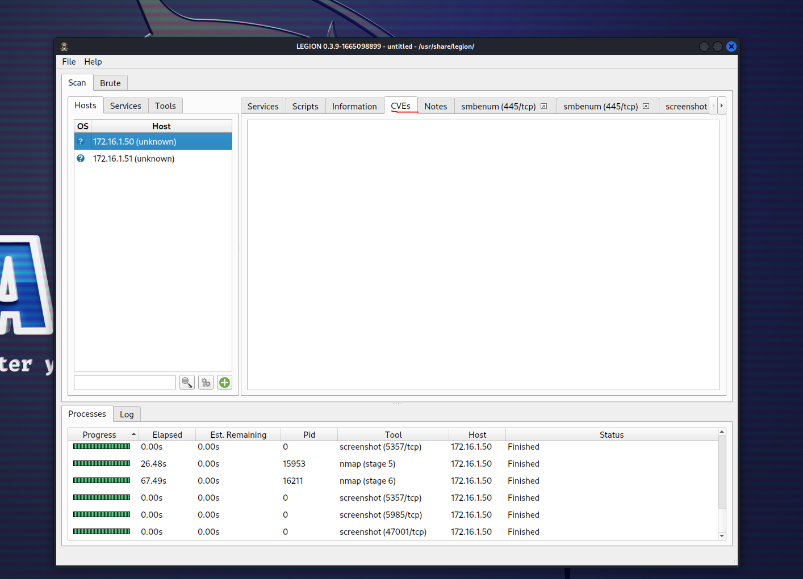
Legion
No CVEs detected for the DC machine.
Discovered some webservers on different ports, re scanned them with Nikto

Slide 9
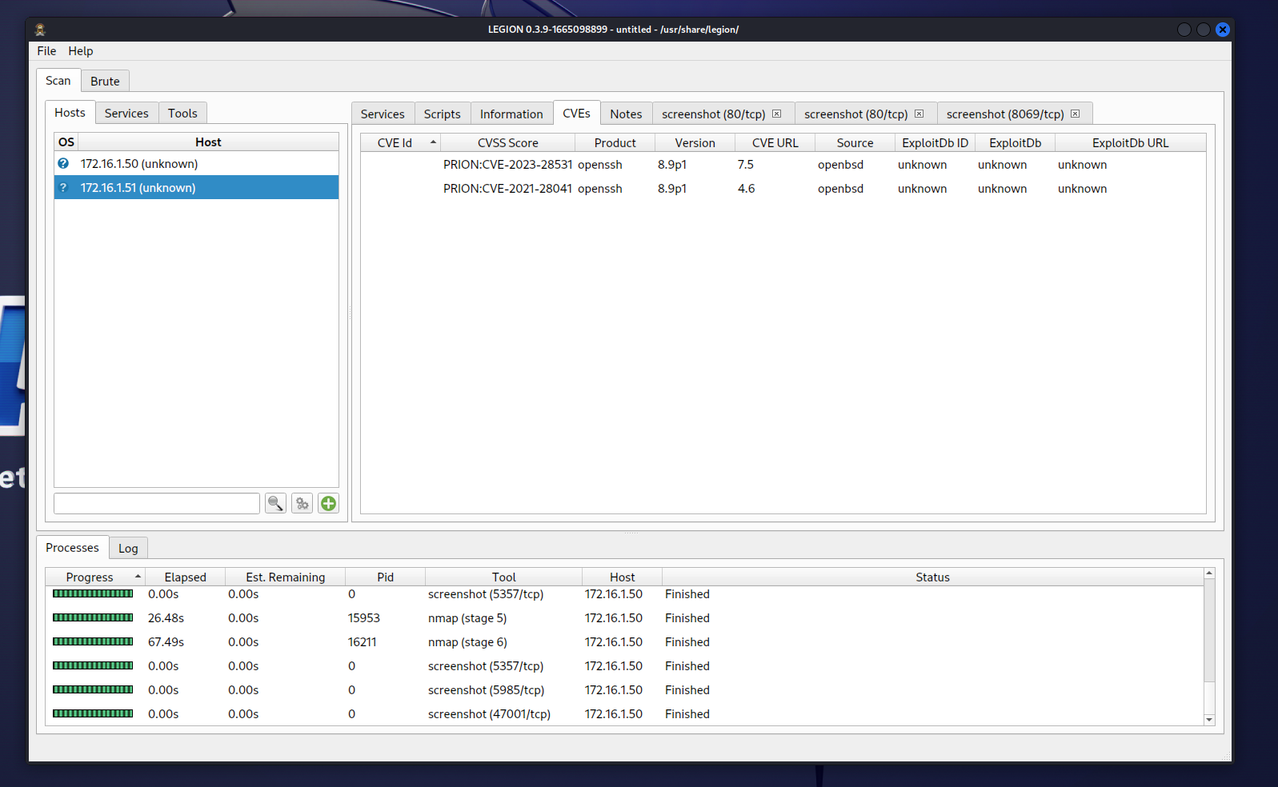
Legion
Legion scan of Odoo server 2 CVEs found

Slide 10
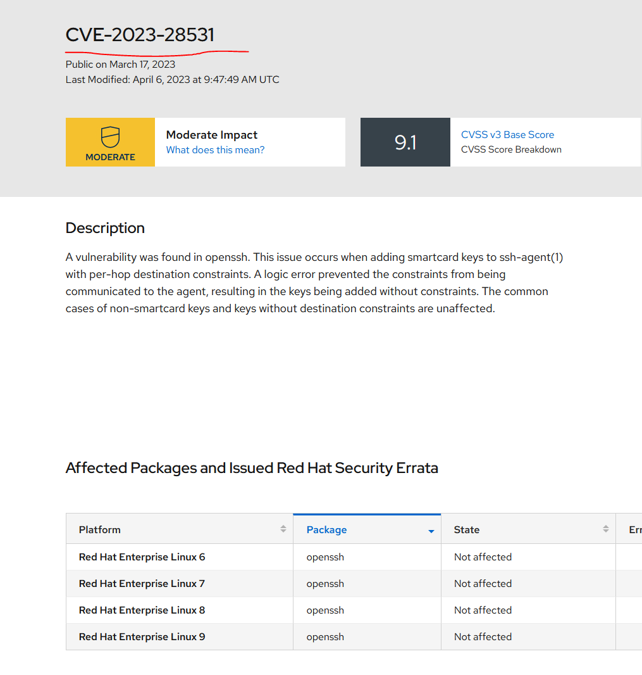
Odoo server CVE-2023-28531

Slide 11
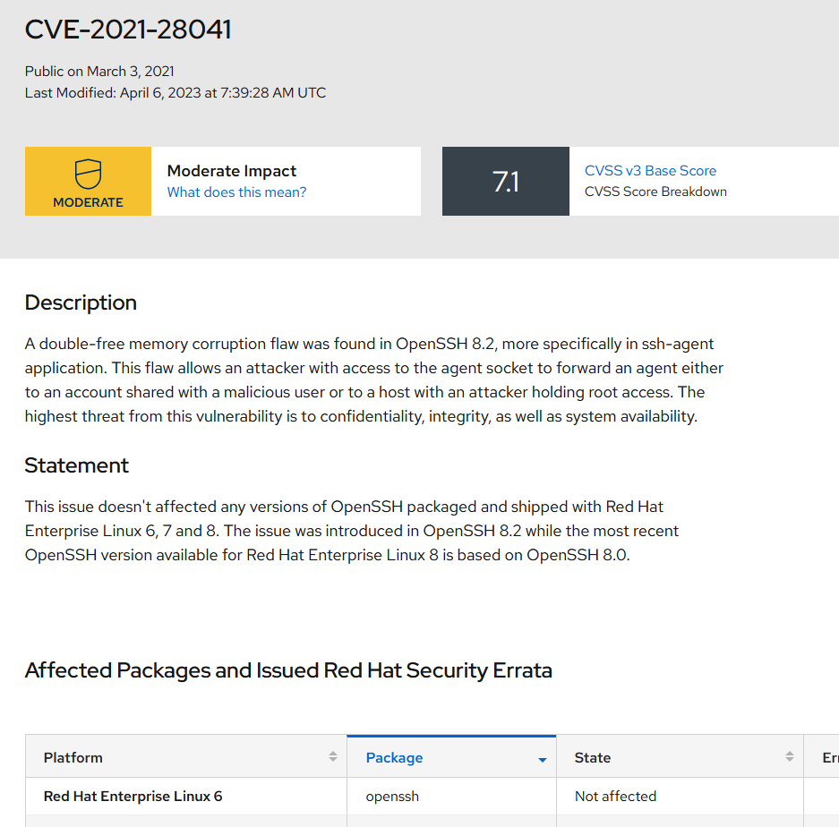
Odoo CVE-2021-28041

Slide 12
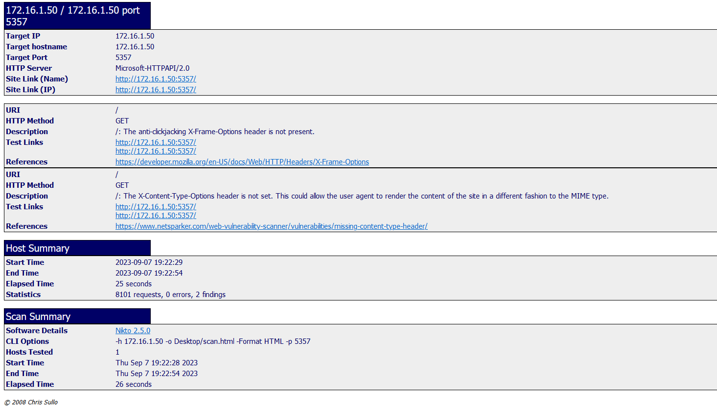
Nikto scan of DC port 5357

Slide 13
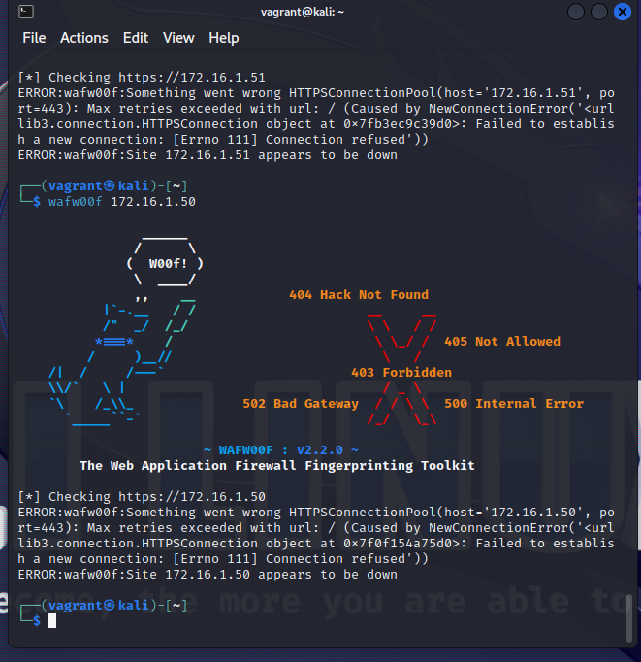
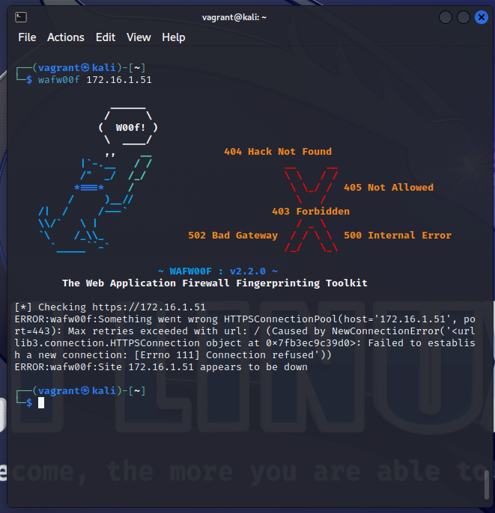
Wafwoof
DC
Odoo

Slide 14
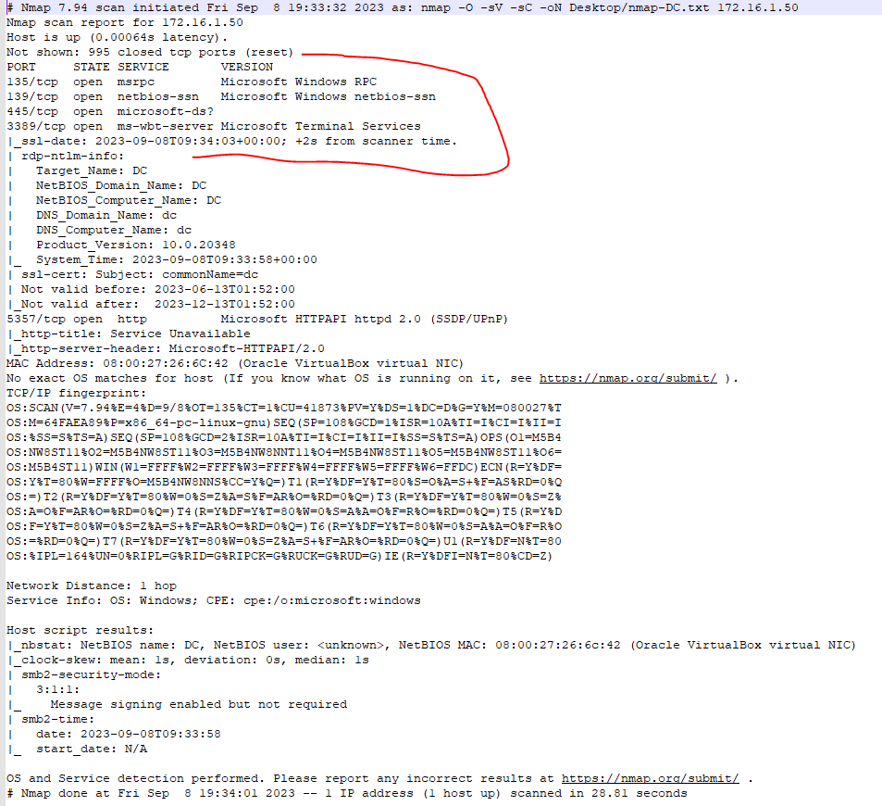
Nmap DC machine

Slide 15
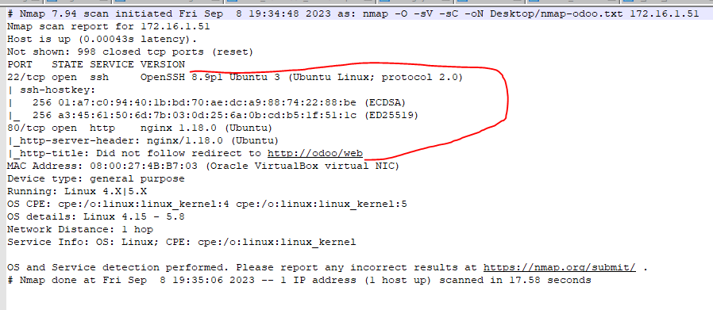
Nmap oDoo

Slide 16
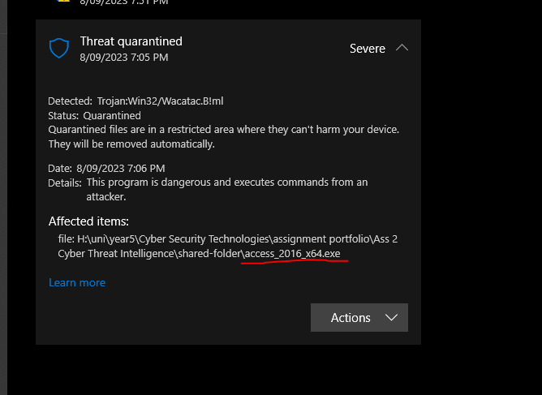
Interesting

Slide 17
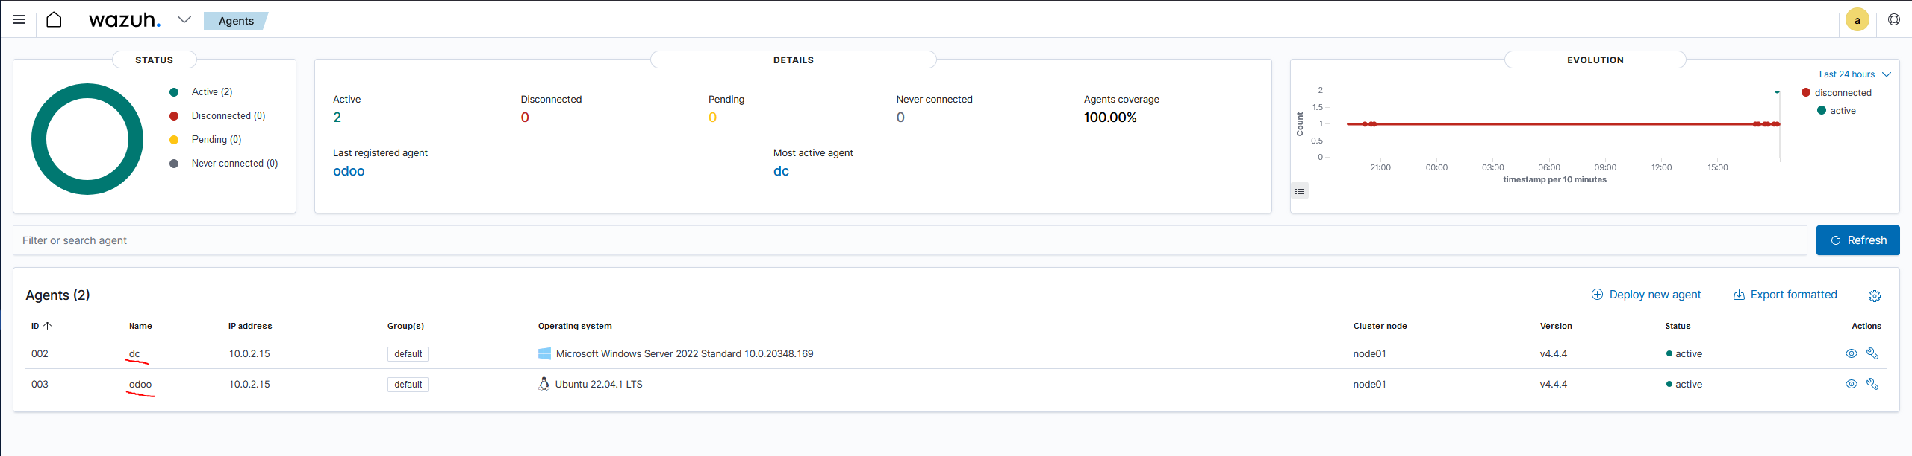
Wazuh

