Slide 1
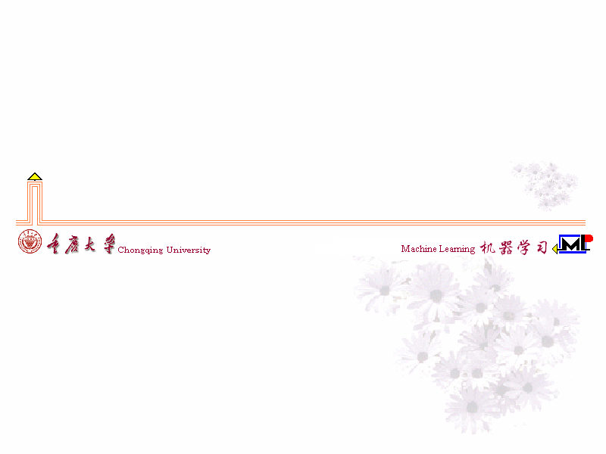
Automated mitral valve segmentation in PLAX-view transthoracic echocardiography
for anatomical assessment and risk stratification
经胸超声心动图胸骨旁长轴切面中二尖瓣的自动分割
用于解剖学评估和风险分层
汇报人：陈浩升
日期：2026-07-27
Notes:
[Sources]
- Jansen GE et al., "Automatic segmentation of the mitral valve in parasternal long-axis transthoracic echocardiography for anatomical assessment and risk stratification." Supplied paper PDF. Title and abstract.

Slide 2
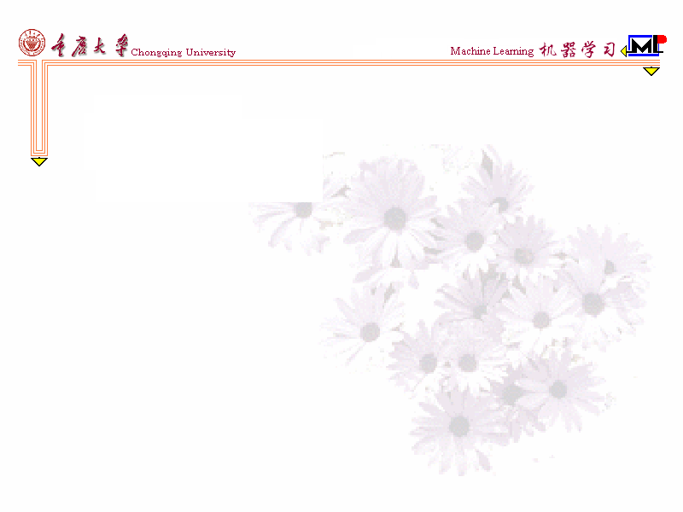
Notes:
[Sources]
- Jansen GE et al., "Automatic segmentation of the mitral valve in parasternal long-axis transthoracic echocardiography for anatomical assessment and risk stratification." Supplied paper PDF. Abstract and Sections 1-2.

Slide 3
研究贡献
1. 将二尖瓣瓣叶建模为细线结构，而非厚区域分割。
2. 以分类图 + 对数距离图双输出，缓解稀疏标签和定位困难。
3. 由分割曲线自动提取瓣叶长度、瓣环直径、帐篷相关指标及对合长度。
4. 在 1,117 例临床队列中验证自动量化指标的预后价值。
Notes:
[Sources]
- Jansen GE et al., "Automatic segmentation of the mitral valve in parasternal long-axis transthoracic echocardiography for anatomical assessment and risk stratification." Supplied paper PDF. Abstract and Sections 1-2.

Slide 4

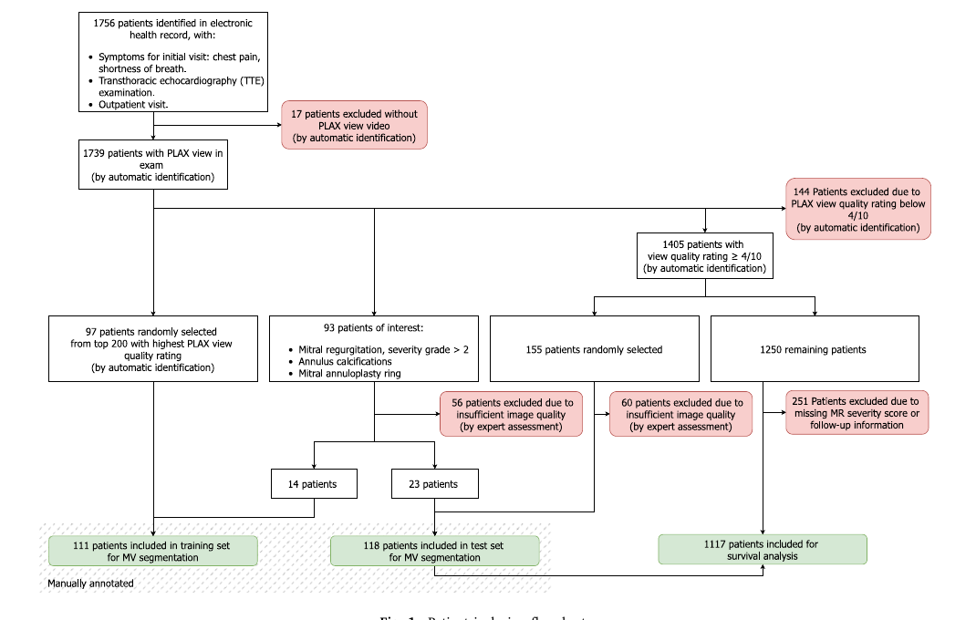
数据队列
回顾性纳入 1,756 例疑似慢性冠状动脉综合征患者的 TTE 检查。
人工标注：训练 369 帧 / 134 视频；测试 270 帧 / 140 视频。
生存分析：1,117 例；临床终点为全因死亡或心力衰竭住院。
Notes:
[Sources]
- Jansen GE et al., "Automatic segmentation of the mitral valve in parasternal long-axis transthoracic echocardiography for anatomical assessment and risk stratification." Supplied paper PDF. Figure 1 and Section 2.1. The paper reports inconsistent test-patient counts; this slide uses annotated frames and videos only.

Slide 5
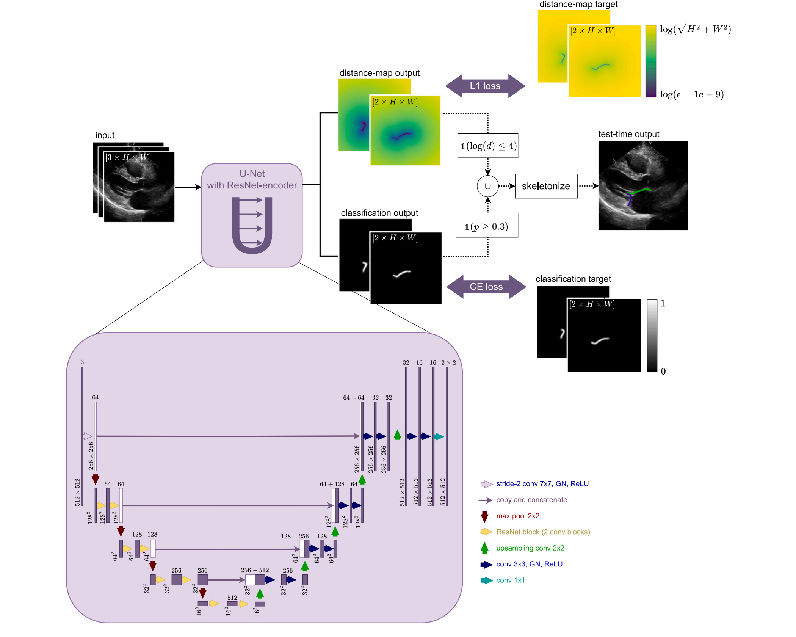
模型概览
输入：以待测时刻为中心的 3 个连续灰度帧。
骨干：ResNet 编码器的 2D U-Net，同时处理前、后瓣叶。
输出：分类图定位 + log 距离图回归，以 CE + L1 损失监督。
推理：阈值融合、骨架化和剪枝，得到单像素瓣叶曲线。
关键：双输出与临床目标中的“线状轮廓”直接匹配。
Notes:
[Sources]
- Jansen GE et al., "Automatic segmentation of the mitral valve in parasternal long-axis transthoracic echocardiography for anatomical assessment and risk stratification." Supplied paper PDF. Figure 2 and Section 2.3.

Slide 6
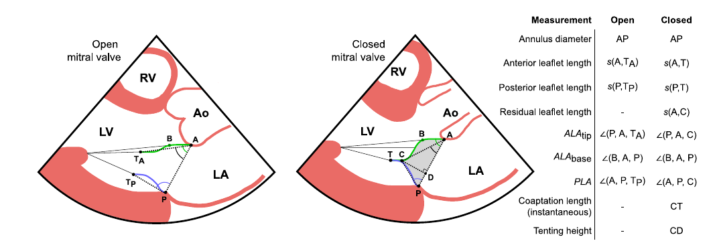
几何测量：分割曲线转为可解释表型
测量对象：瓣叶长度、瓣环直径、帐篷高度、帐篷面积、瓣叶角和对合长度。
对合长度既有单帧瞬时值，也可基于完整视频推导；后者用于临床风险分析。
长度由样条插值曲线计算；两个铰点确定瓣环直径和瓣环平面。关闭期的两条曲线共同确定帐篷相关指标。
Notes:
[Sources]
- Jansen GE et al., "Automatic segmentation of the mitral valve in parasternal long-axis transthoracic echocardiography for anatomical assessment and risk stratification." Supplied paper PDF. Figure 3 and Section 2.4.

Slide 7
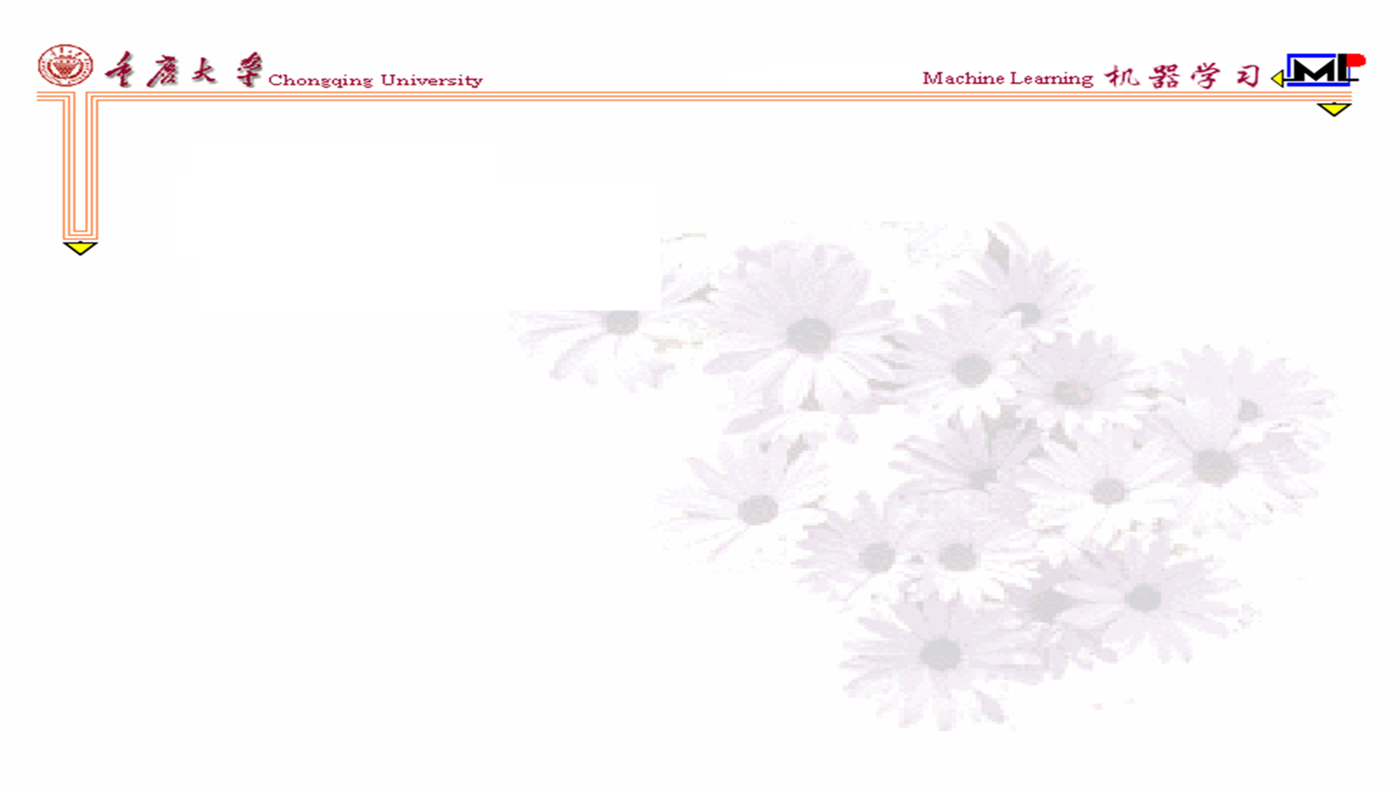
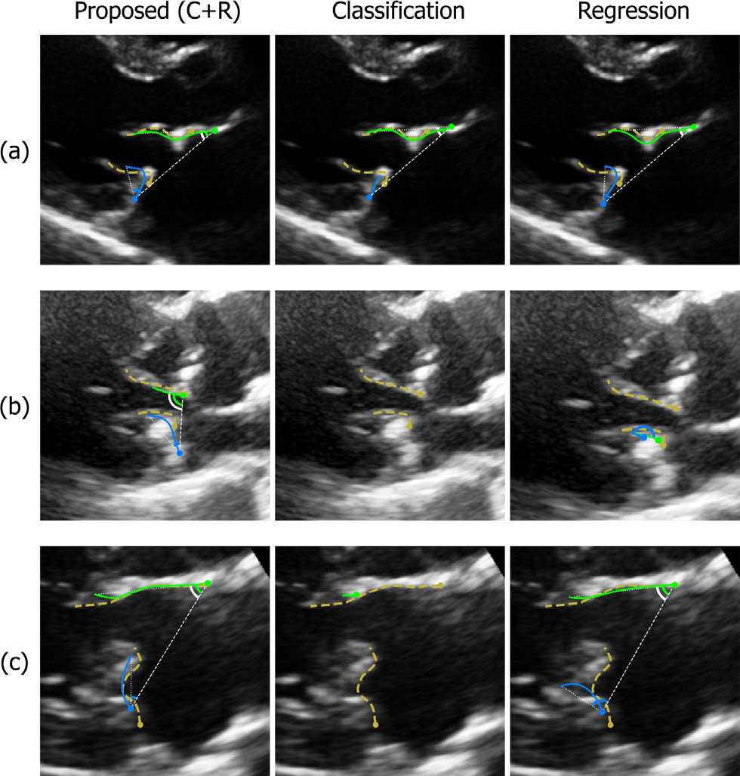
挑战案例与研究局限
图像质量差、瓣环成形环、钙化或瓣叶活动受限会提高分割难度。
研究来自单中心、回顾性 CCS 队列；仍需多中心外部验证其泛化性。
Notes:
[Sources]
- Jansen GE et al., "Automatic segmentation of the mitral valve in parasternal long-axis transthoracic echocardiography for anatomical assessment and risk stratification." Supplied paper PDF. Figure 7, Section 5.2, and Section 6.

Slide 8
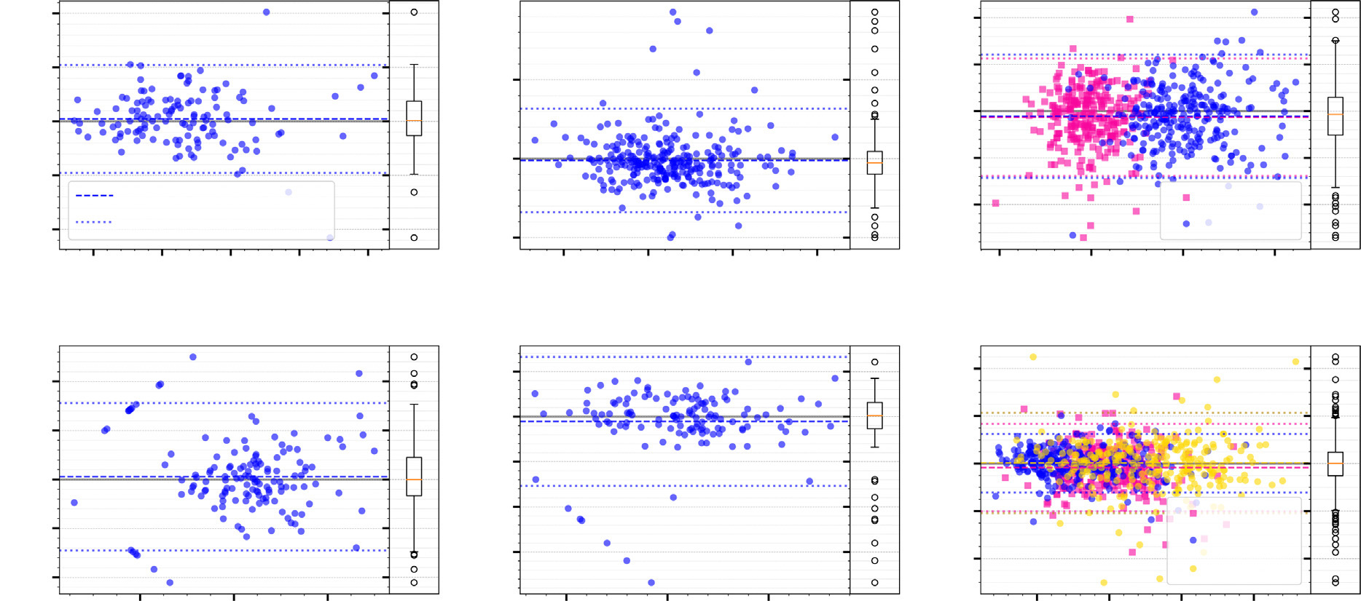
定量性能
平均表面距离 0.89 +/- 0.07 mm；Hausdorff 距离 3.34 +/- 0.13 mm。
对合状态识别 93%，时间一致性 97%。
相较 Attention U-Net，平均表面距离与 Hausdorff 距离分别下降约 38% 和 37%。
Notes:
[Sources]
- Jansen GE et al., "Automatic segmentation of the mitral valve in parasternal long-axis transthoracic echocardiography for anatomical assessment and risk stratification." Supplied paper PDF. Table 1, Figure 4, and Sections 3.1 and 4.1.

Slide 9

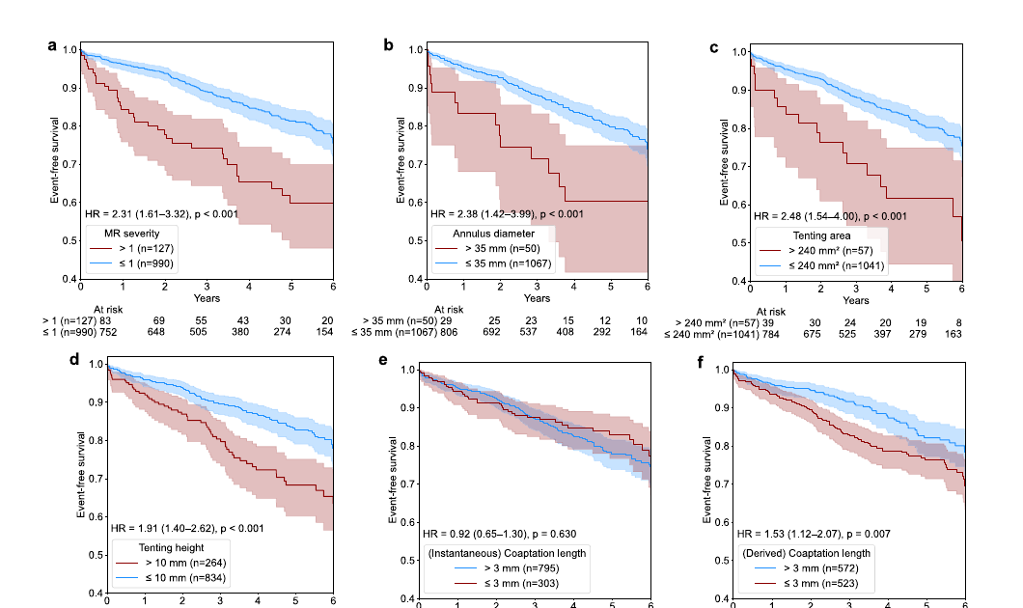
风险分层
瓣环直径 >35 mm：单因素 HR 2.38；多因素 HR 1.83（p=0.03）。
推导对合长度 <3 mm：多因素 HR 1.38（p=0.05）。
Notes:
[Sources]
- Jansen GE et al., "Automatic segmentation of the mitral valve in parasternal long-axis transthoracic echocardiography for anatomical assessment and risk stratification." Supplied paper PDF. Figure 6, Table 2, and Section 4.2. The supplied paper abstract conflicts with the body on the direction of the coaptation-length threshold; this slide follows the Cox results in the body and Table 2.

Slide 10

自动分割可支持
风险分层
Notes:
[Sources]
- Jansen GE et al., "Automatic segmentation of the mitral valve in parasternal long-axis transthoracic echocardiography for anatomical assessment and risk stratification." Supplied paper PDF. Section 7 conclusion.

