Slide 1
Community Data Resources
May 2021 HFNY Statewide Leadership Meeting

Slide 2
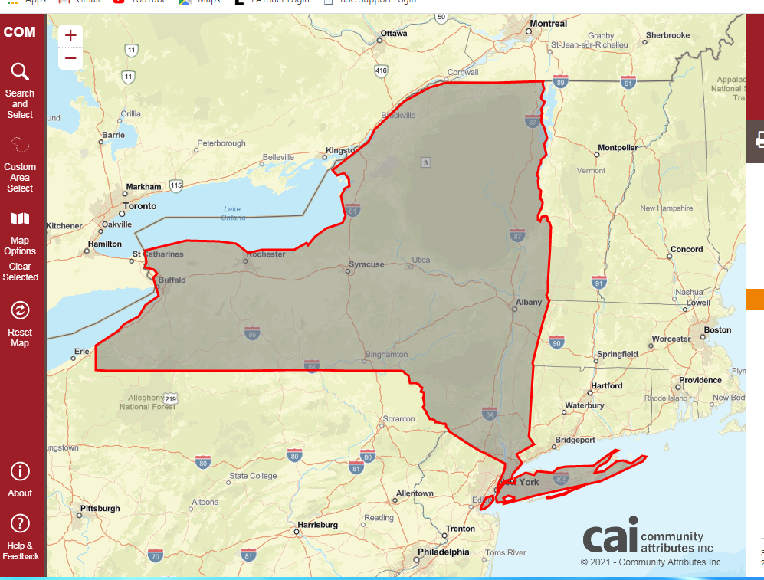
Casey Family Programs: Community Opportunity Map https://caseyfamily.caimaps.info/cailive?state=New%20York&tab=family&searchType=state
The community opportunity map is an interactive data tool.
The map includes select U.S. Census Bureau indicators in 5 categories.
Indicator selection was informed based on significant evidence indicating what community factors are highly correlated with child maltreatment and a healthy community framework.

Slide 3
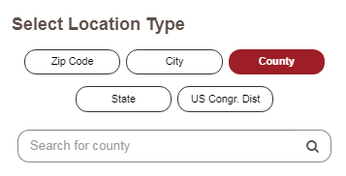
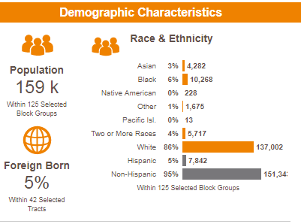
Location Types
The COM allows users to select the geographic level at which to examine indicators.
  Including: State, County; U.S. Congressional District, City, Zip Code
The zip code option even allows the user to select multiple zip codes at once to create a unique geographic area.
For the area you select you will be given some demographic characteristics in including population, race & ethnicity, and % foreign born.

Slide 4






Indicators
The indicator categories available in the COM are:
  Child and Family Well-Being
  Housing
  Education
  Economy
  Accessibility
  COVID-19

Slide 5
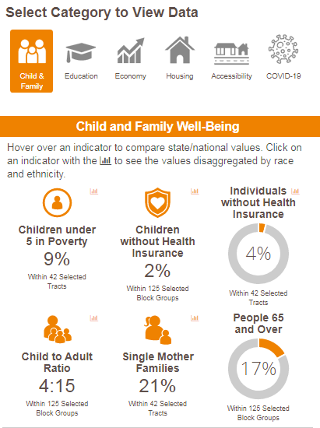
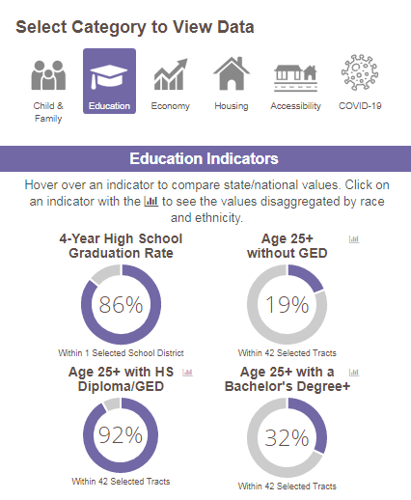
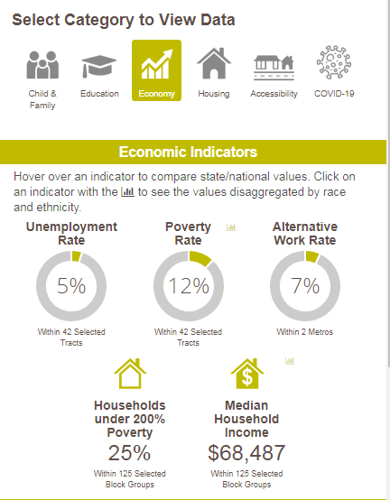
Indicators
Notes:
If you hover over any of the indicators you be able to compare both national and state levels with the specific region you’ve selected

Slide 6
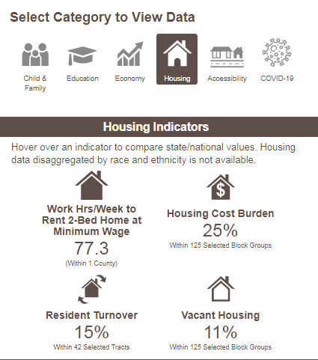
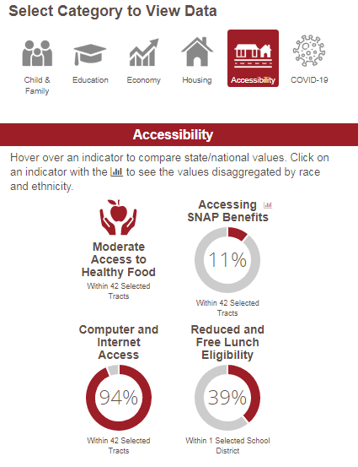
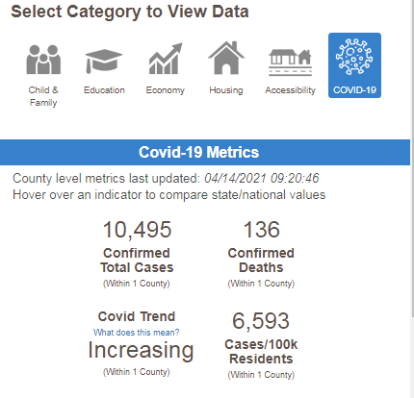
Indicators

Slide 7
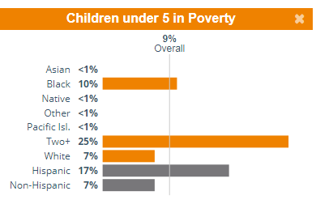
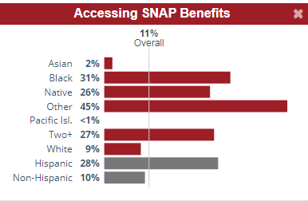
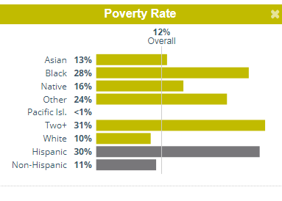
Indicators
Notes:
Some indicators also provide values disaggregated by race and ethnicity (for example ^^)

Slide 8
Kids Well-being Indicator Clearing House https://www.nyskwic.org/
This resource provides a wide range of health, education, and other well-being indicators for children across NYS.
KWIC provides:
  Indicator data
  County level reports
  Data Tools

Slide 9
Indicator Data
KWICs offers indicators for seven different life areas for every county in NYS
  Economic Security
  Physical and Emotional Health
  Education
  Civic Engagement
  Family
  Community
  Behavioral Health Risk Indicators
Some potentially useful indicators include:
  Low Birth-weight birth indicators
  Premature Births
  Indicators for early prenatal care (1st tri) and late prenatal care (3rd tri)
  Children living below poverty
  Children receiving SNAP benefits
  Households in poverty
  Unemployment 16+ yrs – Resident Civilian

Slide 10
KWIC Reports
There are five report topics with county levels data available:
  Child Well-being
  Child Welfare
  Maternal/Infant
  Juvenile Justice
A report for all KWIC Indicator data is also available.
All behavioral health indicators also can be run in a single county level report.

Slide 11
Data Tools
Graph builder
  Allows you to create indicator motion, line or bar charts for selected years, counties, and regions.
Custom Query
  Data can be customized through the selection of specific indicators, years, and counties.
MyKWIC
  If you create a MyKWIC account you are about to build and save custom county regions and frequently used data for future easy access.
Map Builder
  Allows user to map county and subcounty data with community assets to gain an in-depth perspective on communities across NY.

Slide 12
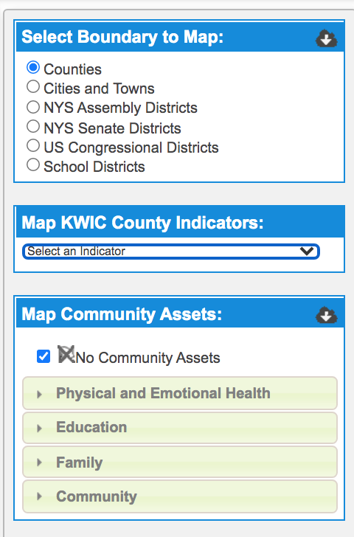
Map Building Tool
The map building tool allows you to select specific boundaries within the NYS map and overlay indicator or community asset data onto the selected area.
https://www.nyskwic.org/map/kwicmap.cfm

Slide 13
Thank you !

