Slide 1

ASR: Acceptance & Retention Rate Analyses Workshop
HFNY SLM
May 2023

Slide 2
Requirements
Report on Acceptance & Retention Rates every year!
Purpose:
Annual point of reflection:
Review activities, progress, important factors;
Determine how to improve next year
Notes:
As you know, as part of your reports, you need to include information on your program’s acceptance & retention rates every year.
This isn’t just an idle exercise, and you shouldn’t only be doing it because we say it’s required. It has a few benefits for you:
-It provides an annual point of reflection to take stock of what’s going on at your program (see the full picture, instead of just the select stories you remember)
-it forces you to review your activities, see if you’ve made any progress, determine what factors seem to be important
-and it guides you to making a plan to improve over the next year

Slide 3
Requirements for Acceptance & Retention
Measure rates
Use MIS report for appropriate time period!
Acceptance Rate:
12 months
Retention Rate:
13-24 months
Analyze rates
Determine what factors impact rates: who is enrolling/ staying? Who is not enrolling/staying? Why?
Implement Plan to address and improve rates
Develop & report plan
(Based on factors identified in analysis)
Determine effectiveness of previous strategies
Notes:
So what do you need to do for each of these pieces?
You’ll use the MIS reports to measure your rates in the appropriate time period: past year for acceptance rate, a year before that for retention rate
You’ll analyze by determining what factors impact your rates: so who is enrolling (or staying), and why?
And you’ll develop a plan based on factors identified in your analysis, and look at the effectiveness of previous strategies.
Today, we’re going to focus on that MIS & analysis piece: what you need to run the MIS reports, and how to interpret the results to perform your analyses and answer those critical questions

Slide 4
Analyses Need:
Formal & Informal Data
Formal: Numbers AND Percentages
Informal: Information from discussions, conversations, Advisory Board meetings, regular staff surveys where feedback overlaps…
Demographic, Programmatic, & Social Factors!
Under BPS 8th Ed: Need at least one factor for a 2 rating (at least three factors for a 3 rating)
Let’s define more specifically…
Notes:
So what do you need to include in your analysis? What types of information, what sources?
Formal & Informal information: what does each mean?
Formal: numbers & percentages (my fave)
Why need both? Well, %age gives the rate, but saying “100% of people were enrolled” means very different things if it’s 100% of 2 or 100% of 50 : need context of who your full group is!
Informal: info from discussions & conversations with staff, advisory board
Ok, so when you’re looking at all this information, what subtypes do we have? What kinds of factors are important?

Slide 5
ASR Requirements: Analysis Factors
Demographic
General population characteristics:
-Gender
-Age
-Race & Ethnicity
-Marital Status
-Education
-Language
-Employment
-Income?
-Location?
Programmatic
General site-related factors that impact service planning, delivery:
-Target population
-Timing of activities
-Staffing issues?
-Staff training
-Service Level
-Referral sources
-Relevant policies?
Social
Related to family support networks, relationships, community:
-FROG score, current issues (DV, SA, MH, DD)
-Religion?
-Community support?
-Work, school issues?
-Grandfamily?
-LGBTQ families?

Slide 6
Analyses Need:
Formal & Informal Data
Formal: Numbers AND Percentages
Informal: Information from discussions, conversations, surveys
Demographic, Programmatic, & Social Factors!
Need to discuss at least one factor!
Reasons for Refusals/Discharges
Compare acceptances to refusals/continues to discharges
Compare to previous year?
A COMPREHENSIVE analysis includes all of these!
Notes:
Ok, so we need formal and informal information, about D, P, & S factors
What else do we need?
Reasons for refusal to enroll, reasons for discharge
And we need to COMPARE acceptances to refusals: who is staying vs going? Any patterns underlying?
Not enough to say that you have lots of single moms enrolling or staying enrolled. You also need to say whether single moms are enrolling/staying at a higher rate than married moms, for example.
But can’t just dump in numbers and say you’ve done the formal part: need to write a narrative that includes data, too: what are the patterns/trends you see? Anything expected, unexpected? Compare BETWEEN GROUPS (stay vs leave) in same period of time
Do the formal & informal match up to each other? Any different info from these two sources?
And you can compare this year’s numbers/cohort to last years! Same patterns? Any differences, and if so, ideas as to why? (did you do some outreach? Hire a new worker w particular skills, community ties?)

Slide 7
Determining Impact
Take a look at overall acceptance or retention rate and total number of families included in report cohort, then determine which factors impact rate
Impact potentially worth noting when: ≈+10% difference between retention or acceptance rates between subgroups, AND at least 10 cases in each subgroup

Slide 8
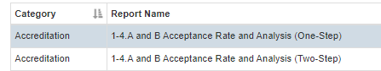
Acceptance Rate Report
Reporting time period: usually past year, but can be run for shorter periods if needed
For this year, given the shift to One-Step on 11/15/22:
Run Two-Step report for start of contract year to 11/14/22
Run One-Step report for 11/15/22 to end of contract year
Perform parallel analyses for each report: expect acceptance rates to be hugely different between!
Notes:
Ok, so now let’s first talk about Acceptance Rate! Including definitions and the updated report for one-step processes
Reporting time period: usually past year, but can be run for shorter periods if needed
For this year, given the shift to One-Step on 11/15/22:
Run Two-Step report for start of contract year to 11/14/22
Run One-Step report for 11/15/22 to end of contract year
Perform parallel analyses for each report: expect acceptance rates to be hugely different between!

Slide 9
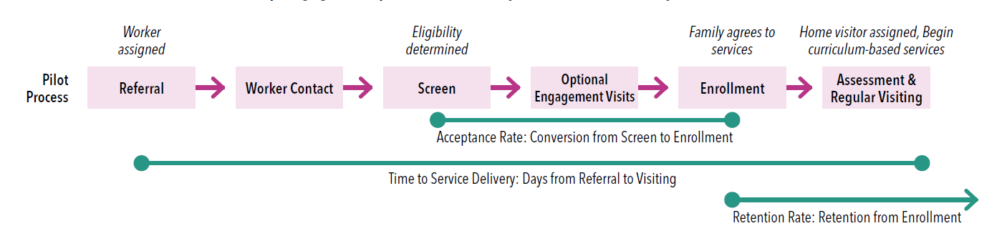
One-Step Acceptance Rate Definitions
Acceptance Rate: Conversion from Screen to Enrollment & First HV
Two-Step: Conversion from Assessment to HV. Acceptance rates often above 75%
One-Step: Conversion from Screen to Enrollment and First HV: Acceptance rates more around 20%, fewer factors available for analysis
Notes:
So how are one-step and two-step different?
Previously, under two-step: Conversion from Assessment to at least one HV. Acceptance rates often above 75%
One-Step: Conversion from Screen to Enrollment & at least one HV: much bigger starting pool, end point is earlier stage! Acceptance rates more around 20%
Your % will be lower!! That is ok!! We know that many many screens don’t go anywhere: that’s ok! But we are following HFA’s definitions of these timepoints
and on that second point, fewer factors:

Slide 10
Acceptance Rate Report
Factors Available: | Type of Factor
Discharge Reason
Screening risk factors: PC1 under 21, Low income, Inconsistent/Lack of prenatal care, Not married | D
PC1 Age, Gender, Relation to TC | D
Primary language | D
Referral Source type | P
Trimester (at screen) | P
Filter/run report by Worker (coming soon!) | P
Notes:
Under one-step, we have way fewer factors than before: we just have what is collected at SCREEN, because that’s what we have for EVERYONE
If you enroll: we collect more info! But not everyone enrolls, so we can’t rely on that stage
Here’s what we have as of screen
S if there is something different about family makeup: grandfamily, LGBTQ+ family, etc, hence the maybe
So social: you’ll have to get through other means: informal data

Slide 11

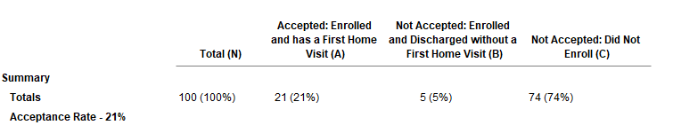
1.4A&B: Acceptance Rate
Cohort: Positive Screens with Outcomes (HV or Discharge) from 05/01/2022 to 04/30/2023
Outcomes:
Notes:
Ok, let’s take a look at how the new acceptance rate report is laid out
first: who’s included? pos screens with an outcome in period: doesn’t include anyone who’s hanging out between stages
Then those major summary categories:
total families in cohort; then broken down into outcomes: accepted (as enrolled AND at least one HV log: frog or not!); not accepted services (enrolled but discharged without at least one HV log); discharged without enrolling

Slide 12
1.4A&B: Acceptance Rate
Set up a full visit, Enter Case Note for visit, Enroll on Engagement Log, Enter first HV Log
Enrollment at engage visit (Case Note, no HV Log)
Discharge before any real HVs
Notes:
Now, most of the time: families probably will enroll at their first HV. You get a referral, screen, talk and explain HF, ask if the family is interested, they say yes, you set up a first HV and enroll them at that time: after the visit, you fill out a case note and the engagement log and say they accepted, and fill out a HV Log. so their enrollment date is the date of their first HV. And you move on from there!
But note: that might not always be the case! You could: get a referral, screen, talk and explain HF, family says maybe… so you set up a short, more informal “sample” visit, or find a time for them to stop by your HF office for a meetup. They meet you, say yes, they want to enroll! Cool, you add a case note saying you had a visit, and fill out the Engagement log saying you had a visit and they enrolled. But you do fill out a HV log? NO! because you didn’t do a FULL HV, just a short sample one. Or alternatively, maybe you found a time for the family to stop by your HF office to meet, and then they decided to enroll! Same deal: enrollment but no real visit yet.
Then: maybe they ghost you. maybe they change their mind. So you eventually discharge them before you get a HV.

Slide 13
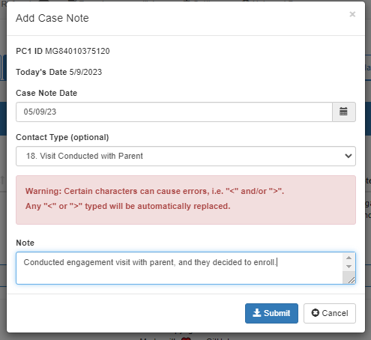
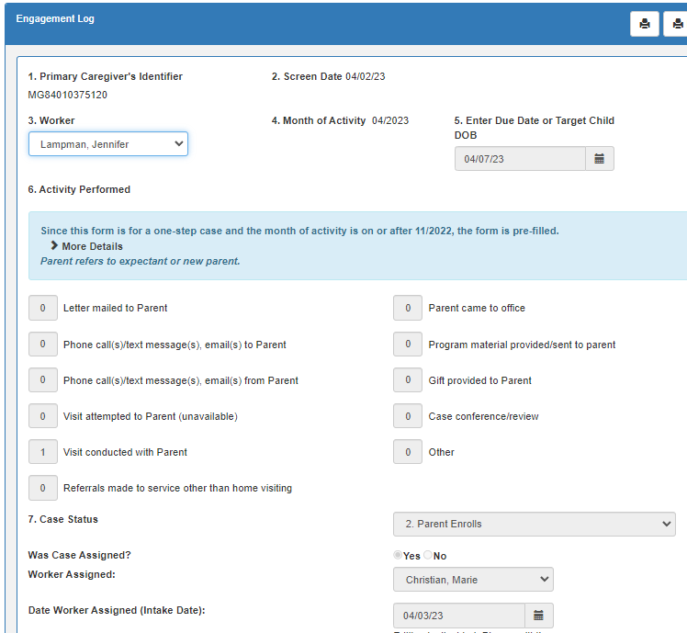
Case Note ->
Engagement Log ->
Maybe HV Log, but also maybe not!
Notes:
Looking at the forms in the MIS you fill out for these steps:
Case Note -> Engagement Log ->
Maybe a HV Log at that point, if you did a real full visit, but also maybe not! Maybe first HV will come later

Slide 14
1.4A&B: Acceptance Rate
Cohort: Positive Screens with Outcomes (HV or Discharge) from 05/01/2022 to 04/30/2023
Outcomes:
So 100 potentially eligible families, SCREEN from 5/1/22 to 4/30/23
21, or 21%, enrolled and have had a first HV
(Note: may have subsequently been discharged)
5, or 5%, enrolled but were discharged before they had a first HV
74, or 74%, were discharged without enrolling
Notes:
Ok, so let’s go back to our example
Let’s say we have 100 potentially eligible families, who had SCREEN between 5/1 and 4/30
Of these: 21, or 21%, enrolled; 5% enrolled (signed the paperwork) but were discharged before any HVs; 74% never enrolled
Enrolled but no HV: probably not too many, but still, what’s going on here?

Slide 15
Acceptance Rate Report
Review overall rates, then examine available factors and consider:
Where is acceptance rate very different from overall 21%? (10+% higher, or 10+% lower, with at least 10 people per group)
Who are you disproportionately missing out on? Are there groups where almost everyone does not enroll?

Slide 16
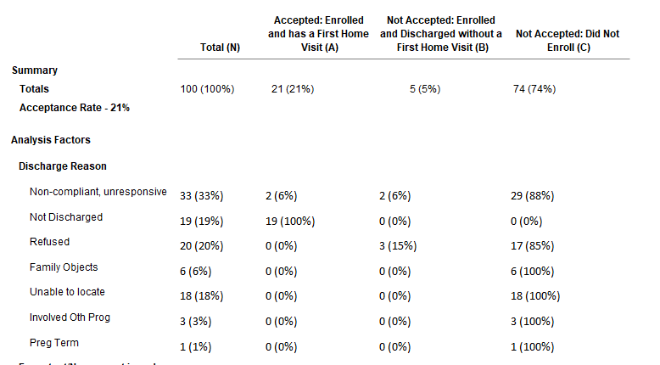
1.4A&B: Acceptance Rate
Sum=100
(all cases)
Sum=21
Sum=5
Sum=74
Notes:
First column: across all categories, what N, % of cases were discharged for this reason?
Then, reading across columns within a row: where are those cases coming from?
Accepted: may have later been discharged. That’s fine!
Not accepted: all have been discharged. Any notable reasons?

Slide 17
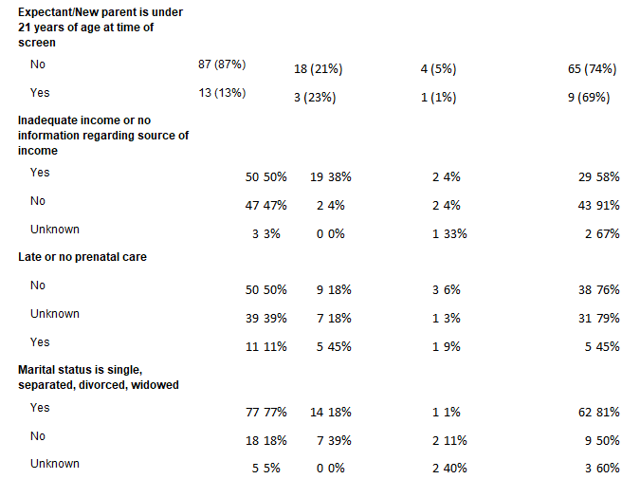
Within each row: where are %s distributed very differently than the overall?
If inadequate income is NOT a risk: not enrolling
If prenatal care IS a risk: likelier to enroll?
Notes:
Screen reasons:
Where are the rates very different from the base distribution?
Under 21: nope, pretty well matches up to overall
Look at income: almost all of those with not-inadequate-income did not accept: this is skewed. A whole bunch with inadequate income also didn’t accept, but a bunch did enroll, so that’s pretty fine. But for people where this isn’t their main risk, they didn’t enroll.
Prenatal care: of those with Yes: almost half did enroll! Way more than the overall acceptance rate
Marital status: eh no differences big enough to talk about

Slide 18
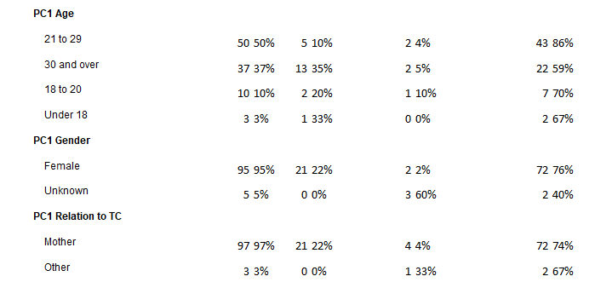
Older parent: more likely to enroll?
Notes:
What’s our overall acceptance rate?
21%
So for age: 4 age bands: Which age group makes up biggest chunk of group to start?
Here, 21-29s are almost half of your sample
Then 30+
Ok, but which age group is MOST LIKELY TO ENROLL? Highest rate of enrollment? Which row is a lot higher than the overall rate?
30+: more than 10% over the overall accept rate
Who is LEAST LIKELY TO ENROLL? Highest rate of refusal? Acceptance rate a lot lower than overall?
20-30s

Slide 19
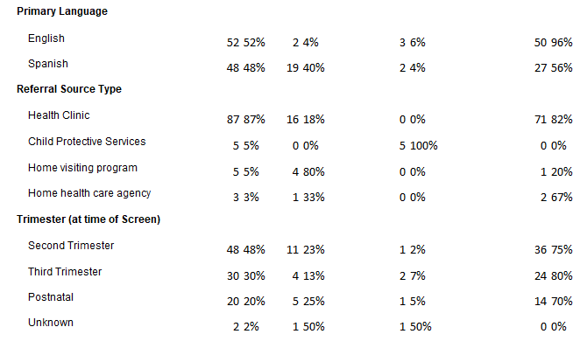
English=less likely;
Spanish=more likely?
CPS: small number, but noteworthy…
How do you have an unknown accepted?

Slide 20
Retention Rate Report
Reporting time period: usually past 13-24 months
One-Step definition: Retention from Enrollment
Reading the (updated!) Report
Acceptance Rate: Conversion from Screen to Enrollment & First HV
Retention Rate: Retention from Enrollment, for those with at least one HV
Notes:
Ok, so that’s it for acceptance rate: we don’t have as many factors anymore, so it’s a bit shorter, but the ideas of how to read the report are the same as they were before
So let’s go on to the retention rate report: and let’s first discuss the reporting time period, with a few examples, since that’s a little bit more complex than for acceptance rate
First: regarding one-step: Retention from Enrollment/date of paperwork signing, for those with at least one HV

Slide 21
Retention Rate: Reporting Time Periods
Retention Rate: Key info, then work backwards:
End of contract year? End of PI period?
What’s the End of Reporting Period?
How long a Retention Period do you want to look at? (1 year? 6 months?)
How long an Enrollment Window do you want to look at? (Volume year?)
Final Report Dates:
Determines Report End Date: Someone who enrolled on the Report End Date must be given the chance to have been retained this long
Determines Report Start Date: How long is your volume period?
End: End of Reporting Period – length of Retention Period
Start: Report End Date – length of Enrollment Window

Slide 22
Retention Rate: Reporting Time Periods
What if: Your 1-year retention, as of basically now?
4/30/23 ->
4/30/23
What’s the End of Reporting Period?
How long a Retention Period do you want to look at?
How long an Enrollment Window do you want to look at?
Final dates:
1 year ->
To have a chance of being enrolled 12 months on ↑, must have been enrolled by 4/30/22
1 year ->
(volume year)
1 year prior to ↑ enroll end date:
So beginning of enrollment window is 5/1/21
Start: 5/1/21
End: 4/30/22
Notes:
To have a chance of being enrolled 12 months on ↑, must have been enrolled by …
1 year prior to ↑ enroll end date: So beginning of enrollment window is …
Start:
End:

Slide 23
Retention Rate: Reporting Time Periods
What if: 6 month retention, 1 year period, ending 12/31/22?
12/31/22 ->
12/31/22
What’s the End of Reporting Period?
How long a Retention Period do you want to look at?
How long an Enrollment Window do you want to look at?
Final dates:
6 months->
To have a chance of being enrolled 6 months on ↑, must have been enrolled by 6/30/22
1 year ->
(volume year)
1 year prior to ↑ enroll end date:
So beginning of enrollment window is 7/1/21
Start: 7/1/21
End: 6/30/22
Notes:
To have a chance of being enrolled 6 months on ↑, must have been enrolled by …
1 year prior to ↑ enroll end date: So beginning of enrollment window is …
Start:
End:

Slide 24
Retention Rate: Reporting Time Periods
Final: 1 year retention, 1 year period, ending 12/31/22
12/31/22 ->
12/31/22
What’s the End of Reporting Period?
How long a Retention Period do you want to look at?
How long an Enrollment Window do you want to look at?
Final dates:
1 year ->
To have a chance of being enrolled 1 year on ↑, must have been enrolled by 12/31/21
1 year ->
(volume year)
1 year prior to ↑ enroll end date:
So beginning of enrollment window is 1/1/21
Start: 1/1/21
End: 12/31/21
Notes:
To have a chance of being enrolled 12 months on ↑, must have been enrolled by …
1 year prior to ↑ enroll end date: So beginning of enrollment window is …
Start:
End:

Slide 25
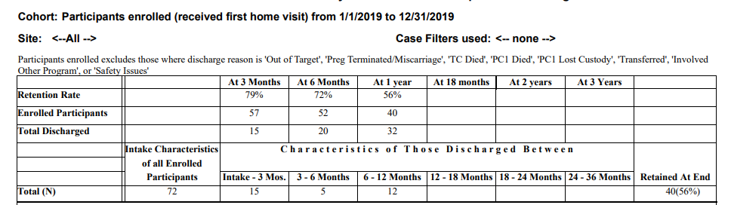
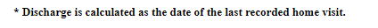
3.4A&B: Retention Rate
5/1/21 to 4/30/22
TOTAL discharged by end of each interval
How many MORE discharged each interval
Notes:
Retention rate!
Here: participants enrolled 1-2 years ago: give possibility of up to 2 years enrollment. But we’re going to be focusing on 1 year retention, because everyone should have that
NOTE THAT:
-excludes any participant where disch reason was clearly unrelated to individual factors, or out of program’s control
-also note: discharge date is backdated to be date of last HV (so if discharged after being on CO for 3 months: this report uses the date of last HV, bc that’s how long they were actually receiving services)
-overall retention rate:
Here, 72 participants enrolled in this window
At 3 mo: had lost 15, so 79% still enrolled
At 6 mo: had lost 20, so 72% still enrolled
At 1 year: had lost 32, so 56% still enrolled (just over half: would this meet the PI standard? Yes!)
40 retained at end of this window
Total discharged row: total discharged by end of each interval (cumulative)
Then, in characteristics of those discharged between each interval: How many MORE discharged at each timepoint (not cumulative)

Slide 26
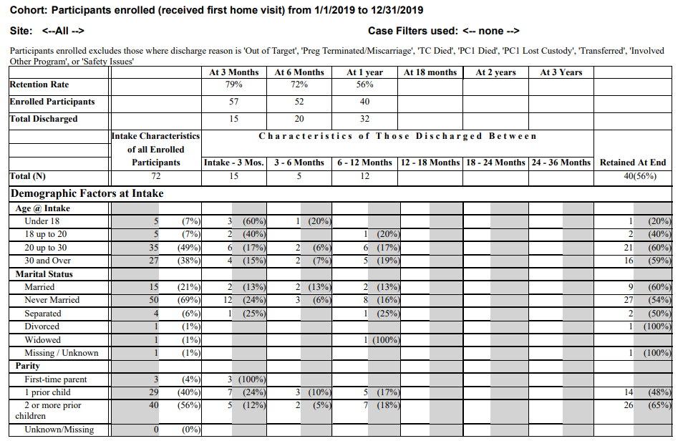
3.4A&B: Retention Rate
Grey %s = % of Grey N
N, % of start group who dropped out
in interval
Initial sample breakdown:
Remaining at end of period: start here, to see if there’s a diff in retention rates
Notes:
Ok, so now let’s take a look at how our factors come in to play
age is the first factor
we’ve got our initial sample breakdown: age groupings of everyone who enrolled in this window
And then the following columns are how many in each age group dropped out IN THAT WINDOW: not cumulative (should add up to which row)
Note that the grey %s are again the % of the grey N

Slide 27

3.4A&B: Retention Rate
Notes:
Ok, so let’s actually see if there are any patterns within age
Start at the end: any diffs in retention rate by age?
Yes: retain more older, lower rates for younger.
Timing: lose all <18s pretty quick
But: back to the beginning to see Ns: very few younger to begin with. Maybe not the biggest thing to address.
What about Primary Language?
First: diff in retention rate? Yes: higher 1 year retention for Spanish than English
Cohort sizes: start with more English! So you’ve got a decent size group to potentially work on keeping: a lot drop out pretty quickly. What can you do to address?

Slide 28
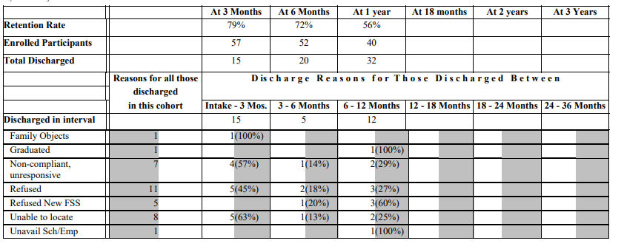
3.4A&B: Retention Rate
Notes:
Finally: REASONS FOR DISCHARGE
Why and when?
Refused: mostly pretty early
Unable to locate: surprisingly early??
Noncompliant/unresp: spread out through window
Refused new FSS: generally not early, bc often don’t switch FSSs early

Slide 29
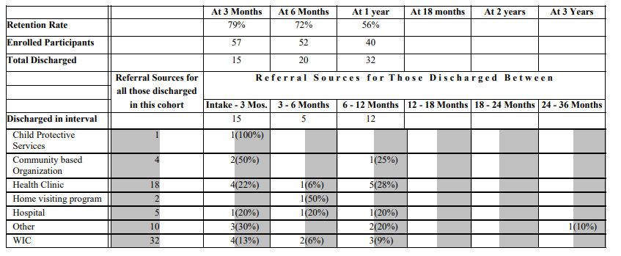
3.4A&B: Retention Rate
Notes:
Referral sources:
1 from CPS: dropped out immediately.

Slide 30
3.4A&B: Retention Rate Report Includes:
Demographic
-Age
-Education
-Employment
-Marital Status
-Parity
-Primary Language
-Race
Programmatic
-Average # HVs
-Level at End
-Multiple HVs
-Time between Screen & Assessment
-Trimester (at Intake)
-Referral Source
Social
-Assessment Scores
-Whose Score Qualifies
-PC1 Issues at Assessment
Also Includes:
Reason for Discharge, Referral Source
Can be run by Worker! (Programmatic factor)
Notes:
The full retention rate report includes the following factors:

Slide 31
Measuring Rates: Informal Information
Formal & Informal Data
Formal: Numbers AND Percentages
Informal: Information from discussions, conversations, surveys
Informal data can support formal (give context, perspective), or can cover new factors!
If important factor not in these reports: Consider using INFORMAL information to discuss, evaluate
Notes:
Ok, so these new reports are great
But they’re all FORMAL information:
And you still need INFORMAL
e.g., information from discussions w staff, staff surveys, surveys of parents who refuse or accept or drop out or stay enrolled, etc
This informal info can be in line with your formal evaluation findings: it can give further context to these findings, or incorporate staff’s perspectives on WHY you might be seeing some of these patterns
Or if can discuss a new factor! Esp if that factor is important to your community but isn’t part of these reports
e.g.: LGBTQ families? Grandfamilies?
Religion?
Locations? Neighborhoods, zip codes within your catchment area?
etc

Slide 32
Plans Need:
Must address demographic, programmatic, social factors identified in your analysis!!
3: Have implemented plan (ongoing), report on progress
2: Discuss plan, but not yet implemented
1: No plan; Plan not related to increasing rate; Plan not based on analysis or does not address D, P, S factors identified
Notes:
Ok, so that’s our measurement and analysis
What about our plan? What does it need?
Plans must relate to your analysis! Must address factors identified!

Slide 33
Plans for previous examples?
Acceptance Plan:
Adequate income, married, English -> less likely to accept
Late prenatal care, age 30+, coming from HV program -> more likely to accept
Referred from CPS: small number, but all enroll & discharge before HV
What sort of plan could you make to address these factors?
Retention Plan:
Language; Discharge reason “Unable to locate” even early on
What could you do to address these factors?

Slide 34

Thank you!
Questions?

