Slide 1

The Data Is In: You’re doing a great job!
Performance recovery & success in key areas after onset of COVID-19
SLM, November 2020

Slide 2
Acknowledging Current Context
Onset of COVID-19 Pandemic has had huge impacts on program practices, performance
But: We do see recovery, strong performance in several key areas!
Acceptance Rates
Key Date Timing
Service Referrals
And on several Performance Indicators:
First Home Visit within 3 Months
Supervision

Slide 3
Timing of COVID and Family Levels

Slide 4
Number of New Families
Number of Screens less in Spring/Summer 2020 than in 2019
Notes:
Incoming screens took a hit (though starting to go back up)

Slide 5
Number of New Families
Number of eventual New Enrollments from those screens less in 2020 than 2019
Notes:
And new enrollments also took a hit in the spring
So here: screens in January: number of them who enrolled eventually
(July, Aug fall of bc don’t yet know what happened to all of those new screens! Hasn’t been long enough yet for all of them to have enrolled or closed! So can only go up!)

Slide 6
Number of New Families
But: Similar conversion RATE from screen to enrollment!
}
About 20% in 2020,
vs about 15% in 2019
Notes:
Around 15-20%

Slide 7
Number of New Families
But: Similar conversion RATE from screen to enrollment!
Notes:
(July, Aug fall of bc don’t yet know what happened to all of those new screens! Hasn’t been long enough yet for all of them to have enrolled or closed! So can only go up!)

Slide 8
Key Date Timing
Slower from screen to intake in Spring/Summer, but recovery!
Notes:
2019: about 53 days from screen to intake, on average
2020: starts off a little slower: matches in March/April
May, June, July: takes a hit
August, Sept: recovery

Slide 9
Key Date Timing
More recently, more intakes with recent screens
Recovery!
New intakes had recent screen!
Moving through process efficiently!
For most intakes in May, screens received pre-COVID (Feb) or at height of “pandemic panic” (March/April), so took longer to get through to intake
Notes:
note that usually about half of new intakes came from a screen in that month, or in the preceeding month
EXCEPT IN MAY: mostly from further back
Bc fewer new screens in May, April, March!!
Again, picking back up in August: 2/3 new intakes had screen in Aug or July!
Getting new screens AND ACTING ON THEM!

Slide 10
Performance Indicators
Some bumps, but also some strengths
First, overall scores:
Similar overall scores vs last fall (last “normal” cycle)
7 or 8
items
12 items
Notes:
In both years, about 34-35 programs meet at least half the items (7 or 8 items)
More programs meet most (12+), or almost all items in 2020 than 2019!

Slide 11
Performance Indicators
#4: First Home Visit Timing
Target: 95% of families have first home visit before TC is 3 months old
Several more just shy! Often by only a few cases
}
}
32 programs meet!
Notes:
Each program as 1 line
Especially notable given first home visits were almost all taking place during covid! Still able to get in on time even with virtual/disrupted schedule

Slide 12
Performance Indicators
#13: Supervision
Target: All workers receive at least 75% of scheduled supervisions
Only 6 programs do not meet
11 programs
score a 3!
26 programs score a 2!
Notes:
Especially important now

Slide 13
Child Abuse & Neglect Referrals
Impact of COVID-19 on service referrals in 4 major areas:
Domestic Violence
Mental Health
Substance Use
Child Abuse & Neglect
Provision of referrals, and families’ subsequent receipt of services

Slide 14
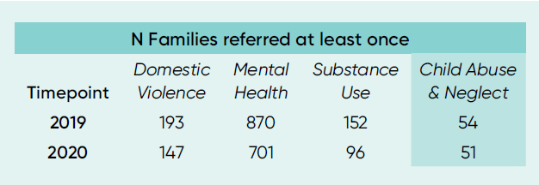
Child Abuse & Neglect Referrals
All referrals in these categories from April-August 2019 & 2020
Families counted as having at least one referral in category in period (for any family member), or having 0
Including both “inform and discuss” and “arrangement” refs
Steady referrals for CAN (p>0.5), versus drop for other services
(χ2 ps <0.025)
Notes:
Though the number of referrals given was highly variable between categories, significantly more families were referred for services related to domestic violence, mental health, and substance use needs in 2019 than 2020 (χ² ps <0.025). In contrast, the number of families with a referral for child abuse and neglect services remained steady (χ² <1, p>0.5).

Slide 15
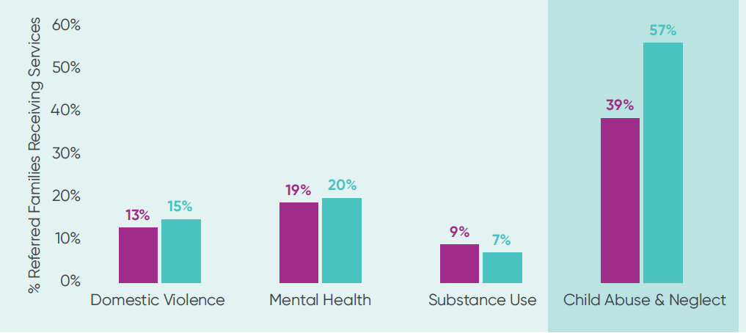
Child Abuse & Neglect Referrals
Outcome of referrals: Rate of receipt of services
Always relatively low, but difference between years?
CAN: Greater number (2019=21, 2020=29) and greater rate of referred families receiving services in 2020 (rate χ2 =6.49, p=0.011)
Notes:
There was no difference in rate of service receipt between the two periods for domestic violence, mental health, or substance use (ps>0.5). However, both a greater number and greater rate of families were recorded as receiving child abuse and neglect services subsequent to referral in 2020 (rate χ² =6.49, p=0.011),

Slide 16
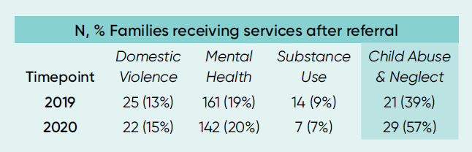
Child Abuse & Neglect Referrals
Outcome of referrals: Rate of receipt of services
Always relatively low, but difference between years?
CAN: Greater number (29, vs 21) and greater rate (57%, vs 39%) receiving in 2020
 | N, % Families receiving services after referral
Timepoint | Domestic Violence | Mental Health | Substance Use | Child Abuse & Neglect
2019 | 25 (13%) | 161 (19%) | 14 (9%) | 21 (39%)
2020 | 22 (15%) | 142 (20%) | 7 (7%) | 29 (57%)
Notes:
N, % Families receiving services after referral
Timepoint
Domestic Violence
Mental Health
Substance Use
Child Abuse & Neglect
2019
25 (13%)
161 (19%)
14 (9%)
21 (39%)
2020
22 (15%)
142 (20%)
7 (7%)
29 (57%)

Slide 17
Child Abuse & Neglect Referrals
So even with virtual visits/under extraordinary circumstances:
Home visitors still able to identify situations needing CAN referrals, provide appropriate info
Home visitors still able to connect families with external providers
Critically important, as COVID-19 presents potentially increased risk for CAN (increased isolation in unstable situations) but other potential detectors are hampered (e.g., teachers and remote schooling)
Small number of cases, but big, meaningful impact

Slide 18
In Summary…
Drop in number of new screens coming in, but good conversion rate
Time from screen to intake took a hit, but is recovering nicely
PI Performance is pretty good! Especially strong on first home visit timing, supervision
CAN referrals and receipt of services is even better than before!
We see your hard work!
Thank you! Keep going!

