Slide 1

Healthy Families New York
An Affiliated Multi Site System of Healthy Families America

Slide 2
What is a Multi-Site System?
An HFA State/Multi-Site System consists of a central administrative entity providing support to a group of HFA Single Sites. The functions of the central administration involve the delivery of policy, training, quality assurance, technical assistance, evaluation, and administrative guidance to the system.
A primary advantage for multi-site systems is that there is an “economy of the whole” that can assist sites in meeting the best practice standards. In affiliated State/Multi-Site Systems, the Central Administration becomes the primary contact with the HFA National Office.
In our state, the Multi-Site System is Healthy Families New York (HFNY).

Slide 3
Healthy Families New York Statement of Purpose (Mission)
The mission of Healthy Families New York is to improve child and family outcomes for the state’s at-risk families by providing supportive home visiting to new and expectant families.

Slide 4
HFNY Program goals
Support parent child bonding and relationships
Promote optimal child and family health, development and safety
Enhance parental self-sufficiency
Prevent child abuse and neglect

Slide 5
HFNY Approach
Healthy Families New York is committed to relationship-based practice, and recognizes the significance of the Parallel Process. Through our relationships – with families, within our program system, and in our communities – we work to decrease risk to children and families, and build Protective Factors. These most basic philosophical and practical concepts underlie all HFNY training, assessment, home visiting, ongoing support and supervision, internal and external quality assurance, and program administration.
The relationship-based approach informs all the policies and procedures described in this manual. Adherence to these policies and procedures promotes fidelity to the Healthy Families America model, which has its foundation in the 12 Critical Elements and Governance and Administration (GA) standards.

Slide 6
Who are the HFNY Central Administration Partners?
New York State Office of Children and Family Services (OCFS)
Prevent Child Abuse New York (PCANY)
Center for Human Services Research (CHSR)

Slide 7
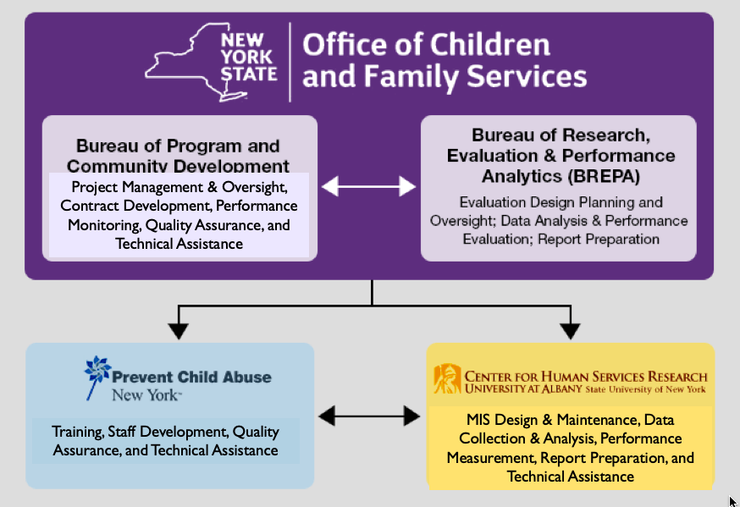

Slide 9
The Central Administration Team provides the statewide system with:
Support to new and developing programs (i.e., policy development & administrative support)
Data collection and analysis
Staff training and professional development opportunities
Information and networking opportunities
Assistance with HFA Accreditation
Access to educational resources
Quality Assurance
Technical Assistance
Evaluation and Continuous Quality Improvement

Slide 10
6 FUNCTIONAL AREAS FOR MULTI-SITE SYSTEMS: A FORMULA FOR MODEL FIDELITY AND QUALITY
§Policy: to guide site operations across the state. These policies describe how all of the components of the system interact and function, as well as how sites within the system are supported in meeting the BPS. The system must review the policy manuals of all the sites within in the system.
§Training: a process to ensure sites have a system to meet needs for training. Systems must have the capacity to provide HFA’s Core trainings in-state, by HFA-certified trainers. Sites must be trained on the functionality of the multi-site system.

Slide 11
§TA: a system to continuously improve the quality of services being delivered at the local level. Central Administration must provide ongoing support to ensure continuous quality improvement. It is provided by well-trained staff within the multi-site system.
§QA: a system that determines the degree to which sites are meeting BPS. Central Administration must have a system that determines the degree to which sites within the multi-site system meet all HFA BPS.

Slide 12
§Evaluation: formal, conducted by qualified researchers. Central Administration must have a formal evaluation component that follows a set of general practices consistent with conducting quality evaluation. Research is integrated into the planning process in a way that informs service delivery.
§Administration: follows a set of general practices consistent with responsible administration. Multi-site systems have a statewide advisory group to guide the operation of the system.

Slide 13
Central Administration Interactions
Statewide Leadership Twice a year, program managers from individual programs across the state and the Central Administration Team gather in Albany to exchange ideas, information, and to offer support in achieving their shared goals. All CA branches and programs are represented on a myriad of subcommittees that are created to address and inform any action steps needed to meet current realities in the state system.
Regional Leadership Program leaders and Central Administration Team members participate in quarterly meetings within their own regions (Capital Region, Central/Western, Hudson Valley, & New York City) for the same purpose as the larger statewide leadership meetings, focusing on topics that are relevant to the region as a whole.
Central Administration Every two months representatives from OCFS, PCANY and CHSR participate in a Central Administration committee which provides guidance and leadership to the larger network of HFNY programs.
Annual Site Visits are made to Programs from OCFS and PCANY, and visits as needed by CHSR.

Slide 14

http://www.healthyfamiliesnewyork.org

Slide 15
More About Office of Children and Family Services (OCFS)
New York State Office of Children and Family Services (OCFS) Mission Statement
The Office of Children and Family Services serves New York's public by promoting the safety, permanency and well-being of our children, families and communities. We will achieve results by setting and enforcing policies, building partnerships, and funding and providing quality services.
Agency Overview
OCFS is dedicated to improving the integration of services for New York’s children, youth, families and vulnerable populations; to promoting their development; and to protecting them from violence, neglect, abuse and abandonment. The agency provides a system of family support, juvenile justice, child care and child welfare services that promote the safety and well-being of children and adults. Among the operating principles across all program areas are that services should be developmentally appropriate, family-centered and family-driven, community-based, locally responsive, and evidence and outcome based.
www.ocfs.ny.gov

Slide 16
More About Prevent Child Abuse New York (PCANY)
Prevent Child Abuse New York is the only private, nonprofit agency serving the entire state whose single mission is to prevent child abuse in all its forms. Through public awareness, training and technical assistance, and policy work and advocacy our work supports the healthy development and prosperity of New York's children, families, and communities.
www.preventchildabuseny.org

Slide 17
More About Center for Human Services Research (CHSR)
The Center for Human Services Research (CHSR) is located at the University at Albany. CHSR has over 25 years of experience conducting evaluation research, designing information systems and informing program and policy development for a broad range of agencies serving vulnerable populations. Rigorous research and evaluation methods, strong relationships with project partners, and timely, accurate and objective information are hallmarks of CHSR’s work.
www.albany.edu/chsr/
518-442-5762

Slide 18

Healthy Families New York!

