Slide 1

New Family Goal Plan Form on MIS
BPS 6-2.A

Slide 2
Before you enter a FGP on the MIS
Complete the In-house FGP Training from PCANY
https://www.healthyfamiliesnewyork.org/Staff/Documents/10.20FamilyGoalPlanMIS.pptx

Slide 3
Notes:
The first page of the “hard copy” FGP form is not included in the new MIS version of the FGP form. Print out this page and use it to guide and capture your initial exploratory goal planning conversations with families. When complete, upload it to the family’s case file on MIS. If your program works with paper files and prefers to keep a paper copy of this document, that is also fine. Please note that family, FSS, and FSS Supervisor signatures are no longer required on this form.

Slide 4

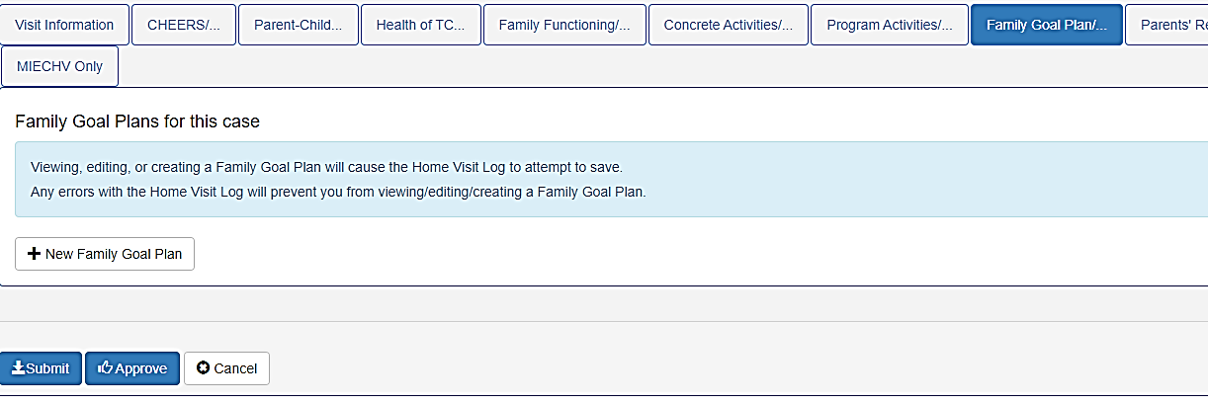
New look of the FGP/Transition Plan tab on Home Visit Log
Click here
Notes:
The Family Goal Plan/Transition Plan tab on the Home Visit Log has changed to show a box that will open the FGP Form by clicking on the +New Family Goal Plan.

Slide 5

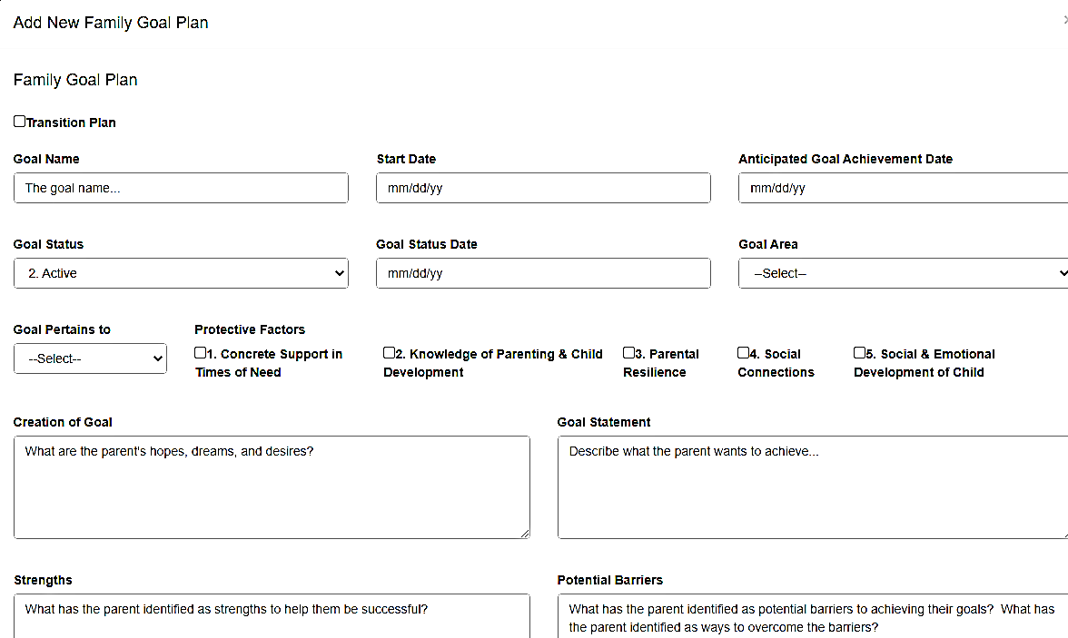
Notes:
The MIS Form has easy to fill out boxes with information such as status of the goal, the goal area, who the goal pertains to. It also lists the Protective Factors for easy clicking and allows room to write down a brief description of the discussions around goal setting. The boxes have language to make it easy for the FSS to remember what needs to go in each one.

Slide 6
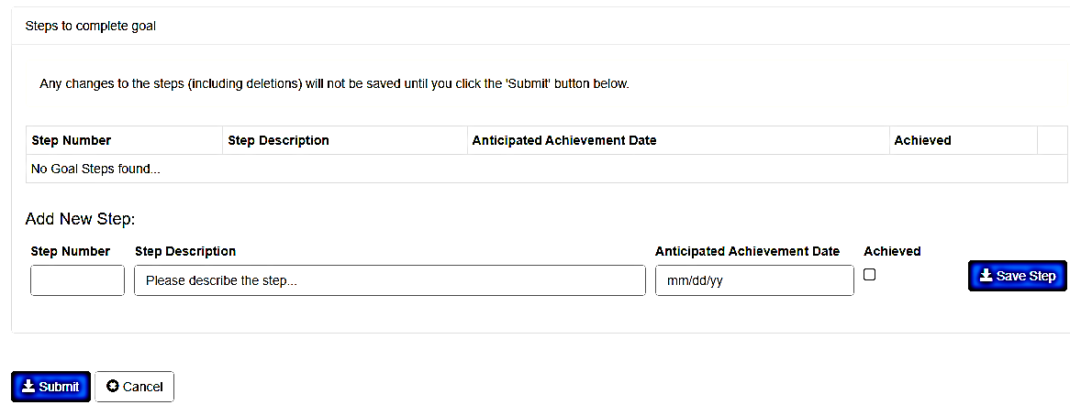
Steps to Complete the goal
Notes:
The form allows for the goal to be broken up into steps. You can add the anticipated achievement date and check the box to indicate it has been achieved.

Slide 7
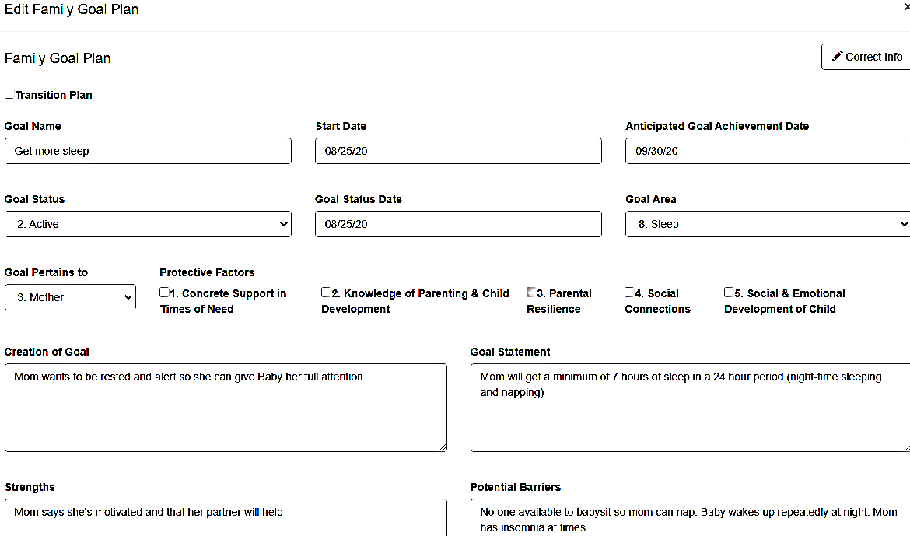
Notes:
Here you have an example of a completed form.

Slide 8
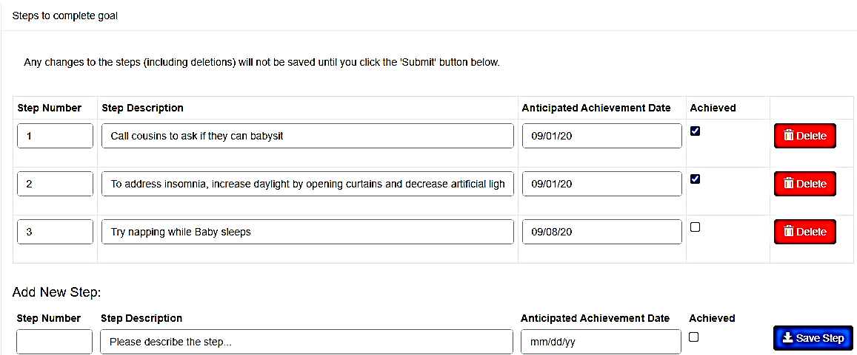
Notes:
Each step is numbered, has a description, an anticipated achievement date and a box to show that it has been achieved.

Slide 9

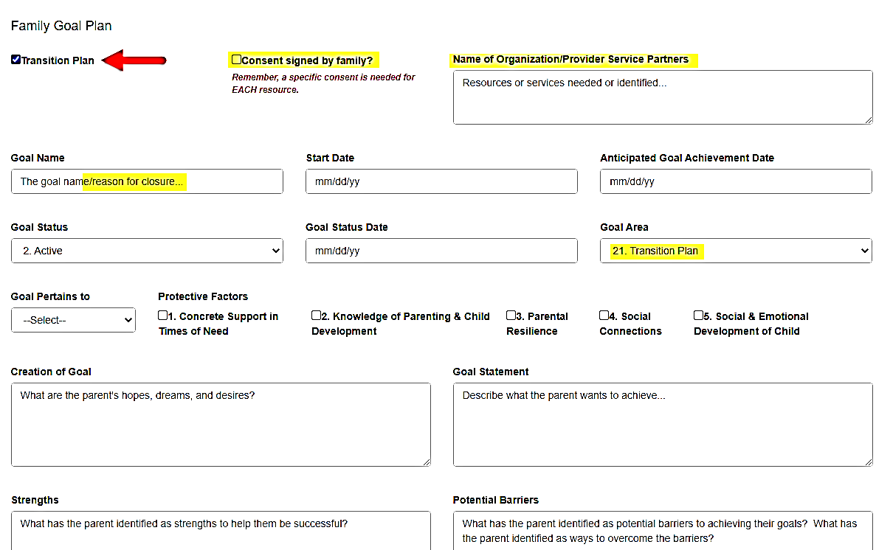
Transition Plan
Notes:
To document the Transition Plan (BPS 4-4A and B) the same form can be used. By clicking on the Transition Plan box, 2 new boxes will appear: One to check a received Consent from the parent to reach out to another HF program or other organization and another to add the name of the program or organization. Note that the Goal Area is automatically set to 21. Transition Plan
The boxes to outline the plan are the same as with a regular goal plan. Steps can be added indicating everything that is needed to support the family during the transition
The “Anticipated Goal Achievement Date” will be the date family transitions out of the program.
In the “Creation of the Goal” section, be sure to note when you and the family first discussed the fact that the family will be transitioning out of the program.

Slide 10
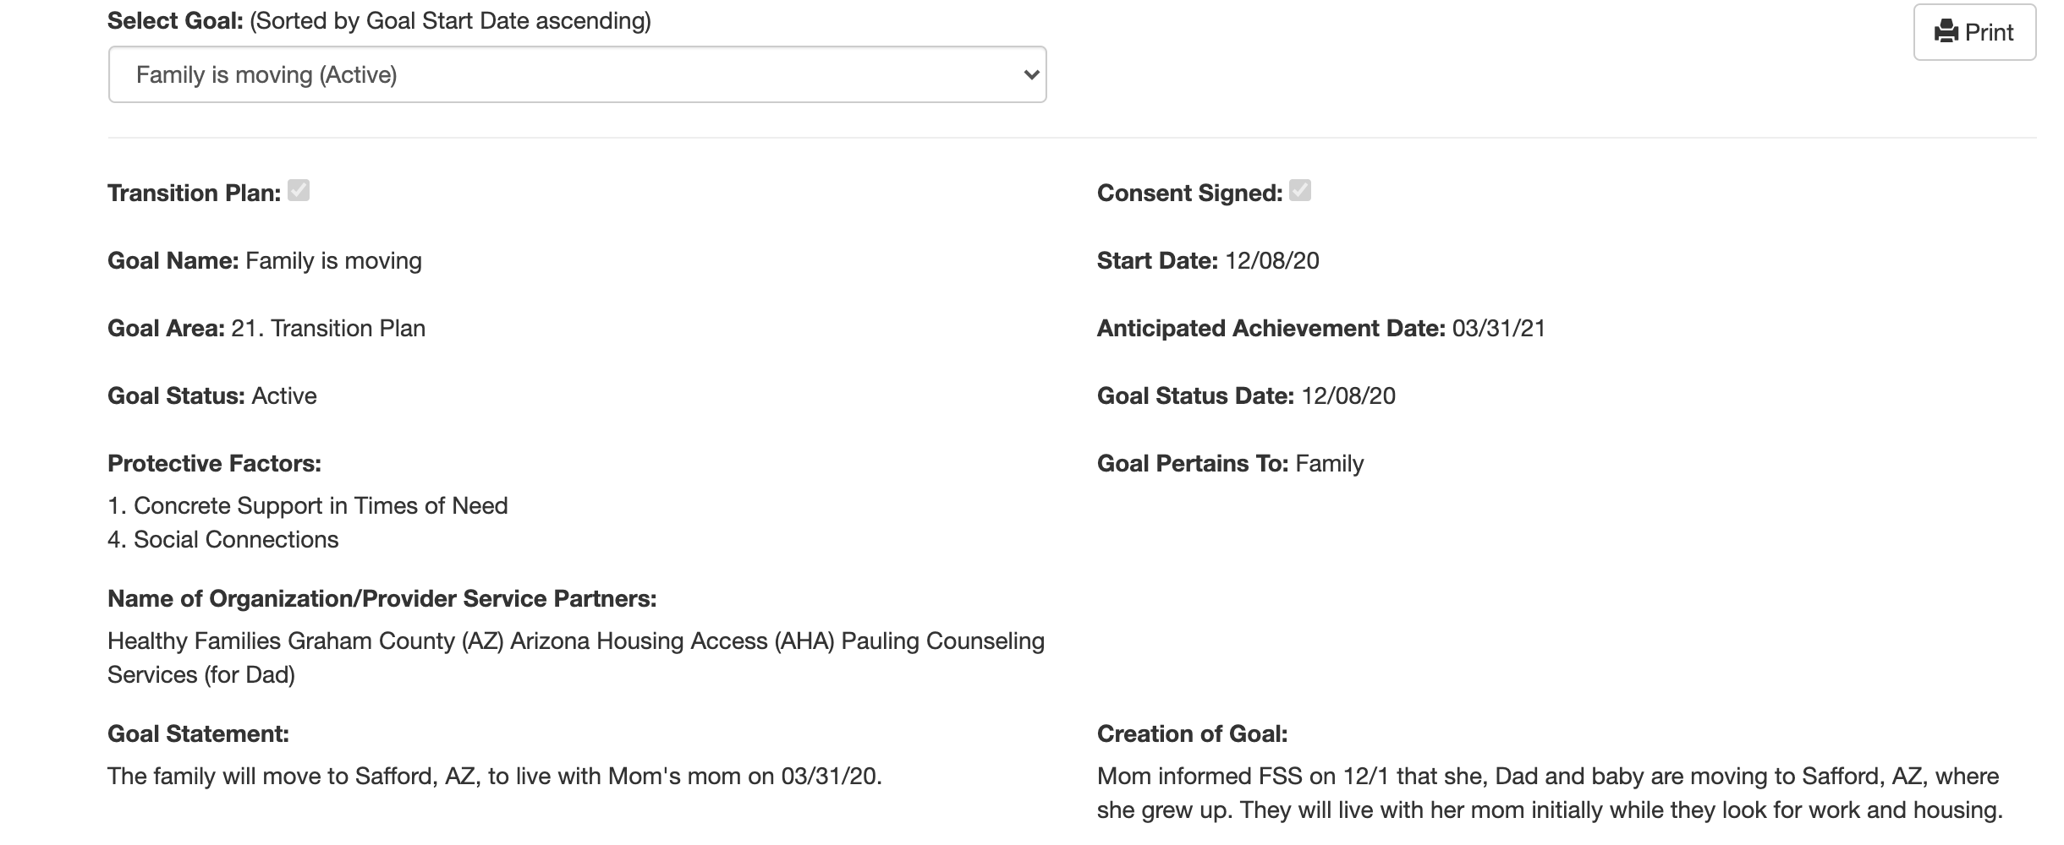
Notes:
A sample of use of the FGP form a Transition Plan.

Slide 11
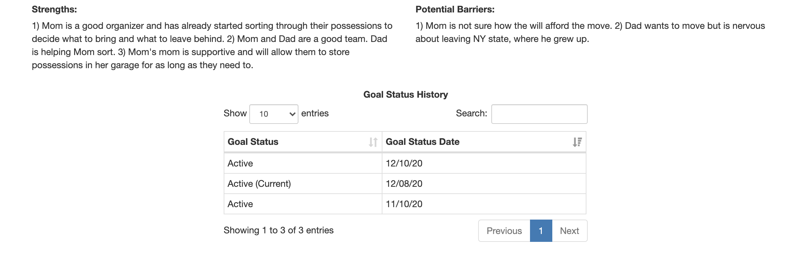

Slide 12
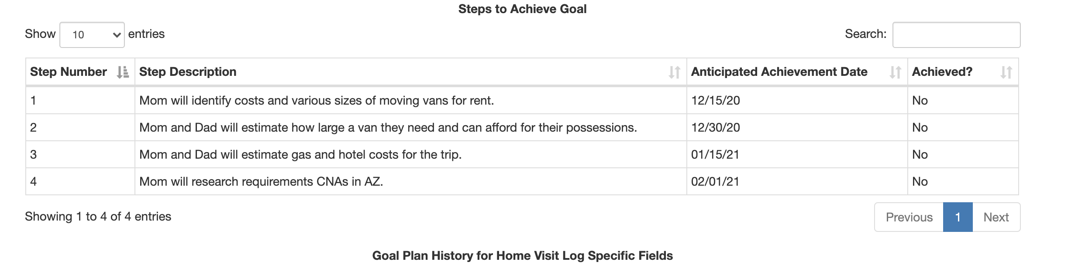

Slide 13
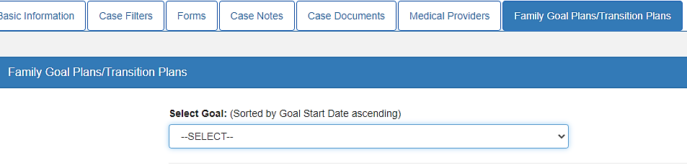
Case Home Page
Notes:
All FGPs will now be kept on a new tab on the Case home page. To view them, select from the dropdown box.

Slide 14
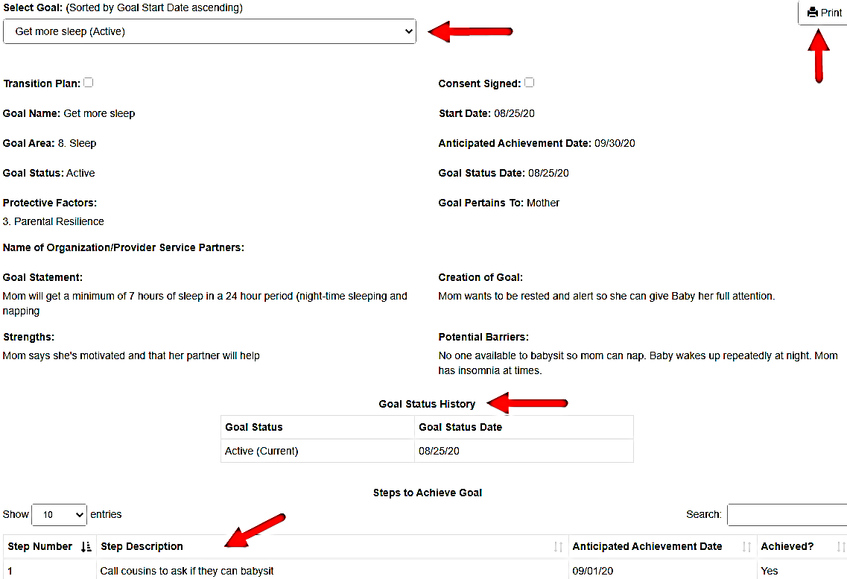
Notes:
Once selected from the dropdown box that will include all the goals for the family, the information for each particular goal (status, steps etc.) will show in one screen.
It has a print option that makes it easy to share with parents.
It shows the Goal status history (Start date and Status)
Not started
Active
Achieved
Discontinued
Extended
Postponed

Slide 15
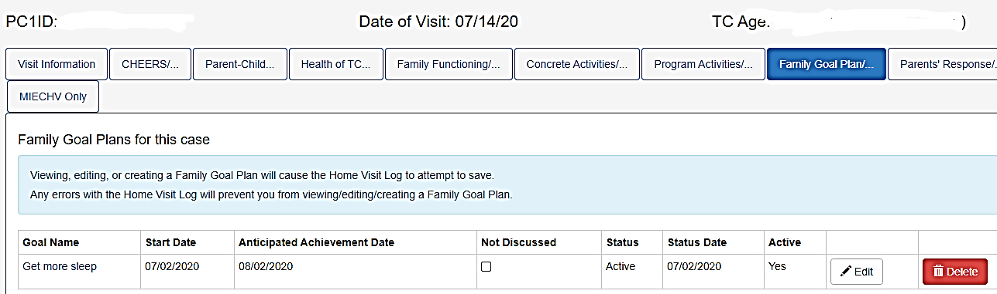
At the next visit
Notes:
When the goal is discussed at the next visit, it can be edited by clicking on the Edit button. The form will open and updates can be added. New steps, achieved ones etc.

Slide 16
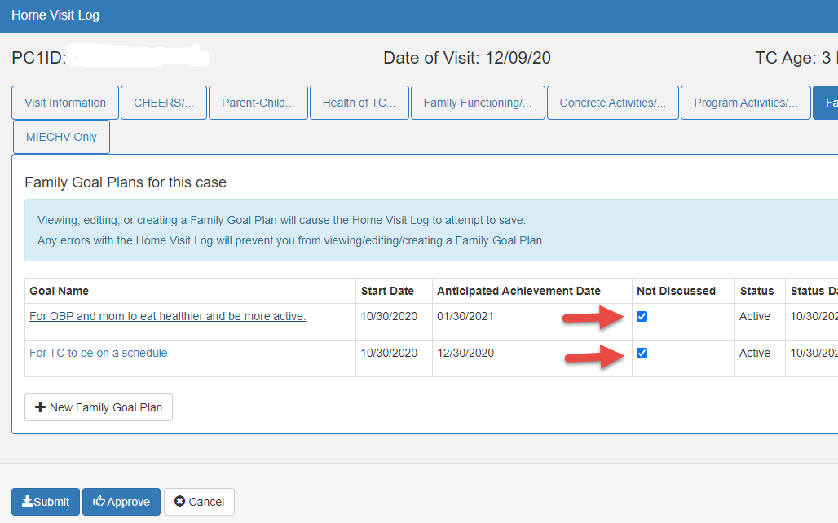
At the next visit
Notes:
When the goal or goals are NOT discussed during the visit, click on the Not discussed box to help you and your supervisor keep track. You can also click on the Family Goal Plans/Transition Plans tab on each case, select the Active cases and review the Goal Status History as shown on slide 18 of this presentation.

Slide 17
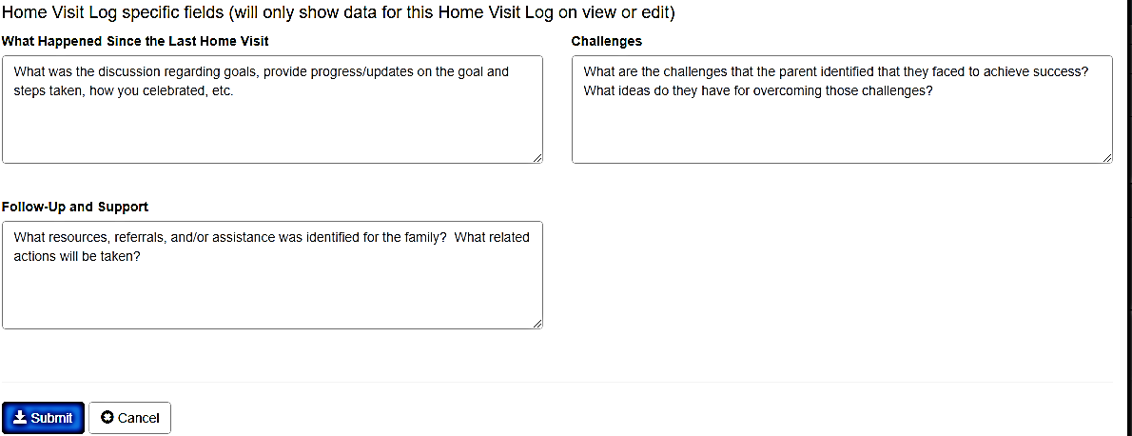
Updating the goal
Notes:
Progress on the goal is documented on each of the boxes indicated as
What happened since the last visit? Where the FSS would write …how successes were celebrated, etc.
Challenges
Follow-up and Support
By clicking Submit, the history will be updated

Slide 18
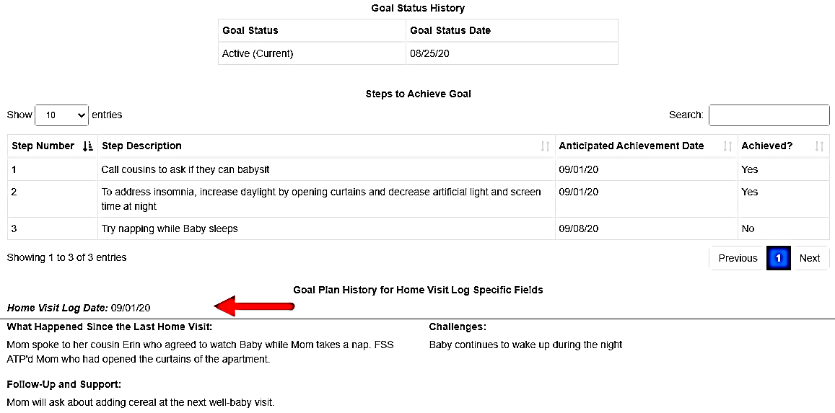
Goal Status History
Notes:
At each home visit, when the goal is edited, successes, challenges and follow-up/support will be added to the history for an easy way of tracking and documenting all the work done at each visit. During supervision, the Goal Plan History will show the frequency of discussion of the goals with families.

Slide 19
Thank You!
Questions/Comments?
cnoble@albany.edu

