Slide 1
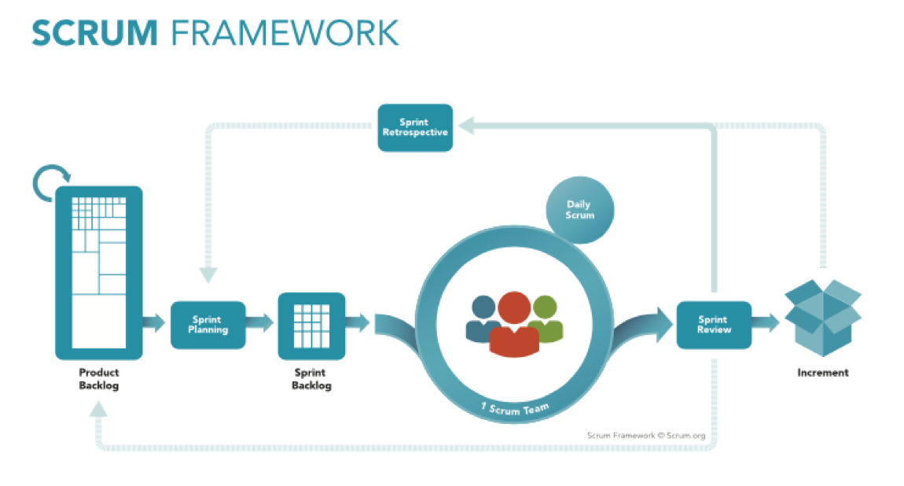
SCRUM Sprint Planning, Sprint Retrospective, Daily Sprints…

Slide 2
Sprint Planning…
Date(Time) | Duration | Discussion
09/08/2020(7 PM) | 1 hr 30 min | Creating a product backlog, discussion of everyones course role in this project.

Slide 3
SPRINT-I
S.No | Date (Time) | Duration | Discussion
Daily Sprint-1 | 11/08/2020 (8:30 pm) | 30 min | Naming of Our Website
Daily Sprint-2 | 13/08/2020 (7 pm) | 45 Min | Creating a repository in projects.kluniversity.in and cloning the repo into local devices
Daily Sprint-3 | 14/08/2020 (9 am) | 45 min | Creating documentation for first review and preparing for presentation
Sprint Retrospective And Sprint Review | 29/08/2020 ( 6pm) | 2 hrs | planning for improvements to be enacted during the next Sprint

Slide 4
SPRINT-II
S.No | Date(Time) | Duration | Discussion
Daily Sprint – 1 | 07/09/2020(6 pm) | 45 min | Designing of algorithms for creating frontend pages
Daily Sprint – 2 | 13/09/2020( 7pm) | 1 hr | About the home page of our website
Daily Sprint – 3 | 28/09/2020(7 pm) | 1 hr | Creating login and signup components
Sprint Retrospective And Sprint Review | 5/10/2020 ( 11 am) | 1hr 30min | Feedback from every team mate about the login and sign up pages and enhancements for next sprint

Slide 5
SPRINT-III
S.No | Date(Time) | Duration | Discussion
Daily Sprint-1 | 11/11/2020(3 pm) | 1hr 30min | About Database Creation in MongoDb
Daily Sprint-2 | 18/11/2020(7 pm) | 1 hr | Chatbot using Watson Studio in IBM cloud
Daily Sprint-3 | 22/11/2020(7 pm) | 45 min | Creating database in cloud using Mongodb Atlas
Sprint Retrospective And Sprint Review | 29/11/202(9 pm) | 1 hr | Creation of Collections in Mongodb and integrating backend to frontend

Slide 6
SPRINT-IV
S.No | Date(Time) | Duration | Discussion
Daily Sprint-1 | 02/12/2020(6 pm) | 1 hr | Designing Cart page
Daily Sprint-2 | 04/12/2020(6 pm) | 1 hr | Creating separate Components for each type of products
Daily Sprint-3 | 06/12/2020(6 pm) | 1 hr | Manually Testing database and front end components
Sprint Retrospective And Sprint Review | 09/12/2020( 6 pm) | 1 hr | Finalizing all CSS style and preparing documentation for final presentation

