Slide 1
Task 1 的攻击模型EEDM的思路
step 1 Dataset Preparation :
【1】Training dataset: Features(Pesticides, Fertilizers, Other chemicals); labels(Loss of Species Richness)
【2】 Testing dataset: LSR data of recent 22 years
Step 2 Building Neural Network: a two-layer multi-layer perceptron with 3-3-1 neuron distributions.
Step 3 Training and Testing: the model reaches an accuracy of 91.3%, acquiring the original form of EEDM
Step 4 Mapping the original model under temporal framework to enhance its practical meaning: acquiring equation (16)

Slide 2
Task 2 杨辉三角的思路
step 1 Generalize the traditional form of Pascal’s Triangle
Step 2 Using the generalized version to dynamically describe reemergence of native species.
Step 3 Quantify the effects of reemergence by integrating Ecosystem Stability Model (Resistance Stability + Resilience Stability.)

Slide 3
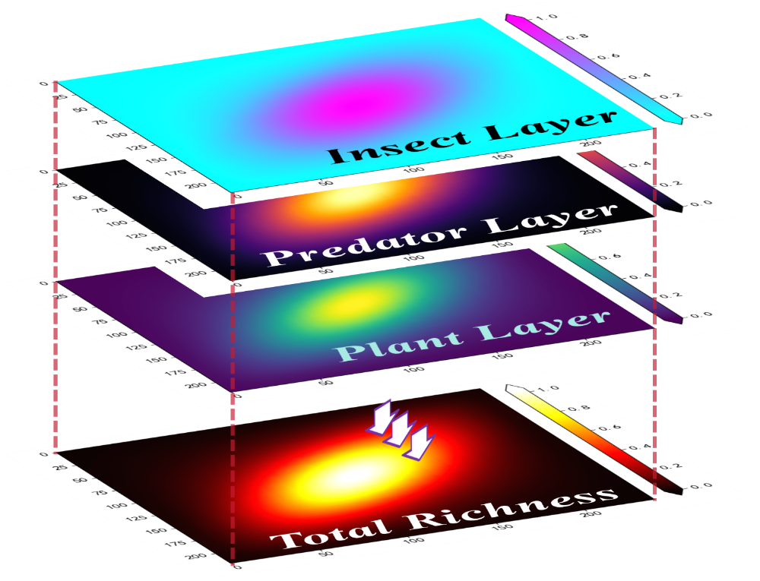
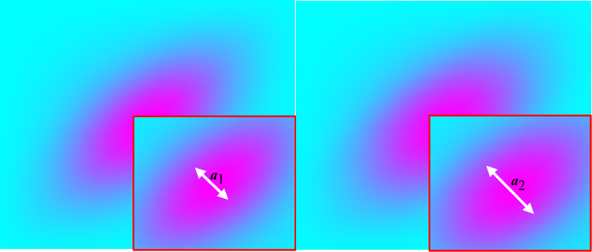
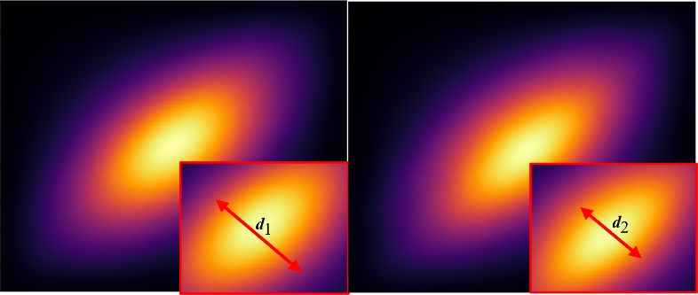
Task 3 卷积的思路 (结果图可以放两个（吗?）这两个图感觉都挺好看的 要搁不下就先放右边那个立体图)
Separate the problem into two categories: Short term solution and Long term solution
【1】short term: removal of herbicide increases stability, because:
(a) Higher Richness (Food Web Model)
(b) Stronger Resistance ( Ecosystem Stability Model)
【2】long term : Introducing bats
(a) Using convolution model to quantify bats’ interactions with other species, designing bats kernels
(b) Provide the specific interval where ecosystem can truly stabilizes ([22%, 75%])
【3】Another species: Grass Snake
(a) Recalculate and design Snake Kernels.
(b) Compare the effects between bats and grass snakes.

