Slide 1
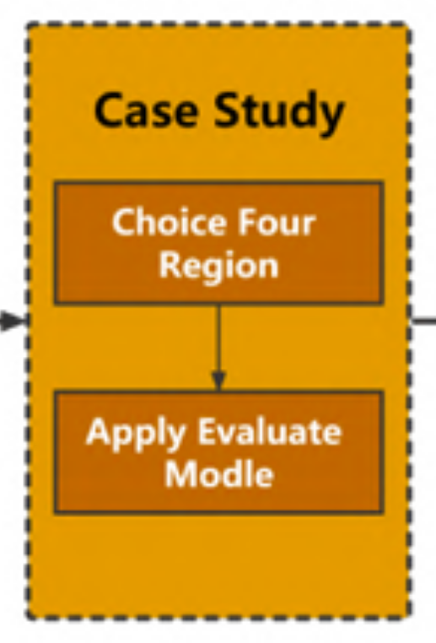

Slide 2
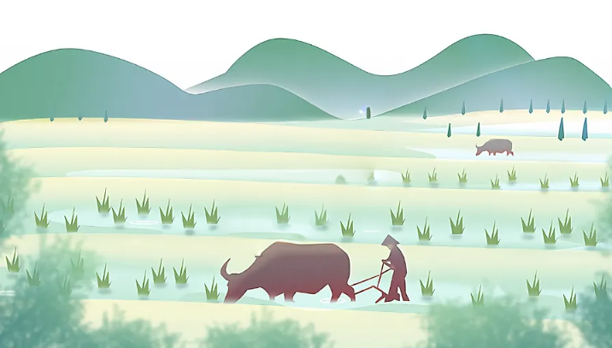
Others
(3.3%)
Birds Population
(3.2%)
Plants Health
(86.4%)
Insect Population
(7.1%)

Slide 3
Input Layer
3 neurons
score
Dense Connections
Hidden Layer
5 neurons
Dense Connections
Output Layer
1 neuron
Notes:
Created By @srvmshr
sourav@yahoo.com

Slide 4
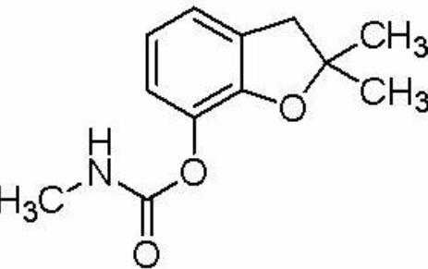
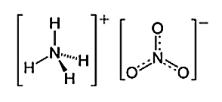
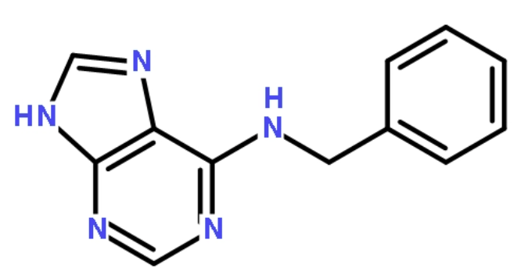
Loss of Species Richness, LSR
Pesticide
Fertilizer
Other Chemicals
Carbofuran
Ammonium nitrate
Benzylaminopurine

Slide 5
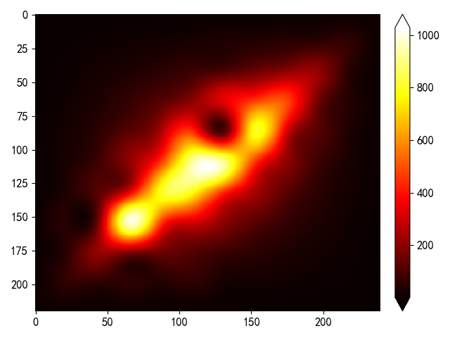
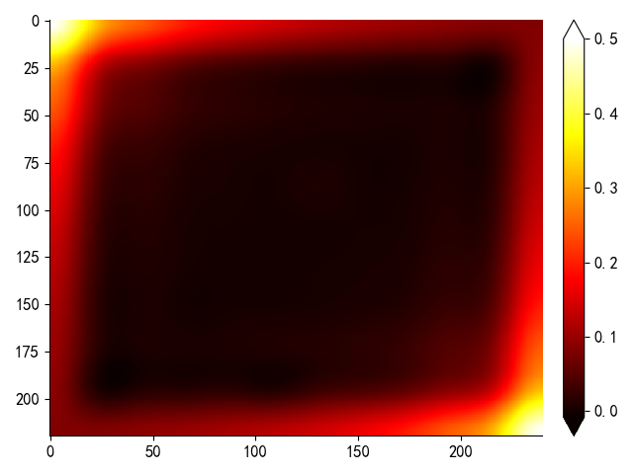
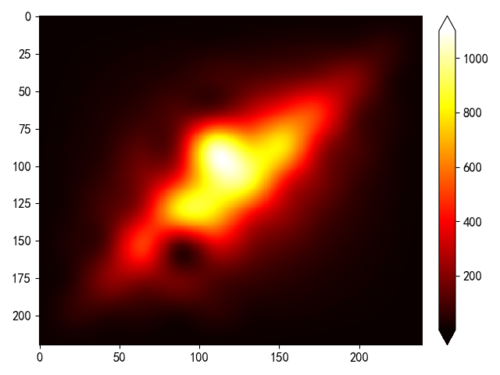
Native
Species
Relocation&
Reemergence
Species A
Human
Exploit
Species B
Natural Forest Area
Converted Agricultural System
(Primary Stage)
Mature Agricultural ecosystem

Slide 6
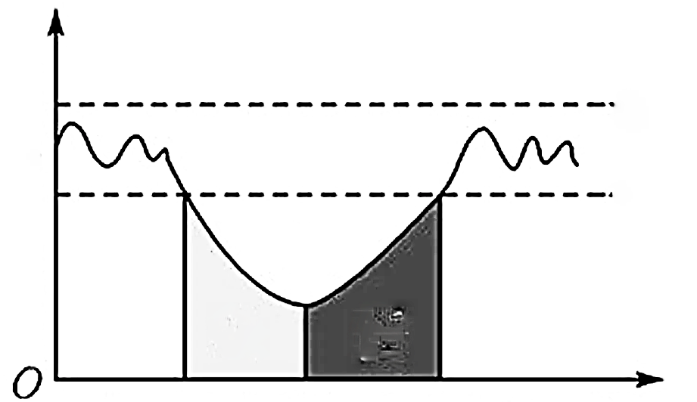
Disturbance
Ecosystem Functions
Normal Fluctuation
Resistance
Stability
Total Ecosystem Stability
t
Resilience Stability

Slide 7
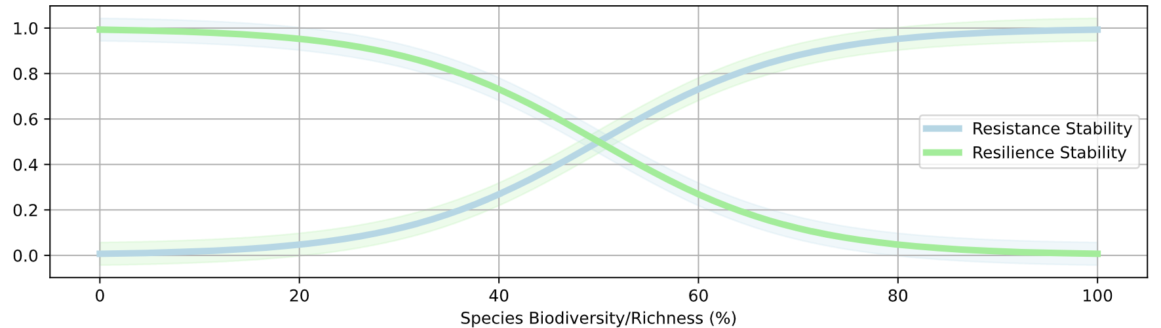
2023 Sept. （83%）
2022 Jan.（21%）
2024 Apr.（65%）
2022 Jan.（42%）

Slide 8
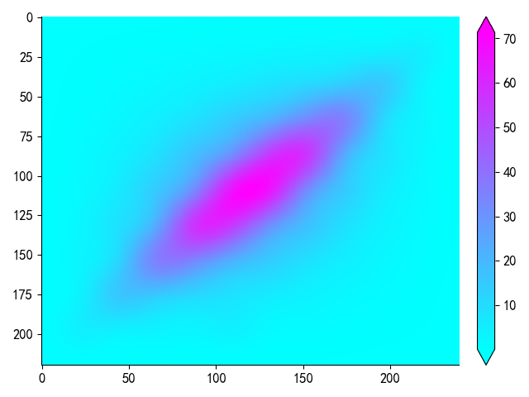
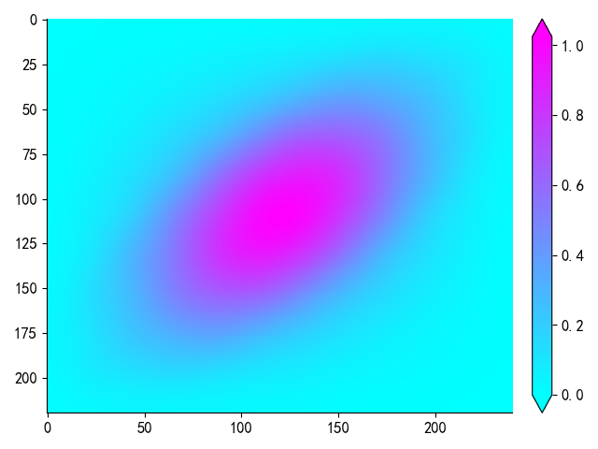
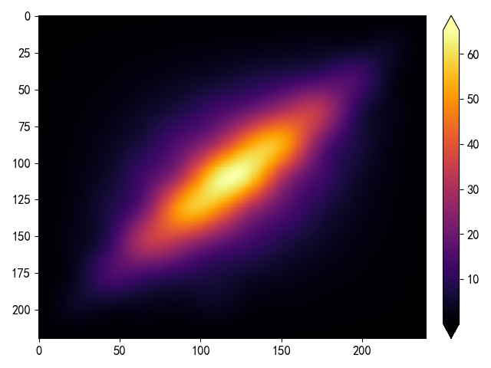
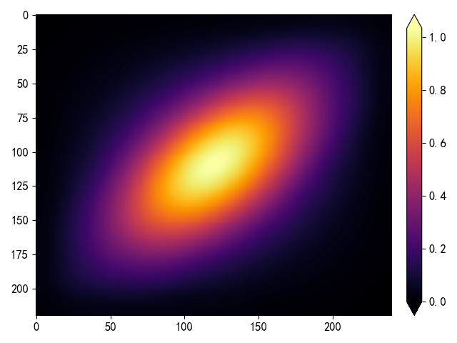
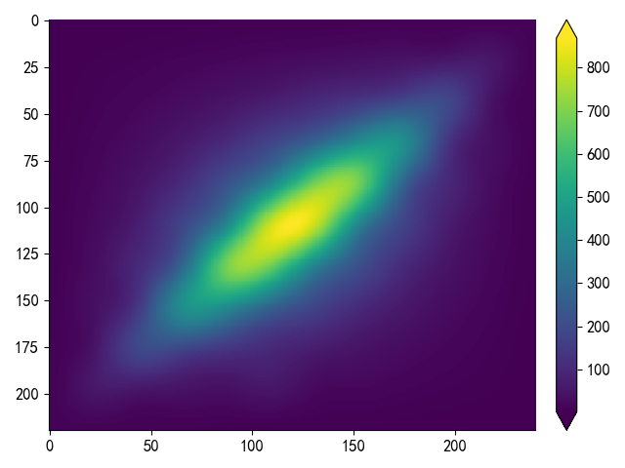
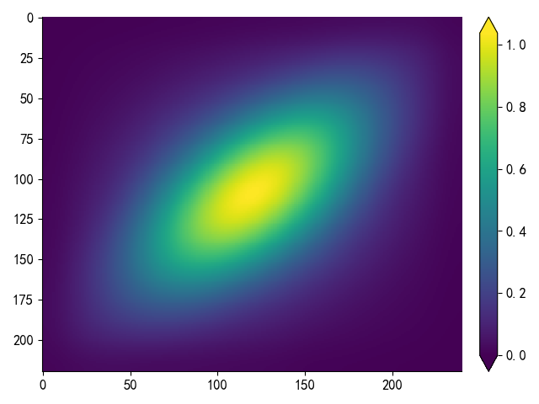
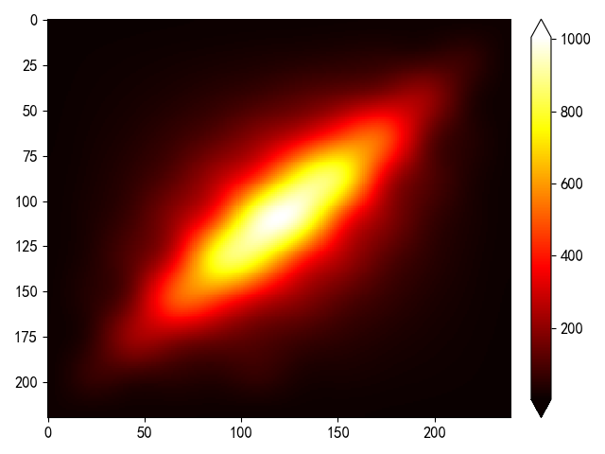
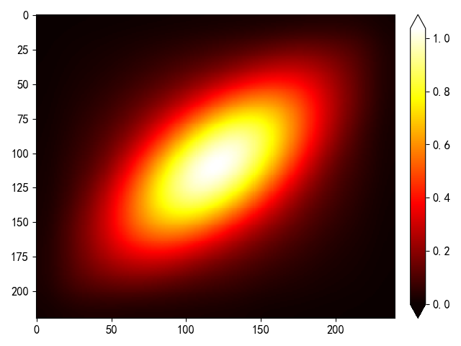


Insect Layer
Insect Layer
Insect Layer
Bat Kernel
Predator Layer
Predator Layer
Insect layer
Plant Layer
Plant Layer
Plant layer
Predator layer
Total Richness
Total Richness
0.37
0.19
0.28
0.92
1.05
0.95
1.42
1.82
1.51
Convolution Kernel Values on Insect layer
Convolution Kernel Values on Plant layer
0.18
0.12
0.22
0.81
0.84
0.94
1.75
1.91
1.80
Convolution Kernel Values on Predator layer
0.26
0.20
0.35
0.98
0.88
1.10
1.48
1.65
1.47
Insect Layer
Insect Layer
Insect Layer
Predator Layer
Predator Layer
Plant Layer
Plant Layer
Total Richness
Total Richness

Slide 9
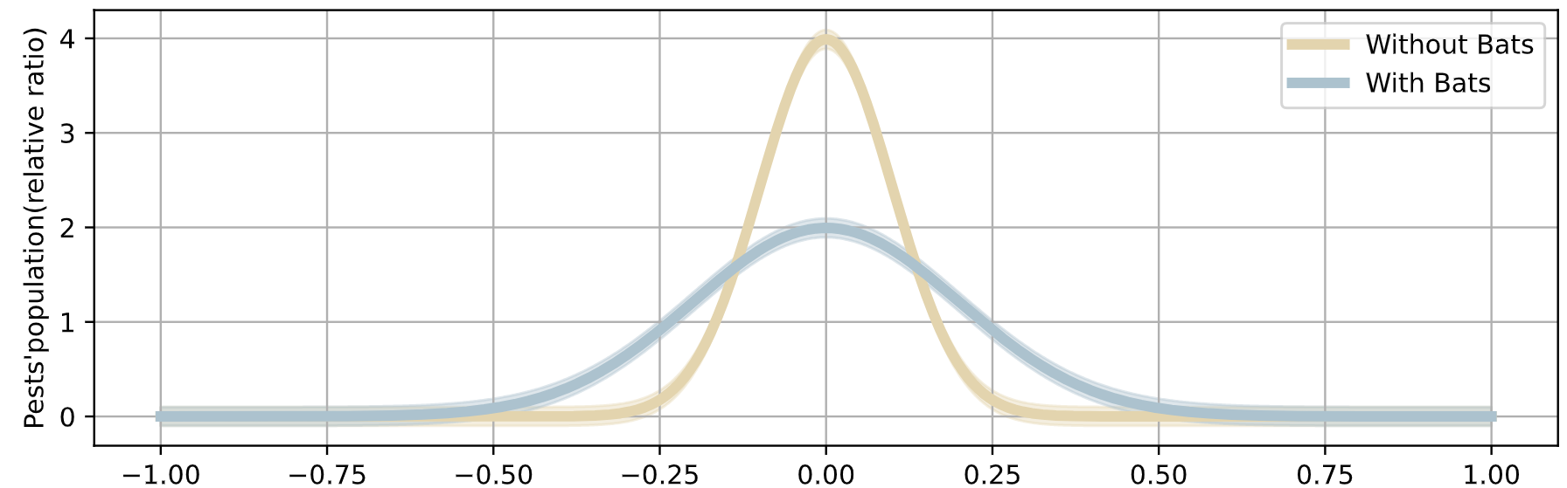

Slide 10
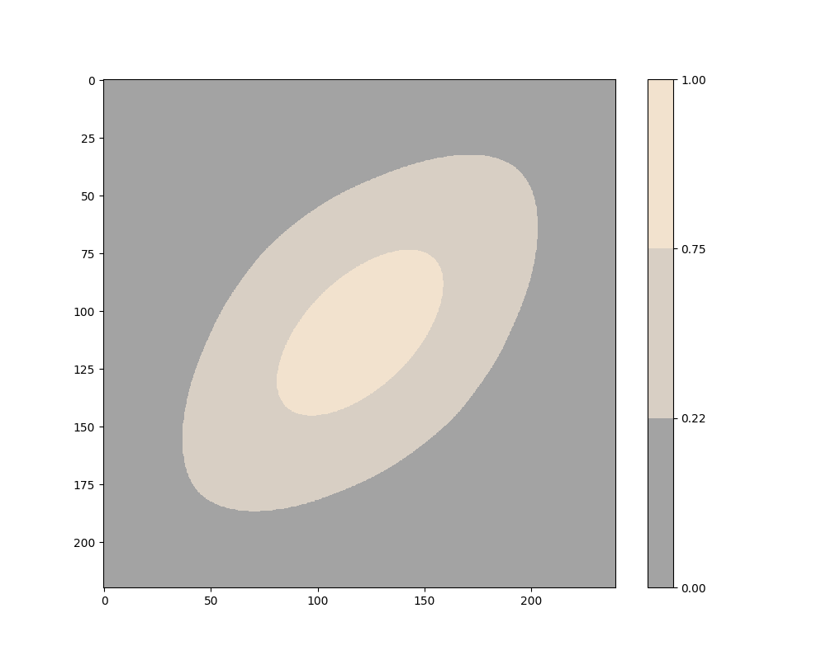
Unstable
Stable
Unstable

Slide 11




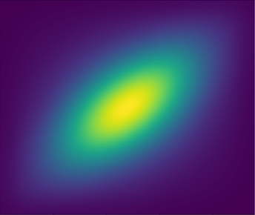
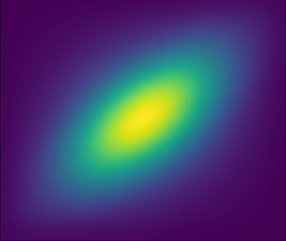

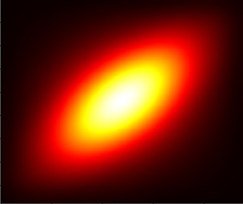








$${\text{d}}_{\text{1}}$$
$${\text{d}}_{\text{2}}$$
$${\text{a}}_{\text{1}}$$
$${\text{a}}_{\text{2}}$$
$${\text{b}}_{\text{1}}$$
$${\text{b}}_{\text{2}}$$
$${\text{c}}_{\text{1}}$$
$${\text{c}}_{\text{2}}$$

Slide 12
0.93
1.01
0.96
0.21
0.09
0.30
1.40
1.61
1.49
Convolution Kernel Values on Insect layer
Convolution Kernel Values on Plant layer
0.83
0.81
0.92
0.11
0.05
0.18
1.73
1.88
1.79
Convolution Kernel Values on Predator layer
0.98
0.89
0.94
0.24
0.21
0.17
1.51
1.62
1.49

Slide 13
Task 1 的攻击模型EEDM的思路
step 1 Dataset Preparation :
【1】Training dataset: Features(Pesticides, Fertilizers, Other chemicals); labels(Loss of Species Richness)
【2】 Testing dataset: LSR data of recent 22 years
Step 2 Building Neural Network: a two-layer multi-layer perceptron with 3-3-1 neuron distributions.
Step 3 Training and Testing: the model reaches an accuracy of 91.3%, acquiring the original form of EEDM
Step 4 Mapping the original model under temporal framework to enhance its practical meaning: acquiring equation (16)

Slide 14
Task 2 杨辉三角的思路
step 1 Generalize the traditional form of Pascal’s Triangle
Step 2 Using the generalized version to dynamically describe reemergence of native species.
Step 3 Quantify the effects of reemergence by integrating Ecosystem Stability Model (Resistance Stability + Resilience Stability.)

Slide 15
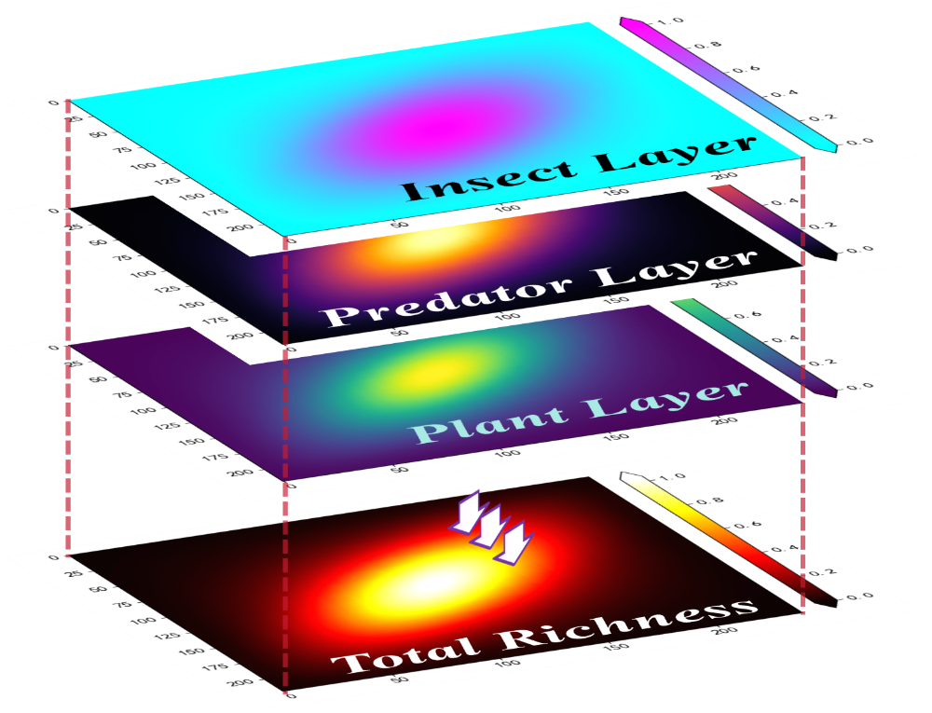
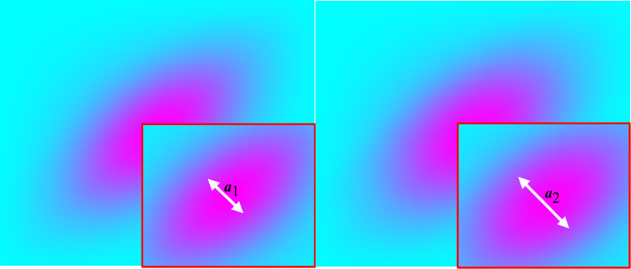
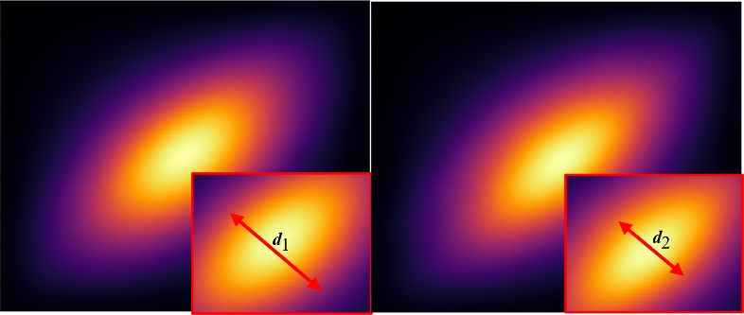
Task 3 卷积的思路 (结果图可以放两个（吗?）这两个图感觉都挺好看的 要搁不下就右边那个立体图)
Separate the problem into two categories: Short term solution and Long term solution
【1】short term: removal of herbicide increases stability, because:
(a) Higher Richness (Food Web Model)
(b) Stronger Resistance ( Ecosystem Stability Model)
【2】long term : Introducing bats
(a) Using convolution model to quantify bats’ interactions with other species, designing bats kernels
(b) Provide the specific interval where ecosystem can truly stabilizes ([22%, 75%])
【3】Another species: Grass Snake
(a) Recalculate and design Snake Kernels.
(b) Compare the effects between bats and grass snakes.

