Slide 1
Cheap cycles from the desktop to the dedicated cluster: combining opportunistic and dedicated scheduling with Condor
Derek Wright
Computer Sciences Department
University of Wisconsin-Madison
wright@cs.wisc.edu
www.cs.wisc.edu/condor

Slide 2
Talk Outline
What’s the problem?
The Condor solution
Architecture of Condor
Condor’s dedicated scheduling
Why some traditional problems in dedicated scheduling do not apply to Condor
How Condor handles failures of dedicated nodes
A look at the UW-Madison Computer Science Condor Pool and Cluster
Future work

Slide 3
What’s the Problem?
Scientists always want to use more cycles
  They can solve larger problems
  They can get more accurate results
Cycles can be expensive
  Buying a super computer (or even time on one) can be costly, particularly for a smaller research group

Slide 4
A recent solution: Dedicated Compute Clusters
Clusters of commodity PC hardware running Linux are becoming widely used as computational resources
  Cost to performance ratio for these clusters is unmatched by other platforms
  It is now feasible for smaller groups to purchase and maintain their own clusters
However, these clusters introduce a new set of problems for the end users

Slide 5
Problems with Dedicated Compute Clusters
Dedicated resources are not dedicated
  Most software for controlling clusters relies on dedicated scheduling algorithms
  Assume constant availability of resources to compute fixed schedules
Due to hardware and software failure, dedicated resources are not always available over the long-term

Slide 6
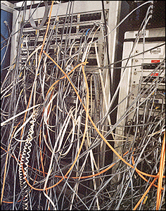
Look Familiar?

Slide 7
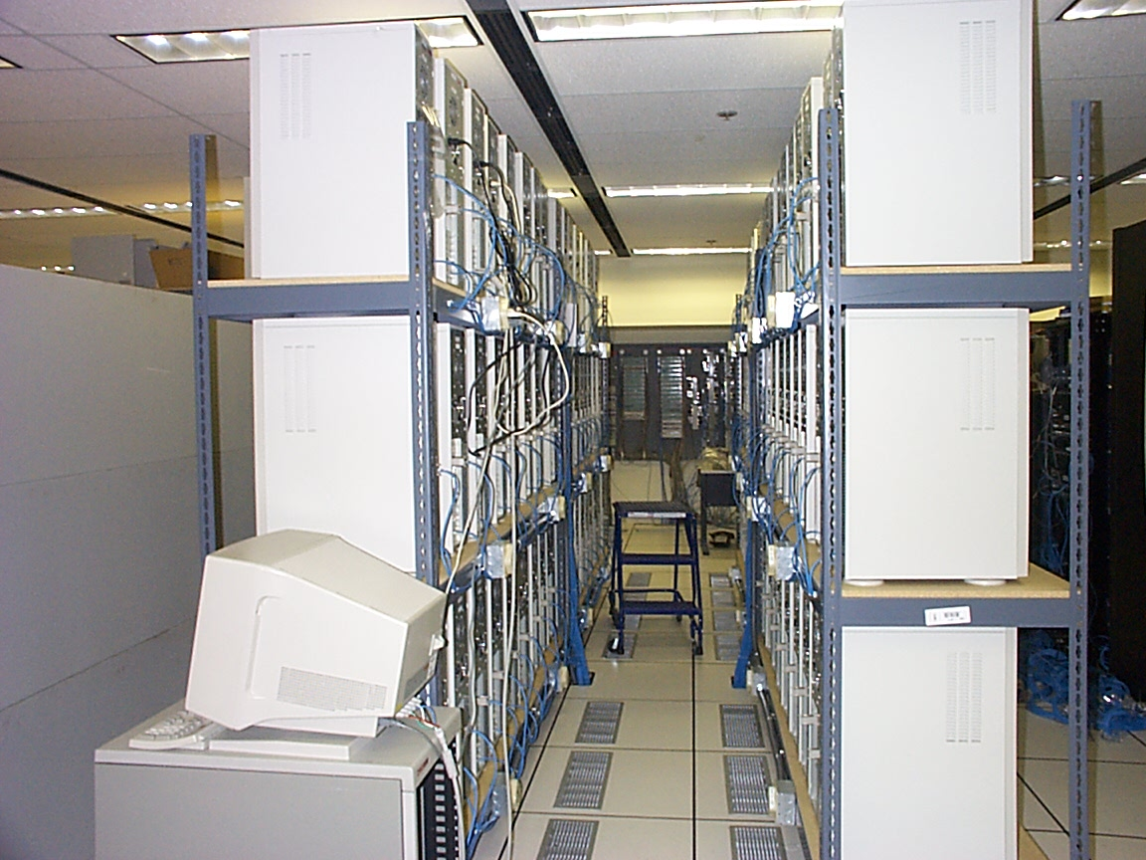
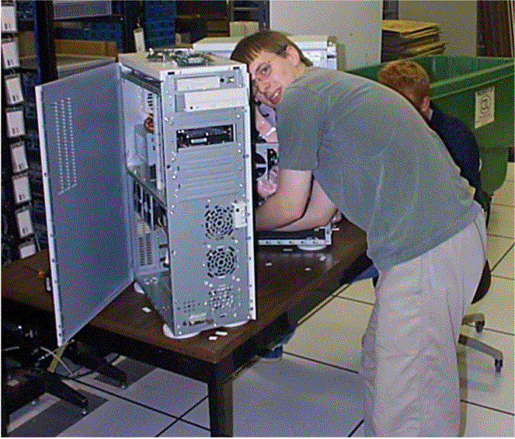
Two common views of a Cluster:

Slide 8
Problems with Dedicated Schedulers
Most dedicated schedulers are only applicable to certain kinds of jobs, and can only manage dedicated clusters or large SMP machines
  If users have both serial and parallel jobs, they are often forced to submit to separate schedulers for each
    Sys-admins must maintain multiple systems
    Users must learn separate tools

Slide 9
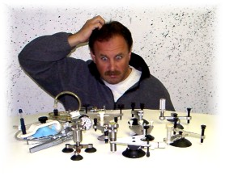
What tool do I use?

Slide 10
Problems with Dedicated Schedulers (cont’d)
Difficult or impossible to manage the same resources with multiple schedulers
  Administrators are often forced to partition their resources
  If there is an uneven distribution of work between the two different systems, users will wait for one set of resources while computers in another set are idle

Slide 11
Talk Outline
  What’s the problem?
The Condor solution
  Architecture of Condor
  Condor’s dedicated scheduling
  Why some traditional problems in dedicated scheduling do not apply to Condor
  How Condor handles failures of dedicated nodes
  A look at the UW-Madison Computer Science Condor Pool and Cluster
  Future work

Slide 12
The Condor Solution
Condor overcomes these difficulties by combining aspects of dedicated and opportunistic scheduling into a single system
  Opportunistic scheduling involves placing jobs on non-dedicated resources under the assumption that the resources might not be available for the entire duration of the jobs

Slide 13
The Condor Solution (cont’d)
Condor manages all resources and jobs within a single system
  Administrators only have to maintain one system, saving time and money
  Users can submit a wide variety of jobs:
    Serial or parallel (including PVM + MPI)
    Spend less time learning tools, more time doing science

Slide 14
What is Condor?
A system of daemons and tools that harness desktop machines and commodity computing resources for High Throughput Computing
  Large #’s of jobs over long periods of time
  Not High Performance Computing, which is short bursts of lots of compute power

Slide 15
What is Condor? (Cont’d)
Condor matches jobs with available machines using “ClassAds”
  “Available machines” can be:
    Idle desktop workstations
    Dedicated clusters
    SMP machines
Can also provide checkpointing and process migration (if you re-link your application against our library)

Slide 16
What’s Condor Good For?
Managing a large number of jobs
  You specify the jobs in a file and submit them to Condor, which runs them all and sends you email when they complete
  Mechanisms to help you manage huge numbers of jobs (1000’s), all the data, etc
  Condor can handle inter-job dependencies (DAGMan)

Slide 17
What’s Condor Good For? (cont’d)
Managing a large number of machines
  Condor daemons run on all the machines in your pool and are constantly monitoring machine state
  You can query Condor for information about your machines
  Condor handles all background jobs in your pool with minimal impact on your machine owners

Slide 18
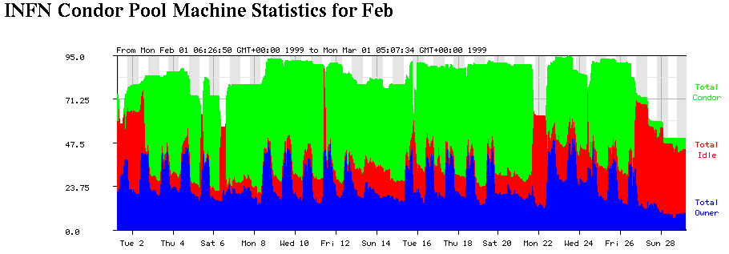
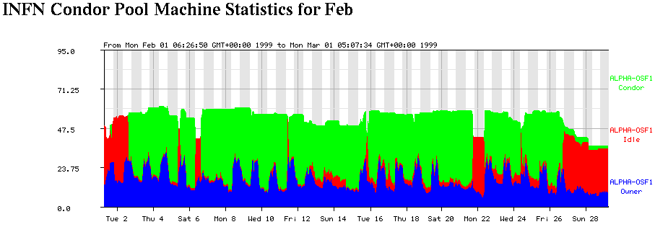

Slide 19
Talk Outline
  What’s the problem?
  The Condor solution
Architecture of Condor
  Condor’s dedicated scheduling
  Why some traditional problems in dedicated scheduling do not apply to Condor
  How Condor handles failures of dedicated nodes
  A look at the UW-Madison Computer Science Condor Pool and Cluster
  Future work

Slide 20
What is a Condor Pool?
A “pool” can be a single machine or a group of machines
Determined by a “central manager” - the matchmaker and centralized information repository
Each machine runs various daemons to provide different services, either to the users who submit jobs, the machine owners, or the pool itself

Slide 21
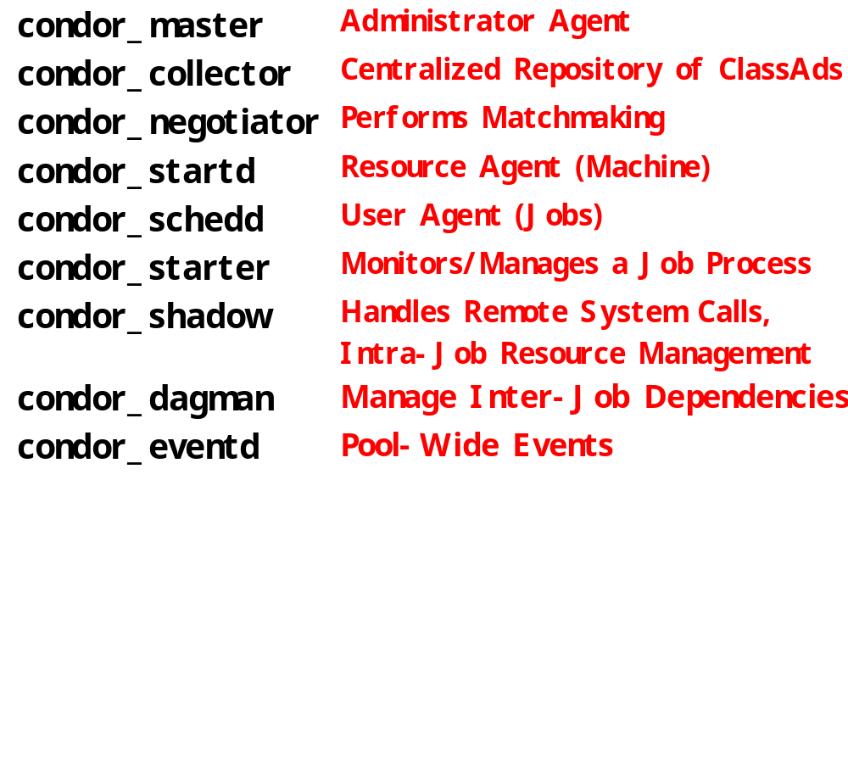
The Condor Daemons

Slide 22
Layout of a Personal Condor Pool
= Process Spawned
Central Manager
= ClassAd
Communication
Pathway
master
startd
negotiator
schedd
collector

Slide 23
Layout of a General Condor Pool
= Process Spawned
Execute-Only
Central Manager
= ClassAd
Communication
Pathway
master
master
startd
startd
negotiator
Execute-Only
schedd
Submit-Only
collector
master
master
startd
schedd
Regular Node
Regular Node
master
master
startd
startd
schedd
schedd

Slide 24
Talk Outline
  What’s the problem?
  The Condor solution
  Architecture of Condor
Condor’s dedicated scheduling
  Why some traditional problems in dedicated scheduling do not apply to Condor
  How Condor handles failures of dedicated nodes
  A look at the UW-Madison Computer Science Condor Pool and Cluster
  Future work

Slide 25
Dedicated Scheduling in Condor
Dedicated scheduling is new in Condor
  Introduced in 2001 in version 6.3.0
Only required some minor changes to the system:
  A new version of the condor_schedd that implements the dedicated scheduling
  A new version of the shadow and starter for launching MPI jobs
  Some configuration file settings

Slide 26
Configuring Resources for Dedicated Scheduling
To support dedicated jobs, certain resources in your Condor pool must be configured as dedicated resources
  Their policy for starting and stopping jobs must be modified
  They must always prefer to run jobs from the dedicated scheduler

Slide 27
Claiming Resources for Dedicated Jobs
Whenever the dedicated scheduler (DS) has idle jobs, it queries the collector for all known resources it could use
DS does its own match-making to decide which resources it wants
DS sends requests to the opportunistic scheduler to claim those resources
Once DS claims the resources, it has exclusive control over them

Slide 28
Condor’s Dedicated Scheduling Algorithm
When dedicated jobs are submitted, the DS performs a scheduling cycle:
  DS considers jobs in FIFO order (for now – this is an area of future work)
  If DS needs more resources, it puts out a ClassAd to claim them
  If DS has resources it can’t use, it returns them to the opportunistic scheduler

Slide 29
Talk Outline
  What’s the problem?
  The Condor solution
  Architecture of Condor
  Condor’s dedicated scheduling
Why some traditional problems in dedicated scheduling do not apply to Condor
  How Condor handles failures of dedicated nodes
  A look at the UW-Madison Computer Science Condor Pool and Cluster
  Future work

Slide 30
Some Traditional Problems Do Not Apply to Condor
Due to the unique combination of dedicated and opportunistic scheduling in one system, certain problems no longer apply:
  Backfilling
  Requiring users to specify a job duration

Slide 31
Backfilling: The Problem
All dedicated schedulers leave “holes”
Traditional solution is to use backfilling
  Use lower priority parallel jobs
  Use serial jobs
However, if you can’t checkpoint the serial jobs, and/or you don’t have any parallel jobs of the right size and duration, you’ve still got holes

Slide 32
Backfilling: The Condor Solution
In Condor, we already have an infrastructure for managing non-dedicated nodes with opportunistic scheduling, so we just use that to cover the holes in the dedicated schedule
  Our opportunistic jobs can be checkpointed and migrated when the dedicated scheduler needs the resources again

Slide 33
User-Specified Job Durations: What’s the Problem?
Most scheduling systems require users to specify how long their jobs will run
  Many users do not know this until they’ve already executed the code – so they guess
  Guessing wrong can be expensive:
    Either your job gets killed because you guessed low
    Or you had to wait much longer or pay more to get resources you didn’t use

Slide 34
User-Specified Job Durations: Why Condor Doesn’t Have to Care
Because we can release and re-claim resources at any time and expect them to be utilized, we do not need to make decisions far into the future
We make all decisions based on the current state of the world (since its always changing)

Slide 35
Talk Outline
  What’s the problem?
  The Condor solution
  Architecture of Condor
  Condor’s dedicated scheduling
  Why some traditional problems in dedicated scheduling do not apply to Condor
How Condor handles failures of dedicated nodes
  A look at the UW-Madison Computer Science Condor Pool and Cluster
  Future work

Slide 36
Fault Tolerance at All Levels of the Condor System
Condor has been doing this since 1985… we’ve got a lot of experience
All network protocols are designed to recover gracefully from nodes disappearing
Little or no state in most Condor daemons
Persistent job queue logged to disk
Dedicated support is built on top of this robust yet dynamic foundation

Slide 37
What do we do with Parallel Jobs?
For now, all we can do is make sure we clean everything up and restart the job
  Loosing a job is a cardinal sin!
  Checkpointing parallel jobs is hard
  Restarting it from the beginning is acceptable (for now)

Slide 38
Talk Outline
  What’s the problem?
  The Condor solution
  Architecture of Condor
  Condor’s dedicated scheduling
  Why some traditional problems in dedicated scheduling do not apply to Condor
  How Condor handles failures of dedicated nodes
A look at the UW-Madison Computer Science Condor Pool and Cluster
  Future work

Slide 39
Layout of the UW-Madison Pool
Submit-only
machines at
other sites
Flocking to other Pools
Dedicated Scheduler
Central Manager
EventD
Dedicated Linux
Cluster (~200 cpus)
Instructional Computer Labs (~225 cpus)
Desktop Workstations (~325 cpus)
Checkpoint Server
Checkpoint Server

Slide 40
Composition of the UW/CS Cluster
Current cluster: 100 Dual XEON 550MHz with 1 gig of RAM (tower cases)
New nodes being installed: 150 Dual 933MHz Pentium III, 36 nodes w/ 2 gigs of RAM, the rest w/ 1 gig (2U racks)
100 Mbit Switched Ethernet to nodes
Gigabit Ethernet to the file servers and checkpoint server

Slide 41
Composition of the rest of the UW/CS Pool
Instructional Labs
  60 Intel/Linux
  60 Sparc/Solaris
  105 Intel/NT
“Desktop Workstations”
  Includes 12 and 8-way Ultra E6000s, other SMPs, and real desktops, etc.
Central Manager - 600MHz Pentium III running Solaris, 512 Megs RAM

Slide 42
Talk Outline
  What’s the problem?
  The Condor solution
  Architecture of Condor
  Condor’s dedicated scheduling
  Why some traditional problems in dedicated scheduling do not apply to Condor
  How Condor handles failures of dedicated nodes
  A look at the UW-Madison Computer Science Condor Pool and Cluster
Future work

Slide 43
Future Work
Incorporating user priorities into the dedicated scheduler
Knowing when to claim and release resources
Scheduling into the future using job duration information
Allowing a hierarchy of dedicated schedulers

Slide 44
Future Work (Cont’d)
Allowing multiple executables within the same application
Supporting MPI implementations other than MPICH
Dynamic resource management routines in the MPI-2 standard
Generic dedicated jobs
Allowing resource reservations

Slide 45
Future Work (Cont’d)
Checkpointing Parallel Applications
  This is a really difficult task!
  The main challenge is checkpointing the state of the network communication
    Preliminary research at UW-Madison (by Victor Zandy) on migrating sockets and in-flight data (“ROCKS”)
    Try to flush all communication paths

Slide 46
Summary
Pooling all of your resources into one big collection is a Good Thing™
Using a single tool for all of your jobs makes your users less confused
Combining opportunistic and dedicated scheduling provides many advantages
Even “dedicated” nodes should be treated with caution… they’ll all crash sooner or later

Slide 47
Obtaining Condor
Condor can be downloaded from the Condor web site at:
http://www.cs.wisc.edu/condor
Complete Users and Administrators manual available
http://www.cs.wisc.edu/condor/manual
Contracted Support is available
Questions? Email:
condor-admin@cs.wisc.edu

