Slide 1

Your Automatic Project Memory Assistant: From scattered updates to one clear timeline
By: Crystal Xu
Live Product Demo · 2026 · Personal Project · Crystal Xu

Slide 2



THE PROBLEM
Imagine After You Came Back from a Vacation/Break
Inbox Flooding
Missing context
Manual catch-up
Hundreds of unread emails and calendar invites waiting after one week away
What happened, when, and what was decided?
Scroll back from the oldest unread message to rebuild every project
The result: hours — sometimes days — spent just getting back up to speed

Slide 3
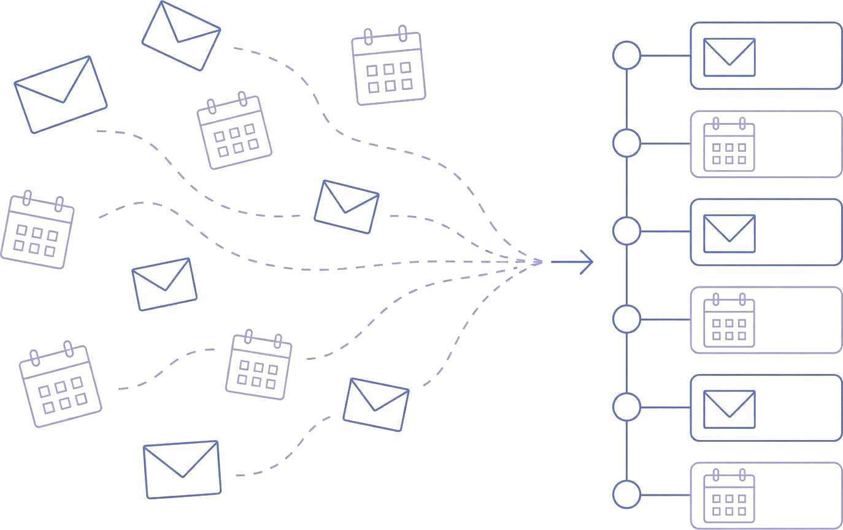
THE SOLUTION
An AI-Powered Project Memory Assistant Where Project Managers use it to:
Connect
Gmail and Google Calendar, read-only access -- nothing else
Organize
AI groups messages and events into projects and extracts decisions and action items -- Nothing needed from you
Catch Up
One digest of what changed, a live action board, everything editable inline

Slide 4
Market Validation
People already want AI to help them catch up
86%
of early Microsoft 365 Copilot users said Copilot made it easier to catch up on what they missed
Survey of 297 Microsoft 365 Copilot Early Access users
THREADLINE FOCUSES THAT NEED ON PROJECT MEMORY
What changed?
When was it changed?
What needs my attention?
Source: Microsoft Work Trend Index, 2023 · 297 Copilot Early Access users
Verify: microsoft.com/worklab/work-trend-index/copilots-earliest-users-teach-us-about-generative-ai-at-work

Slide 5
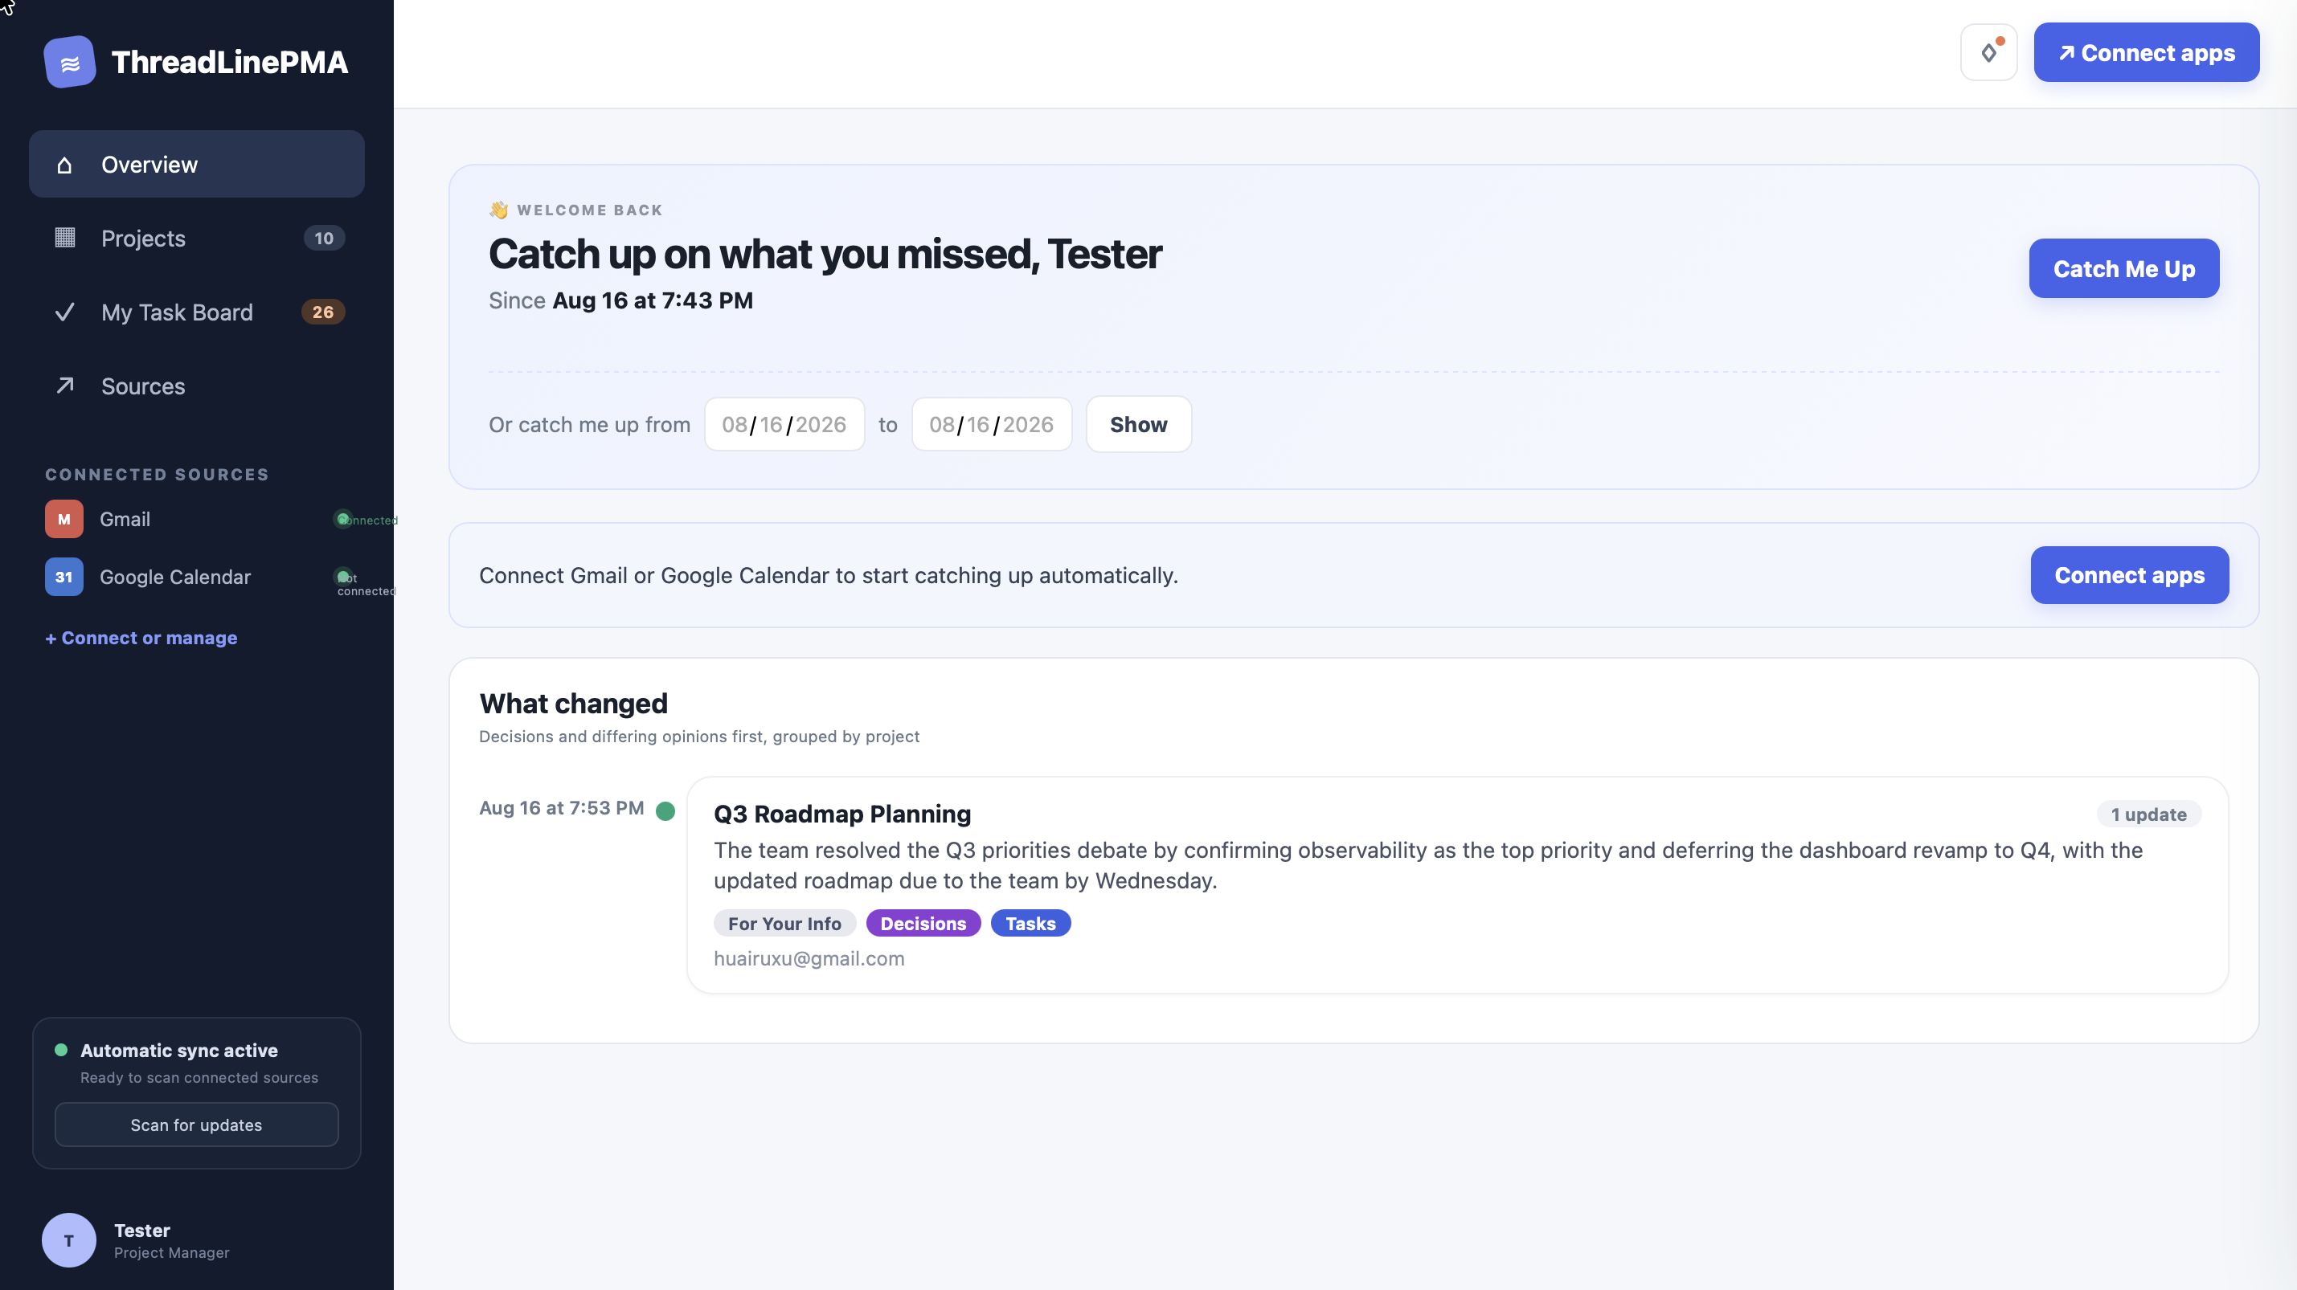
Real Pipeline, Real Data
Product
Technologies Used:
— Supabase data tables
— Anthropic APIs Claude Sonnet 5, Haiku 4.5
— Anthropic Claude AI
— Google Cloud Platform Gmail + Calendar API
— Python
— HTML, CSS, JavaScript

Slide 6
Thank you for listening
Any questions?
Crystal Xu · ThreadLinePMA · 2026

