Slide 1

Installing from Sources
CHUGALUG Meeting
20090319
Lachele Foley

Slide 2
Tips for Safety and Convenience
Avoid installing extra programs as root
  Make an ”installer” account
    Be sure to give ”installer” ownership of a public location
  Some programs require root installation, most do not
    Some actively discourage it
Keep all sources in a common location
  I use /application_downloads
  Easy to back up and to see what you've installed

Slide 3
Selecting a Version
Look for words like ”stable version”
  Avoid nightly builds or pulls from a source repository (e.g. CVS, SVN, git)
    Useful, mostly, for bleeding-edge features and bugfixes
If architecture matters (rarely), ”uname -a”
Linux hawthorne.woods.ccrc 2.6.9-42.0.3.EL #1 Mon Sep 25 17:14:19 EDT 2006 i686 i686 i386 GNU/Linux
Linux byron.woods.ccrc 2.6.9-42.0.3.EL #1 SMP Mon Sep 25 17:14:34 EDT 2006 ia64 ia64 ia64 GNU/Linux

Slide 4
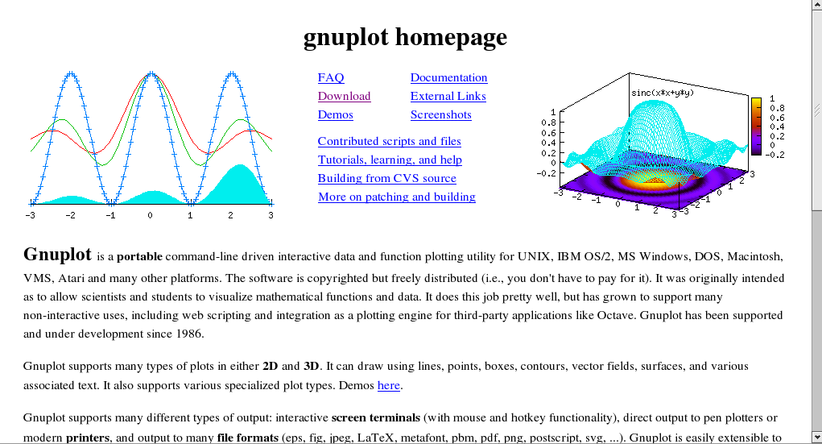
Selecting a Version

Slide 5
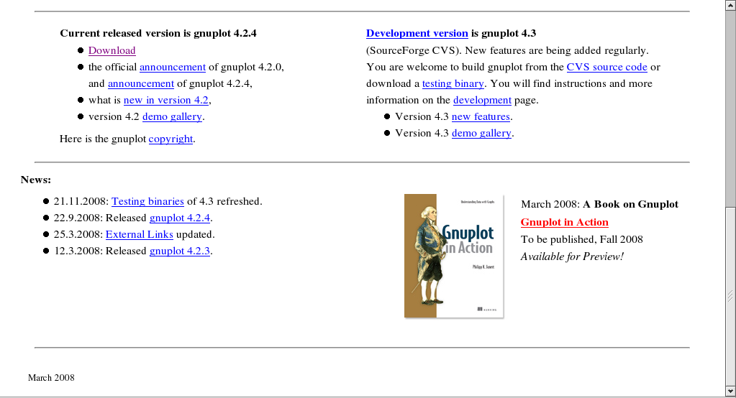
Selecting a Version

Slide 6
Tarballs
tar = ”tape archive”
  ”some_downloaded_file.tar”
Similar to a zipped file in WinX
Might contain files and/or directories
Can also be compressed
  .tar.gz = .tgz (gzipped)
  .tar.bz2 = .tbz (bzipped)

Slide 7
Unpacking Tarballs
Check the contents ”-t”:
  ”tar -tf somefile.tar” or ”tar -tzf somefile.tgz”
Make sub-directory and cd if needed
  Most make their own subdirectory, but not all do
Unpack ”-x”
  ”tar -xf file.tar” or ”tar -xjf file.tar.bz2”
  Verbose, if desired: ”tar -xjvf file.tbz”

Slide 8
Finding the Instructions
Not always easy! (...not always present...)
  Common: README or INSTALL
  Try looking on the web site
  ...or just read the source/makefile/etc.
Most importantly: read!
  Pay careful attention to prerequisites
    If it wants version 2.5, your version 2.6 might not work...

Slide 9
A Common Sequence
./configure; make; make install
./configure
  Customizes the install and checks your setup
make
  Compiles the program (uses a ”makefile”)
make install
  Copies files and info to public locations (etc.)

Slide 10
./configure
Occasionally, instructed to edit manually
  Won't hurt to look at it
Sometimes, help is available
  ./configure -h or ./configure --help often work
If this step ends in an error message, stop
  Re-read and triple-check your setup
  Contact the programmer if you can't resolve

Slide 11
make
Requires ”make utilities” (generally present)
Usually requires a compiler (C, Fortran, etc.)
  Not always present!!! (esp. w/ user-friendly distros)
Executes instructions in a file
  Usually ”makefile” or ”Makefile”
  Only rarely will you have cause to edit
  Change file with ”make -f other_makefile”

Slide 12
More about make
If invoked more than once, will generally pick up where it left off
  Usually the last failed directive
  Useful for troubleshooting
”make clean”
  Usually returns directory to un-”made” state

Slide 13
Libraries
Executables often do not contain all instructions
  Centralized instruction sets
  Smaller executables
  Override with a ”static” build
The communal instructions are in ”libraries.”
  Must be the proper versions, etc.
Check out /lib, /usr/lib, etc., to see some (show)

Slide 14
Troubleshooting
C.a.r.e.f.u.l.l.y read and re-read the instructions
  A misplaced comma or misspelling can wreck
Look at the very first error message
  Re-running make can sometimes help find it
  Often, can make easy sense (e.g. ”file not found”)
Search on the text of the error message
  Can delete terms obviously system-specific

Slide 15
Troubleshooting
Still won't work? Contact the developers.
See if they use bug-tracking software
  Search there, again, for your problem
Find their list of required information

