Slide 1

Scientific Computing and Linux
CHUGALUG Meeting
20090319
Lachele Foley

Slide 2
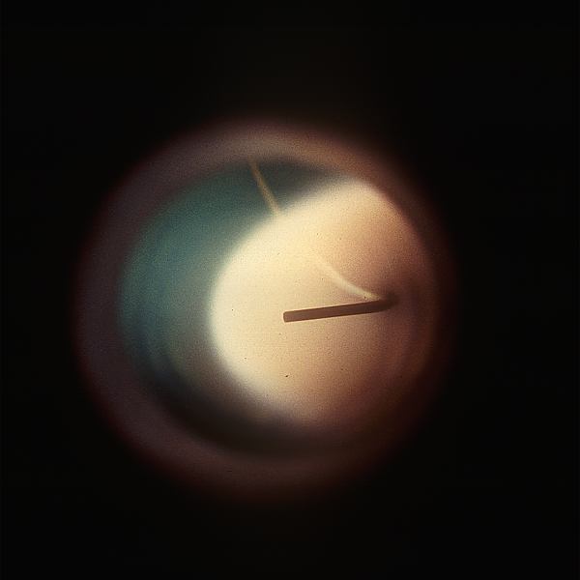
My Background
Linux & scientific computing start together
  Dissertation with major computational component

Slide 3
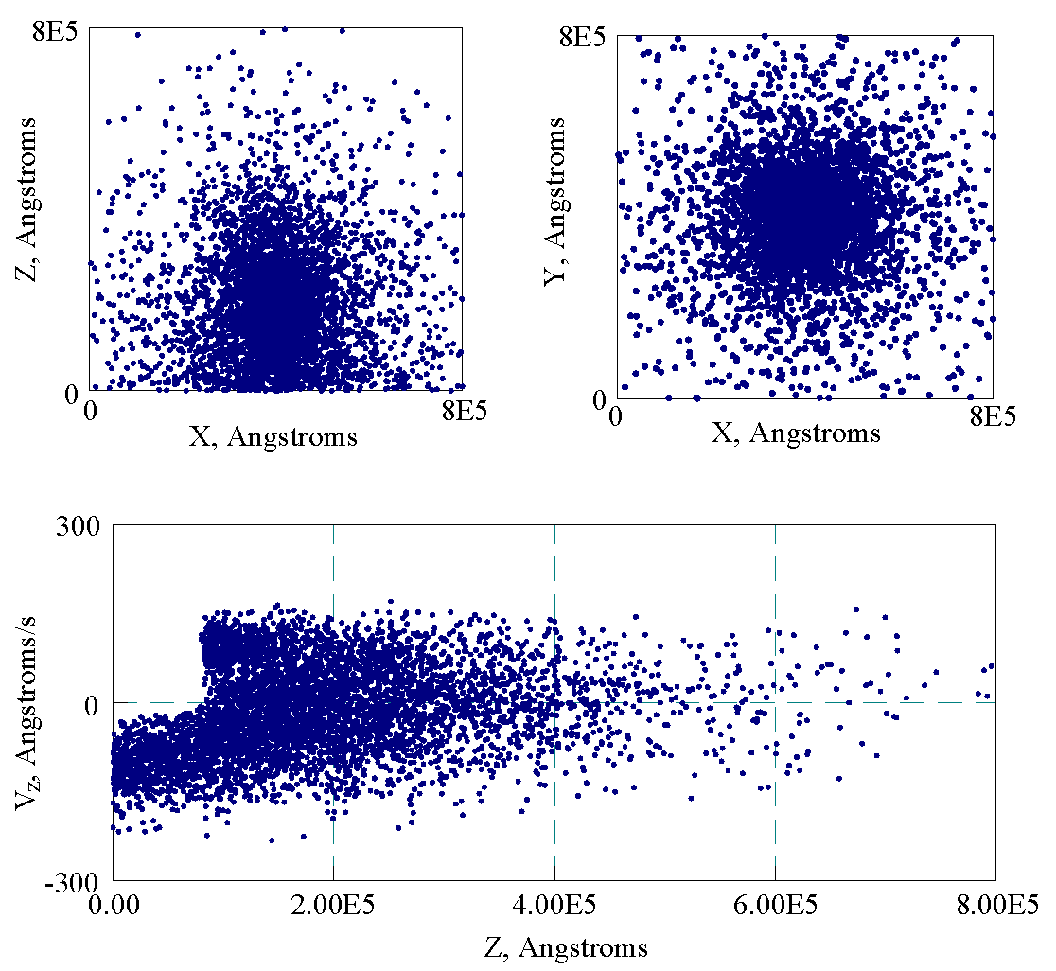

Slide 4
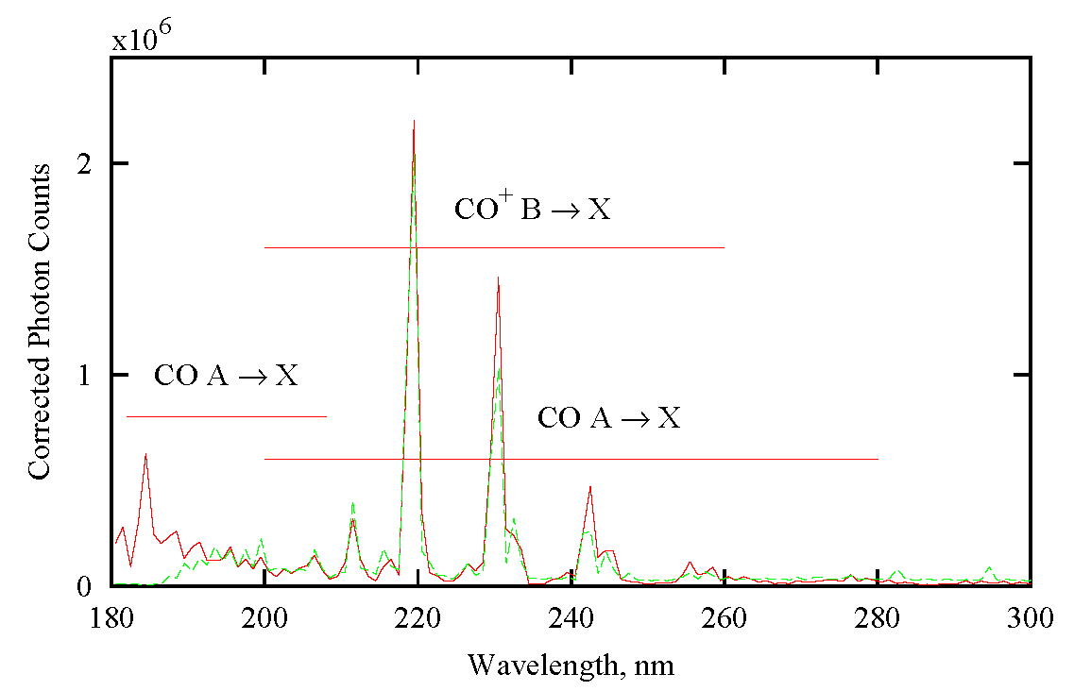

Slide 5
+

Slide 6
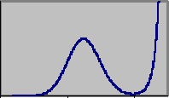
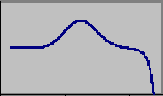
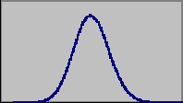
My Background
Computational emphasis when teaching
  Students had to use Linux, compile programs, etc.

Slide 7
My Background
Currently researcher/sysadmin for comp. lab.
  Complex Carbohydrate Research Center (UGA)
  www.glycam.com
    or search on ”Glycam” to learn more

Slide 8
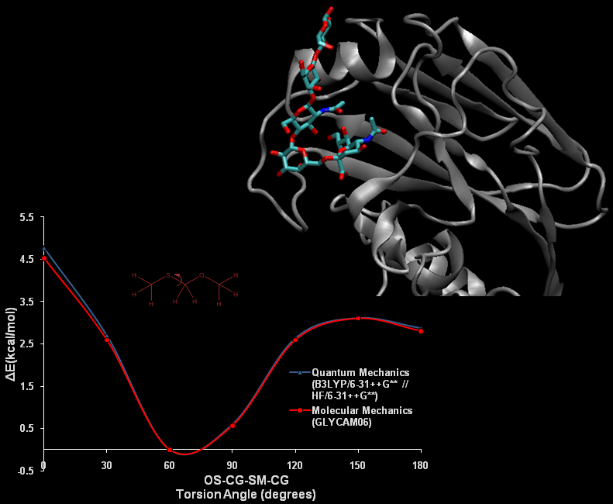

Slide 9
Scientific Computing
Two categories:
  Users of pre-existing scientific software
  Persons involved in generation of the software
    Programmers
    Theoreticians
    Engineers
    (etc.)
Our lab does both

Slide 10
Pre-existing Software
Usually written by scientists, not programmers
    Dictated by practicality, probably won't change
Often not (or minimally) user-friendly
    Mostly ok because scientists are used to that... :-)
Can be out of date, not-quite-portable, etc.
    Just installing it is sometimes a nightmare
Not all is bad!
    Some is also very good, portable, etc.

Slide 11
Pre-existing Software Issues
Not so different from other software:
Hastily written by whoever has the time
Might have very specific pre-requisites
    upgrading the OS breaks package one
    ...but package two requires the bleeding-edge newest
Portability problems
    installing from sources often fixes this

Slide 12
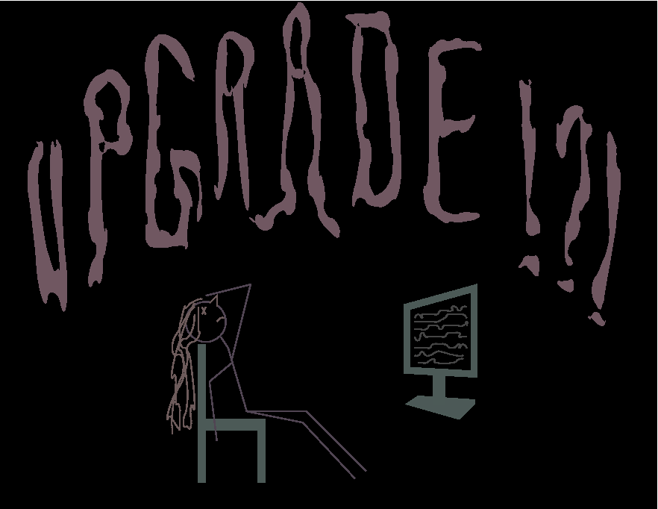

Slide 13
A Bad Day
Need to make simple-ish modification to a file
There is a script already written
  Just need to install it
  Yay!

Slide 14
A Bad Day
It requires the absolute newest numpy
...which requires the newest python
...which requires the newest gcc
...which requires mpid
...and gmp

Slide 15
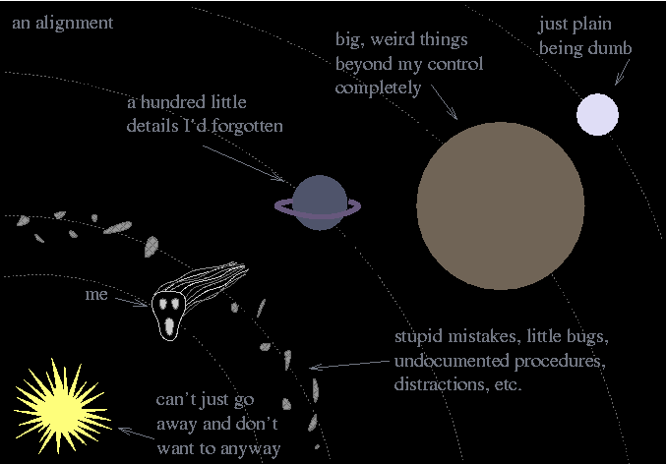

Slide 16
A Bad Day
The script requires the absolute newest numpy
...which requires the newest python
...which requires the newest gcc
...which requires mpid
...and gmp
...and about 8 hours

Slide 17
Getting Better, Mostly
Scientists adopt standard practices
    e.g., ./configure; make; make install
Internet eases learning curves
”Portability” is a commonly known term
    ...as is ”backwards compatibility”, etc.
Larger projects hire programmers, write GUI's

Slide 18
When There Is No Software
Research
  New methods
  Not yet implemented old methods
  Hybrid methods
  Parameter and instruction-set development
Linux's flexibility makes it appealing
...but can also be a source of stress

Slide 19
”...but program X will do that.”
Obtain initial data from somewhere
Use program Z to convert to new format
Write script to rearrange format from 2 for simulation program Y
Write another script for running program Y in unusual manner
Run simulation program Y
Extract results from Y with post-processing program X
Write script to rearrange data from 6 for math package W
Run math package W
Write script to merge results from 8 with original data

Slide 20
Some Utilities Exist
Flexible software packages
    VMD, Chimera
Scripting languages
    MMTK, NAB
Features
  Ready-made, easy & modular for common tasks
  Protection from having to write code (but can...)

Slide 21
Easier Just To Code It
The bottleneck is data read/reformat
    Includes some complex stuff like pattern recognition
    The ”hard” parts – e.g., the math – often easiest
”So, use Perl or Python, etc.” (I know Perl)
    arrays of hashes of arrays indexed to other arrays
    ...and loose memory management means mistakes
    If complex, I find it's easier just to go back to C

Slide 22
So, a Library...
Not a radical idea
  MMTK is fairly similar
Use it rather than
  finding another program to install
  learning a new scripting language
  learning yet another programming language
  stealing other folks' code
    (open is not necessarily free...)

Slide 23
GLYLIB
GLYLIB because ”glyco” for ”sugar”
Centralized data structures
  intuitive and easily extensible
Modular functions
  most operate directly on central data
In plain C
  ANSI/POSIX simplicity wherever possible

Slide 24
GLYLIB
www.glycam.com/glylib
  also: glycam.ccrc.uga.edu/glylib

