Slide 1
Google web graph
7107056103 邱泰霖
7107056045 范均泓

Slide 2
Dataset Introduction
2002 website dataset
Node website
Edge hyperlink
Nodes number: 875,713
Edges number: 5,105,039

Slide 3
Graph Diameter
A
Directed diameter: 22
Undirected diameter: 24
B

Slide 4
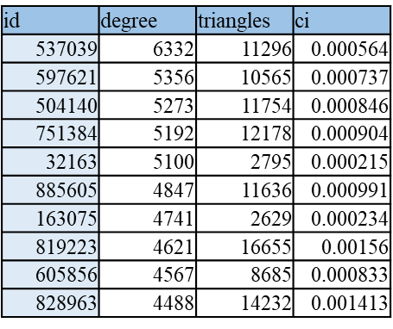

Graph Average Clustering Coefficient
Average $C_{i}$ = 0.160976
Degree為1的Node數: 153,407
扣除Degree為1的Node後Average $C_{i}$ = 0.195165
A

Slide 5
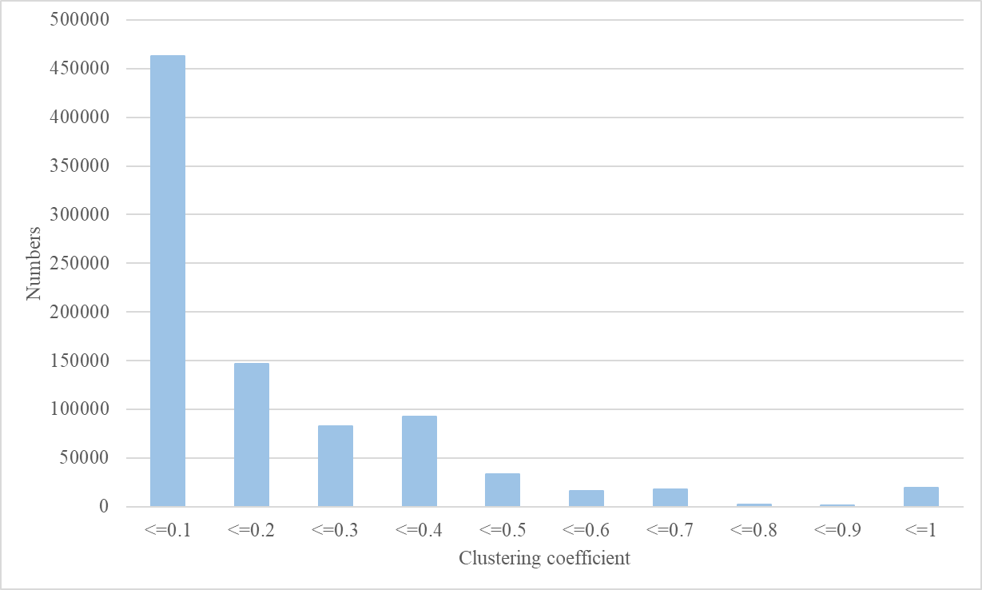
Clustering Coefficient Distribution

Slide 6
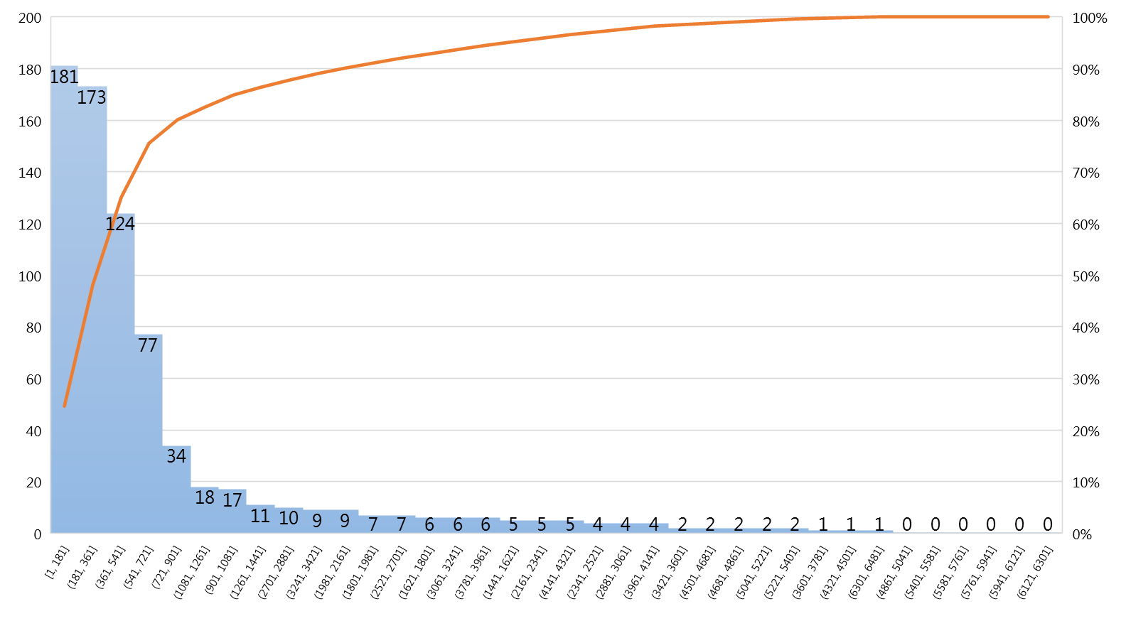
Graph Degree Distribution and Avg. Degree
Average degree: 9

Slide 7
2002 Website Situation
2002年時網頁的總數量為38,760,373
Extended star topology
擁有共同hyperlink的網站互有hyperlink的數量極低
Degree大的網站推測為入口網站
有edge相連的nodes應為同質性高的網站
不同類型的網站有hyperlink的機率低

Slide 8
