Slide 1
Exsample scenario with DRC-DA
Kazuhito MATSUDA

Slide 2
Example scenario: Path validation
Content Provider
(e.g. Facebook)
FUJITSU Cloud K5
DRC-DA
index node
transmit meta-info.
DRC-DA
directory node
post a content
content
put meta-info.
transmit meta-info.
subscribe
AS
(community)
request
actual content
Edge Computer
Edge Computer
AS
(community)
DRC-DA
index node
DRC-DA
index node
Local Delivery
Local Delivery
get or subscribe
content meta-info.
put meta-info.
put meta-info.
subscribe
path validation

Slide 3
Example of meta-info.
a meta-info entry
page_id: unique ID of content owner (such as original AS number)
post_id: unique ID of content
distribution_path: ordered list of distribution path (list of AS number)
requested_num: number of users requesting this content
duration: time duration of this meta-info. entry

Slide 4
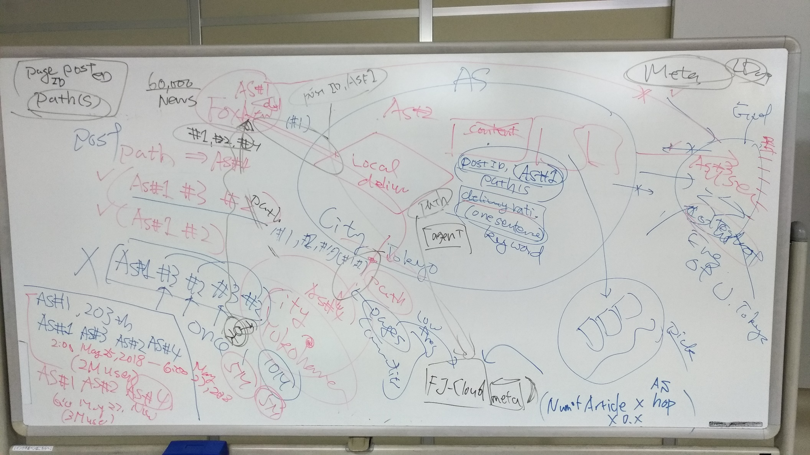

Slide 5
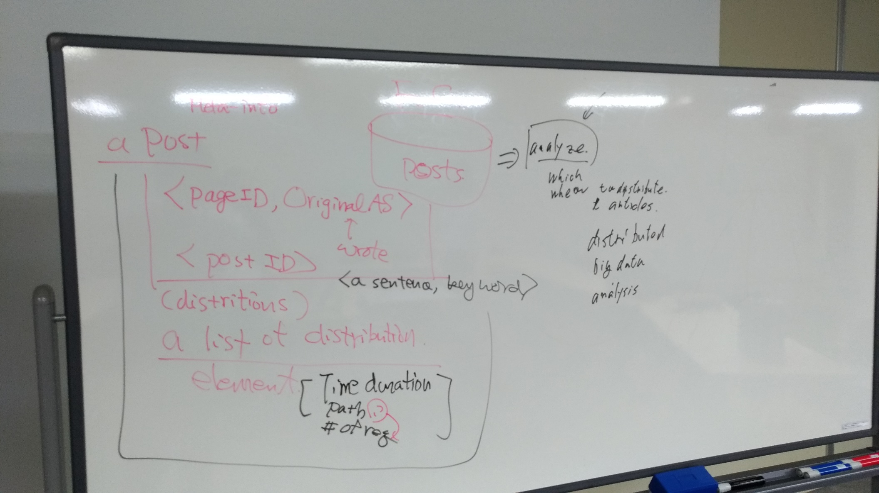

Slide 7
Example scenario: Path validation
Ensure “the content has been published at certain AS”
Note: it rely on PKI
FUJITSU Cloud K5
DRC-DA
directory node
Content Provider
(e.g. Facebook)
AS
(community)
content
b3. get meta-info.
b2. get content
AS
(community)
a4. put content
Edge Computer
a3. transmit meta-info.
Edge Computer
Local Delivery
DRC-DA
index node
DRC-DA
index node
Local Delivery
a1. publish content
b1. request content
a2. put meta-info.
includes signature
for path validation
b4. path validation

Slide 8
Example scenario: Additional meta-info.
Even after the first news posted, some additional meta-info. can be generated
ex.) related posts by other users can validate that the post is fake or not
FUJITSU Cloud K5
DRC-DA
directory node
Content Provider
(e.g. Facebook)
AS
(community)
content
b3. get meta-info.
b2. get content
AS
(community)
a4. put content
c1. get content
Edge Computer
a3. transmit meta-info.
Edge Computer
Local Delivery
DRC-DA
index node
DRC-DA
index node
Local Delivery
a1. publish content
b1. request content
a2. put meta-info.
includes signature
for path validation
c2. put additional
meta-info.
b4. path validation

Slide 9
Topic
What kind of meta-info. suits to the use-case?
some similar posts are published by other users
GPS, image content analysis, etc.
How develop a PoC prototype?
Can communicate via slack?

