Slide 1

case studies
Lead UX designer for AI products.
Five case studies, each with the calls I made,
how I led the team, and what came of them.
michaelthibodea(UX)
www.michaeljthibodeau.com

Slide 2
POINT OF VIEW
I design trust into high-stakes business decisions.
AI verifies; the person decides
Measurements, not confidence scores
AI translates, explains and checks the user’s own criteria. It never recommends, predicts or places orders.
Show what was measured and how often it held, with sample sizes. Abstain when the data isn’t there.
Consequences before commitment
Guidance that fits the frequency
Rules are replayed on recent history before they’re saved. Every change is logged, with Undo.
Daily users get help that fades with fluency. Rare tasks, like OBI and MOCA, get a short guided path.
FINVIZ · CREDIT SUISSE · WELLS FARGO · AMEX · MERIDIAN

Slide 3

CASE STUDY 01 · AI PRODUCT · CONCEPT
FinViz
AI Screener: The Trading Day
Getting new traders to a screen they trust in their first session, then watching it for them. Goal: cut sign-up to Elite from 42 to 21 days.
ROLE
Lead UX designer
TEAM
Solo lead with AI agents for drafting; four design reviewers
SCOPE
Research to hi-fi: 19 screens, design system, live prototype
STATUS
Concept. Tests are set; none has run yet
“Alerts are everything. Once you close FinViz, you get nothing.”
Notes:
Opener in the portfolio format. Concept-stage work; screens are illustrative with fictional tickers. The quote paraphrases reviewer point R3 from the 30 Sept design review.

Slide 4
FINVIZ AI SCREENER · OVERVIEW
The Trading Day: FinViz keeps watch while you work
PRODUCT
An AI layer for the FinViz stock screener.
PROBLEM
Swing traders with day jobs build a screen at night, can’t watch the market 9:30–4, and miss the moment their setup happens. New users take 42 days to see why Elite is worth paying for.
AI SOLUTION
AI turns the stocks he already likes into a working screen, remembers why he picked each one, watches it on his schedule and explains every finding with its evidence. It verifies; he decides.
MY ROLE
Lead UX designer: research, strategy, AI UX principles, concept, low-fi to hi-fi, design system. AI agents for drafting; every call mine.
HERO The Insight Board at 7:45 AM: three sourced findings about his own names, on the FinViz Home he already knows.
19 hi-fi screens · one trade · Monday evening to Sunday · FinViz design system v1.0 · personas and data are synthetic
Notes:
SCRIPT
[open] Meet Gary. He swing trades, and he has a day job. He finds ideas at night, can't watch the market from 9:30 to 4, and too often misses the moment a stock does exactly what he was waiting for. Today, a FinViz screen is something he visits. By morning, it's forgotten.
This is what changes when FinViz keeps watch for him.

Slide 5
FINVIZ AI SCREENER · CONTEXT
An AI layer that turns what a trader already has into a working screen, and watches it through the day.
TARGET AUDIENCE
— Swing traders with a day job
— Day traders
— Value investors
THE PROBLEMS
— Ideas don’t become a working, watched screen
— FinViz is nearly absent during market hours
— 89 filters in preset buckets; exact values are Elite-only
— Results show no reason why a stock matched
— New users stall before Elite’s value is obvious
TEAM AND MY PART
— Concept project from a design-course brief. I led it, with AI agents for drafting and four design reviewers
— I ran discovery, research, strategy, the AI design principles and the hands-on design
— I led every deliverable in Figma and FigJam, ran the design review, and made and recorded the key calls

Slide 6
FINVIZ AI SCREENER · WHY
Why design an AI layer for the screener?
89
filter dropdowns, most in preset buckets
42 → 21
days from sign-up to Elite: the business goal
87 of 89
filters need Elite for an exact value
0
Today: 42 days
AI features in the FinViz screener today
Goal: 21 days
“Too many filters, and no filter literacy. And a chat box is not the answer.”
Notes:
Facts from FINVIZ-CONTEXT (verified on the live site): 89 filter dropdowns, 87 with Custom as Elite-only, no generative AI. 42 → 21 days is the case-brief goal. Quote paraphrases reviewer point R5.

Slide 7


FINVIZ AI SCREENER · CONTEXT
FinViz today: tour-led onboarding, AI only on the news
1
The guided-tour prompt
“First Time Here? Watch the Guided Tour”: FinViz’s answer to first use is still a tour, now promoted on the home page.
2
3
2
“Weekend Brief”
A news summary that appears AI-generated, with 👍/👎, but isn’t labelled as AI. Nothing like it in the screener.
3
A dense dashboard
Rule-based signals, insider tables, futures, a heat map and heavy ads: what a newcomer meets first.
1
finviz.com home page, Oct 4 2026
Notes:
Current state, from screenshots taken Oct 4 2026. The Weekend Brief appears AI-generated but is not labelled as AI.

Slide 8
FINVIZ AI SCREENER · CONTEXT AND CONSTRAINTS
The environment the AI had to fit
BUSINESS CHALLENGE
Halve the time from free to Elite, 42 → 21 days, without annoying users (course brief, OKR 1). Elite sells persistence: alerts, real-time data, backtests. A user without a working screen has no reason to pay.
STAKEHOLDERS
Traders: Growth Gary (primary), Fast Frank, Value Vivian, Multi Mike. FinViz growth (Elite conversion), compliance (the advice line), engineering (screener, alerts, data feeds).
SUCCESS CRITERIA
Time to first success: an insight that is actionable, timely and relevant to his own holdings, in the first session. Then a habit: a saved screen re-run 3+ days a week (North Star).
TECHNICAL CONSTRAINTS
No AI in FinViz’s screener today. 89 filters; Free uses preset buckets. Free quotes 1-min delayed; pre-market is Elite. LLMs can invent: output must map to real filters. No AI-originated advice, predictions or confidence %. Desktop only.
WHAT THIS MEANT FOR THE DESIGN
Free builds and previews; Elite watches
Every AI output maps to something real
Verification, not advice
The paywall sits where the value is felt: live alerts on his own names.
A FinViz filter, a measured value or a cited source, or it says it can’t tell.
The AI checks his own criteria; decisions end in his broker.

Slide 9
FINVIZ AI SCREENER · COMPETITIVE LANDSCAPE
FinViz stays the fastest place to find ideas. The AI layer explains them.
WHERE IT IS STRONG
WHERE THE AI LAYER FITS
TradingView
Charting and community. Ships AI document and news summaries, and a Chart Copilot (beta) that sets alerts in plain English.
Explains the trader’s own screen and keeps his reasons. FinViz stays the fastest place to find ideas.
Trade Ideas
Real-time scanning at tick speed. Holly AI posts trade ideas with entry, stop and target; a plain-English scan builder.
FinViz never originates trades or confidence scores. It checks the trader’s own criteria and watches his saved screen.
Bloomberg Terminal
Market data and news for professionals, with AI document search and news summaries.
Cost and complexity. FinViz’s job is discovery for individual traders.
Source: competitor product pages and reviews, checked October 2026. Competitor features change quickly.

Slide 10
FINVIZ AI SCREENER · THE PROBLEM
Two problems, defined separately, so the AI only does what a rule can’t.
User problem
AI problem
Why AI is appropriate
Gary can find ideas but can’t hold on to them. 89 filters with no explanation; a list that forgets why he picked each stock; nothing reaches him at work; the decision to hold or exit happens in his head.
Infer a screen from 3 example tickers · explain why each row matched from real values · re-check his reasons against fresh data 3× a day · detect chart patterns with measurable criteria · summarize overnight news on his names, with sources · turn corrections into proposed rule changes.
Translating examples and plain English into 89 filters, and summarizing many sources, are language tasks. Scanning 30 charts for the same setup is repetitive perception. Where a rule is enough we used a rule: the since-last-night diff, exit lines, quiet hours and the activity log are not AI.

Slide 11
FINVIZ AI SCREENER · THE PROBLEM
“Once you close FinViz you get nothing, and setting up alerts today is quirky.”
Design review feedback, Sept 30
SEVEN PAINS, RANKED BY USER AND BUSINESS IMPACT
01
Ideas can’t become a working, watched screen
05
Filters in fixed buckets; exact values are Elite
02
Blind during market hours
06
Alert noise
03
Too many results, and no reason why they matched
07
Catalysts scattered across pages
04
Which metric matters, and what counts as good?
Notes:
From the pain register (03c), P1, P9, P5, P3, P2, P10, P13: 27 pains in total, scored urgency × business impact.

Slide 12
FINVIZ AI SCREENER · DATA FOUNDATION
Designed for what the data supports.
DATA SOURCE
USED FOR
VOLUME
QUALITY AND CONSTRAINTS
Screener data
89 filters, ~11,700 tickers
Examples → filters; why it matched; lenses
~11.7k tickers × 89 fields, daily; intraday on Elite
Free maps to preset buckets (marked ≈); exact values on Elite
Price and volume bars
Daily bars per ticker
Pattern detection; 30-day replay; reasons checks
3+ years of daily bars per ticker
Gaps and splits: the detector says “not enough data” instead of guessing
Calendar, news, analysts
Third-party feeds
Morning glance; insight cards; map notes
Dozens of sources a day
Every claim cites source and time; no cause inferred without a source
His data, opt-in
Screens, reasons, notes, exit lines
Personal rules; what to watch and when
Small, per user
Visible, editable, deletable; never turned into recommendations
Labels
His corrections + weekly audits
Evaluate and tune detection and alerts
Grows with use; 50 detections audited a week
Corrections skew toward noise; sampled audits keep the error rate fair
Volumes are design estimates to validate with FinViz engineering. Every AI output shows the data behind it and its time; when data is missing, the product says so.

Slide 13
FINVIZ AI SCREENER · THE SOLUTION
One trade, one trading day.
Hi-fi first: one trade followed through one trading day, Monday evening to Sunday. 19 screens designed in the FinViz dark theme, built only from the design system’s tokens. Purple marks AI and nothing else.

Slide 14
FINVIZ AI SCREENER · SOLUTION
One trade, followed through one trading day.
Growth Gary, a swing trader with a day job, finds an idea at night, checks it before work, gets one alert while he’s busy, and decides after the close whether his reasons still hold. FinViz watches and explains at the right moment; Gary makes every decision, in his own broker.
1
8–10 PM
Evening
Reviews what’s new, pins 3–5 names, taps “Watch these for me”
2
WHILE HE SLEEPS
Overnight
Nothing to do; a bounded agent re-checks his names
3
7:30 AM
Before work
Reads one short note
4
9:30 AM–4 PM
During work
Taps one alert, if it comes
5
4:30 PM
After the close
Decides: hold, or exit in his own broker
Notes:
SCRIPT
[open] Meet Gary. He swing trades, and he has a day job. He finds ideas at night, can't watch the market from 9:30 to 4, and too often misses the moment a stock does exactly what he was waiting for. Today, a FinViz screen is something he visits. By morning, it's forgotten.
This is what changes when FinViz keeps watch for him.

Slide 15


















FINVIZ AI SCREENER · SOLUTION
The whole trading day
One trade, Monday evening to Sunday. Every screen is designed in hi-fi and linked as a clickable prototype.
01 Show It
Mon 8:05 PM
02 Since last night
Mon 8:10 PM
03 Lens grid
Mon 8:20 PM
04 Linked compare
Mon 8:26 PM
05 Reasons ledger
Mon 8:32 PM
06 Watch these for me
Mon 8:40 PM
07 Morning glance
Tue 7:30 AM
08 Why marked
Tue 7:40 AM
09 Insight Board
Tue 7:45 AM
10 Insight, opened
Tue 7:45 AM
11 Quiet hours, one alert
Tue 10:14 AM
12 This was wrong
Tue 10:31 AM
13 Board at lunch
Tue 12:30 PM
14 Reasons still hold?
Tue 4:30 PM
15 Portfolio vs plan
Tue 4:45 PM
TRY IT
Open the clickable prototype →
Starts at step 1 in Figma
16 Lens on portfolio
Tue 4:50 PM
17 Activity log + Undo
Tue 5:15 PM
18 Weekly review
Sun 7 PM
19 Build the board
Sunday

Slide 16
FINVIZ AI SCREENER · SOLUTION · STEPS 1–2 OF 19
Show It + Since Last Night: an idea becomes a screen he trusts
Mon Oct 5, 8 PM, after Monday’s close. Free account.
THE DAY Evening › Overnight › Before work › During work › After the close
Where the story starts: Monday after the close, on a free account.
STEP 2 · OW2 New, dropped and near-miss rows first, each with which of his criteria it meets
STEP 1 · OW1 Pastes 3 tickers; AI writes what they share as editable filter chips
AI BEHAVIOR
Programming by example: three tickers become editable filter chips
Constrained to FinViz’s real filters; nothing invented
Decision point: he keeps or drops each chip (Tab / Esc)
Notes:
SCRIPT
[OW1] Gary doesn't start with 89 dropdowns or a chat box. He pastes three stocks he already likes. FinViz's AI works out what they have in common, and the result is real filter chips he can edit, with a live count. AI learns from his examples. It doesn't make him write a query.
[OW2] He opens his saved screen. The new names are at the top, and every row shows which of his criteria it meets, or how close it came. The "why it matched" comes from real values, never a score.

Slide 17
FINVIZ AI SCREENER · SOLUTION · STEP 6 OF 19
Watch These For Me
Mon 8:40 PM. The one earned Elite moment.
THE DAY Evening › Overnight › Before work › During work › After the close
Before this: he checks his charts (steps 3–4) and pins 3 names with reasons (5).
DECISION POINT
Replay before commitment: his criteria “would have fired 4 times in the last 30 days”
The noise dial redraws history live as he drags it (9 → 4 → 2 a month)
The 7-day Elite trial starts here, where the value is obvious, not at sign-up
Notes:
SCRIPT
[OW4] One tap. Before he commits, FinViz replays the last 30 days: "Your criteria would have fired 4 times." He drags the noise dial and the timeline redraws. He sees what he'll get before he signs up for it. His 7-day Elite trial starts here, because this is the moment the value is obvious.

Slide 18
FINVIZ AI SCREENER · SOLUTION · STEP 7 OF 19
Morning glance: one note before work
Tue Oct 6, 7:30 AM. An email, readable in 30 seconds.
THE DAY Evening › Overnight › Before work › During work › After the close
Overnight, a bounded agent re-checked his 3 names only; there is nothing to log in to.
AI BEHAVIOR
A bounded agent on his names only: sourced news, earnings and his reasons, re-checked
DOCN: 1 of 3 reasons at risk, with its source and time
Only clear lens hits reach the inbox; borderline ones wait in the grid

Slide 19
FINVIZ AI SCREENER · SOLUTION · STEP 8 OF 19
Chart Lens: why FinViz marked this
Tue 7:40 AM. Opened from “Why marked?” in the morning glance.
THE DAY Evening › Overnight › Before work › During work › After the close
Opened from “Why marked?” in the 7:30 AM morning glance (step 7).
AI BEHAVIOR
Measurements, not a confidence score: wick 2.6× body, at support, volume 2.4× its norm
Clear, borderline or not enough data; only clear findings reach his inbox
History with its sample size (38 matches in 3 years) and a visible track record
Notes:
SCRIPT
[CL4] His chart setups show up too, but only the clear ones. Tap "Why?" and he sees what FinViz measured: wick 2.6 times the body, at support, volume 2.4 times its norm. When it isn't sure, it says so. Reliable by design: measurements, not confidence scores.

Slide 20
FINVIZ AI SCREENER · SOLUTION · STEP 9 OF 19
Insight Board, pre-market
Tue 7:45 AM. FinViz Home, upgraded.
THE DAY Evening › Overnight › Before work › During work › After the close
Then: he opens one finding to see its evidence and source (step 10).
AI BEHAVIOR
Three findings that need him today, each sourced and labelled Clear
The familiar parts stay: index row, breadth bars, S&P 500 map, now with AI notes
Pre-market prices on his own names are the Elite moment
Notes:
SCRIPT
[DB1] When Gary sits down, the board he keeps open isn't a page of data. At the top are three findings that need him, each one sourced: a DOCN reason at risk, QLYS reports tonight, and semis are down after NVDA's results, with RMBS in that group. Insights, not widgets.

Slide 21
FINVIZ AI SCREENER · SOLUTION · STEP 11 OF 19
Quiet hours, one alert
Tue 10:14 AM. At work; a browser push that leads with the reason.
THE DAY Evening › Overnight › Before work › During work › After the close
He painted quiet hours once (9:30 AM–4 PM); only his own criteria can interrupt.
DECISION POINT
Quiet 9:30–4 unless his own criteria are met
One push, reason first: Rel Vol 2.9 (your > 1.5), crossed its 20-day high
Three choices: open the chart, say it was wrong, or mute the name

Slide 22
FINVIZ AI SCREENER · SOLUTION · STEP 12 OF 19
Alert correction: “this was wrong” becomes a proposed fix
Tue 10:31 AM. The alert opened on the RMBS quote page.
THE DAY Evening › Overnight › Before work › During work › After the close
Straight from the 10:14 AM alert (step 11): he tapped “This was wrong”.
DECISION POINT
His reason (“too early”) becomes a specific change to his own rule
Before/after replay: 4 → 2 alerts in 30 days, both acted-on alerts kept
Nothing changes until he applies it; every change is logged with Undo
Notes:
SCRIPT
[AN7] It came too early, so he taps "This was wrong" and gives the reason. FinViz proposes a tighter rule and shows him the replay: 4 alerts become 2, and the ones he acted on are kept. Nothing changes until he applies it. The AI learns from his corrections, in the open.

Slide 23
FINVIZ AI SCREENER · SOLUTION · STEP 14 OF 19
Reasons Still Hold?
Tue 4:30 PM. DOCN closes below its SMA50: a reason breaks.
THE DAY Evening › Overnight › Before work › During work › After the close
Before this: at lunch the board showed alerts sent and held back (step 13).
DECISION POINT
A checklist that ticks itself against today’s close
What changed and when, on the chart; his exit line ($34.00) not met
Hold or exit is his call, in his own broker; FinViz never places orders
Notes:
SCRIPT
[OW7] After the close, a checklist that ticks itself. RMBS and QLYS: all reasons hold. DOCN: two of three. FinViz shows what changed and when. It checks his reasons. It doesn't give advice. Hold or exit is Gary's call, made in his own broker. FinViz never places a trade.

Slide 24
FINVIZ AI SCREENER · SOLUTION · STEP 17 OF 19
Activity log: everything, with Undo
Tue 5:15 PM. Every send and change, who did it, and why.
THE DAY Evening › Overnight › Before work › During work › After the close
The day’s record: every alert FinViz sent and every rule that changed, by FinViz or by him.
AI BEHAVIOR
✦ marks what FinViz did; a dot marks what he did
Every change shows its reason and effect, with Undo for 30 days
Nothing changes silently; sent messages can’t be unsent, so they have no Undo

Slide 25
FINVIZ AI SCREENER · PROTOTYPE
Click through the whole day yourself.
19 linked hi-fi screens in Figma, starting at step 1. Each screen moves forward through its real button: Save screen, Charts, Compare selected, Watch these 3 for me… through Save layout on Sunday.
Open the Figma prototype →
Or start at the workflow map →
ALSO AVAILABLE
An offline HTML version with the narrative for every step and a full link map: The-Trading-Day-Prototype.html.

Slide 26
FINVIZ AI SCREENER · REASONING
Trade-offs and rejected alternatives
The section that matters most: why the AI behaves the way it does.
WE CHOSE
WE REJECTED
WHY
Examples → editable filter chips
A chat box as the main way in
Real tasks are ambiguous; chips can be inspected, edited and saved
Measurements; clear / borderline / abstain
A confidence % on each detection
A number implies precision we can’t guarantee; measurements can be checked
Verify the trader’s own reasons
AI buy/sell calls, “top picks”, scores
Compliance and trust; attributed third-party views only, pending compliance review
One reason-first alert in quiet hours
A live stream of every signal
Alert fatigue kills the habit; replay shows the cost first
Propose rule changes; apply on accept
Silent auto-tuning
He keeps control; every change announced, with Undo
A bounded agent on his names only
An open-ended research agent
Limits cost, hallucination surface and privacy exposure
Neutral “Clear”, amber “Borderline”
Green for “Clear”
Green means price up, nothing else
Desktop first
Mobile in release 1
The screener lives on desktop; mobile deferred, not dropped
ACCURACY VS CONTROL When the model is unsure, the product shows less and asks more. Borderline findings stay visible but never interrupt.

Slide 27
FINVIZ AI SCREENER · REASONING
Eight design calls that changed the work
01
SEPT 23
Map today’s onboarding before designing
02
SEPT 23
Desktop only, for now
03
SEPT 23
One design for first-time and repeat users
04
SEPT 24
Remove real frictions with new AI models
05
SEPT 30
Optimize time to first success; no chat box first
06
SEPT 30
Set the advice line, pending compliance
07
SEPT 30
Lead with the swing trader’s trading day
08
OCT 1
Bring teammates’ screens in line with the rules
The two orange rules mark the calls that reset the project: time to first success, and leading with the trading day.

Slide 28
FINVIZ AI SCREENER · REASONING
What each call solved (1 of 2)
DESIGN LEAD CALL
WHY IT WAS NEEDED
WHAT IT SOLVED
01 Map today’s onboarding before designing
SEPT 23
The docs assumed there was no trial and that slow free quotes were a big pain
A live-site walk found the existing 7-day trial and 1-minute-delayed quotes; the trial now starts from the first saved screen
02 Desktop only, for now
SEPT 23
No native app; two form factors would split the effort
Every screen scoped to 1440px desktop; mobile deferred
03 One design for first-time and repeat users
SEPT 23
Onboarding gates fail repeat users, who keep meeting new filters and decisions
“Onboarding is not a phase”: help fades per concept; no wizard, no tour
04 Remove real frictions with new AI models
SEPT 24
The first concepts were generic AI features
Every mechanic names the friction it removes and the AI advance it uses

Slide 29
FINVIZ AI SCREENER · REASONING
What each call solved (2 of 2)
DESIGN LEAD CALL
WHY IT WAS NEEDED
WHAT IT SOLVED
05 Optimize time to first success; no chat box first
SEPT 30
Text-to-filters assumed traders can state ambiguous intent precisely
Imports and examples lead; success must be timely, relevant and actionable
06 Set the advice line, pending compliance
SEPT 30
Buy or sell advice is a legal line
AI never originates advice; attributed analyst views behind a flag
07 Lead with the swing trader’s trading day
SEPT 30
Three concepts competed; none followed the real routine
The Trading Day became the lead concept
08 Bring teammates’ screens in line with the rules
OCT 1
Frames drafted orders, showed confidence % and fit scores
Every flow ends at the trader’s decision and “Open in your broker”

Slide 30
FINVIZ AI SCREENER · REASONING
Scope, evidence, approval, undo: the agent trust pattern.
Scope
Evidence
The overnight agent works on his names only, in one batch at 6 AM. It reports; it never acts.
Every line cites a value or a source and its time: clear, borderline or “not enough data”, never a guess.
Approval
Ledger and Undo
Corrections become proposed rule changes with a before/after replay. Nothing changes until he applies it.
Every send and change is logged with who did it, why and when. Any of it can be undone.

Slide 31
FINVIZ AI SCREENER · METHODOLOGY
AI drafts. The design lead decides.
1
Frame
DESIGN LEAD
Sets the question, audience, scope and rules: desktop only, no advice, purple means AI
2
Draft
AI AGENTS
Research, docs, FigJam boards and Figma screens, drafted against those rules
3
Review
LEAD + TEAM
Fact checks on the live site; critique with the team; rule breaks caught
4
Decide
DESIGN LEAD
What to adopt, rename, cut or lead with, and why
5
Propagate
AI AGENTS
Each decision applied across every doc, board and screen
Repeated in every phase: research → principles → concepts → screens. Rules set by the lead live in the project brief, so every AI draft starts from them.
Notes:
Crimson = design lead checkpoints; violet = AI. The workflow I ran for this project.

Slide 32
FINVIZ AI SCREENER · IMPLEMENTATION
Built mostly on what FinViz already runs, plus a few small services.
ALREADY IN FINVIZ
— Screener and its URL filter engine
— Rule-based pattern signals
— Elite alerts and the 7-day trial
— Earnings calendar and news feeds
— Portfolio and Maps
NEW SERVICES
— Translation: LLM + filter-schema validator
— Reasons engine: checks at 7:30, 12:00 and 4:30
— Replay service for alert previews
— Overnight agent: one batch at 6 AM
— Quiet-hours scheduler + activity log
INTEGRATION CHALLENGES
— LLM latency vs an instant screener: stream chips, cache common screens
— Free (delayed) vs Elite (real-time) data paths
— Overnight agent cost per user
— Compliance gate and feature flag for attributed views
Proposed, not built: a plan to agree with FinViz engineering. One token library (Figma variables matched to FinViz CSS variables), KPI events defined with analytics, compliance pre-review.

Slide 33
FINVIZ AI SCREENER · WHAT WE SAW
FinViz has 89 filters and no AI in the screener. New users still get a tour.
0
89
87/89
7 days
filters need Elite for an exact value
Elite trial, card required, offered at sign-up, before any value
filter dropdowns, most in preset buckets
AI features in the screener; AI appears only on the news
A four-person design review (Sept 30, 31 points) changed the goal: time to a first success, an insight that is actionable, timely and relevant to the trader’s own stocks. Then a habit.
Sources: live-site audit of finviz.com, Oct 4 2026; design review, Sept 30. Desk evidence, not yet confirmed with FinViz users.

Slide 34
FINVIZ AI SCREENER · AFTER TESTING
Four tests are set, each with a bar to pass. Nothing is measured yet.
TEST
WHAT IT MEASURES
BAR TO PASS
RESULT
Show It eval
40 fixed requests on the live prototype
Right filters, invented codes stopped, asks when vague, refuses to predict
< 2% wrong translations
PLANNED
Ready to run
Trader sessions
5 swing traders, think-aloud
Time to a first saved screen; trust; whether the replay is understood
Under 5 min · trust 5+ of 7 · 4 of 5 explain the replay
PLANNED
Kit ready
Alert diary
2 weeks with alerts on
Alerts that lead to an action; alerts muted
Over 40% acted on · under 10% muted
PLANNED
After sessions
Days to Elite
A/B against today’s sign-up trial
Days from sign-up to Elite
42 → 21 days
PLANNED
Needs FinViz data
Each PLANNED result is replaced with the measured number when its test runs. Bars come from the KPI framework and the validation kit.

Slide 35
FINVIZ AI SCREENER · LEARNINGS
What leading with AI taught me.
The bottleneck moves to judgment
Write the rules down once
Drafts take minutes. The lead’s value is framing, checking facts and deciding what to keep.
Rules in the project brief made every AI draft start compliant.
Check the live product, not the docs
Reconcile, don’t overwrite
One live-site walk overturned two assumptions.
Teammates’ screens kept their best ideas and lost only what broke the rules.

Slide 36
FINVIZ AI SCREENER · NEXT STEPS
Before launch: what to validate next
Nothing has launched, so these replace post-launch learnings: the riskiest assumptions, and how to test them.
RISKY ASSUMPTION
HOW WE TEST IT
Will traders trust AI-detected patterns?
Offline audit of 500 labeled charts; track the “not a real hammer” rate; test clear vs borderline wording.
Does free AI screen-building speed up Elite or replace it?
A/B the earned Elite moment (step 6) against today’s sign-up trial; measure days to Elite.
Is one alert a day the right amount?
2-week diary study: alert-to-action over 40%, muted under 10%.
Can the overnight agent pay for itself?
Cost per user per morning vs conversion lift; batch and cache by ticker.
Is the advice line clear enough for compliance?
Legal review of every AI string; attributed views stay behind a flag until cleared.

Slide 37
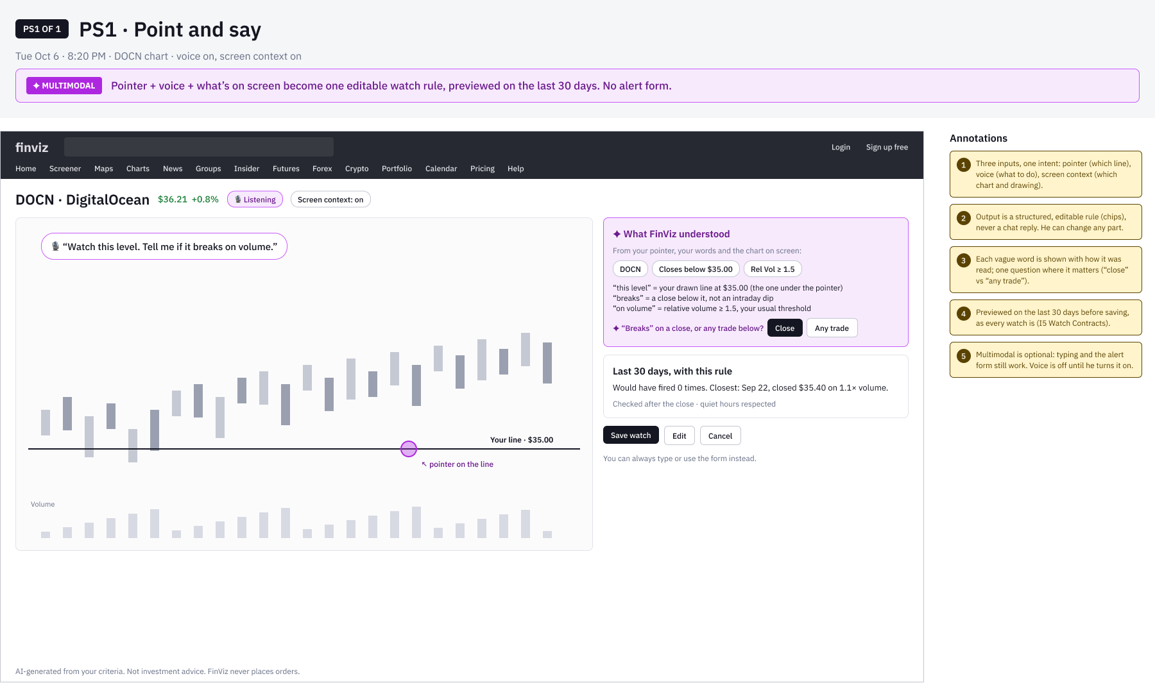
FINVIZ AI SCREENER · NEXT
Point and say: a watch without a form
Lo-fi concept (PS1). Gary points at the line he drew and says what to watch.
WHY IT’S NEW
Pointer + voice + screen become one editable rule; no alert form
Vague words shown as read; one question where it matters
Previewed on 30 days before saving; voice off by default

Slide 38
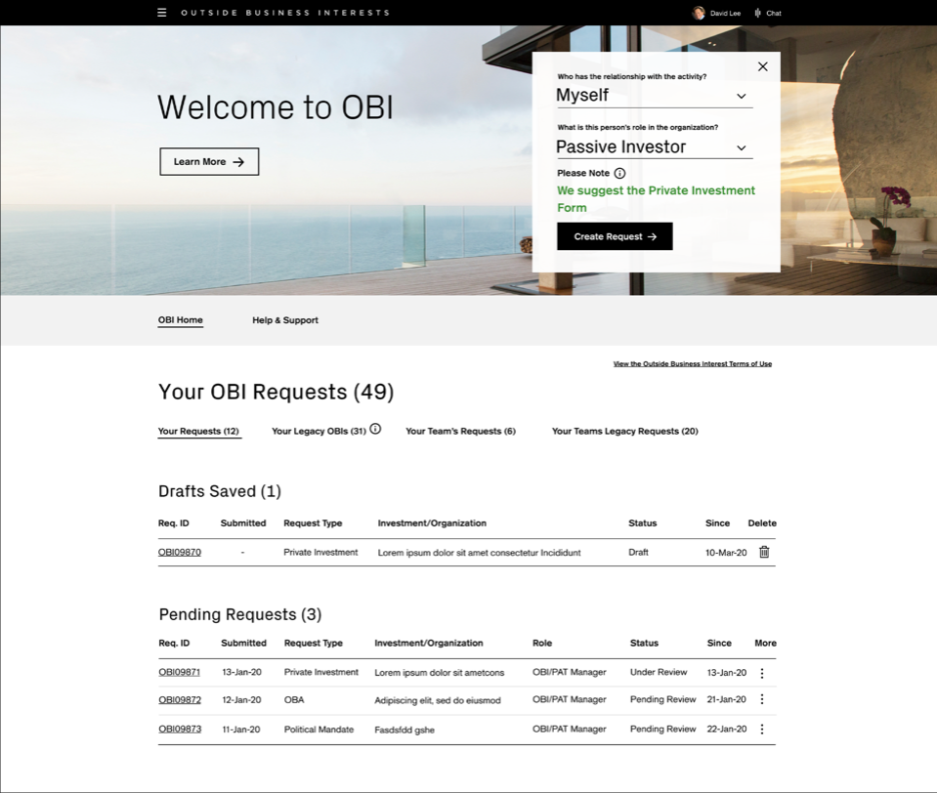
CASE STUDY 02 · ENTERPRISE · DELIVERED
Credit Suisse
Outside Business Interests (OBI)
Saving money by reducing friction, educating employees and removing risk from pre-clearance for outside activities.
ROLE
Led the project team
TEAM
2 UX designers and a content designer
SCOPE
Discovery to delivery: 33 Agile sprints, usability testing every week
USERS
All employees and managers, reviewers, and Risk & Compliance managers
“It’s too limited in its functionality to be of use for an Approver. Too much time is wasted trying to do more complex tasks.”

Slide 39
CREDIT SUISSE OBI · INTRODUCTION
A browser-based tool that gives employees pre-clearance for outside activities, reviewed by two lines of defense.
TARGET AUDIENCE
— Risk and Compliance managers
— All Credit Suisse employees
— All Credit Suisse managers
THE PROBLEMS
— Submission status tracking isn’t clear
— Lines of responsibility aren’t transparent
— No reporting
— Navigation is hard
— People don’t know why and when to submit
— No mobile access for Risk & Compliance managers
— A confusing submission process, with no education
TEAM AND MY PART
— I led a project team of 2 UX designers and a content designer
— I managed discovery, including research, strategy and hands-on design
— I led every deliverable in Sketch and Figma, with Lean UX and usability testing, and presented to the client and stakeholders

Slide 40
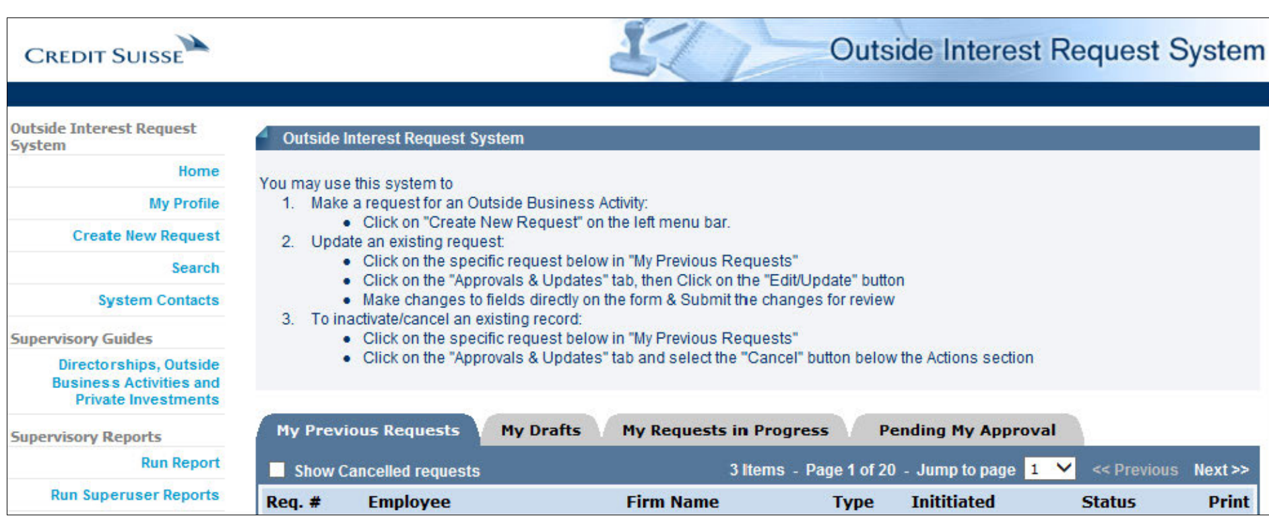
CREDIT SUISSE OBI · DISCOVERY
Where we started: the original application
The tool employees used to request pre-clearance before the redesign.

Slide 41
CREDIT SUISSE OBI · WHY REDESIGN
Why redesign OBI?
475
22 min
58%
average time employees need to resubmit
approval rating from Risk & Compliance managers
returned submissions missing required information, every year
5.4%
6.1%
61%
drop-off on Outside Business Activities forms
drop-off on Private Investments forms
approval rating from employees

Slide 42
CREDIT SUISSE OBI · DISCOVERY
We set out to find real user needs, test the business’s assumptions and generate new ideas.
METHODS
— Interviews with reviewers, Risk & Compliance managers and their managers
— Contextual interviews
— Persona development
— Research synthesis
— Design thinking exercises
PROBLEM STATEMENT
As part of the iComply ecosystem of Employee Compliance, users need an interactive, web-based pre-clearance application for outside activities, where requests flow through an integrated, pre-defined workflow for review by first-line Reviewers and second-line Risk & Compliance Managers.

Slide 43
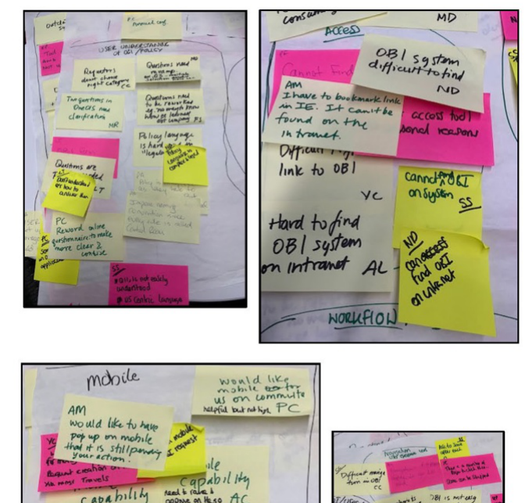
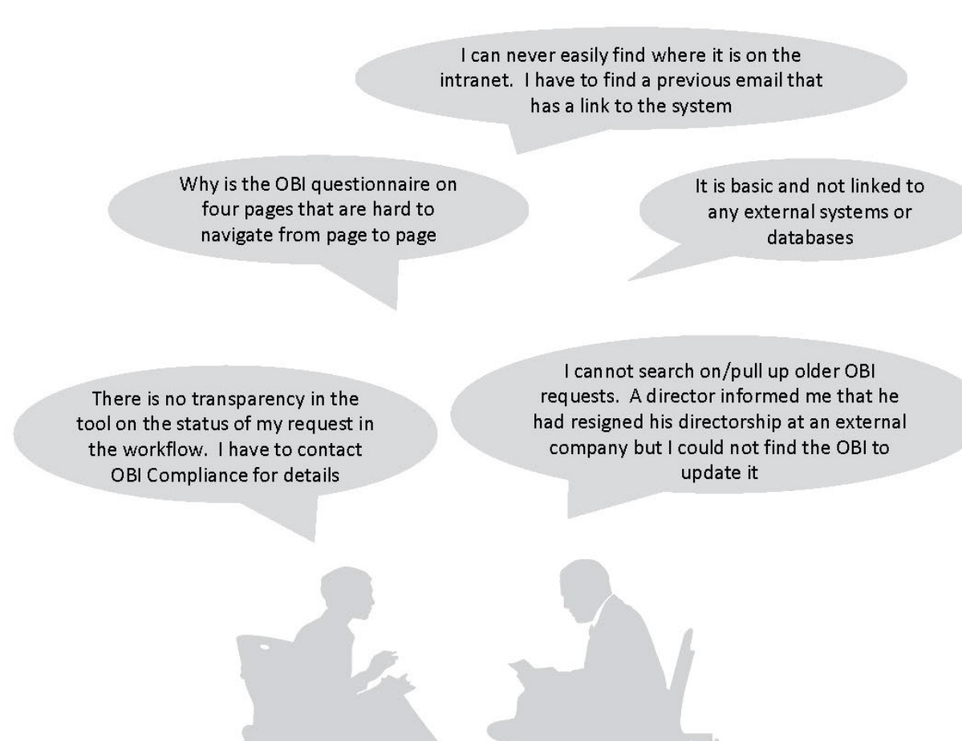
CREDIT SUISSE OBI · DISCOVERY
What we heard: major themes from the interviews
Reviewers, Risk & Compliance managers and their managers
MAJOR THEMES
— Integration with other systems on the platform
— Search
— Reporting
— Shadowing
— Everyone understanding the policies
— Mobile
— Clear navigation
— Clear workflow
— Status awareness

Slide 44
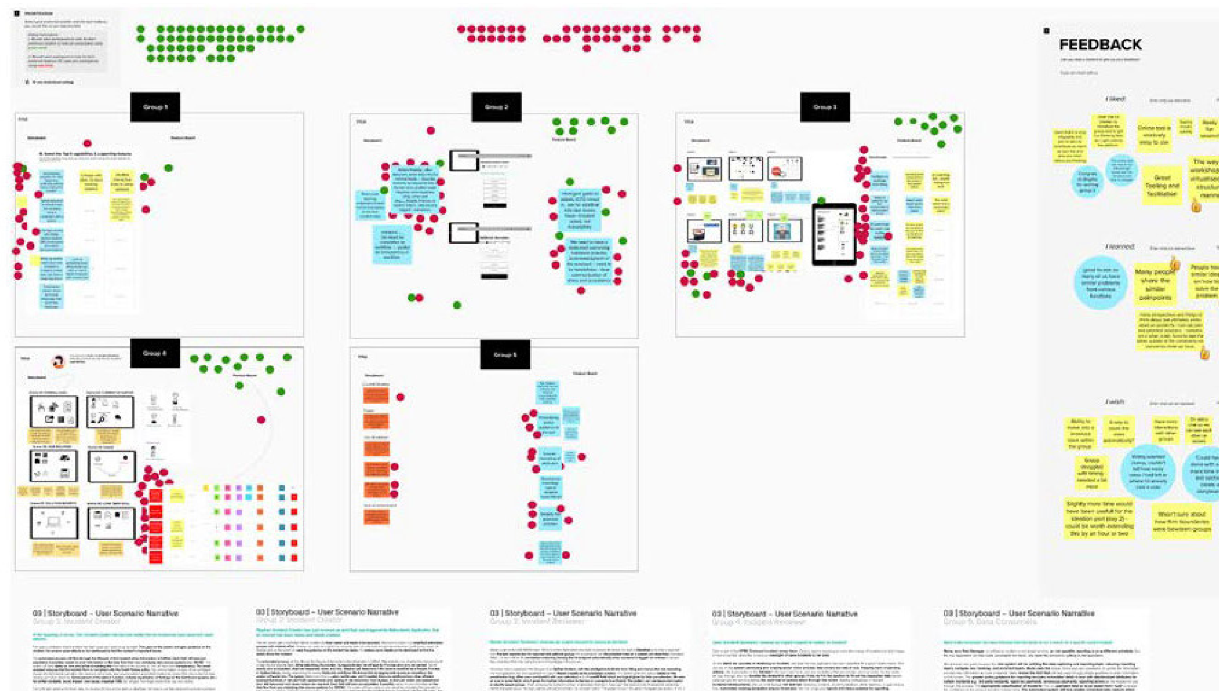
CREDIT SUISSE OBI · DISCOVERY
Design thinking: 5 concepts with 30 participants
Concepts for the dashboard, reporting and submission, for every type of end user
SESSION FORMAT
— Ice breaker
— What would the headlines say?
— How do we…?
— Concepts and interfaces
— Voting

Slide 45
CREDIT SUISSE OBI · STRATEGY
Pain points + business goals + UX strategy = feature set
+
+
=
PAIN POINTS
Integration with other systems on the platform
Navigation
Clear workflows
Status awareness
Lack of features
BUSINESS GOALS
Education
Functionality parity
Platform parity
Mobile
UX STRATEGY
Integrations with other systems on the platform
Everyone understanding the policies
Access for all in the platform
Mobile
Clear navigation
Clear workflows
FEATURE SET
Search
Reporting
Shadowing
Proxies
Queries
Mobile

Slide 46
CREDIT SUISSE OBI · DELIVERY
One dashboard for Submitters, Reviewers and Risk & Compliance Managers.
The dashboard was the main starting point for all three user types, so it got the most attention. It went through many iterations shaped by company goals, line-of-business goals, UX strategy, legal, risk and ADA requirements, and the design system.
HOW WE DELIVERED
— Feature refinement and road map
— 33 Agile sprints
— Usability testing every week
— Demos and QA

Slide 47
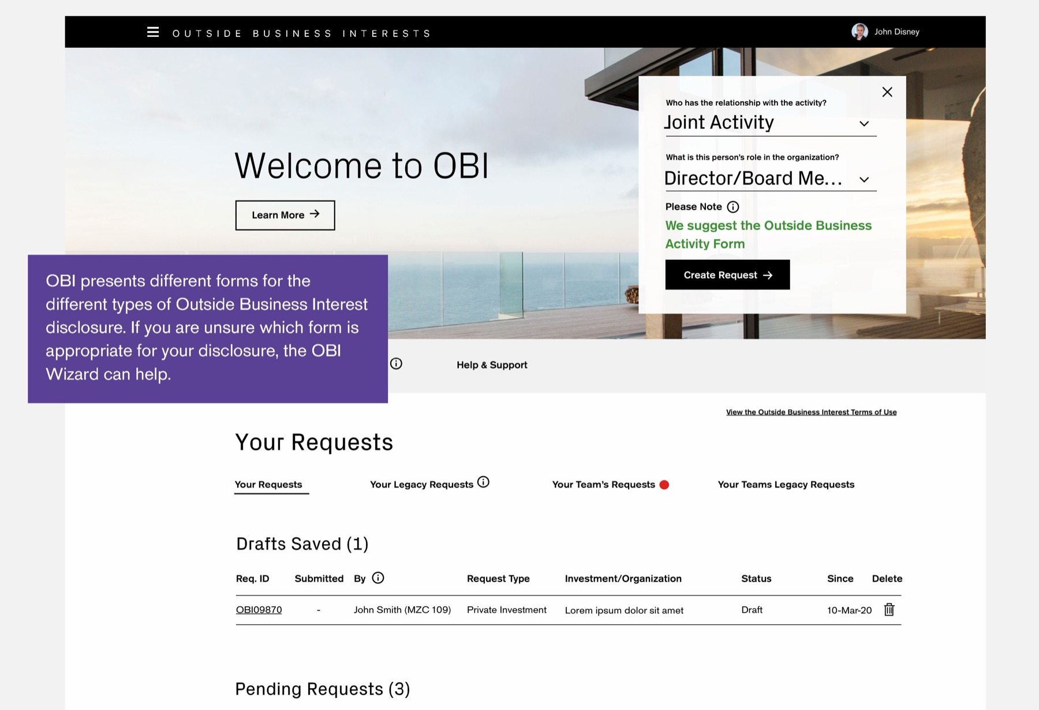
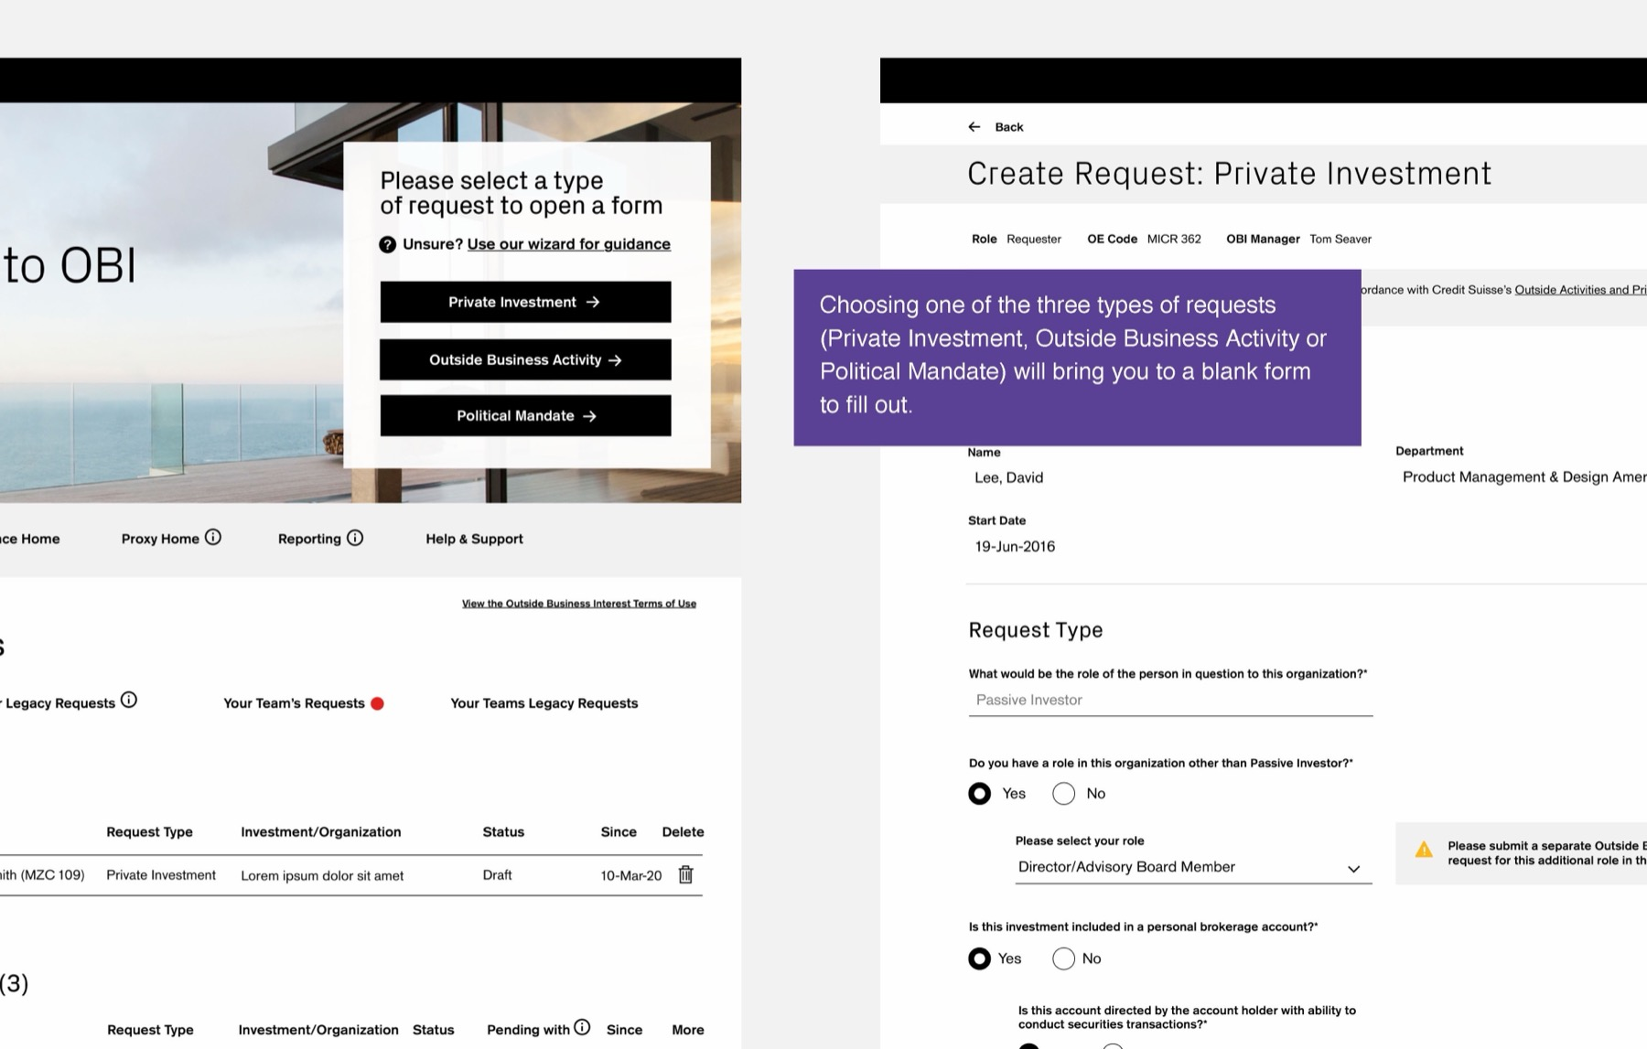
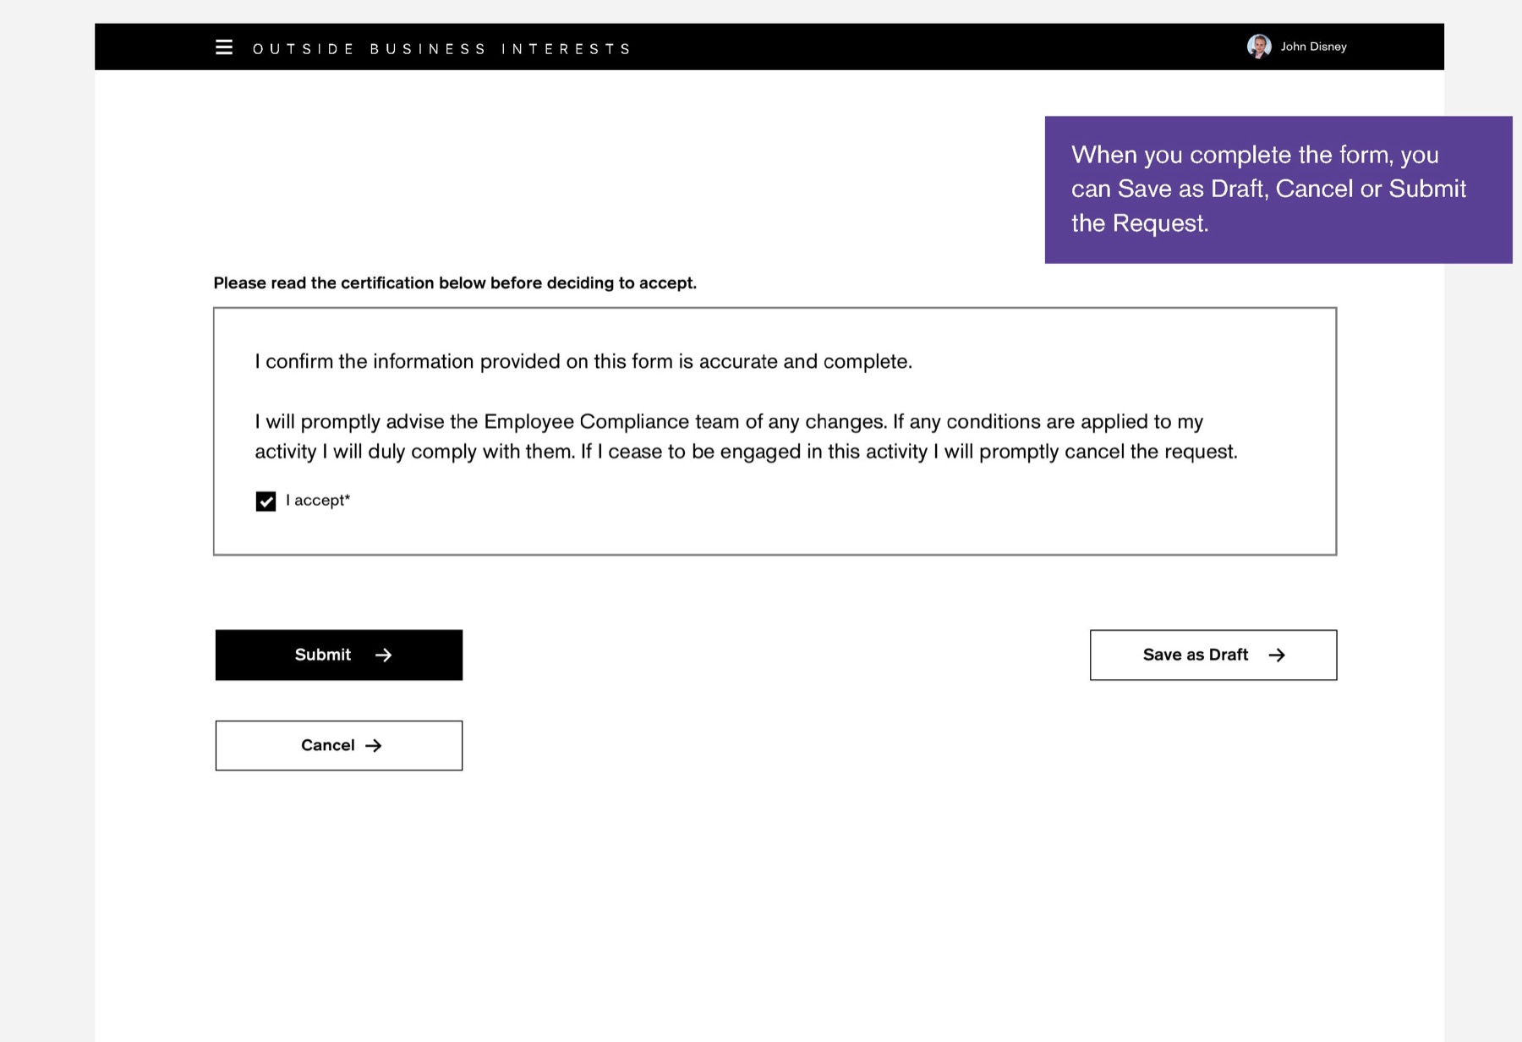
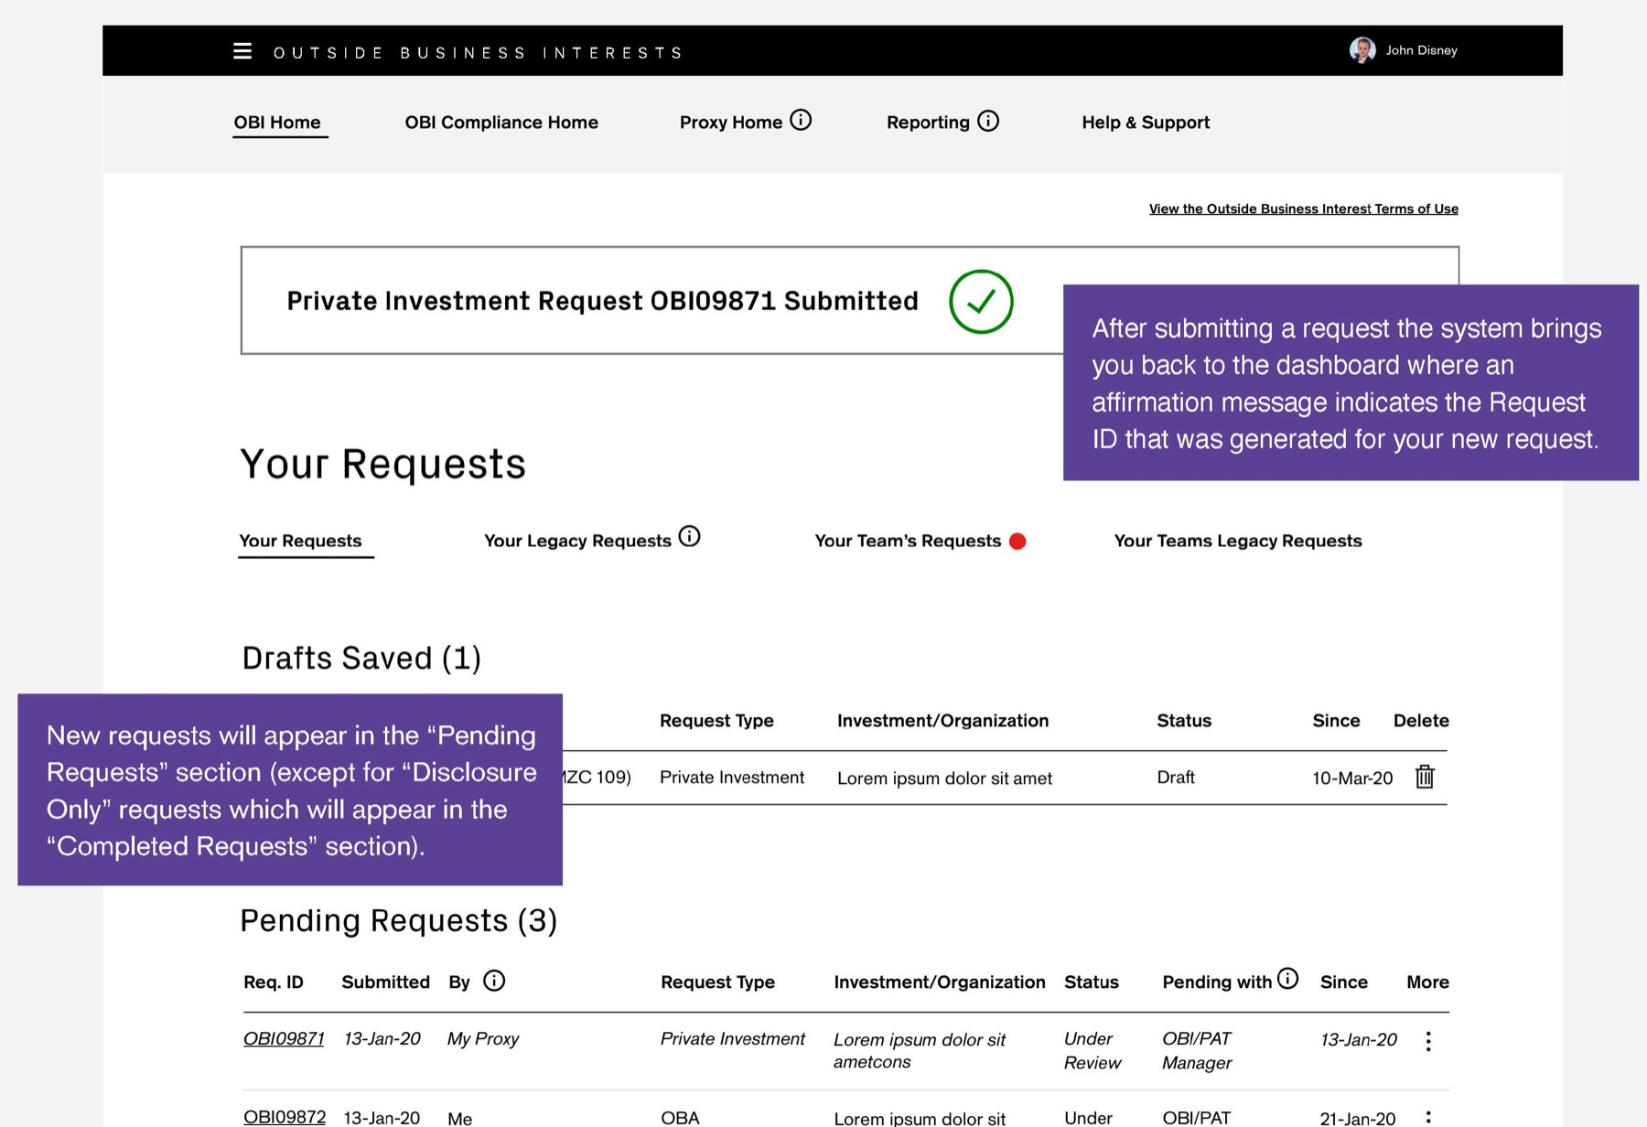
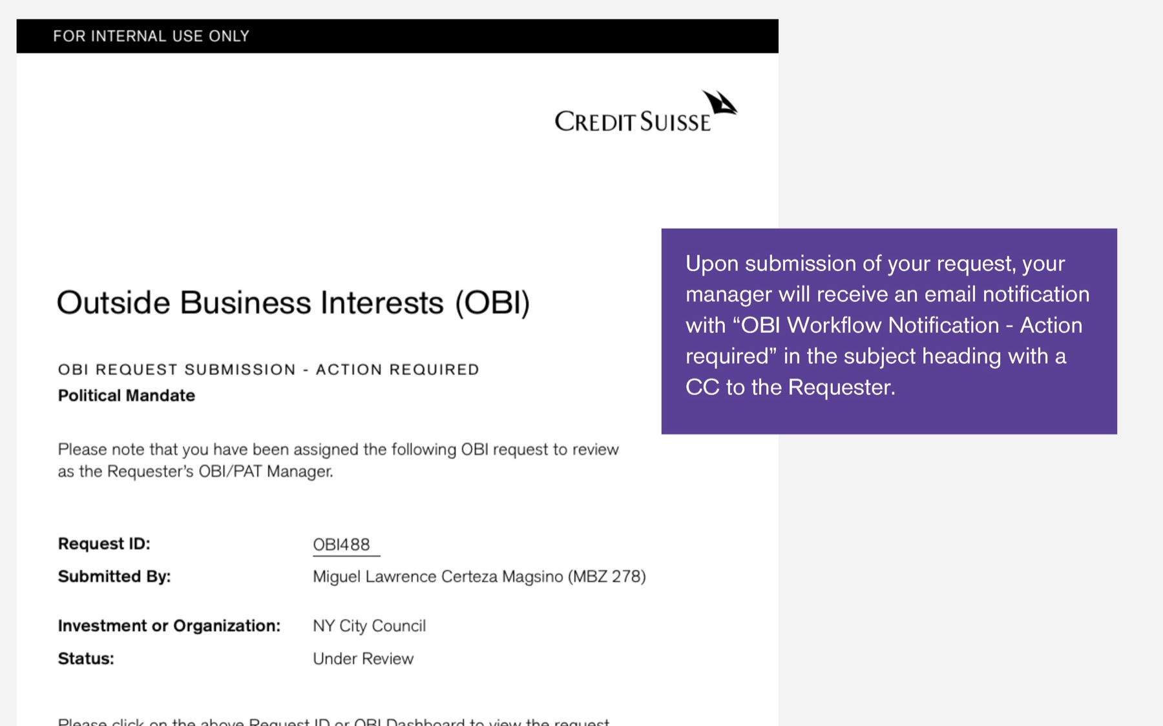
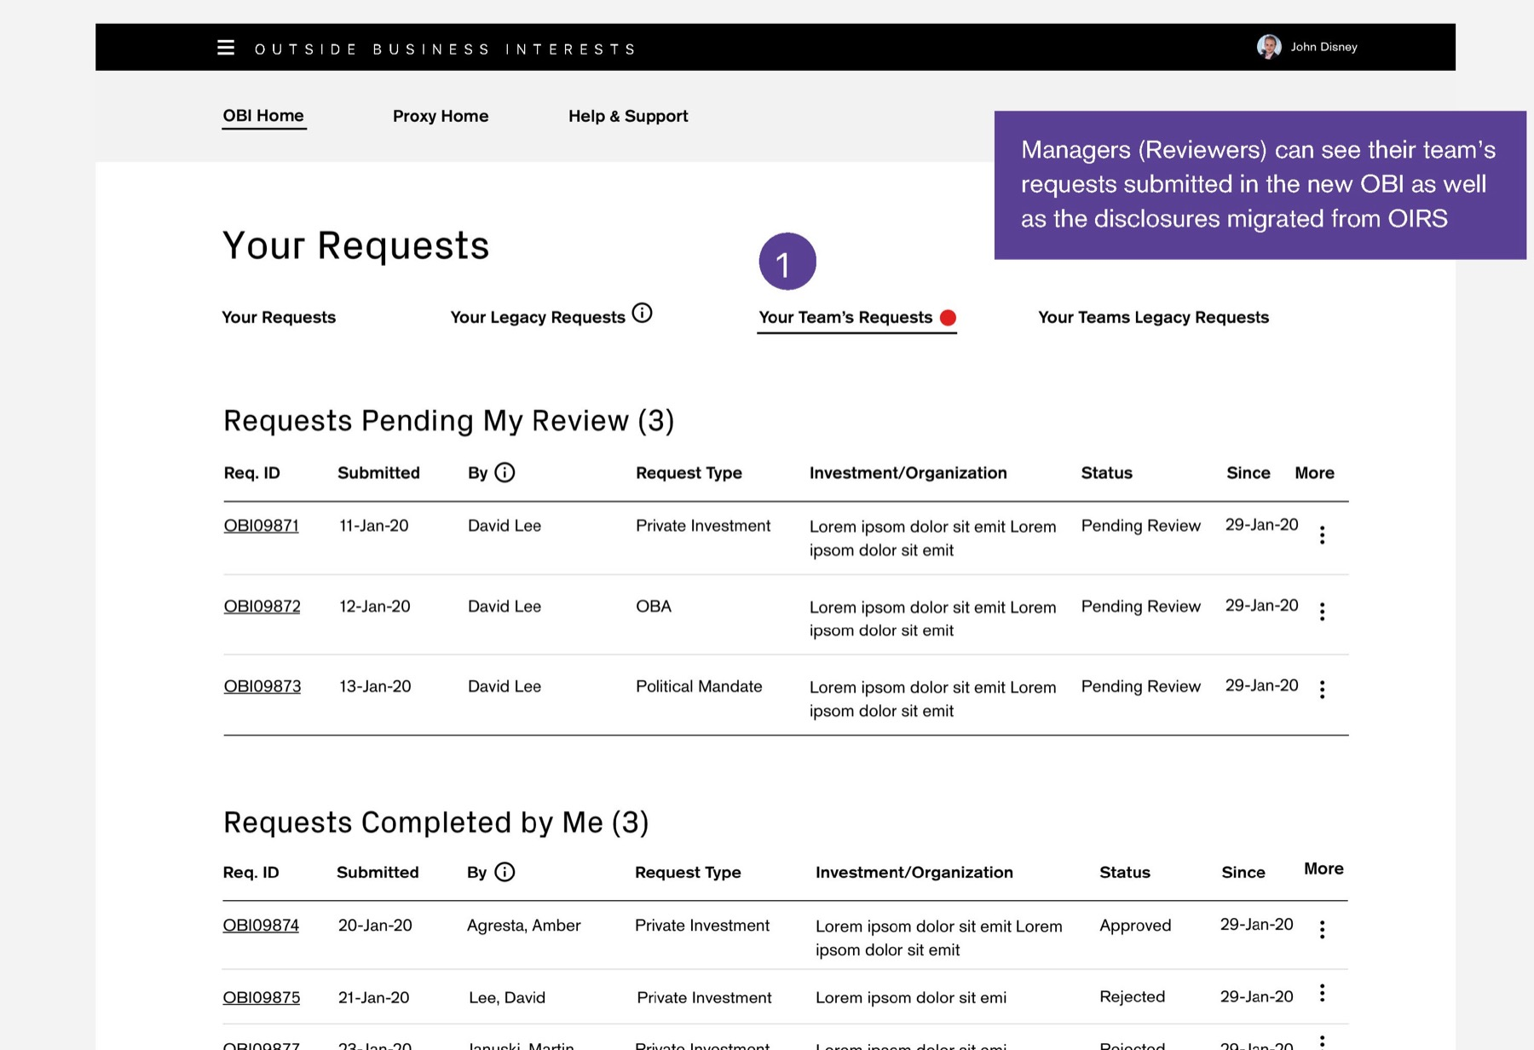
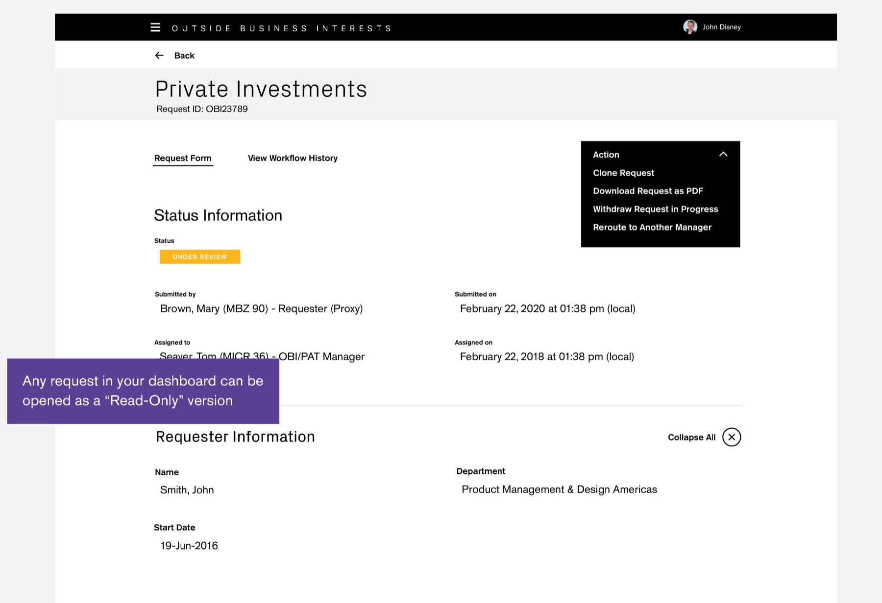
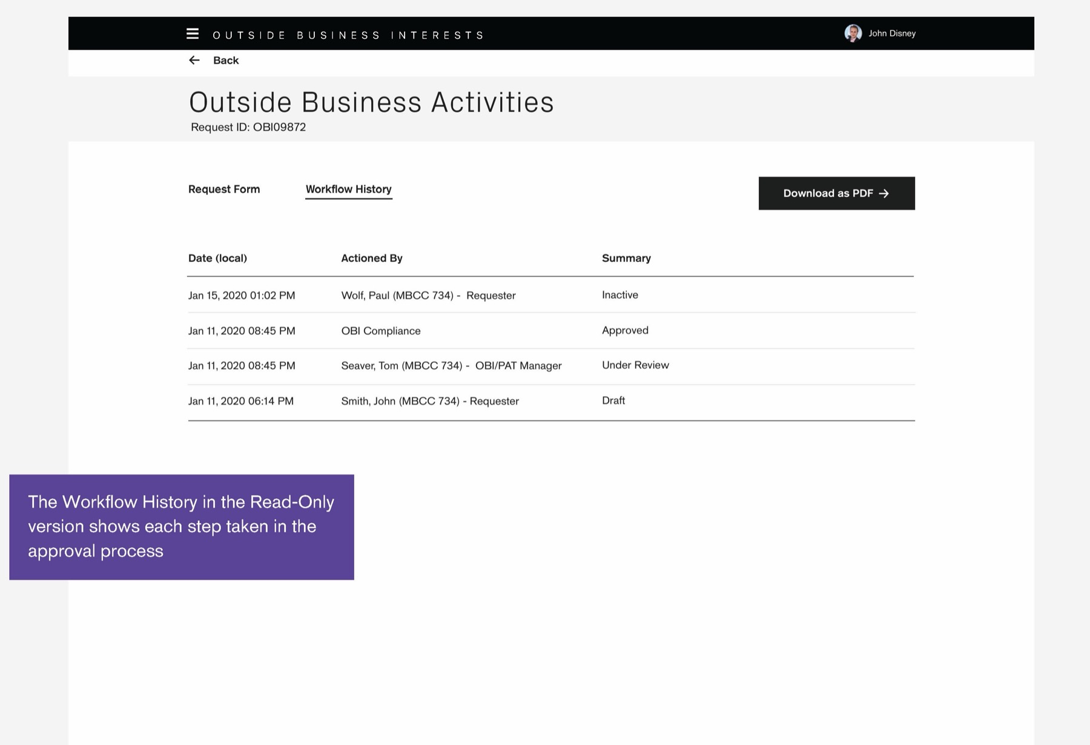
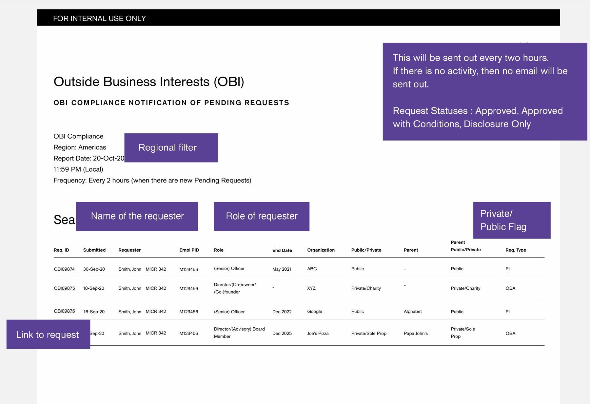
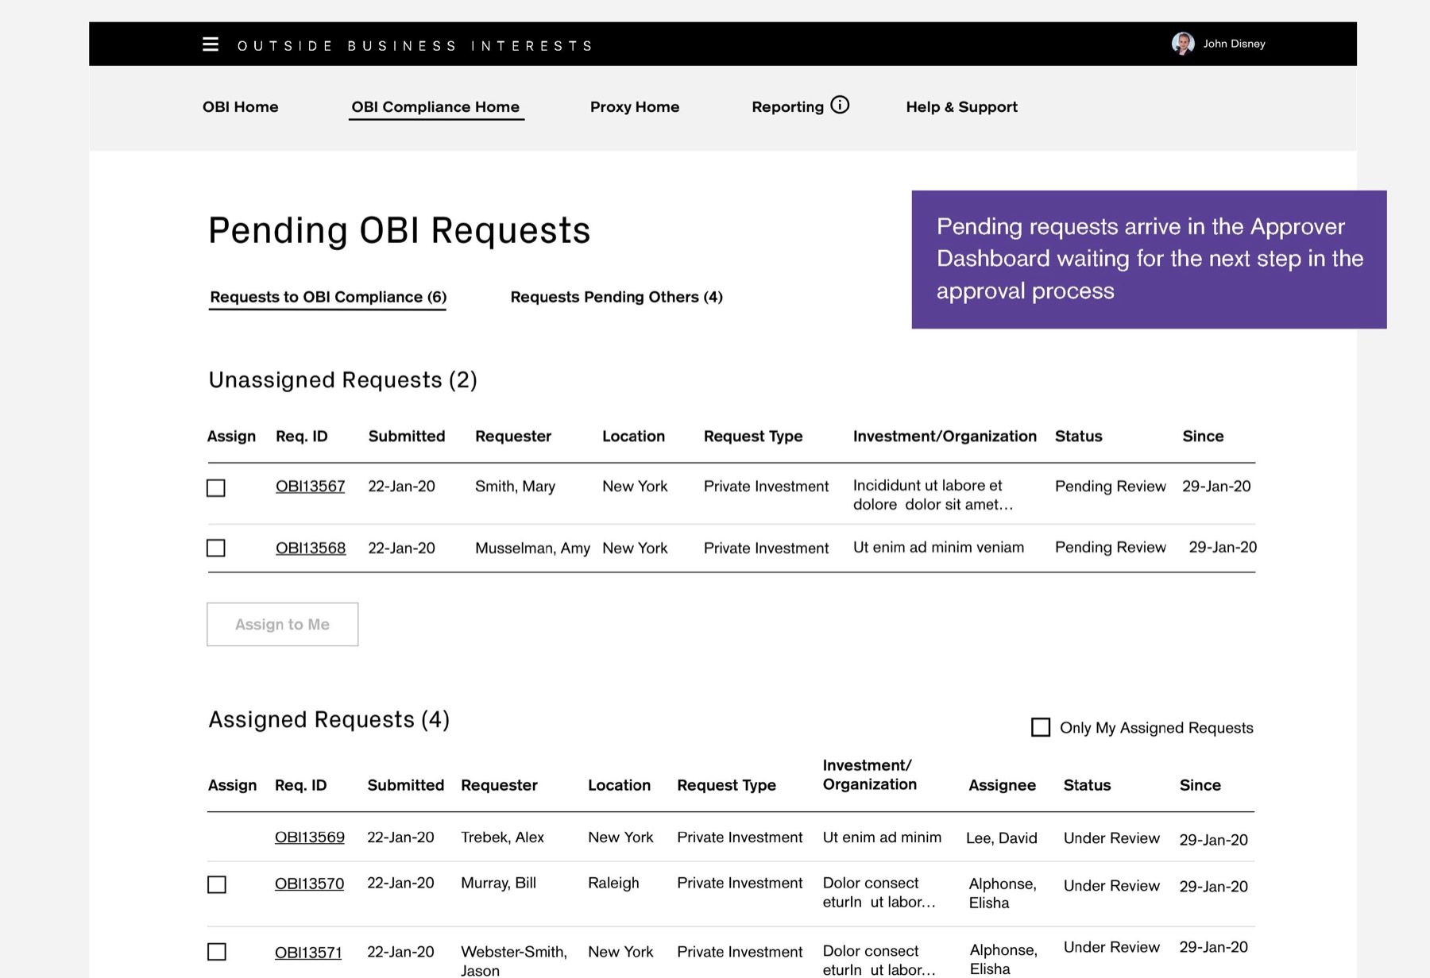
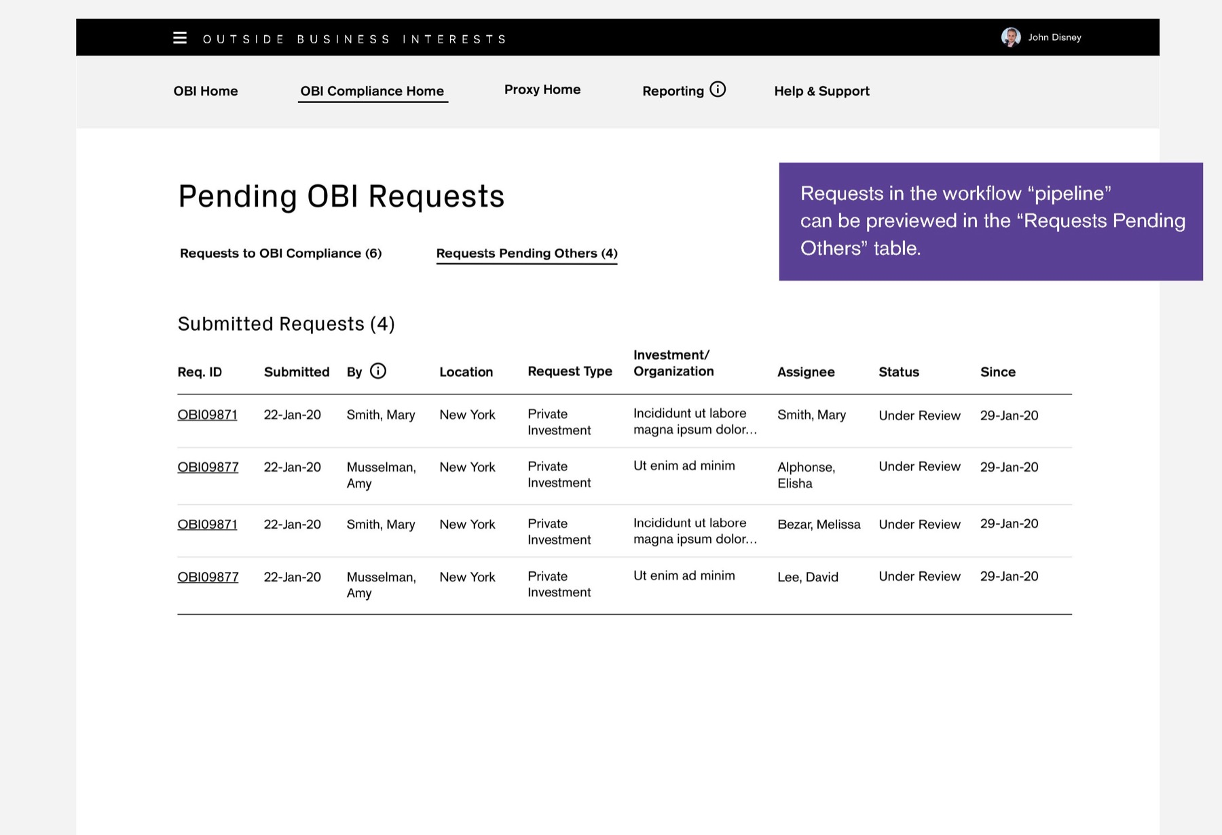
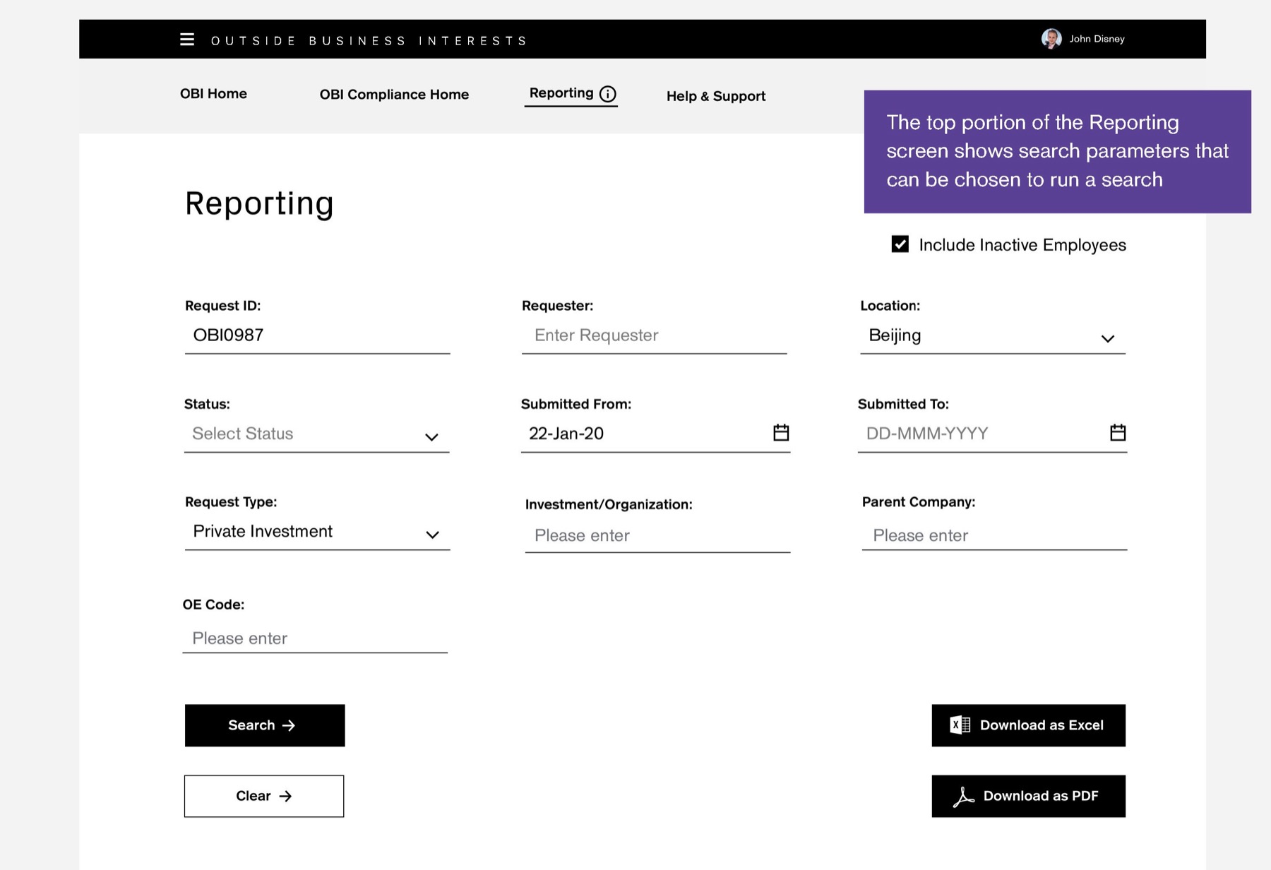
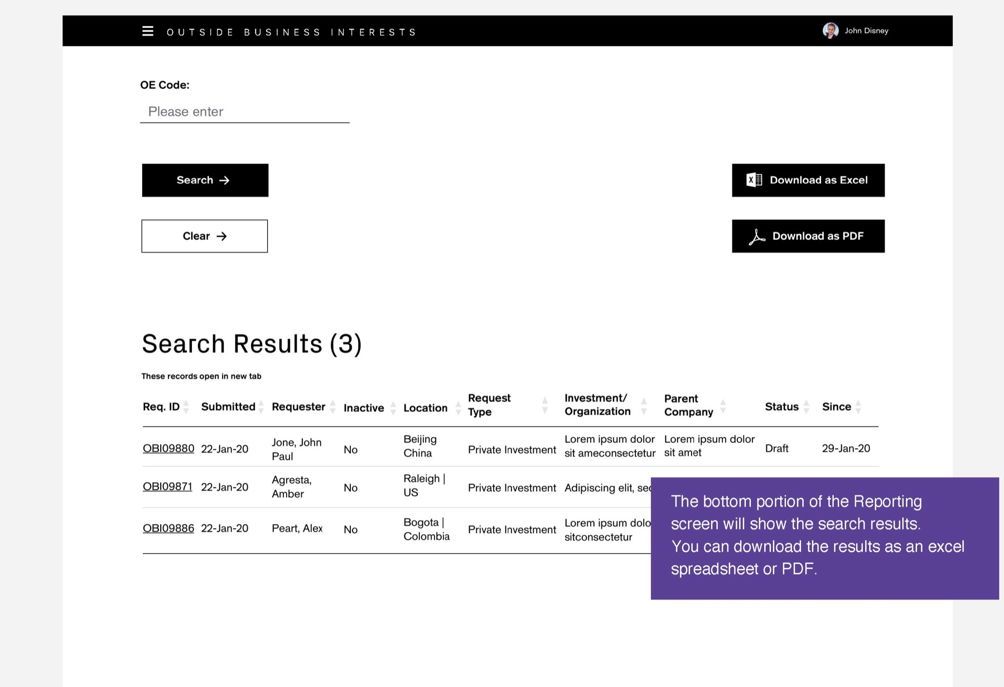
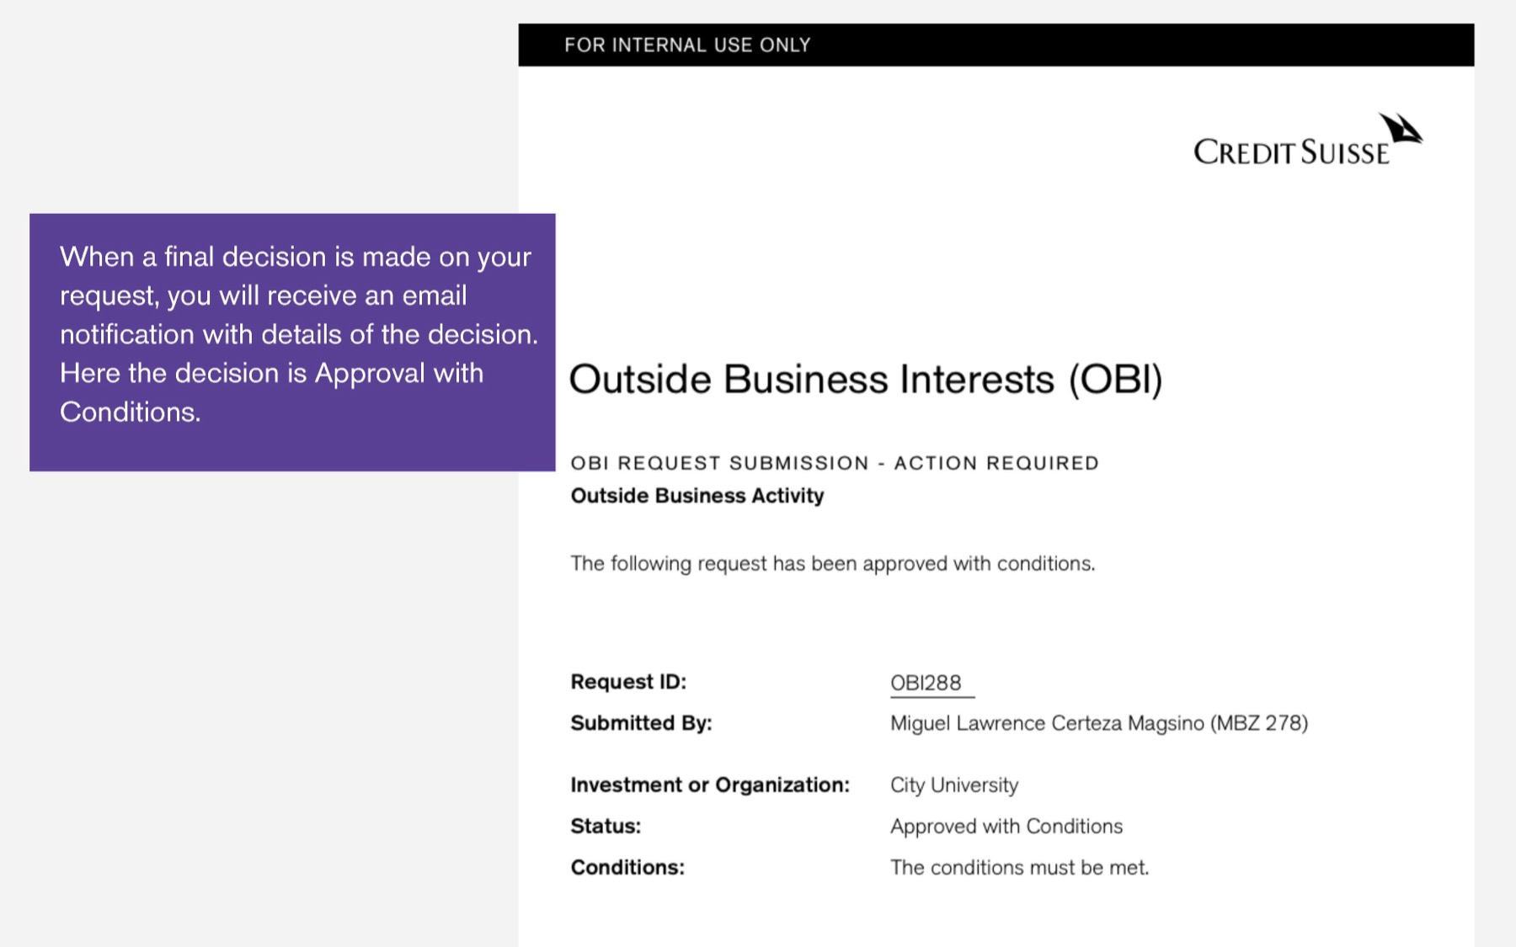
CREDIT SUISSE OBI · DELIVERY
The delivered app, one request end to end
The employee submits, the manager reviews, Compliance decides. Screens from the OBI Training Guide.
01 Welcome and wizard
Employee
02 Create request
Employee
03 Certify and submit
Employee
04 Submitted
Employee
05 Manager notified
Manager
06 Pending my review
Manager
07 Read-only request
Manager
08 Workflow history
Manager
09 Compliance digest
Compliance
10 Pending queue
Compliance
TRY IT
Open the prototype →
Starts at the welcome screen
11 Pipeline
Compliance
12 Reporting search
Compliance
13 Reporting results
Compliance
14 Decision email
Employee

Slide 48
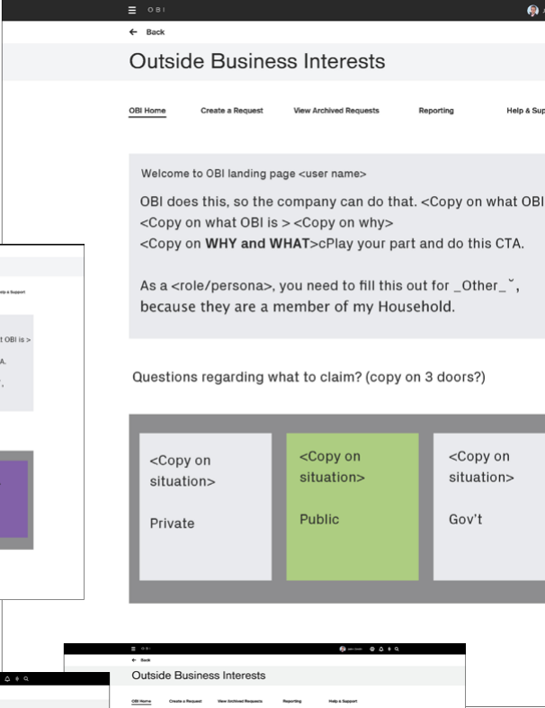
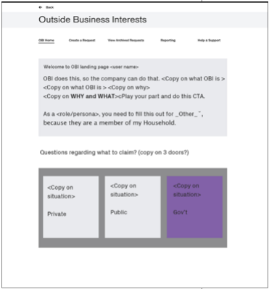
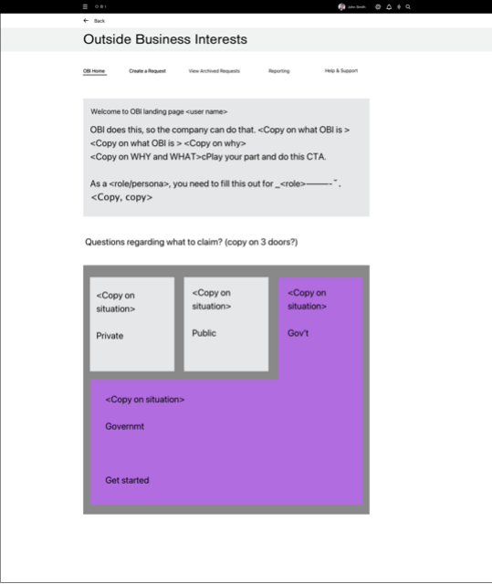
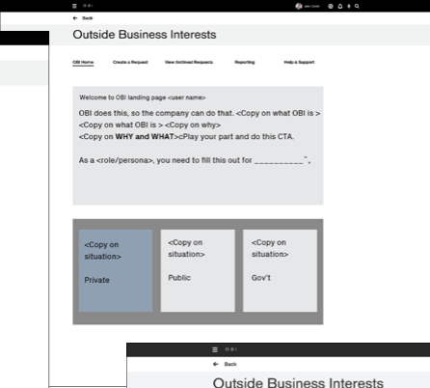
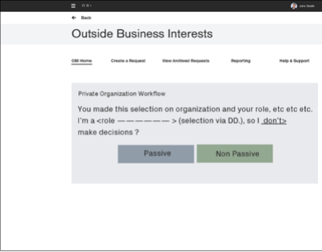
CREDIT SUISSE OBI · DESIGN
Experience design strategy
Based on POC 2 from the design thinking process, and thumbnail sketches.
WHAT WE LEARNED FROM DISCOVERY AND DESIGN THINKING
— Risk & Compliance managers need a dashboard to understand and filter request statuses
— Reporting and other major functions, with sharing and alerts to second-line managers
— Employees were often confused about which form they needed
— They needed education on why, how and when
— They needed to know what to expect when they came back
— One central place to see every submitted request

Slide 49
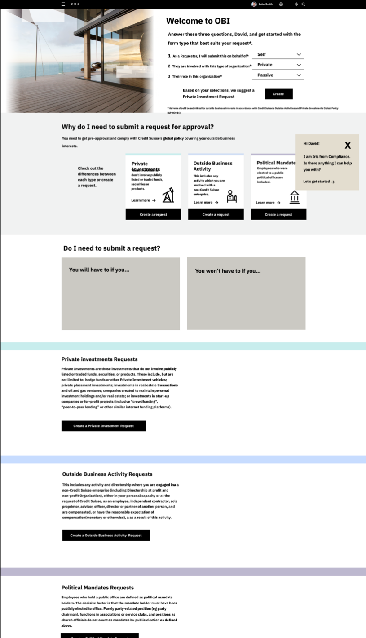
CREDIT SUISSE OBI · DESIGN
Dashboard design sprint: second iteration
The first iterations put education front and center. Testing showed newer users needed it, but not all.
WHAT WE LEARNED IN TESTING
— Education was a priority for all users
— Users responded to friendlier copy that described the situations they might be in
— Content for Swiss users could be surfaced by user ID and location

Slide 50
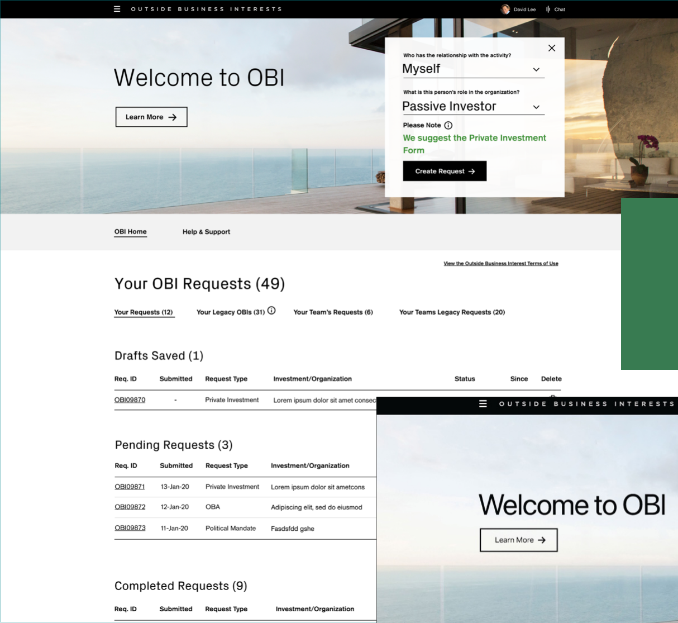
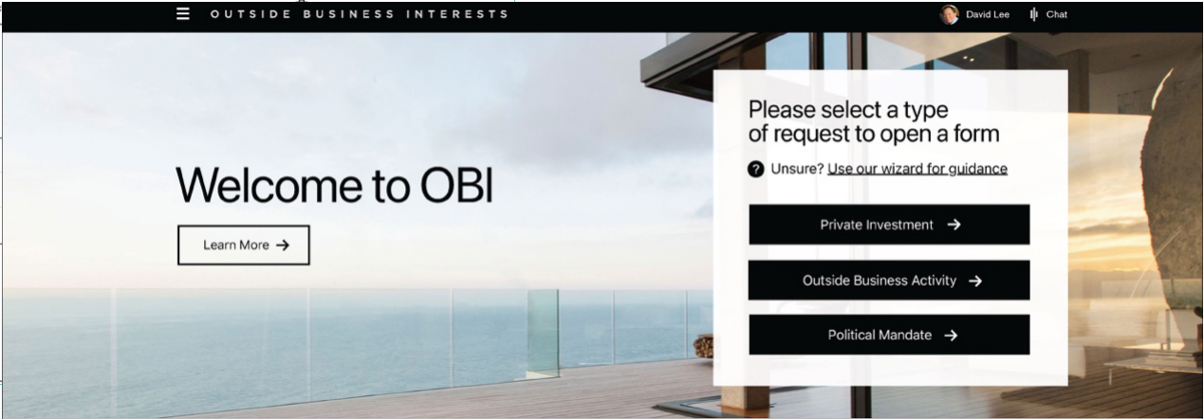
CREDIT SUISSE OBI · DESIGN
Dashboard design sprint: final version
Submitters reach a wizard that asks only 2 questions to find the right form.
WHAT WE LEARNED
— Easy access to education
— A cleaner interface
— A quick way to start a request
Final Version

Slide 51
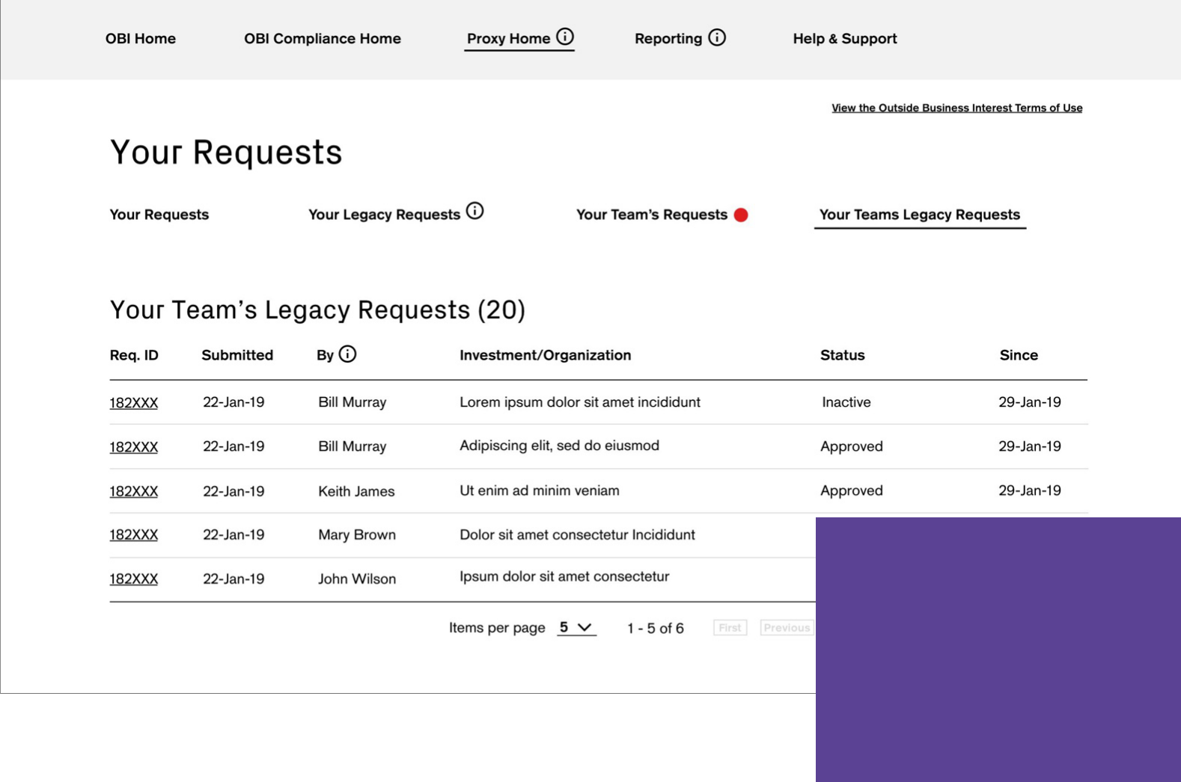
CREDIT SUISSE OBI · DESIGN
Landing page design sprint
Legacy requests from the previous system, OIRS, were migrated into OBI.
YOUR REQUESTS
— Opens by default on the requester dashboard
— Drafts saved
— Pending requests
— Completed requests
The landing page shows the requester dashboard. “Your Requests” opens by default, in three sections:
1. Drafts saved
2. Pending requests
3. Completed requests

Slide 52
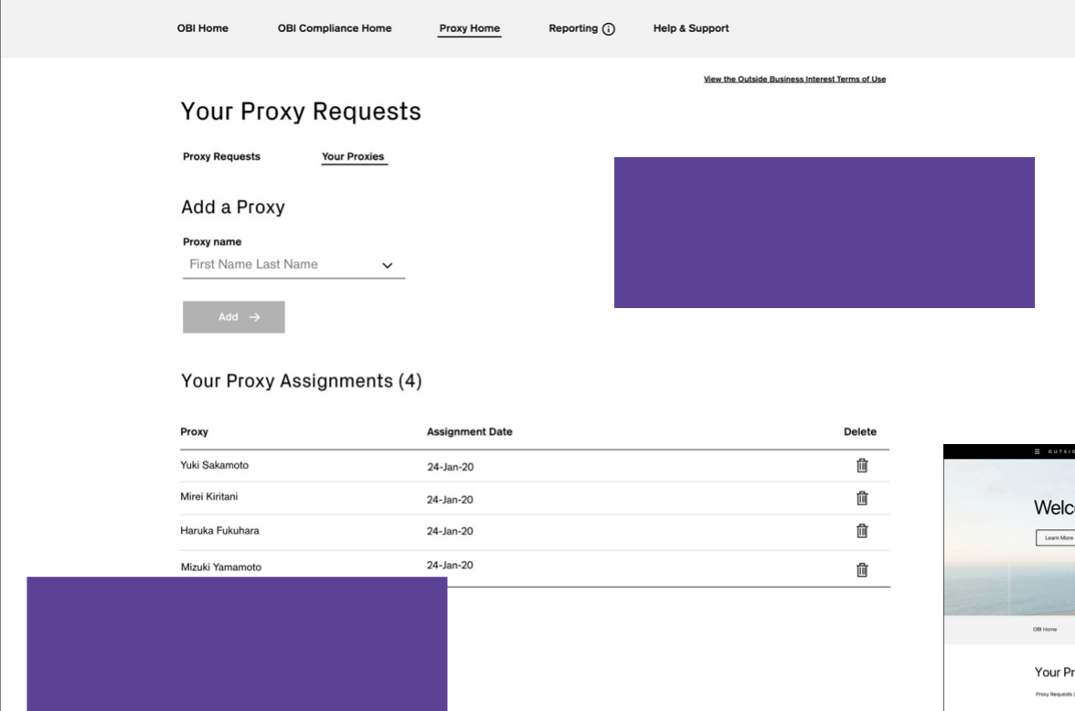
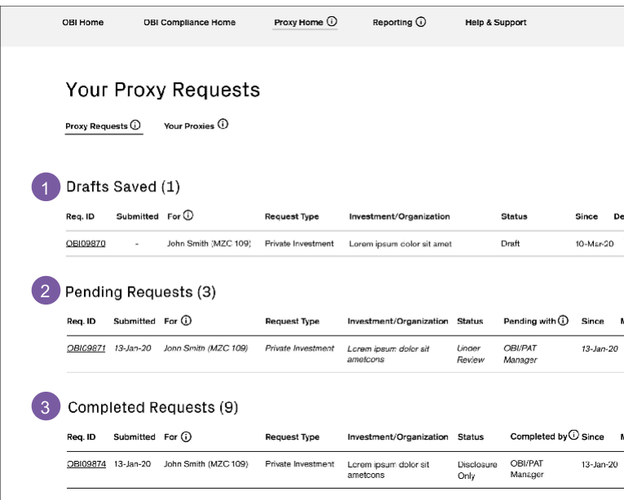
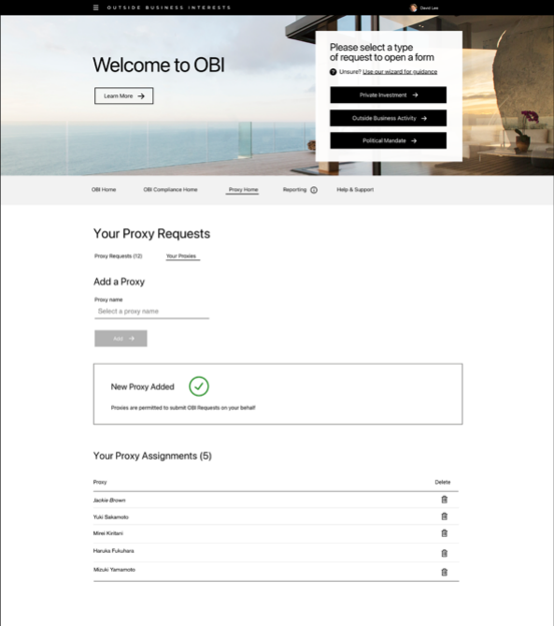
CREDIT SUISSE OBI · DESIGN
Proxy request design sprint
For people who can’t access OBI to make the disclosures they need to.
For people who can’t access OBI themselves to make the disclosures they need to, OBI has proxy functions.
Staff can name colleagues to act as proxies. A proxy can submit requests on behalf of anyone who has given them permission.

Slide 53
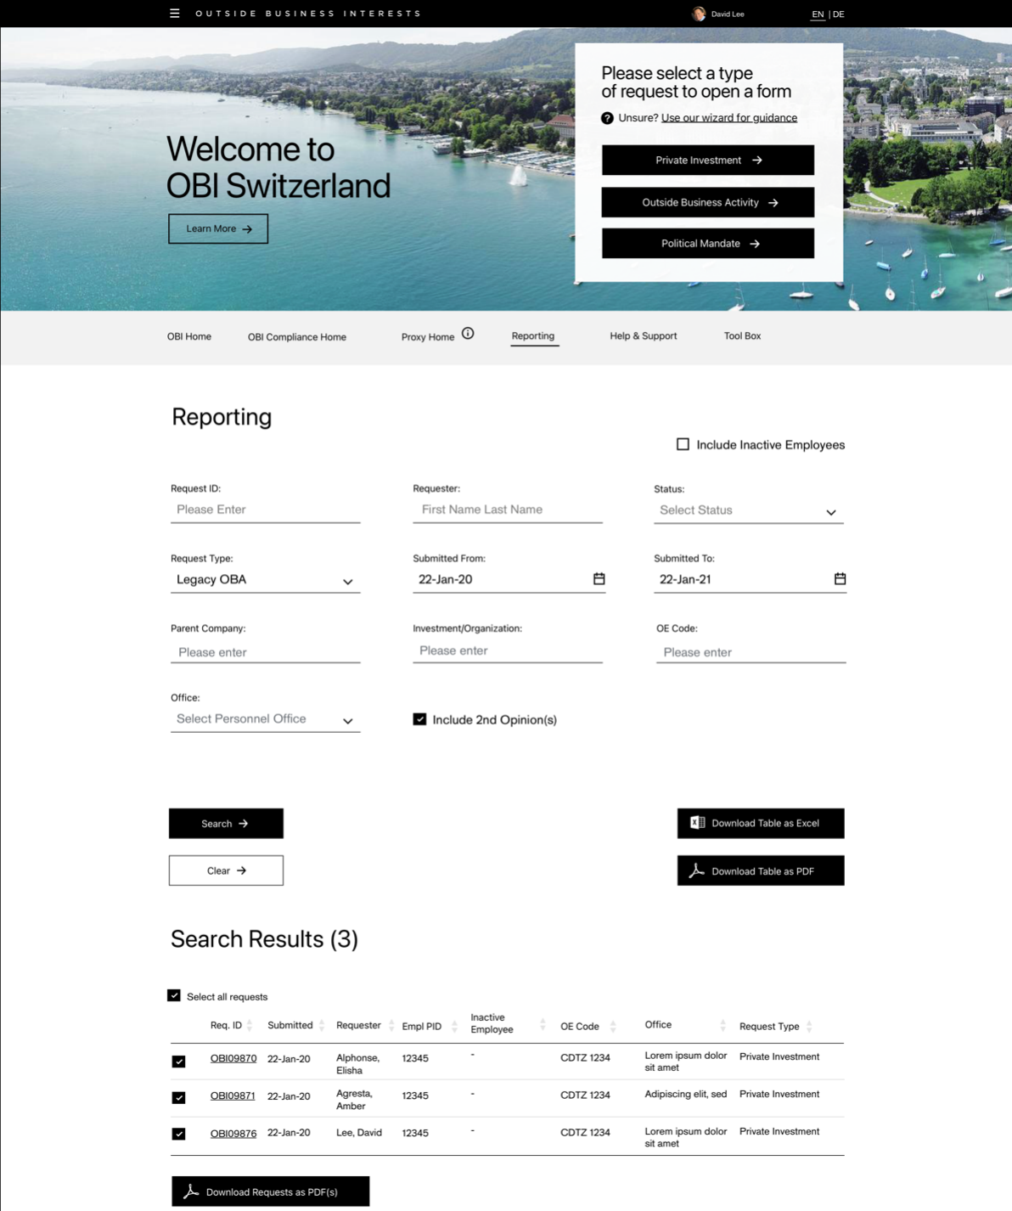
CREDIT SUISSE OBI · DESIGN
Reporting design sprint
Risk & Compliance managers find any request and export the results.
SEARCH BY
— Request ID and requester
— Status and type
— Submission dates
— Company and office
— Export to Excel or PDF

Slide 54
CREDIT SUISSE OBI · KEY CALLS
Four calls that shaped OBI.
A separate dashboard for submitters
Two questions pick the form
Testing showed submitters needed their own starting point, with forms that reveal one step at a time.
Employees didn’t know which form applied. A short wizard asks two questions and opens the right one.
Education written as scenarios
Tools for approvers too
Every user group asked for education. Copy built around real situations tested best, after three iterations.
Proxy submissions for people who can’t access OBI, and reporting by ID, status, office and date, exported to Excel or PDF.

Slide 55
CREDIT SUISSE OBI · OUTCOME
Delivered: one place to submit, review and report, with education built in.
WHAT SHIPPED
— A submitter dashboard with a 2-question wizard that opens the right form
— Your Requests: drafts, pending and completed, with legacy OIRS requests migrated
— Proxy submissions for people who can’t access OBI themselves
— Reporting by ID, requester, status, type, dates, company and office, exported to Excel or PDF
WHAT TESTING TAUGHT US
— Education matters to every user, but only newer users need it front and center
— Copy that describes real situations works better than policy language
— A cleaner interface and a quick start beat more options on the dashboard

Slide 56
CREDIT SUISSE OBI · PROTOTYPE
Follow 1 request through the delivered app.
14 screens from the OBI Training Guide, linked in order: the employee submits, the manager reviews, Compliance decides, and the employee hears back.
Open the OBI prototype →
Or start at the workflow map →
ALSO AVAILABLE
An offline version with the narrative for every step and a full link map: OBI-Request-Prototype.html.

Slide 57

CASE STUDY 03 · CONSUMER MOBILE · DELIVERED
Wells Fargo
Integrated Trade Ticket
Increasing revenue by letting investors trade by share quantity or dollar amount, in one simpler mobile ticket.
ROLE
Led the project team
TEAM
2 UX designers
SCOPE
Discovery, competitive analysis, 3 tested iterations, 6 Agile sprints
USERS
Experienced and novice self-directed traders
“It’s a confusing interface, the app’s interface is non-intuitive, making it difficult to navigate and find specific functions or features.”

Slide 58
WELLS FARGO TRADE TICKET · INTRODUCTION
One trade ticket that lets investors trade in shares or dollars, with fewer errors and less effort.
TARGET AUDIENCE
— Experienced consumer traders
— Novice consumer traders
THE PROBLEMS
— Wealth & Investment Management investors can’t trade in both shares and dollars
— The mobile trading process needs simplifying
— A confusing interface
— Limited functionality
— Technical issues and no real-time updates
— Poor customer support
TEAM AND MY PART
— I led a project team of 2 UX designers
— I managed discovery, including research, strategy and hands-on design, supported by AI applications
— I led every deliverable in Figma, with Lean UX and usability testing, and presented to the client and stakeholders

Slide 59
WELLS FARGO TRADE TICKET · WHY REDESIGN
Why redesign the trade ticket?
8.2 min
for a new user to complete their first trade
18.3%
of users ask to trade in both shares and dollars
1.4%
error rate on submissions
6.1%
drop-off on trades in the mobile app
“The app lacks advanced features like drawing tools or technical indicators. Customer support options are limited, with no chat support available.”

Slide 60
WELLS FARGO TRADE TICKET · DISCOVERY
We set out to find real user needs, test the business’s assumptions and generate new ideas.
METHODS
— Interviews with external users, internal stakeholders and SMEs
— Experienced and novice traders
— Persona development
— Google design thinking exercises
— Competitive analysis
PROBLEM STATEMENT
As the most important part of the trading experience, experienced and novice users need an integrated trade ticket that simplifies trading, reduces errors and improves efficiency, while letting them trade in shares or dollar amounts.

Slide 61
WELLS FARGO TRADE TICKET · DISCOVERY
“…so non-intuitive, it makes it hard to navigate, find specific functions and just make a quick trade.”
PAIN POINTS WE HEARD IN INTERVIEWS
01
Can’t trade in both shares and dollars on mobile
05
More trading options
02
Several interfaces aren’t intuitive
06
Speed
03
Need more of the right trade detail
07
Mobile native
04
Flexibility needs to improve

Slide 62
WELLS FARGO TRADE TICKET · STRATEGY
Pain points + business goals + UX strategy = feature set
+
+
=
PAIN POINTS
Can’t trade in both shares and dollars
Interfaces aren’t intuitive
Need more of the right trade detail
Flexibility
More trading options
Transaction speed
Mobile native
BUSINESS GOALS
Speed
Education
Platform parity
Integrated systems
Data
UX STRATEGY
Simplified interface
Dynamic functionality
Trade speed
Real-time updates
FEATURE SET
Order entry
Execution management
Real-time monitoring
Risk management
Post-trade processing
Integration with other systems
Shares vs. dollars
Analytics and reporting

Slide 63












WELLS FARGO TRADE TICKET · DISCOVERY
Competitive analysis
How the leading trading apps handle shares, dollars and the ticket itself
Robinhood
Whole and fractional shares in dollar amounts. A simple switch between shares and dollars, tickets with every detail, and instant trade notifications.
Charles Schwab
Fractional shares from $5 with Stock Slices. Clear, complete trade tickets and an intuitive design.
Fidelity
Shares or dollars, with fractional shares across stocks and ETFs. Detailed tickets with execution time, and easy navigation.

Slide 64


WELLS FARGO TRADE TICKET · DESIGN
Trade ticket design sprint: discovery
WHAT WE LEARNED FROM DISCOVERY AND DESIGN THINKING
— Account switching would serve most experienced traders and 60% of novice users, and fit the new mobile-native navigation
— Dark mode is important

Slide 65


WELLS FARGO TRADE TICKET · DESIGN
First iteration: start from what they hold
If a user holds the asset, they go straight into a ticket to buy or sell.
THE IDEA
— The asset is already held, so the user lands straight in the funnel
— One toggle switches between dollars and shares
— A predictive interface: only the choices that apply, never too many
First iteration

Slide 66


WELLS FARGO TRADE TICKET · DESIGN
Second and third iterations
A flexible ticket with detail on the stock and on the holding itself.
WHAT WE LEARNED IN TESTING
— Education was a priority for all users, but shouldn’t distract or slow them down
— Trading in quick amounts is good
— Feedback on the share amount is valuable too
— A custom keyboard was tried in several iterations, then replaced by the system keyboard
Second iteration
Third iteration

Slide 67





WELLS FARGO TRADE TICKET · DESIGN
Testing two versions: list or tabs
Every order type stays available, whether trading by shares or dollars.
WHAT WE LEARNED IN TESTING
— People preferred the list view to tabs
— The icon next to “Action” scored high
— Quantity and order sheets that appear only when needed made sense to many
Test version 1

Slide 68


WELLS FARGO TRADE TICKET · DESIGN
Final delivered solution
Every field stays editable if the user needs to change the order.
WHAT WE LEARNED IN TESTING
— Order types vary
— Color and status changes show where an order is
— Seeing the status right away is vital
— A cleaner interface
— Quick transactions
— Watchlist alerts you can act on
Final delivered solution

Slide 69
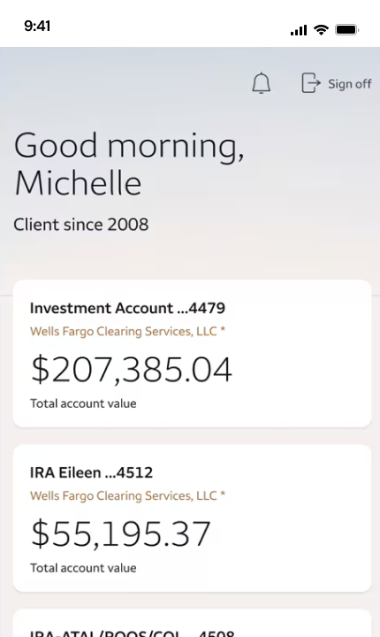
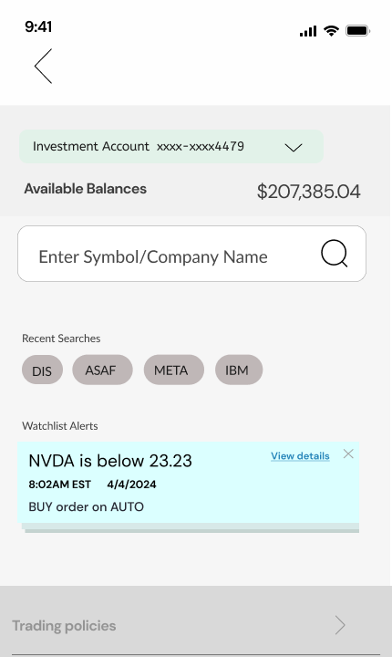
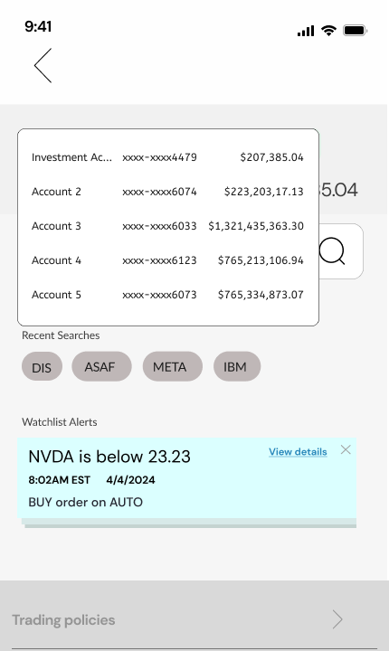
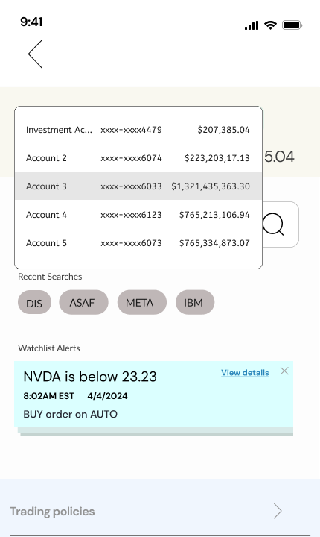
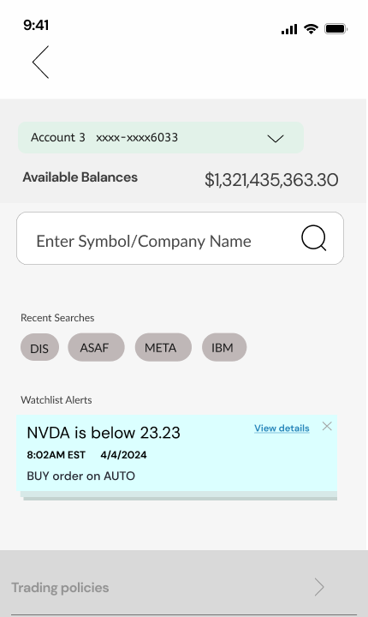
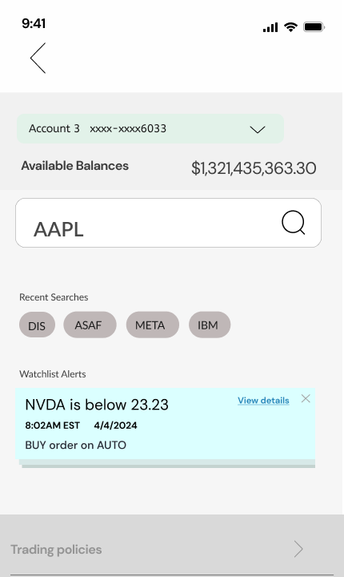
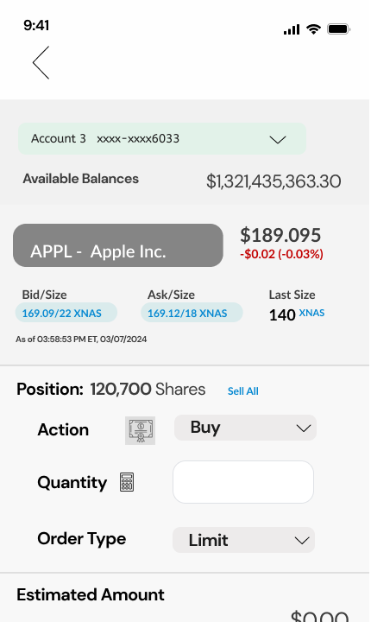
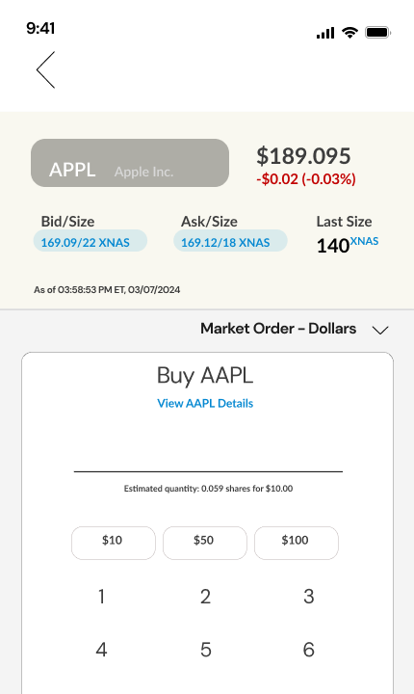
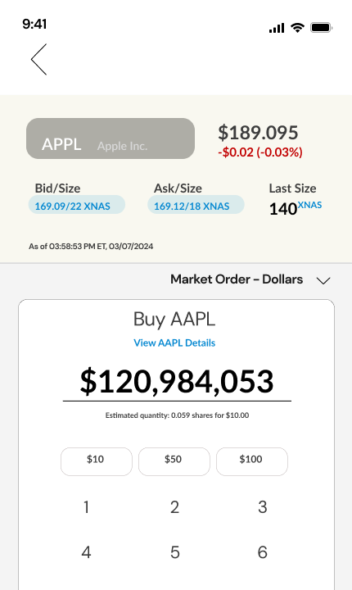
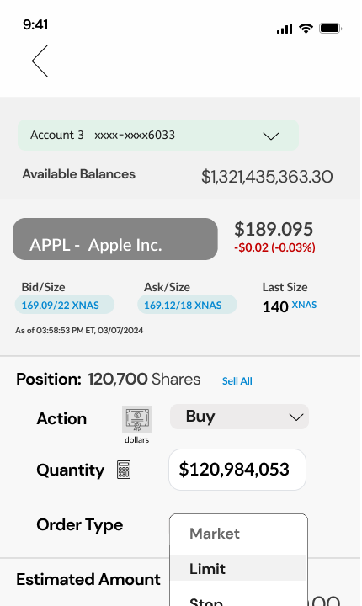
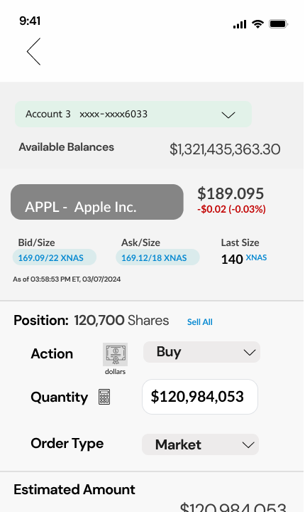
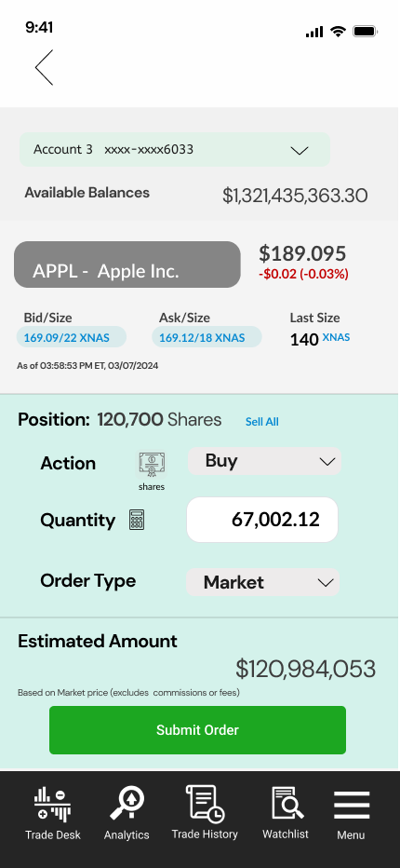
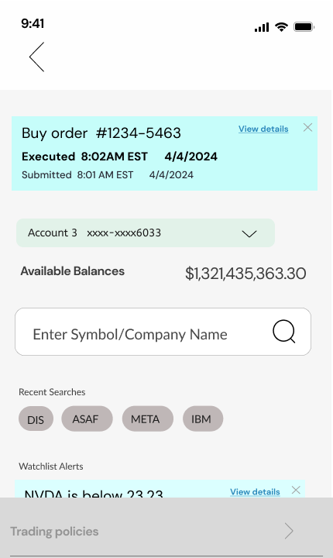
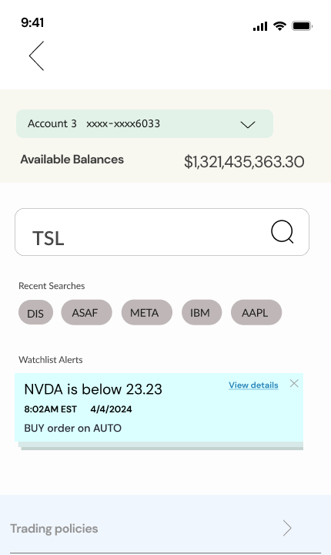
WELLS FARGO TRADE TICKET · DELIVERY
One buy order, on the phone
Account, stock, Buy, a dollar amount on the keypad, order type, review in shares, submit, executed.
01 Accounts home
Pick
02 The ticket
Pick
03 Account menu
Pick
04 Account 3
Pick
05 Search
Pick
06 AAPL
Pick
07 Position, then Buy
Build
08 Keypad
Build
TRY IT
Open the prototype →
Starts at the accounts home
09 Dollar amount
Build
10 Order type
Build
11 Review Order
Review
12 In shares, submit
Review
13 Executed
Status
14 Next trade
Status

Slide 70
WELLS FARGO TRADE TICKET · KEY CALLS
Four calls that shaped the trade ticket.
Shares or dollars in one ticket
Start from what they hold
One toggle switches between trading by share quantity and by dollar amount, instead of two flows.
If a user already holds the asset, they go straight into the ticket with their position shown.
Lists over tabs; fields on demand
Status at a glance
Testers preferred a list view to tabs. Quantity and order sheets appear only when they apply.
Order status changes color as it moves. Testers said seeing the status right away was vital.

Slide 71
WELLS FARGO TRADE TICKET · OUTCOME
Delivered: one ticket for shares or dollars, tested in three rounds.
WHAT SHIPPED
— A single ticket with a shares / dollars toggle
— Held assets go straight into a ticket to buy or sell
— A list view, with quantity and order sheets that appear only when needed
— Order status that changes color as it moves, and every field editable
WHAT TESTING TAUGHT US
— Education matters, but it must never slow a trade down
— Quick amounts and feedback on the share amount build confidence
— Seeing the status right away is vital
— The system keyboard beat a custom one

Slide 72
WELLS FARGO TRADE TICKET · PROTOTYPE
Place one order, in dollars or shares.
14 hi-fi screens of the mobile ticket, linked as in the Figma prototype: pick the account and stock, choose Buy, type a dollar amount, pick the order type, review it in shares, submit, and see it executed.
Open the trade ticket prototype →
Or start at the workflow map →
ALSO AVAILABLE
An offline version with the narrative for every step and a full link map: Trade-Ticket-Prototype.html.
Or open the original Figma design file →

Slide 73

CASE STUDY 04 · B2B DESKTOP · DELIVERED
American Express
MOCA
Increasing revenue by helping advertisers and marketers decide their advertising budgets with AMEX sales partners.
ROLE
Led discovery and all design deliverables
TEAM
Partnered with AMEX data scientists, who built the projection and optimization engines
SCOPE
Wizard, scenario builder and data visualizer for a desktop app
RESULTS
Partner approval 58% → 88%; average client budget $1.34M → $1.8M
“Comparing budgets and then optimizing it would allow me to have the confidence to increase the budget.”

Slide 74
AMEX MOCA · INTRODUCTION
A desktop app that projects a marketer’s budget and compares built and optimized scenarios.
TARGET AUDIENCE
— American Express sales managers
— American Express sales advisors
THE PROBLEMS
— Sales partners had no effective tool for clients to budget their AMEX advertising dollars
— No way to compare scenarios
— No way to understand how well an investment works
— Need for a more customizable, predictive app using nascent AI technology
TEAM AND MY PART
— I partnered with AMEX data scientists, who built the projection and optimization engines; I designed how partners build, compare and trust scenarios
— I managed discovery, including research, strategy and hands-on design
— I led every deliverable in Sketch and Figma, with Lean UX and usability testing

Slide 75
AMEX MOCA · WHY
Why design MOCA?
58%
approval from internal business partners
$1.34M
average client budget, before MOCA
12 min
average time for partners to complete a budget
5.4%
drop-off on the current budget process
Before MOCA: $1.34M
After launch: $1.8M (see Results)

Slide 76
AMEX MOCA · DISCOVERY
We set out to find real user needs, test the business’s assumptions and generate new ideas.
METHODS
— Interviews with internal stakeholders, SMEs and users
— Sales managers and sales advisors
— Contextual interviews
— Persona development
— Co-design sessions with data scientists
PROBLEM STATEMENT
Internal business partners have no tool to help their clients budget AMEX advertising dollars effectively. Users need an application to allocate marketing budgets across the AMEX product lines.

Slide 77
AMEX MOCA · STRATEGY
Pain points + business goals + UX strategy = feature set
+
+
=
PAIN POINTS
Scenario builder
Data visualizer
Comparison
Importing data sets from Excel
Changing each allocation by channel or product
BUSINESS GOALS
Education
Platform parity
Integrated systems
Data
UX STRATEGY
Walk-through wizard
Scenario builder
Data visualizer
Import data sets
Channel and product allocation
Optimization budget tool
FEATURE SET
Walk-through wizard
Scenario builder
Data visualizer
Comparison
Import data sets
Channel and product allocation
Optimization budget tool
Integration with internal systems

Slide 78

AMEX MOCA · DISCOVERY
The journey, distilled into 3 steps
1
Walk-through wizard
Guides users through the budget projection: import data, set dates, adjust each allocation by channel and product.
2
Scenario builder
Build separate scenarios, compare them, and optimize a selected budget using the tool’s business intelligence and data.
3
Data visualizer
Visualizations show how each plan breaks down and how the plans compare.

Slide 79

AMEX MOCA · DESIGN
Experience design sprint: start from a past budget
WHAT WE LEARNED FROM DISCOVERY
— Users wanted to import one budget and keep it as a template for the next
— So a new budget can start from an imported one, by duplicating it

Slide 80
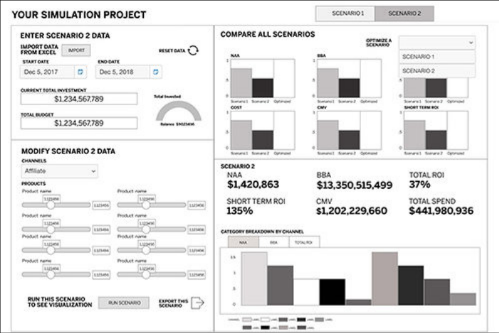
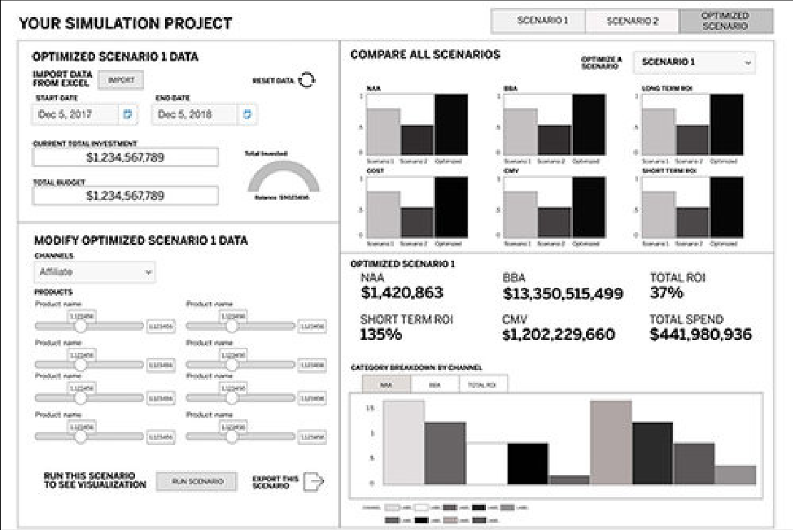
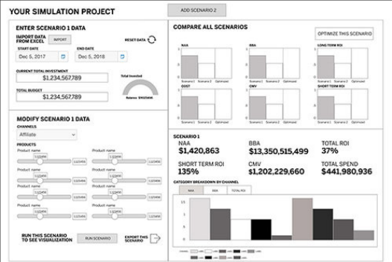
AMEX MOCA · DESIGN
Unexpected challenge: the rest of the desktop
THE CHALLENGE
— As a desktop app, MOCA had to account for the other applications on the desktop
— And how it would connect to them through APIs

Slide 81
AMEX MOCA · DESIGN
Partners want to compare budget scenarios, down to each channel and product.
Users want to see, through data visualizations, how scenarios differ. For a deeper understanding of their allocations, they want to adjust each channel and the products inside it.

Slide 82


AMEX MOCA · DESIGN
Wizard design sprint
A short, efficient wizard for budget details and time frame.
WHAT WE LEARNED FROM RESEARCH
— Partners use the tool only once every 6–12 months, so many needed more structured guidance
— First-time users wanted a friction-free way to start

Slide 83

AMEX MOCA · DESIGN
Scenario comparison design sprint
Testers called the channel breakdown vital, and a game changer.

Slide 84











AMEX MOCA · DELIVERY
One client budget, end to end
Import, the three-step wizard, the ROI projection, then scenarios, the optimizer and the comparison.
01 Import the budget
Wizard · step 1
02 File imported
Wizard · step 1
03 Time period
Wizard · step 2
04 Dates set
Wizard · step 2
05 Allocations
Wizard · step 3
06 Shift and watch the gauge
Wizard · step 3
07 ROI projection
Results
08 Scenario workspace
Scenarios
09 Second scenario
Scenarios
10 Optimized, still editable
Scenarios
TRY IT
Open the prototype →
Starts at the import step
11 Compare all three
Comparison

Slide 85
AMEX MOCA · KEY CALLS
Four calls that shaped MOCA.
A wizard, because use is rare
Start from last year’s budget
Partners plan once every 6–12 months, so a guided wizard walks them through each parameter.
Users import a budget and duplicate it as the template for the next one.
Allocate down to channel and product
Compare scenarios side by side
Allocations go down to product line or channel, so partners see which part of the budget works.
Scenarios are compared visually with switchable chart types; testers called the channel breakdown a game changer.

Slide 86
AMEX MOCA · RESULTS
Partner approval rose from 58% to 88%, and budgets grew.
88%
$1.8M
3.4%
average client budget
drop-off on the budget process
approval from internal business partners
Up from $1.34M · +34%
Down from 5.4%
10 min
5 min
to complete a budget
to compare budget scenarios
Before MOCA: 58%
After: 88% (+30 pts)
Down from 12 min
A new capability

Slide 87
AMEX MOCA · PROTOTYPE
Build, project and compare a client budget.
11 hi-fi screens linked in order: import the client’s budget, set the period, shape the allocations, see the ROI projection, then add, optimize and compare scenarios.
Open the MOCA prototype →
Or start at the workflow map →
ALSO AVAILABLE
An offline version with the narrative for every step and a full link map: MOCA-Budget-Prototype.html.

Slide 88
CASE STUDY 05 · AI PRODUCT · PROTOTYPE
Meridian
Navigator: AI beside the trade
Retail investors juggle research, orders and monitoring across separate tools. Meridian puts sourced AI insight beside the trade, and the investor approves every step.
ROLE
Lead UX designer
TEAM
Solo lead, with AI agents for drafting
SCOPE
Five iOS screens, two eight-step trade flows, agent concepts, design system
STATUS
Prototype. Mock data. Tests are set; none has run yet
“Does AI insight beside the trade help investors decide, without deciding for them?”

Slide 89
MERIDIAN NAVIGATOR · OVERVIEW
Meridian Navigator: AI beside the trade, never instead of it
PRODUCT
An AI layer on a trading app, next to the order flow.
PROBLEM
Research, order entry, position watching and rebalancing sit in different places. The hold-or-exit call gets made in the investor’s head.
AI SOLUTION
Summaries with their source, alerts on a daily budget, and plans the investor edits and approves one step at a time.
MY ROLE
Lead UX designer: framed the problem, set the AI rules and five innovation concepts, designed the trade, AI and agent flows, built the design system and the prototype.
HERO Insight, Prospect and Guard in hi-fi: evidence first, options instead of picks, alerts on the investor’s own budget.
5 hi-fi iOS screens · 2 trade flows of 8 steps · Meridian design system · mock data throughout

Slide 90
MERIDIAN NAVIGATOR · MY ROLE AND APPROACH
What I did, how, why, with whom, and what came of it
WHAT I DID
HOW I DID IT
Framed the problem and scope. Set the AI rules and the five innovation concepts, each tied to a breakdown. Designed the trade, AI and workflow flows. Built the Figma design system. Produced the SwiftUI prototype.
Frame, hypothesize, map flows, design every state, prototype, then test. Testing is planned, not yet run.
WHY I DID IT
WHO WAS INVOLVED
Insight, Prospect, Guard, and Adapt show what the trade needs without making the call. Each decision has a stated trade-off.
Solo lead designer. AI agents helped with drafting; every call is mine. Personas are drafts for validation, not user research yet.
WHAT CAME OF IT
RESULT
Five screens, two eight-step trade flows, five concepts and one workflow for testing, a design system shared with the code, and wireframes for states, agent, and full experience.
Not yet measured. The planned measures are listed in the methodology section, with targets set before any test.

Slide 91
MERIDIAN NAVIGATOR · WHY
Why put AI beside the trade?
8
steps in one trade, by share quantity or dollar amount
4 → 1
places a self-directed investor works across today (research, orders, watching, rebalancing), brought into one app
3
autonomy levels: Observe, Suggest, Act within limits. Act is off by default
0
orders placed without the investor’s approval
The AI proposes and explains. The investor decides, one step at a time.

Slide 92
MERIDIAN NAVIGATOR · CONTEXT
Meridian before: AI that sounded like advice
1
A confidence score with no source
“Conf: 87%” on a market signal, with no source, date or data behind it.
1
2
2
Rebalancing in the AI’s voice
“Buy 5 NVDA · AI rationale: high momentum” reads as advice, against the product’s own advice line.
3
3
One approval for the whole batch
A single banner at the end: approve or dismiss everything, nothing in between.
First version of the AI screens: Insight, Prospect, Guard, Adapt (Figma page 03). Mock data. These set up the five breakdowns that follow.

Slide 93
MERIDIAN NAVIGATOR · CONTEXT AND CONSTRAINTS
Context and constraints
What the prototype has to prove, and what it cannot yet.
BUSINESS CHALLENGE
STAKEHOLDERS
Show one complete loop, from noticing a change to placing an order, in a prototype stakeholders can test.
Active traders, busy investors, and first-time investors.
CONSTRAINTS
ADVICE LINE
Mock data and a 0.8-second mock delay. No real market feed, brokerage connection, or authentication backend at this stage.
The AI does not originate buy or sell advice. Trade wording needs compliance review before it ships.

Slide 94
MERIDIAN NAVIGATOR · THE PROBLEM
The user problem and the AI problem, defined separately
USER PROBLEM
AI PROBLEM
Research, order entry, watching positions, and rebalancing live in different places. The hold-or-exit call gets made in the user’s head.
Summarize what moved and why, with the source. Rank alerts by how much they need attention. Propose a rebalance the user can review.

Slide 95
MERIDIAN NAVIGATOR · THE PROBLEM
The AI made calls the investor couldn’t check, and couldn’t take back.
Design review of the first prototype, recorded on the FigJam board
FIVE BREAKDOWNS IN THE FIRST VERSION
01
Outputs without reasoning
Insight shows sentiment with no source, date or data.
04
Advice line in conflict
Adapt says buy and sell; the design rule says the AI never should.
02
All or nothing
Adapt offers one batch: approve all of it or dismiss all of it.
05
Context lost between screens
Moving from an insight to an order drops the reason.
03
No learning loop
Dismissing or correcting an insight changes nothing later.

Slide 96
MERIDIAN NAVIGATOR · USERS
Three draft personas to validate before we rely on them
DRAFT PERSONA · MAYA
DRAFT PERSONA · DANIEL
DRAFT PERSONA · PRIYA
Active self-directed trader. Trades several times a week from her phone.
Goal: get in and out quickly; spot momentum early.
Pain: research is scattered; order entry takes too many taps.
Busy professional investor. Invests a fixed amount each month and checks his portfolio weekly.
Goal: grow long-term savings without big mistakes.
Pain: no time to research; unsure when to rebalance.
First-time investor. Wants to start small and learn while she invests.
Goal: learn by doing; avoid a wrong trade.
Pain: jargon; fear of ordering the wrong amount.
Hypotheses from the FigJam board. Interviews come before any decision rests on them.

Slide 97
MERIDIAN NAVIGATOR · DATA
Designed for mock data, and labelled as mock everywhere
No live data is connected. Every value is labelled.
DATA
USED FOR
SOURCE IN THIS PROTOTYPE
Quotes and holdings
Dashboard, trade ticket
Mock service, with a 0.8-second delay
Insight summaries
Sentiment and the source line
Mock content with a dated source line
Opportunities
Prospect cards with upside and downside
Mock cards
Alerts
Guard ranking and severity
Mock alerts
Trade submission
Outcome screen
Mock order result

Slide 98
MERIDIAN NAVIGATOR · THE SOLUTION
Five questions, one approval at a time.
Hi-fi on iOS: five screens, each answering one question, and a trade by shares or dollars in eight steps. The agent drafts and explains; nothing runs until the investor approves. Mock data throughout.

Slide 99
MERIDIAN NAVIGATOR · SOLUTION
One goal, followed through five screens.
An investor set a goal on Oct 22: keep technology under 40% of the portfolio. It is 46%. Meridian shows what they own, what moved, what might fit, what needs attention, and a plan to close the gap. The investor approves each step, or none.
1
DASHBOARD
What do I own today?
The goal sits above the holdings: 46% → under 40%
2
INSIGHT
What moved, and why?
Evidence first, then the agent’s reading, labelled as such
3
PROSPECT
What might fit my plan?
Options compared against the goal, never ranked as picks
4
GUARD
What needs my attention?
The investor’s reason, rechecked within a daily alert budget
5
ADAPT
Should my mix change?
A five-step draft plan to edit, skip or approve

Slide 100
MERIDIAN NAVIGATOR · SOLUTION · STEP 1 OF 5
Dashboard: the goal comes first
What do I own today? Holdings, the goal, and the decision still open.
THE FLOW Dashboard › Insight › Prospect › Guard › Adapt
The investor set a goal on Oct 22: keep technology under 40%. It is 46% now.
LO-FI
Structure and wording first, in grayscale. The same five-part layout on every screen.
HI-FI
The same screen in the Meridian design system: navy surfaces, one cyan action.
DECISION POINT
The goal sits above the holdings: technology 46% → under 40%, no orders filled
Every value names its source: holdings snapshot, time, mock data
An open decision carries forward: the reason has a follow-up in Guard

Slide 101
MERIDIAN NAVIGATOR · SOLUTION · STEP 2 OF 5
Insight: evidence, then interpretation
What moved, and why? The market move and the investor’s own exposure, side by side.
THE FLOW Dashboard › Insight › Prospect › Guard › Adapt
Opened from the Dashboard. The sector index rose 4.2% this week.
LO-FI
Structure and wording first, in grayscale. The same five-part layout on every screen.
HI-FI
The same screen in the Meridian design system: navy surfaces, one cyan action.
AI BEHAVIOR
Evidence first: sector index 104.2 vs 100.0, with its feed and time
The agent’s reading is labelled as interpretation and shows its trace
What would change the view: 3 down sessions, testable in the Scenario Sandbox

Slide 102
MERIDIAN NAVIGATOR · SOLUTION · STEP 3 OF 5
Prospect: options, not recommendations
What might fit my plan? Each option shows its upside, downside and source.
THE FLOW Dashboard › Insight › Prospect › Guard › Adapt
The goal is to reduce technology concentration. Nothing on this screen changes the portfolio.
LO-FI
Structure and wording first, in grayscale. The same five-part layout on every screen.
HI-FI
The same screen in the Meridian design system: navy surfaces, one cyan action.
AI BEHAVIOR
Options are compared against the investor’s goal, never ranked as picks
Upside and downside on every card, with a dated source and no assumed return
Test a watchlist condition, such as rates +1 point. No order is created

Slide 103
MERIDIAN NAVIGATOR · SOLUTION · STEP 4 OF 5
Guard: attention on a budget
What needs my attention? Alerts by severity, inside the investor’s daily limit.
THE FLOW Dashboard › Insight › Prospect › Guard › Adapt
The reason the investor gave on the Dashboard comes back here to be rechecked.
LO-FI
Structure and wording first, in grayscale. The same five-part layout on every screen.
HI-FI
The same screen in the Meridian design system: navy surfaces, one cyan action.
DECISION POINT
Critical security alerts always arrive and never use the budget
Recheck your reason: technology still 46%, limit under 40%, no fill confirmed
1 of 3 interruptions used today; the rest wait for the 18:00 digest

Slide 104
MERIDIAN NAVIGATOR · SOLUTION · STEP 5 OF 5
Adapt: a plan the investor edits, step by step
Should my mix change? Five editable steps over two days. Nothing executes.
THE FLOW Dashboard › Insight › Prospect › Guard › Adapt
Goal: keep technology under 40%. The actual weight stays 46% until fills are confirmed.
LO-FI
Structure and wording first, in grayscale. The same five-part layout on every screen.
HI-FI
The same screen in the Meridian design system: navy surfaces, one cyan action.
DECISION POINT
The agent drafts 5 steps toward the investor’s own target: $8,500 to cash, 39.38% projected
Each amount can be edited, skipped or opened to its evidence in the Plan Editor
Autonomy Ledger: Suggest is on. $2,000 per trade, 5% per day, hold positions below cost

Slide 105
MERIDIAN NAVIGATOR · SOLUTION · THE TRADE
The trade: eight steps, by share quantity
From trade setup to the return state, with a human checkpoint before anything is submitted.
DECISION POINT
AI guidance is marked as supportive; every trade choice stays explicit
A human control checkpoint before quantity and order type
“Approve & Submit Simulation”: the outcome is logged to an audit trail

Slide 106
MERIDIAN NAVIGATOR · SOLUTION · THE TRADE
The same trade, by dollar amount
Eight steps again: the investor enters dollars and sees the shares before confirming.
DECISION POINT
Keypad presets of $10, $50 and $100; the estimated quantity updates as they type
Dollar mode labels the entered amount and the derived shares before review
The order-type rationale is marked advisory only, behind a human checkpoint

Slide 107
MERIDIAN NAVIGATOR · STATES
Designing for the states that mock data hides
The dashboard in four states. The other four screens follow the same pattern.
STATE
WHAT THE USER SEES
Empty
No holdings yet. One clear next step.
Loading
Skeleton cards hold the layout while data loads.
Error
Says what failed, and offers a retry.
Offline
Says the data is from the last update, with its time.

Slide 108

MERIDIAN NAVIGATOR · WIREFRAMES
Every state designed before the screens
THE PROBLEM IT ANSWERS
Mock data shows only the happy path. A user who meets an empty or failed screen with no guidance stops trusting the app.
THE SOLUTION AND THE INNOVATION
Every screen designs five states before the build: empty, loading, error, offline, and the reviewed path. This is design-system rule 10.
WHAT IT SHOWS ABOUT MY LEADERSHIP
I set the states as the review standard, and reviewers judged the hard cases, not only the happy path.

Slide 109
MERIDIAN NAVIGATOR · ADAPT
Adapt as a plan, not a batch
Set a goal, review the plan, then approve each step. Nothing runs without approval.
SET A GOAL
PLAN PREVIEW
STEP REVIEW
The user states a target. The agent drafts a plan.
Each proposed step shows its effect on the allocation.
Each step shows its reason and source. The user approves, edits, or skips it.

Slide 110

MERIDIAN NAVIGATOR · WIREFRAMES
The agent, drawn as bounded steps
THE PROBLEM IT ANSWERS
All or nothing (breakdown 2). An agent that acts whole or not at all forces the user to trust it blindly or reject it.
THE SOLUTION AND THE INNOVATION
Adapt shows a goal, a plan preview, and step review. Each step is a proposed step with its source and its undo. Nothing runs without approval. This is the Plan Editor concept, drawn.
WHAT IT SHOWS ABOUT MY LEADERSHIP
I drew the AI rules onto the screens before the prototype, so reviewers tested the rules in place, not in a document.

Slide 111

MERIDIAN NAVIGATOR · AGENT EXPERIENCE
Agentic support, inside the trade flow
Representative hi-fi screens. The agent proposes; the user approves each step.
THE PROBLEM IT ANSWERS
An agent that acts inside a trade flow needs visible limits and approval on every step, or it cannot be trusted.
THE SOLUTION AND THE INNOVATION
Proposed steps sit beside the order, each with its source. Approval, undo, and limits are on the screen, not in a later release.
WHAT IT SHOWS ABOUT MY LEADERSHIP
I designed agentic support as part of the trade flow itself, so the same pattern can extend to every new AI surface.
Portfolio prototype. Mock data. Hypotheses until validated. Proposed-step language only.

Slide 112
MERIDIAN NAVIGATOR · AGENT EXPERIENCE
Five concepts, each answering one breakdown
Concepts for testing. Proposals, not built. Each one follows the AI rules.
DECISION JOURNAL
SCENARIO SANDBOX
Breakdowns 3 and 5. The user writes one line of their reason when acting. Guard later checks whether the reason still holds.
Breakdowns 1 and 4. Each insight lists what would change it. The user adjusts an input and sees the view update, with sources.
PLAN EDITOR
ATTENTION BUDGET
Breakdown 2. The user edits each proposed step, and the allocation preview recalculates after each change.
Breakdown 3. The user sets a daily budget of interruptions. Critical alerts always pass; the rest go to a digest.
AUTONOMY LEDGER
Breakdowns 2 and 4. Each goal shows its level and limits. Every action is logged and can be undone within 48 hours.

Slide 113
MERIDIAN NAVIGATOR · AGENT EXPERIENCE
Concept board: five innovations, one loop
Each card names the breakdown it answers. Concepts for testing; proposals, not built.
Decision Journal
Scenario Sandbox
Plan Editor
Attention Budget
Autonomy Ledger
BREAKDOWNS 3 AND 5
BREAKDOWNS 1 AND 4
BREAKDOWN 2
BREAKDOWN 3
BREAKDOWNS 2 AND 4
Writes the reason; Guard re-checks it
Shows what would change a view
Edits each proposed step
Sets a daily alert budget
Levels, limits, and a 48-hour undo
The loop: insight → condition → proposed steps → approval within limits → reason, re-checked → back to insight.
Portfolio prototype. Mock data. Hypotheses until validated. Proposed-step language only.

Slide 114
MERIDIAN NAVIGATOR · AGENT EXPERIENCE
The workflow: from insight to a reasoned decision
Each step names the concept behind it. Nothing runs without approval.
1 · INSIGHT
2 · CONDITION
3 · PROPOSED STEPS
4 · APPROVE WITHIN LIMITS
5 · REASON, RE-CHECKED
Shows its source, date, and data. No confidence percentage.
The user sets what would change the view (Scenario Sandbox).
The agent drafts steps; the user edits each one (Plan Editor).
The user approves. Act is opt-in, with limits beside it (Autonomy Ledger).
The user writes why they acted. Guard re-checks it later (Decision Journal).
Each step shows its source. Changes can be reversed within 48 hours. The AI proposes; the user decides.

Slide 115
MERIDIAN NAVIGATOR · AGENT EXPERIENCE
The AI advancements, from breakdown to test
Each row links a breakdown to the concept that answers it, the workflow step where it shows, and what is drawn today.
THE BREAKDOWN | THE ADVANCEMENT | WHERE IT SHOWS IN THE WORKFLOW | STATUS
1 · Outputs without reasoning | Scenario Sandbox | Steps 1 and 2: source on each insight; the condition the user sets | Insight with source drawn; sandbox not drawn
2 · All or nothing | Plan Editor and Autonomy Ledger | Steps 3 and 4: each proposed step is editable; Act is opt-in | Adapt plan drawn; ledger not drawn
3 · No learning loop | Decision Journal and Attention Budget | Step 5: the reason is kept and re-checked | Not drawn
4 · Advice line in conflict | Proposed-step wording and the Autonomy Ledger limits | Steps 3 and 4: wording and limits on every screen | Wording fix on the board; compliance review open
5 · Context lost between screens | Decision Journal | Step 5: the reason travels with the order | Full experience drawn; reason field not drawn
Portfolio prototype. Mock data. Hypotheses until validated. Proposed-step language only.

Slide 116
MERIDIAN NAVIGATOR · AGENT EXPERIENCE
Agentic support scales in three levels, each with limits
The user sets the level for each goal. Act is off by default.
Observe
GUARDRAILS
Critical alerts always pass.
The advice line holds: proposed-step wording only.
Limits belong to the user, not the model.
The agent watches and reports. Nothing is proposed.
Suggest
The agent proposes steps with sources. The user decides each one.
WHY IT SCALES
The same three levels apply to every goal and every new agent surface.
Act within limits
The agent acts inside limits the user set. Every action is logged and can be undone within 48 hours.
Portfolio prototype. Mock data. Hypotheses until validated. Proposed-step language only.

Slide 117
MERIDIAN NAVIGATOR · AGENT EXPERIENCE
How agentic support scales across the product
One token source, one component registry, and one set of AI rules, shared by every surface.
Tokens
Components
Screens
Agent surfaces
One source for colour, type, and spacing, shared by Figma and Swift.
→
Existing, Extended, or New. New components go through review first.
→
Five screens, each with empty, loading, error, and offline states.
→
Any new AI feature reuses the same levels, limits, and proposed-step wording.
THE AGENTIC STORY
WHAT IT SHOWS ABOUT MY LEADERSHIP
AI features are built from these parts, not one-off screens. Each new agent surface reuses the rules, so the product scales without losing the user’s control.
I designed the system that lets agentic support be built at scale, and I wrote its rules before the screens.
Portfolio prototype. Mock data. Hypotheses until validated. Proposed-step language only.

Slide 118
MERIDIAN NAVIGATOR · PROTOTYPE
Click through the flows yourself.
Start at the Dashboard. Open Insight, then start a share trade and follow it to the outcome. Then open Adapt and set a goal; each proposed step can be edited before approval.
Open the Figma file →
Or see every state: empty, loading, error, offline →
ALSO AVAILABLE
A SwiftUI build of the five screens on a mock API with a 0.8-second delay, and the FigJam working board.

Slide 119
MERIDIAN NAVIGATOR · REASONING
Four calls, and what each one cost
WE CHOSE
WE REJECTED
WHY, AND THE TRADE-OFF
Share and dollar entry in one ticket
One entry model only
Unclear which model new investors prefer. Trade-off: two flows to maintain; open question for testing.
A mock API with a 0.8-second delay
A live backend now
Tests flows and loading states without a backend. Trade-off: real timing, errors, and data limits stay untested.
Adapt proposes steps the user can review
A batch the user approves or dismisses
It is the screen’s job. Trade-off: trade wording needs compliance review; it may become explanation only.
Five tabs, one home screen
Trading as a separate app area
A scannable set of areas, with trading one tap away. Trade-off: AI screens compete with trade entry; test it.

Slide 120
MERIDIAN NAVIGATOR · METHODOLOGY
How the AI behaves, and how we will test it
AI BEHAVIOR · DESIGNED, MOCK DATA
VALIDATION · PLANNED
Insight: sentiment summaries, with the screen as the source.
Prospect: opportunity cards with upside and downside.
Guard: alerts ranked by severity; mark as read.
Adapt: before and after allocation, and a reviewable list of proposed steps.
Five-person think-aloud on the share and dollar flows.
Comprehension check on the labels for Insight, Prospect, Guard, and Adapt.
Card sort on the five tabs.
Compliance review of trade and AI copy.

Slide 121
MERIDIAN NAVIGATOR · IMPLEMENTATION
Built on SwiftUI, with tokens shared with Figma
WHAT IS BUILT
NEXT TO BUILD · PROPOSED
MVVM: one ViewModel per screen.
MockAPIService with realistic data and a delay.
DesignTokens.swift: colors, type, and spacing.
AuthManager: Face ID and Touch ID, with Keychain storage.
Figma library mirrors the same tokens.
Real market data and quotes behind the mock service.
Brokerage connection for order placement.
Session and authentication with a real backend.
Audit log for trade and AI actions.

Slide 122
MERIDIAN NAVIGATOR · RESULTS
What exists today, and what we still need to measure
5
8
3
3
core iOS screens, each with a ViewModel
steps in each trade flow, share and dollar
interactive prototypes published, plus this case study
wireframe pages: states, agent, and full experience
OUTCOMES · NOT YET MEASURED
Time to complete a trade, task success, the share of users who open an AI screen in week one, and a usability score. Targets are planned and will be set with stakeholders before the first test.

Slide 123
MERIDIAN NAVIGATOR · MEASURES
What we would measure (planned, not run)
Hypotheses to test before any claim about the agent. None of these has data yet.
MEASURE
QUESTION IT ANSWERS
Time from insight to decision
Does evidence on the card shorten the decision?
Edit and reject rate on proposed steps
Do users trust the plan enough to approve it as drafted?
Reversal rate of agent actions
Does acting within limits create regret, or stay trusted?
Learned rules kept or reversed
Do users value the learning loop, or switch it off?

Slide 124
MERIDIAN NAVIGATOR · LEARNINGS AND NEXT STEPS
What building this taught me, and what comes next
LEARNINGS
NEXT STEPS
One token source for Figma and Swift keeps the two in step.
Settle AI boundaries before more screens. Proposed-step wording needs compliance review first.
Mock data hides timing and error states, so design them explicitly.
Keep working documents in one place: the FigJam board.
Validate the three personas with five to eight interviews.
Usability-test the share and dollar flows.
Review the three wireframe pages with stakeholders.
Resolve the open questions on the FigJam board.
Set metric targets with stakeholders.
Complete compliance review before the screens go further.

Slide 125

MERIDIAN NAVIGATOR · WIREFRAMES
The whole experience, end to end
THE PROBLEM IT ANSWERS
Context lost between screens (breakdown 5). Approval, undo, and the learning loop each sit on a different screen, so no one sees the whole decision.
THE SOLUTION AND THE INNOVATION
One set of frames: entry, the five tabs, Adapt, the trade flow, the learning loop, and the states. Each trade-off is visible where the decision is made.
WHAT IT SHOWS ABOUT MY LEADERSHIP
I designed the whole experience, not separate screens, and checked that the parts agree. Reviewers see one story.

Slide 126
MERIDIAN NAVIGATOR · WIREFRAMES
Lo-fi first: the trade flow before the look
THE PROBLEM IT ANSWERS
The trade flow had to hold together first: steps, choices, and where approval sits. Light, sketch-level screens tested that structure.
THE SOLUTION AND THE INNOVATION
No colour or type decisions yet. Home, order entry, and review were shown with the approval point visible on each step.
WHAT IT SHOWS ABOUT MY LEADERSHIP
I settled the structure before the styling, so the team reviewed the flow itself, not the look.
Portfolio prototype. Mock data. Hypotheses until validated. Proposed-step language only.

Slide 127
MERIDIAN NAVIGATOR · WIREFRAMES
Hi-fi: the same flow in the design system
THE PROBLEM IT ANSWERS
A structure that works on paper can still fail on screen: contrast, density, and the advice wording all need checking.
THE SOLUTION AND THE INNOVATION
The same flows in the design system: dark surfaces, the action colour, icon-and-word status, and proposed-step wording.
WHAT IT SHOWS ABOUT MY LEADERSHIP
Every hi-fi screen was checked against the design rules, so each one shows its source and status.
Portfolio prototype. Mock data. Hypotheses until validated. Proposed-step language only.

Slide 128

MERIDIAN NAVIGATOR · WORKING DOCUMENTS
One FigJam board as the working record
THE PROBLEM IT ANSWERS
No learning loop (breakdown 3). Decisions and their reasons disappear into chat and slides, so the agent cannot learn from them.
THE SOLUTION AND THE INNOVATION
Decisions, reasons, and open questions live on one board, each linked to the breakdown it answers. This is the record the Decision Journal concept builds on.
WHAT IT SHOWS ABOUT MY LEADERSHIP
I ran the design in the open, so the team could challenge each call and its trade-off. The record shows who decided what.

Slide 129

MERIDIAN NAVIGATOR · WORKING DOCUMENTS
Personas, drafted to be validated
THE PROBLEM IT ANSWERS
Flows built for users nobody has met. Without evidence, the team designs for its own assumptions.
THE SOLUTION AND THE INNOVATION
Three draft personas, each labelled untested, with the features they use. They decide which flows get designed first, and stay hypotheses until five to eight interviews confirm them.
WHAT IT SHOWS ABOUT MY LEADERSHIP
I separated what we know from what we assume, and labelled each one, so the next decision rests on evidence, not confidence.

Slide 130



MERIDIAN NAVIGATOR · WORKING DOCUMENTS
The agent experience, reasoned on the board
THE PROBLEM IT ANSWERS
Advice in conflict (breakdown 4). Agent wording drifts toward buy and sell, and the advice line breaks. Trade wording belongs in compliance review.
THE SOLUTION AND THE INNOVATION
The breakdowns and the concepts sit together. Each concept is traced to the breakdown it answers, and states which side it takes on autonomy against trust.
WHAT IT SHOWS ABOUT MY LEADERSHIP
Every design answers a stated problem, so a reviewer can check the reasoning, not only the screen.

Slide 131

MERIDIAN NAVIGATOR · USER FLOW
The AI flow, as the board now writes it
THE PROBLEM IT ANSWERS
The AI flow is one dashboard leading to four steps: Insight, Prospect, Guard, and Adapt. Each step is a choice the user makes.
THE SOLUTION AND THE INNOVATION
Adapt is where the advice rule is most at risk. Its wording must read as proposed steps, not buy or sell advice.
WHAT IT SHOWS ABOUT MY LEADERSHIP
I found agent wording that broke the advice rule and changed it on the board, so the flow and the rule agree.

Slide 132
End-to-end design process, including Design Thinking and AI-supported methods, for an AI layer on the FinViz stock screener that guides a swing trader through the trading day
FinViz
Helping FinViz cut the time from sign-up to Elite from 42 to 21 days by getting new traders to a screen they trust, then watching it for them
“Alerts are everything. Once you close FinViz, you get nothing.”
Notes:
Opener in the portfolio format. Concept-stage work; screens are illustrative with fictional tickers. The quote paraphrases reviewer point R3 from the 30 Sept design review.

Slide 133
01 · Overview FinViz AI Screener
How this case study is organized
The final experience first, then the reasoning, data and method behind it. Process artifacts are in the appendix.
01
Overview
Hero and contents
02
Context & constraints
Business goal, stakeholders, success, limits
03
Problem: user and AI
What users struggle with; what the AI must do
04
Data foundation
Sources, volume, quality, labels
05
The solution, hi-fi
One trade through one trading day, 19 screens
06
Reasoning & trade-offs
Chosen vs rejected, accuracy vs control
07
Methodology
AI methods, validation, UX research
08
Implementation
Built on FinViz; new services; collaboration
09
Results & impact
Targets and how they’ll be measured
10
Learnings & Next Steps
What I learned; what to validate before launch

Slide 134
02 · Context & constraints FinViz AI Screener
The brief, and how we answer it
WEEK 1
Domain, needs, pains, AI Solution Canvas
→ Context file, personas, 27 pains scored, KPI tree, canvas
WEEK 2
Onboarding or filters: first success faster
→ First Steps + Filtering → The Trading Day · On Watch (OW1–OW7) → hi-fi flow
WEEK 3
Alerts & notifications: input, output, refinement
→ Canvas v2, three journeys, 18 ideas, AN7–AN8
WEEK 4
Charts UX: insights, accuracy, just in time
→ Chart Lens: lenses over a list, reliability layer (CL1–CL4) · Insight Board dashboard (DB1–DB5)
WHERE WE DELIBERATELY DEPART FROM THE BRIEF
Brief: users are mostly expert day traders and multi-portfolio managers.
We center Growth Gary, a swing trader with a day job: the largest new-user group that can’t watch the market at work, where alerts sell Elite. Day traders stay the conversion lever.
Brief: users want expert recommendations with probability scores.
No AI-originated probabilities or buy/sell. Attributed analyst views are allowed (pending compliance); history is shown as history, with sample sizes.
Brief: mobile is a goal.
Desktop only for this exploration, as Week 2 asks; FinViz has no native app. Mobile is deferred, not dropped.
Notes:
Course brief summarized in Research-Notes/Course-Design-Brief.md (all 🔶 case-brief facts). Live-site facts win for the real product, e.g. 7-day card trial vs the brief’s 30-day money-back.

Slide 135
Competitive landscape
Competitive landscape: where FinViz is strong, and where the AI layer fits
Examples from the FinViz research notes, as of September 2026.
Product | Where it is strong | Where the AI layer fits
TradingView | Charting and community. Ships AI chart analysis and document summaries. | Explains the trader’s own screen. FinViz stays the fastest place to find ideas.
Trade Ideas | Real-time scanning and alerts at tick speed. | FinViz does not compete on tick speed. Push alerts on a saved screen matter more to this user.
Bloomberg Terminal | Market data and news flow for professionals. | Cost and complexity. FinViz’s job is discovery for individual traders.
Source: FinViz research notes. Competitor features change. Re-check before publishing.

Slide 136
03 · Problem FinViz AI Screener
The user problem and the AI problem
Defined separately, so the AI only does what a rule can’t.
USER PROBLEM
Gary can find ideas but can’t hold on to them. 89 filters with no explanation; a list that forgets why he picked each stock; nothing reaches him at work; the decision to hold or exit happens in his head (P1, P5, P8, P9, P13).
AI PROBLEM
Infer a screen from 3 example tickers · explain why each row matched from real values · re-check his own reasons against fresh data 3× a day · detect chart patterns at support with measurable criteria · summarize overnight news on his names only, with sources · turn his corrections into proposed rule changes.
WHY AI IS APPROPRIATE
Translating examples and plain English into 89 filters, and summarizing many sources, are language tasks. Scanning 30 charts for the same setup every day is repetitive perception. Remembering his reasons needs memory. Where a rule is enough we used a rule: the since-last-night diff, exit lines, quiet hours and the activity log are not AI.

Slide 137
03 · Problem FinViz AI Screener
Pain points, scored by user and business impact
1 Ideas can’t become a working, watched screen
2 Blind during market hours
3 Too many results, and no reason why they matched
4 Which metric matters, and what counts as good?
5 Filters in fixed buckets; exact values are Elite
6 Alert noise
7 Catalysts scattered across pages
“Once you close FinViz you get nothing, and setting up alerts today is quirky.”
Design review feedback, Sept 30
Notes:
From the pain register (03c), P1, P9, P5, P3, P2, P10, P13: 27 pains in total, scored urgency × business impact.

Slide 138
05 · Solution FinViz AI Screener
One trade, followed through one trading day
This case study follows Growth Gary, a swing trader with a day job, through a single trade. He finds an idea at night, checks it before work, gets one alert while he’s busy, and decides after the close whether his reasons still hold. FinViz does the watching and explaining at the right moment; Gary makes every decision, in his own broker.
☾ 8–10 PM
☾ while he sleeps
☀ 7:30 AM
☀ 9:30 AM–4 PM
☀ 4:30 PM
1
2
3
4
5
Evening
Overnight
Before work
During work
After the close
Reviews what’s new, pins 3–5 names, taps “Watch these for me”
Nothing
Reads one short note
Taps one alert, if it comes
Decides: hold, or exit in his own broker
Notes:
SCRIPT
[open] Meet Gary. He swing trades, and he has a day job. He finds ideas at night, can't watch the market from 9:30 to 4, and too often misses the moment a stock does exactly what he was waiting for. Today, a FinViz screen is something he visits. By morning, it's forgotten.
This is what changes when FinViz keeps watch for him.
— Production notes —
The one workflow this case study showcases: The Trading Day. Everything else in the deck either explains why (research), how it was led (leadership) or how it works (design).

Slide 139
05 · Solution FinViz AI Screener
The whole trading day, in 19 screens
One trade, Monday evening to Sunday. Every screen is designed in hi-fi and linked as a clickable prototype.
01 Show It
Mon 8:05 PM
02 Since last night
Mon 8:10 PM
03 Lens grid
Mon 8:20 PM
04 Linked compare
Mon 8:26 PM
05 Reasons ledger
Mon 8:32 PM
06 Watch these for me
Mon 8:40 PM
07 Morning glance
Tue 7:30 AM
08 Why marked
Tue 7:40 AM
09 Insight Board
Tue 7:45 AM
10 Insight, opened
Tue 7:45 AM
11 Quiet hours, one alert
Tue 10:14 AM
12 This was wrong
Tue 10:31 AM
13 Board at lunch
Tue 12:30 PM
14 Reasons still hold?
Tue 4:30 PM
15 Portfolio vs plan
Tue 4:45 PM
TRY IT
Open the clickable prototype →
Starts at step 1 in Figma
16 Lens on portfolio
Tue 4:50 PM
17 Activity log + Undo
Tue 5:15 PM
18 Weekly review
Sun 7 PM
19 Build the board
Sunday

Slide 140






05 · Solution FinViz AI Screener
The User Journey: From market noise to a focused next step
Six beats on the Insight Board: Gary’s day around work, then Mike, an advisor. The board surfaces what changed; he decides.
1 · Morning DB1 · 7:45 AM
“What needs my attention?”
Three findings about his own names come first: DOCN at risk, QLYS earnings, semis down with RMBS exposed.
2 · Investigating DB2
“Show me the evidence.”
The card shows measured moves, quote time and the Reuters source; RMBS +1.1% on its own news.
3 · Refining DB2 · feedback
“Ask before changing it.”
“Move too small for me” → a previewed threshold change he applies or cancels.
4 · After the close DB3 · 4:45 PM
“How do I compare with my plan?”
Tech 46% vs his 40% target; the cause is RMBS +18.4%. Explained, never rebalanced.
5 · Advisor DB4 · Mike
“Exceptions, not 54 dashboards.”
Mike starts with 6 portfolios that crossed his limits; uncertainty stays visible.
6 · Personalization DB5 · Sunday
“Build the board around my routine.”
Habit-based suggestions he accepts or declines; every change reversible.
Notes:
WALKTHROUGH (5–7 min) · From market noise to a focused next step
Positioning: AI is a contextual research and monitoring assistant, not a chat window. Monitoring and explanation are automatic; changes to preferences or layouts need approval; trading stays outside the agent's role.
[1 Morning · DB1] It's 7:45. Gary doesn't need another feed of headlines; he needs to know what changed for the names he follows. FinViz keeps the familiar context (futures, breadth, heatmap) but puts three findings first: DOCN is trading below its 50-day moving average before the open, so one of his saved reasons is at risk; QLYS reports after the close; semiconductor weakness may matter because RMBS is on his shortlist. Each has a source, a reliability label and somewhere to investigate.
[2 Investigating · DB2] He opens the semiconductor finding: measured moves, number of stocks, quote time, the Reuters report. His exposure is separated from the industry move: RMBS is up 1.1% on its own news while the industry falls 2.1%. FinViz measures the move; it attributes a cause only when a source supports it, otherwise "No reported cause". Research support, not a prediction or a trade recommendation.
[3 Refining · DB2] The move is too small to be useful to him. FinViz asks why and previews a change (only industry moves > 3%; about two fewer cards a week). He applies or cancels. Borderline signals stay on the board without pushing. Reduce interruption, don't manufacture urgency.
[4 After the close · DB3] Technology is 46% of the portfolio, six points above his 40% target and outside his band; the cause is RMBS +18.4% this month. FinViz explains where he differs from his own plan; it doesn't rebalance or turn that into a trade instruction.
[5 Advisor · DB4] Mike manages 54 portfolios: 6 crossed one of his limits, 48 are within them. He starts with an exception queue; each shows evidence and when it appeared; uncertainty stays visible. Acknowledging records review, not resolution.
[6 Personalization · DB5] FinViz notices habits and offers to pin or hide cards, says why, and asks. "No thanks" is remembered; changes are reversible.
[Closing] AI has three jobs: notice relevant changes, explain them with evidence, keep a focused workflow. Sources, timestamps, uncertainty and approval are part of the experience. The user stays in control of criteria, attention and decisions.
Before presenting: conceptual screens with synthetic data; reliability labels describe the evidence, not investment performance; the "Ask about…" entry points are proposed.

Slide 141
05 · Solution FinViz AI Screener
Evening: Turn his idea into a screen he trusts
Mon Oct 5, 8 PM, after Monday’s close. Free account.
STEP 2 · OW2 New, dropped and near-miss rows first, each with which of his criteria it meets
STEP 1 · OW1 Pastes 3 tickers; AI writes what they share as editable filter chips
AI BEHAVIOR Programming by example, constrained to FinViz’s real filters. Decision point: he keeps or drops each chip (Tab / Esc).
Notes:
SCRIPT
[OW1] Gary doesn't start with 89 dropdowns or a chat box. He pastes three stocks he already likes. FinViz's AI works out what they have in common, and the result is real filter chips he can edit, with a live count. AI learns from his examples. It doesn't make him write a query.
[OW2] He opens his saved screen. The new names are at the top, and every row shows which of his criteria it meets, or how close it came. The "why it matched" comes from real values, never a score.

Slide 142
05 · Solution FinViz AI Screener
Evening: Remember why, then watch it for me
Mon 8:32–8:52 PM. The one earned Elite moment.
STEP 5 · OW3 Pinned names keep their reasons as checkable conditions; exit lines dragged on the chart
STEP 6 · OW4 Replay: “would have fired 4 times in the last 30 days”; noise dial; 7-day trial starts here
DECISION POINT He commits only after seeing what watching would have done. History, never a forecast.
Notes:
SCRIPT
[OW3] He pins three names. His reasons come with them, his own note too, and he drags an "out if" line straight onto the chart. The product remembers why he picked each one.
[OW4] One tap. Before he commits, FinViz replays the last 30 days: "Your criteria would have fired 4 times." He drags the noise dial and the timeline redraws. He sees what he'll get before he signs up for it. His 7-day Elite trial starts here, because this is the moment the value is obvious.

Slide 143
05 · Solution FinViz AI Screener
Close-up · Step 8 · CL4 · Why FinViz marked this
Tue 7:40 AM. Opened from “Why marked?” in the morning glance.
AI BEHAVIOR
Measurements, not a confidence score: wick 2.6× body, at support, volume 2.4× its norm
Clear, borderline or not enough data; only clear findings reach his inbox
History with its sample size (38 matches in 3 years) and a visible track record
Notes:
SCRIPT
[CL4] His chart setups show up too, but only the clear ones. Tap "Why?" and he sees what FinViz measured: wick 2.6 times the body, at support, volume 2.4 times its norm. When it isn't sure, it says so. Reliable by design: measurements, not confidence scores.

Slide 144
05 · Solution FinViz AI Screener
Close-up · Step 9 · DB1 · Insight Board, pre-market
Tue 7:45 AM. FinViz Home, upgraded.
AI BEHAVIOR
• Three findings that need him today, each sourced and labelled Clear
• The familiar parts stay: index row, breadth bars, S&P 500 map, now with AI notes
• Pre-market prices on his own names are the Elite moment
Notes:
SCRIPT
[DB1] When Gary sits down, the board he keeps open isn't a page of data. At the top are three findings that need him, each one sourced: a DOCN reason at risk, QLYS reports tonight, and semis are down after NVDA's results, with RMBS in that group. Insights, not widgets.

Slide 145
05 · Solution FinViz AI Screener
Close-up · Step 12 · AN7 · “This was wrong” → proposed fix
Tue 10:31 AM. The alert opened on the RMBS quote page.
DECISION POINT
His reason (“too early”) becomes a specific change to his own rule
Before/after replay: 4 → 2 alerts in 30 days, both acted-on alerts kept
Nothing changes until he applies it; every change is logged with Undo
Notes:
SCRIPT
[AN7] It came too early, so he taps "This was wrong" and gives the reason. FinViz proposes a tighter rule and shows him the replay: 4 alerts become 2, and the ones he acted on are kept. Nothing changes until he applies it. The AI learns from his corrections, in the open.

Slide 146
05 · Solution FinViz AI Screener
Close-up · Step 14 · OW7 · Reasons Still Hold?
Tue 4:30 PM. DOCN closes below its SMA50: a reason breaks.
DECISION POINT
A checklist that ticks itself against today’s close
What changed and when, on the chart; his exit line ($34.00) not met
Hold or exit is his call, in his own broker; FinViz never places orders
Notes:
SCRIPT
[OW7] After the close, a checklist that ticks itself. RMBS and QLYS: all reasons hold. DOCN: two of three. FinViz shows what changed and when. It checks his reasons. It doesn't give advice. Hold or exit is Gary's call, made in his own broker. FinViz never places a trade.

Slide 147
05 · Solution FinViz AI Screener
Try it: click through the whole day
The full trading day is a clickable prototype in Figma, starting at step 1: Show It.
PROTOTYPE
Open the Figma prototype →
19 linked hi-fi screens, each moving forward through its real button
Also available offline, with the narrative for every step: The-Trading-Day-Prototype.html

Slide 148
05 · Solution FinViz AI Screener
Wireframes: the Day Board, drawn before the model
Lo-fi to hi-fi, for logon, afternoon, and end of day. Figma page: Dashboards · The Day Board.
THE PROBLEM IT ANSWERS
Onboarding today is a tour, and nothing shows a swing trader what changed since last night. The check is done by hand, across tabs.
THE SOLUTION AND THE INNOVATION
The Day Board is drawn for three moments of the day: logon, afternoon, and end of day. One layout, and every card names its source and why it appeared.
WHAT IT SHOWS ABOUT MY LEADERSHIP
I drew the board before the model. The layout was tested against the trader's routine, so the AI fills a structure that already works.

Slide 149



05 · Solution FinViz AI Screener
User flow: one trader's morning, in six beats
Each beat asks one question. Three beats shown here; the rest are in the walkthrough page.
BEAT 1 · MORNING
BEAT 2 · INVESTIGATING
BEAT 4 · AFTER THE CLOSE
“What needs my attention?”
“Show me the evidence.”
“How does my portfolio compare with my plan?”
THE PROBLEM IT ANSWERS
THE SOLUTION AND THE INNOVATION
WHAT IT SHOWS ABOUT MY LEADERSHIP
A swing trader cannot read 11,666 tickers each morning. The question is what needs attention, and the answer cannot be a black box.
The AI surfaces what changed. Each insight carries its evidence, and the trader decides. Nothing is changed without asking first.
I wrote the flow as the questions a trader asks, so reviewers can follow each decision and see the rules on screen.

Slide 150

07 · Methodology FinViz AI Screener
FigJam: pain points and KPIs, the record behind the design
FinViz AI: Swing Trader Workflow board. Sections 10, 11, 14, and 15.
THE PROBLEM IT ANSWERS
The reasons for each decision sat in separate documents, so a KPI or a backlog item could drift away from the pain point it answers.
THE SOLUTION AND THE INNOVATION
Pain points, the pain register, prioritization, and the KPI tree sit on one board. Each KPI traces back to a pain point it is meant to move.
WHAT IT SHOWS ABOUT MY LEADERSHIP
I kept the working record in the open, so the team could challenge a KPI or a backlog item before it reached a screen.

Slide 151
05 · Solution FinViz AI Screener
Onboarding Day One: no tour, the first evening
Lo-fi to hi-fi. Figma page: Onboarding · Day One.
THE PROBLEM IT ANSWERS
FinViz onboarding today is a tour video. A new trader learns outside the product, then has to remember it on the first screen.
THE SOLUTION AND THE INNOVATION
Day One is AI-led with no tour. Each screen teaches what it shows at the moment it is used, so learnability is a property of every screen.
WHAT IT SHOWS ABOUT MY LEADERSHIP
I drew Day One as a sequence of screens, so the first evening can be reviewed step by step, not only as a principle.

Slide 152
05 · Solution FinViz AI Screener
Test: a rebalance agent, outside the guardrails
Figma page: Rebalance Agent (outside guardrails).
THE PROBLEM IT ANSWERS
An agent that rebalances a portfolio can act beyond what the trader set. That is the most serious risk in the concept.
THE SOLUTION AND THE INNOVATION
The rebalance idea is drawn as a test, outside the guardrails, with the boundary stated on the screen. It is not part of the first release.
WHAT IT SHOWS ABOUT MY LEADERSHIP
I kept the riskiest idea labeled as a test, so reviewers can see the line between proposal and action.

Slide 153
05 · Solution FinViz AI Screener
The daily blueprint, from morning to close
FigJam working document, section 3.
THE PROBLEM IT ANSWERS
A swing trader's day runs across tools, and each moment has a different need. Without a map, the design guesses at the day.
THE SOLUTION AND THE INNOVATION
The blueprint lays out the trader's day in order, with the touchpoints where FinViz could help and where it should stay out of the way.
WHAT IT SHOWS ABOUT MY LEADERSHIP
I mapped the whole day before designing any screen, so each screen answers a moment in that day.

Slide 154
07 · Methodology FinViz AI Screener
Onboarding today: the baseline
FigJam working document, section 19.
THE PROBLEM IT ANSWERS
The current onboarding is a tour and help articles. Without a baseline, the team cannot tell whether a change helps.
THE SOLUTION AND THE INNOVATION
The board records each step a new trader takes today, with the gap at each step. It is the baseline the proposed onboarding is measured against.
WHAT IT SHOWS ABOUT MY LEADERSHIP
I documented today before proposing a change, so the team could check the new flow against the old one.

Slide 155
07 · Methodology FinViz AI Screener
Onboarding proposed: learning in place
FigJam working document, section 20.
THE PROBLEM IT ANSWERS
A tour teaches before the trader needs anything. By the time the trader reaches the screen, the lesson is gone.
THE SOLUTION AND THE INNOVATION
The proposed flow teaches on the screen the trader is using, one step at a time, with no separate tour. Each step traces back to a gap on the baseline board.
WHAT IT SHOWS ABOUT MY LEADERSHIP
Each proposed step is traced to a gap in today's flow, so the change answers a stated problem.

Slide 156
05 · Solution FinViz AI Screener
Concept 1: First Steps
FigJam working document, section 17.
THE PROBLEM IT ANSWERS
A new trader does not know which first step matters. The first session can end before the first useful result.
THE SOLUTION AND THE INNOVATION
First Steps is one of three lead concepts. It builds the first success around a short, guided route to a screen the trader trusts.
WHAT IT SHOWS ABOUT MY LEADERSHIP
I wrote each concept as a building block with its own test, so the team could compare them on the same measures.

Slide 157
05 · Solution FinViz AI Screener
Concept 2: Filtering
FigJam working document, section 18.
THE PROBLEM IT ANSWERS
The screener has 89 filter dropdowns across six tabs, and a new trader does not know which ones answer their question.
THE SOLUTION AND THE INNOVATION
Filtering is the second concept. It builds the first success around choosing the right filters for a question, not around the full list.
WHAT IT SHOWS ABOUT MY LEADERSHIP
I checked each concept against the same pain points, so the choice between concepts rests on evidence, not preference.

Slide 158
05 · Solution FinViz AI Screener
Workflow: First Steps
FigJam working document, section 21.
THE PROBLEM IT ANSWERS
A concept is only useful if it works across the whole path, not only on one screen.
THE SOLUTION AND THE INNOVATION
The workflow shows the path from first sign-on to the first trading day, with the screens and the decision points for the concept.
WHAT IT SHOWS ABOUT MY LEADERSHIP
I traced each concept's workflow, so a reviewer can follow the path and find where it breaks.

Slide 159
05 · Solution FinViz AI Screener
Workflow: Filtering
FigJam working document, section 22.
THE PROBLEM IT ANSWERS
Filtering can look simple on one screen but fail across a session, when the trader changes a filter and loses the result.
THE SOLUTION AND THE INNOVATION
The filtering workflow shows the same path for concept two, so the two concepts can be compared step for step.
WHAT IT SHOWS ABOUT MY LEADERSHIP
Both workflows follow one format, so the comparison is fair.

Slide 160
07 · Methodology FinViz AI Screener
The concept set: three ways into the day
FigJam working document, section 25.
THE PROBLEM IT ANSWERS
Three possible first experiences, and no shared way to compare them.
THE SOLUTION AND THE INNOVATION
The Trading Day, Your Playbook, and The Decision Board are three concepts, each built around one property of a first success.
WHAT IT SHOWS ABOUT MY LEADERSHIP
I set the three concepts side by side, so the team chose a lead on evidence, not on the first idea.

Slide 161
07 · Methodology FinViz AI Screener
Lead concept: The Trading Day
FigJam working document, section 26.
THE PROBLEM IT ANSWERS
A trader who opens FinViz cold has no single picture of the day ahead.
THE SOLUTION AND THE INNOVATION
The Trading Day follows one trade through one day, from the evening idea to the next morning check. It is the lead concept.
WHAT IT SHOWS ABOUT MY LEADERSHIP
I made it the lead and recorded the reasons on the board, so the choice can be challenged.

Slide 162
07 · Methodology FinViz AI Screener
Concept: Your Playbook
FigJam working document, section 27.
THE PROBLEM IT ANSWERS
A trader's own rules are not in the product, so the screener cannot apply them.
THE SOLUTION AND THE INNOVATION
Your Playbook stores the trader's rules as a screen they can rerun. It is a workflow, not a tip.
WHAT IT SHOWS ABOUT MY LEADERSHIP
I tested it against the same measures as the lead concept, so the comparison stays fair.

Slide 163
07 · Methodology FinViz AI Screener
Concept: The Decision Board
FigJam working document, section 28.
THE PROBLEM IT ANSWERS
Decisions are made quickly, and the reasons are lost.
THE SOLUTION AND THE INNOVATION
The Decision Board records the reason for each decision next to the evidence that supported it.
WHAT IT SHOWS ABOUT MY LEADERSHIP
I drew the decision record as its own concept, so reasons can be reviewed later.

Slide 164
06 · Reasoning FinViz AI Screener
Eight design lead calls that changed the work
Sept 23
Sept 23
Sept 23
Sept 24
Sept 30
Sept 30
Sept 30
Oct 1
1
2
3
4
5
6
7
8
Map today’s onboarding before designing
Desktop only, for now
One design for first-time and repeat users
Remove real frictions with new AI models
Optimize time to first success; no chat box first
Set the advice line, pending compliance
Lead with the swing trader’s trading day
Bring teammates’ screens in line with the rules
Teal marks the team design review

Slide 165
DESIGN LEAD CALL One design for first-time and repeat users
AI UX Principles
Onboarding is not a phase: learnability is a property of every screen; no wizard, no tour.
Judgment stays with the trader: AI explains and verifies; it never recommends, predicts or places orders.
Learn by doing: every explanation is attached to a chip, a row or an alert.
Explain at the moment of doubt: “why it matched” on every row and every alert.
Scaffolds fade: help per concept fades with fluency and returns after 30 days.
Show consequences first: an alert is previewed against the last 30 days before it is saved.
Editable output: AI writes filters, rules and columns, never chat bubbles.
Honest history: base rates with sample sizes, never a confidence % on a trade.
Remembers your why: screens and watches keep the reasons they were created.
Grounded in research: Microsoft HAX guidelines and Google PAIR.

Slide 166
07 · Methodology FinViz AI Screener
The AI UX workflow: AI drafts, the design lead decides
1 · Frame
DESIGN LEAD
Sets the question, audience, scope and rules: desktop only, no advice, purple means AI
2 · Draft
AI AGENTS
Research, docs, FigJam boards and Figma screens, drafted against those rules
3 · Review
LEAD + TEAM
Fact checks on the live site; critique with the team; rule breaks caught
4 · Decide
DESIGN LEAD
What to adopt, rename, cut or lead with, and why
5 · Propagate
AI AGENTS
Each decision applied across every doc, board and screen
Repeated in every phase: research → principles → concepts → screens. Rules set by the lead live in the project brief, so every AI draft starts from them.
Notes:
Crimson = design lead checkpoints; violet = AI. The workflow I ran for this project.

Slide 167
09 · Results & impact FinViz AI Screener
Trust is designed, then measured
< 2%
100%
filter translations wrong (weekly audit)
explanation accuracy: “why it matched” built from real values
< 40%
0
alerts with no action, the biggest driver of trust erosion
compliance incidents: no advice, no forecasts, no orders
Targets from the KPI framework, sitting next to product metrics so a faster screen never comes at the cost of a wrong one.

Slide 168
09 · Results & impact FinViz AI Screener
How success will be measured
42 → 21
3+ days
days from sign-up to Elite
a week re-running a saved screen: the North Star
< 5 min
> 40%
to a first saved screen
of alerts lead to an action
Concept-stage work: these are targets with a plan to baseline them, not results.

Slide 169
10 · Learnings & Next Steps FinViz AI Screener
What leading with AI taught me
The bottleneck moves to judgment
Drafts take minutes. The lead’s value is framing, checking facts and deciding what to keep.
Write the rules down once
Rules in the project brief made every AI draft start compliant.
Check the live product, not the docs
One live-site walk overturned two assumptions.
Reconcile, don’t overwrite
Teammates’ screens kept their best ideas and lost only what broke the rules.
Notes:
My reflection; edit to match how I'd say it in an interview.

Slide 170
Next Steps
Usability test the first-release flow with swing traders in their first 14 days
Baseline time to first success and habit before claiming improvement
Clear the advice line and attributed analyst views with compliance
Clickable hi-fi prototype of the 19-step flow for usability testing

Slide 171
MORE WORK
More work, on request.
PROJECT
WHAT IT IS
Wells Fargo mySMALLBUSINESS
A B2B mobile app that helps small business owners track spending and plan
Show It
A live prototype of FinViz’s hero mechanic, with an eval that scores the AI
Full archived case studies at michaeljthibodeau.com

Slide 172
CONTACT
Let’s talk about your next product.
michaelthibodea(UX)
michaelthbd@yahoo.com
646 436 2876
michaeljthibodeau.com

