Slide 1
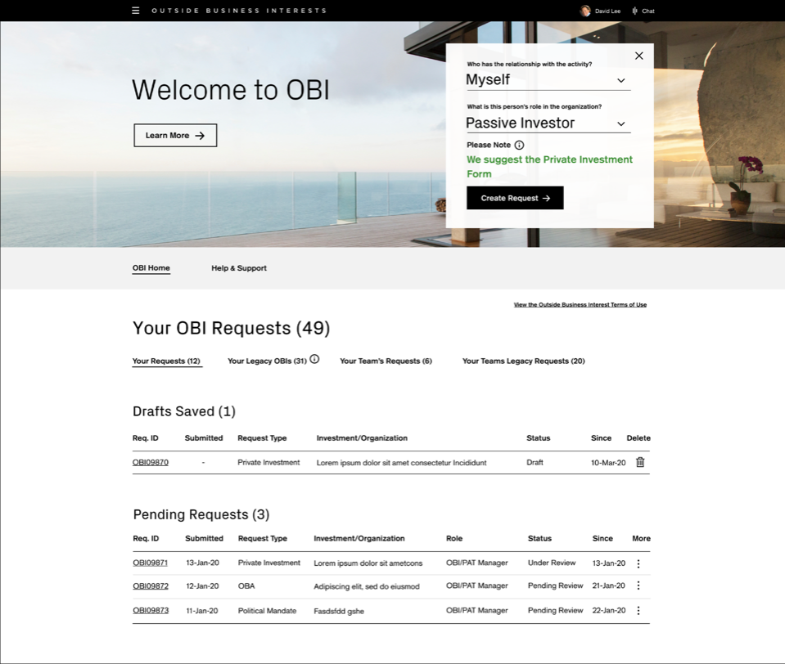
CASE STUDY 02 · ENTERPRISE · DELIVERED
Credit Suisse
Outside Business Interests (OBI)
Saving money by reducing friction, educating employees and removing risk from pre-clearance for outside activities.
ROLE
Led the project team
TEAM
2 UX designers and a content designer
SCOPE
Discovery to delivery: 33 Agile sprints, usability testing every week
USERS
All employees and managers, reviewers, and Risk & Compliance managers
“It’s too limited in its functionality to be of use for an Approver. Too much time is wasted trying to do more complex tasks.”

Slide 2
CREDIT SUISSE OBI · INTRODUCTION
A browser-based tool that gives employees pre-clearance for outside activities, reviewed by two lines of defense.
TARGET AUDIENCE
— Risk and Compliance managers
— All Credit Suisse employees
— All Credit Suisse managers
THE PROBLEMS
— Submission status tracking isn’t clear
— Lines of responsibility aren’t transparent
— No reporting
— Navigation is hard
— People don’t know why and when to submit
— No mobile access for Risk & Compliance managers
— A confusing submission process, with no education
TEAM AND MY PART
— I led a project team of 2 UX designers and a content designer
— I managed discovery, including research, strategy and hands-on design
— I led every deliverable in Sketch and Figma, with Lean UX and usability testing, and presented to the client and stakeholders

Slide 3
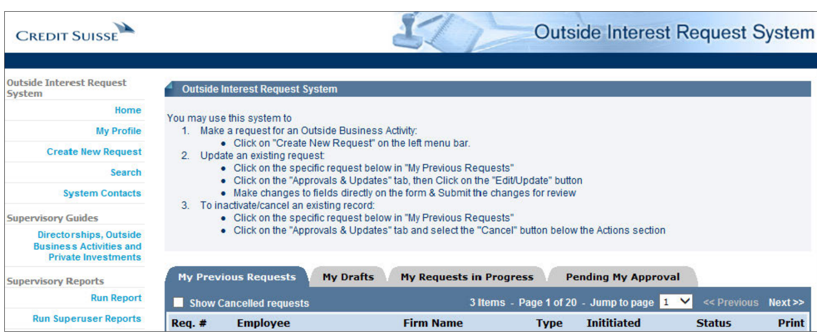
CREDIT SUISSE OBI · DISCOVERY
Where we started: the original application
The tool employees used to request pre-clearance before the redesign.

Slide 4
CREDIT SUISSE OBI · WHY REDESIGN
Why redesign OBI?
475
22 min
58%
average time employees need to resubmit
approval rating from Risk & Compliance managers
returned submissions missing required information, every year
5.4%
6.1%
61%
drop-off on Outside Business Activities forms
drop-off on Private Investments forms
approval rating from employees

Slide 5
CREDIT SUISSE OBI · DISCOVERY
We set out to find real user needs, test the business’s assumptions and generate new ideas.
METHODS
— Interviews with reviewers, Risk & Compliance managers and their managers
— Contextual interviews
— Persona development
— Research synthesis
— Design thinking exercises
PROBLEM STATEMENT
As part of the iComply ecosystem of Employee Compliance, users need an interactive, web-based pre-clearance application for outside activities, where requests flow through an integrated, pre-defined workflow for review by first-line Reviewers and second-line Risk & Compliance Managers.

Slide 6
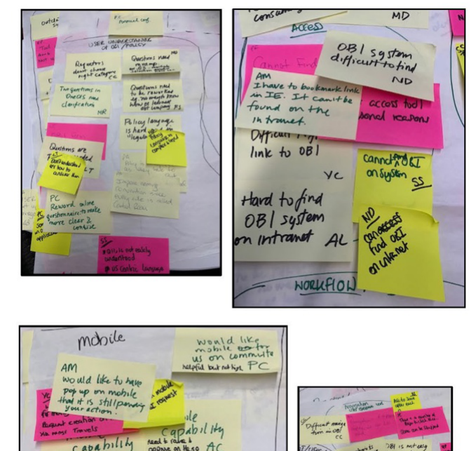
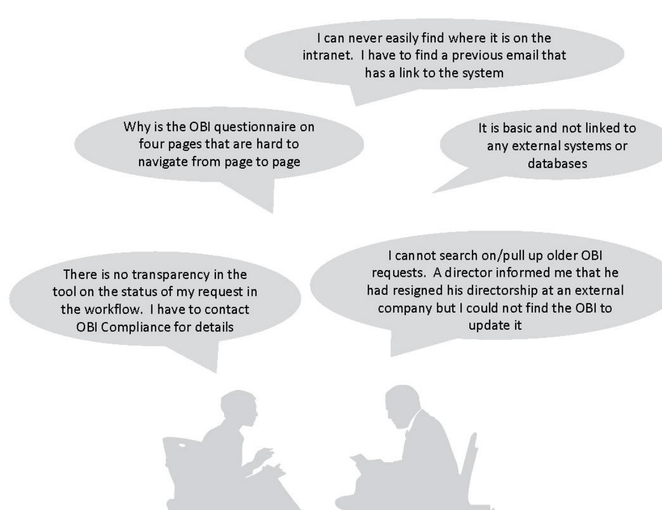
CREDIT SUISSE OBI · DISCOVERY
What we heard: major themes from the interviews
Reviewers, Risk & Compliance managers and their managers
MAJOR THEMES
— Integration with other systems on the platform
— Search
— Reporting
— Shadowing
— Everyone understanding the policies
— Mobile
— Clear navigation
— Clear workflow
— Status awareness

Slide 7
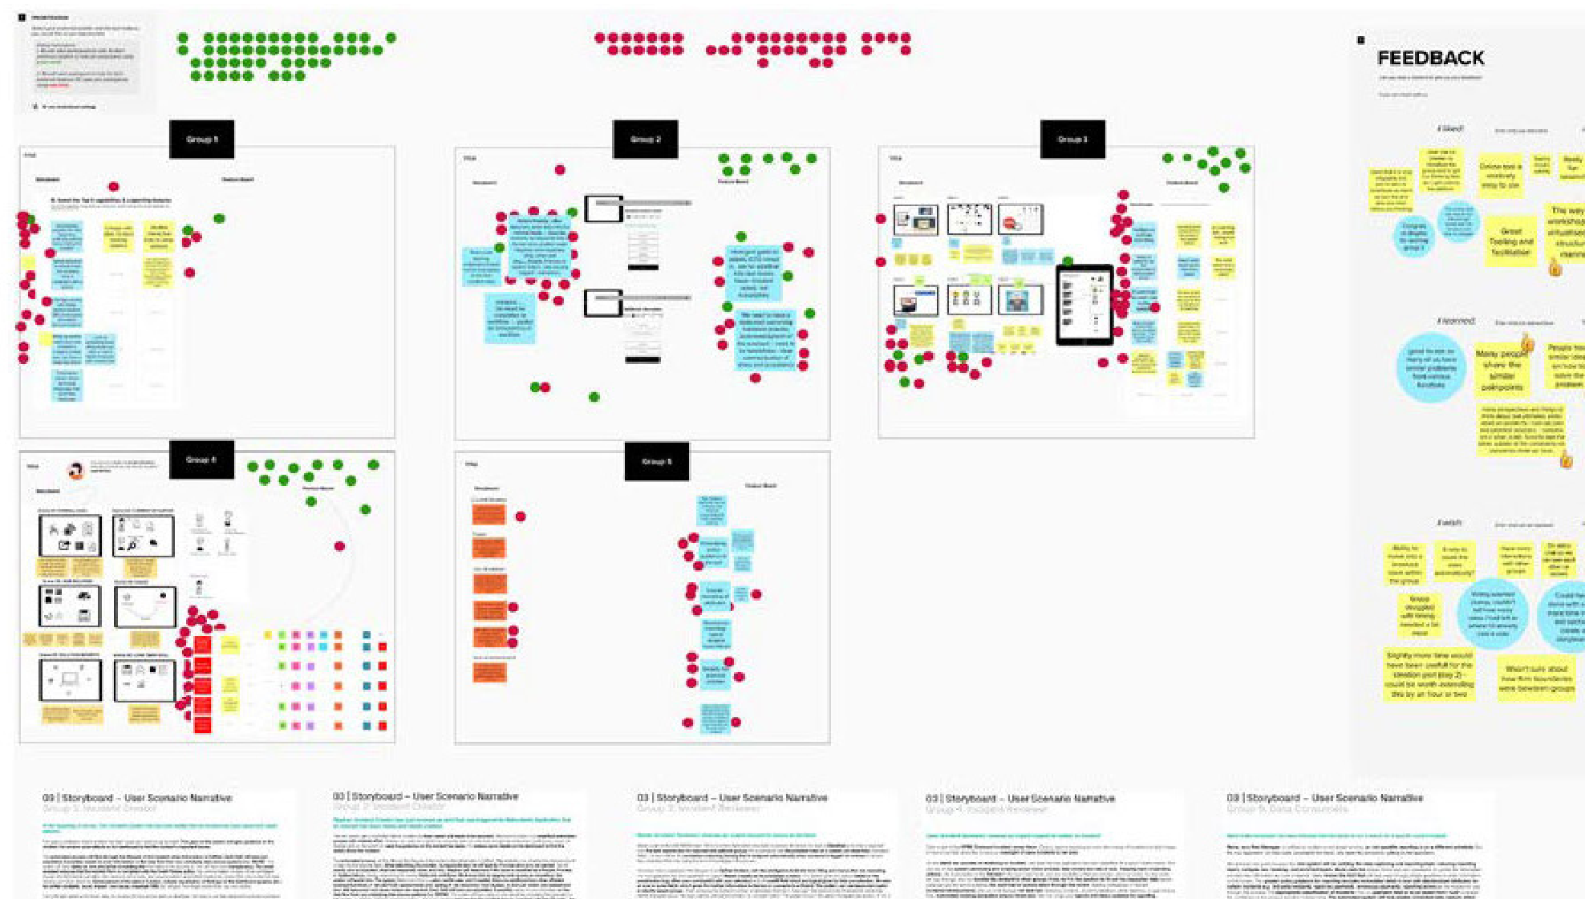
CREDIT SUISSE OBI · DISCOVERY
Design thinking: 5 concepts with 30 participants
Concepts for the dashboard, reporting and submission, for every type of end user
SESSION FORMAT
— Ice breaker
— What would the headlines say?
— How do we…?
— Concepts and interfaces
— Voting

Slide 8
CREDIT SUISSE OBI · STRATEGY
Pain points + business goals + UX strategy = feature set
+
+
=
PAIN POINTS
Integration with other systems on the platform
Navigation
Clear workflows
Status awareness
Lack of features
BUSINESS GOALS
Education
Functionality parity
Platform parity
Mobile
UX STRATEGY
Integrations with other systems on the platform
Everyone understanding the policies
Access for all in the platform
Mobile
Clear navigation
Clear workflows
FEATURE SET
Search
Reporting
Shadowing
Proxies
Queries
Mobile

Slide 9
CREDIT SUISSE OBI · DELIVERY
One dashboard for Submitters, Reviewers and Risk & Compliance Managers.
The dashboard was the main starting point for all three user types, so it got the most attention. It went through many iterations shaped by company goals, line-of-business goals, UX strategy, legal, risk and ADA requirements, and the design system.
HOW WE DELIVERED
— Feature refinement and road map
— 33 Agile sprints
— Usability testing every week
— Demos and QA

Slide 10
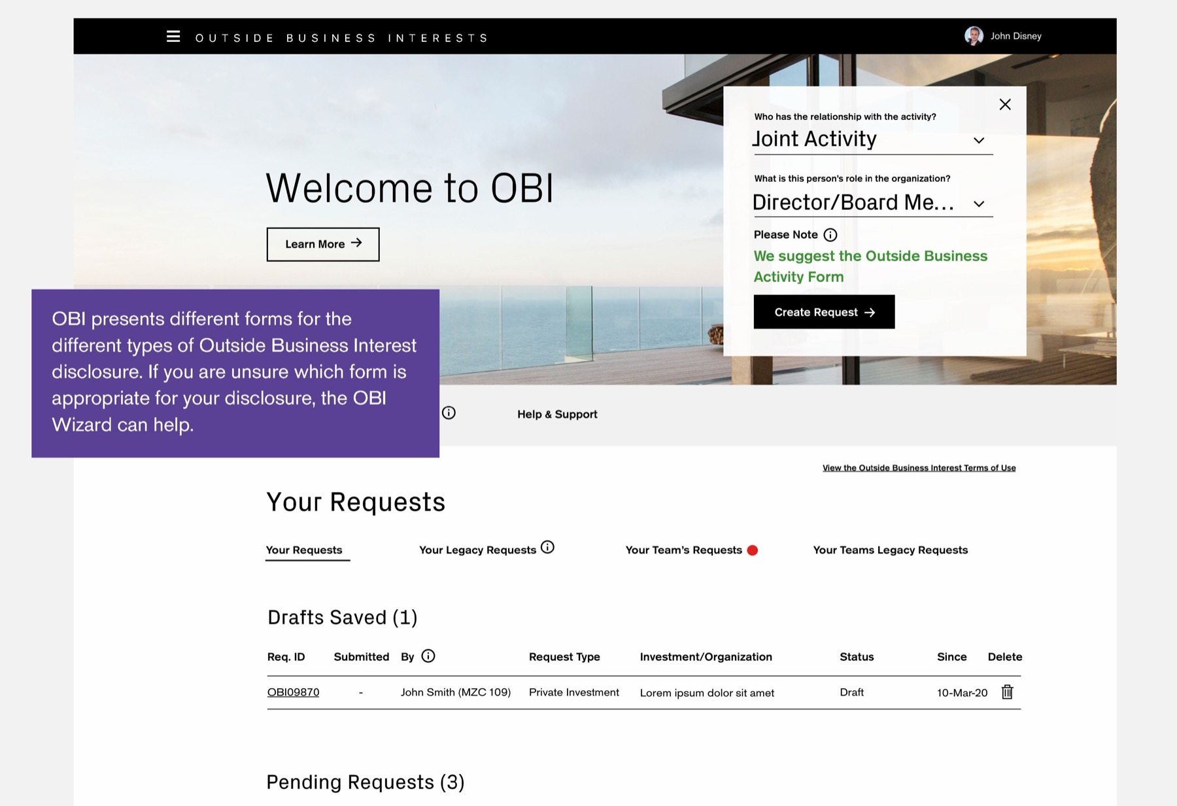
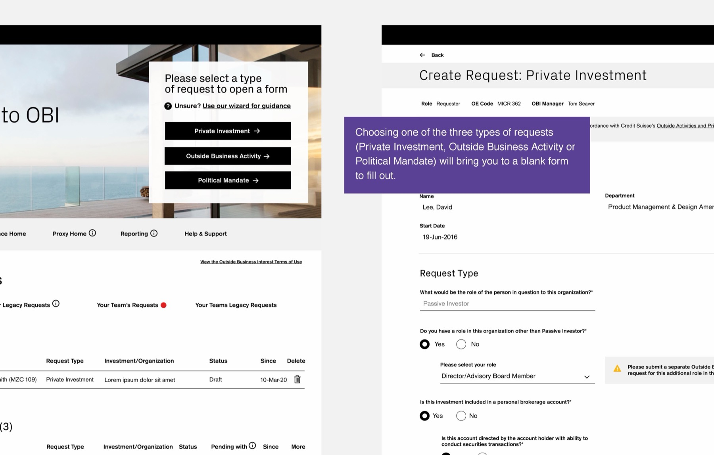
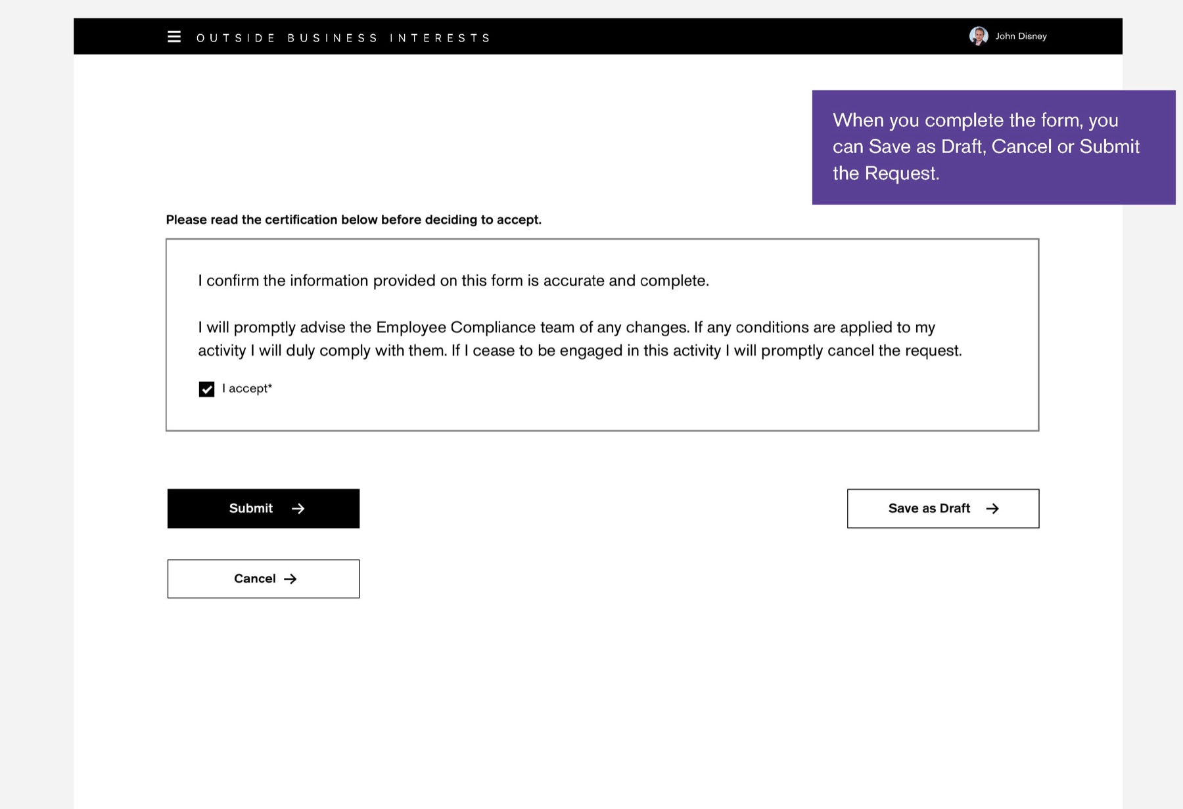
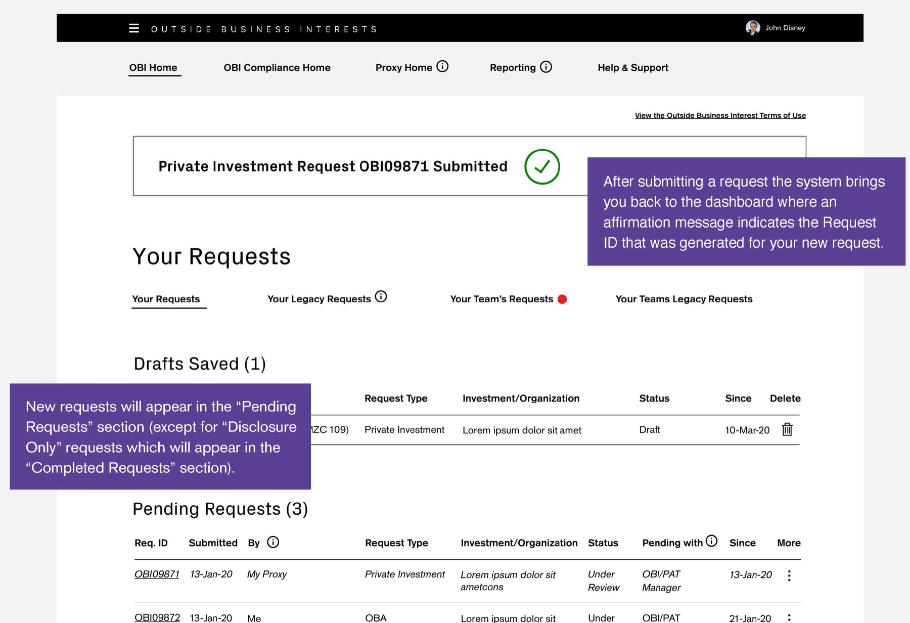
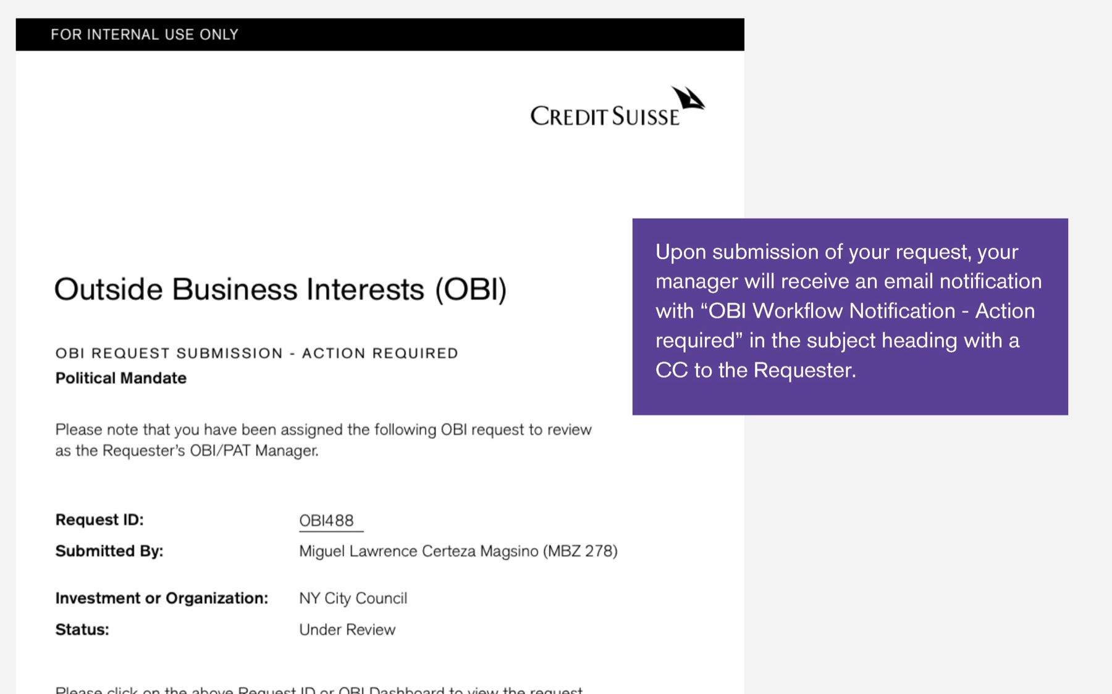
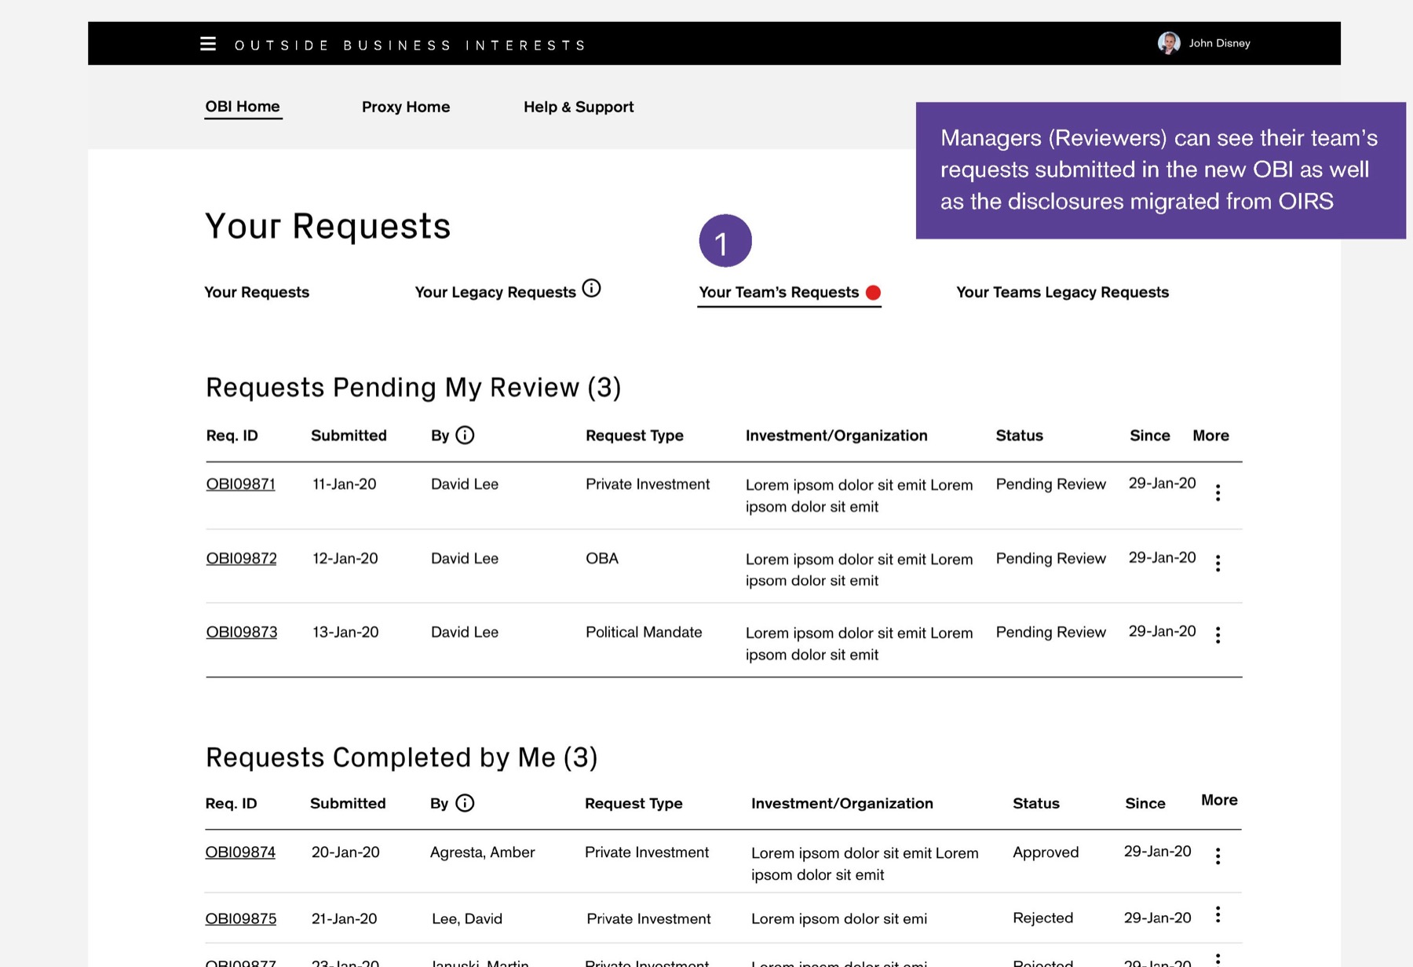
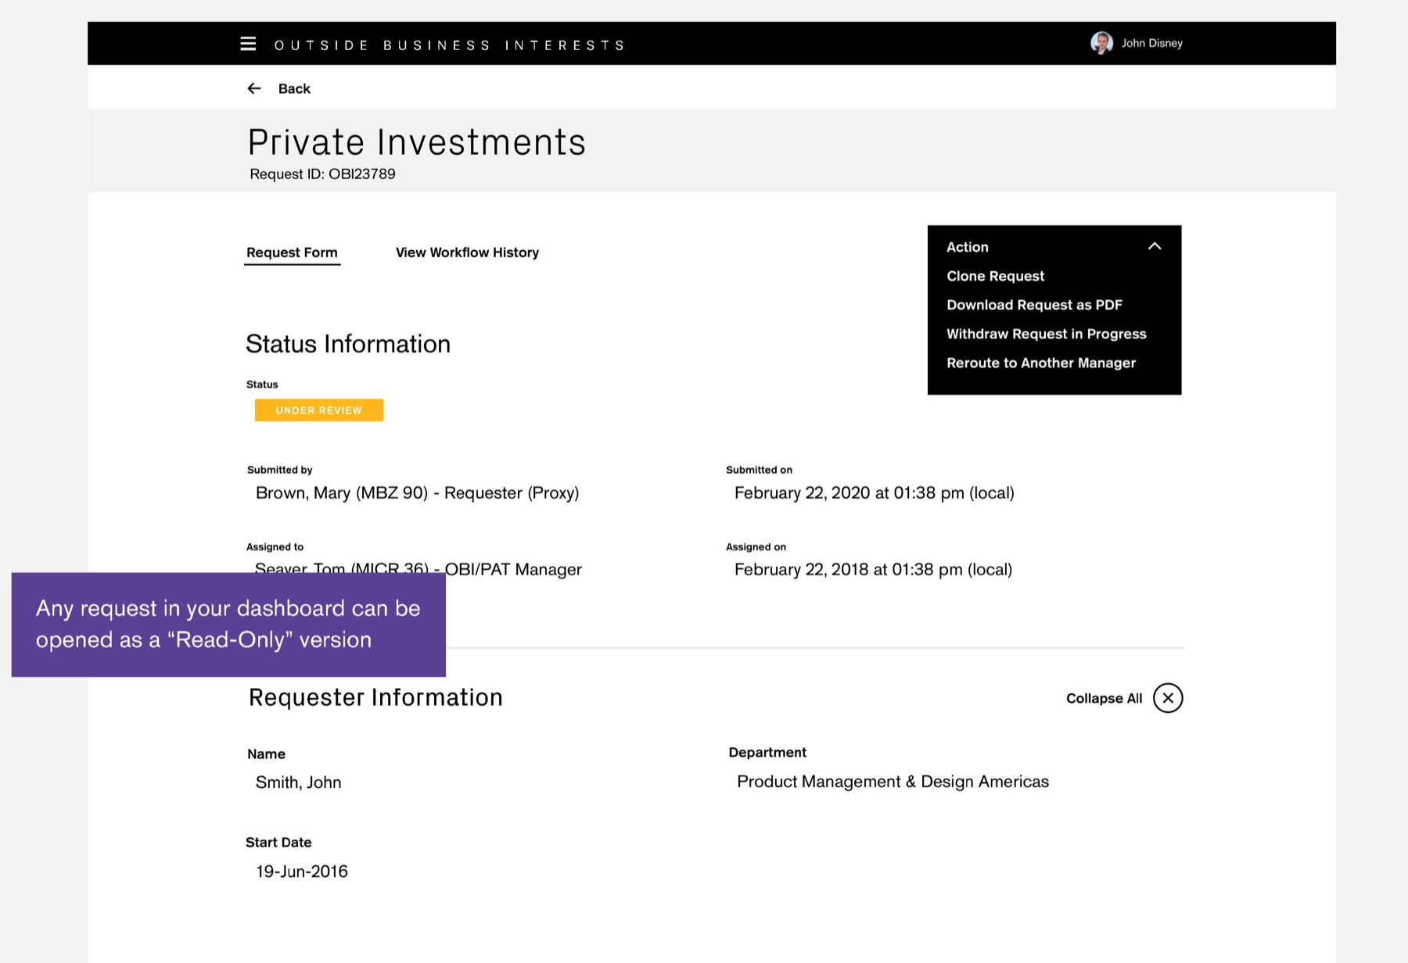
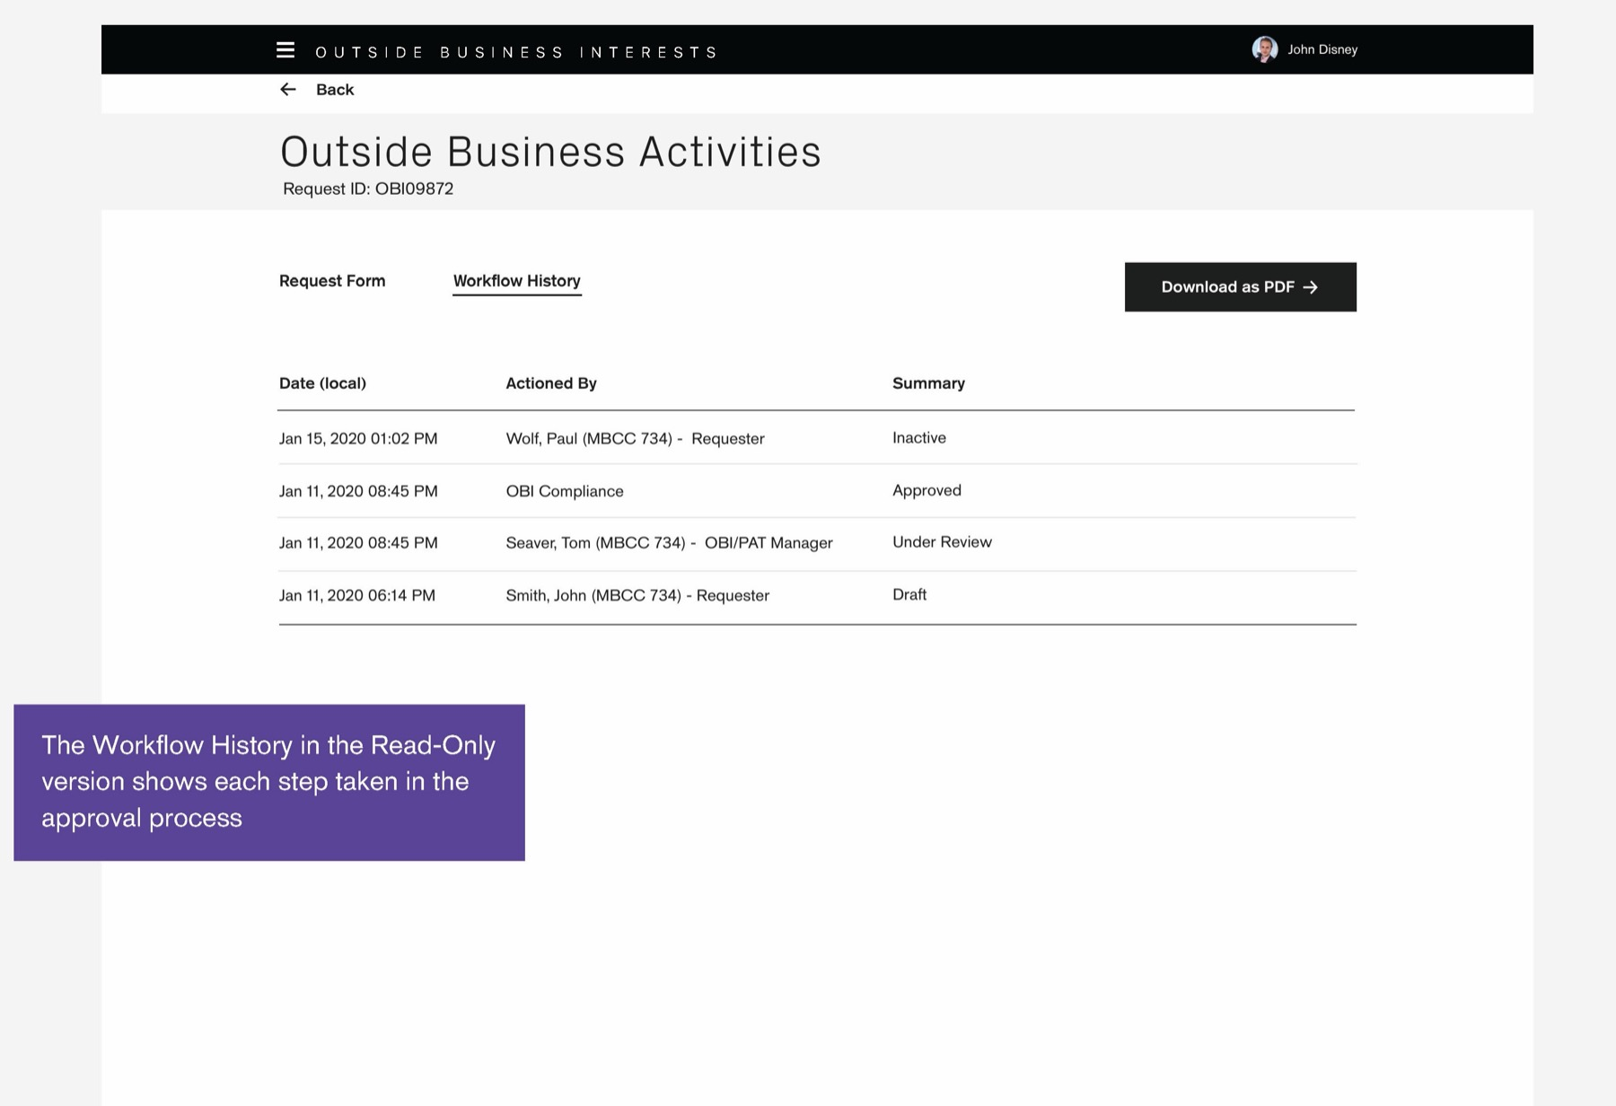
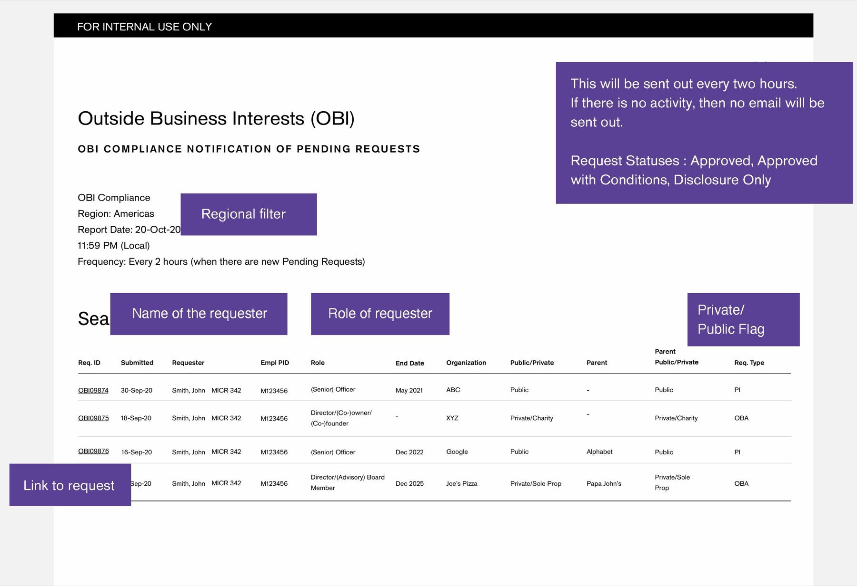
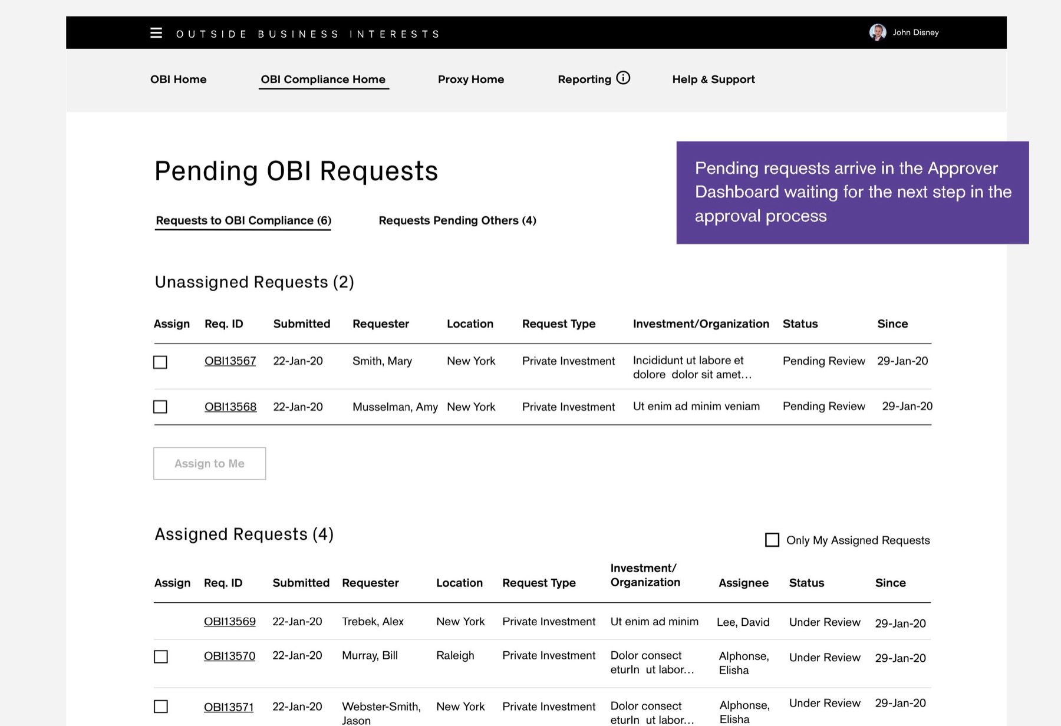
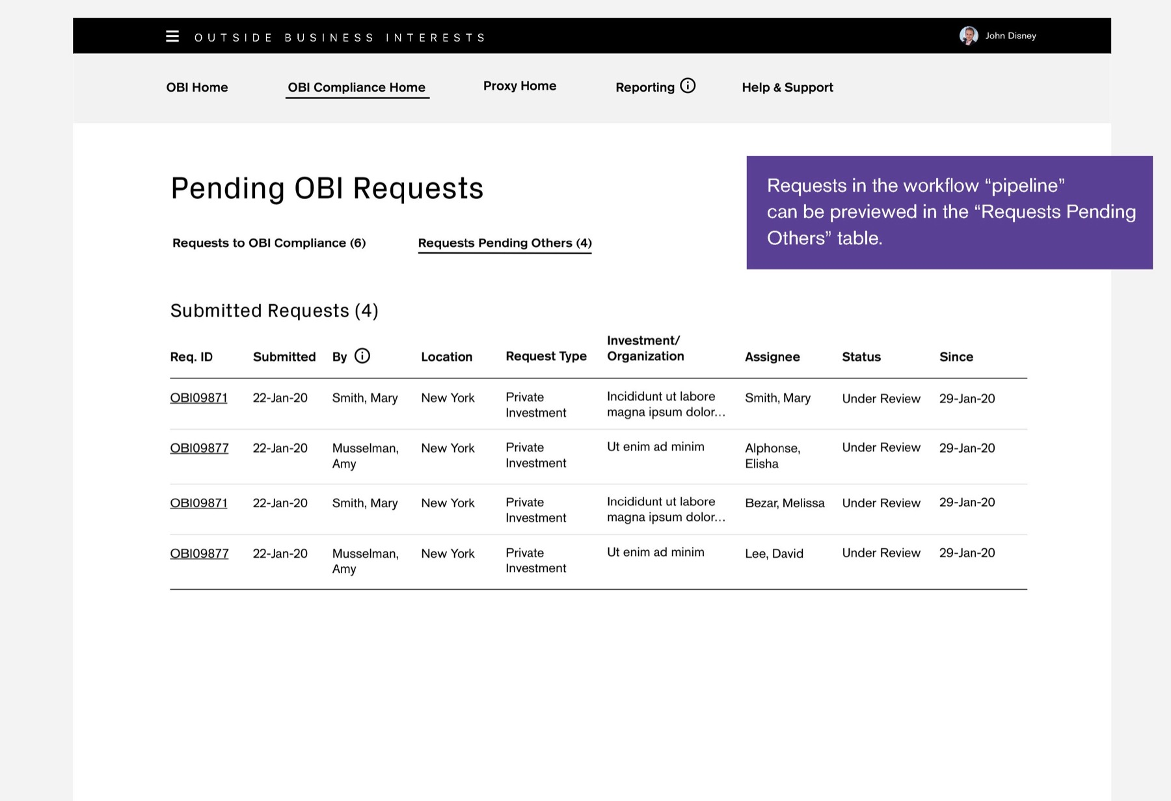
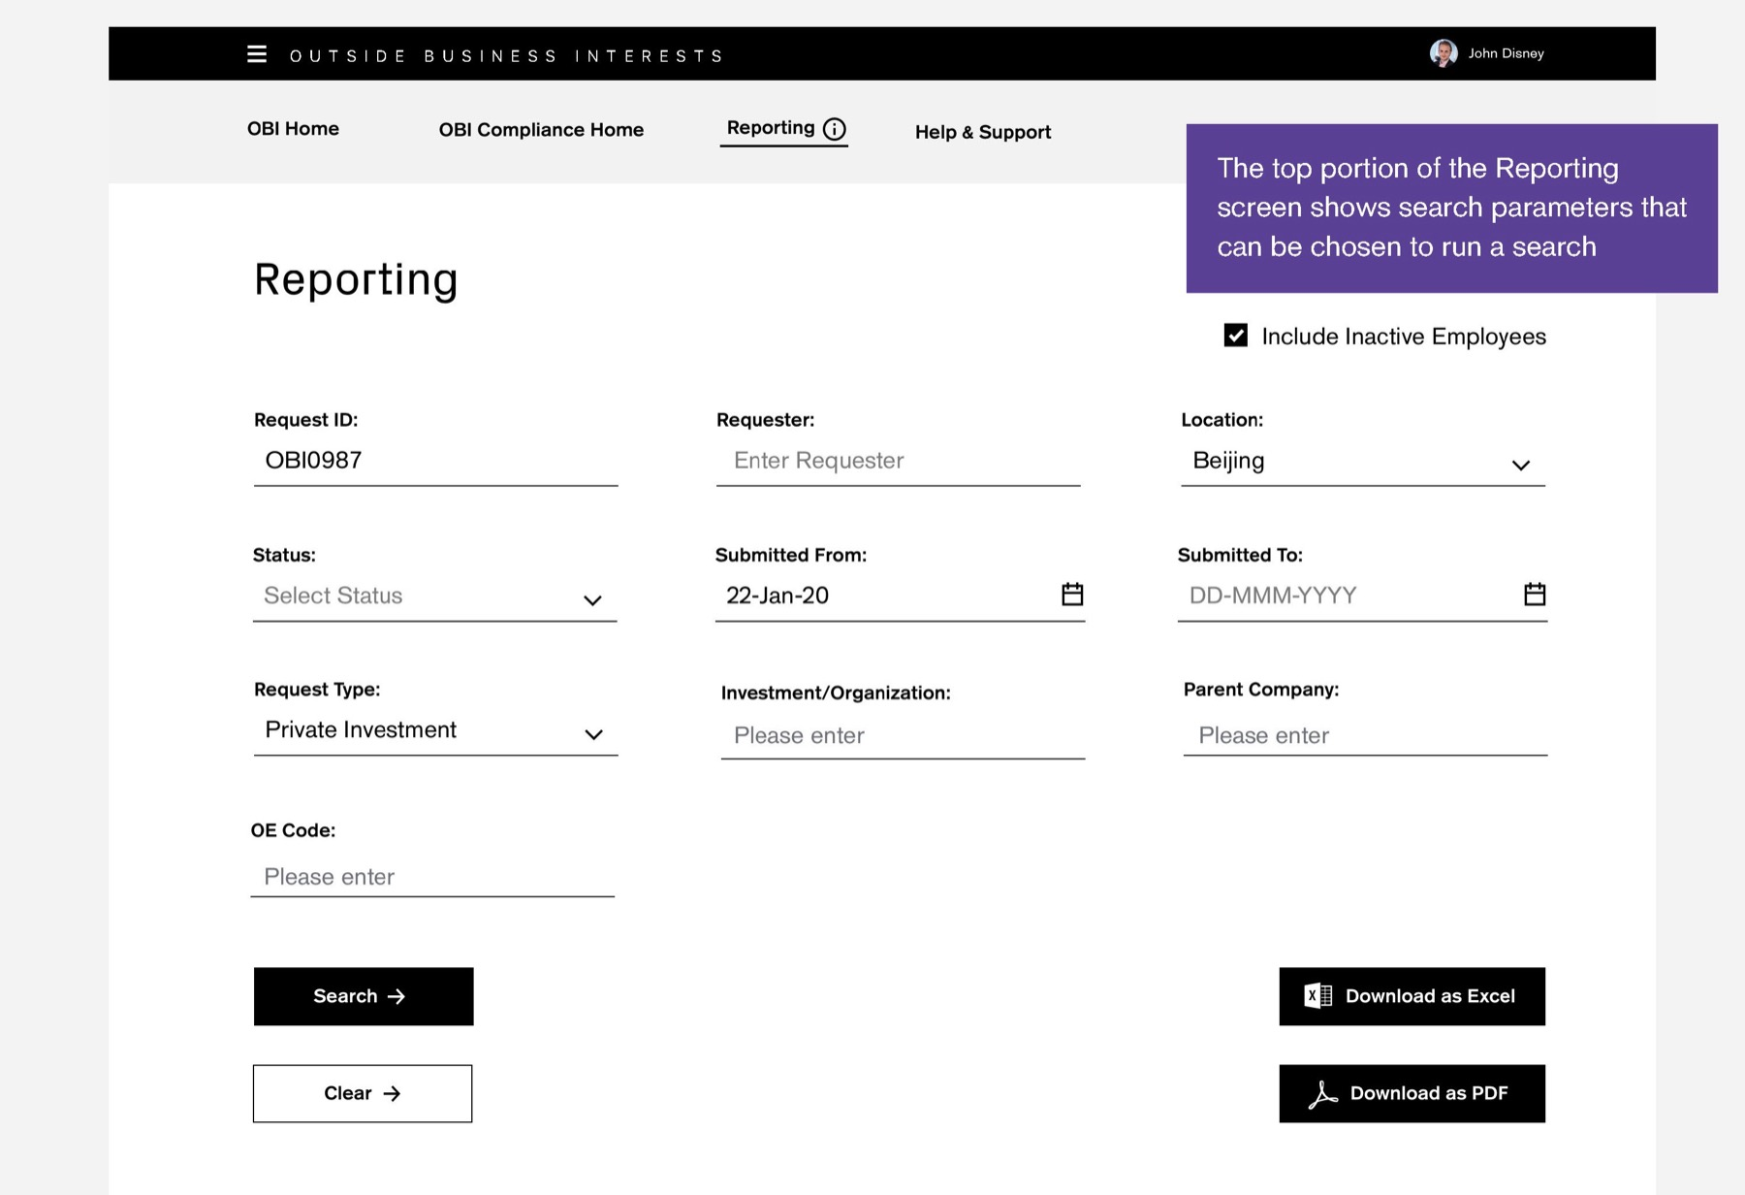
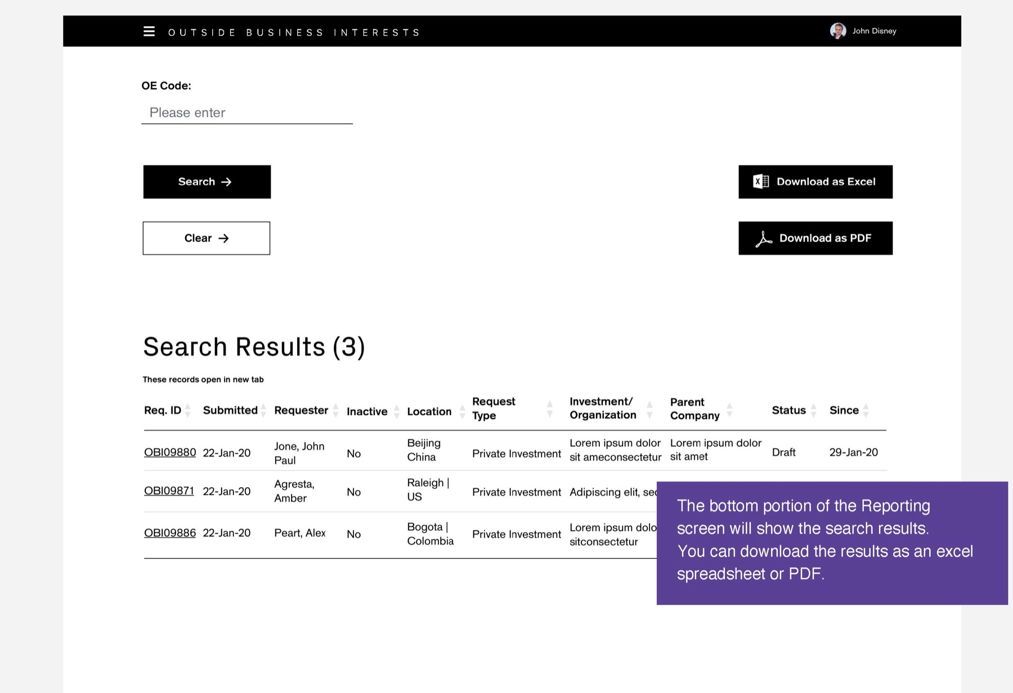
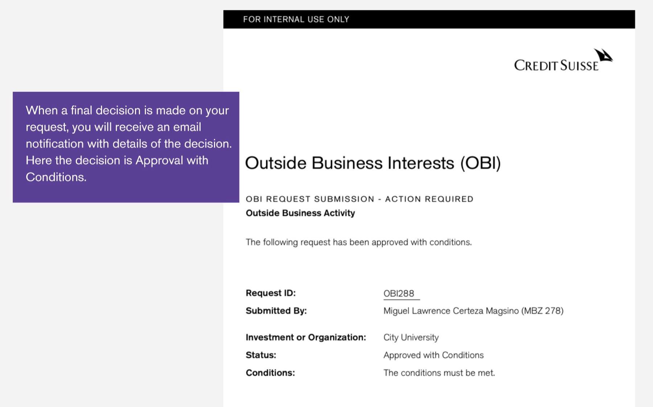
CREDIT SUISSE OBI · DELIVERY
The delivered app, one request end to end
The employee submits, the manager reviews, Compliance decides. Screens from the OBI Training Guide.
01 Welcome and wizard
Employee
02 Create request
Employee
03 Certify and submit
Employee
04 Submitted
Employee
05 Manager notified
Manager
06 Pending my review
Manager
07 Read-only request
Manager
08 Workflow history
Manager
09 Compliance digest
Compliance
10 Pending queue
Compliance
TRY IT
Open the prototype →
Starts at the welcome screen
11 Pipeline
Compliance
12 Reporting search
Compliance
13 Reporting results
Compliance
14 Decision email
Employee

Slide 11
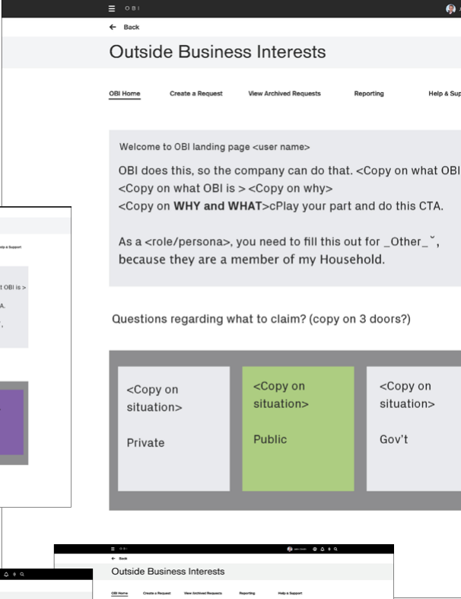
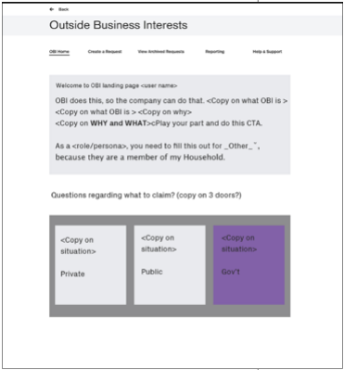
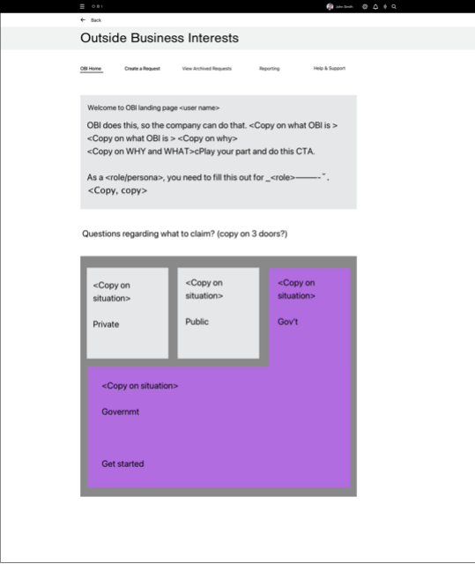
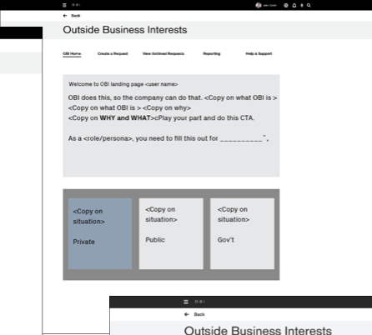
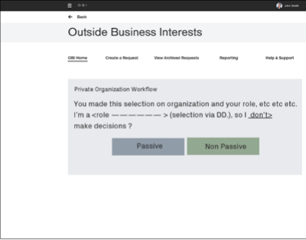
CREDIT SUISSE OBI · DESIGN
Experience design strategy
Based on POC 2 from the design thinking process, and thumbnail sketches.
WHAT WE LEARNED FROM DISCOVERY AND DESIGN THINKING
— Risk & Compliance managers need a dashboard to understand and filter request statuses
— Reporting and other major functions, with sharing and alerts to second-line managers
— Employees were often confused about which form they needed
— They needed education on why, how and when
— They needed to know what to expect when they came back
— One central place to see every submitted request

Slide 12
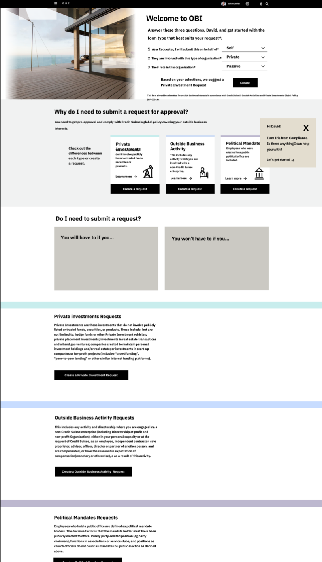
CREDIT SUISSE OBI · DESIGN
Dashboard design sprint: second iteration
The first iterations put education front and center. Testing showed newer users needed it, but not all.
WHAT WE LEARNED IN TESTING
— Education was a priority for all users
— Users responded to friendlier copy that described the situations they might be in
— Content for Swiss users could be surfaced by user ID and location

Slide 13
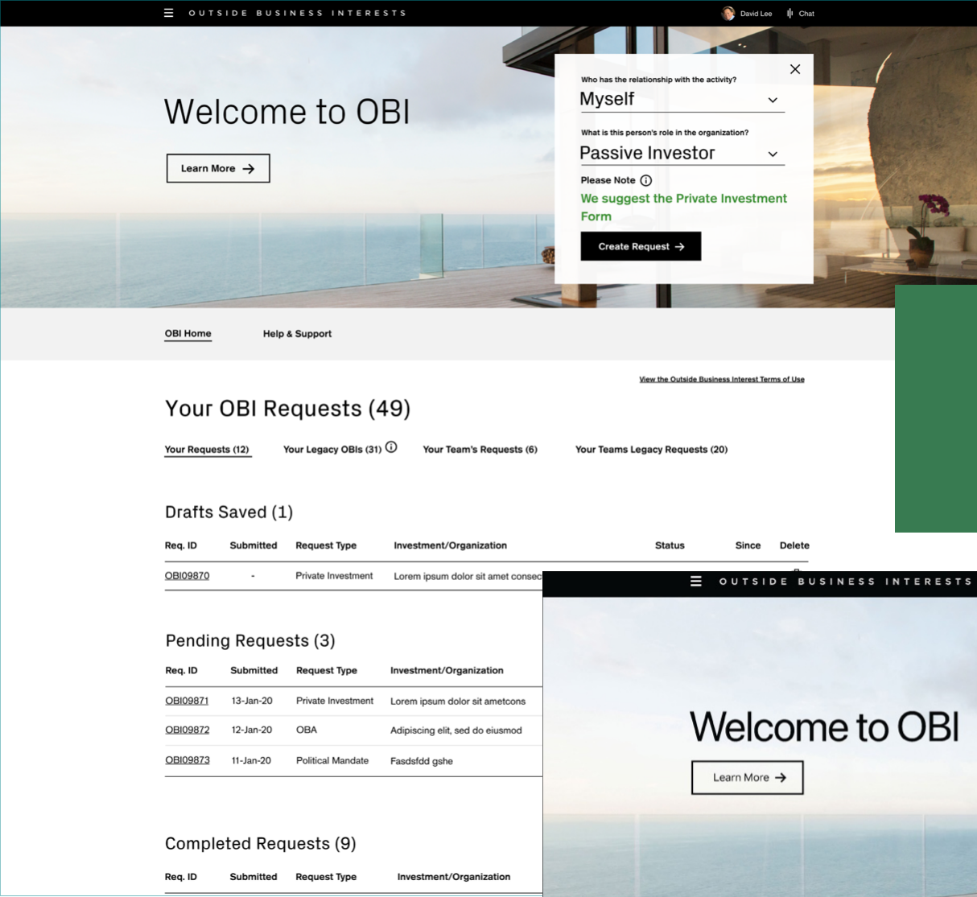
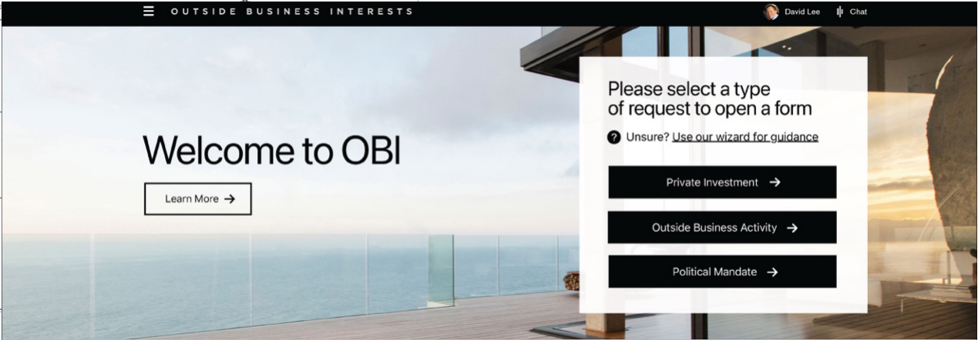
CREDIT SUISSE OBI · DESIGN
Dashboard design sprint: final version
Submitters reach a wizard that asks only 2 questions to find the right form.
WHAT WE LEARNED
— Easy access to education
— A cleaner interface
— A quick way to start a request
Final Version

Slide 14
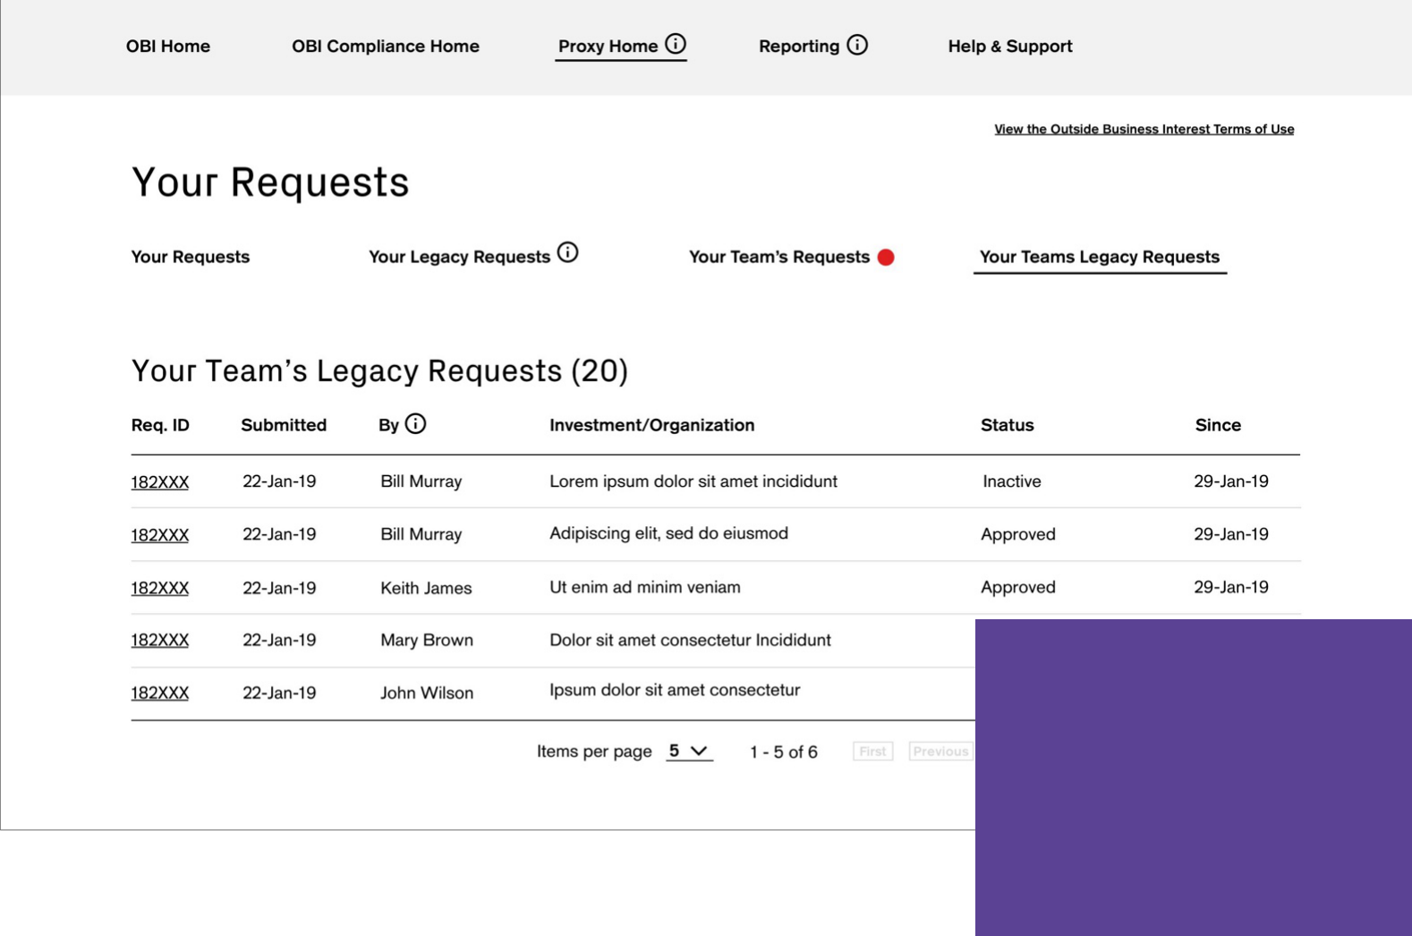
CREDIT SUISSE OBI · DESIGN
Landing page design sprint
Legacy requests from the previous system, OIRS, were migrated into OBI.
YOUR REQUESTS
— Opens by default on the requester dashboard
— Drafts saved
— Pending requests
— Completed requests
The landing page shows the requester dashboard. “Your Requests” opens by default, in three sections:
1. Drafts saved
2. Pending requests
3. Completed requests

Slide 15
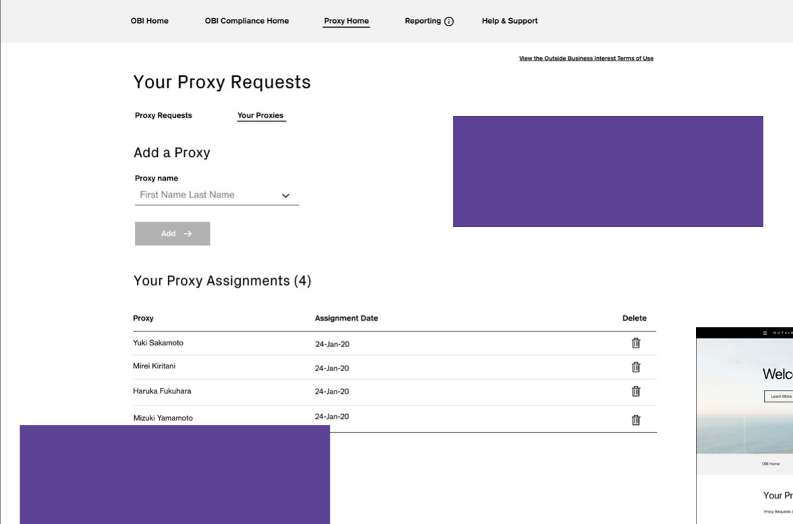
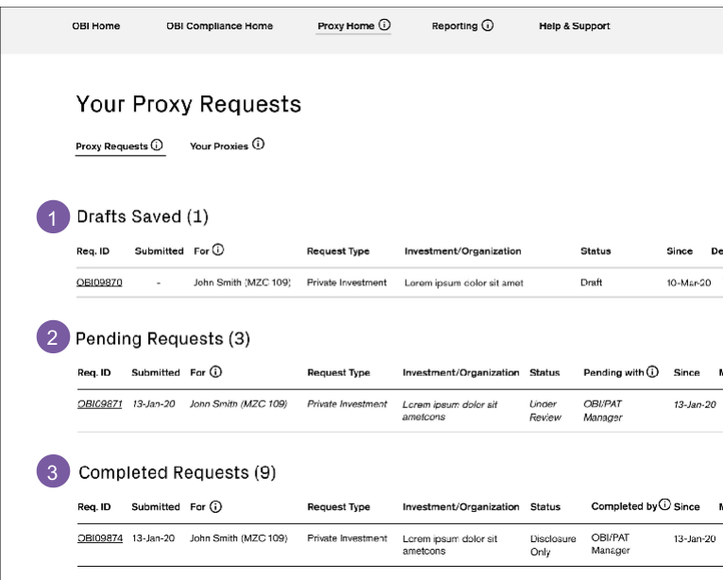
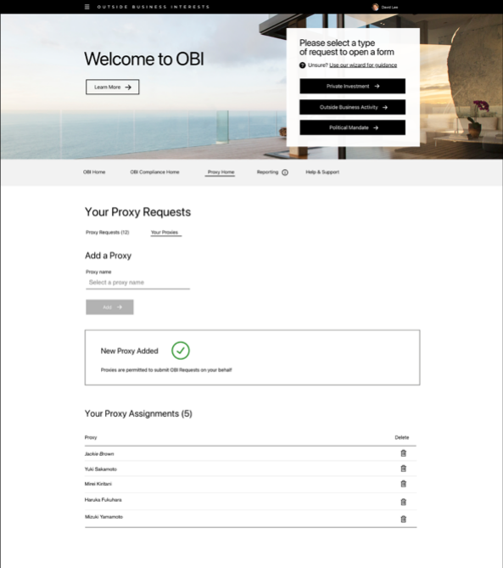
CREDIT SUISSE OBI · DESIGN
Proxy request design sprint
For people who can’t access OBI to make the disclosures they need to.
For people who can’t access OBI themselves to make the disclosures they need to, OBI has proxy functions.
Staff can name colleagues to act as proxies. A proxy can submit requests on behalf of anyone who has given them permission.

Slide 16
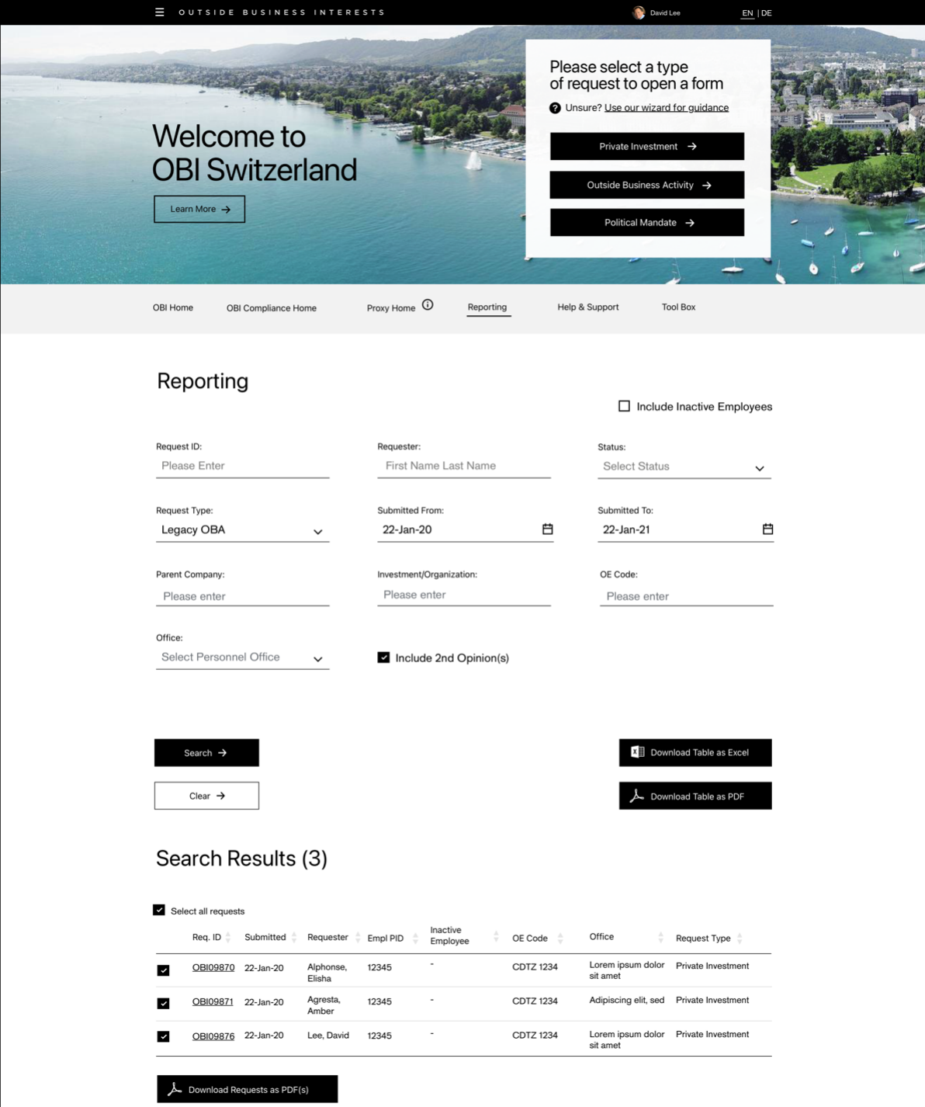
CREDIT SUISSE OBI · DESIGN
Reporting design sprint
Risk & Compliance managers find any request and export the results.
SEARCH BY
— Request ID and requester
— Status and type
— Submission dates
— Company and office
— Export to Excel or PDF

Slide 17
CREDIT SUISSE OBI · KEY CALLS
Four calls that shaped OBI.
A separate dashboard for submitters
Two questions pick the form
Testing showed submitters needed their own starting point, with forms that reveal one step at a time.
Employees didn’t know which form applied. A short wizard asks two questions and opens the right one.
Education written as scenarios
Tools for approvers too
Every user group asked for education. Copy built around real situations tested best, after three iterations.
Proxy submissions for people who can’t access OBI, and reporting by ID, status, office and date, exported to Excel or PDF.

Slide 18
CREDIT SUISSE OBI · OUTCOME
Delivered: one place to submit, review and report, with education built in.
WHAT SHIPPED
— A submitter dashboard with a 2-question wizard that opens the right form
— Your Requests: drafts, pending and completed, with legacy OIRS requests migrated
— Proxy submissions for people who can’t access OBI themselves
— Reporting by ID, requester, status, type, dates, company and office, exported to Excel or PDF
WHAT TESTING TAUGHT US
— Education matters to every user, but only newer users need it front and center
— Copy that describes real situations works better than policy language
— A cleaner interface and a quick start beat more options on the dashboard

Slide 19
CREDIT SUISSE OBI · PROTOTYPE
Follow 1 request through the delivered app.
14 screens from the OBI Training Guide, linked in order: the employee submits, the manager reviews, Compliance decides, and the employee hears back.
Open the OBI prototype →
Or start at the workflow map →
ALSO AVAILABLE
An offline version with the narrative for every step and a full link map: OBI-Request-Prototype.html.

