Slide 1

CASE STUDY 03 · CONSUMER MOBILE · DELIVERED
Wells Fargo
Integrated Trade Ticket
Increasing revenue by letting investors trade by share quantity or dollar amount, in one simpler mobile ticket.
ROLE
Led the project team
TEAM
2 UX designers
SCOPE
Discovery, competitive analysis, 3 tested iterations, 6 Agile sprints
USERS
Experienced and novice self-directed traders
“It’s a confusing interface, the app’s interface is non-intuitive, making it difficult to navigate and find specific functions or features.”

Slide 2
WELLS FARGO TRADE TICKET · INTRODUCTION
One trade ticket that lets investors trade in shares or dollars, with fewer errors and less effort.
TARGET AUDIENCE
— Experienced consumer traders
— Novice consumer traders
THE PROBLEMS
— Wealth & Investment Management investors can’t trade in both shares and dollars
— The mobile trading process needs simplifying
— A confusing interface
— Limited functionality
— Technical issues and no real-time updates
— Poor customer support
TEAM AND MY PART
— I led a project team of 2 UX designers
— I managed discovery, including research, strategy and hands-on design, supported by AI applications
— I led every deliverable in Figma, with Lean UX and usability testing, and presented to the client and stakeholders

Slide 3
WELLS FARGO TRADE TICKET · WHY REDESIGN
Why redesign the trade ticket?
8.2 min
for a new user to complete their first trade
18.3%
of users ask to trade in both shares and dollars
1.4%
error rate on submissions
6.1%
drop-off on trades in the mobile app
“The app lacks advanced features like drawing tools or technical indicators. Customer support options are limited, with no chat support available.”

Slide 4
WELLS FARGO TRADE TICKET · DISCOVERY
We set out to find real user needs, test the business’s assumptions and generate new ideas.
METHODS
— Interviews with external users, internal stakeholders and SMEs
— Experienced and novice traders
— Persona development
— Google design thinking exercises
— Competitive analysis
PROBLEM STATEMENT
As the most important part of the trading experience, experienced and novice users need an integrated trade ticket that simplifies trading, reduces errors and improves efficiency, while letting them trade in shares or dollar amounts.

Slide 5
WELLS FARGO TRADE TICKET · DISCOVERY
“…so non-intuitive, it makes it hard to navigate, find specific functions and just make a quick trade.”
PAIN POINTS WE HEARD IN INTERVIEWS
01
Can’t trade in both shares and dollars on mobile
05
More trading options
02
Several interfaces aren’t intuitive
06
Speed
03
Need more of the right trade detail
07
Mobile native
04
Flexibility needs to improve

Slide 6
WELLS FARGO TRADE TICKET · STRATEGY
Pain points + business goals + UX strategy = feature set
+
+
=
PAIN POINTS
Can’t trade in both shares and dollars
Interfaces aren’t intuitive
Need more of the right trade detail
Flexibility
More trading options
Transaction speed
Mobile native
BUSINESS GOALS
Speed
Education
Platform parity
Integrated systems
Data
UX STRATEGY
Simplified interface
Dynamic functionality
Trade speed
Real-time updates
FEATURE SET
Order entry
Execution management
Real-time monitoring
Risk management
Post-trade processing
Integration with other systems
Shares vs. dollars
Analytics and reporting

Slide 7












WELLS FARGO TRADE TICKET · DISCOVERY
Competitive analysis
How the leading trading apps handle shares, dollars and the ticket itself
Robinhood
Whole and fractional shares in dollar amounts. A simple switch between shares and dollars, tickets with every detail, and instant trade notifications.
Charles Schwab
Fractional shares from $5 with Stock Slices. Clear, complete trade tickets and an intuitive design.
Fidelity
Shares or dollars, with fractional shares across stocks and ETFs. Detailed tickets with execution time, and easy navigation.

Slide 8


WELLS FARGO TRADE TICKET · DESIGN
Trade ticket design sprint: discovery
WHAT WE LEARNED FROM DISCOVERY AND DESIGN THINKING
— Account switching would serve most experienced traders and 60% of novice users, and fit the new mobile-native navigation
— Dark mode is important

Slide 9


WELLS FARGO TRADE TICKET · DESIGN
First iteration: start from what they hold
If a user holds the asset, they go straight into a ticket to buy or sell.
THE IDEA
— The asset is already held, so the user lands straight in the funnel
— One toggle switches between dollars and shares
— A predictive interface: only the choices that apply, never too many
First iteration

Slide 10


WELLS FARGO TRADE TICKET · DESIGN
Second and third iterations
A flexible ticket with detail on the stock and on the holding itself.
WHAT WE LEARNED IN TESTING
— Education was a priority for all users, but shouldn’t distract or slow them down
— Trading in quick amounts is good
— Feedback on the share amount is valuable too
— A custom keyboard was tried in several iterations, then replaced by the system keyboard
Second iteration
Third iteration

Slide 11





WELLS FARGO TRADE TICKET · DESIGN
Testing two versions: list or tabs
Every order type stays available, whether trading by shares or dollars.
WHAT WE LEARNED IN TESTING
— People preferred the list view to tabs
— The icon next to “Action” scored high
— Quantity and order sheets that appear only when needed made sense to many
Test version 1

Slide 12


WELLS FARGO TRADE TICKET · DESIGN
Final delivered solution
Every field stays editable if the user needs to change the order.
WHAT WE LEARNED IN TESTING
— Order types vary
— Color and status changes show where an order is
— Seeing the status right away is vital
— A cleaner interface
— Quick transactions
— Watchlist alerts you can act on
Final delivered solution

Slide 13
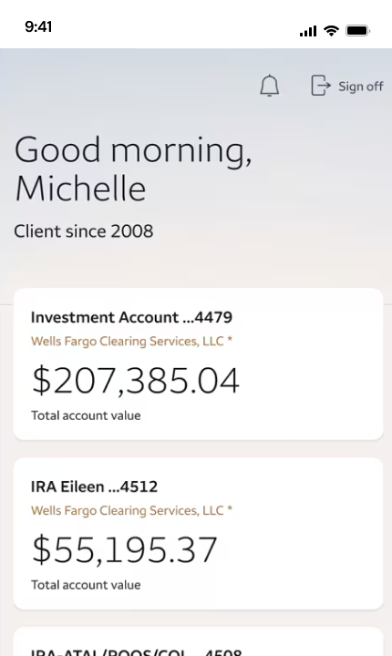
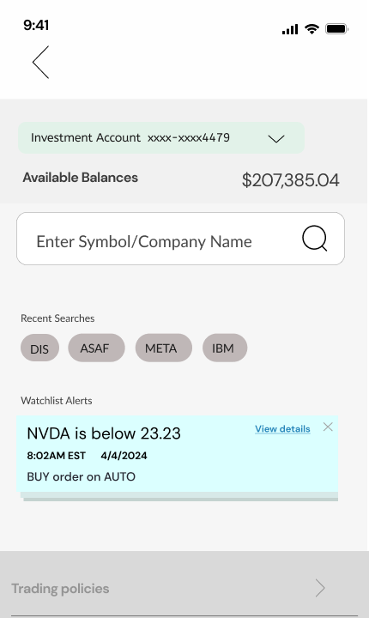
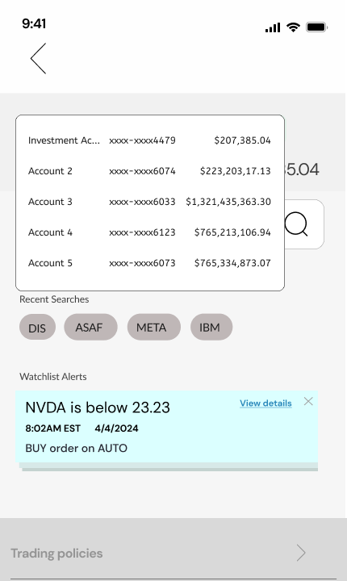
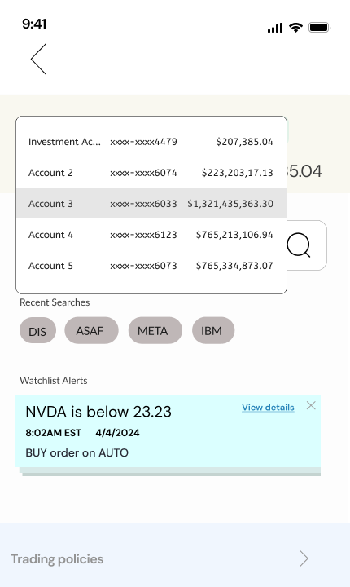
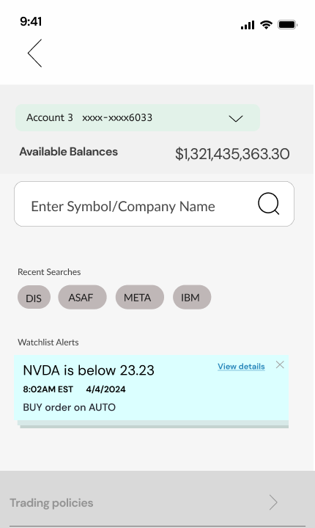
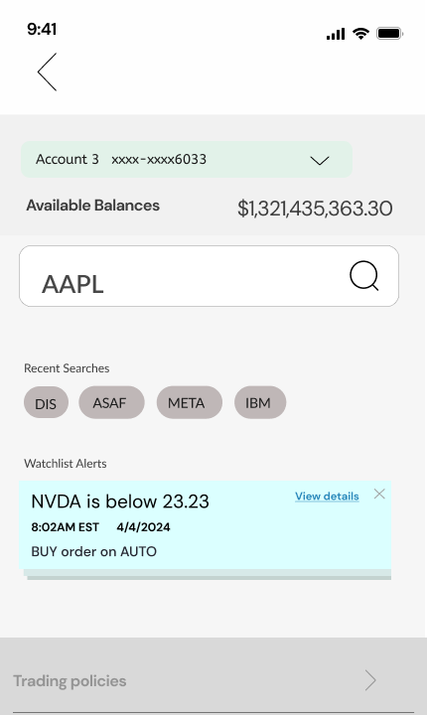
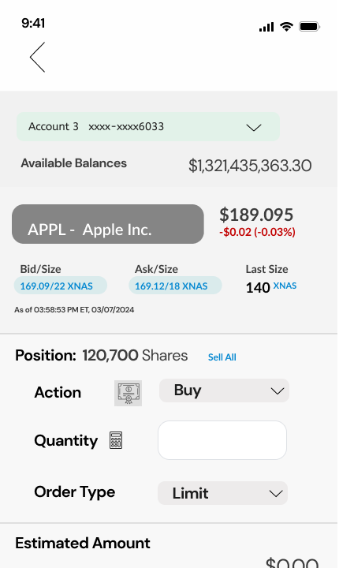
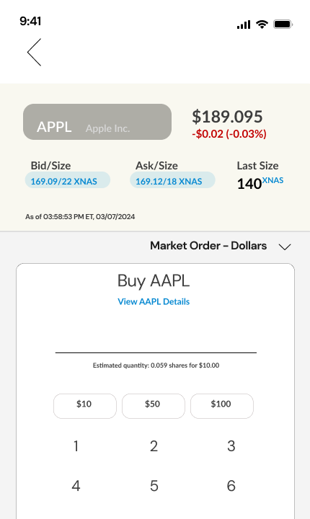
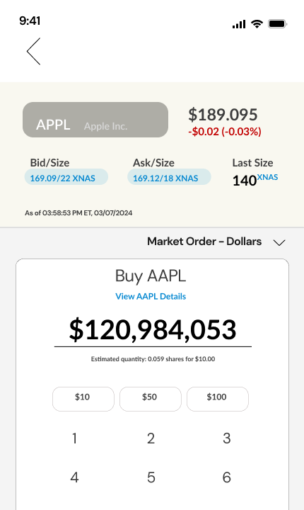
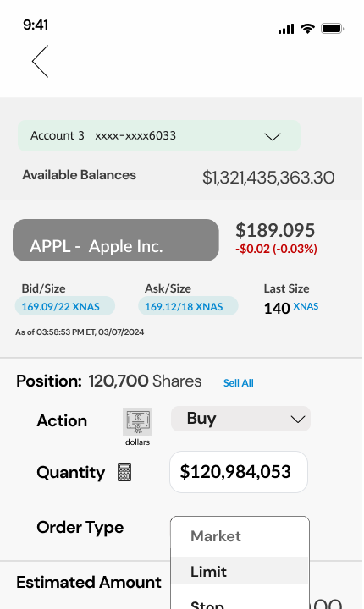
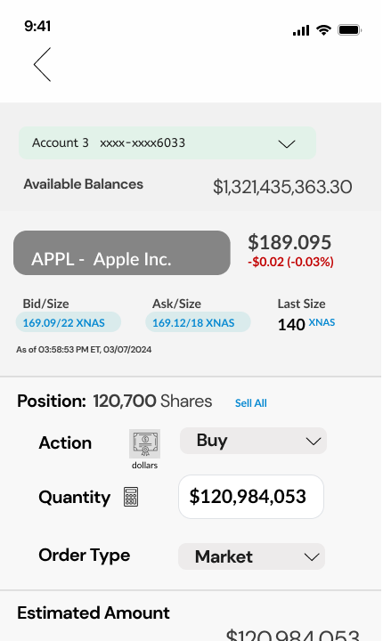
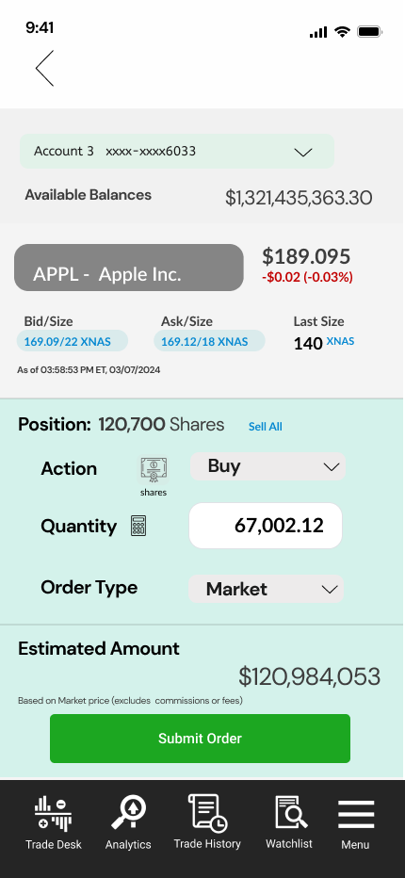
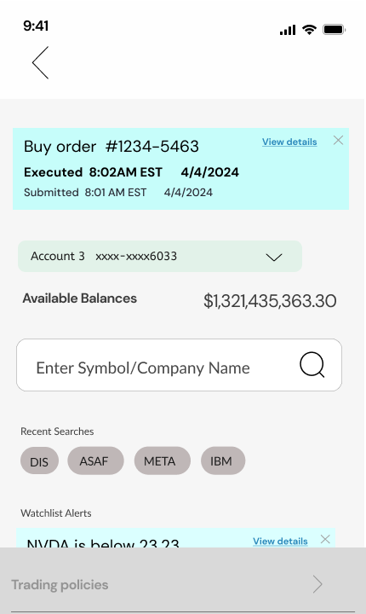
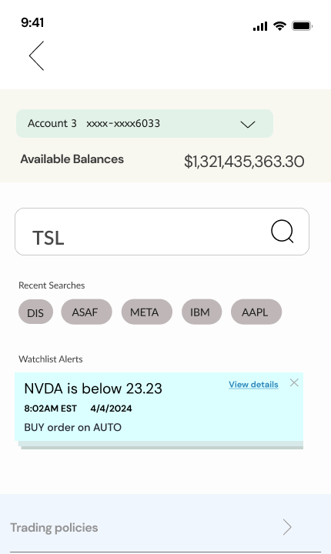
WELLS FARGO TRADE TICKET · DELIVERY
One buy order, on the phone
Account, stock, Buy, a dollar amount on the keypad, order type, review in shares, submit, executed.
01 Accounts home
Pick
02 The ticket
Pick
03 Account menu
Pick
04 Account 3
Pick
05 Search
Pick
06 AAPL
Pick
07 Position, then Buy
Build
08 Keypad
Build
TRY IT
Open the prototype →
Starts at the accounts home
09 Dollar amount
Build
10 Order type
Build
11 Review Order
Review
12 In shares, submit
Review
13 Executed
Status
14 Next trade
Status

Slide 14
WELLS FARGO TRADE TICKET · KEY CALLS
Four calls that shaped the trade ticket.
Shares or dollars in one ticket
Start from what they hold
One toggle switches between trading by share quantity and by dollar amount, instead of two flows.
If a user already holds the asset, they go straight into the ticket with their position shown.
Lists over tabs; fields on demand
Status at a glance
Testers preferred a list view to tabs. Quantity and order sheets appear only when they apply.
Order status changes color as it moves. Testers said seeing the status right away was vital.

Slide 15
WELLS FARGO TRADE TICKET · OUTCOME
Delivered: one ticket for shares or dollars, tested in three rounds.
WHAT SHIPPED
— A single ticket with a shares / dollars toggle
— Held assets go straight into a ticket to buy or sell
— A list view, with quantity and order sheets that appear only when needed
— Order status that changes color as it moves, and every field editable
WHAT TESTING TAUGHT US
— Education matters, but it must never slow a trade down
— Quick amounts and feedback on the share amount build confidence
— Seeing the status right away is vital
— The system keyboard beat a custom one

Slide 16
WELLS FARGO TRADE TICKET · PROTOTYPE
Place one order, in dollars or shares.
14 hi-fi screens of the mobile ticket, linked as in the Figma prototype: pick the account and stock, choose Buy, type a dollar amount, pick the order type, review it in shares, submit, and see it executed.
Open the trade ticket prototype →
Or start at the workflow map →
ALSO AVAILABLE
An offline version with the narrative for every step and a full link map: Trade-Ticket-Prototype.html.
Or open the original Figma design file →

