Slide 1

CASE STUDY 04 · B2B DESKTOP · DELIVERED
American Express
MOCA
Increasing revenue by helping advertisers and marketers decide their advertising budgets with AMEX sales partners.
ROLE
Led discovery and all design deliverables
TEAM
Partnered with AMEX data scientists, who built the projection and optimization engines
SCOPE
Wizard, scenario builder and data visualizer for a desktop app
RESULTS
Partner approval 58% → 88%; average client budget $1.34M → $1.8M
“Comparing budgets and then optimizing it would allow me to have the confidence to increase the budget.”

Slide 2
AMEX MOCA · INTRODUCTION
A desktop app that projects a marketer’s budget and compares built and optimized scenarios.
TARGET AUDIENCE
— American Express sales managers
— American Express sales advisors
THE PROBLEMS
— Sales partners had no effective tool for clients to budget their AMEX advertising dollars
— No way to compare scenarios
— No way to understand how well an investment works
— Need for a more customizable, predictive app using nascent AI technology
TEAM AND MY PART
— I partnered with AMEX data scientists, who built the projection and optimization engines; I designed how partners build, compare and trust scenarios
— I managed discovery, including research, strategy and hands-on design
— I led every deliverable in Sketch and Figma, with Lean UX and usability testing

Slide 3
AMEX MOCA · WHY
Why design MOCA?
58%
approval from internal business partners
$1.34M
average client budget, before MOCA
12 min
average time for partners to complete a budget
5.4%
drop-off on the current budget process
Before MOCA: $1.34M
After launch: $1.8M (see Results)

Slide 4
AMEX MOCA · DISCOVERY
We set out to find real user needs, test the business’s assumptions and generate new ideas.
METHODS
— Interviews with internal stakeholders, SMEs and users
— Sales managers and sales advisors
— Contextual interviews
— Persona development
— Co-design sessions with data scientists
PROBLEM STATEMENT
Internal business partners have no tool to help their clients budget AMEX advertising dollars effectively. Users need an application to allocate marketing budgets across the AMEX product lines.

Slide 5
AMEX MOCA · STRATEGY
Pain points + business goals + UX strategy = feature set
+
+
=
PAIN POINTS
Scenario builder
Data visualizer
Comparison
Importing data sets from Excel
Changing each allocation by channel or product
BUSINESS GOALS
Education
Platform parity
Integrated systems
Data
UX STRATEGY
Walk-through wizard
Scenario builder
Data visualizer
Import data sets
Channel and product allocation
Optimization budget tool
FEATURE SET
Walk-through wizard
Scenario builder
Data visualizer
Comparison
Import data sets
Channel and product allocation
Optimization budget tool
Integration with internal systems

Slide 6

AMEX MOCA · DISCOVERY
The journey, distilled into 3 steps
1
Walk-through wizard
Guides users through the budget projection: import data, set dates, adjust each allocation by channel and product.
2
Scenario builder
Build separate scenarios, compare them, and optimize a selected budget using the tool’s business intelligence and data.
3
Data visualizer
Visualizations show how each plan breaks down and how the plans compare.

Slide 7

AMEX MOCA · DESIGN
Experience design sprint: start from a past budget
WHAT WE LEARNED FROM DISCOVERY
— Users wanted to import one budget and keep it as a template for the next
— So a new budget can start from an imported one, by duplicating it

Slide 8
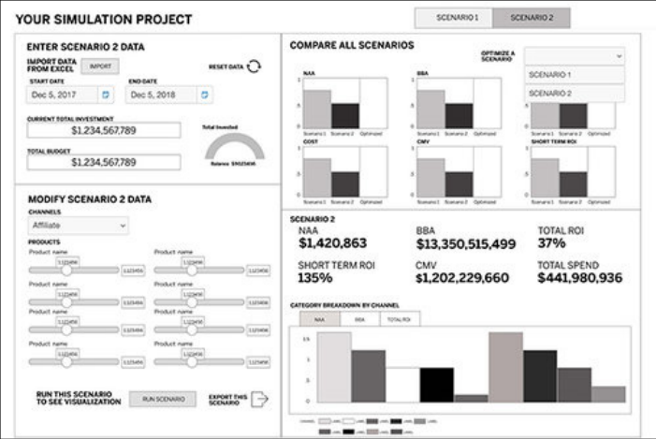
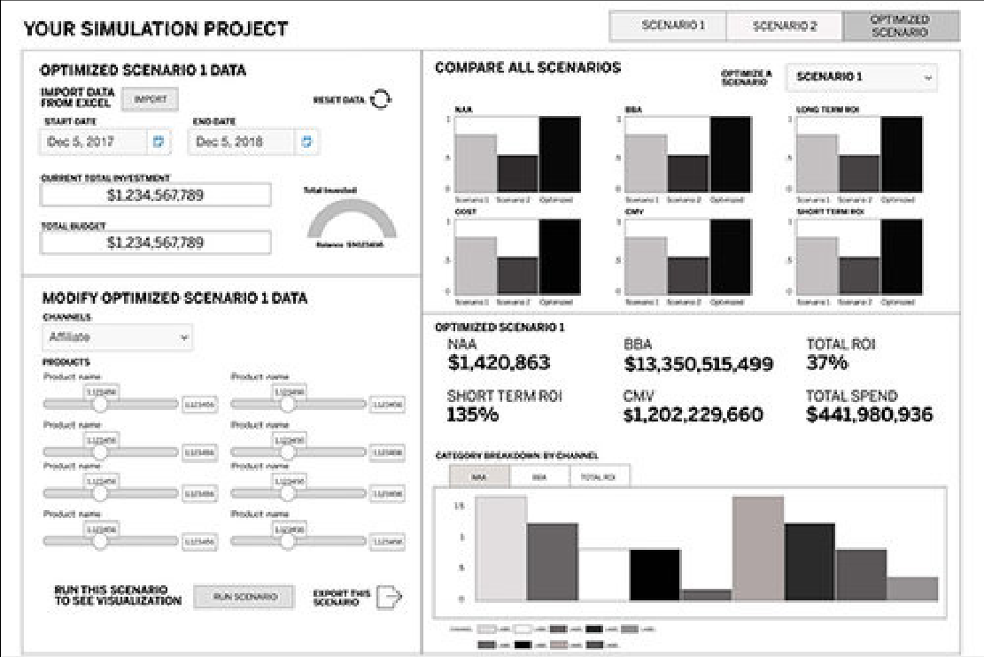
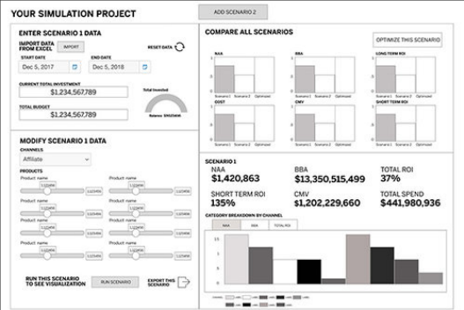
AMEX MOCA · DESIGN
Unexpected challenge: the rest of the desktop
THE CHALLENGE
— As a desktop app, MOCA had to account for the other applications on the desktop
— And how it would connect to them through APIs

Slide 9
AMEX MOCA · DESIGN
Partners want to compare budget scenarios, down to each channel and product.
Users want to see, through data visualizations, how scenarios differ. For a deeper understanding of their allocations, they want to adjust each channel and the products inside it.

Slide 10
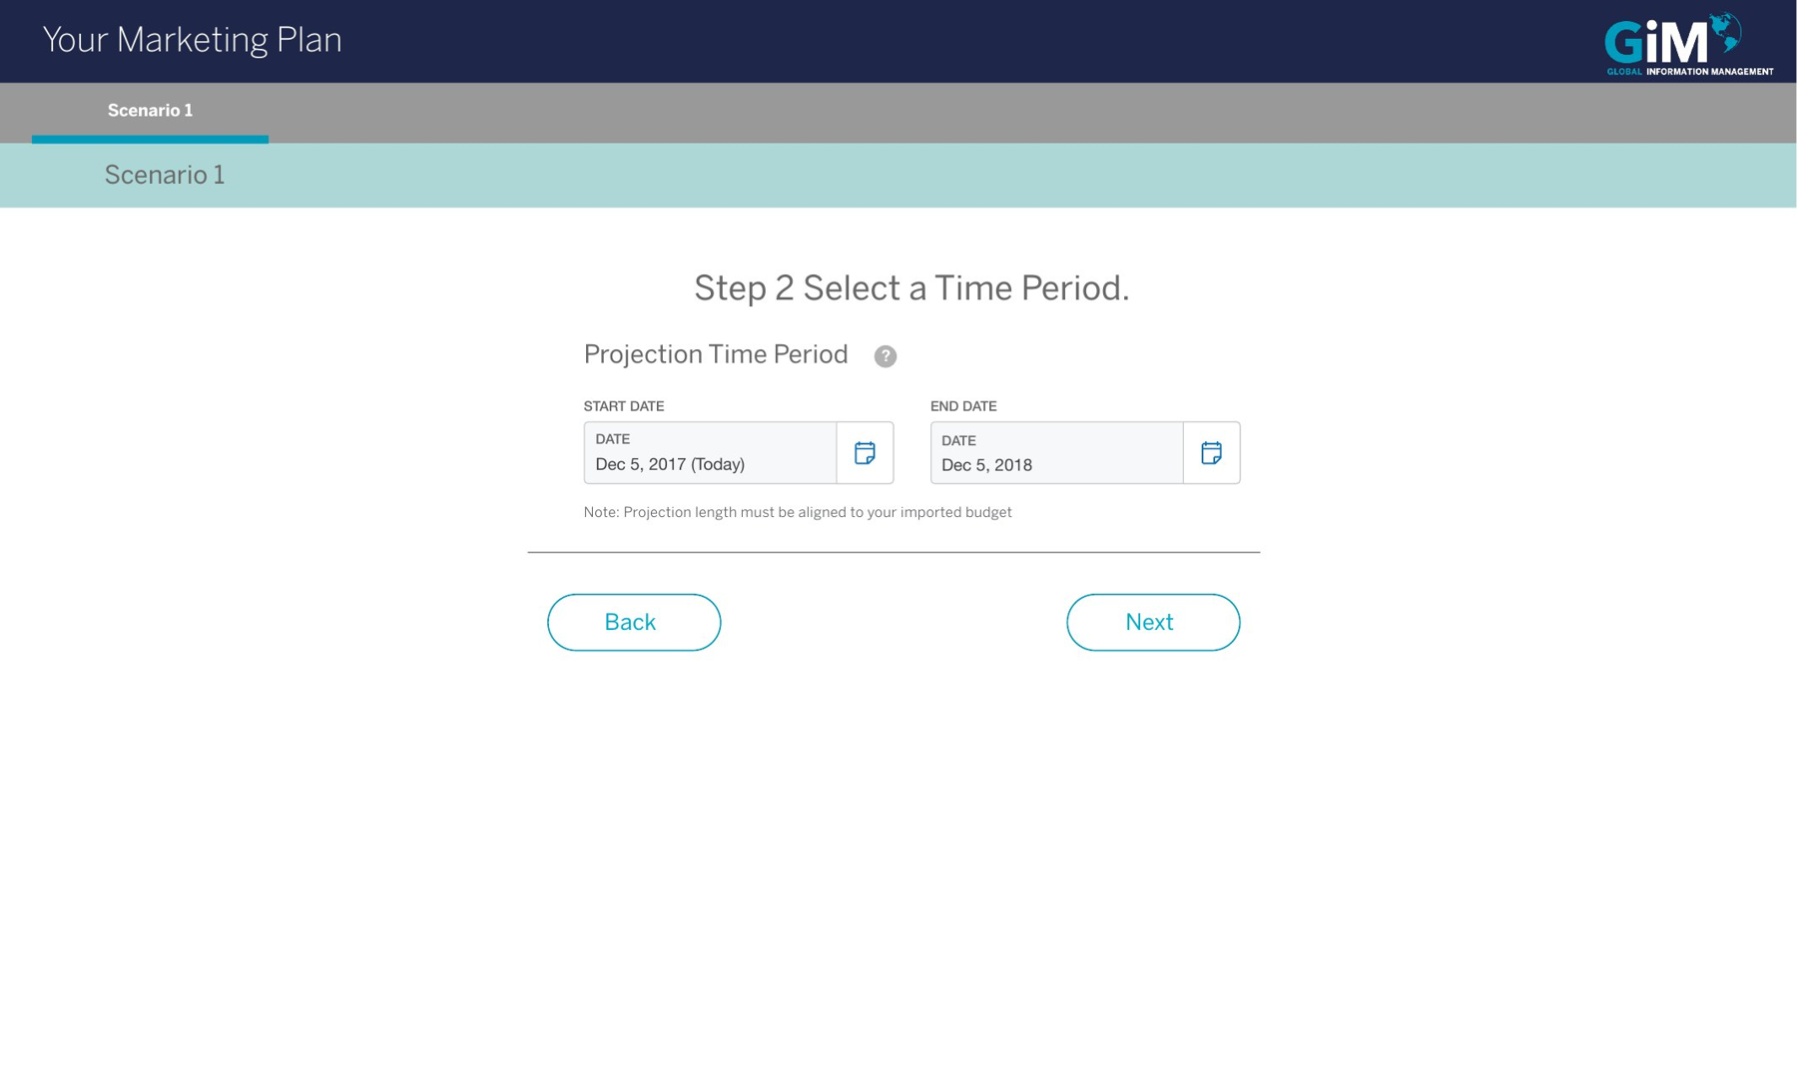
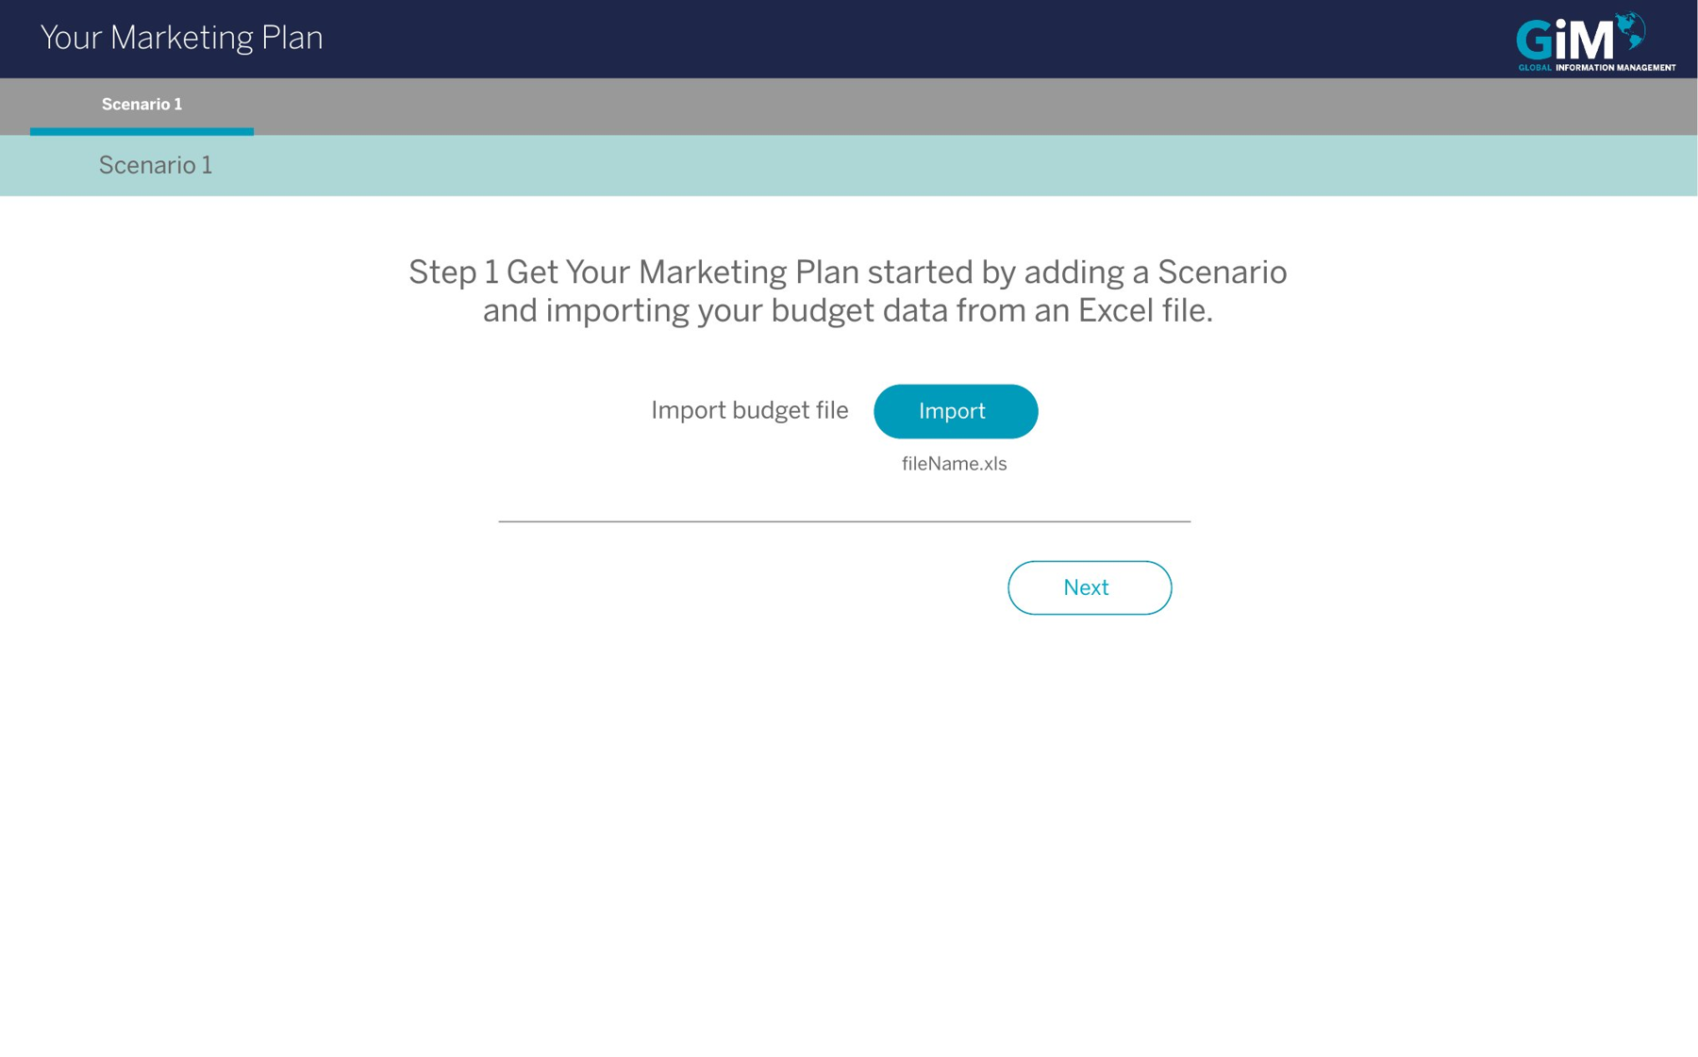
AMEX MOCA · DESIGN
Wizard design sprint
A short, efficient wizard for budget details and time frame.
WHAT WE LEARNED FROM RESEARCH
— Partners use the tool only once every 6–12 months, so many needed more structured guidance
— First-time users wanted a friction-free way to start

Slide 11
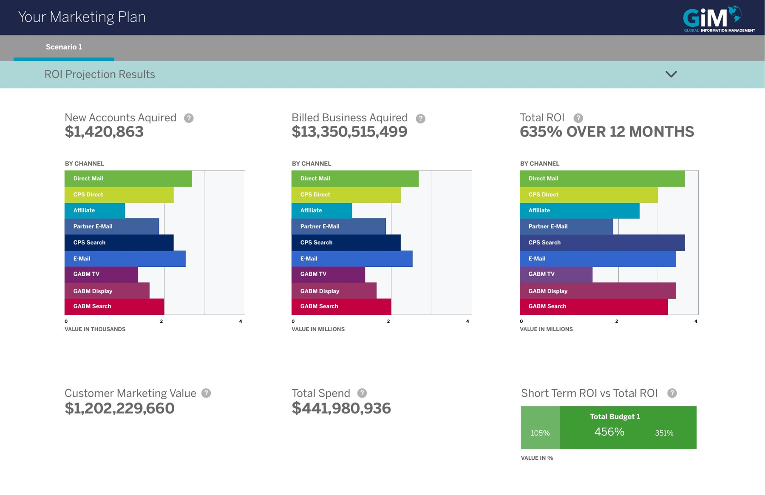
AMEX MOCA · DESIGN
Scenario comparison design sprint
Testers called the channel breakdown vital, and a game changer.

Slide 12
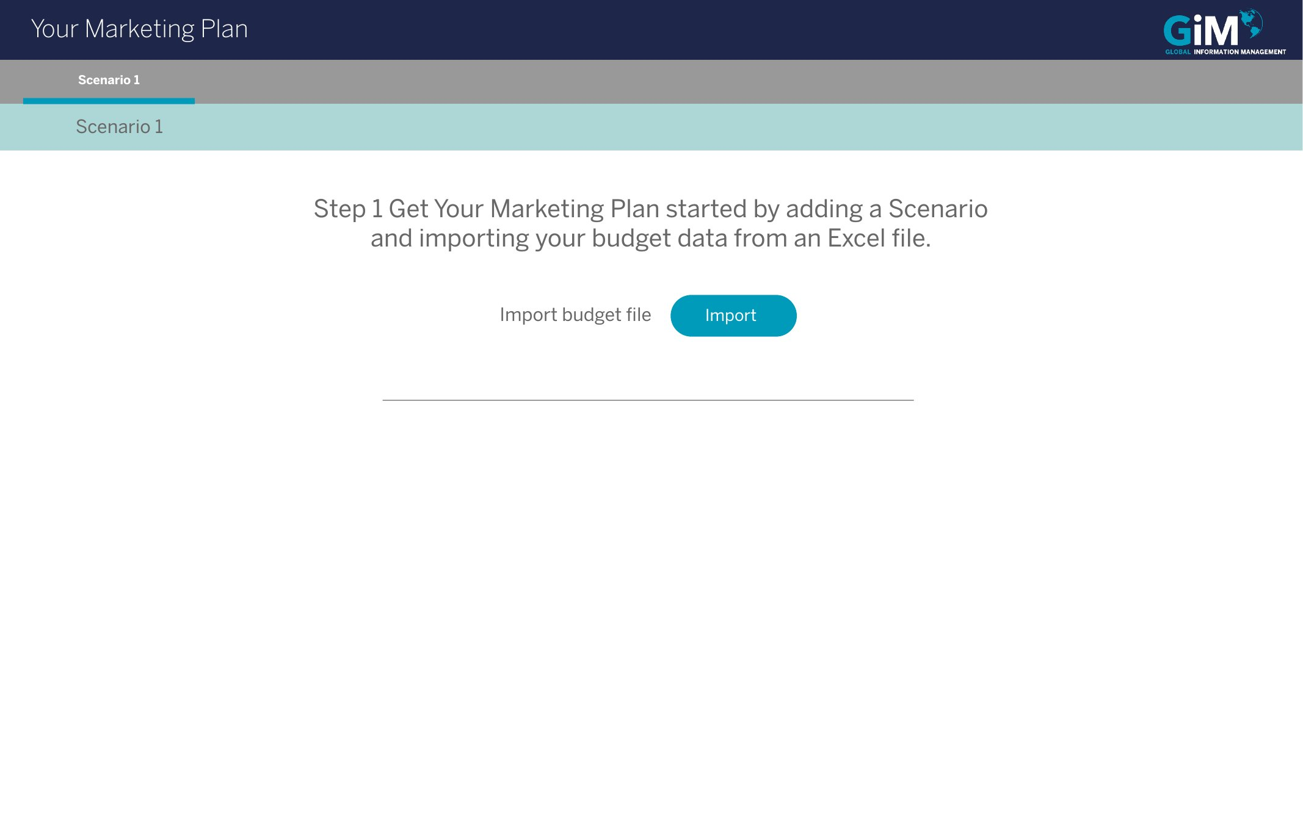
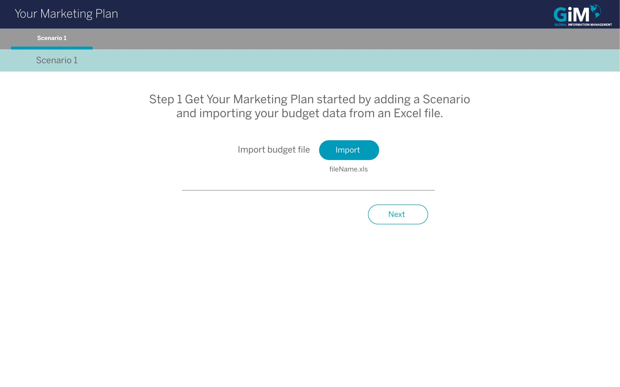
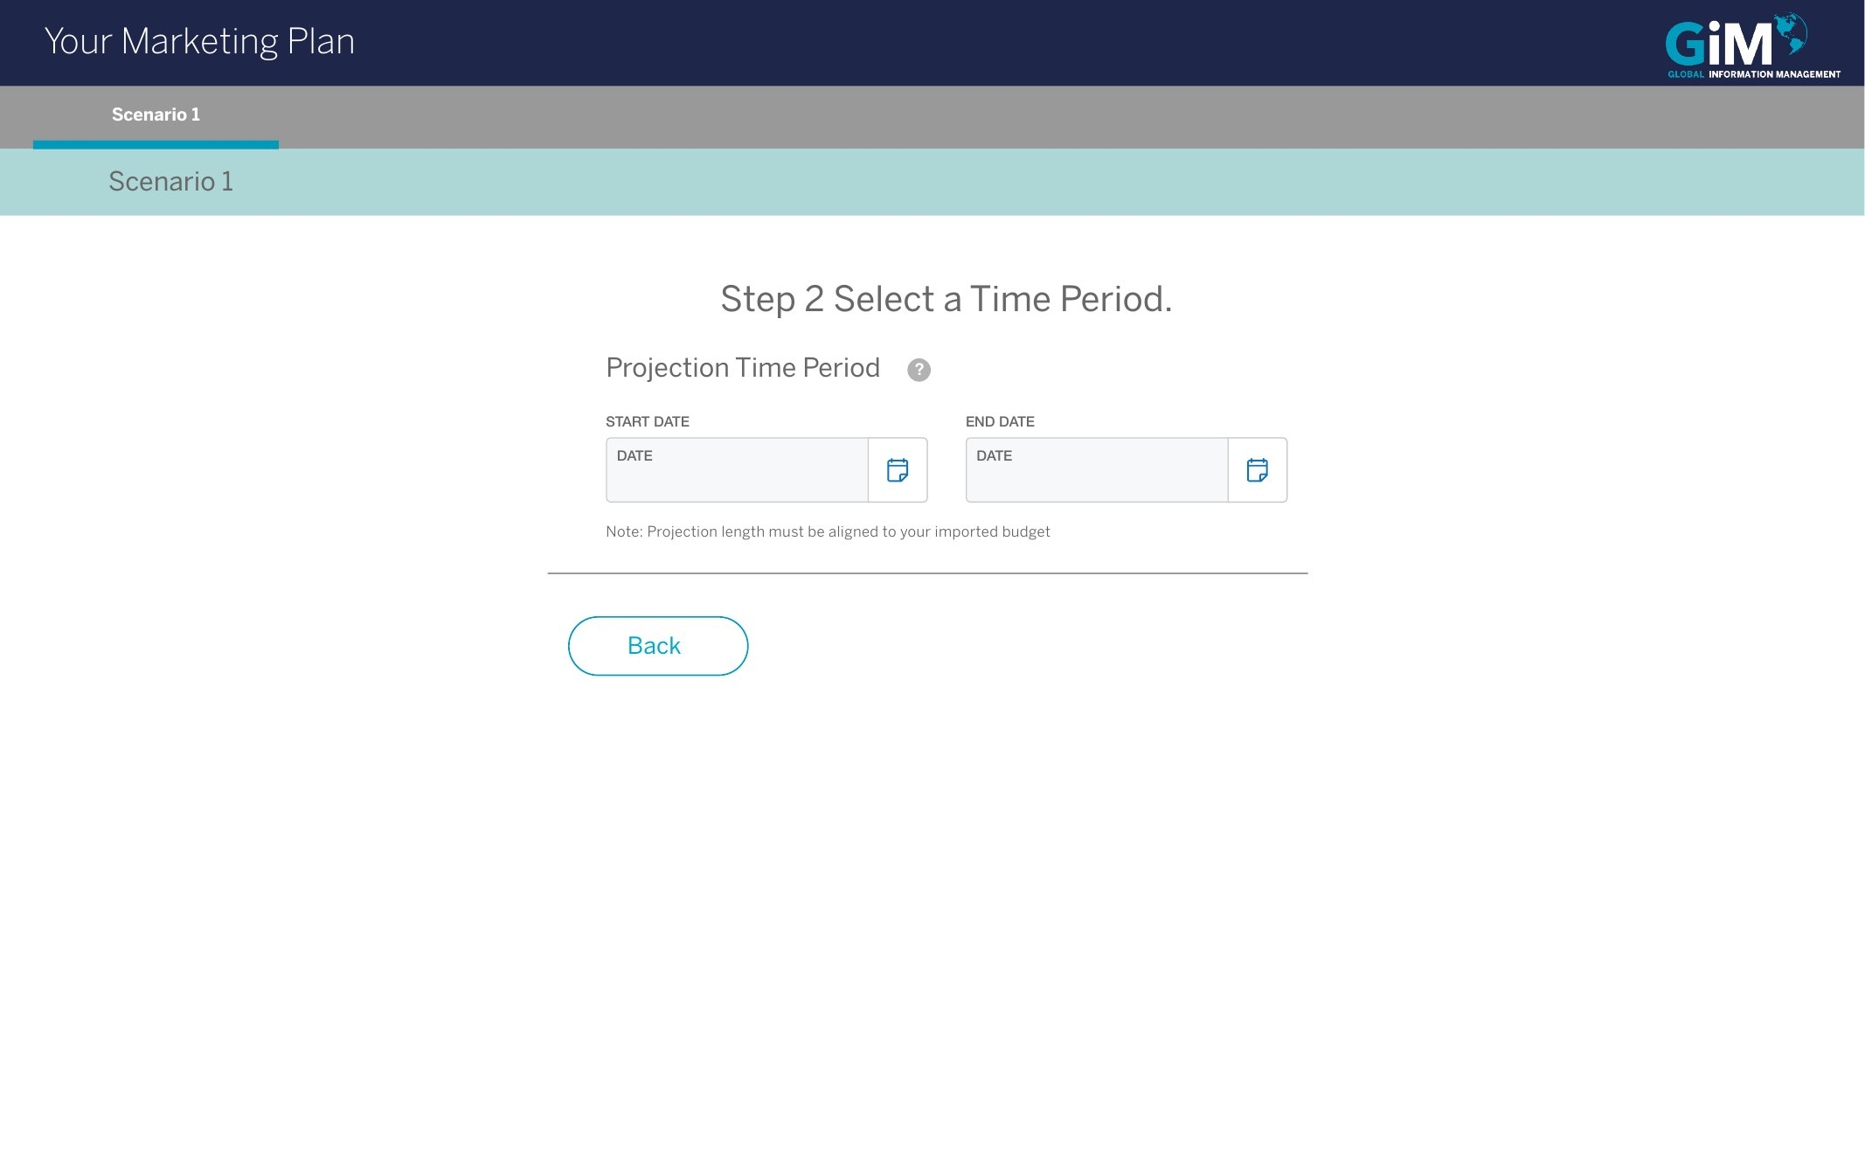
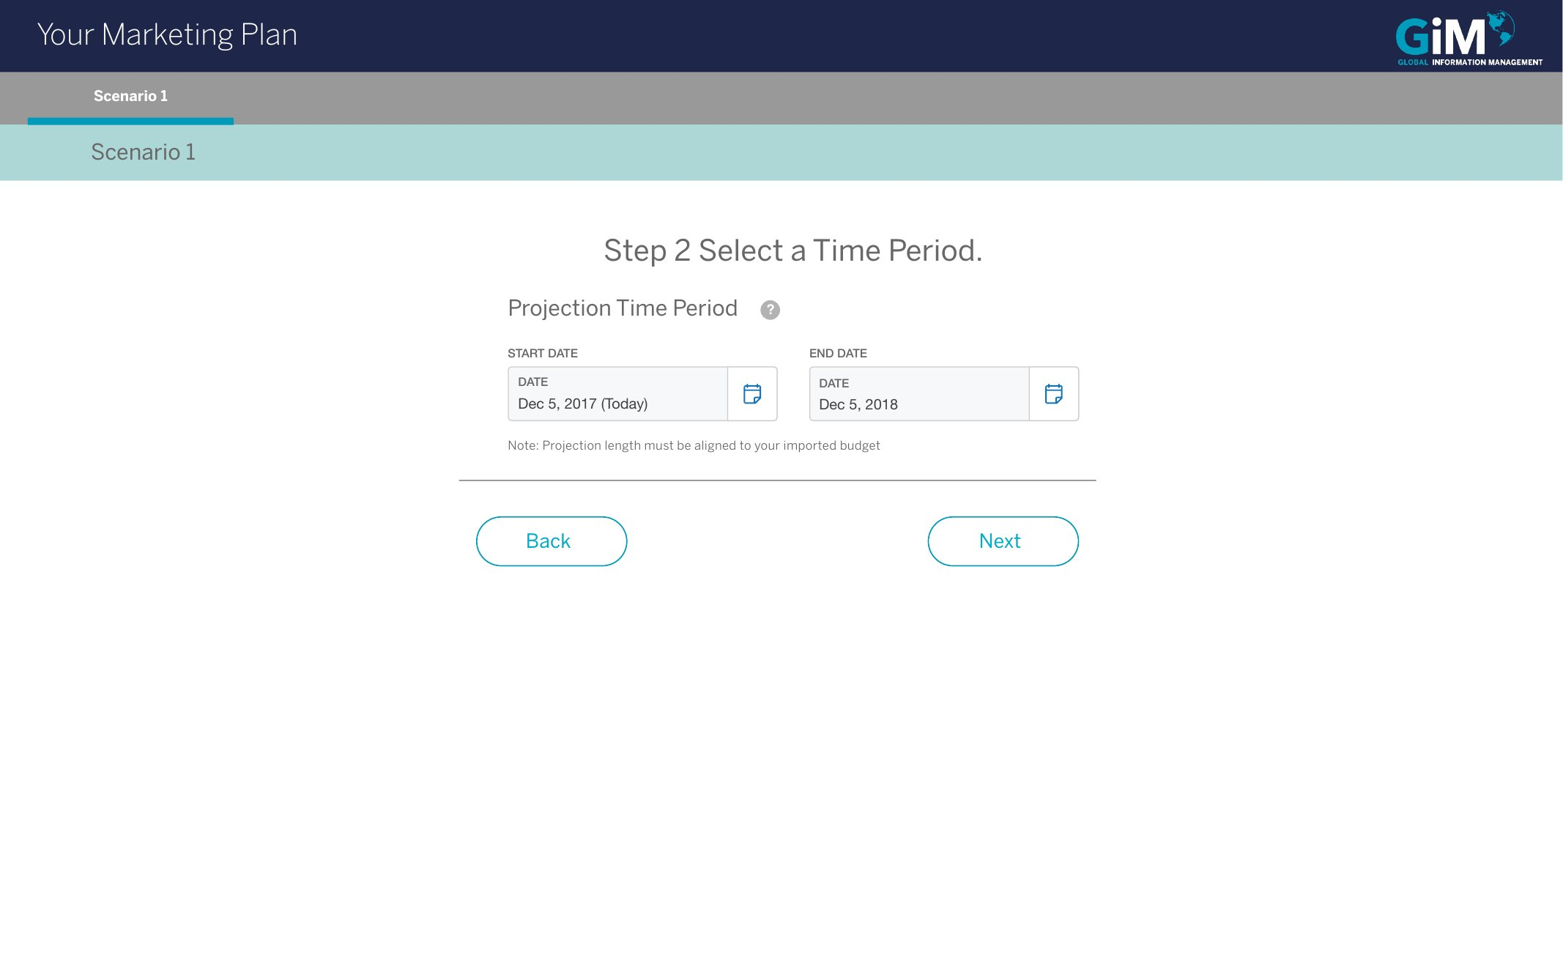
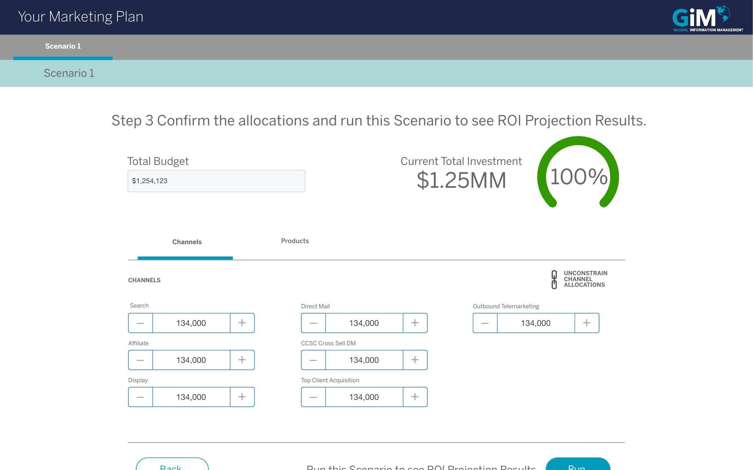

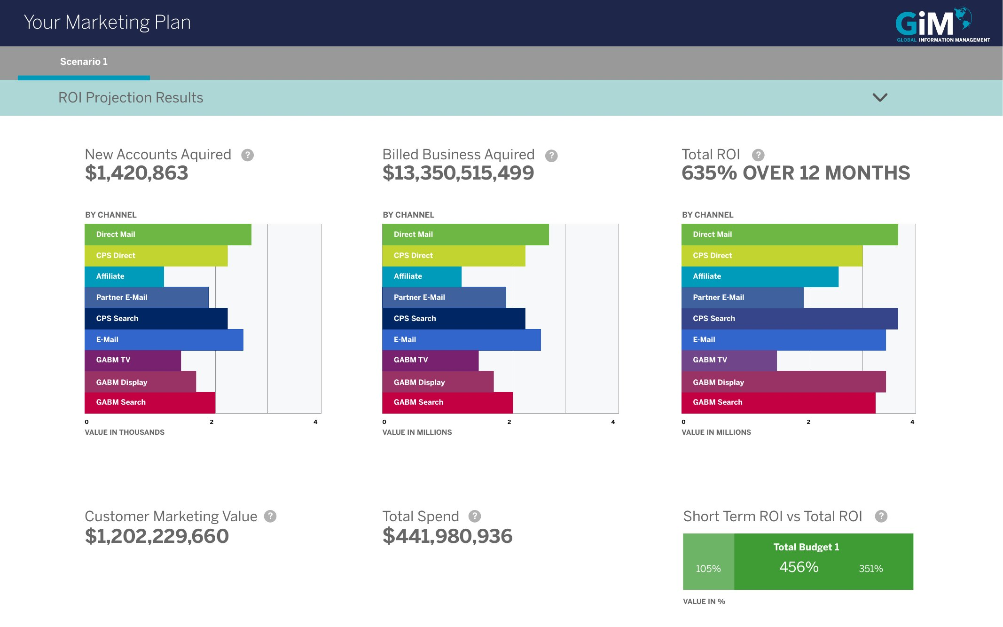
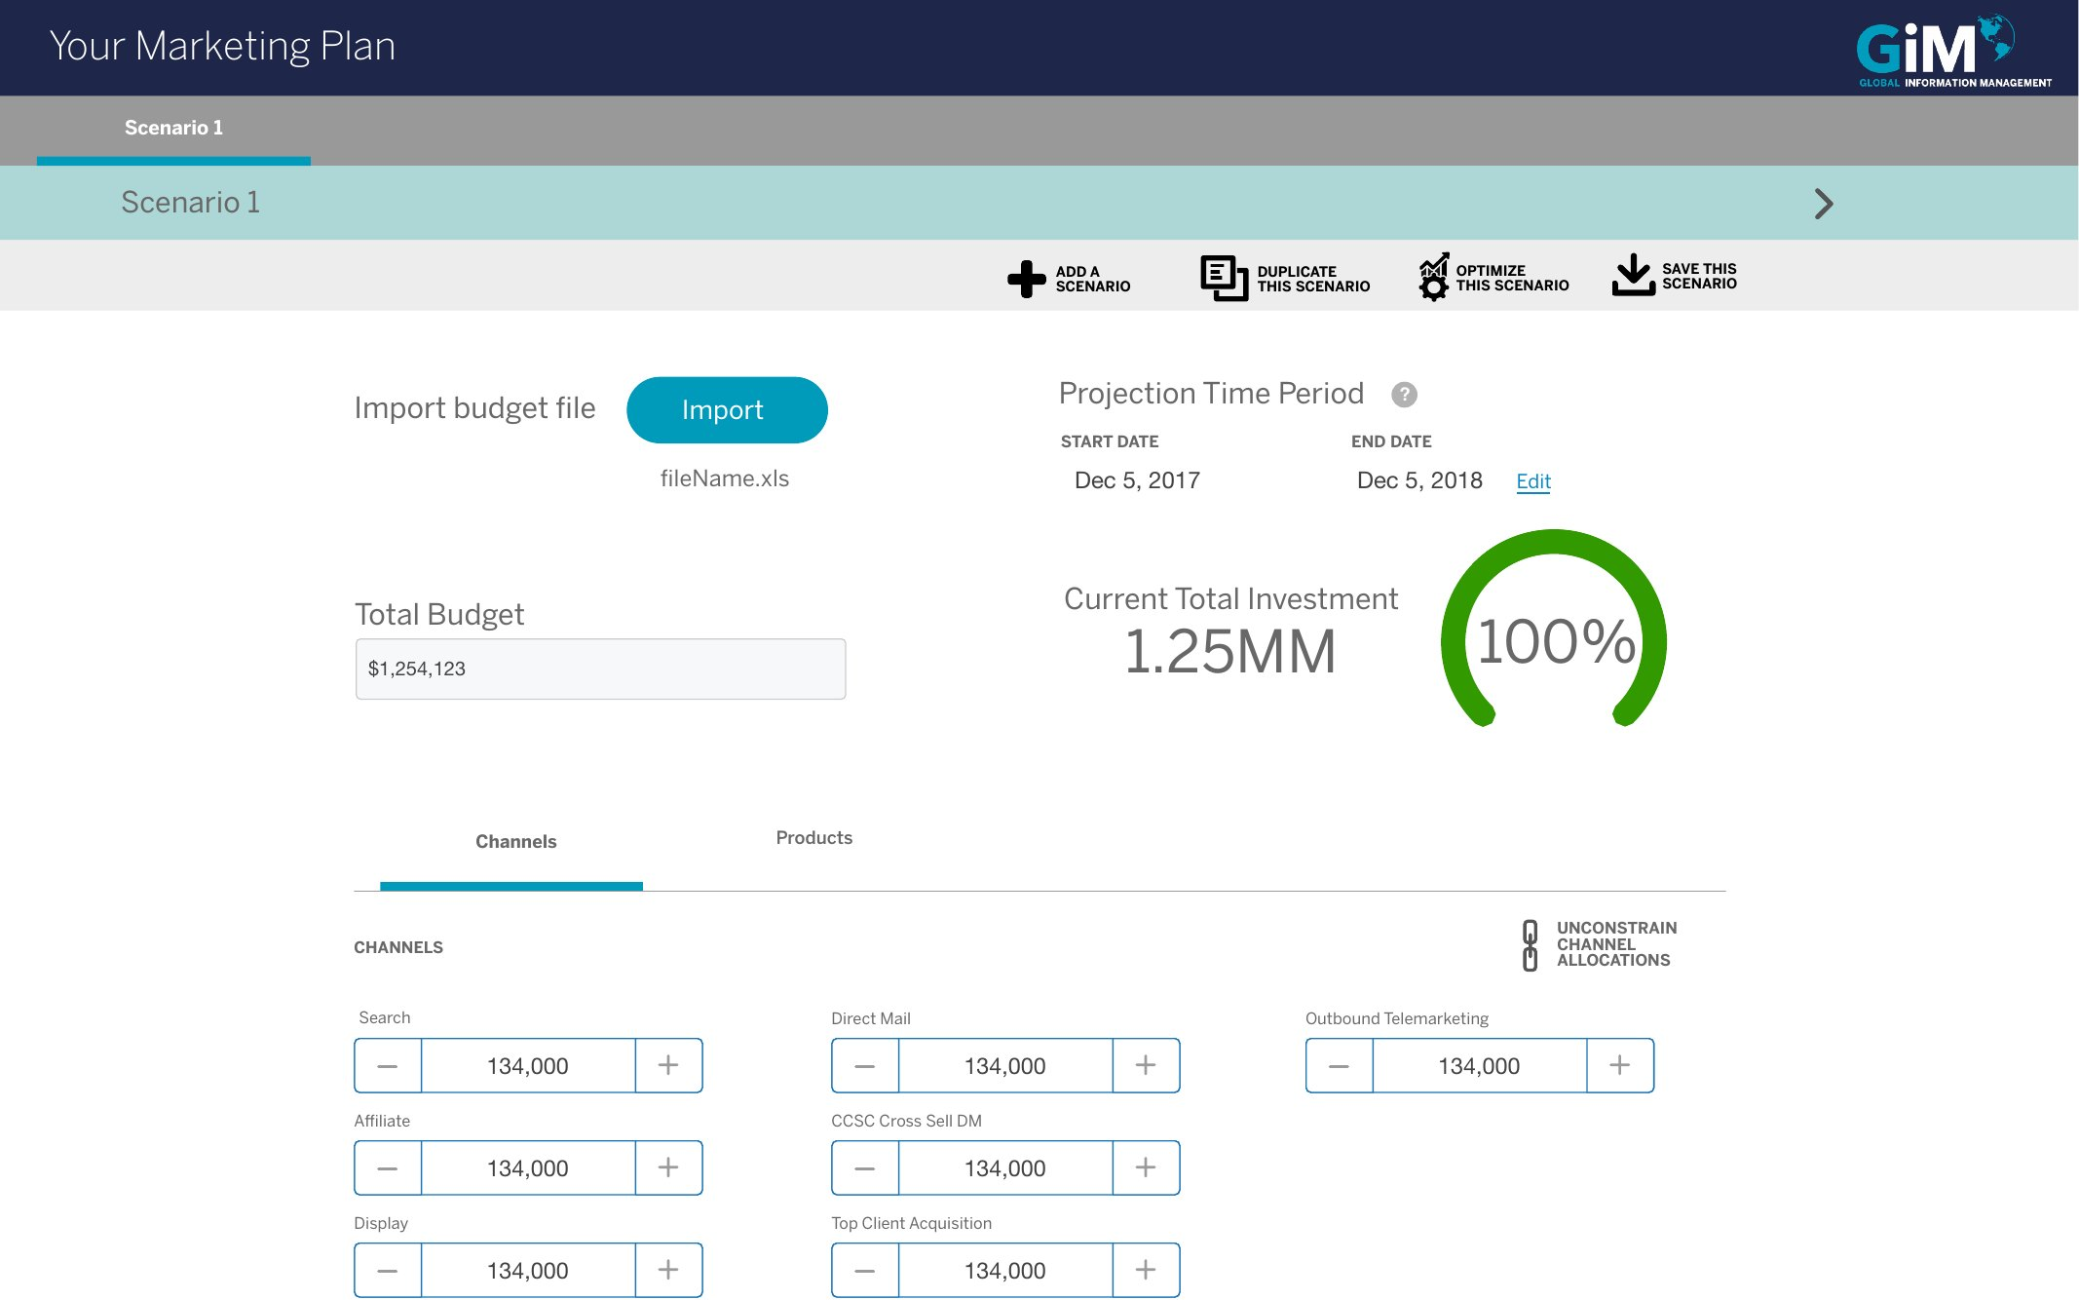
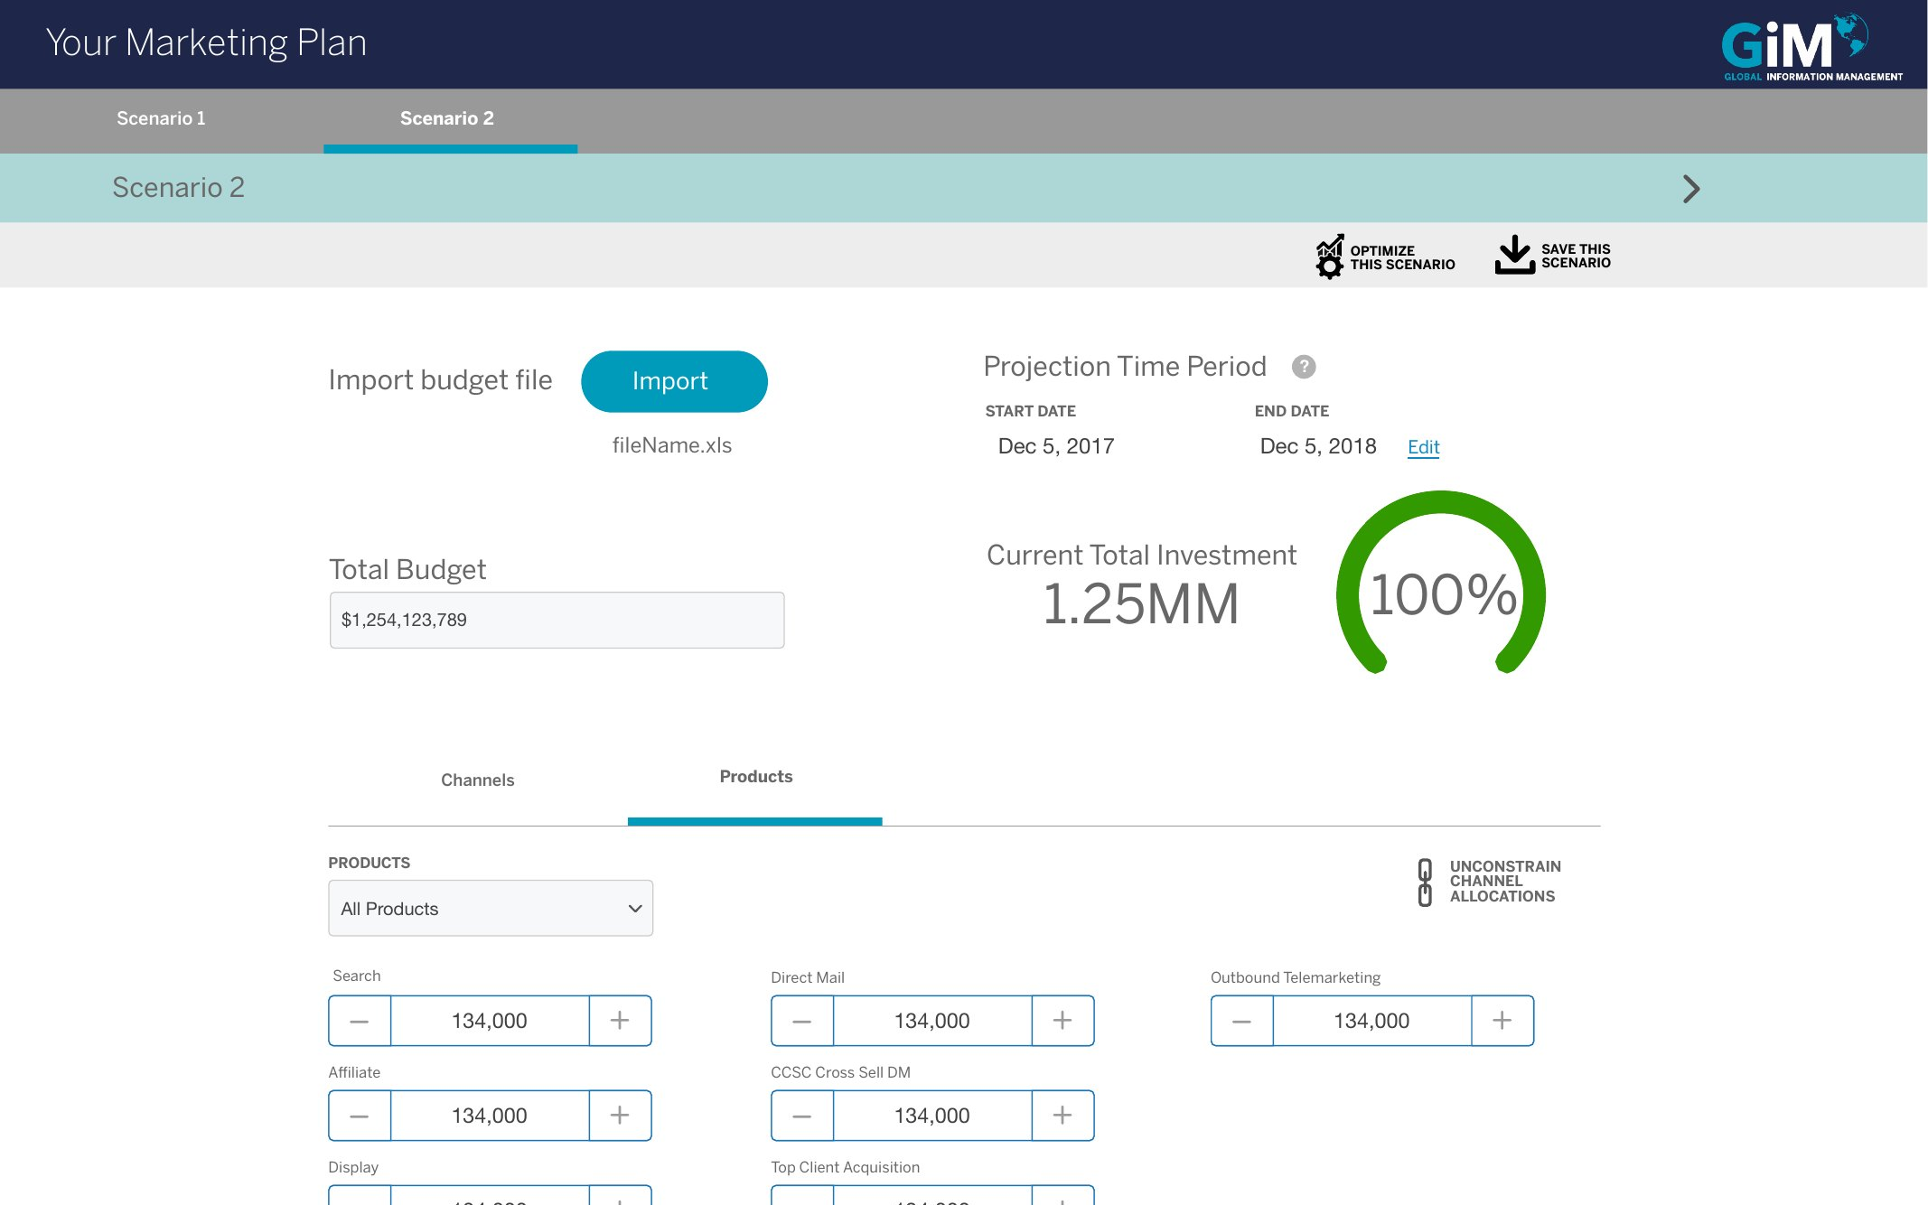
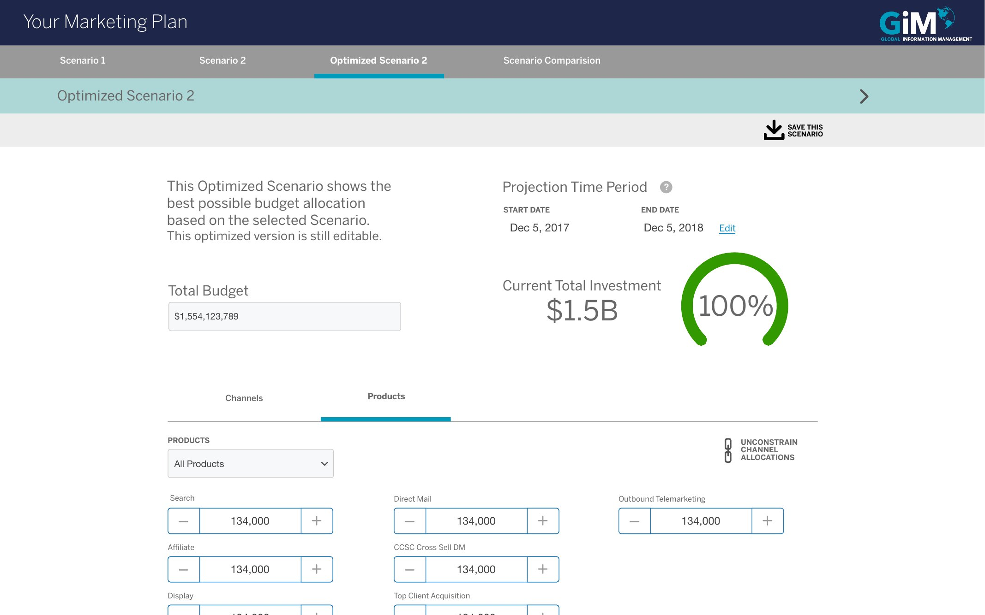
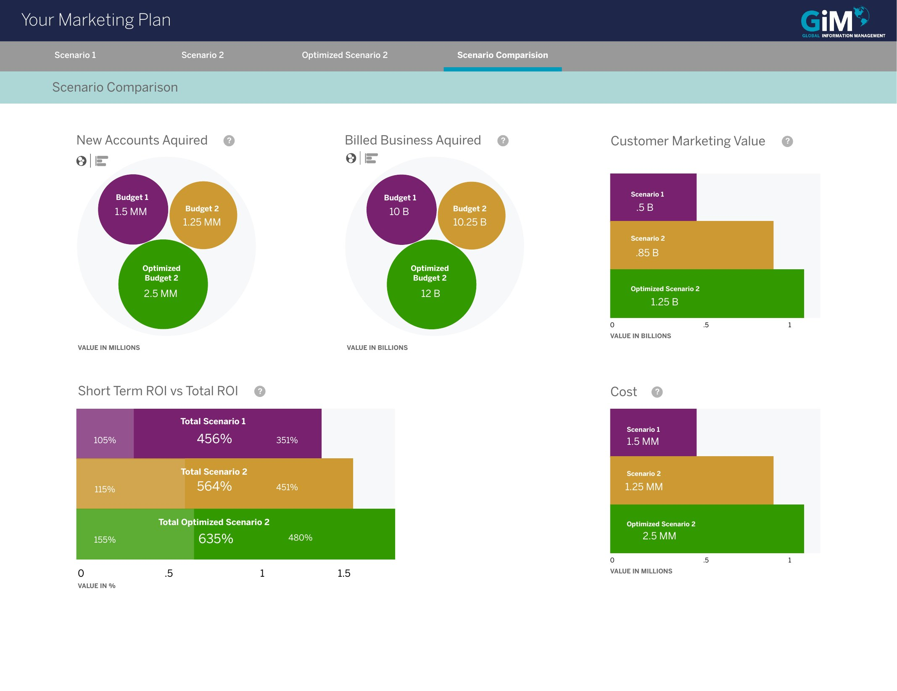
AMEX MOCA · DELIVERY
One client budget, end to end
Import, the three-step wizard, the ROI projection, then scenarios, the optimizer and the comparison.
01 Import the budget
Wizard · step 1
02 File imported
Wizard · step 1
03 Time period
Wizard · step 2
04 Dates set
Wizard · step 2
05 Allocations
Wizard · step 3
06 Shift and watch the gauge
Wizard · step 3
07 ROI projection
Results
08 Scenario workspace
Scenarios
09 Second scenario
Scenarios
10 Optimized, still editable
Scenarios
TRY IT
Open the prototype →
Starts at the import step
11 Compare all three
Comparison

Slide 13
AMEX MOCA · KEY CALLS
Four calls that shaped MOCA.
A wizard, because use is rare
Start from last year’s budget
Partners plan once every 6–12 months, so a guided wizard walks them through each parameter.
Users import a budget and duplicate it as the template for the next one.
Allocate down to channel and product
Compare scenarios side by side
Allocations go down to product line or channel, so partners see which part of the budget works.
Scenarios are compared visually with switchable chart types; testers called the channel breakdown a game changer.

Slide 14
AMEX MOCA · RESULTS
Partner approval rose from 58% to 88%, and budgets grew.
88%
$1.8M
3.4%
average client budget
drop-off on the budget process
approval from internal business partners
Up from $1.34M · +34%
Down from 5.4%
10 min
5 min
to complete a budget
to compare budget scenarios
Before MOCA: 58%
After: 88% (+30 pts)
Down from 12 min
A new capability

Slide 15
AMEX MOCA · PROTOTYPE
Build, project and compare a client budget.
11 hi-fi screens linked in order: import the client’s budget, set the period, shape the allocations, see the ROI projection, then add, optimize and compare scenarios.
Open the MOCA prototype →
Or start at the workflow map →
ALSO AVAILABLE
An offline version with the narrative for every step and a full link map: MOCA-Budget-Prototype.html.

