Slide 1

case studies
Lead UX designer for AI products.
Four case studies, each with the calls I made,
how I led the team, and what came of them
michaelthibodea(UX)
www.michaeljthibodeau.com

Slide 2
POINT OF VIEW
I design trust into high-stakes business decisions.
AI verifies; the person decides
Measurements, not confidence scores
AI translates, explains and checks the user’s own criteria. It never recommends, predicts or places orders.
Show what was measured and how often it held, with sample sizes. Abstain when the data isn’t there.
Consequences before commitment
Guidance that fits the frequency
Rules are replayed on recent history before they’re saved. Every change is logged, with Undo.
Daily users get help that fades with fluency. Rare tasks, like OBI and MOCA, get a short guided path.
CREDIT SUISSE · WELLS FARGO · AMEX · FINVIZ

Slide 3

CASE STUDY 01 · AI PRODUCT · CONCEPT
FinViz
AI Screener: The Trading Day
Getting new traders to a screen they trust in their first session, then watching it for them. Goal: cut sign-up to Elite from 42 to 21 days.
ROLE
Lead UX designer
TEAM
Solo lead with AI agents for drafting; four design reviewers
SCOPE
Research to hi-fi: 19 screens, design system, live prototype
STATUS
Concept. Tests are set; none has run yet
“Alerts are everything. Once you close FinViz, you get nothing.”
Notes:
Opener in the portfolio format. Concept-stage work; screens are illustrative with fictional tickers. The quote paraphrases reviewer point R3 from the 30 Sept design review.

Slide 4
FINVIZ AI SCREENER · OVERVIEW
The Trading Day: FinViz keeps watch while you work
PRODUCT
An AI layer for the FinViz stock screener.
PROBLEM
Swing traders with day jobs build a screen at night, can’t watch the market 9:30–4, and miss the moment their setup happens. New users take 42 days to see why Elite is worth paying for.
AI SOLUTION
AI turns the stocks he already likes into a working screen, remembers why he picked each one, watches it on his schedule and explains every finding with its evidence. It verifies; he decides.
MY ROLE
Lead UX designer: research, strategy, AI UX principles, concept, low-fi to hi-fi, design system. AI agents for drafting; every call mine.
HERO The Insight Board at 7:45 AM: three sourced findings about his own names, on the FinViz Home he already knows.
19 hi-fi screens · one trade · Monday evening to Sunday · FinViz design system v1.0 · personas and data are synthetic
Notes:
SCRIPT
[open] Meet Gary. He swing trades, and he has a day job. He finds ideas at night, can't watch the market from 9:30 to 4, and too often misses the moment a stock does exactly what he was waiting for. Today, a FinViz screen is something he visits. By morning, it's forgotten.
This is what changes when FinViz keeps watch for him.

Slide 5
FINVIZ AI SCREENER · CONTEXT
An AI layer that turns what a trader already has into a working screen, and watches it through the day.
TARGET AUDIENCE
— Swing traders with a day job
— Day traders
— Value investors
THE PROBLEMS
— Ideas don’t become a working, watched screen
— FinViz is nearly absent during market hours
— 89 filters in preset buckets; exact values are Elite-only
— Results show no reason why a stock matched
— New users stall before Elite’s value is obvious
TEAM AND MY PART
— Concept project from a design-course brief. I led it, with AI agents for drafting and four design reviewers
— I ran discovery, research, strategy, the AI design principles and the hands-on design
— I led every deliverable in Figma and FigJam, ran the design review, and made and recorded the key calls
Notes:
Mirrors the introduction page of the other case studies: what it is, target audience, problems, my role. Confirm the team description.

Slide 6
FINVIZ AI SCREENER · WHY
Why design an AI layer for the screener?
89
filter dropdowns, most in preset buckets
42 → 21
days from sign-up to Elite: the business goal
87 of 89
filters need Elite for an exact value
0
Today: 42 days
AI features in the FinViz screener today
Goal: 21 days
“Too many filters, and no filter literacy. And a chat box is not the answer.”
Notes:
Facts from FINVIZ-CONTEXT (verified on the live site): 89 filter dropdowns, 87 with Custom as Elite-only, no generative AI. 42 → 21 days is the case-brief goal. Quote paraphrases reviewer point R5.

Slide 7


FINVIZ AI SCREENER · CONTEXT
FinViz today: tour-led onboarding, AI only on the news
1
The guided-tour prompt
“First Time Here? Watch the Guided Tour”: FinViz’s answer to first use is still a tour, now promoted on the home page.
2
3
2
“Weekend Brief”
A news summary that appears AI-generated, with 👍/👎, but isn’t labelled as AI. Nothing like it in the screener.
3
A dense dashboard
Rule-based signals, insider tables, futures, a heat map and heavy ads: what a newcomer meets first.
1
finviz.com home page, Oct 4 2026
Notes:
Current state, from screenshots taken Oct 4 2026. The Weekend Brief appears AI-generated but is not labelled as AI.

Slide 8
FINVIZ AI SCREENER · CONTEXT AND CONSTRAINTS
The environment the AI had to fit
BUSINESS CHALLENGE
Halve the time from free to Elite, 42 → 21 days, without annoying users (course brief, OKR 1). Elite sells persistence: alerts, real-time data, backtests. A user without a working screen has no reason to pay.
STAKEHOLDERS
Traders: Growth Gary (primary), Fast Frank, Value Vivian, Multi Mike. FinViz growth (Elite conversion), compliance (the advice line), engineering (screener, alerts, data feeds).
SUCCESS CRITERIA
Time to first success: an insight that is actionable, timely and relevant to his own holdings, in the first session. Then a habit: a saved screen re-run 3+ days a week (North Star).
TECHNICAL CONSTRAINTS
No AI in FinViz’s screener today. 89 filters; Free uses preset buckets. Free quotes 1-min delayed; pre-market is Elite. LLMs can invent: output must map to real filters. No AI-originated advice, predictions or confidence %. Desktop only.
WHAT THIS MEANT FOR THE DESIGN
Free builds and previews; Elite watches
Every AI output maps to something real
Verification, not advice
The paywall sits where the value is felt: live alerts on his own names.
A FinViz filter, a measured value or a cited source, or it says it can’t tell.
The AI checks his own criteria; decisions end in his broker.

Slide 9
FINVIZ AI SCREENER · COMPETITIVE LANDSCAPE
FinViz stays the fastest place to find ideas. The AI layer explains them.
WHERE IT IS STRONG
WHERE THE AI LAYER FITS
TradingView
Charting and community. Ships AI chart analysis and document summaries.
Explains the trader’s own screen. FinViz stays the fastest place to find ideas.
Trade Ideas
Real-time scanning and alerts at tick speed.
FinViz does not compete on tick speed. Push alerts on a saved screen matter more to this user.
Bloomberg Terminal
Market data and news flow for professionals.
Cost and complexity. FinViz’s job is discovery for individual traders.
Source: FinViz research notes, September 2026. Competitor features change; re-check before publishing.

Slide 10
FINVIZ AI SCREENER · THE PROBLEM
Two problems, defined separately, so the AI only does what a rule can’t.
User problem
AI problem
Why AI is appropriate
Gary can find ideas but can’t hold on to them. 89 filters with no explanation; a list that forgets why he picked each stock; nothing reaches him at work; the decision to hold or exit happens in his head.
Infer a screen from 3 example tickers · explain why each row matched from real values · re-check his reasons against fresh data 3× a day · detect chart patterns with measurable criteria · summarize overnight news on his names, with sources · turn corrections into proposed rule changes.
Translating examples and plain English into 89 filters, and summarizing many sources, are language tasks. Scanning 30 charts for the same setup is repetitive perception. Where a rule is enough we used a rule: the since-last-night diff, exit lines, quiet hours and the activity log are not AI.

Slide 11
FINVIZ AI SCREENER · THE PROBLEM
“Once you close FinViz you get nothing, and setting up alerts today is quirky.”
Design review feedback, Sept 30
SEVEN PAINS, RANKED BY USER AND BUSINESS IMPACT
01
Ideas can’t become a working, watched screen
05
Filters in fixed buckets; exact values are Elite
02
Blind during market hours
06
Alert noise
03
Too many results, and no reason why they matched
07
Catalysts scattered across pages
04
Which metric matters, and what counts as good?
Notes:
From the pain register (03c), P1, P9, P5, P3, P2, P10, P13: 27 pains in total, scored urgency × business impact.

Slide 12
FINVIZ AI SCREENER · THE SOLUTION
One trade, one trading day.
Hi-fi first: one trade followed through one trading day, Monday evening to Sunday. 19 screens designed in the FinViz dark theme, built only from the design system’s tokens. Purple marks AI and nothing else.

Slide 13
FINVIZ AI SCREENER · SOLUTION
One trade, followed through one trading day.
Growth Gary, a swing trader with a day job, finds an idea at night, checks it before work, gets one alert while he’s busy, and decides after the close whether his reasons still hold. FinViz watches and explains at the right moment; Gary makes every decision, in his own broker.
1
8–10 PM
Evening
Reviews what’s new, pins 3–5 names, taps “Watch these for me”
2
WHILE HE SLEEPS
Overnight
Nothing to do; a bounded agent re-checks his names
3
7:30 AM
Before work
Reads one short note
4
9:30 AM–4 PM
During work
Taps one alert, if it comes
5
4:30 PM
After the close
Decides: hold, or exit in his own broker
Notes:
SCRIPT
[open] Meet Gary. He swing trades, and he has a day job. He finds ideas at night, can't watch the market from 9:30 to 4, and too often misses the moment a stock does exactly what he was waiting for. Today, a FinViz screen is something he visits. By morning, it's forgotten.
This is what changes when FinViz keeps watch for him.
— Production notes —
The one workflow this case study showcases: The Trading Day. Everything else in the deck either explains why (research), how it was led (leadership) or how it works (design).

Slide 14


















FINVIZ AI SCREENER · SOLUTION
The whole trading day
One trade, Monday evening to Sunday. Every screen is designed in hi-fi and linked as a clickable prototype.
01 Show It
Mon 8:05 PM
02 Since last night
Mon 8:10 PM
03 Lens grid
Mon 8:20 PM
04 Linked compare
Mon 8:26 PM
05 Reasons ledger
Mon 8:32 PM
06 Watch these for me
Mon 8:40 PM
07 Morning glance
Tue 7:30 AM
08 Why marked
Tue 7:40 AM
09 Insight Board
Tue 7:45 AM
10 Insight, opened
Tue 7:45 AM
11 Quiet hours, one alert
Tue 10:14 AM
12 This was wrong
Tue 10:31 AM
13 Board at lunch
Tue 12:30 PM
14 Reasons still hold?
Tue 4:30 PM
15 Portfolio vs plan
Tue 4:45 PM
TRY IT
Open the clickable prototype →
Starts at step 1 in Figma
16 Lens on portfolio
Tue 4:50 PM
17 Activity log + Undo
Tue 5:15 PM
18 Weekly review
Sun 7 PM
19 Build the board
Sunday

Slide 15
FINVIZ AI SCREENER · SOLUTION · STEPS 1–2 OF 19
Show It + Since Last Night: an idea becomes a screen he trusts
Mon Oct 5, 8 PM, after Monday’s close. Free account.
THE DAY Evening › Overnight › Before work › During work › After the close
Where the story starts: Monday after the close, on a free account.
STEP 2 · OW2 New, dropped and near-miss rows first, each with which of his criteria it meets
STEP 1 · OW1 Pastes 3 tickers; AI writes what they share as editable filter chips
AI BEHAVIOR
Programming by example: three tickers become editable filter chips
Constrained to FinViz’s real filters; nothing invented
Decision point: he keeps or drops each chip (Tab / Esc)
Notes:
SCRIPT
[OW1] Gary doesn't start with 89 dropdowns or a chat box. He pastes three stocks he already likes. FinViz's AI works out what they have in common, and the result is real filter chips he can edit, with a live count. AI learns from his examples. It doesn't make him write a query.
[OW2] He opens his saved screen. The new names are at the top, and every row shows which of his criteria it meets, or how close it came. The "why it matched" comes from real values, never a score.

Slide 16
FINVIZ AI SCREENER · SOLUTION · STEP 6 OF 19
Watch These For Me
Mon 8:40 PM. The one earned Elite moment.
THE DAY Evening › Overnight › Before work › During work › After the close
Before this: he checks his charts (steps 3–4) and pins 3 names with reasons (5).
DECISION POINT
Replay before commitment: his criteria “would have fired 4 times in the last 30 days”
The noise dial redraws history live as he drags it (9 → 4 → 2 a month)
The 7-day Elite trial starts here, where the value is obvious, not at sign-up
Notes:
SCRIPT
[OW4] One tap. Before he commits, FinViz replays the last 30 days: "Your criteria would have fired 4 times." He drags the noise dial and the timeline redraws. He sees what he'll get before he signs up for it. His 7-day Elite trial starts here, because this is the moment the value is obvious.

Slide 17
FINVIZ AI SCREENER · SOLUTION · STEP 7 OF 19
Morning glance: one note before work
Tue Oct 6, 7:30 AM. An email, readable in 30 seconds.
THE DAY Evening › Overnight › Before work › During work › After the close
Overnight, a bounded agent re-checked his 3 names only; there is nothing to log in to.
AI BEHAVIOR
A bounded agent on his names only: sourced news, earnings and his reasons, re-checked
DOCN: 1 of 3 reasons at risk, with its source and time
Only clear lens hits reach the inbox; borderline ones wait in the grid

Slide 18
FINVIZ AI SCREENER · SOLUTION · STEP 8 OF 19
Chart Lens: why FinViz marked this
Tue 7:40 AM. Opened from “Why marked?” in the morning glance.
THE DAY Evening › Overnight › Before work › During work › After the close
Opened from “Why marked?” in the 7:30 AM morning glance (step 7).
AI BEHAVIOR
Measurements, not a confidence score: wick 2.6× body, at support, volume 2.4× its norm
Clear, borderline or not enough data; only clear findings reach his inbox
History with its sample size (38 matches in 3 years) and a visible track record
Notes:
SCRIPT
[CL4] His chart setups show up too, but only the clear ones. Tap "Why?" and he sees what FinViz measured: wick 2.6 times the body, at support, volume 2.4 times its norm. When it isn't sure, it says so. Reliable by design: measurements, not confidence scores.

Slide 19
FINVIZ AI SCREENER · SOLUTION · STEP 9 OF 19
Insight Board, pre-market
Tue 7:45 AM. FinViz Home, upgraded.
THE DAY Evening › Overnight › Before work › During work › After the close
Then: he opens one finding to see its evidence and source (step 10).
AI BEHAVIOR
Three findings that need him today, each sourced and labelled Clear
The familiar parts stay: index row, breadth bars, S&P 500 map, now with AI notes
Pre-market prices on his own names are the Elite moment
Notes:
SCRIPT
[DB1] When Gary sits down, the board he keeps open isn't a page of data. At the top are three findings that need him, each one sourced: a DOCN reason at risk, QLYS reports tonight, and semis are down after NVDA's results, with RMBS in that group. Insights, not widgets.

Slide 20
FINVIZ AI SCREENER · SOLUTION · STEP 11 OF 19
Quiet hours, one alert
Tue 10:14 AM. At work; a browser push that leads with the reason.
THE DAY Evening › Overnight › Before work › During work › After the close
He painted quiet hours once (9:30 AM–4 PM); only his own criteria can interrupt.
DECISION POINT
Quiet 9:30–4 unless his own criteria are met
One push, reason first: Rel Vol 2.9 (your > 1.5), crossed its 20-day high
Three choices: open the chart, say it was wrong, or mute the name

Slide 21
FINVIZ AI SCREENER · SOLUTION · STEP 12 OF 19
Alert correction: “this was wrong” becomes a proposed fix
Tue 10:31 AM. The alert opened on the RMBS quote page.
THE DAY Evening › Overnight › Before work › During work › After the close
Straight from the 10:14 AM alert (step 11): he tapped “This was wrong”.
DECISION POINT
His reason (“too early”) becomes a specific change to his own rule
Before/after replay: 4 → 2 alerts in 30 days, both acted-on alerts kept
Nothing changes until he applies it; every change is logged with Undo
Notes:
SCRIPT
[AN7] It came too early, so he taps "This was wrong" and gives the reason. FinViz proposes a tighter rule and shows him the replay: 4 alerts become 2, and the ones he acted on are kept. Nothing changes until he applies it. The AI learns from his corrections, in the open.

Slide 22
FINVIZ AI SCREENER · SOLUTION · STEP 14 OF 19
Reasons Still Hold?
Tue 4:30 PM. DOCN closes below its SMA50: a reason breaks.
THE DAY Evening › Overnight › Before work › During work › After the close
Before this: at lunch the board showed alerts sent and held back (step 13).
DECISION POINT
A checklist that ticks itself against today’s close
What changed and when, on the chart; his exit line ($34.00) not met
Hold or exit is his call, in his own broker; FinViz never places orders
Notes:
SCRIPT
[OW7] After the close, a checklist that ticks itself. RMBS and QLYS: all reasons hold. DOCN: two of three. FinViz shows what changed and when. It checks his reasons. It doesn't give advice. Hold or exit is Gary's call, made in his own broker. FinViz never places a trade.

Slide 23
FINVIZ AI SCREENER · SOLUTION · STEP 17 OF 19
Activity log: everything, with Undo
Tue 5:15 PM. Every send and change, who did it, and why.
THE DAY Evening › Overnight › Before work › During work › After the close
The day’s record: every alert FinViz sent and every rule that changed, by FinViz or by him.
AI BEHAVIOR
✦ marks what FinViz did; a dot marks what he did
Every change shows its reason and effect, with Undo for 30 days
Nothing changes silently; sent messages can’t be unsent, so they have no Undo

Slide 24
FINVIZ AI SCREENER · PROTOTYPE
Click through the whole day yourself.
19 linked hi-fi screens in Figma, starting at step 1. Each screen moves forward through its real button: Save screen, Charts, Compare selected, Watch these 3 for me… through Save layout on Sunday.
Open the Figma prototype →
Or start at the workflow map →
ALSO AVAILABLE
An offline HTML version with the narrative for every step and a full link map: The-Trading-Day-Prototype.html.

Slide 25
FINVIZ AI SCREENER · REASONING
Trade-offs and rejected alternatives
The section that matters most: why the AI behaves the way it does.
WE CHOSE
WE REJECTED
WHY
Examples → editable filter chips
A chat box as the main way in
Real tasks are ambiguous; chips can be inspected, edited and saved
Measurements; clear / borderline / abstain
A confidence % on each detection
A number implies precision we can’t guarantee; measurements can be checked
Verify the trader’s own reasons
AI buy/sell calls, “top picks”, scores
Compliance and trust; only attributed third-party views
One reason-first alert in quiet hours
A live stream of every signal
Alert fatigue kills the habit; replay shows the cost first
Propose rule changes; apply on accept
Silent auto-tuning
He keeps control; every change announced, with Undo
A bounded agent on his names only
An open-ended research agent
Limits cost, hallucination surface and privacy exposure
Neutral “Clear”, amber “Borderline”
Green for “Clear”
Green means price up, nothing else
Desktop first
Mobile in release 1
The screener lives on desktop; mobile deferred, not dropped
ACCURACY VS CONTROL When the model is unsure, the product shows less and asks more. Borderline findings stay visible but never interrupt.

Slide 26
FINVIZ AI SCREENER · REASONING
Eight design calls that changed the work
01
SEPT 23
Map today’s onboarding before designing
02
SEPT 23
Desktop only, for now
03
SEPT 23
One design for first-time and repeat users
04
SEPT 24
Remove real frictions with new AI models
05
SEPT 30
Optimize time to first success; no chat box first
06
SEPT 30
Set the advice line, pending compliance
07
SEPT 30
Lead with the swing trader’s trading day
08
OCT 1
Bring teammates’ screens in line with the rules
The two orange rules mark the calls that reset the project: time to first success, and leading with the trading day.

Slide 27
FINVIZ AI SCREENER · REASONING
What each call solved (1 of 2)
DESIGN LEAD CALL
WHY IT WAS NEEDED
WHAT IT SOLVED
01 Map today’s onboarding before designing
SEPT 23
The docs assumed there was no trial and that slow free quotes were a big pain
A live-site walk found the existing 7-day trial and 1-minute-delayed quotes; the trial now starts from the first saved screen
02 Desktop only, for now
SEPT 23
No native app; two form factors would split the effort
Every screen scoped to 1440px desktop; mobile deferred
03 One design for first-time and repeat users
SEPT 23
Onboarding gates fail repeat users, who keep meeting new filters and decisions
“Onboarding is not a phase”: help fades per concept; no wizard, no tour
04 Remove real frictions with new AI models
SEPT 24
The first concepts were generic AI features
Every mechanic names the friction it removes and the AI advance it uses

Slide 28
FINVIZ AI SCREENER · REASONING
What each call solved (2 of 2)
DESIGN LEAD CALL
WHY IT WAS NEEDED
WHAT IT SOLVED
05 Optimize time to first success; no chat box first
SEPT 30
Text-to-filters assumed traders can state ambiguous intent precisely
Imports and examples lead; success must be timely, relevant and actionable
06 Set the advice line, pending compliance
SEPT 30
Buy or sell advice is a legal line
AI never originates advice; attributed analyst views behind a flag
07 Lead with the swing trader’s trading day
SEPT 30
Three concepts competed; none followed the real routine
The Trading Day became the lead concept
08 Bring teammates’ screens in line with the rules
OCT 1
Frames drafted orders, showed confidence % and fit scores
Every flow ends at the trader’s decision and “Open in your broker”

Slide 29
FINVIZ AI SCREENER · REASONING
Scope, evidence, approval, undo: the agent trust pattern.
Scope
Evidence
The overnight agent works on his names only, in one batch at 6 AM. It reports; it never acts.
Every line cites a value or a source and its time: clear, borderline or “not enough data”, never a guess.
Approval
Ledger and Undo
Corrections become proposed rule changes with a before/after replay. Nothing changes until he applies it.
Every send and change is logged with who did it, why and when. Any of it can be undone.

Slide 30
FINVIZ AI SCREENER · METHODOLOGY
AI drafts. The design lead decides.
1
Frame
DESIGN LEAD
Sets the question, audience, scope and rules: desktop only, no advice, purple means AI
2
Draft
AI AGENTS
Research, docs, FigJam boards and Figma screens, drafted against those rules
3
Review
LEAD + TEAM
Fact checks on the live site; critique with the team; rule breaks caught
4
Decide
DESIGN LEAD
What to adopt, rename, cut or lead with, and why
5
Propagate
AI AGENTS
Each decision applied across every doc, board and screen
Repeated in every phase: research → principles → concepts → screens. Rules set by the lead live in the project brief, so every AI draft starts from them.
Notes:
Crimson = design lead checkpoints; violet = AI. The workflow I ran for this project.

Slide 31
FINVIZ AI SCREENER · WHAT WE SAW
FinViz has 89 filters and no AI in the screener. New users still get a tour.
0
89
87/89
7 days
filters need Elite for an exact value
Elite trial, card required, offered at sign-up, before any value
filter dropdowns, most in preset buckets
AI features in the screener; AI appears only on the news
A four-person design review (Sept 30, 31 points) changed the goal: time to a first success, an insight that is actionable, timely and relevant to the trader’s own stocks. Then a habit.
Sources: live-site audit of finviz.com, Oct 4 2026; design review, Sept 30. Desk evidence, not yet confirmed with FinViz users.

Slide 32
FINVIZ AI SCREENER · AFTER TESTING
Four tests are set, each with a bar to pass. Nothing is measured yet.
TEST
WHAT IT MEASURES
BAR TO PASS
RESULT
Show It eval
40 fixed requests on the live prototype
Right filters, invented codes stopped, asks when vague, refuses to predict
< 2% wrong translations
PLANNED
Ready to run
Trader sessions
5 swing traders, think-aloud
Time to a first saved screen; trust; whether the replay is understood
Under 5 min · trust 5+ of 7 · 4 of 5 explain the replay
PLANNED
Kit ready
Alert diary
2 weeks with alerts on
Alerts that lead to an action; alerts muted
Over 40% acted on · under 10% muted
PLANNED
After sessions
Days to Elite
A/B against today’s sign-up trial
Days from sign-up to Elite
42 → 21 days
PLANNED
Needs FinViz data
Each PLANNED result is replaced with the measured number when its test runs. Bars come from the KPI framework and the validation kit.

Slide 33
FINVIZ AI SCREENER · LEARNINGS
What leading with AI taught me.
The bottleneck moves to judgment
Write the rules down once
Drafts take minutes. The lead’s value is framing, checking facts and deciding what to keep.
Rules in the project brief made every AI draft start compliant.
Check the live product, not the docs
Reconcile, don’t overwrite
One live-site walk overturned two assumptions.
Teammates’ screens kept their best ideas and lost only what broke the rules.
Notes:
My reflection; edit to match how I'd say it in an interview.

Slide 34
FINVIZ AI SCREENER · NEXT STEPS
Before launch: what to validate next
Nothing has launched, so these replace post-launch learnings: the riskiest assumptions, and how to test them.
RISKY ASSUMPTION
HOW WE TEST IT
Will traders trust AI-detected patterns?
Offline audit of 500 labeled charts; track the “not a real hammer” rate; test clear vs borderline wording.
Does free AI screen-building speed up Elite or replace it?
A/B the earned Elite moment (step 6) against today’s sign-up trial; measure days to Elite.
Is one alert a day the right amount?
2-week diary study with alerts on; alert-to-action over 40%, muted under 10%.
Can the overnight agent pay for itself?
Cost per user per morning vs conversion lift; batch and cache by ticker.
Is the advice line clear enough for compliance?
Legal review of every AI string; attributed views stay behind a flag until cleared.

Slide 35
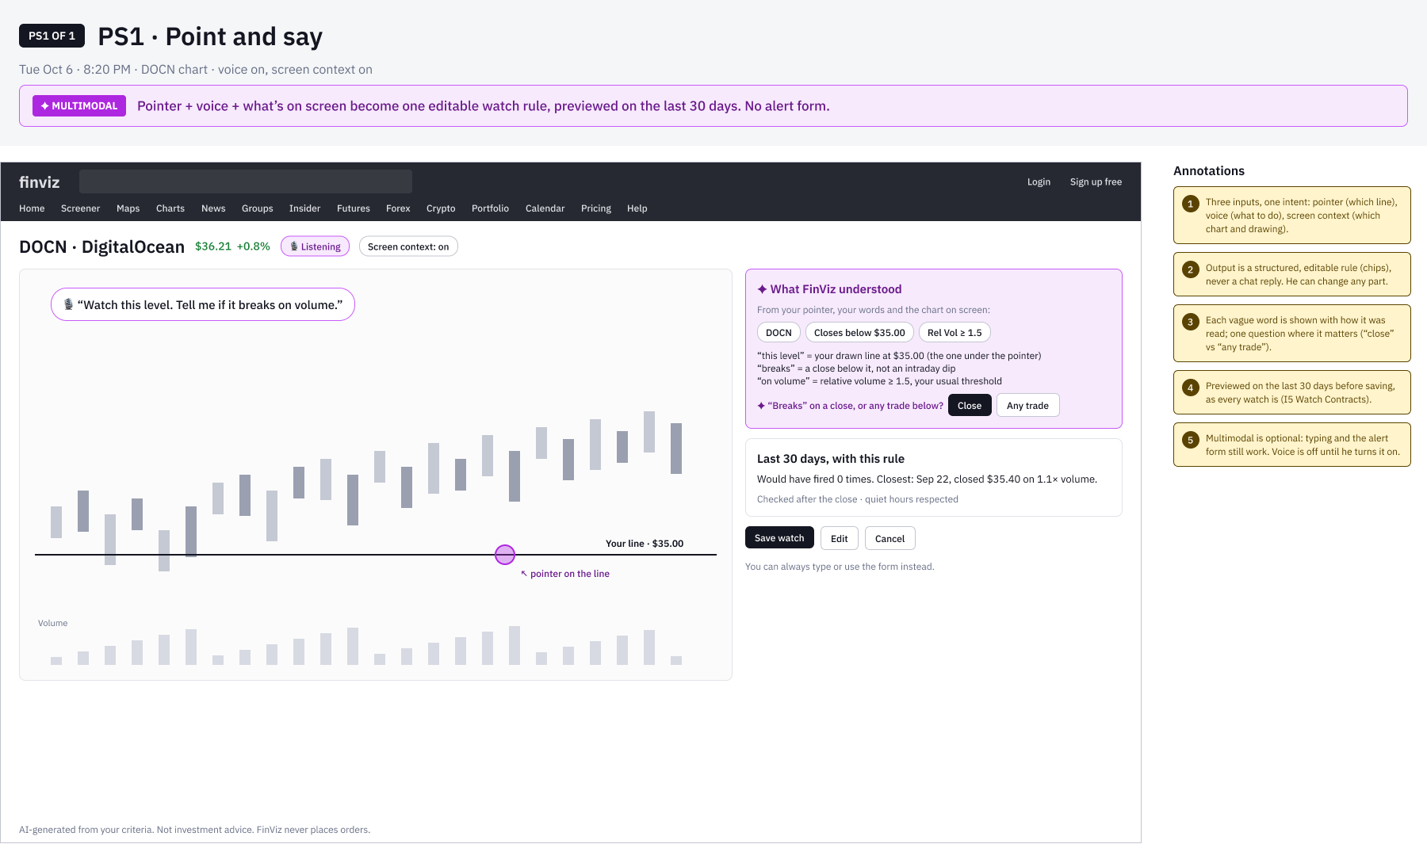
FINVIZ AI SCREENER · NEXT
Point and say: a watch without a form
Lo-fi concept (PS1). Gary points at the line he drew and says what to watch.
WHY IT’S NEW
Pointer + voice + screen become one editable rule; no alert form
Vague words shown as read; one question where it matters
Previewed on 30 days before saving; voice off by default

Slide 36
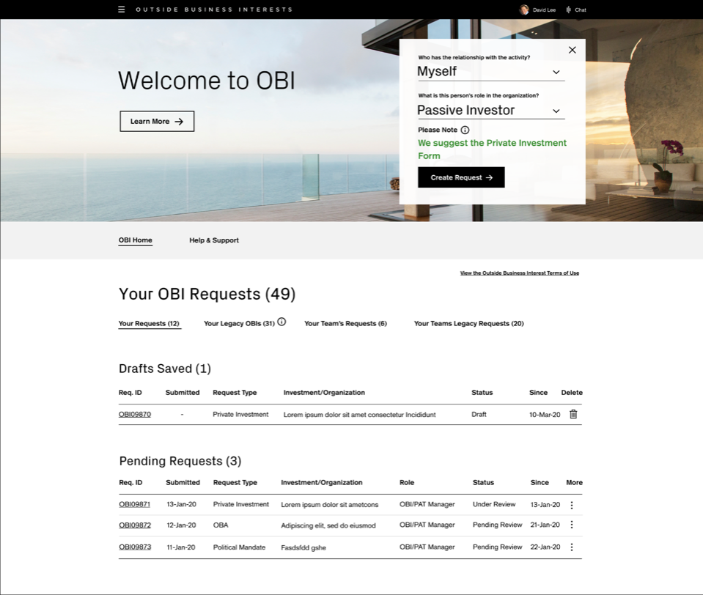
CASE STUDY 02 · ENTERPRISE · DELIVERED
Credit Suisse
Outside Business Interests (OBI)
Saving money by reducing friction, educating employees and removing risk from pre-clearance for outside activities.
ROLE
Led the project team
TEAM
2 UX designers and a content designer
SCOPE
Discovery to delivery: 33 Agile sprints, usability testing every week
USERS
All employees and managers, reviewers, and Risk & Compliance managers
“It’s too limited in its functionality to be of use for an Approver. Too much time is wasted trying to do more complex tasks.”

Slide 37
CREDIT SUISSE OBI · INTRODUCTION
A browser-based tool that gives employees pre-clearance for outside activities, reviewed by two lines of defense.
TARGET AUDIENCE
— Risk and Compliance managers
— All Credit Suisse employees
— All Credit Suisse managers
THE PROBLEMS
— Submission status tracking isn’t clear
— Lines of responsibility aren’t transparent
— No reporting
— Navigation is hard
— People don’t know why and when to submit
— No mobile access for Risk & Compliance managers
— A confusing submission process, with no education
TEAM AND MY PART
— I led a project team of 2 UX designers and a content designer
— I managed discovery, including research, strategy and hands-on design
— I led every deliverable in Sketch and Figma, with Lean UX and usability testing, and presented to the client and stakeholders

Slide 38
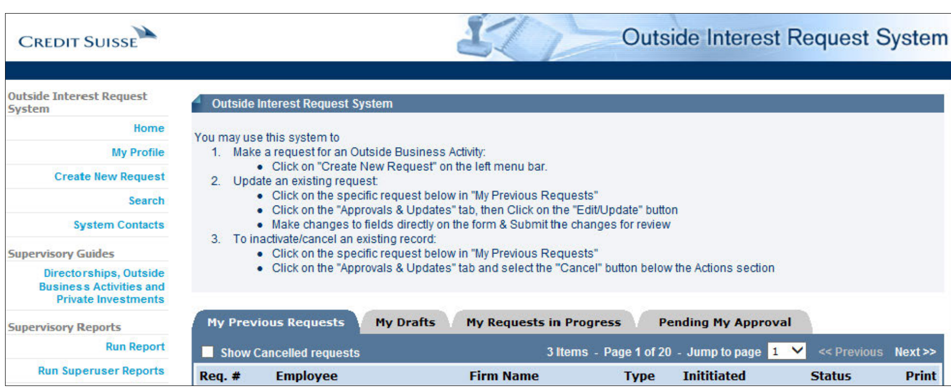
CREDIT SUISSE OBI · DISCOVERY
Where we started: the original application
The tool employees used to request pre-clearance before the redesign.

Slide 39
CREDIT SUISSE OBI · WHY REDESIGN
Why redesign OBI?
475
22 min
58%
average time employees need to resubmit
approval rating from Risk & Compliance managers
returned submissions missing required information, every year
5.4%
6.1%
61%
drop-off on Outside Business Activities forms
drop-off on Private Investments forms
approval rating from employees

Slide 40
CREDIT SUISSE OBI · DISCOVERY
We set out to find real user needs, test the business’s assumptions and generate new ideas.
METHODS
— Interviews with reviewers, Risk & Compliance managers and their managers
— Contextual interviews
— Persona development
— Research synthesis
— Design thinking exercises
PROBLEM STATEMENT
As part of the iComply ecosystem of Employee Compliance, users need an interactive, web-based pre-clearance application for outside activities, where requests flow through an integrated, pre-defined workflow for review by first-line Reviewers and second-line Risk & Compliance Managers.

Slide 41
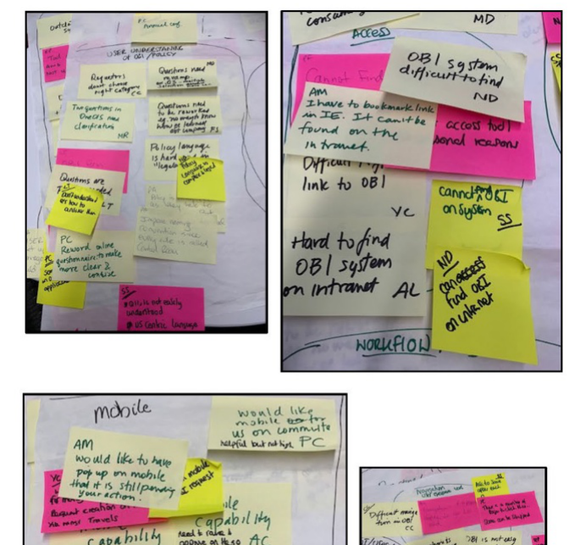
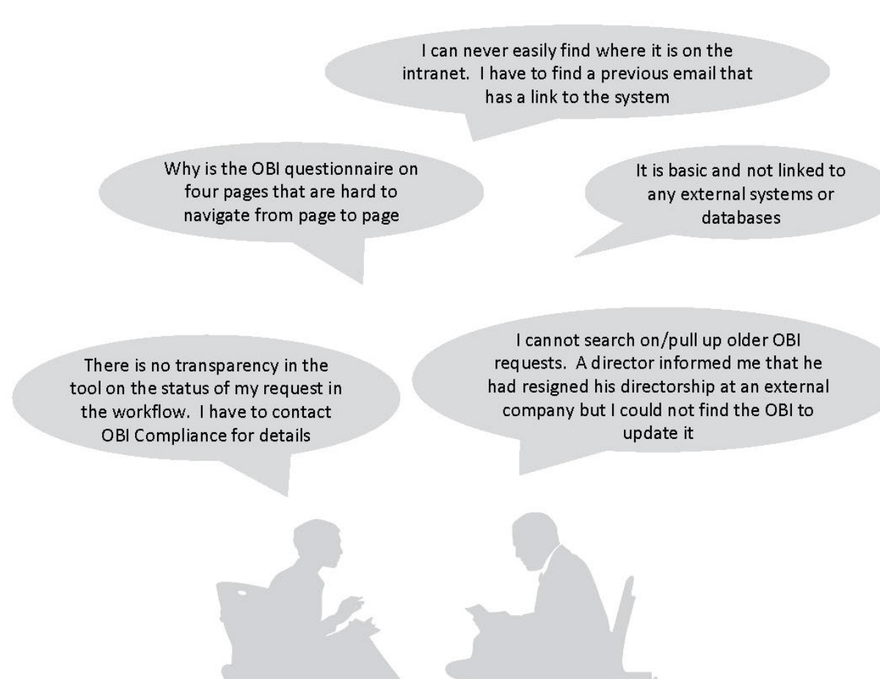
CREDIT SUISSE OBI · DISCOVERY
What we heard: major themes from the interviews
Reviewers, Risk & Compliance managers and their managers
MAJOR THEMES
— Integration with other systems on the platform
— Search
— Reporting
— Shadowing
— Everyone understanding the policies
— Mobile
— Clear navigation
— Clear workflow
— Status awareness

Slide 42
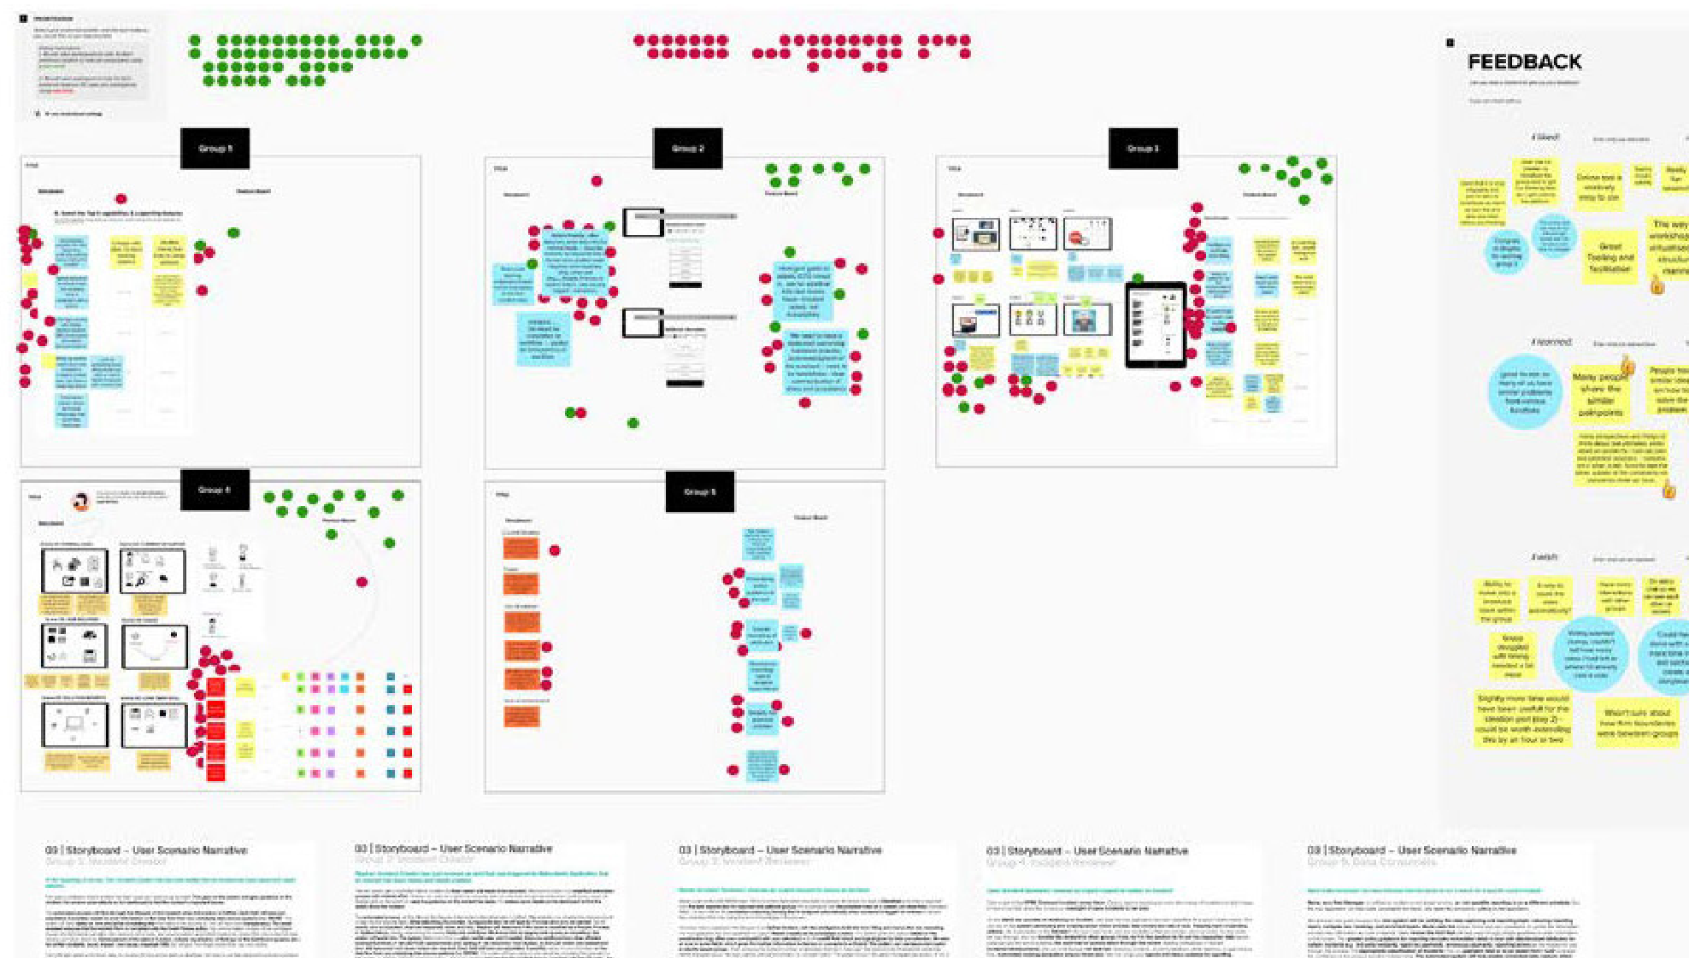
CREDIT SUISSE OBI · DISCOVERY
Design thinking: 5 concepts with 30 participants
Concepts for the dashboard, reporting and submission, for every type of end user
SESSION FORMAT
— Ice breaker
— What would the headlines say?
— How do we…?
— Concepts and interfaces
— Voting

Slide 43
CREDIT SUISSE OBI · STRATEGY
Pain points + business goals + UX strategy = feature set
+
+
=
PAIN POINTS
Integration with other systems on the platform
Navigation
Clear workflows
Status awareness
Lack of features
BUSINESS GOALS
Education
Functionality parity
Platform parity
Mobile
UX STRATEGY
Integrations with other systems on the platform
Everyone understanding the policies
Access for all in the platform
Mobile
Clear navigation
Clear workflows
FEATURE SET
Search
Reporting
Shadowing
Proxies
Queries
Mobile

Slide 44
CREDIT SUISSE OBI · DELIVERY
One dashboard for Submitters, Reviewers and Risk & Compliance Managers.
The dashboard was the main starting point for all three user types, so it got the most attention. It went through many iterations shaped by company goals, line-of-business goals, UX strategy, legal, risk and ADA requirements, and the design system.
HOW WE DELIVERED
— Feature refinement and road map
— 33 Agile sprints
— Usability testing every week
— Demos and QA

Slide 45
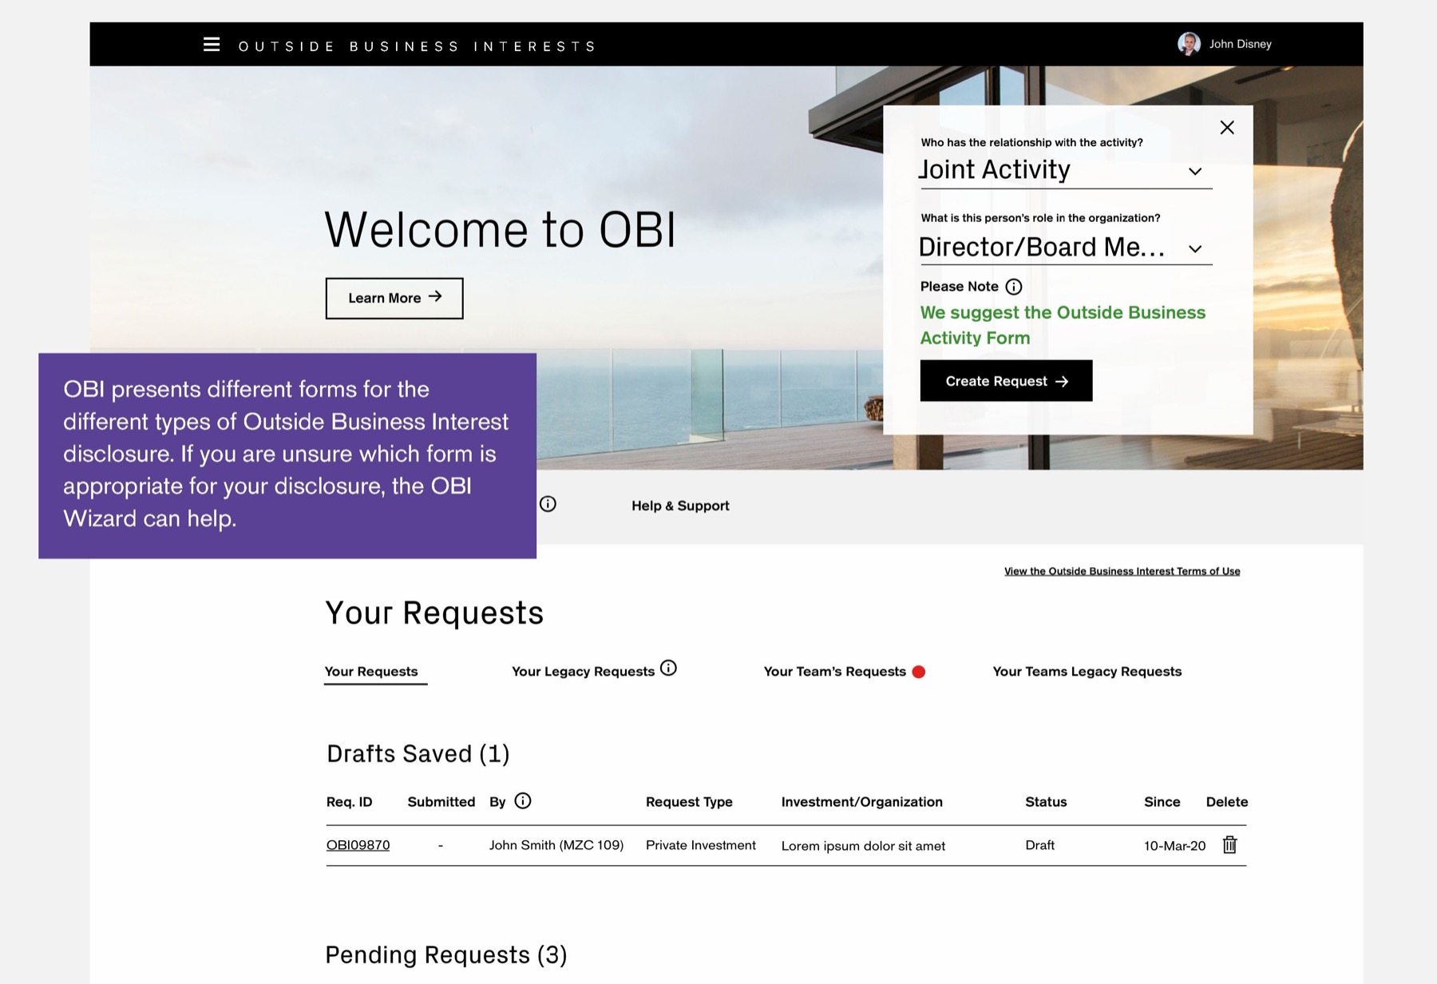
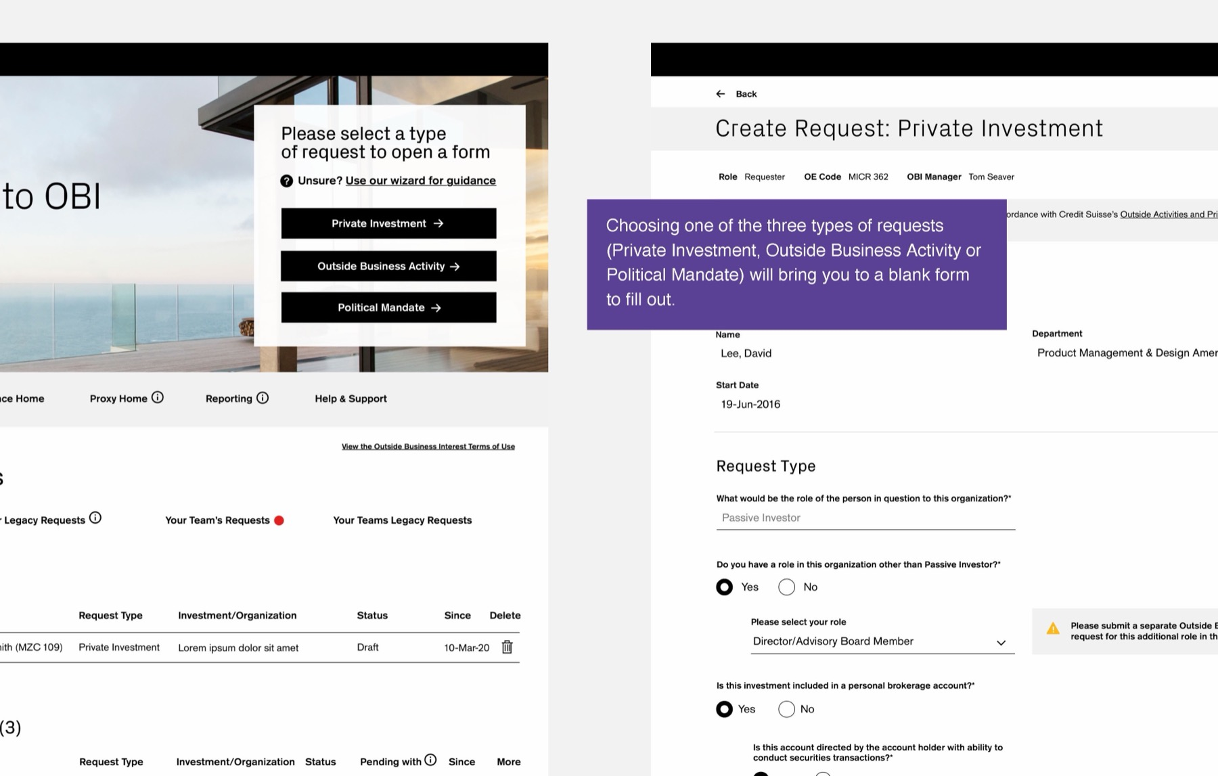
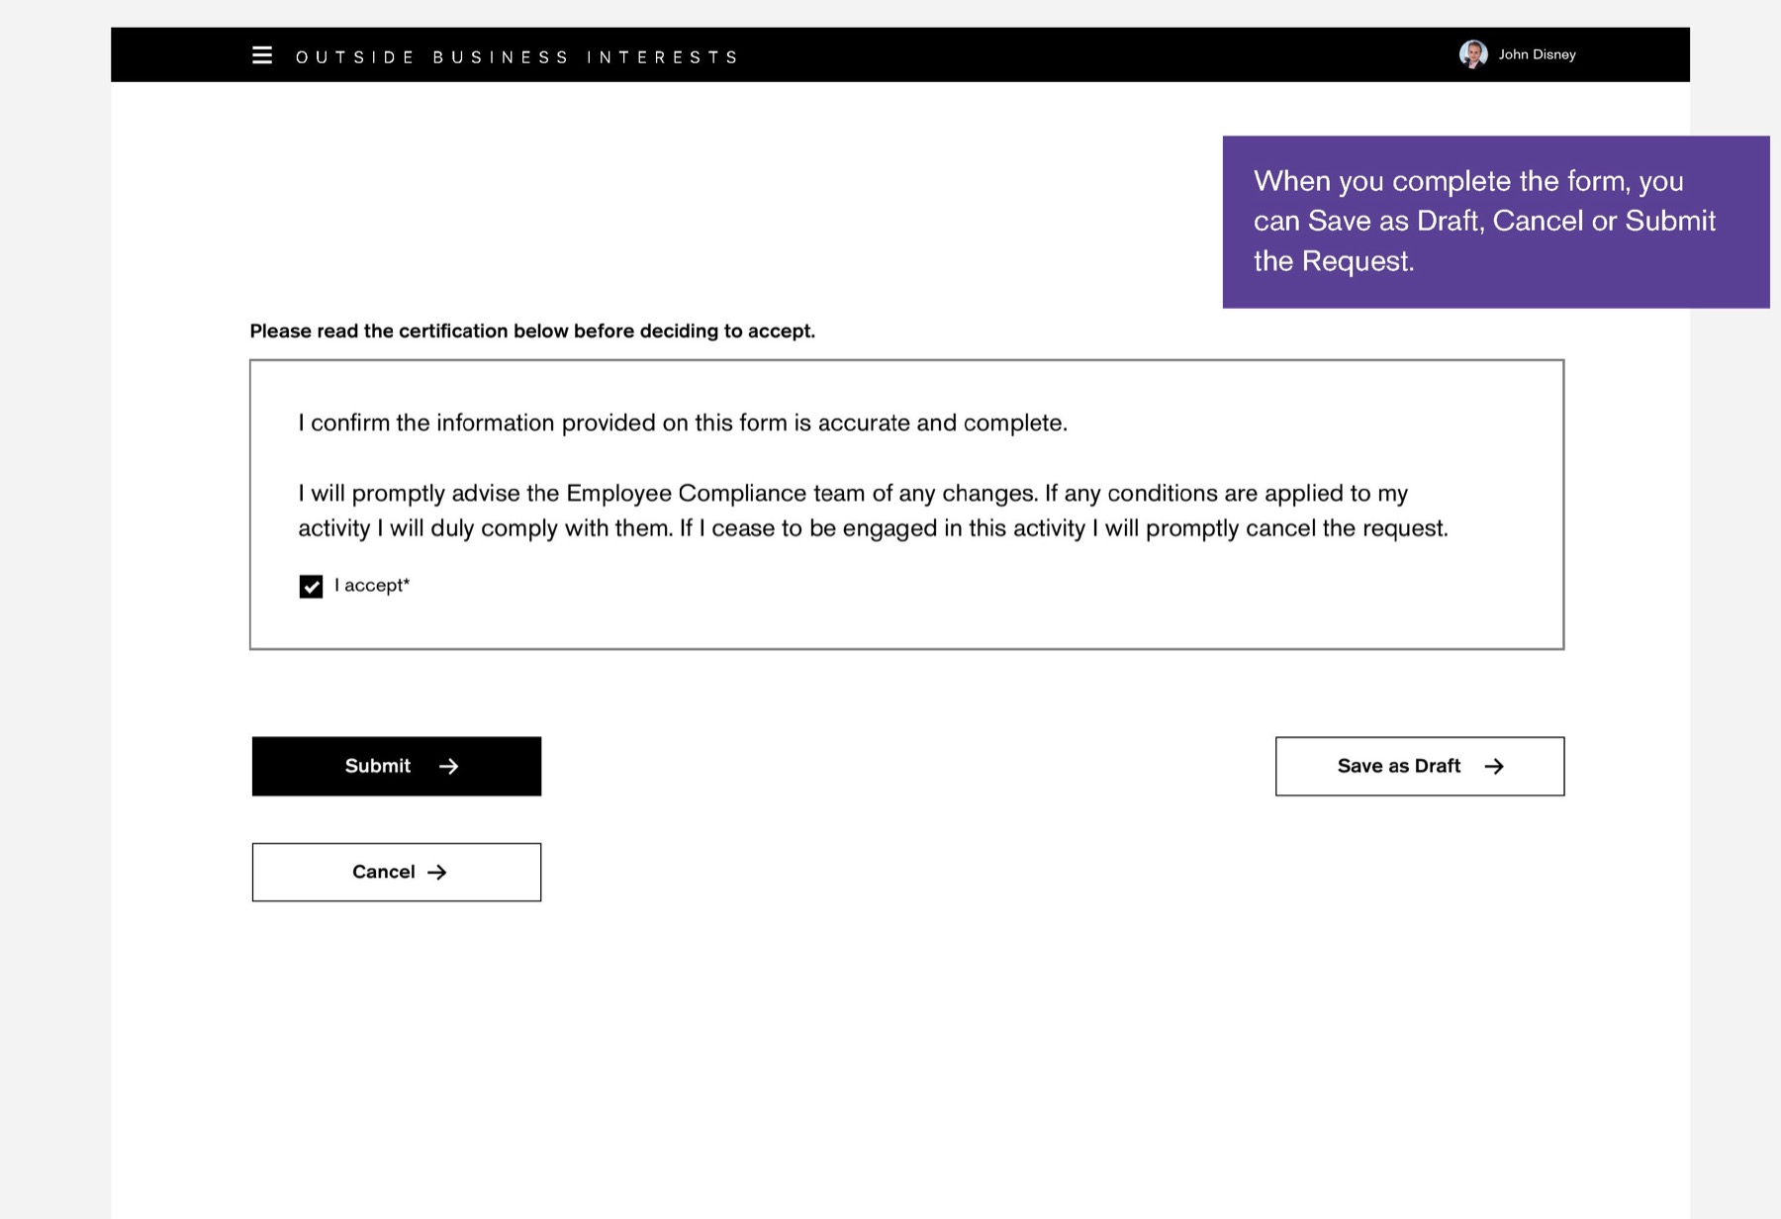
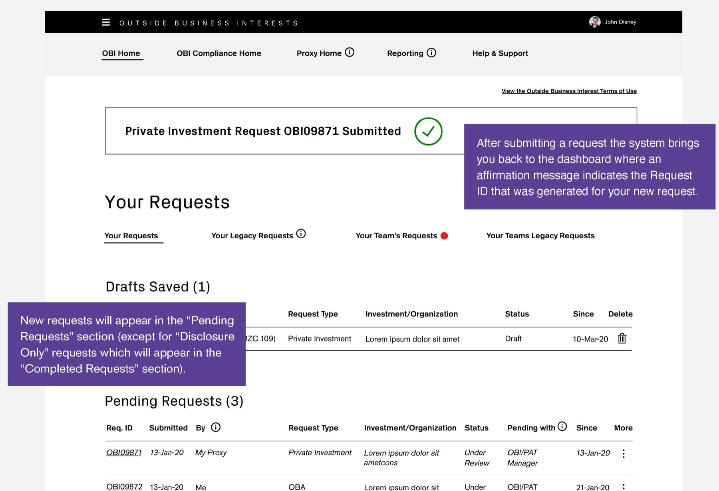
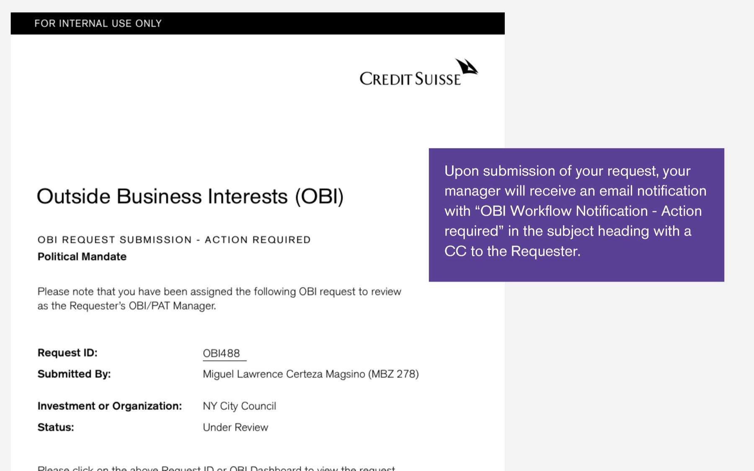
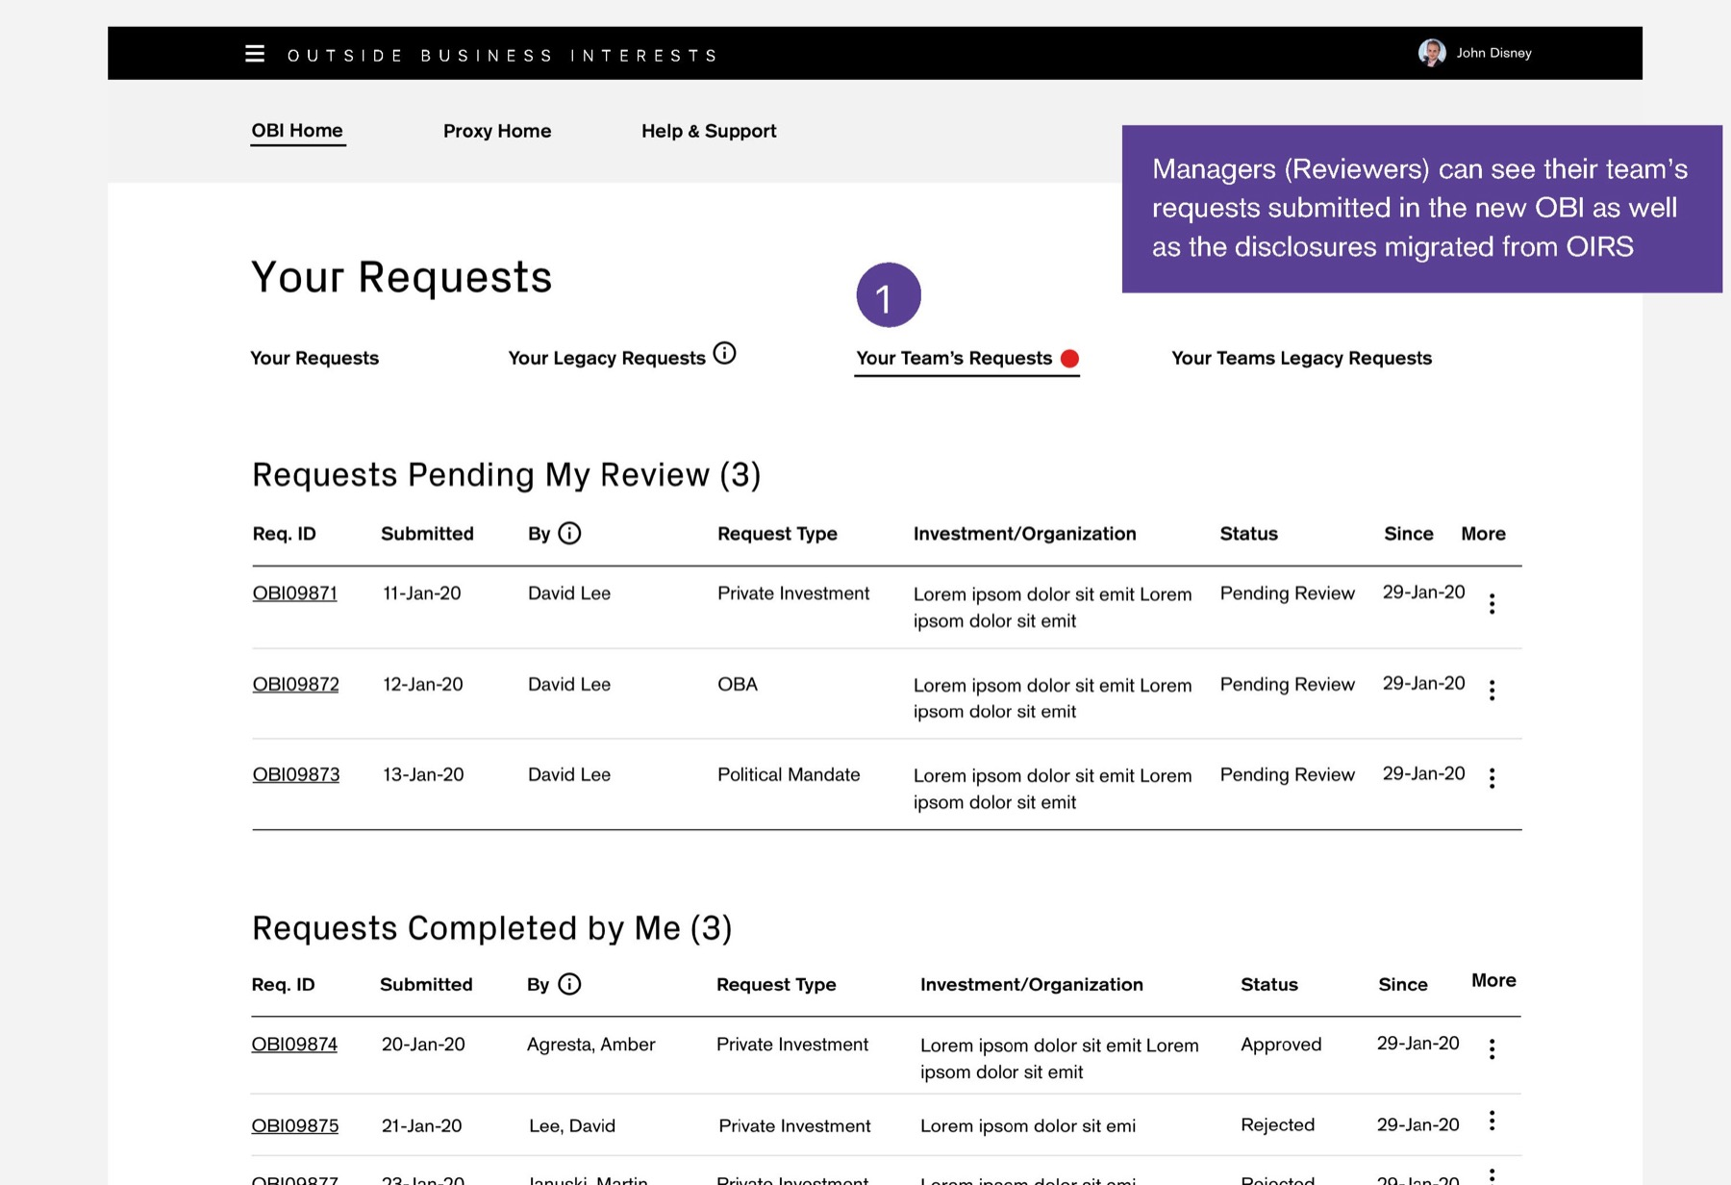
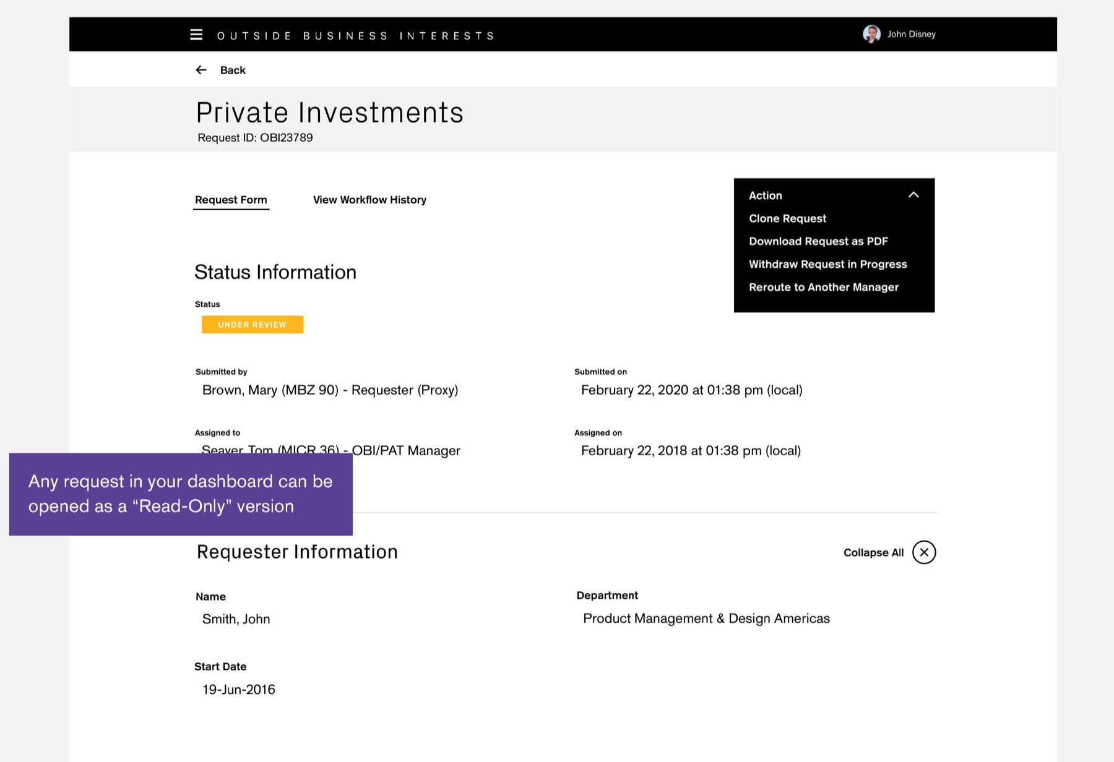
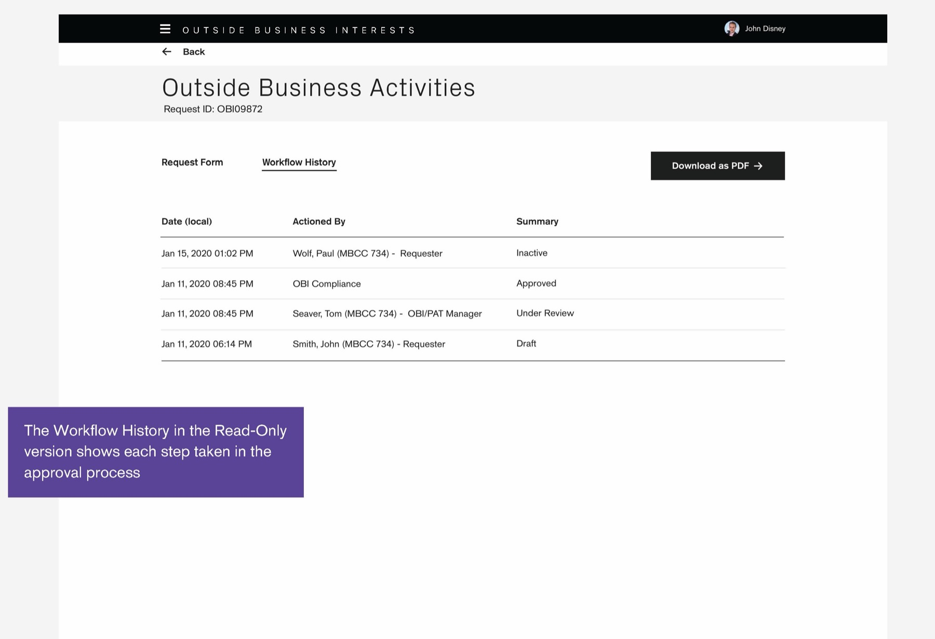
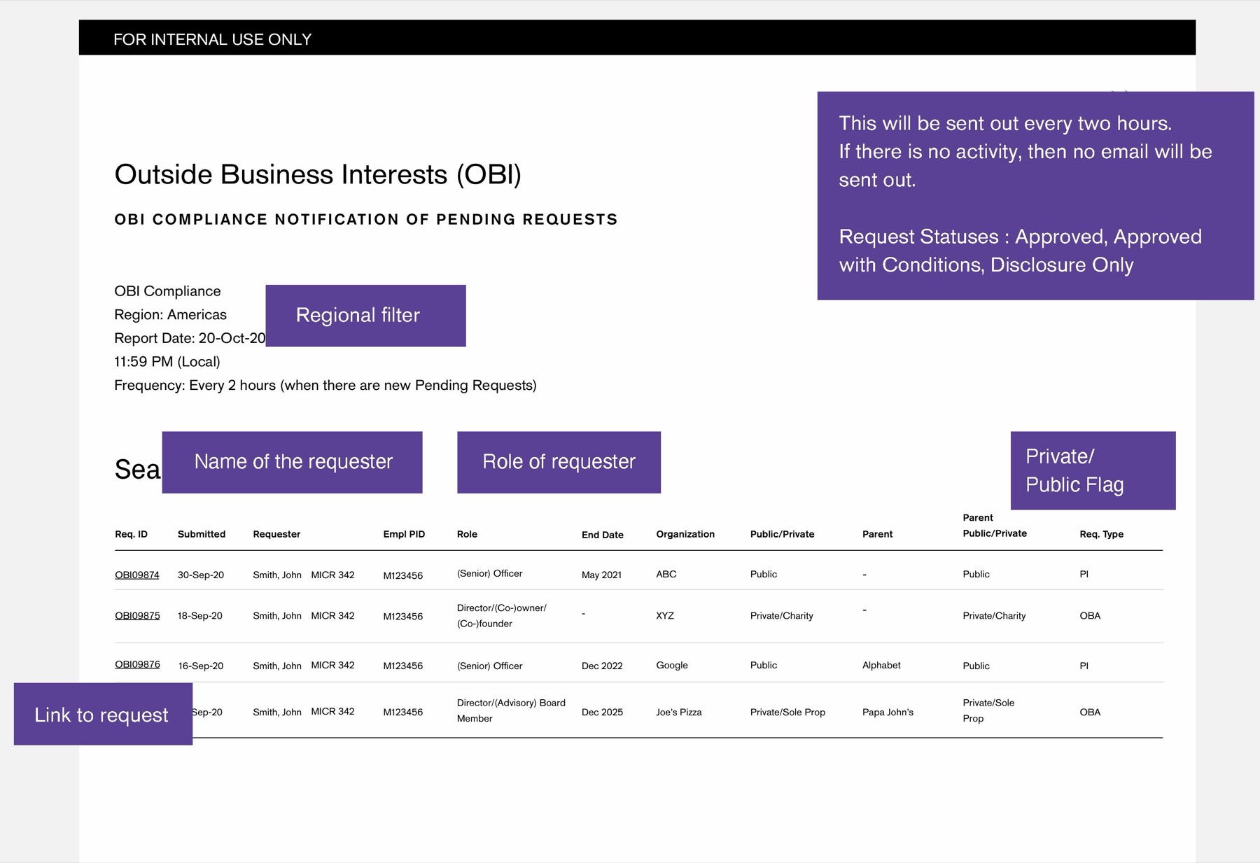
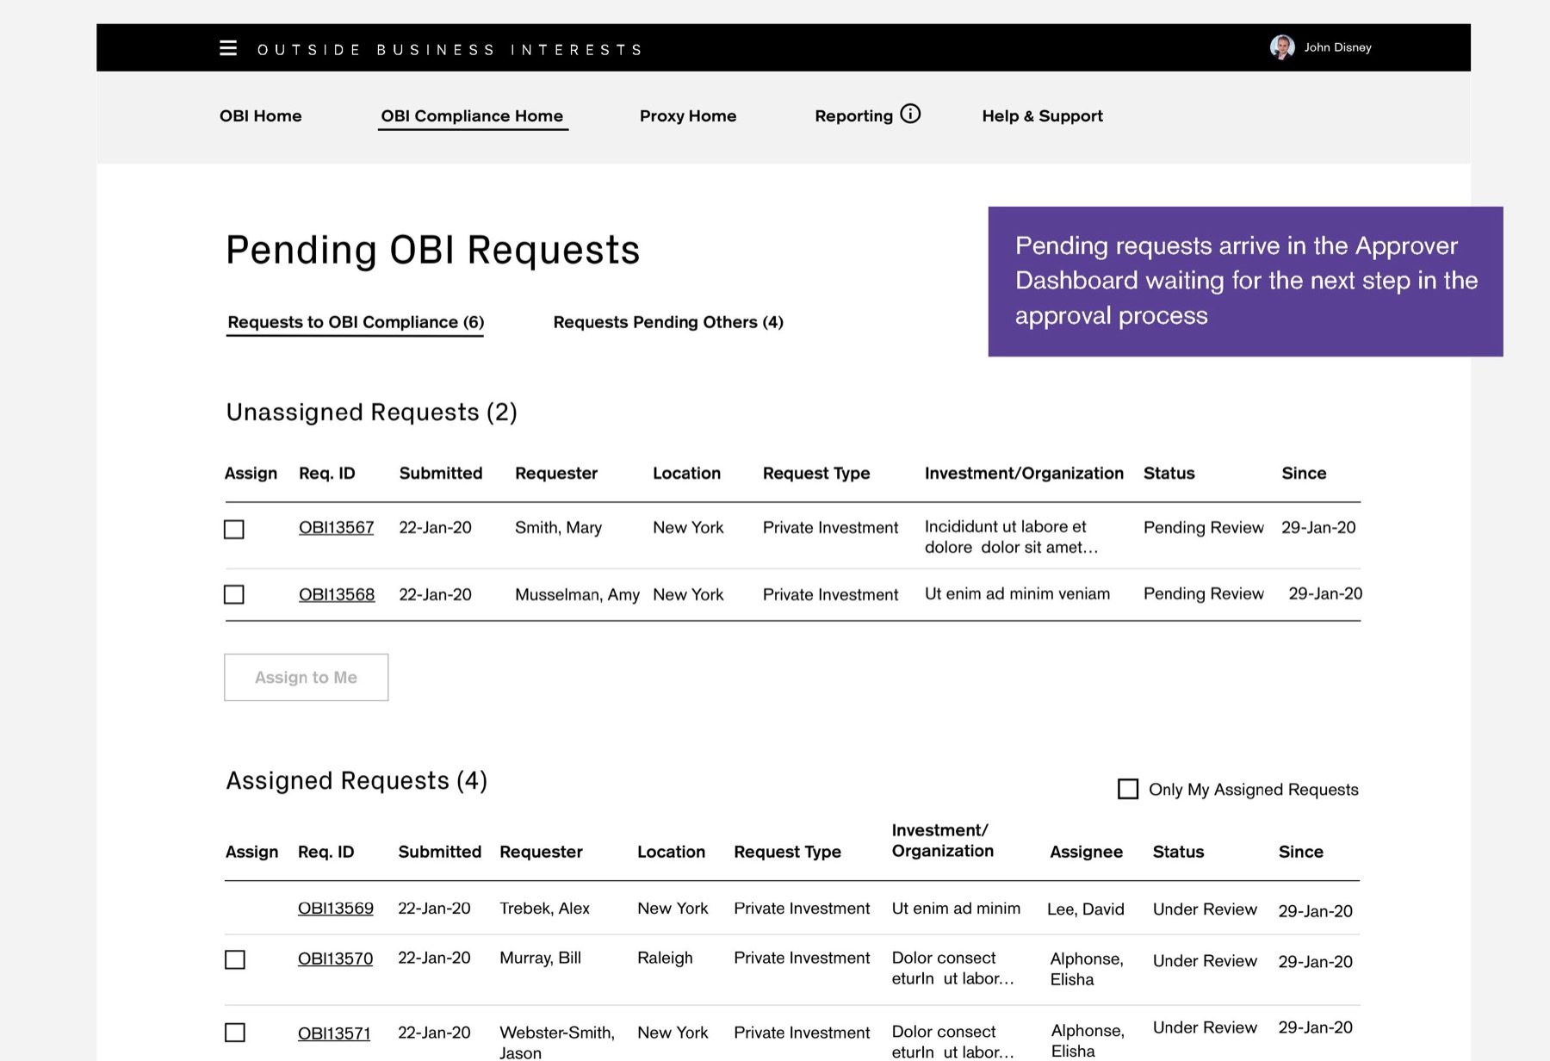
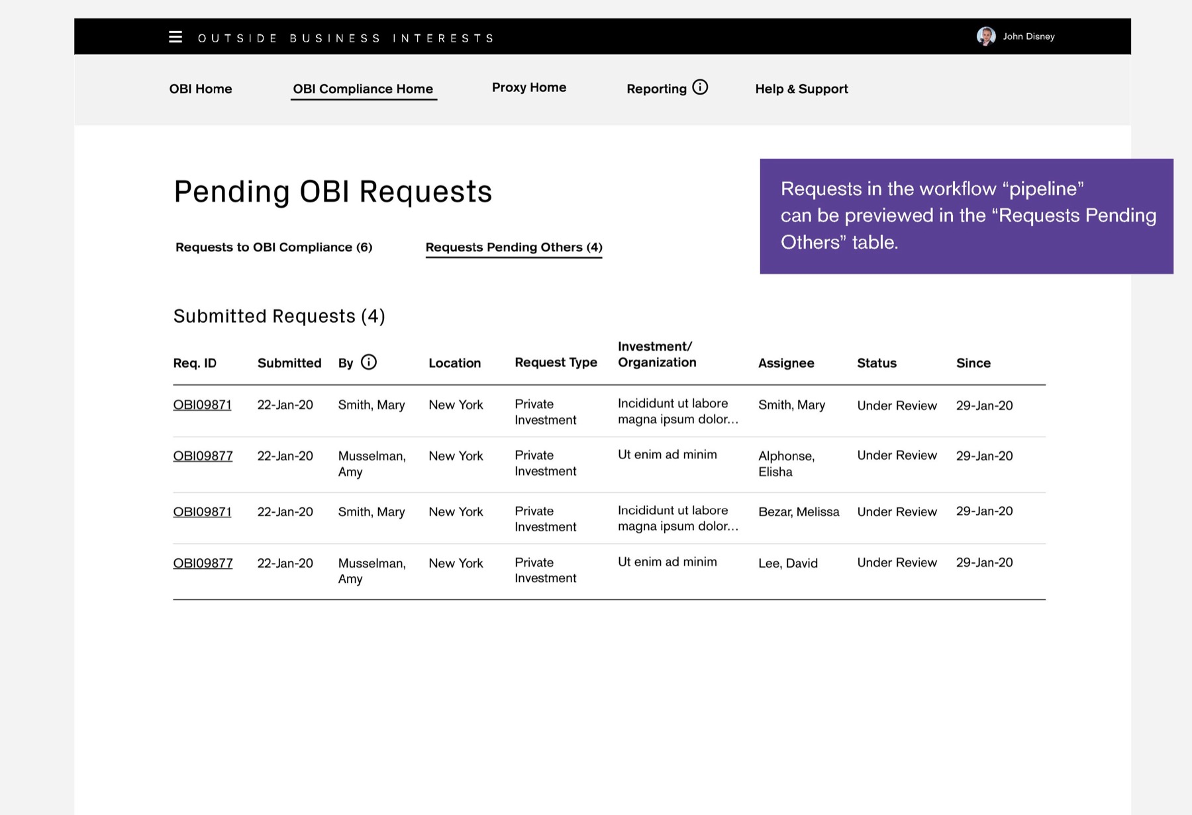
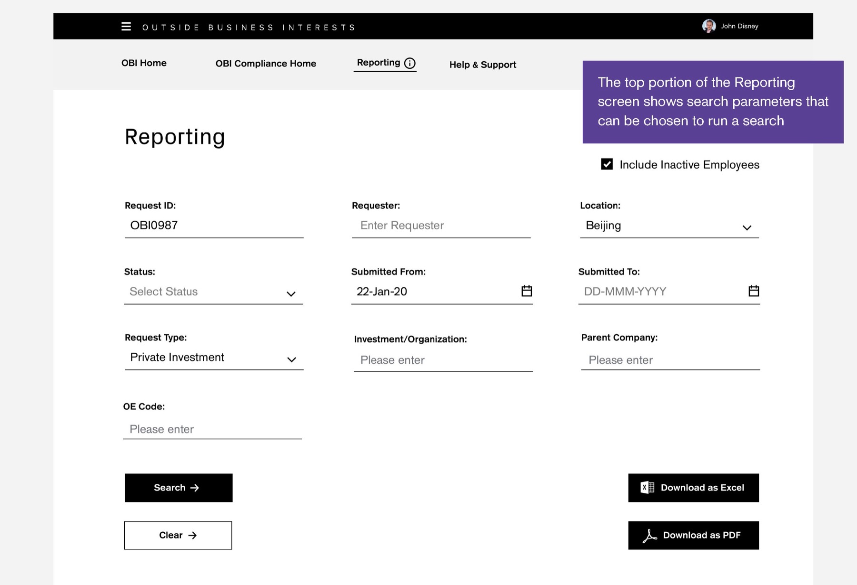
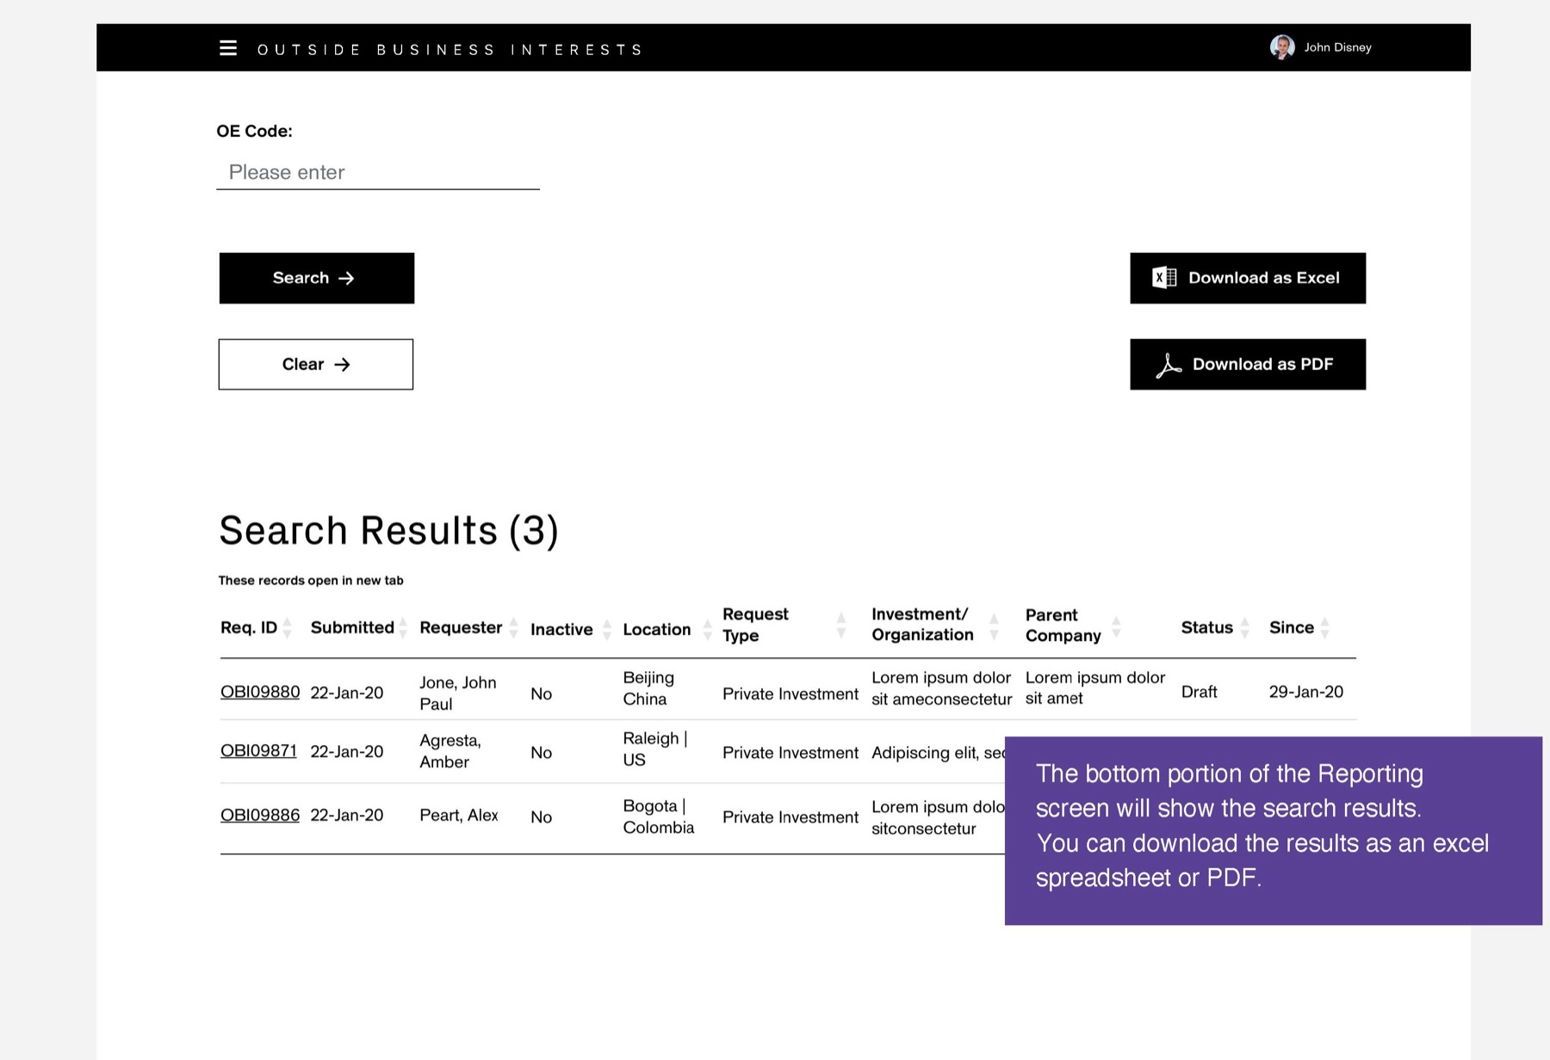
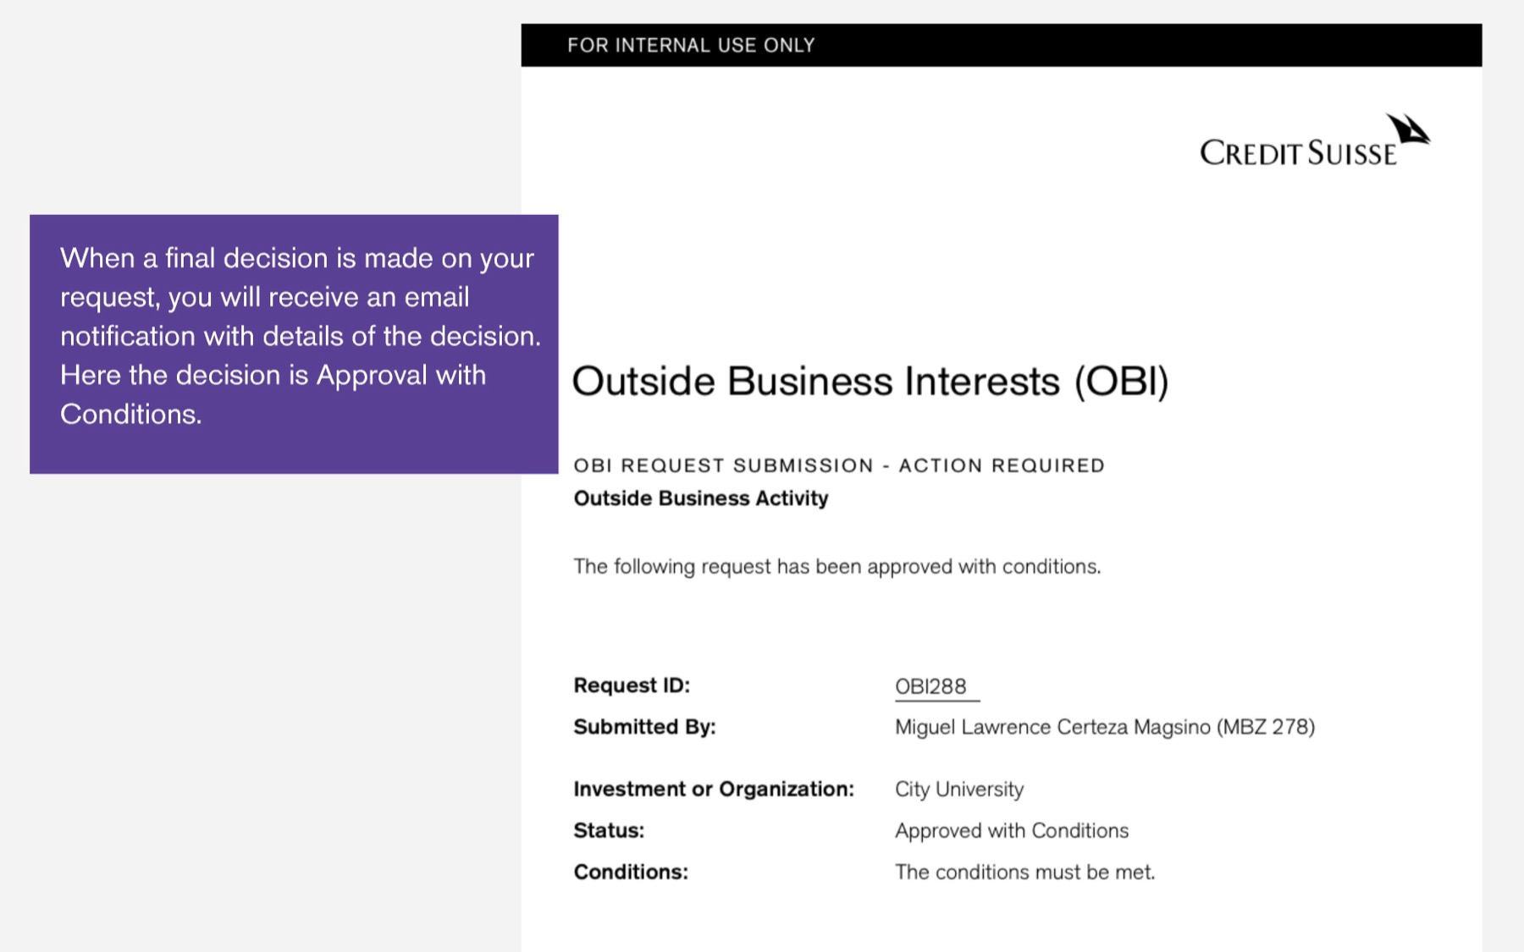
CREDIT SUISSE OBI · DELIVERY
The delivered app, one request end to end
The employee submits, the manager reviews, Compliance decides. Screens from the OBI Training Guide.
01 Welcome and wizard
Employee
02 Create request
Employee
03 Certify and submit
Employee
04 Submitted
Employee
05 Manager notified
Manager
06 Pending my review
Manager
07 Read-only request
Manager
08 Workflow history
Manager
09 Compliance digest
Compliance
10 Pending queue
Compliance
TRY IT
Open the prototype →
Starts at the welcome screen
11 Pipeline
Compliance
12 Reporting search
Compliance
13 Reporting results
Compliance
14 Decision email
Employee

Slide 46
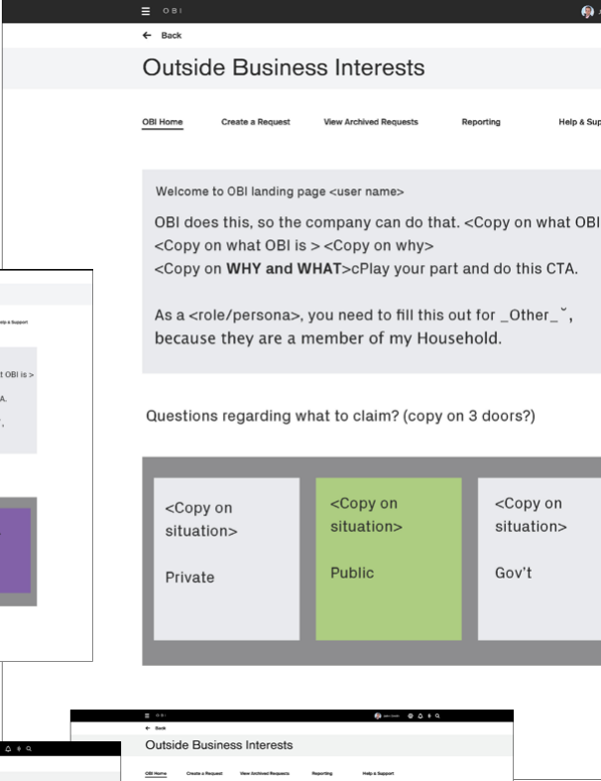
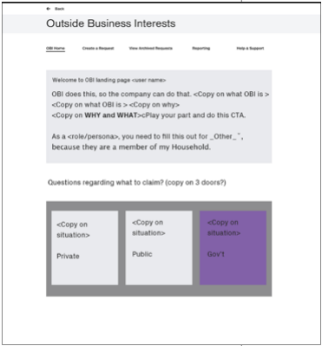
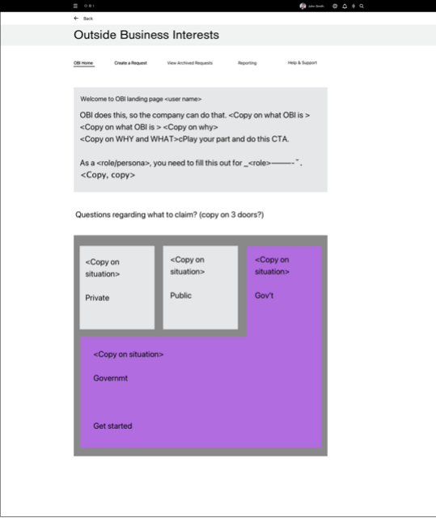
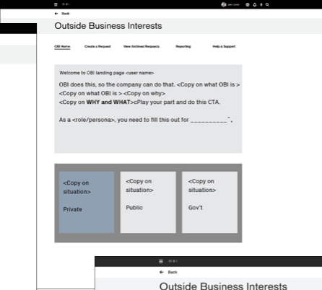
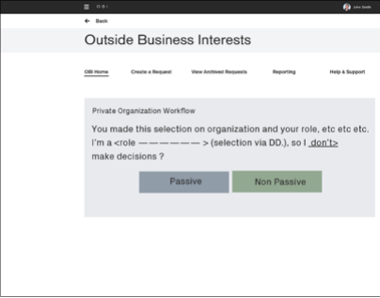
CREDIT SUISSE OBI · DESIGN
Experience design strategy
Based on POC 2 from the design thinking process, and thumbnail sketches.
WHAT WE LEARNED FROM DISCOVERY AND DESIGN THINKING
— Risk & Compliance managers need a dashboard to understand and filter request statuses
— Reporting and other major functions, with sharing and alerts to second-line managers
— Employees were often confused about which form they needed
— They needed education on why, how and when
— They needed to know what to expect when they came back
— One central place to see every submitted request

Slide 47
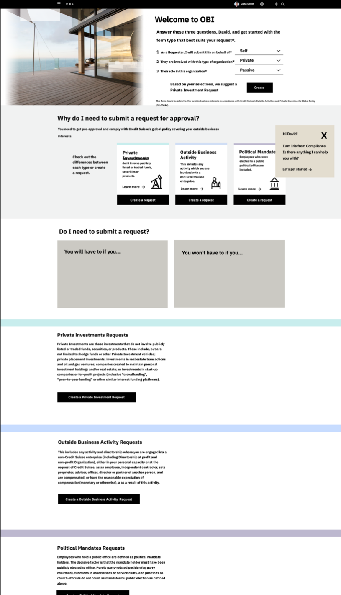
CREDIT SUISSE OBI · DESIGN
Dashboard design sprint: second iteration
The first iterations put education front and center. Testing showed newer users needed it, but not all.
WHAT WE LEARNED IN TESTING
— Education was a priority for all users
— Users responded to friendlier copy that described the situations they might be in
— Content for Swiss users could be surfaced by user ID and location

Slide 48
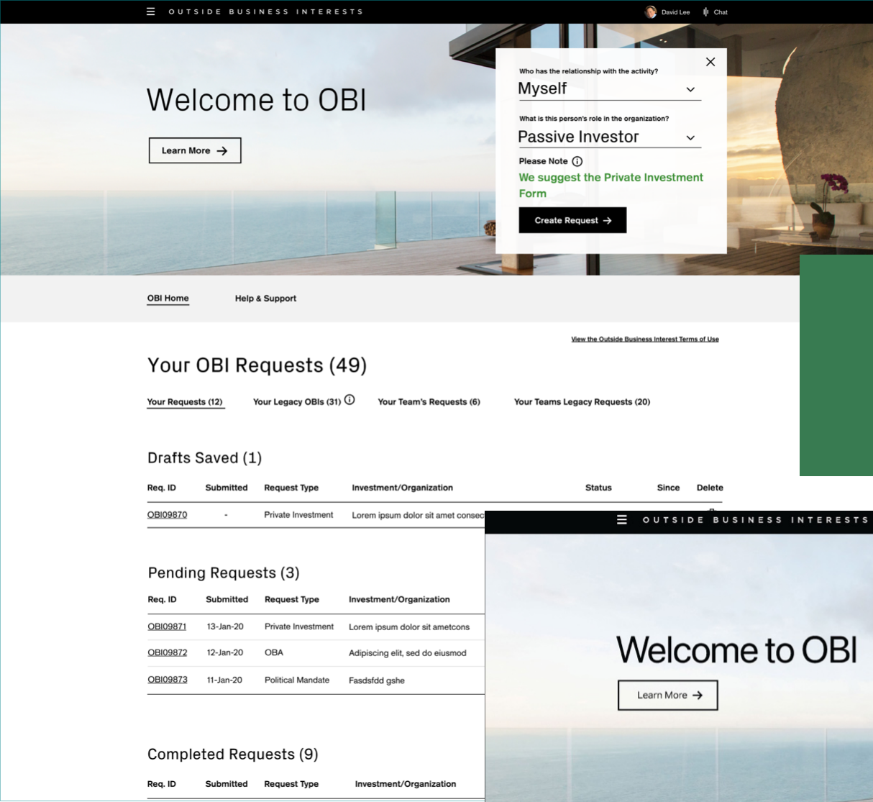
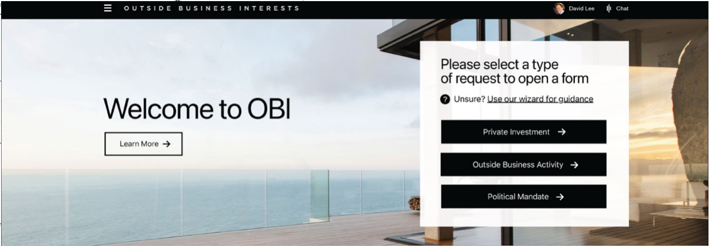
CREDIT SUISSE OBI · DESIGN
Dashboard design sprint: final version
Submitters reach a wizard that asks only 2 questions to find the right form.
WHAT WE LEARNED
— Easy access to education
— A cleaner interface
— A quick way to start a request
Final Version

Slide 49
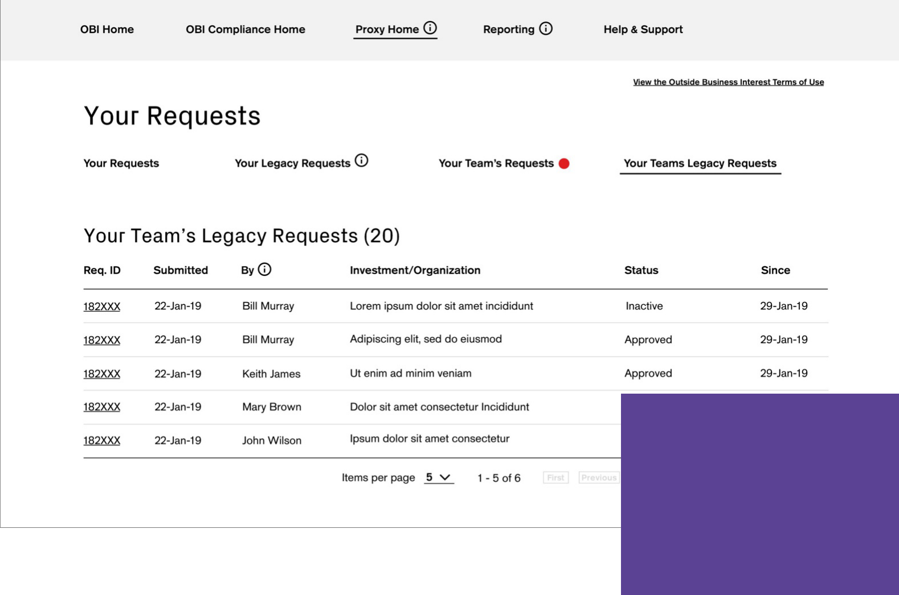
CREDIT SUISSE OBI · DESIGN
Landing page design sprint
Legacy requests from the previous system, OIRS, were migrated into OBI.
YOUR REQUESTS
— Opens by default on the requester dashboard
— Drafts saved
— Pending requests
— Completed requests
The landing page shows the requester dashboard. “Your Requests” opens by default, in three sections:
1. Drafts saved
2. Pending requests
3. Completed requests

Slide 50
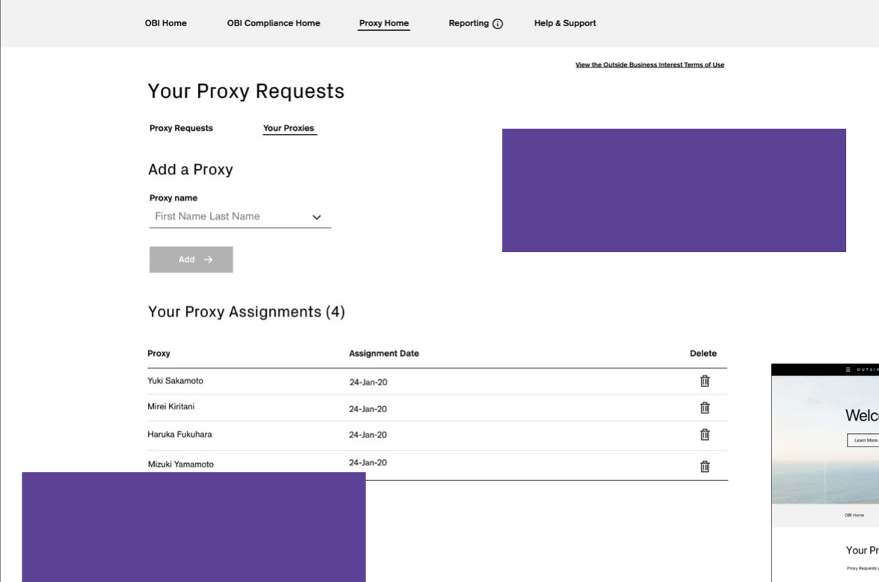
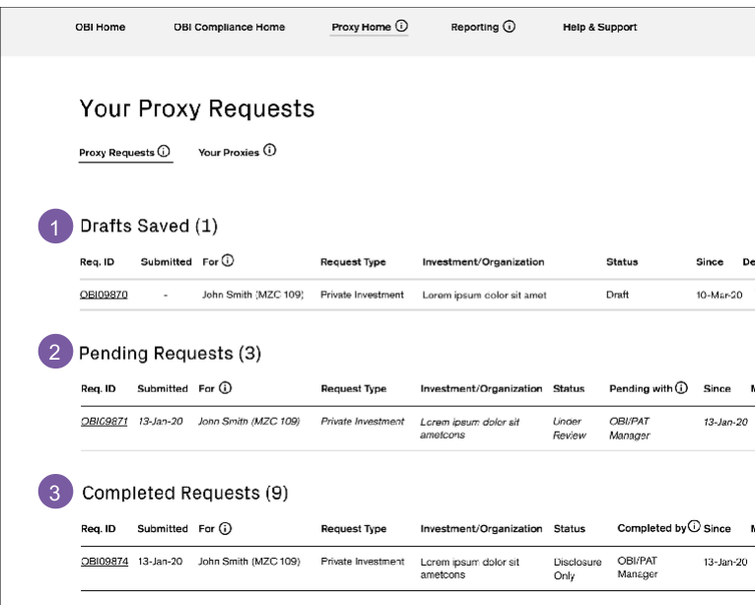
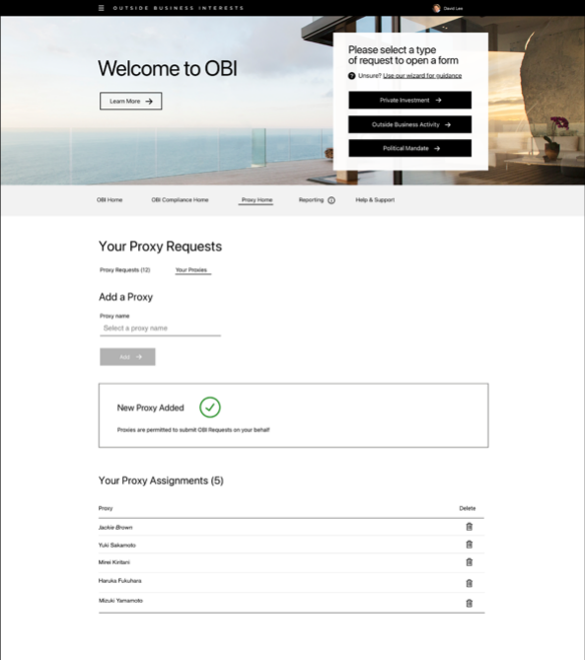
CREDIT SUISSE OBI · DESIGN
Proxy request design sprint
For people who can’t access OBI to make the disclosures they need to.
For people who can’t access OBI themselves to make the disclosures they need to, OBI has proxy functions.
Staff can name colleagues to act as proxies. A proxy can submit requests on behalf of anyone who has given them permission.

Slide 51
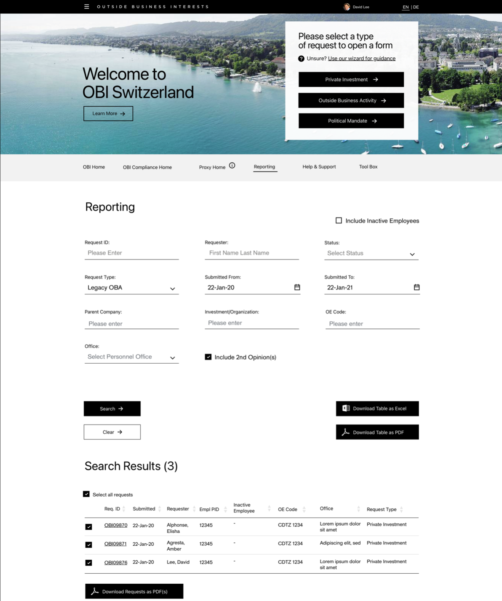
CREDIT SUISSE OBI · DESIGN
Reporting design sprint
Risk & Compliance managers find any request and export the results.
SEARCH BY
— Request ID and requester
— Status and type
— Submission dates
— Company and office
— Export to Excel or PDF

Slide 52
CREDIT SUISSE OBI · KEY CALLS
Four calls that shaped OBI.
A separate dashboard for submitters
Two questions pick the form
Testing showed submitters needed their own starting point, with forms that reveal one step at a time.
Employees didn’t know which form applied. A short wizard asks two questions and opens the right one.
Education written as scenarios
Tools for approvers too
Every user group asked for education. Copy built around real situations tested best, after three iterations.
Proxy submissions for people who can’t access OBI, and reporting by ID, status, office and date, exported to Excel or PDF.

Slide 53
CREDIT SUISSE OBI · OUTCOME
Delivered: one place to submit, review and report, with education built in.
WHAT SHIPPED
— A submitter dashboard with a 2-question wizard that opens the right form
— Your Requests: drafts, pending and completed, with legacy OIRS requests migrated
— Proxy submissions for people who can’t access OBI themselves
— Reporting by ID, requester, status, type, dates, company and office, exported to Excel or PDF
WHAT TESTING TAUGHT US
— Education matters to every user, but only newer users need it front and center
— Copy that describes real situations works better than policy language
— A cleaner interface and a quick start beat more options on the dashboard

Slide 54
CREDIT SUISSE OBI · PROTOTYPE
Follow 1 request through the delivered app.
14 screens from the OBI Training Guide, linked in order: the employee submits, the manager reviews, Compliance decides, and the employee hears back.
Open the OBI prototype →
Or start at the workflow map →
ALSO AVAILABLE
An offline version with the narrative for every step and a full link map: OBI-Request-Prototype.html.

Slide 55

CASE STUDY 03 · CONSUMER MOBILE · DELIVERED
Wells Fargo
Integrated Trade Ticket
Increasing revenue by letting investors trade by share quantity or dollar amount, in one simpler mobile ticket.
ROLE
Led the project team
TEAM
2 UX designers
SCOPE
Discovery, competitive analysis, 3 tested iterations, 6 Agile sprints
USERS
Experienced and novice self-directed traders
“It’s a confusing interface, the app’s interface is non-intuitive, making it difficult to navigate and find specific functions or features.”

Slide 56
WELLS FARGO TRADE TICKET · INTRODUCTION
One trade ticket that lets investors trade in shares or dollars, with fewer errors and less effort.
TARGET AUDIENCE
— Experienced consumer traders
— Novice consumer traders
THE PROBLEMS
— Wealth & Investment Management investors can’t trade in both shares and dollars
— The mobile trading process needs simplifying
— A confusing interface
— Limited functionality
— Technical issues and no real-time updates
— Poor customer support
TEAM AND MY PART
— I led a project team of 2 UX designers
— I managed discovery, including research, strategy and hands-on design, supported by AI applications
— I led every deliverable in Figma, with Lean UX and usability testing, and presented to the client and stakeholders

Slide 57
WELLS FARGO TRADE TICKET · WHY REDESIGN
Why redesign the trade ticket?
8.2 min
for a new user to complete their first trade
18.3%
of users ask to trade in both shares and dollars
1.4%
error rate on submissions
6.1%
drop-off on trades in the mobile app
“The app lacks advanced features like drawing tools or technical indicators. Customer support options are limited, with no chat support available.”

Slide 58
WELLS FARGO TRADE TICKET · DISCOVERY
We set out to find real user needs, test the business’s assumptions and generate new ideas.
METHODS
— Interviews with external users, internal stakeholders and SMEs
— Experienced and novice traders
— Persona development
— Google design thinking exercises
— Competitive analysis
PROBLEM STATEMENT
As the most important part of the trading experience, experienced and novice users need an integrated trade ticket that simplifies trading, reduces errors and improves efficiency, while letting them trade in shares or dollar amounts.

Slide 59
WELLS FARGO TRADE TICKET · DISCOVERY
“…so non-intuitive, it makes it hard to navigate, find specific functions and just make a quick trade.”
PAIN POINTS WE HEARD IN INTERVIEWS
01
Can’t trade in both shares and dollars on mobile
05
More trading options
02
Several interfaces aren’t intuitive
06
Speed
03
Need more of the right trade detail
07
Mobile native
04
Flexibility needs to improve

Slide 60
WELLS FARGO TRADE TICKET · STRATEGY
Pain points + business goals + UX strategy = feature set
+
+
=
PAIN POINTS
Can’t trade in both shares and dollars
Interfaces aren’t intuitive
Need more of the right trade detail
Flexibility
More trading options
Transaction speed
Mobile native
BUSINESS GOALS
Speed
Education
Platform parity
Integrated systems
Data
UX STRATEGY
Simplified interface
Dynamic functionality
Trade speed
Real-time updates
FEATURE SET
Order entry
Execution management
Real-time monitoring
Risk management
Post-trade processing
Integration with other systems
Shares vs. dollars
Analytics and reporting

Slide 61












WELLS FARGO TRADE TICKET · DISCOVERY
Competitive analysis
How the leading trading apps handle shares, dollars and the ticket itself
Robinhood
Whole and fractional shares in dollar amounts. A simple switch between shares and dollars, tickets with every detail, and instant trade notifications.
Charles Schwab
Fractional shares from $5 with Stock Slices. Clear, complete trade tickets and an intuitive design.
Fidelity
Shares or dollars, with fractional shares across stocks and ETFs. Detailed tickets with execution time, and easy navigation.

Slide 62

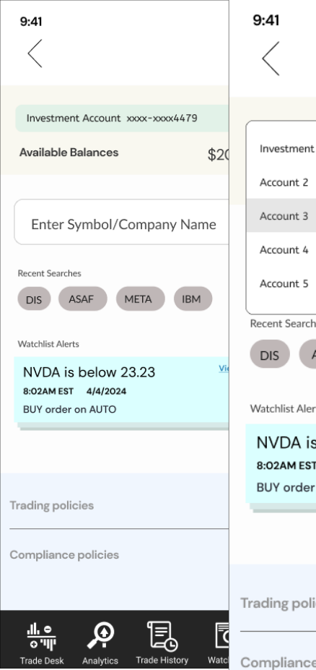

WELLS FARGO TRADE TICKET · DESIGN
Trade ticket design sprint: discovery
WHAT WE LEARNED FROM DISCOVERY AND DESIGN THINKING
— Switching accounts would support most experienced traders and 60% of novice users, and the new mobile-native navigation
— Dark mode is important

Slide 63


WELLS FARGO TRADE TICKET · DESIGN
First iteration: start from what they hold
If a user holds the asset, they go straight into a ticket to buy or sell.
THE IDEA
— The asset is already held, so the user lands straight in the funnel
— One toggle switches between dollars and shares
— A predictive interface: only the choices that apply, never too many
First iteration

Slide 64


WELLS FARGO TRADE TICKET · DESIGN
Second and third iterations
A flexible ticket with detail on the stock and on the holding itself.
WHAT WE LEARNED IN TESTING
— Education was a priority for all users, but shouldn’t distract or slow them down
— Trading in quick amounts is good
— Feedback on the share amount is valuable too
— A custom keyboard was tried in several iterations, then replaced by the system keyboard
Second iteration
Third iteration

Slide 65





WELLS FARGO TRADE TICKET · DESIGN
Testing two versions: list or tabs
Every order type stays available, whether trading by shares or dollars.
WHAT WE LEARNED IN TESTING
— People preferred the list view to tabs
— The icon next to “Action” scored high
— Quantity and order sheets that appear only when needed made sense to many
Test version 1

Slide 66


WELLS FARGO TRADE TICKET · DESIGN
Final delivered solution
Every field stays editable if the user needs to change the order.
WHAT WE LEARNED IN TESTING
— Order types vary
— Color and status changes show where an order is
— Seeing the status right away is vital
— A cleaner interface
— Quick transactions
— Watchlist alerts you can act on
Final delivered solution

Slide 67
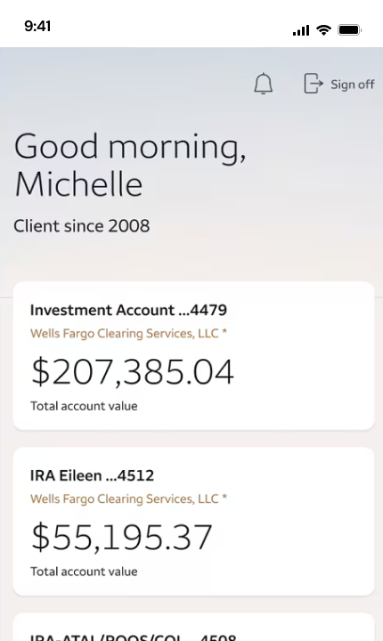
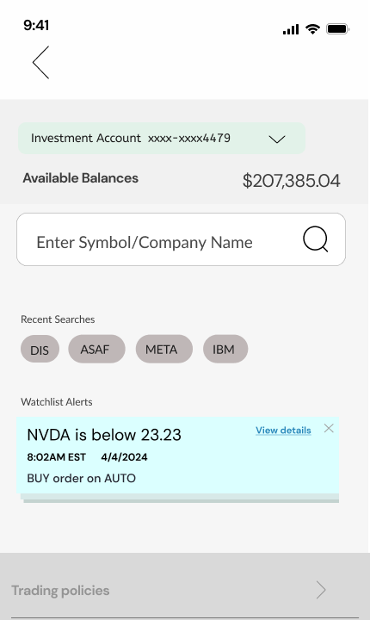
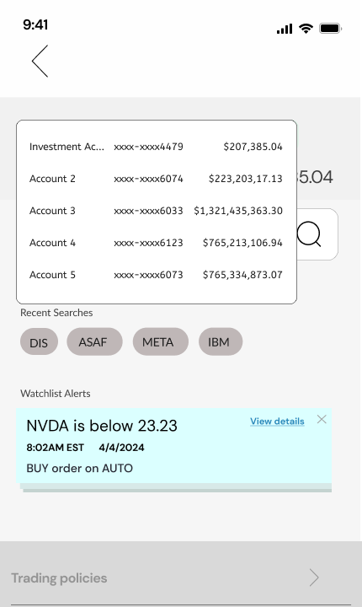
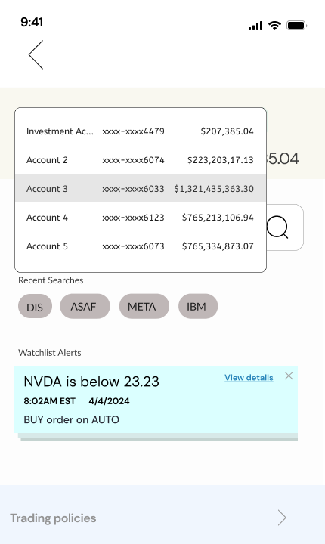
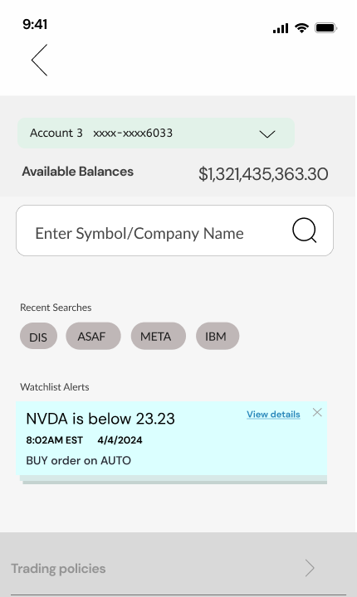
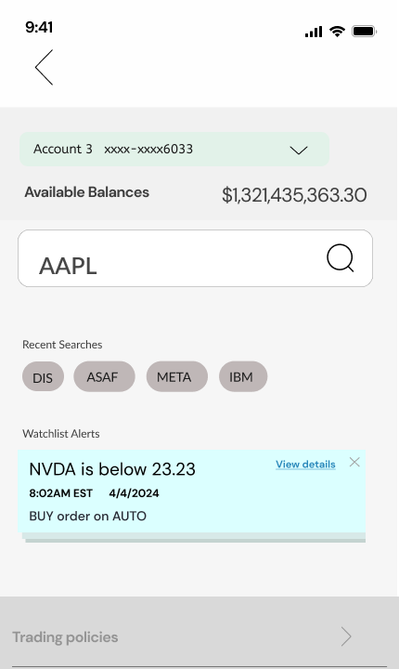
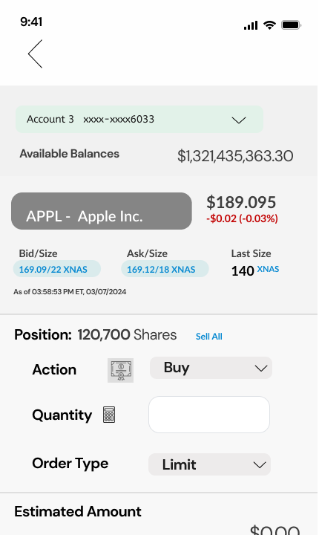
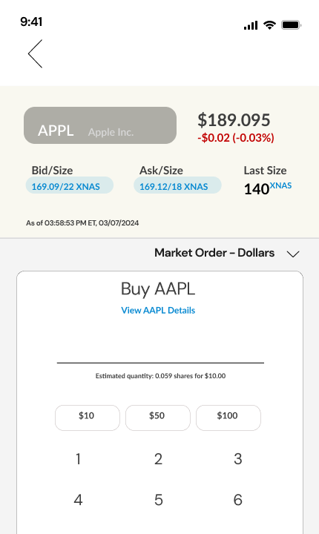
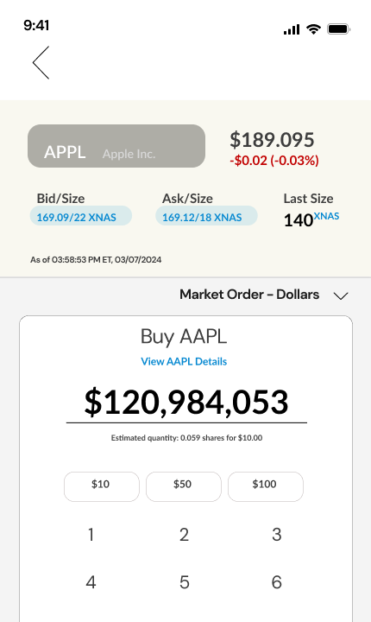
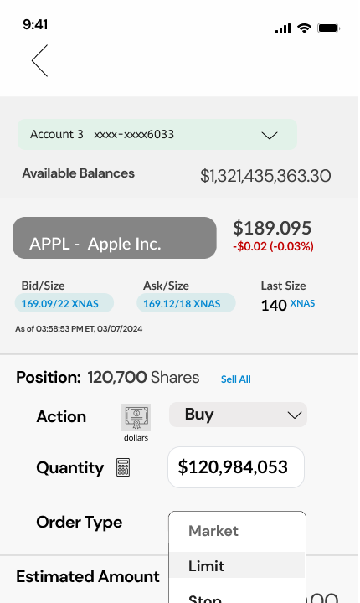
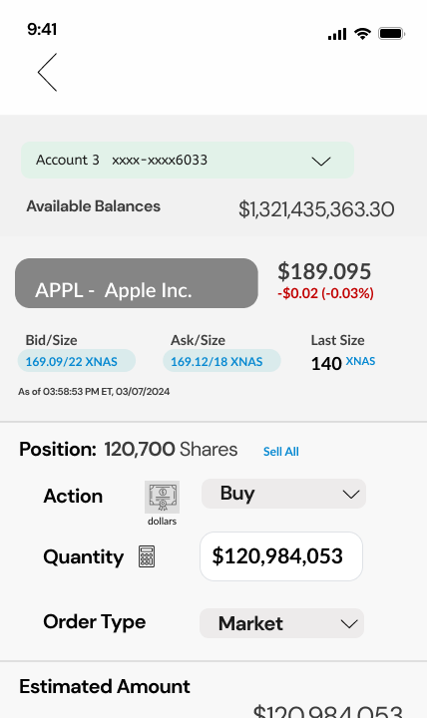
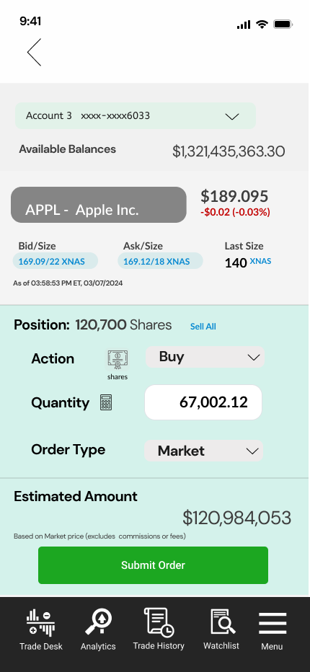
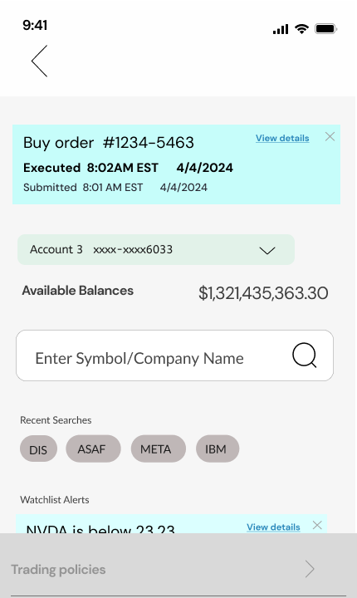
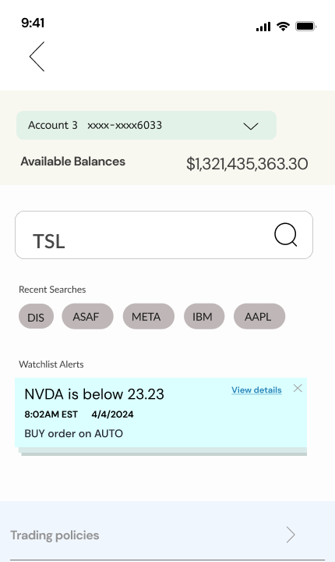
WELLS FARGO TRADE TICKET · DELIVERY
One buy order, on the phone
Account, stock, Buy, a dollar amount on the keypad, order type, review in shares, submit, executed.
01 Accounts home
Pick
02 The ticket
Pick
03 Account menu
Pick
04 Account 3
Pick
05 Search
Pick
06 AAPL
Pick
07 Position, then Buy
Build
08 Keypad
Build
TRY IT
Open the prototype →
Starts at the accounts home
09 Dollar amount
Build
10 Order type
Build
11 Review Order
Review
12 In shares, submit
Review
13 Executed
Status
14 Next trade
Status

Slide 68
WELLS FARGO TRADE TICKET · KEY CALLS
Four calls that shaped the trade ticket.
Shares or dollars in one ticket
Start from what they hold
One toggle switches between trading by share quantity and by dollar amount, instead of two flows.
If a user already holds the asset, they go straight into the ticket with their position shown.
Lists over tabs; fields on demand
Status at a glance
Testers preferred a list view to tabs. Quantity and order sheets appear only when they apply.
Order status changes color as it moves. Testers said seeing the status right away was vital.

Slide 69
WELLS FARGO TRADE TICKET · OUTCOME
Delivered: one ticket for shares or dollars, tested in three rounds.
WHAT SHIPPED
— A single ticket with a shares / dollars toggle
— Held assets go straight into a ticket to buy or sell
— A list view, with quantity and order sheets that appear only when needed
— Order status that changes color as it moves, and every field editable
WHAT TESTING TAUGHT US
— Education matters, but it must never slow a trade down
— Quick amounts and feedback on the share amount build confidence
— Seeing the status right away is vital
— The system keyboard beat a custom one

Slide 70
WELLS FARGO TRADE TICKET · PROTOTYPE
Place one order, in dollars or shares.
14 hi-fi screens of the mobile ticket, linked as in the Figma prototype: pick the account and stock, choose Buy, type a dollar amount, pick the order type, review it in shares, submit, and see it executed.
Open the trade ticket prototype →
Or start at the workflow map →
ALSO AVAILABLE
An offline version with the narrative for every step and a full link map: Trade-Ticket-Prototype.html.
Or open the original Figma design file →

Slide 71

CASE STUDY 04 · B2B DESKTOP · DELIVERED
American Express
MOCA
Increasing revenue by helping advertisers and marketers decide their advertising budgets with AMEX sales partners.
ROLE
Led discovery and all design deliverables
TEAM
Partnered with AMEX data scientists, who built the projection and optimization engines
SCOPE
Wizard, scenario builder and data visualizer for a desktop app
RESULTS
Partner approval 58% → 88%; average client budget $1.34M → $1.8M
“Comparing budgets and then optimizing it would allow me to have the confidence to increase the budget.”

Slide 72
AMEX MOCA · INTRODUCTION
A desktop app that projects a marketer’s budget and compares built and optimized scenarios.
TARGET AUDIENCE
— American Express sales managers
— American Express sales advisors
THE PROBLEMS
— Sales partners had no effective tool for clients to budget their AMEX advertising dollars
— No way to compare scenarios
— No way to understand how well an investment works
— Need for a more customizable, predictive app using nascent AI technology
TEAM AND MY PART
— I partnered with AMEX data scientists, who built the projection and optimization engines; I designed how partners build, compare and trust scenarios
— I managed discovery, including research, strategy and hands-on design
— I led every deliverable in Sketch and Figma, with Lean UX and usability testing

Slide 73
AMEX MOCA · WHY
Why design MOCA?
58%
approval from internal business partners
$1.34M
average client budget, before MOCA
12 min
average time for partners to complete a budget
5.4%
drop-off on the current budget process
Before MOCA: $1.34M
After launch: $1.8M (see Results)

Slide 74
AMEX MOCA · DISCOVERY
We set out to find real user needs, test the business’s assumptions and generate new ideas.
METHODS
— Interviews with internal stakeholders, SMEs and users
— Sales managers and sales advisors
— Contextual interviews
— Persona development
— Co-design sessions with data scientists
PROBLEM STATEMENT
Internal business partners have no tool to help their clients budget AMEX advertising dollars effectively. Users need an application to allocate marketing budgets across the AMEX product lines.

Slide 75
AMEX MOCA · STRATEGY
Pain points + business goals + UX strategy = feature set
+
+
=
PAIN POINTS
Scenario builder
Data visualizer
Comparison
Importing data sets from Excel
Changing each allocation by channel or product
BUSINESS GOALS
Education
Platform parity
Integrated systems
Data
UX STRATEGY
Walk-through wizard
Scenario builder
Data visualizer
Import data sets
Channel and product allocation
Optimization budget tool
FEATURE SET
Walk-through wizard
Scenario builder
Data visualizer
Comparison
Import data sets
Channel and product allocation
Optimization budget tool
Integration with internal systems

Slide 76

AMEX MOCA · DISCOVERY
The journey, distilled into 3 steps
1
Walk-through wizard
Guides users through the budget projection: import data, set dates, adjust each allocation by channel and product.
2
Scenario builder
Build separate scenarios, compare them, and optimize a selected budget using the tool’s business intelligence and data.
3
Data visualizer
Visualizations show how each plan breaks down and how the plans compare.

Slide 77

AMEX MOCA · DESIGN
Experience design sprint: start from a past budget
WHAT WE LEARNED FROM DISCOVERY
— Users wanted to import one budget and keep it as a template for the next
— So a new budget can start from an imported one, by duplicating it

Slide 78
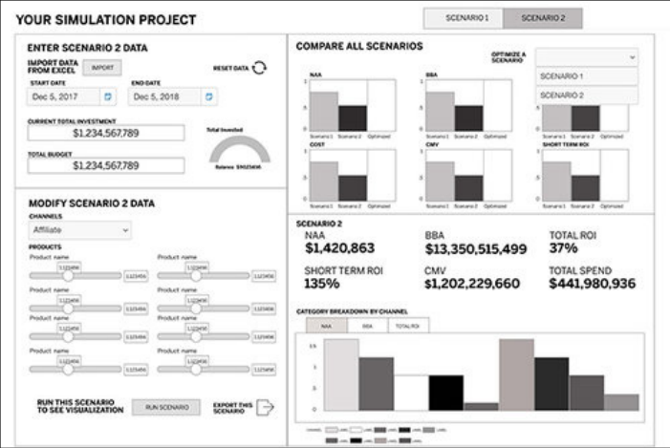
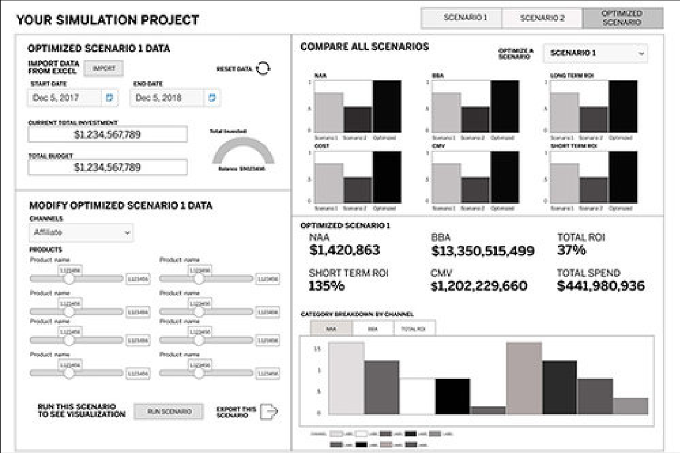

AMEX MOCA · DESIGN
Unexpected challenge: the rest of the desktop
THE CHALLENGE
— As a desktop app, MOCA had to account for the other applications on the desktop
— And how it would connect to them through APIs

Slide 79
AMEX MOCA · DESIGN
Partners want to compare budget scenarios, down to each channel and product.
Users want to see, through data visualizations, how scenarios differ. For a deeper understanding of their allocations, they want to adjust each channel and the products inside it.

Slide 80


AMEX MOCA · DESIGN
Wizard design sprint
A short, efficient wizard for budget details and time frame.
WHAT WE LEARNED FROM RESEARCH
— Partners use the tool only once every 6–12 months, so many needed more structured guidance
— First-time users wanted a friction-free way to start

Slide 81

AMEX MOCA · DESIGN
Scenario comparison design sprint
Testers called the channel breakdown vital, and a game changer.

Slide 82











AMEX MOCA · DELIVERY
One client budget, end to end
Import, the three-step wizard, the ROI projection, then scenarios, the optimizer and the comparison.
01 Import the budget
Wizard · step 1
02 File imported
Wizard · step 1
03 Time period
Wizard · step 2
04 Dates set
Wizard · step 2
05 Allocations
Wizard · step 3
06 Shift and watch the gauge
Wizard · step 3
07 ROI projection
Results
08 Scenario workspace
Scenarios
09 Second scenario
Scenarios
10 Optimized, still editable
Scenarios
TRY IT
Open the prototype →
Starts at the import step
11 Compare all three
Comparison

Slide 83
AMEX MOCA · KEY CALLS
Four calls that shaped MOCA.
A wizard, because use is rare
Start from last year’s budget
Partners plan once every 6–12 months, so a guided wizard walks them through each parameter.
Users import a budget and duplicate it as the template for the next one.
Allocate down to channel and product
Compare scenarios side by side
Allocations go down to product line or channel, so partners see which part of the budget works.
Scenarios are compared visually with switchable chart types; testers called the channel breakdown a game changer.

Slide 84
AMEX MOCA · RESULTS
Partner approval rose from 58% to 88%, and budgets grew.
88%
$1.8M
3.4%
average client budget
drop-off on the budget process
approval from internal business partners
Up from $1.34M · +34%
Down from 5.4%
10 min
5 min
to complete a budget
to compare budget scenarios
Before MOCA: 58%
After: 88% (+30 pts)
Down from 12 min
A new capability

Slide 85
AMEX MOCA · PROTOTYPE
Build, project and compare a client budget.
11 hi-fi screens linked in order: import the client’s budget, set the period, shape the allocations, see the ROI projection, then add, optimize and compare scenarios.
Open the MOCA prototype →
Or start at the workflow map →
ALSO AVAILABLE
An offline version with the narrative for every step and a full link map: MOCA-Budget-Prototype.html.

Slide 86
MORE WORK
More work, on request.
PROJECT
WHAT IT IS
Wells Fargo mySMALLBUSINESS
A B2B mobile app that helps small business owners track spending and plan
Meridian Navigator
An AI trading prototype built in SwiftUI, with a design system shared with Figma
Show It
A live prototype of FinViz’s hero mechanic, with an eval that scores the AI
Full archived case studies at michaeljthibodeau.com

Slide 87
CONTACT
Let’s talk about your next AI product.
michaelthibodea(UX)
michaelthbd@yahoo.com
646 436 2876
michaeljthibodeau.com

