Slide 1


End-to-end design process, including Design Thinking and AI-supported methods, for a trading experience that serves a
wide variety of Wells Fargo customers and gives them an easier way to trade
Wells Fargo
Integrated Trade Ticket
Helping Wells Fargo increase revenue by allowing
users to transact by share or dollar amount
“It’s a confusing interface, the app’s interface
is non-intuitive, making it difficult to navigate
and find specific functions or features. This
extends to both basic banking functions and
the stock trading capabilities.”

Slide 2
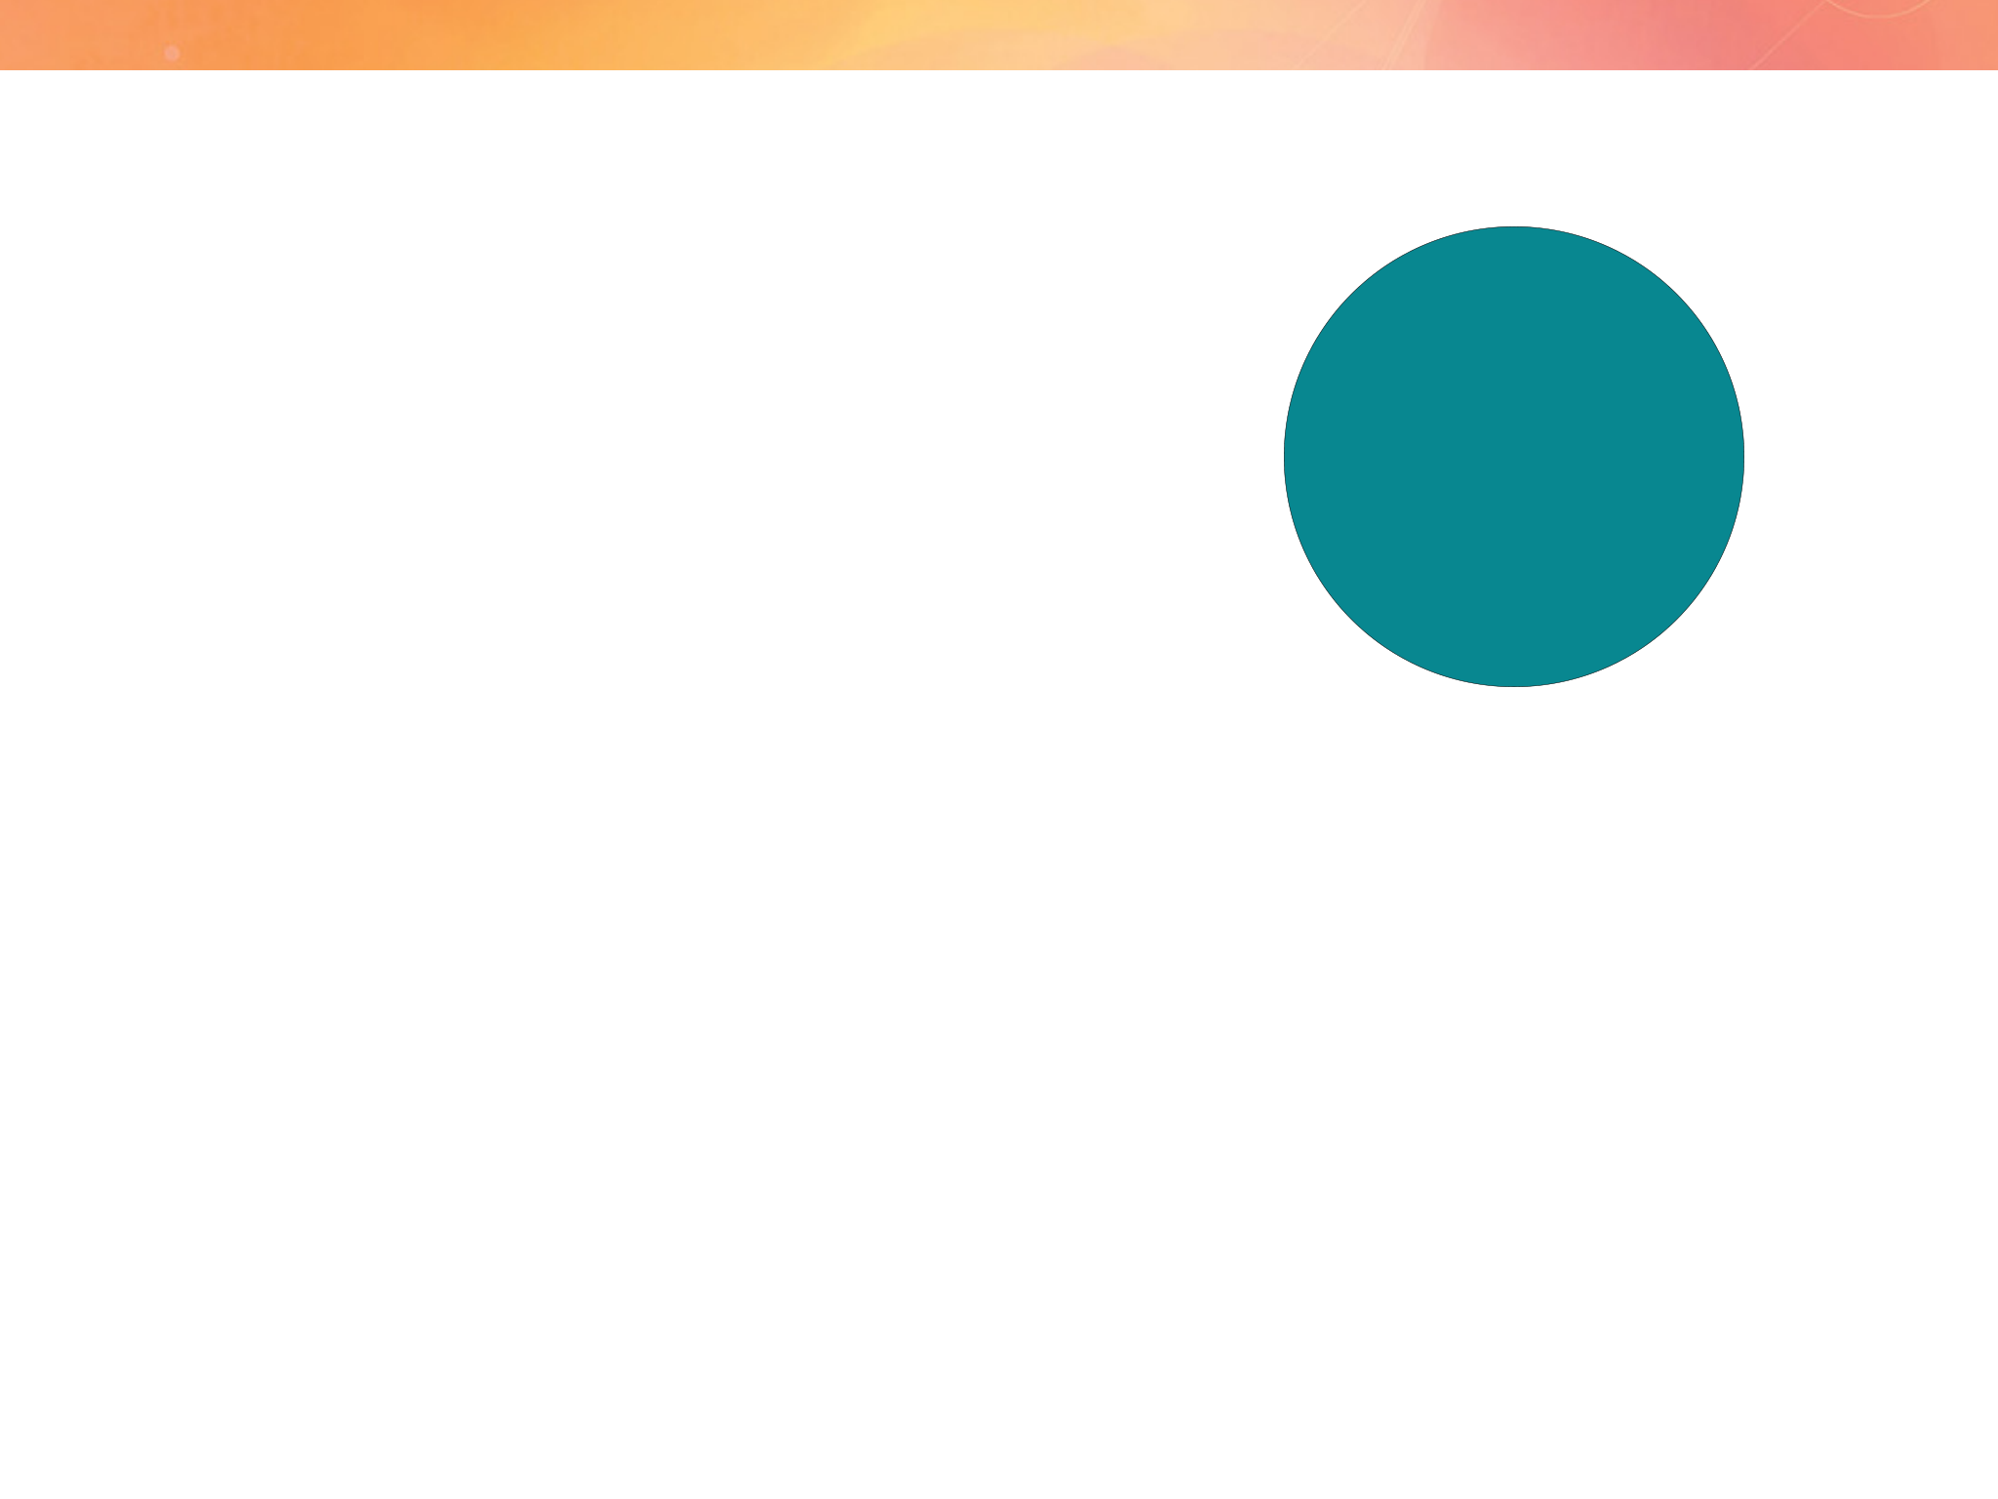
Introduction Wells Fargo Integrated Trade Ticket
What’s the Integrated Trade Ticket?
Target audience
An integrated trade platform that simplifies the trading
• Experienced consumer
process, reduces the likelihood of errors, and enhances
traders
overall efficiency, while giving users the ability to trade in
• Novice consumer
shares or dollar amounts and all the needs they have for
traders
self-directed trading.
The problems
My Role
• WIM investors don’t have a way to trade in both shares and
• I led the project team utilizing the support of 2
dollars
UX designers.
• I was responsible for managing the discovery process, including research, strategy and overall hands-on design of the material and artifacts, supported by AI applications.
• Needing a trade ticket that simplifies the current trading process in the native mobile app
• Confusing Interface
• I led the work on all deliverables and artifacts in Figma using Lean UX and usability testing, presenting these to the client and key stakeholders.
• Limited Functionality
• Technical Issues
• Lack of Real-Time Updates
• Poor Customer Support

Slide 3

Discovery & Research Wells Fargo Integrated Trade Ticket
Why redesign the Trade Ticket?
18.3%
of users request
trading both shares and dollars
8.2 mins
Transaction Time: The time taken for a new user to complete their first trade.
1.4%
Error rate on submissions
6.1%
drop-off on trades executed through the mobile app
“The app lacks advanced features like drawing tools or technical indicators. Customer support options are limited, with no chat
support available.”

Slide 4

Because of the KPIs assembled, the assumptions of the business partners, and feedback from users based on help requests we determined we needed to use methods to identify user needs, validate existing assumptions, and generate new ideas.
Discovery
• Interviews with primary external users,
Problem statement
internal stakeholders, and SMEs
As the most important part of the trading experience, experienced and novice users need an integrated trade ticket that simplifies the trading process, reduces the likelihood of errors, and enhances overall efficiency, while giving users the ability to trade in shares or dollar amounts.
• Experienced Traders
• Novice Traders
• Persona development
• Google Design Thinking Exercises
• Competitive Analysis

Slide 5

Design Patterns
Education and NUX: Effective onboarding through upfront and contextual education, using examples like Duolingo and DOT.
Enabling Experimentation: Allowing users to preview, undo, and retrace steps for enhanced control.
Contextual UI: Strategies like inline actions, side panels, and quick actions to offer users more control.
Feedback Mechanisms: Implementing thumbs-up/down ratings and regeneration options for better AI refinement.
Addressing the Cold Start Problem: Solutions like icebreakers, templates, and guided input to help users get started.
Providing Controls: Offering users tools like source verification, image editing, and content manipulation for more control over AI outputs.
Continued Guidance: Providing suggested prompts and contextual assistance to keep users engaged.
Transparency: Ensuring trust by watermarking AI content, labeling generated text, and clarifying data usage.
Personalization: Customizing user experiences through memory, suggestions, and personal input options.
Voice and Streaming: Exploring voice interactions and message streaming patterns to create seamless experiences.

Slide 6
Discovery & Research Wells Fargo Integrated Trade Ticket
Interviews: Experienced and novice traders
I led the interviews of users with more experience trading and less experienced traders. Experienced investors can
average anywhere from 20 to over 1,000 trades per year depending on their trading style; inexperienced investors
typically make fewer trades, ranging from 10 to 100 per year.
Some common complaints include:
Confusing Interface
Many users find the app’s interface non-intuitive, making it difficult to navigate and find specific functions or features.
Lack of Real-Time Updates
Some users have complained about delays in real-time updates for stock prices and portfolio values, which can be critical for making timely trading decisions.
Limited Functionality
Several users have expressed frustration with the limited features available in the trading section of the app. For example, some noted that important functionalities like detailed transaction histories or useful budgeting and spending tools are either buried under unclear tabs or entirely absent.
Poor Customer Support
Dissatisfaction with customer service is another common theme. Users have mentioned that getting support through the app is challenging, and responses to issues are often slow or unhelpful.
Technical Issues
There are reports of the app experiencing technical problems during peak trading times, which can delay access and execution of trades. This unreliability during high-demand periods is a significant drawback for active traders.

Slide 7

Discovery & Research Wells Fargo Integrated Trade Ticket
Pain points we heard from the interviews
1 Can’t trade in both shares and dollar amounts using the mobile platform
2 Several interfaces aren’t intuitive
3 Need more of the right detailed trade information
4 Flexibility needs to be improved
5 More trading options
6 Speed
7 Mobile native
“...the app’s interface is so non-intuitive, it makes
it hard to navigate, find specific functions and
just make a quick trade”

Slide 8
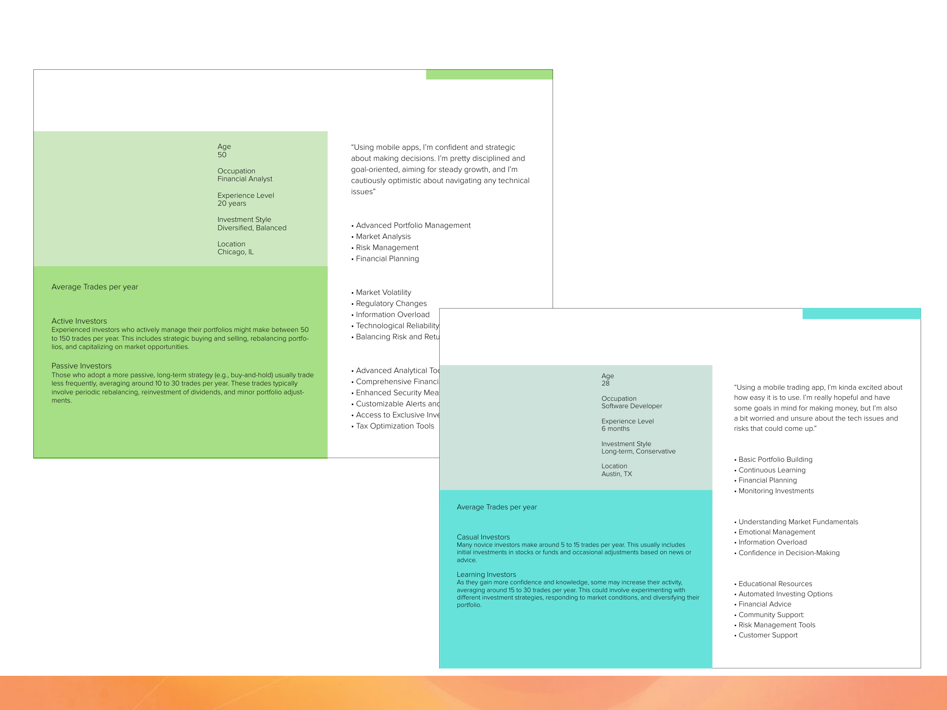


Discovery & Research Wells Fargo Integrated Trade Ticket
Experienced Investor
Jordan
Sentiments
Responsibilities
Key Challenges and Areas of Concern
20 to over 1,000 trades
Novice Investor
Taylor
Wishlist of Features
Sentiments
Responsibilities
10 to 100
Key Challenges and Areas of Concern
Wishlist of Features

Slide 9

Discovery & Research Wells Fargo Integrated Trade Ticket
Pain Points + Business Goals + UX Strategy = Feature Set
UX Strategy
Pain Points
Business Goals
Feature Set
• Can’t trade in both shares
• Speed
• Simplified Interface
• Order Entry
and dollar
• Education
• Dynamic Functionality
• Execution Management
• Interfaces aren’t intuitive
• Platform parity
• Trade speed
• Real-time Monitoring
• Need more of the right detailed trade information
• Integrated systems
• Real-Time Updates
+
• Risk Management
=
+
• Post-trade Processing
• Data
• Integration with Other
• Flexibility
Systems
• More trading options
• Shares vs. dollars
• Transaction speed
• Analytics and Reporting
• Mobile native

Slide 10
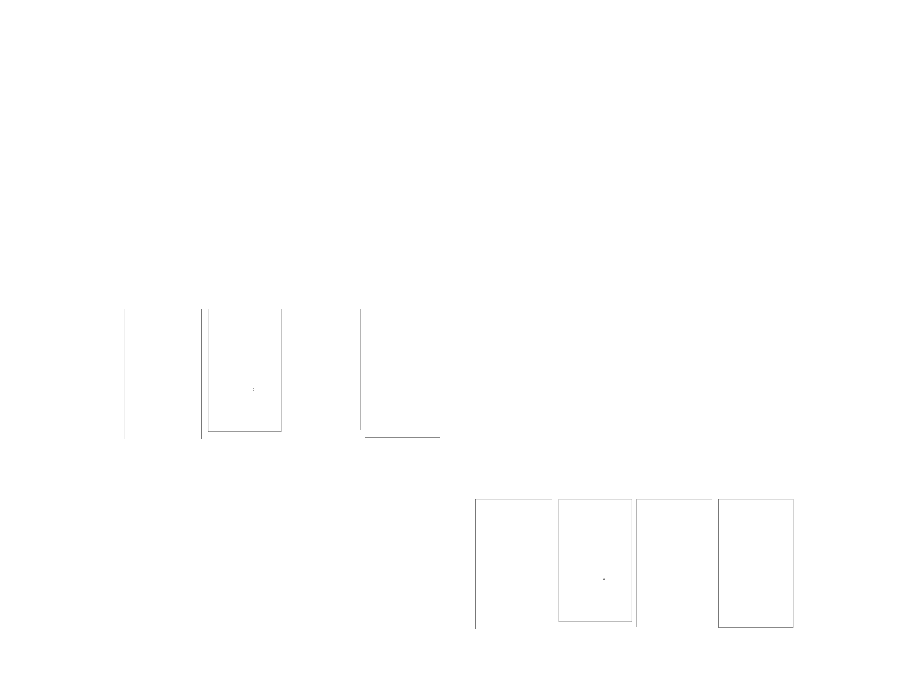












Discovery & Research Wells Fargo Integrated Trade Ticket
Competitive Analysis
Robinhood
• Shares and Dollar-Based Trading
Robinhood allows users to trade both whole shares and fractional shares in dollar amounts, making it accessible for investors with varying budget sizes.
• User-Friendly Interface
The app’s interface is simple and intuitive, making it easy to switch between trading shares and dollar amounts. Trade tickets display all necessary details, including stock name, order type, quantity, and estimated cost.
• Instant Notifications
Users receive immediate in-app notifications once a trade is executed, providing details of the trade.
Fidelity Mobile App
• Flexible Trading Options
Fidelity’s mobile app supports trading in both shares and dollar amounts, offering fractional shares for a wide range of stocks and ETFs.
• Comprehensive Trade Tickets
The app provides detailed trade tickets that include the stock symbol, order type, quantity, price, and execution time. Users can easily switch between dollar-based and share-based trades.
• Easy Navigation
The app is designed for ease of use, ensuring that placing trades and reviewing tickets is straightforward.
Charles Schwab Mobile
• Fractional Shares
Charles Schwab’s mobile app allows users to trade fractional shares through its Stock Slices feature, enabling investments in dollar amounts as low as $5.
• Detailed Trade Tickets
The app provides clear and comprehensive trade tickets, showing all necessary information such as stock symbol, order type, quantity, and price.
• Intuitive Design
The app’s interface is user-friendly, making it easy to place trades and review transaction history.

Slide 11

Design
• 6 Agile-based sprints
• Usability testing on weekly cadence
• Demos and QA
The Delivered Solution
Order Entry
Allows traders to enter orders quickly and efficiently, specifying details such as asset type, quantity, price, and order type (market, limit, stop, etc.).
Real-time Monitoring
Provides real-time updates on market conditions, order status, and trade confirmations. This helps traders to make informed decisions and adjust their strategies as needed.
Post-trade Processing
Streamlines the post-trade process by handling settlement, clearing, and reconciliation. This ensures that trades are correctly recorded and settled in a timely manner.
Analytics and Reporting
Provides analytical tools and reporting features to help
traders review performance, analyze trends, and generate reports for regulatory or internal purposes.
Execution Management
Facilitates the execution of trades across various exchanges and trading venues. It ensures that orders are routed correctly and executed at the best possible prices.
Risk Management
Includes tools to assess and manage the risk associated with trades. This might involve setting limits on positions,
monitoring exposure, and ensuring compliance with regulatory requirements.
Integration with Other Systems
Connects with other trading and back-office systems, such as portfolio management systems, compliance tools, and accounting systems. This integration helps in maintaining consistency and accuracy across all stages of the trading process.

Slide 12
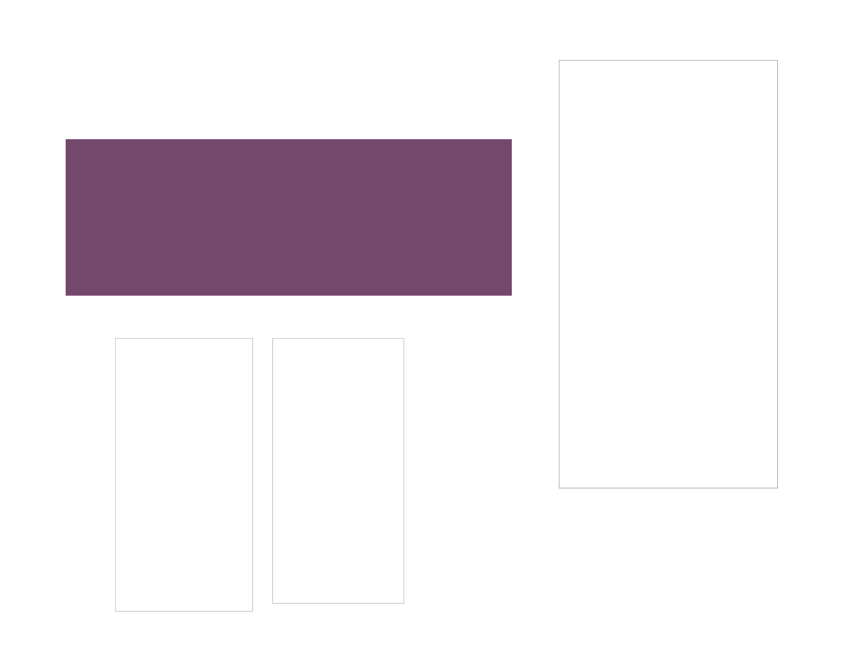
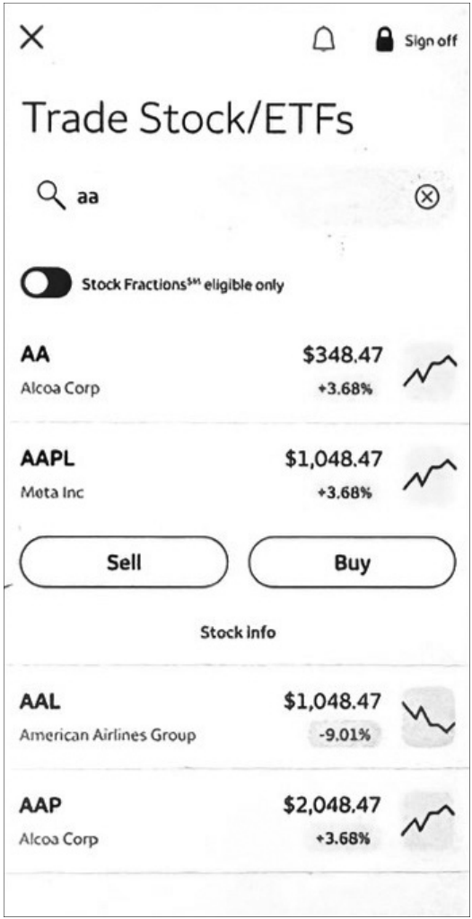
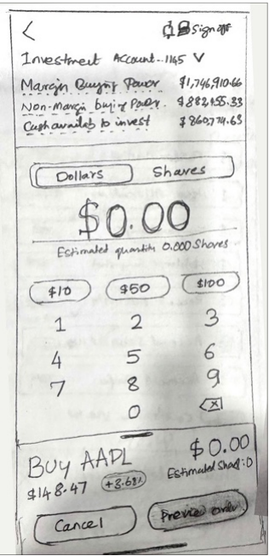
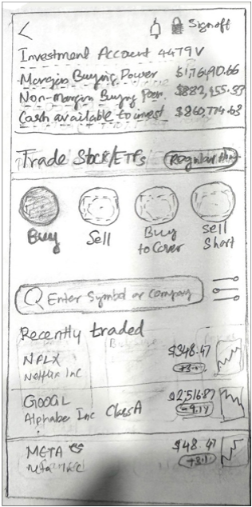
Design Wells Fargo Integrated Trade Ticket
Trade Ticket Experience Design Sprint
• Users can switch accounts
• Users have view of balances and the stock details in a
concise configuration
• If they have a position the system provides their holdings
• Users can switch between shares and dollars
in a centralized place
“While the app is functional for basic trading, it falls short for those seeking more sophisticated
trading tools and resources.”

Slide 13
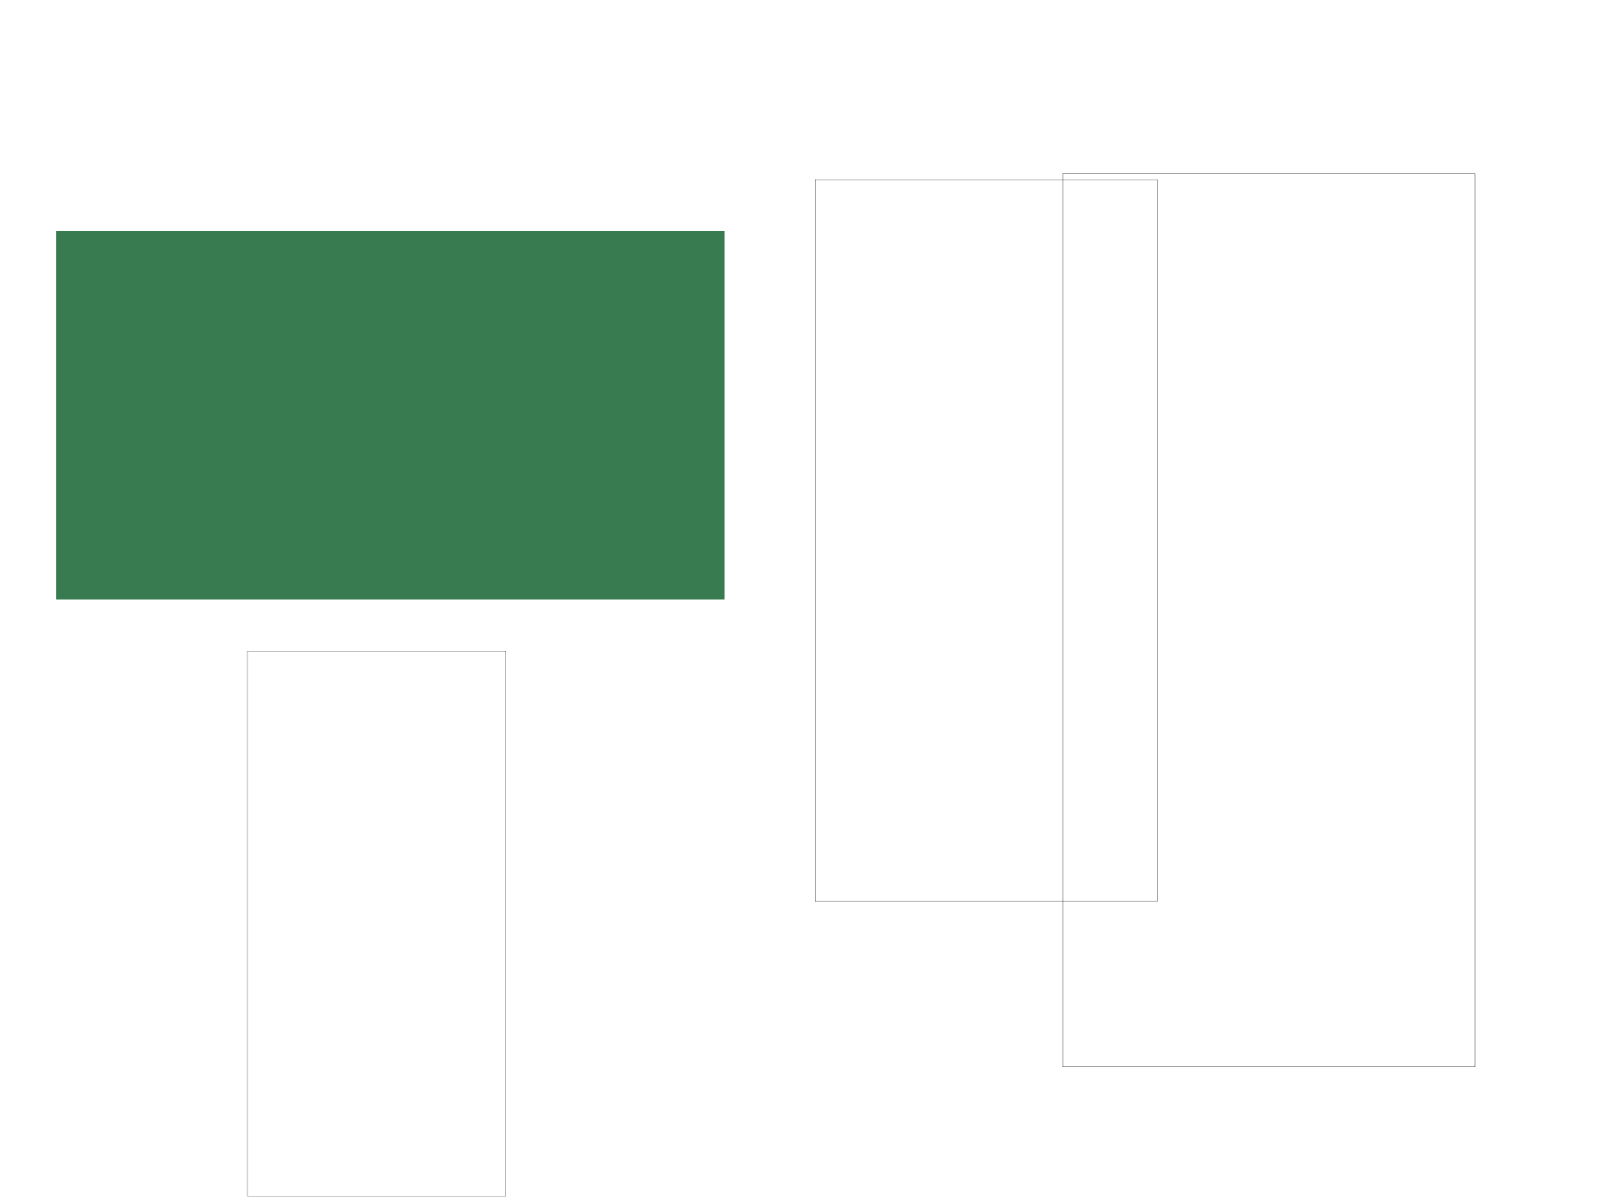
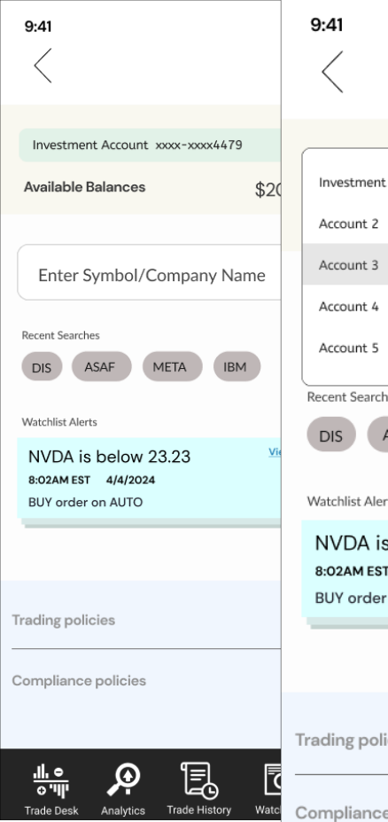


Design Wells Fargo Integrated Trade Ticket
Trade Ticket Experience Design Sprint
What we learned from discovery and design thinking
• Ability to switch accounts would support the
majority of experienced traders and 60% of novice users and support new navigation for mobile native
• Dark mode is important

Slide 14
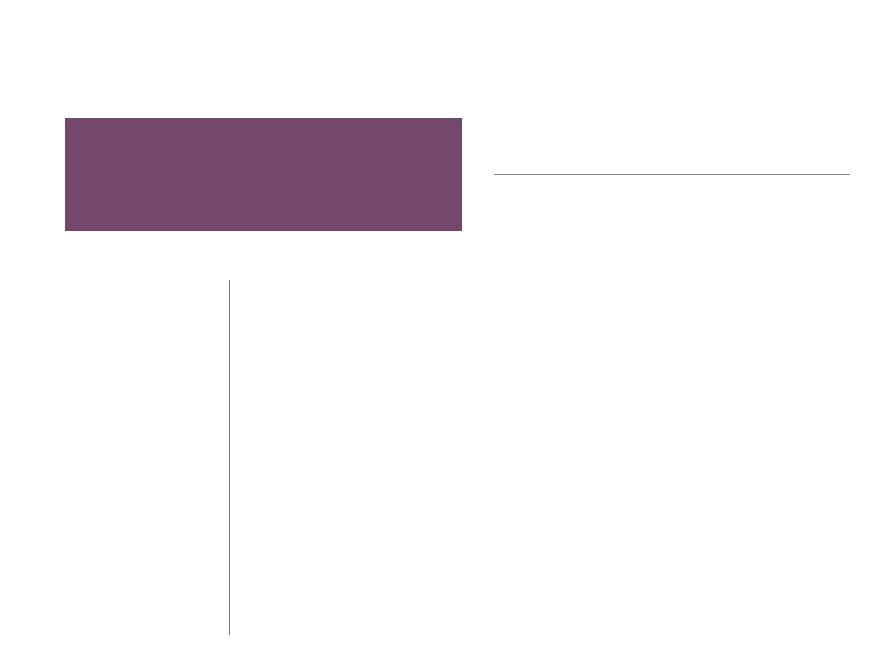


Design Wells Fargo Integrated Trade Ticket
Trade Ticket Experience Design Sprint
• Asset is held already, so the user is driven right
into the funnel
• User can immediately toggle between selling
by dollar amount vs. shares
First iteration
If a user holds an asset they’re
driven right into an interface to buy
or sell. Next to Actions is the icon
to change shares vs. dollars. As
a predictive interface, users are
never burdened with too many
choices, only the appropriate
ones.

Slide 15
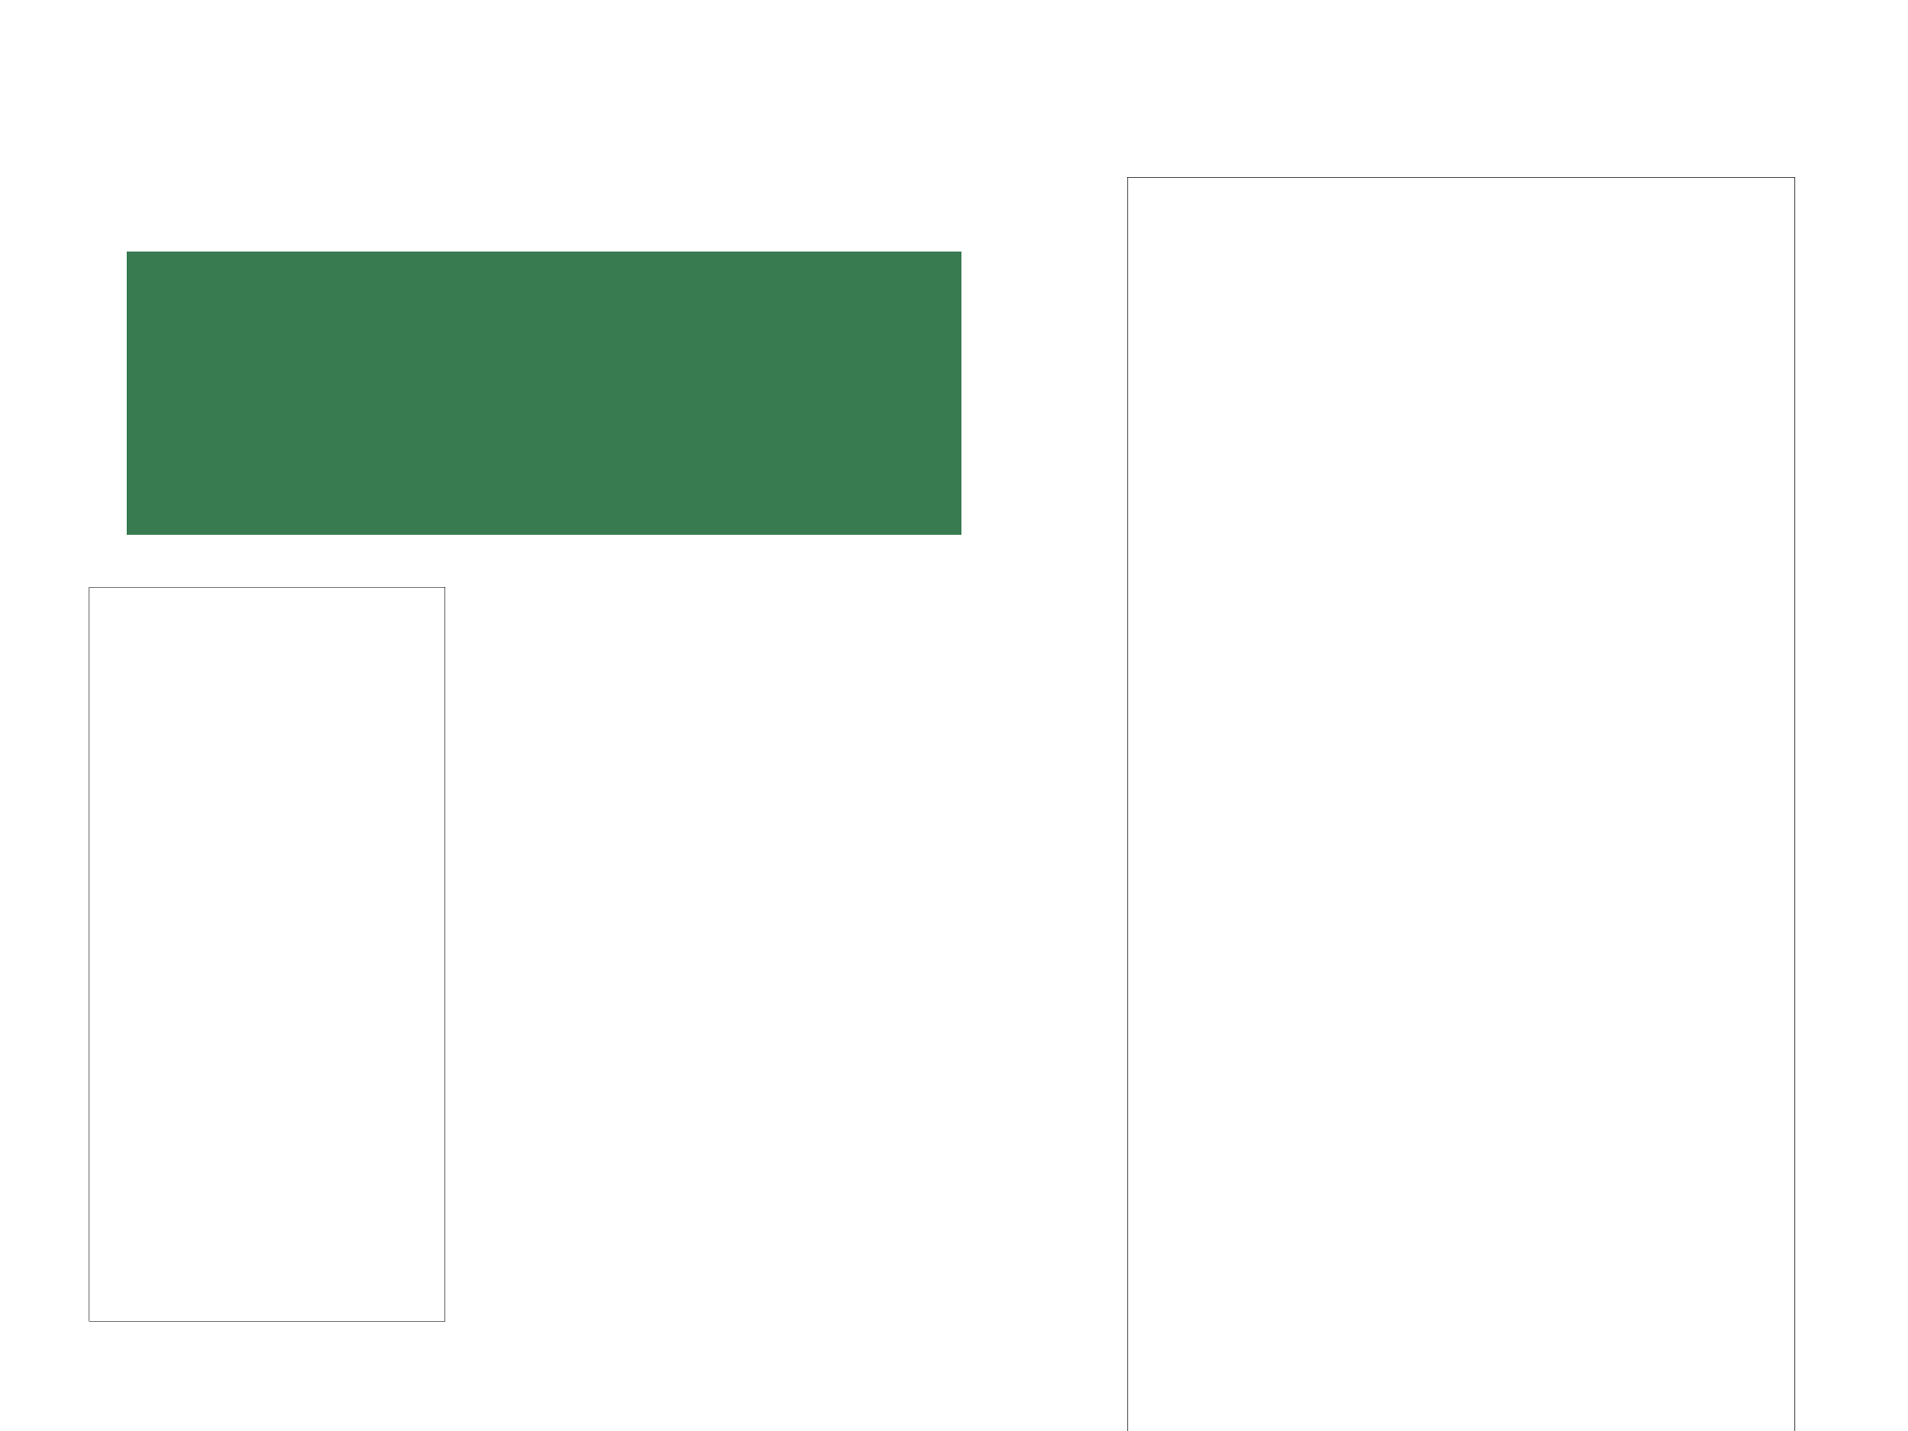


Design Wells Fargo Integrated Trade Ticket
Trade Ticket Experience Design Sprint
What we learned in the testing
• Education was a priority for all users, but
shouldn’t distract nor impede progress
• Trading in quick amounts is good
• Feedback on share amount valuable as well
We designed an interface that was flexible,
allowed vision into details of a stock and
information into the holding itself.
Using a custom keyboard was part of several iterations, but was replaced by the system keyboard.
Second iteration
Third iteration

Slide 16
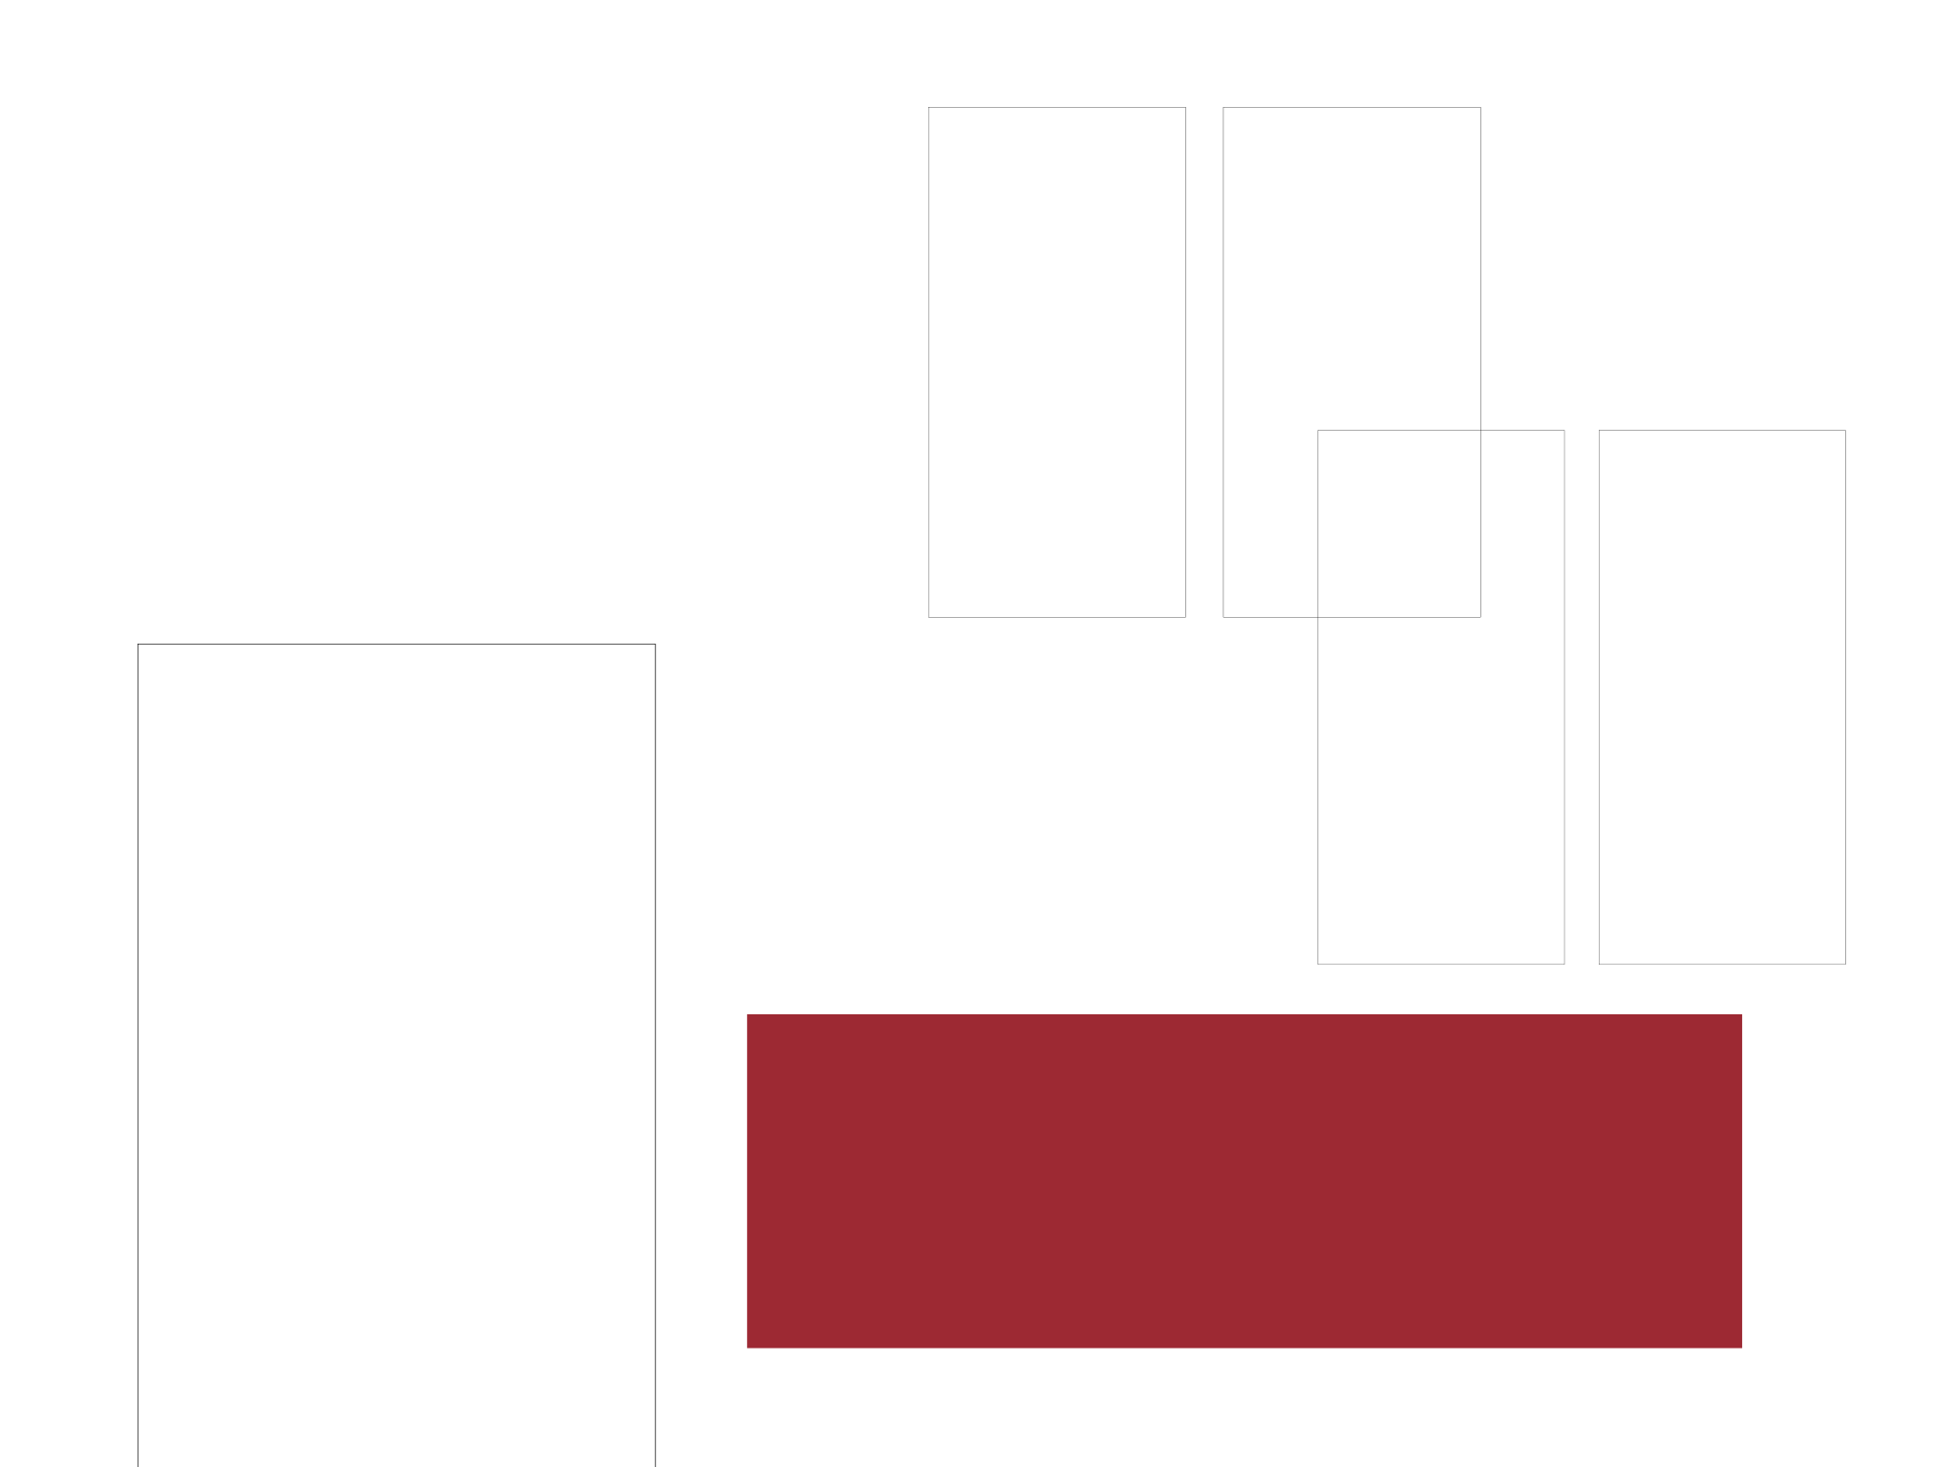





Design Wells Fargo Integrated Trade Ticket
Trade Ticket Experience Design Sprint
We designed an interface that drove users to be allowed
to see all the variations or Order Types regardless of
shares vs. dollars. We tested 2 variations, one as a list
view and another with tabs.
Test version 1
Test version 2
What we learned in testing
• Tabs vs. list view: people preferred “list view”
• The icon position next to “Action” scored high
• Conditional appearance of Quantity and Order sheets
makes sense to many

Slide 17
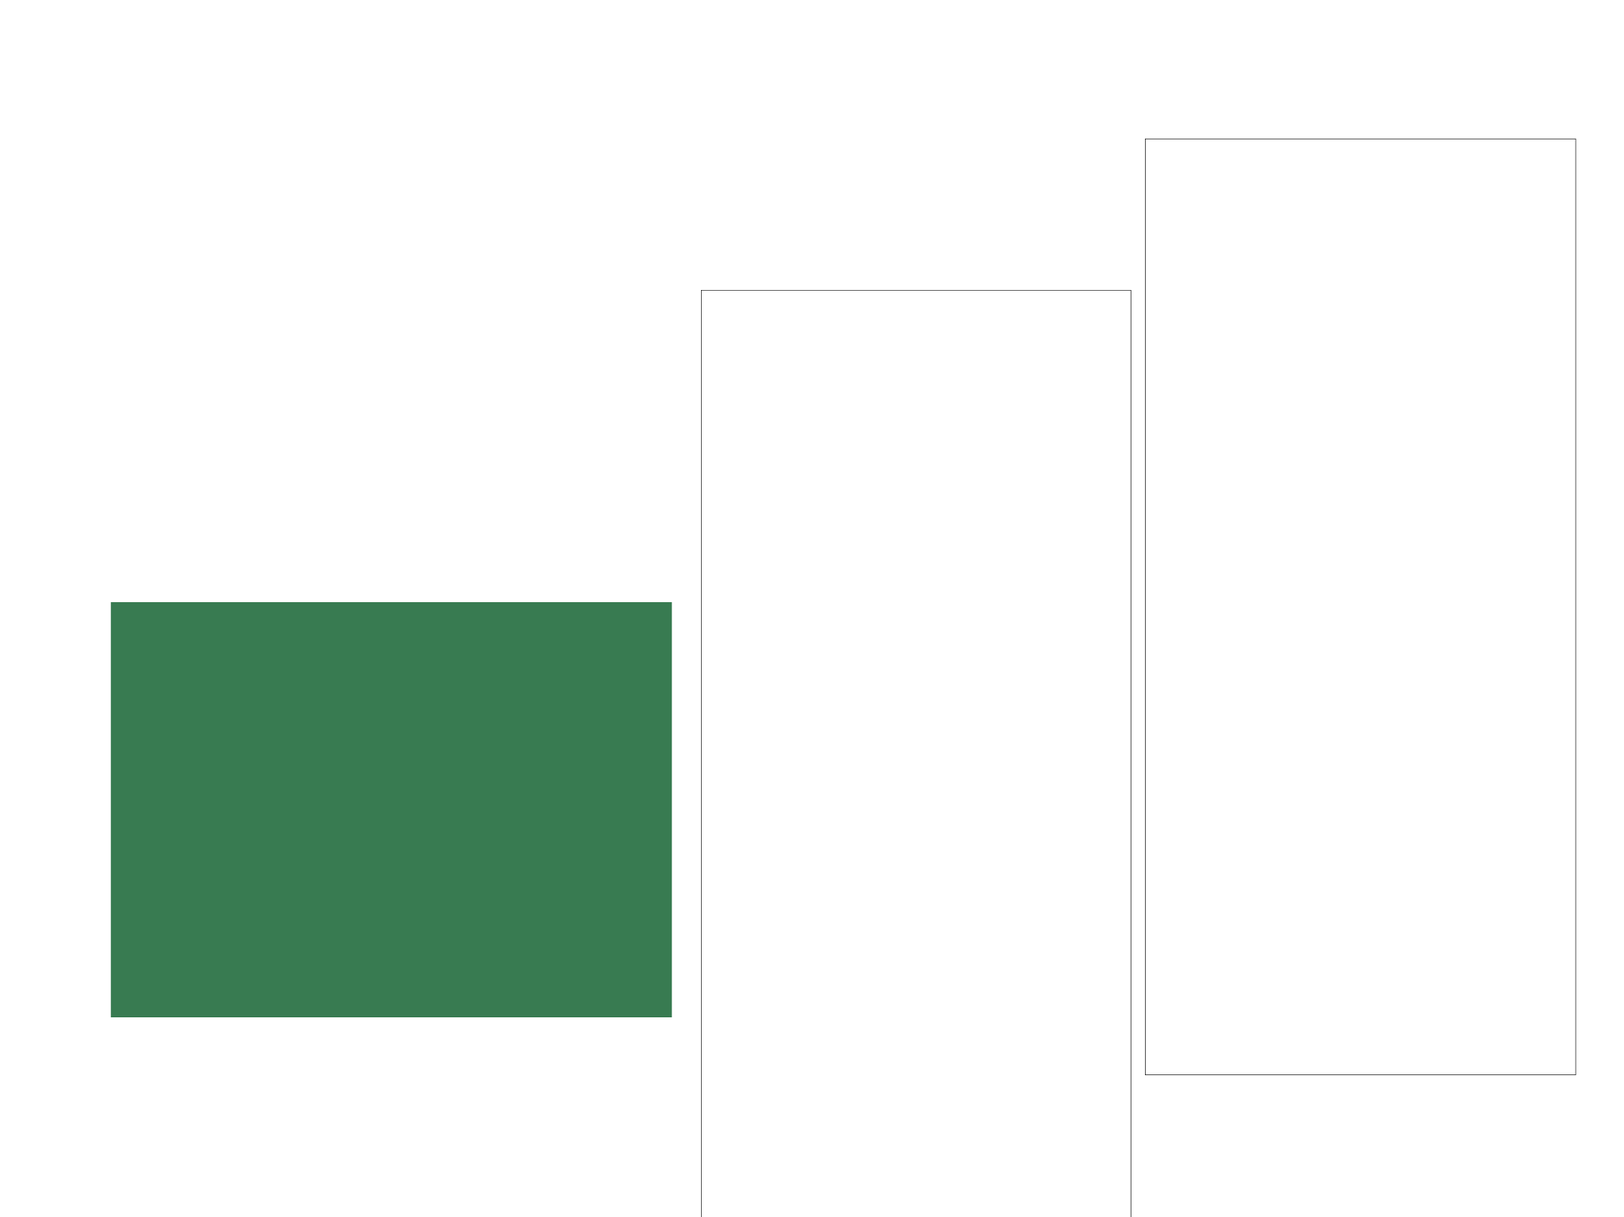


Design Wells Fargo Integrated Trade Ticket
Trade Ticket Experience Design Sprint
If a user needs to edit the order ticket all
the fields are available for editing.
What we learned in the testing
• Order types are variable
• Change of color and status give users idea of change in status and process
• Status immediacy is vital
• Cleaner interface
• Ability to quickly transact
• Watchlist alerts actionable
Final delivered solution

Slide 18
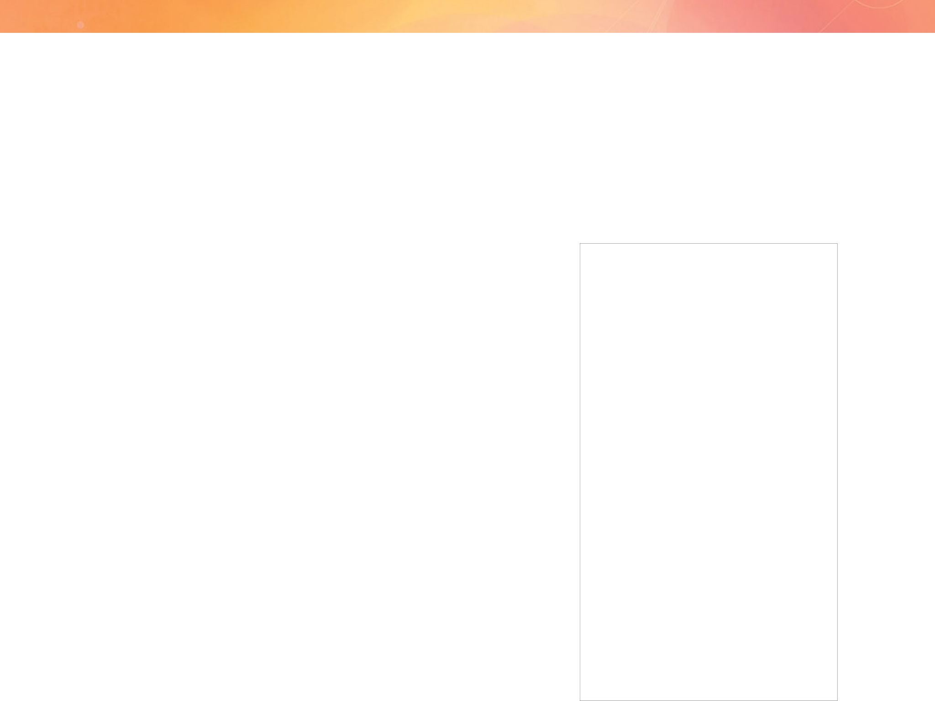
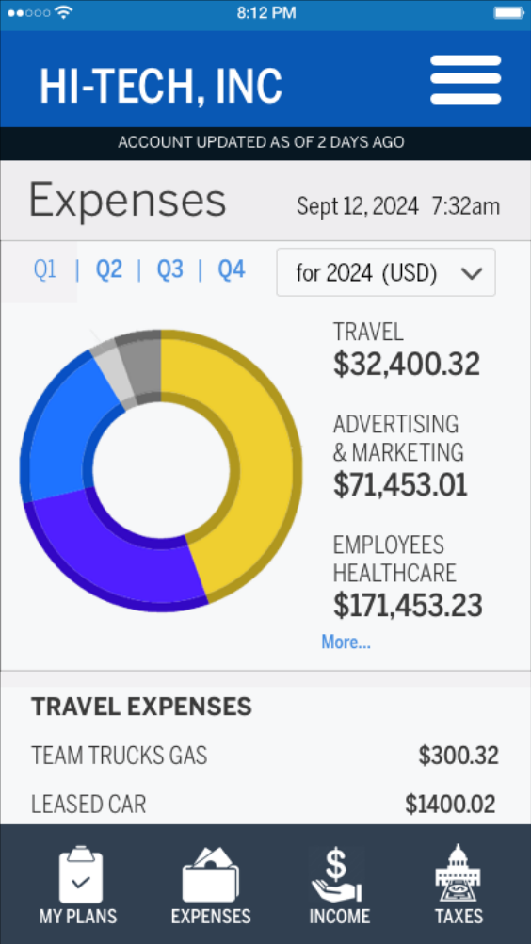
End-to-end design process, including Design Thinking for a B2B small business management mobile application
Wells Fargo
mySMALLBUSINESS
Helping Wells Fargo small business owners save money by reducing inefficiency, educating themselves on optimizing their businesses and removing risk vulnerability in their operations
“I have too much to do, and I’m on the road all the time, so a mobile app
would be awesome”

Slide 19
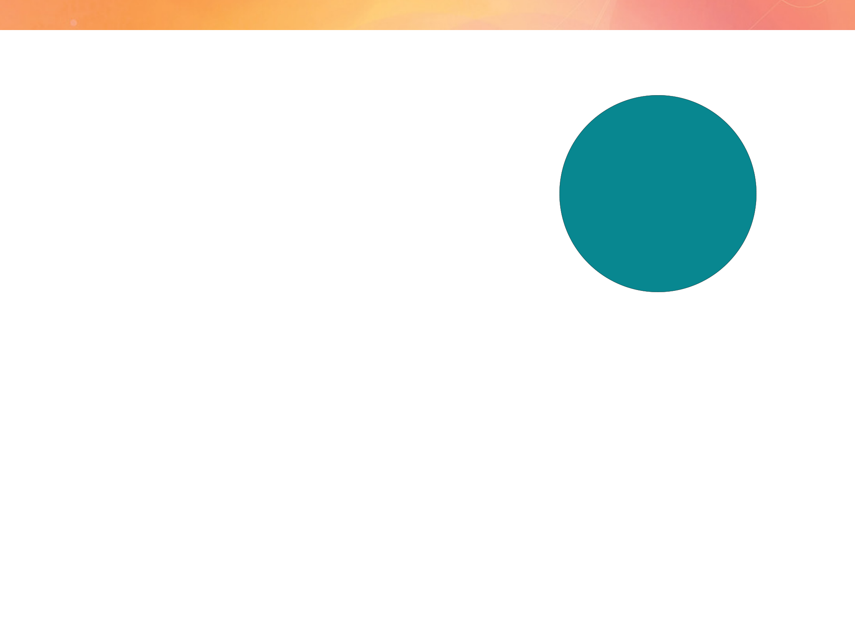
Introduction Wells Fargo mySMALLBUSINESS
Target audience
What’s mySMALLBUSINESS?
• Small Business
Owners
An AI-supported guidance-based application that allows small business owners to monitor and track spending and expenses, optimize business plans and if needed, be educated on the subject of small business finances and business operation.
• Admin support
The problems
My Role
Small business owners who are also bank customers don’t have a dedicated integrated mobile application to better understand their business finances. They need to account for their spending, track business expenses, set budgetary plans and goals, and view their quarterly budgets.
• I led the project team utilizing the support of 2
UX designers.
• I was responsible for managing the discovery process,
including research, strategy and overall hands-on design
of the material and artifacts.
• I led the work on all deliverables and artifacts in Figma
using Lean UX and usability testing, presenting these to
the client and key stakeholders.

Slide 20

How we worked with data scientists using AI
Identifying User Needs and Behavior
Enhancing Data Visualization
• UX Designers: Used AI tools to analyze user behavior,
• UX Designers: Focused on the usability and aesthetic
preferences, and feedback. AI-driven sentiment analysis on user reviews provided insights into user satisfaction and pain points.
aspects of data visualizations, ensuring they were intuitive and engaging for users.
• Data Scientists: Used AI to generate dynamic and
• Data Scientists: Applied machine learning algorithms to
interactive visualizations.
analyze large datasets and uncover patterns or trends that informed UX design.
Improving User Interactions
Designing Personalized Experiences
• UX Designers: Implemented AI-driven virtual assistants
to enhance user interactions and support.
• UX Designers: Worked with AI to create personalized
• Data Scientists: Developed and trained AI models for
user experiences. Used AI to tailor content,
recommendations, interfaces based on individual user preferences.
natural language processing, and other interactive features.
• Data Scientists: Developed personalization models
that feed into UX design. They provided the data and insights necessary for creating these personalized experiences.

Slide 21

Business goals
KPIs
The small business application will see an increase in adoption, use, efficiency of users actions, speed in planning and setting goals, as well as the continual improvement in sales of Wells Fargo for Business products. The increase in usage, education regarding business budgetary planning, increase in sales of supplemental Wells Fargo for Business Products will all add to the net income for the company.
• adoption rate
• usage time
• time on task especially primary tasks
• continual improvement in sales
• increase in use of education regarding business budgetary planning
• increase in sales of supplemental Wells Fargo for Business Products will all add to the net income for the company.

Slide 22
Because of the KPIs assembled, the assumptions of the business partners, and feedback from users based on help requests we determined we needed to use methods to identify user needs, explore new opportunities, validate existing assumptions, and generate new ideas.
Discovery
• Interviews with external users
• Small business owners
• Support staff
• Persona development
• Design Thinking Exercises
Problem statement
Small business owners don’t have a place to monitor their spending, track expenses, set budgetary goals, and view their current budget plans. They will achieve their goal of better understanding of their small business finances through use of this mobile application.

Slide 23

Discovery & Research Wells Fargo mySMALLBUSINESS
Pain points we heard from the interviews
1 Can’t track expenses
2 Limited planning methods
3 Need Photo Receipt and Check Capture functionality
4 Auto bill pay, expense and spending overrun alerts and contingencies
5 No automation of processes
6 Limited status updates
7 Limited up-sell to new Wells Fargo products
“I’d like to have a better understanding of my
spending, and easily be able to track my expenses. Being able to set goals would be even
better, and view my budgets anytime.”

Slide 24
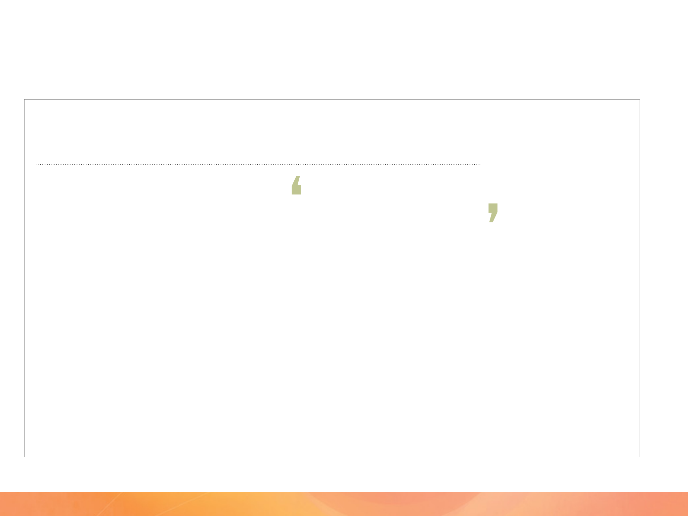

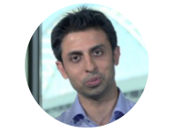

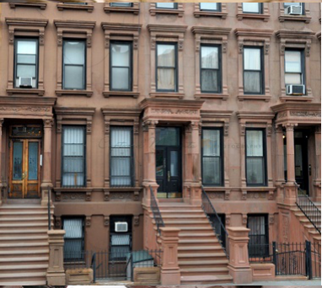

Discovery & Research Wells Fargo mySMALLBUSINESS
Small Business Owner Persona
Small BizOwner Power User
Kunal Power User
General Contractor and Technophile
12 years as a General Contracting small business owner, wants to grow and expand HI-TECH, INC
I spend most of my time trying to understand my finances, trying to track my expenses, I don’t have enough time to plan, or even put out the financial fires, let alone find new ways to save, or connect with other owners and find new products to help me expand.
Pain points in current system
• No spending tracking
Tasks in role
• Find leads, meet leads
• No single place to see current business plans and goals
• No alerts system when a bill is past due or not paid
• Make proposals for new jobs
• Manage crews on jobs
• No place to optimize business budget plan
• Build timelines for projects
• No place for planning and monitoring budgets
• No way to understand and build business for the future
• Budget expenses for work
• Business expenses, general upkeep
• Fractured touch points, no single space for all activities
• Promotion of business
• Research on new opportunities
Expectations of System
• Be able to monitor specific spending
• Get predictive recommendations and alerts
Tools for Tasks
• Optimize current Budgets
• Aid Expansion of business
• Freshbooks
• Square (POS)
• Share, socialize, communicate about the Small Businesses
• MailChimp, SurveyMonkey
• ZipRecruiter
• LegalZoom
• Social Networking sites, i.e., Instagram, Yelp, Facebook
• Squarespace

Slide 25
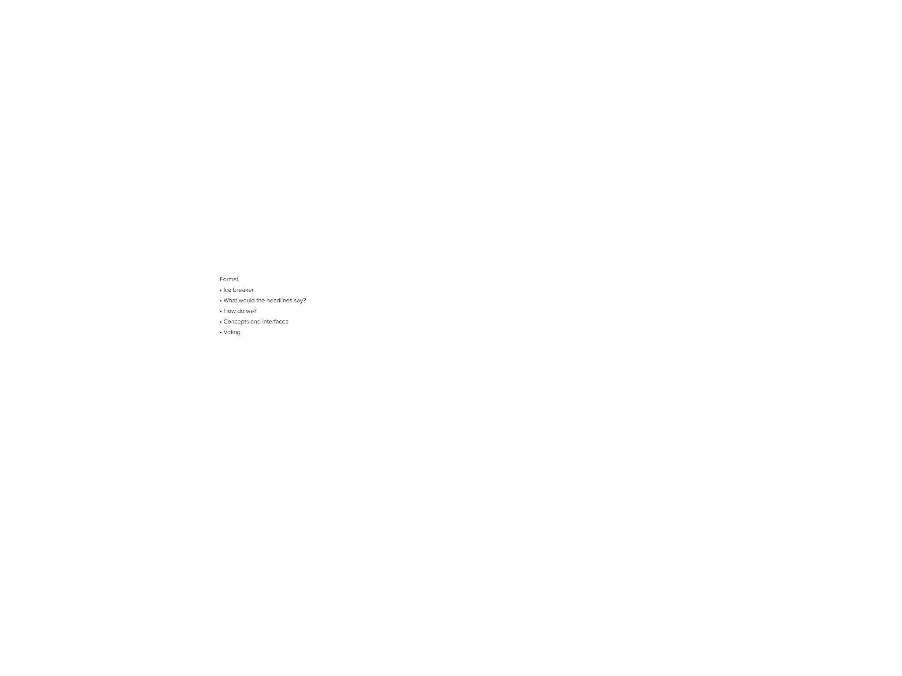
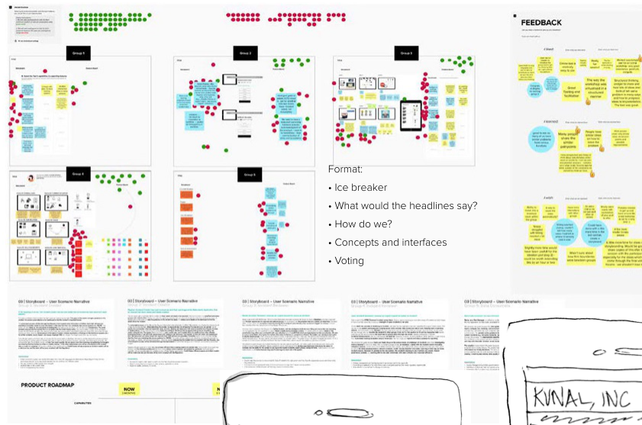
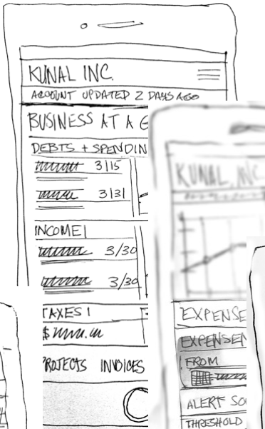
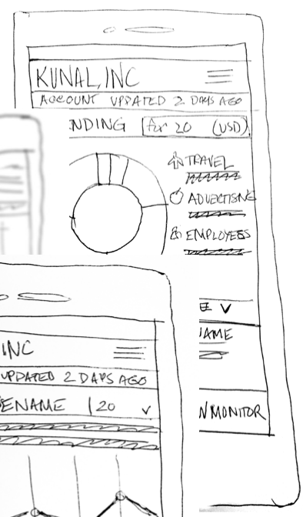
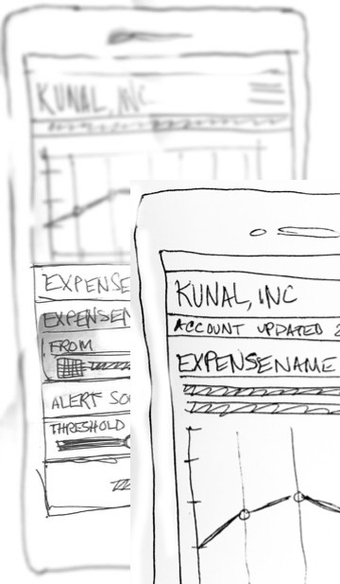
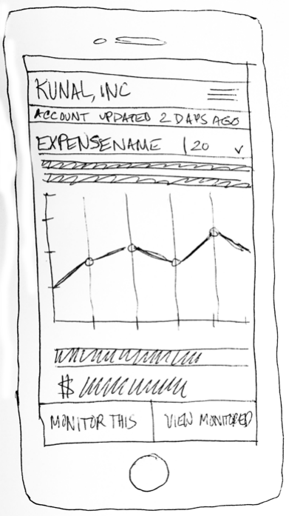
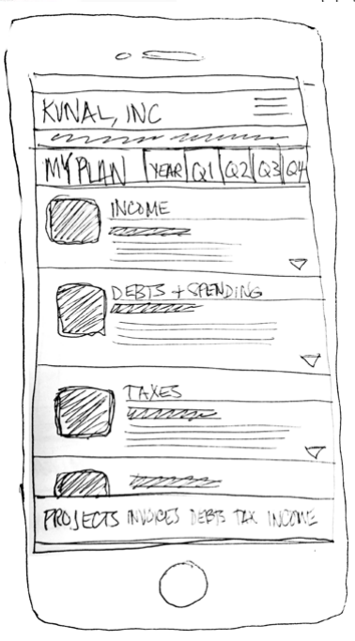
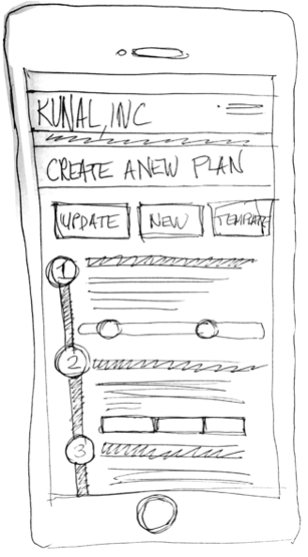
Discovery & Research Wells Fargo mySMALLBUSINESS
Design Thinking Exercises
Generated concepts for interfaces with 6 participants with 5 concepts for mobile native account views, reporting features and planning processes

Slide 26

Discovery & Research Wells Fargo mySMALLBUSINESS
Pain Points + Business Goals + UX Strategy = Feature Set
UX Strategy
Pain Points
Business Goals
Feature Set
• No way to track spending
• Integrated applications
• Guide
• Expense & Spending
• No workspace for monitoring budgets and planning
• Mobile
• Educate
Tracker
• Functionality Parity
• Optimize
• Budget and Goal Planning Wizard and Workspace
• No place to optimize current business finances
• Optimize customer
• Predict
service experience
=
+
+
• Communicate
• No way to understand and
• Automate
• Business Optimizer and Data Visualization Functionality
build business for the future
• Technology
• Fractured touch points
• Always available to
• No alerts system
help
• Photo Receipt and
Check Capture
• Alert and Predictive
• Tip System
• Multiple Form Factors
• Geared to Users lifestyle
• Chatbot, Voice-based
Customer Support

Slide 27
• Feature refinement and road map
• 22 projected Agile-based sprints
• Usability testing on weekly cadence
• Demos and QA
Design
The Delivered Solution
A predictive, guidance-based application that allows small business owners to monitor and track spending and expenses, optimize Financial Plans and if needed, be educated on the subject of small business finances and business operation. Users will be given guided work-flows when they want to:
• Plan a business budget
• Get status updates, badging and gamification to work
• Track expenses and spending
efficiency and access new Wells Fargo products
• Get recommendations and tips for optimizing their
• Automatically be matched with small business buddies
business
and social network opportunities
• Automate regular business processes
• Optimize business procedures through analytics, and
data visualization
• Set automated procedures, i.e. bill pay, spending overrun
and contingency plans

Slide 28
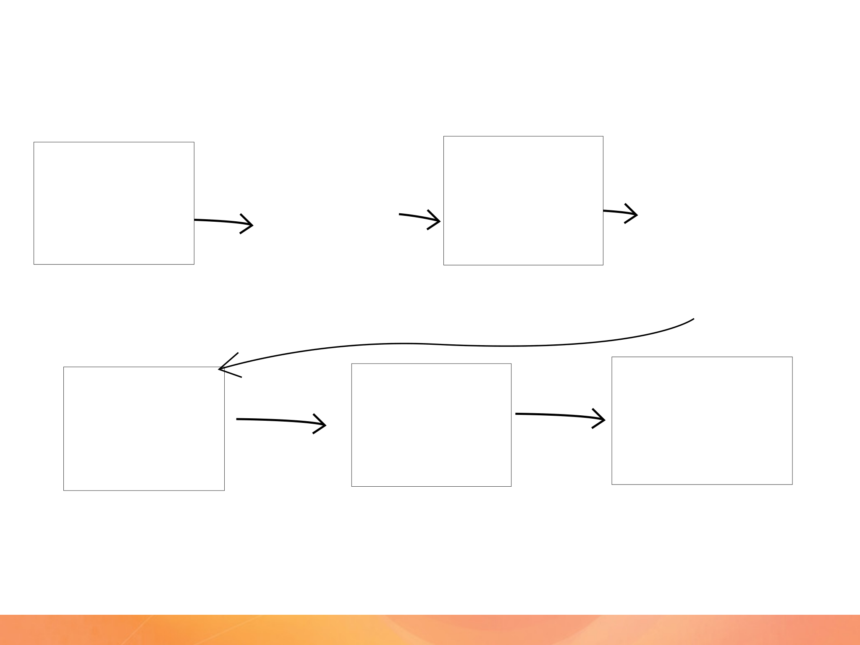
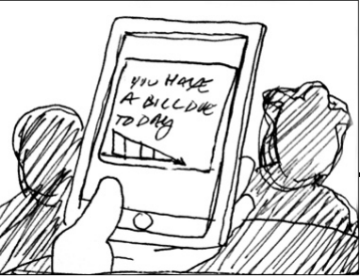
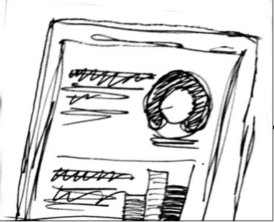
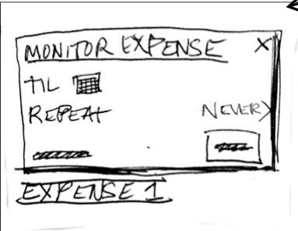
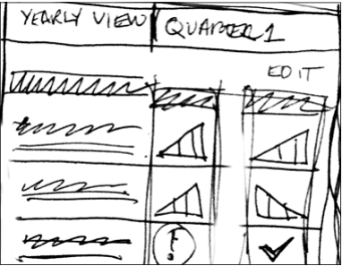
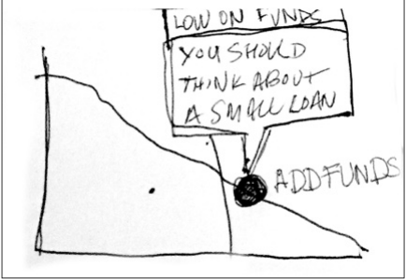
Discovery & Research Wells Fargo mySMALLBUSINESS
mySMALLBUSINESS Financial Hub Concept Scenario
About an hour later while he is working at a job site, he receives another notification on his mobile phone that his budget goals are in jeopardy. Because he is interested in this plan, he goes on the application and sees the account dashboard.
He needs to investigate deeper into a specific expense. He can view an expense and then see its relationship to a Project and the details the expense was part of.
Kunal Power User is having breakfast at home with his 2 children Preeti and Aziz. While he helps them make their breakfast he gets a notification on his mobile phone that he has an expense that is scheduled to be automatically paid this morning, through his mySMALLBUSINESS application, but that the company’s account is running low on capital.
On the dashboard he gets a visualization of his current mySMALLBUSINESS Financial Plan, the goals, expenses, debts and assets.
He sees the expense and knows it is valid, but he wants to monitor it over time, it is a recurring debt. He goes into the monitoring wizard to set up the preferences to monitor the expense.
During lunch, after overseeing a project, he gets an alert that his yearly budget has issues with employee pay for this quarter. On his mobile he accesses the quarterly view of his current yearly budget for 2023.
When he built his original plan, he used a business budget template that gave him an optimized plan based on his profile and past usage of the application. However, due to an unforeseen increase in business for the quarter, not only did his workload increase, but his expenses did too.

Slide 29
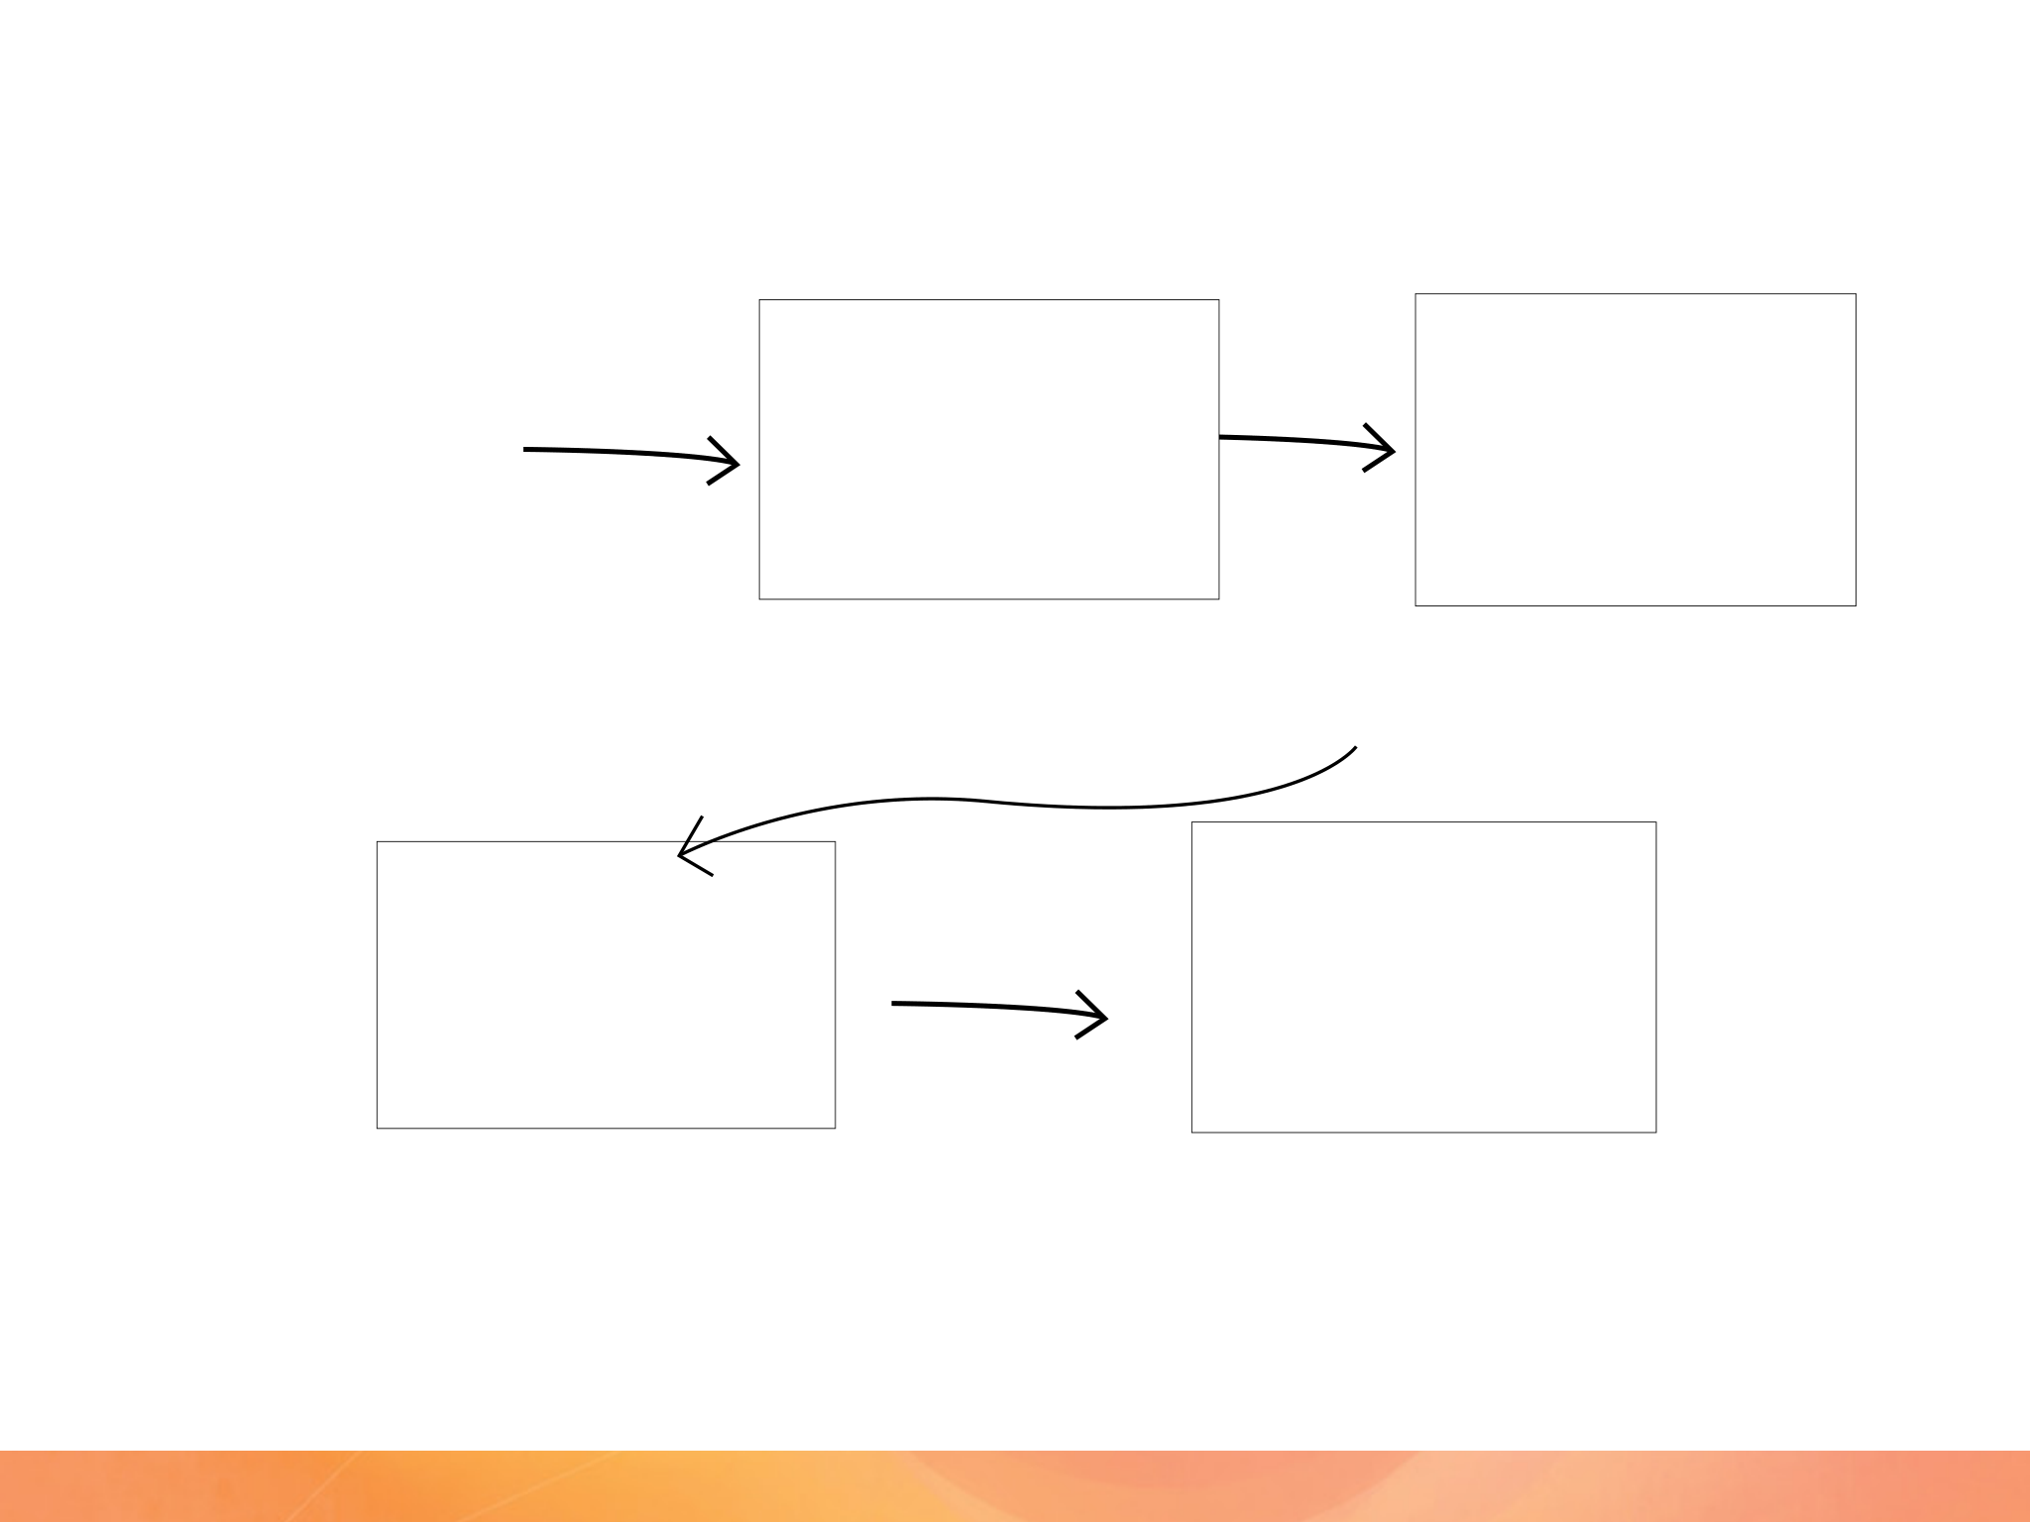
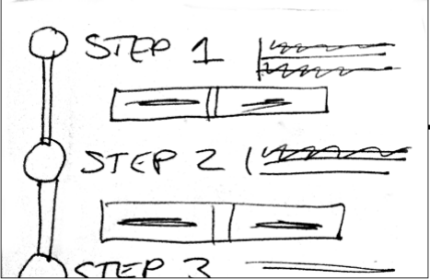
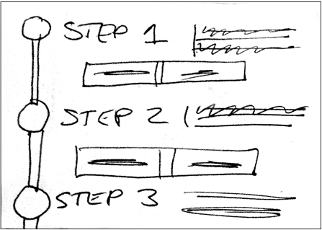
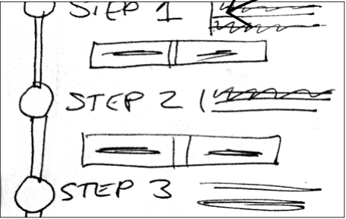
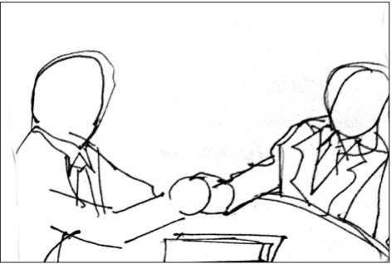
Discovery & Research Wells Fargo mySMALLBUSINESS
mySMALLBUSINESS Financial Hub Concept Scenario
The data visualization feature of the app gives him insight into the increase in activity, expenses and lack of revenue received. The plan gives him real time suggestions and tips to help him run his business better and stay on budget.
Because this has happened several times the app upsells relevant Wells Fargo Small Business products to Kunal, through the Tips and Recommendation engine. Since the quarter is almost ending, he is encouraged to build a new Business Financial Plan. He can use the existing one as a base and adjust, use a suggested Small Business Plan template auto suggested to him, or start from scratch.
By using a Planning Wizard, he decides to use his current plan as a base. The wizard guides him through the process, asking him simple plain-language questions; he could even build it using Siri or other voice-activated technology. He adjusts his plan projecting an increase of 12% in revenue over the next year.
The Wizard algorithmically projects and allocates speculative information and constructs the Plan. He has a new plan to guide him in the new fiscal year. He can also compare past plans to help understand the trends of expenses, debts, spending and revenue.
The interactive data visualizations allow deeper insight of past activity, and help him with his plans for business expansion. He decides to approach Wells Fargo for a new small business loan product, the one that was auto suggested when he was building his budget.

Slide 30
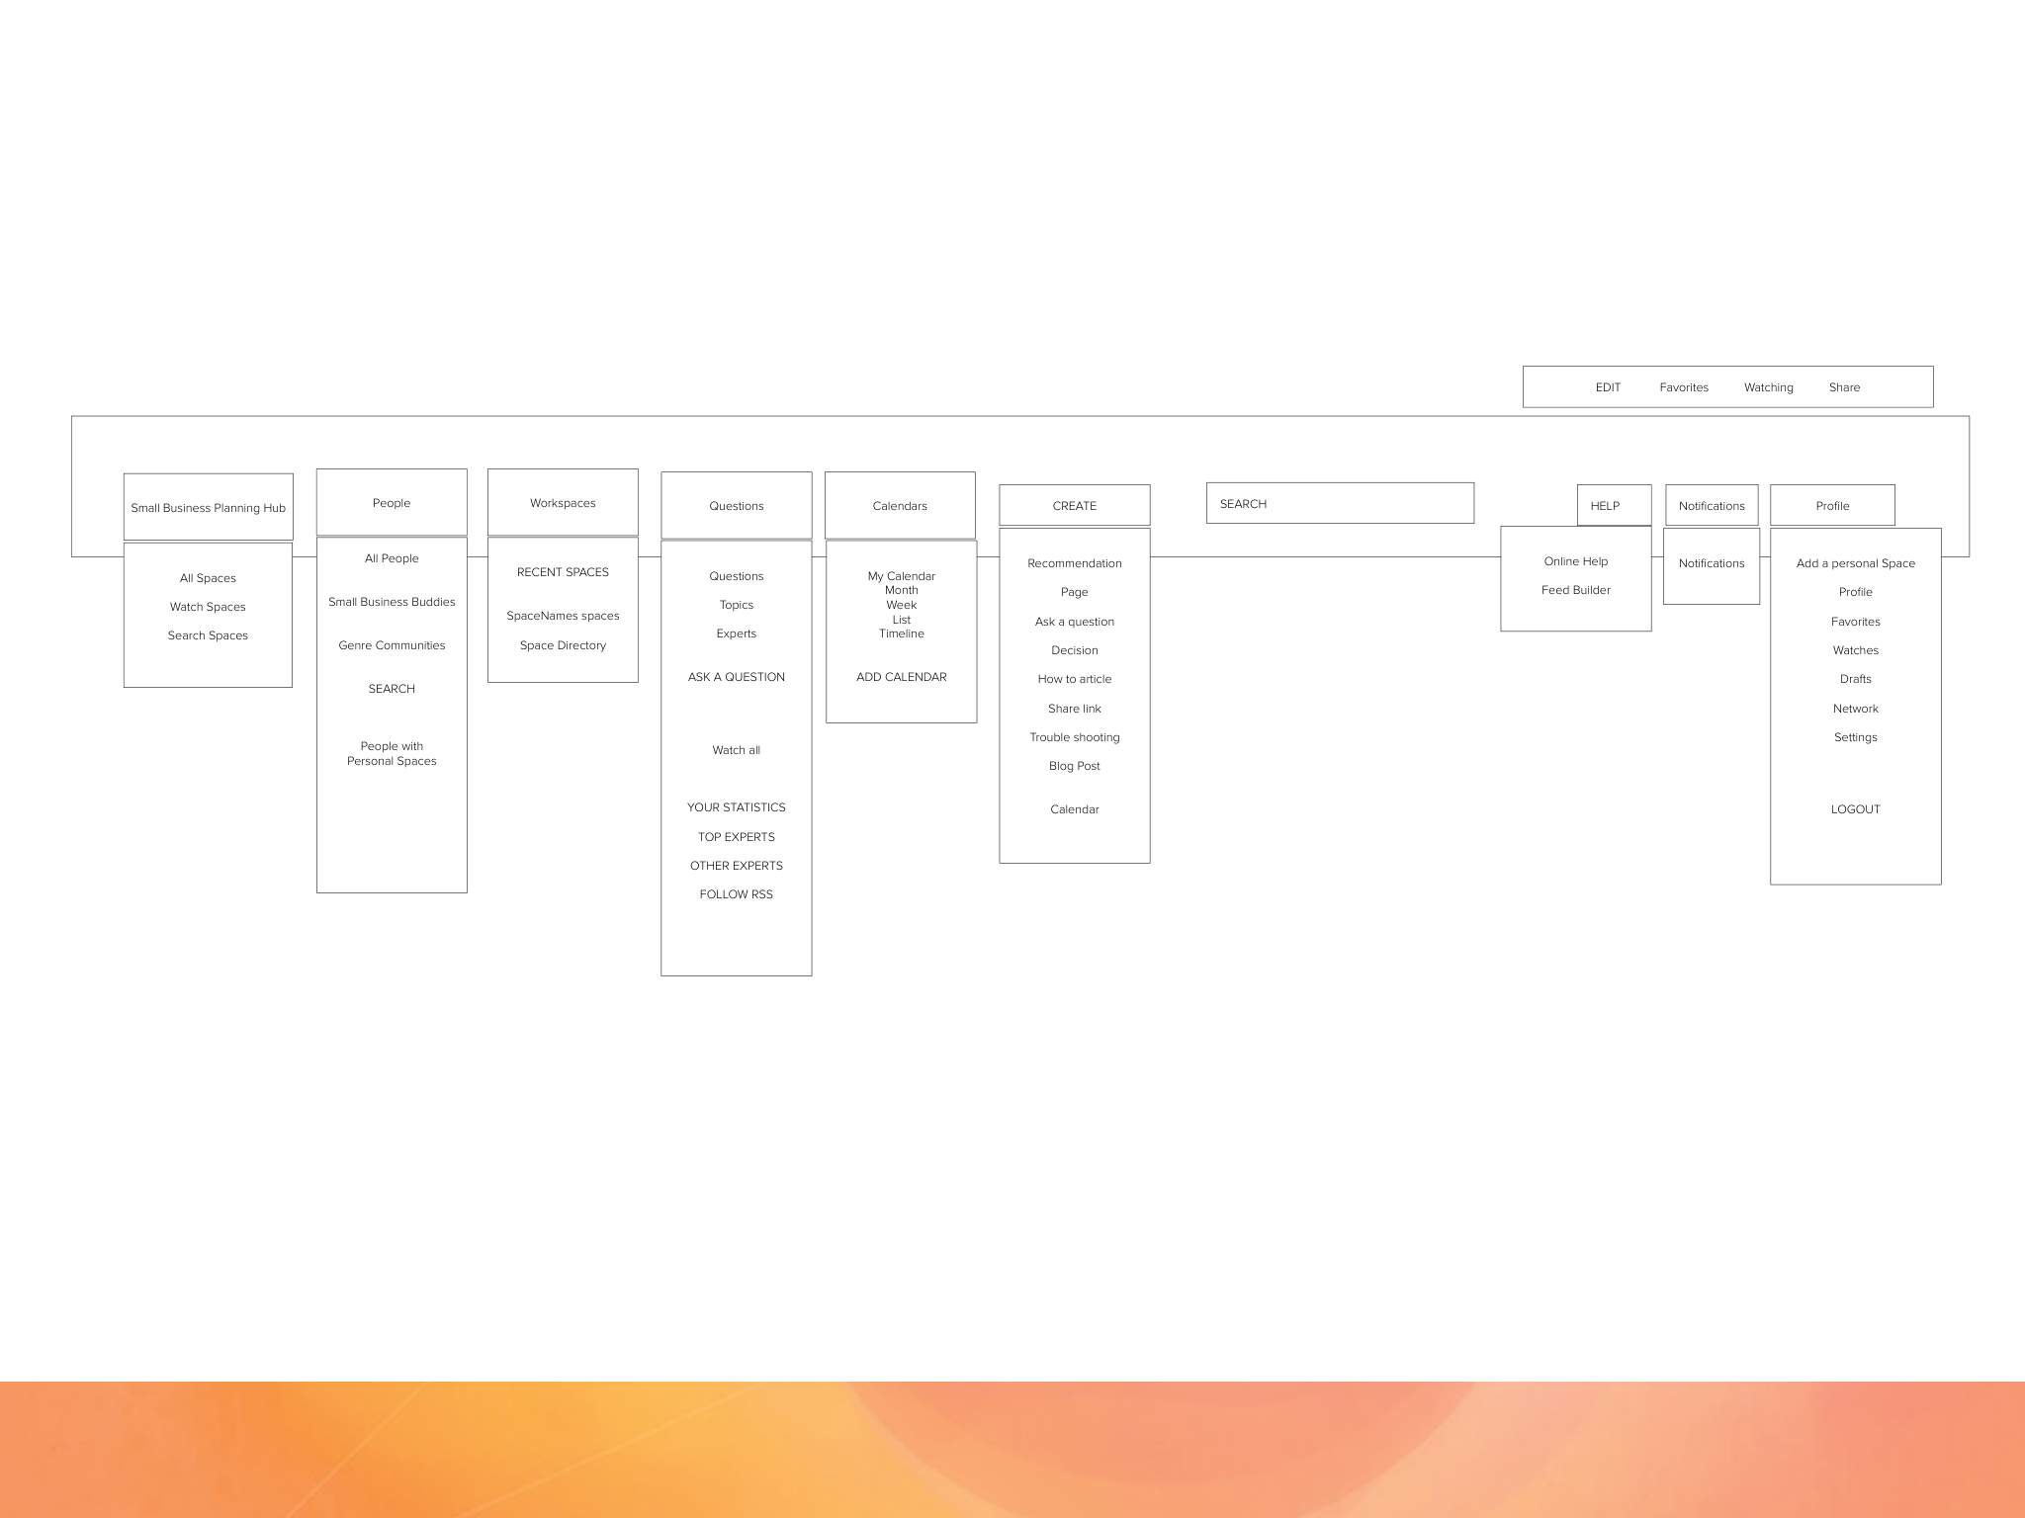
Discovery & Research Wells Fargo mySMALLBUSINESS
mySMALLBUSINESS Information Architecture

Slide 31
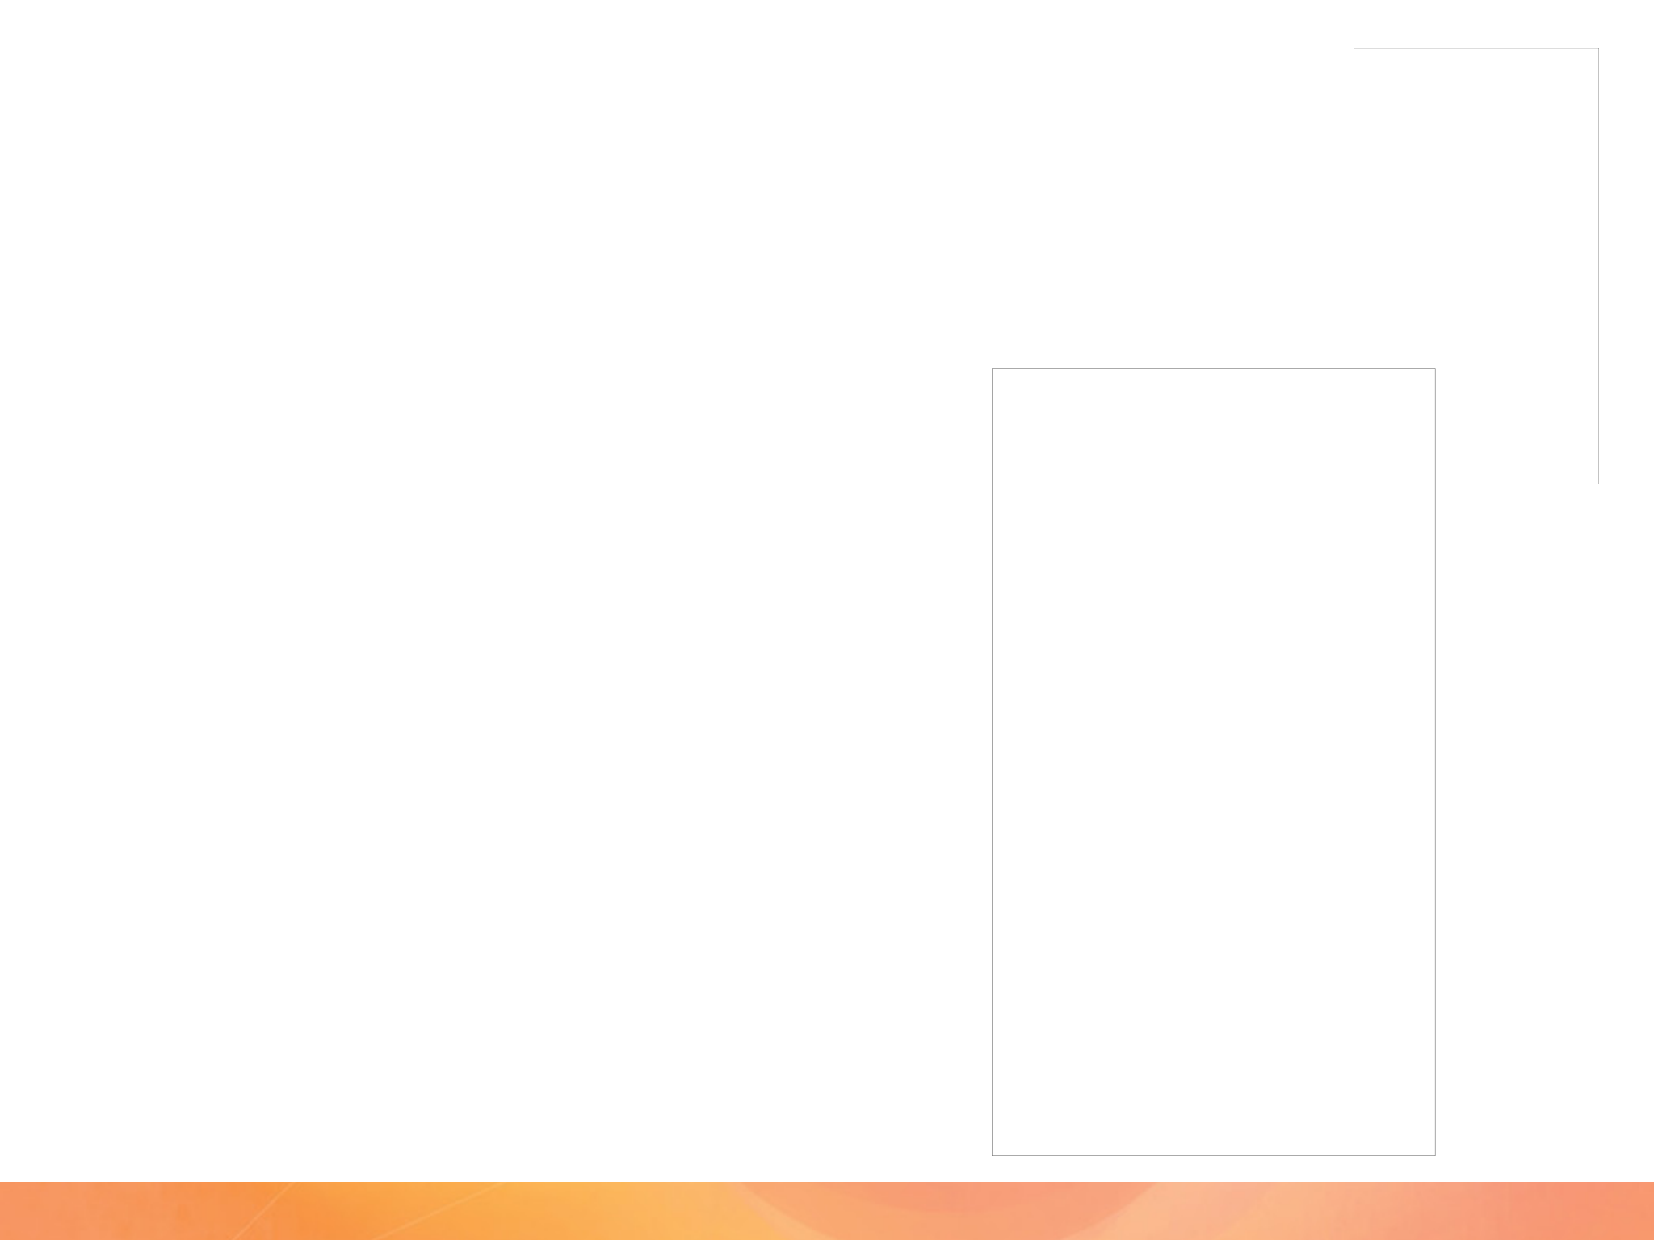
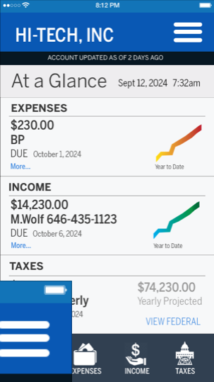
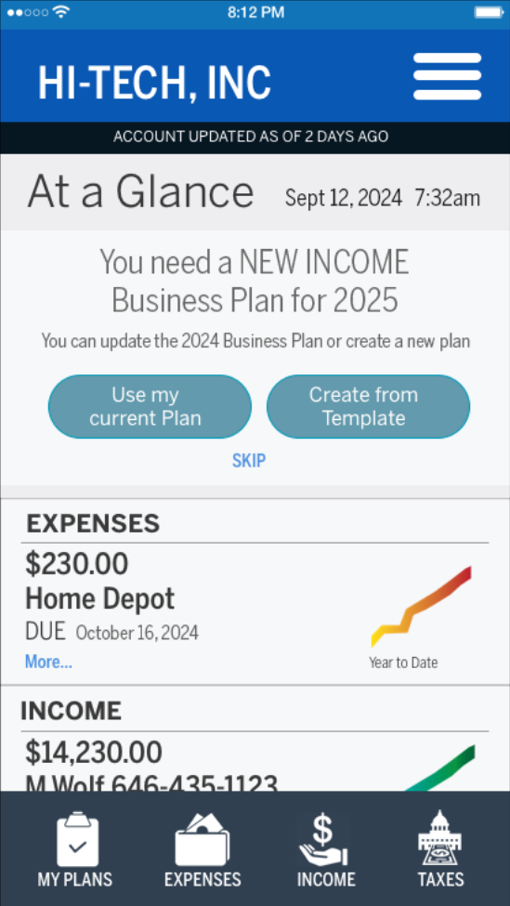
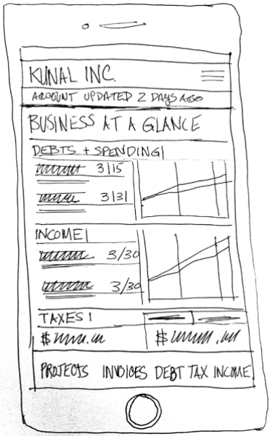
Design Wells Fargo mySMALLBUSINESS
Proof of Concept Design 5
mySMALLBUSINESS Dashboard
On the dashboard he gets an AT A GLANCE understanding of his business. From this dashboard he can see his most important and urgent DEBTS and SPENDING. He’d see any INCOME to be expected. A snapshot of TAXES would be seen from a STATE and FEDERAL level.
He can access visualizations of his current FINANCIAL PLANS, the GOALS, EXPENSES, DEBTS,
SPENDING, PAYROLL, and ASSETS. He could
capture any checks for his business as well as
transfer any monies too.
From this dash a user could dive deeper into the
users’ profile, preferences, accounts, security.
They’d be able to set any alerts and monitoring of
spending, accounts, projects, employees, payroll.

Slide 32
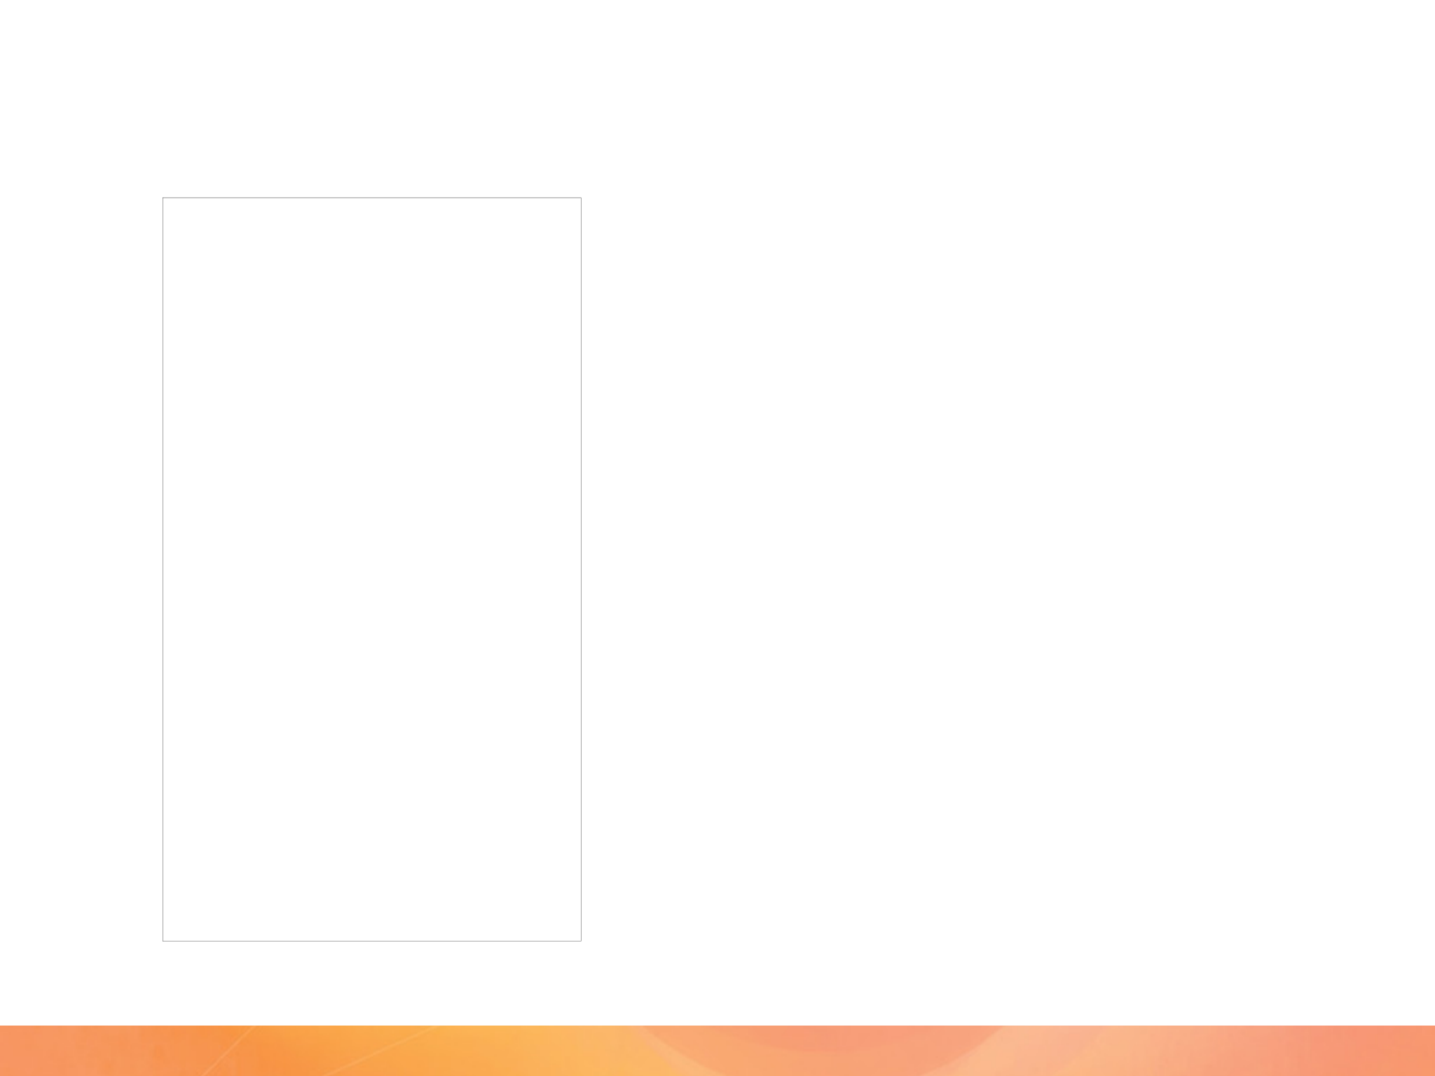
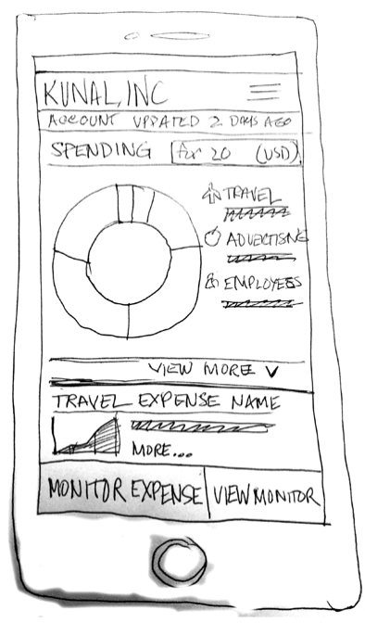

Design Wells Fargo mySMALLBUSINESS
Proof of Concept Design 1
Expenses Breakdown
Kunal can view all his SPENDING, then investigate deeper into a specific
EXPENSE. He can view an expense and then see its relationship to a
job and the time frame the expense was part of. He sees the expense
and knows it is valid, but he wants to monitor it over time, as it is a
recurring debt that varies according to the PROJECT it is used on. He
goes into the monitoring wizard to set up the preferences to monitor the
expense.

Slide 33

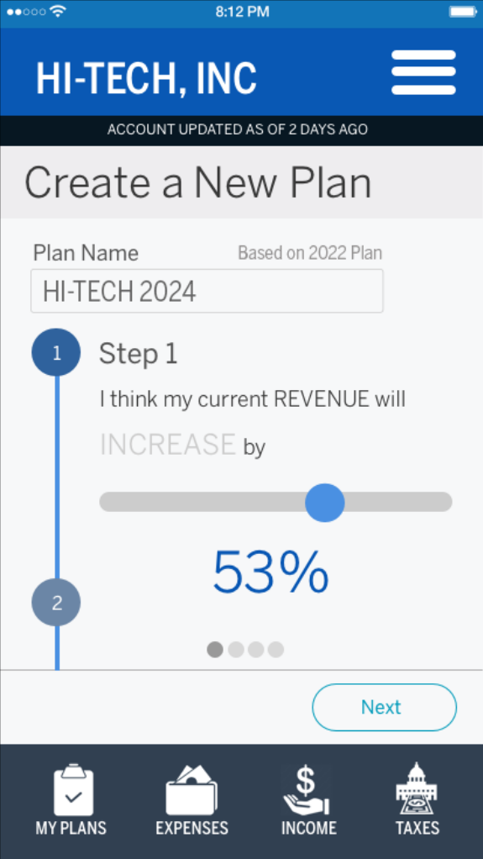

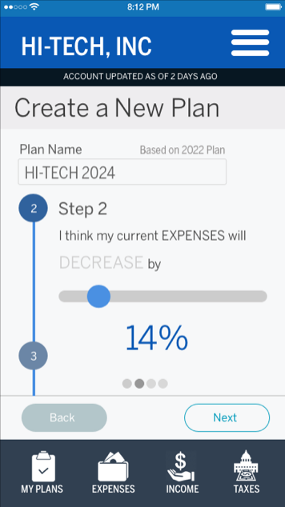
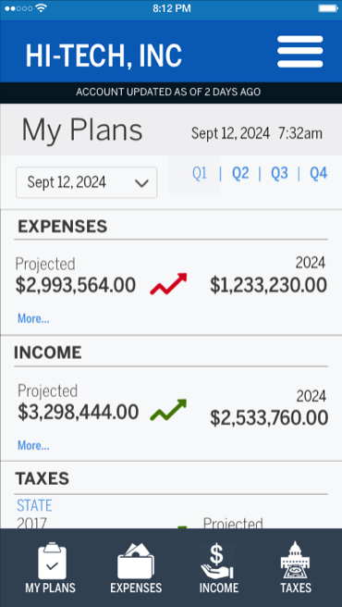
Design Wells Fargo mySMALLBUSINESS
Proof of Concept Design 4
Budget Plan Wizard
Using his current plan as a base, the
wizard guides him through the process,
asking him simple plain-language
questions. He could even build
it using AI or other voice-activated technology. He adjusts his plan projecting an increase of 12% in revenue over the next year. The Wizard algorithmically projects and allocates speculative information and constructs the Plan. He has a new plan to guide him in the new fiscal year. He can also compare past plans to help understand the trends of expenses, debts, spending and revenue. The interactive data visualizations allow deeper insight of past activity.

Slide 34
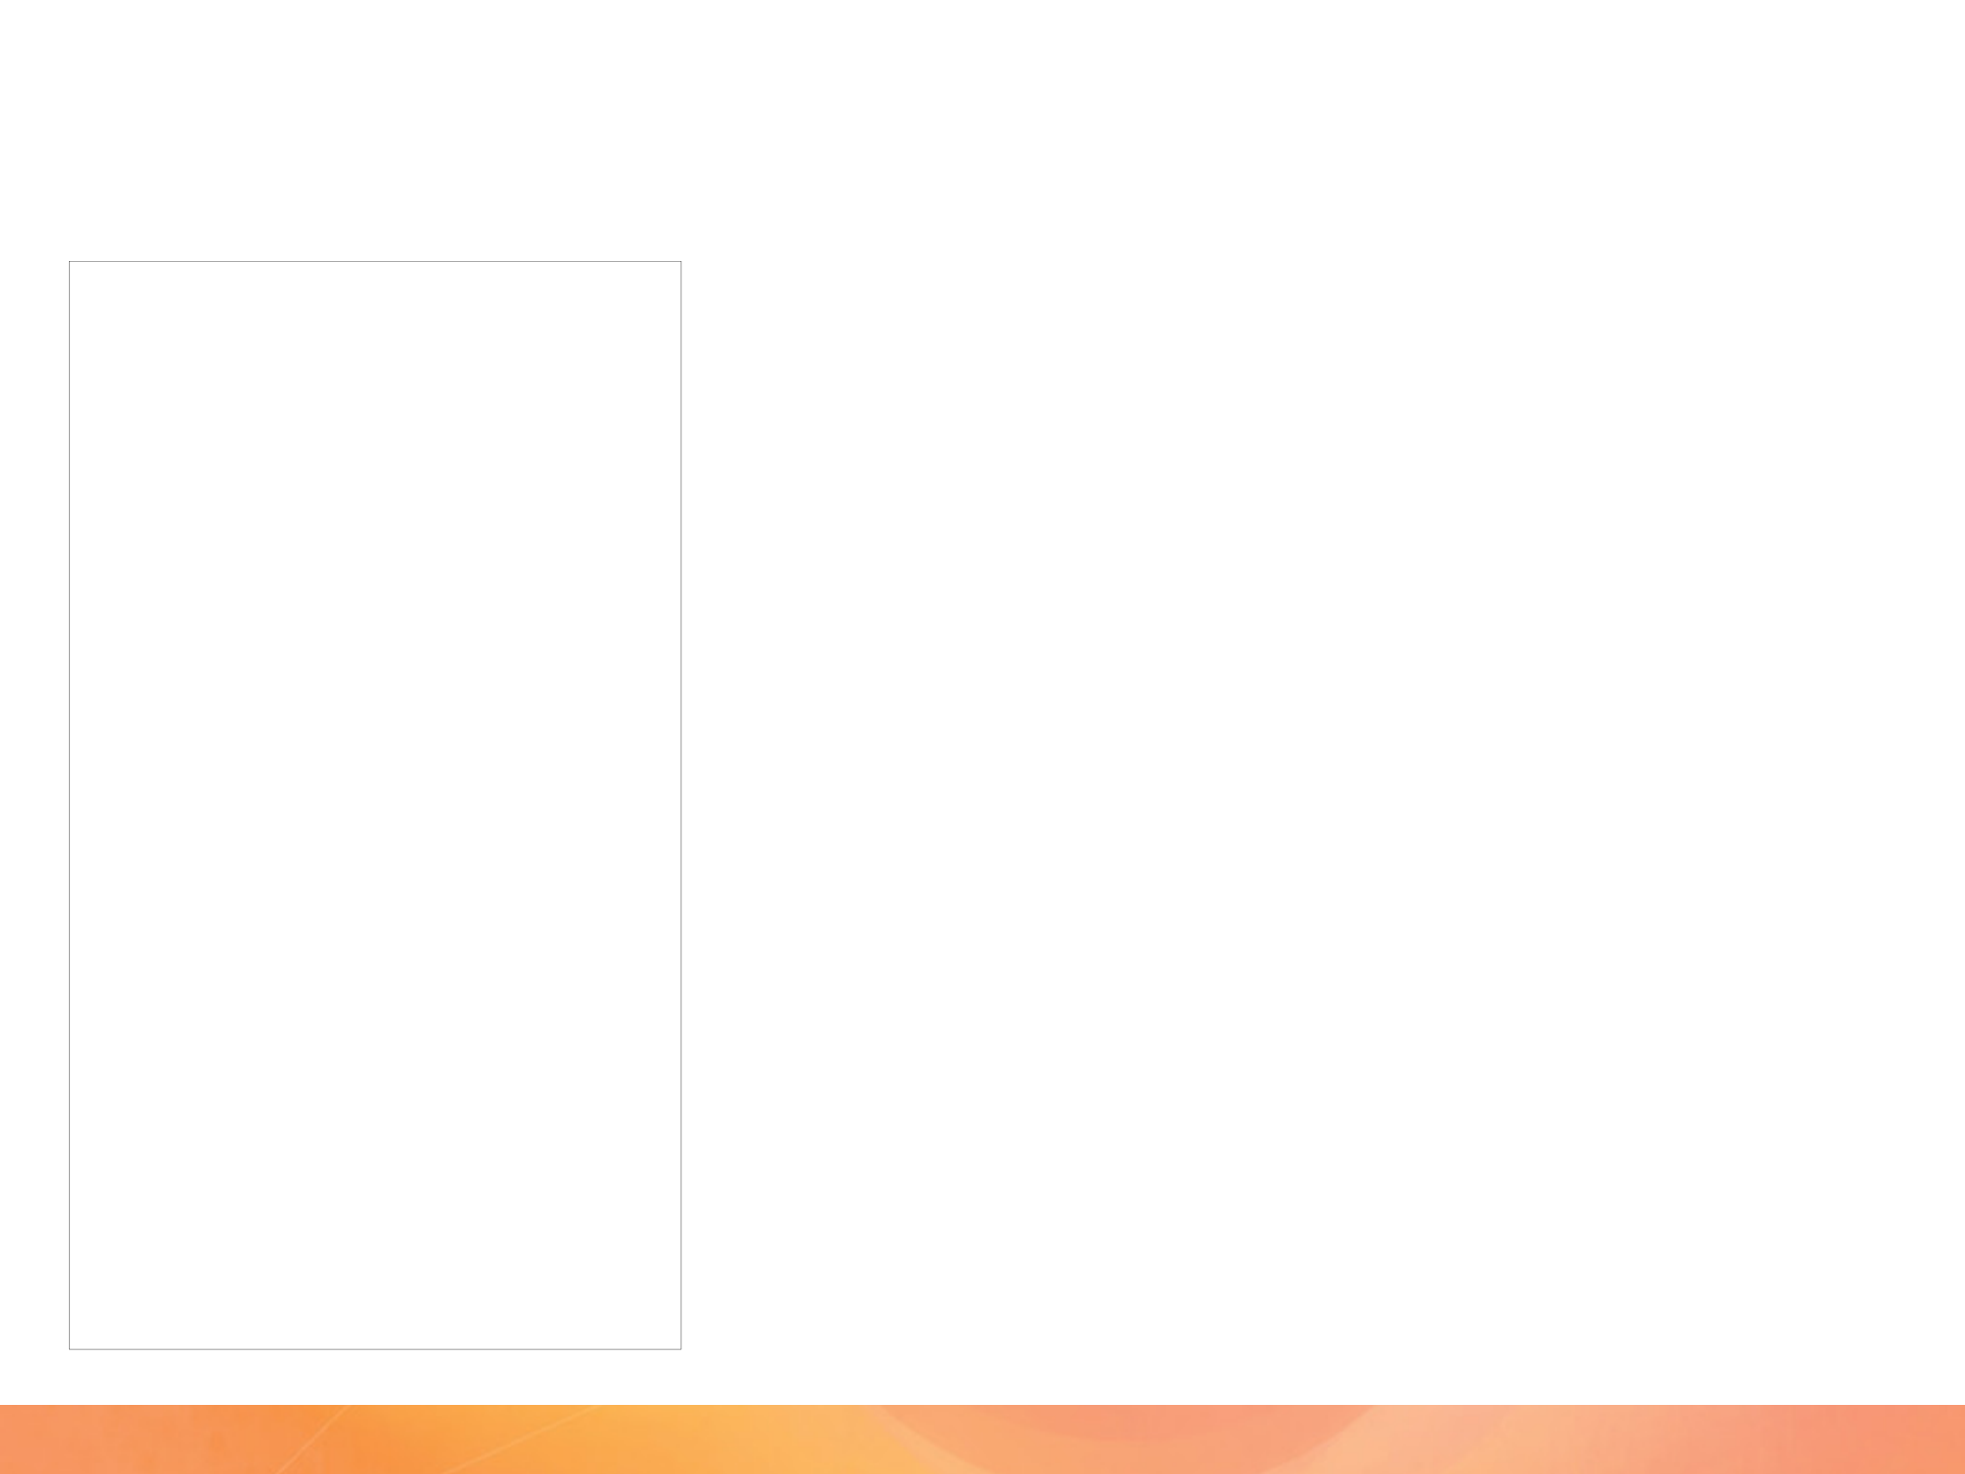
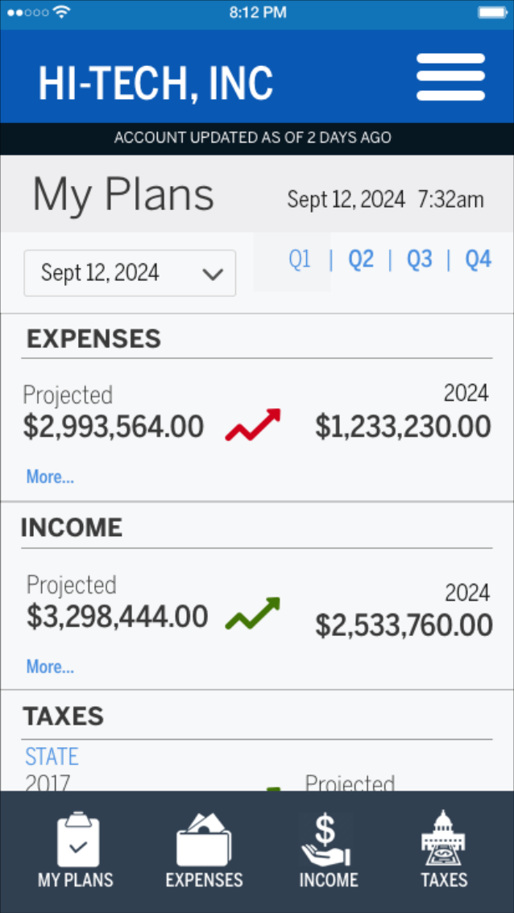

Design Wells Fargo mySMALLBUSINESS
Proof of Concept Design 2
Spending Monitoring
When he built his original plan, he used a business budget template that gave him an optimized plan based on his profile and past usage of the application. However, due to an unforeseen increase in business for the quarter, not only did his work load increase, but his expenses did too. The data visualization feature of the app gives him insight.
Year to Date Plan Data vs... Quarterly Plan Data
A BUDGET PLAN gives Kunal real vision to help him run his business better and stay on budget. On a couple occasions he has received alerts and tips. Because this has happened several times the app upsells relevant Wells Fargo Small Business products to Kunal, through the Tips and Recommendation engine. Since the quarter is almost ending, he is encouraged to build a new Business Financial Plan. He can use the existing one as a base and adjust, use a suggested mySMALLBUSINESS Plan template auto suggested to him, or start from scratch.

Slide 35






Design Wells Fargo mySMALLBUSINESS
Proof of Concept Design 3
Spending Monitoring
When he built his original plan, he used a business budget template that gave him an optimized plan based on his profile and past usage of the application. However, due to an unforeseen increase in business for the quarter, not only did his work load increase, but his expenses did too. The data visualization feature of the app gives him insight.

