Slide 1
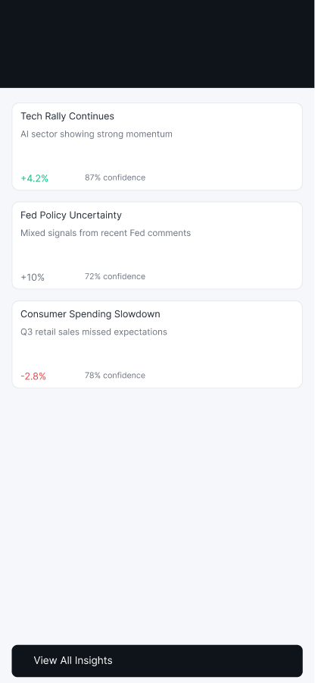
SELECTED WORK · LEAD UX DESIGNER
Michael
Thibodeau
Two projects: an AI screener for active traders, and an AI-assisted mobile trading app.
Notes:
Two case studies, both with an AI layer on a trading product. Lead with the process and the decisions, not the screens.

Slide 2
Contents
Two projects, one process
Select a project to jump to it.
01
FinViz AI Screener
Problem, decisions and what comes next
02
Meridian Navigator
Trade and AI flows, designed states, trade-offs
03
Leadership and process
How I set direction, the calls, and the status
04
Next steps
What I would do next
Notes:
Each row is a link to the section. Pick the project the interviewer cares about first.

Slide 3
FinViz AI Screener · Outcome
FinViz: cut sign-up to Elite from 42 days to 21
The target came from the case brief. It has not been measured yet.
PROBLEM
42 → 21
New traders take 42 days to see why Elite is worth paying for. The screener gives no reasons, and the list forgets them.
days from sign-up to Elite, the target for new traders
DECISION
An AI layer turns the trader’s own picks into a working screen, and explains each finding with its source.
Measured: not yet. Validation is planned (slide 7).
RESULT
Hi-fi concepts for one trading day. Outcome measurement is planned, not done.
Notes:
Lead with the target: 42 to 21 days from sign-up to Elite. Be explicit that it is a target, not a result. Success is time to first success, then habit.

Slide 4
FinViz AI Screener · Role
My role, and where the AI stops
I led discovery, strategy and the Figma design. AI agents helped with drafting.
PROBLEM
Build a screen from three example tickers, explain why each row matched, and check whether the trader’s reasons still hold.
DECISION
The AI verifies the trader’s own criteria. It never originates buy or sell advice. Attributed analyst views sit behind a flag, pending compliance.
RESULT
A design that a compliance review can act on, with the advice line written down before the screens were built.
Notes:
Be specific about the AI boundary: the AI translates and checks the trader’s own criteria. It never originates a recommendation. That line was set in review and is pending compliance.

Slide 5
FinViz AI Screener · Decisions
Decisions, including the ones I reversed
Each call came from a review. The reasoning is kept in the full deck.
DECISION 1
DECISION 2
No chat box first
Set the advice line
Imports and examples lead. Success must be timely, relevant and actionable.
The AI never originates advice. Attributed analyst views sit behind a flag, pending compliance.
DECISION 3
DECISION 4
Lead with the trading day
Map today’s onboarding first
Three concepts competed. The one that followed his real routine won.
A live-site walk found an existing 7-day trial and 1-minute delayed quotes. Two assumptions were wrong.
Notes:
Walk through one reversal in detail. The strongest story is the first-run change: the walk-through onboarding was replaced once the live site showed the 7-day trial and delayed quotes.

Slide 6
Leadership
Leadership: how I set direction and made calls
Evidence from the project record, with dates where the record has them.
SET THE DIRECTION
RECONCILED, NOT OVERWRITTEN
Logged 31 points from a four-reviewer review on 30 Sept. The organizing goal moved to time to first success.
Teammates’ screens kept their best ideas. Only what broke the rules was cut.
MADE THE CALLS, DATED
KEPT OPEN DECISIONS VISIBLE
Lead calls on 23 and 30 Sept, each written with its reason: no chat box first, set the advice line, lead with the trading day.
Meridian: open questions and decisions logged on the FigJam board, and settled items marked separately.
SET THE RULES ONCE
Rules in the project brief made every AI draft start compliant.
Notes:
Lead with the review: four team members gave feedback, 31 points were logged, and the organizing goal moved to time to first success. Then the dated calls. Then the rule that made AI drafts compliant from the start. Admit what is not shown yet: mentoring and hiring.

Slide 7
FinViz AI Screener · Validation
What I would validate next
Planned, not run. Nothing here is a result yet.
1
Think-aloud
5 users, on the first evening and the board
2
Alert diary study
Two weeks of real alerts, logged by participants
3
Labeled chart checks
Weekly audits, with a target of under 1% wrong among clear detections
4
Compliance review
The advice line and the trial timing, before any launch
Notes:
Make clear these are planned. Offer to share the interview guide if asked.

Slide 8
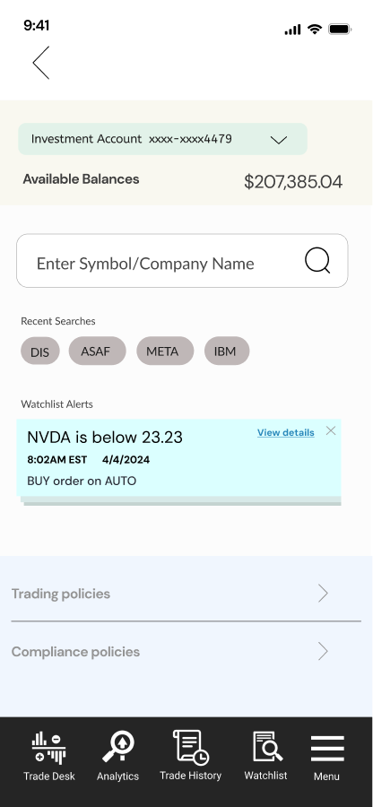
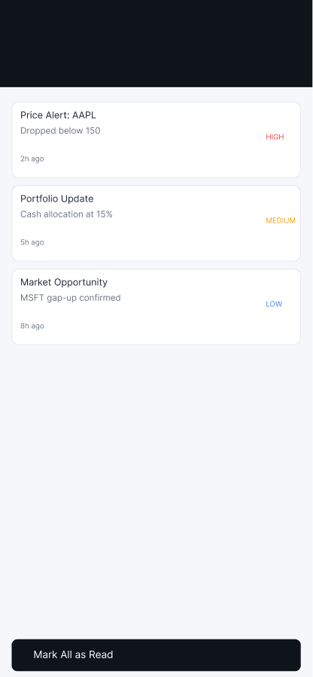
Meridian Navigator · Solution
Meridian: a trade and AI flow, prototyped in Figma
Five core screens, each answering one question. Outcomes are not yet measured.
PROBLEM
Research, order entry and monitoring live in separate tools.
DECISION
Put trade flows and AI screens in one app, with mock data.
RESULT
A clickable prototype. Outcomes not yet measured.
Dashboard
Insight
Guard
What do I own today?
What moved, and why?
What needs my attention?
Notes:
Show the three screens large. Be clear the prototype uses mock data, so the flow is tested, not the AI output.

Slide 9
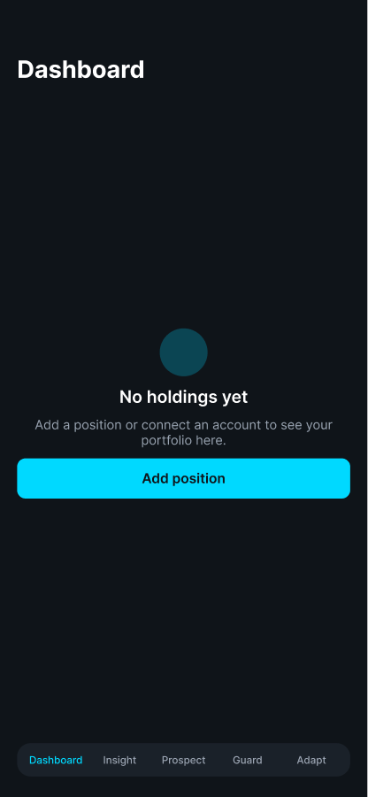
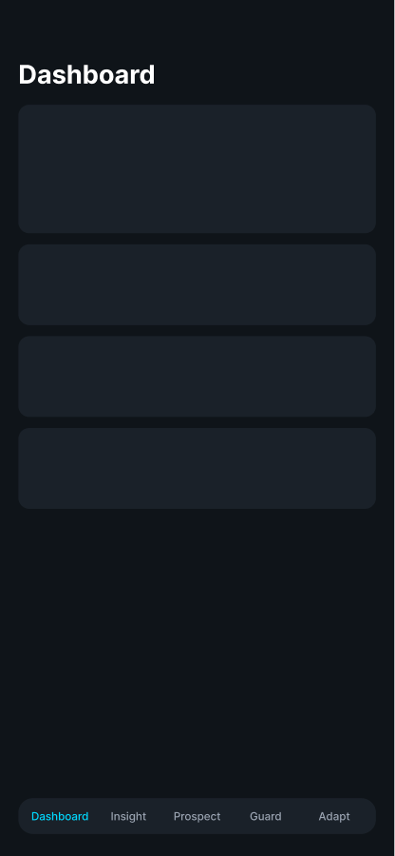
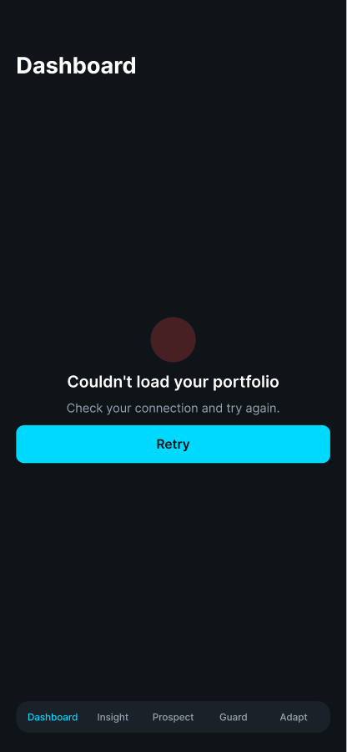
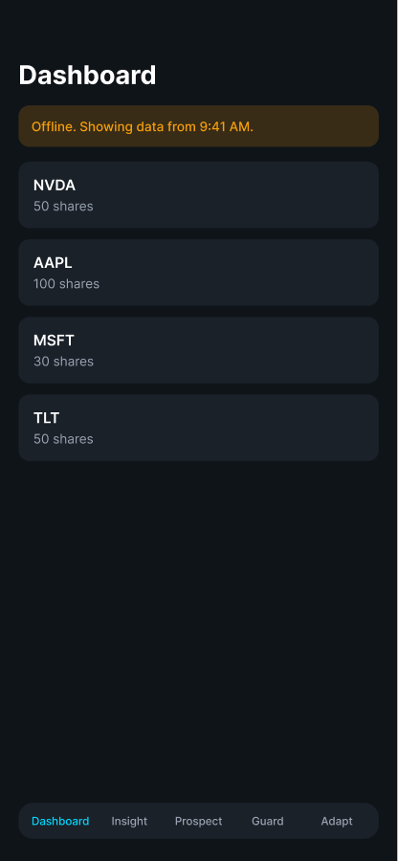
Meridian Navigator · States
Designing for the states that mocked data hides
Dashboard in four states. The other four screens follow the same pattern.
Empty
Loading
Error
Offline
No holdings yet. One clear next step.
Skeleton cards hold the layout while data loads.
Says what failed and offers a retry.
Warns that data is stale and shows the last update.
Notes:
The states are a design decision: mock data hides loading, error and offline behavior. These are drafted in hi-fi and need usability testing.

Slide 10
Meridian Navigator · Trade-offs
Trade-offs I chose, and what they cost
Each call is stated with its cost. Open items are marked as open.
DECISION 1
DECISION 2
Keep both share and dollar entry
Mock API with a delay
Unclear which model new investors prefer. Two flows to maintain, and open for testing.
Lets us test flows and loading states without a backend. Real timing and errors are untested.
DECISION 3
DECISION 4
Adapt suggests buys and sells
Five tabs, one home screen
It is the screen’s job, but the wording needs compliance review before release.
Scannable areas, with trading one tap away. AI screens compete with trade entry for attention.
Notes:
The open item to discuss is the buy and sell wording on Adapt. It needs compliance review before release, and may become explanation only.

Slide 11
How I work · Process
How I work, across both projects
Self-assessed status. No interviews or usability tests have run yet.
1
2
3
4
5
6
Frame
Hypothesize
Map flows
Design system
Design states
Validate
DONE
DRAFTED
DRAFTED
IN PROGRESS
DRAFTED
PLANNED
Problem, scope and assumptions written down before design.
Personas and principles, marked as untested.
Flows and screens for the core job, drafted in Figma.
Shared tokens for Figma and code. Component library not yet audited.
Empty, loading, error and offline states.
Interviews, usability tests and compliance review.
Notes:
Be direct: discovery so far is desk research and design review. Interviews are the next step, not a finished one.

Slide 12
Next steps
What I would do next
The order that unblocks the most work.
Run five to eight interviews to test the personas
Usability-test the share and dollar flows
Set metric targets with stakeholders and measure them
Complete the compliance review of trade and AI copy
Get in touch
[Add email]
[Add phone]
[Add portfolio URL]
Notes:
Close on the next step you would take with this team in the first two weeks.

