Slide 1

case studies
Portfolio of case studies that show the conceptual
development, design process, artifact construction,
and final released experiences
michaelthibodea(UX)
www.michaeljthibodeau.com

Slide 2

End-to-end design process, including Design Thinking and AI-supported methods, for an AI layer on the FinViz stock screener that guides a swing trader through the trading day
FinViz
Helping FinViz cut the time from sign-up to Elite from 42 to 21 days by getting new traders to a screen they trust, then watching it for them
“Alerts are everything. Once you close FinViz, you get nothing.”
Notes:
Opener in the portfolio format. Concept-stage work; screens are illustrative with fictional tickers. The quote paraphrases reviewer point R3 from the 30 Sept design review.

Slide 3
01 · Overview FinViz AI Screener
The Trading Day: FinViz keeps watch while you work
PRODUCT
An AI layer for the FinViz stock screener
PROBLEM
Swing traders with day jobs build a screen at night, can’t watch the market 9:30–4, and miss the moment their setup happens. New users take 42 days to see why Elite is worth paying for.
AI SOLUTION
AI turns the stocks he already likes into a working screen, remembers why he picked each one, watches it on his schedule and explains every finding with its evidence. It verifies; he decides.
MY ROLE
Lead UX designer: research, strategy, AI UX principles, concept, low-fi to hi-fi, design system. AI agents for drafting; every call mine.
Hero The Insight Board at 7:45 AM: three sourced findings about his own names, on the FinViz Home he already knows.
19 hi-fi screens · one trade · Monday evening to Sunday · dark theme, FinViz design system v1.0 · personas and data are synthetic
Notes:
SCRIPT
[open] Meet Gary. He swing trades, and he has a day job. He finds ideas at night, can't watch the market from 9:30 to 4, and too often misses the moment a stock does exactly what he was waiting for. Today, a FinViz screen is something he visits. By morning, it's forgotten.
This is what changes when FinViz keeps watch for him.

Slide 4
01 · Overview FinViz AI Screener
How this case study is organized
The final experience first, then the reasoning, data and method behind it. Process artifacts are in the appendix.
01
Overview
Hero and contents
02
Context & constraints
Business goal, stakeholders, success, limits
03
Problem: user and AI
What users struggle with; what the AI must do
04
Data foundation
Sources, volume, quality, labels
05
The solution, hi-fi
One trade through one trading day, 19 screens
06
Reasoning & trade-offs
Chosen vs rejected, accuracy vs control
07
Methodology
AI methods, validation, UX research
08
Implementation
Built on FinViz; new services; collaboration
09
Results & impact
Targets and how they’ll be measured
10
Learnings & Next Steps
What I learned; what to validate before launch

Slide 5
02 · Context & constraints FinViz AI Screener
What’s the FinViz AI layer?
An AI layer on FinViz’s screener that turns what a trader already has (tickers, holdings, a chart) into a working screen, explains every match, and watches it through the trading day, so the trader only steps in when their own criteria are met.
Target audience
• Swing traders with
a day job
• Day traders
• Value investors
The problems
Ideas don’t become a working, watched screen
FinViz is nearly absent during market hours
89 filters in preset buckets; exact values are Elite-only
Results show no reason why a stock matched
New users stall before Elite’s value is obvious
My Role
I led the project with AI agents for drafting.
I was responsible for discovery, research, strategy, the AI design principles and the hands-on design of artifacts, supported by AI applications.
I led all deliverables in Figma and FigJam, ran the design review, and made and recorded the key calls.
Notes:
Mirrors the introduction page of the other case studies: what it is, target audience, problems, my role. Confirm the team description.

Slide 6
02 · Context & constraints FinViz AI Screener
The brief, and how we answer it
WEEK 1
Domain, needs, pains, AI Solution Canvas
→ Context file, personas, 27 pains scored, KPI tree, canvas
WEEK 2
Onboarding or filters: first success faster
→ First Steps + Filtering → The Trading Day · On Watch (OW1–OW7) → hi-fi flow
WEEK 3
Alerts & notifications: input, output, refinement
→ Canvas v2, three journeys, 18 ideas, AN7–AN8
WEEK 4
Charts UX: insights, accuracy, just in time
→ Chart Lens: lenses over a list, reliability layer (CL1–CL4) · Insight Board dashboard (DB1–DB5)
WHERE WE DELIBERATELY DEPART FROM THE BRIEF
Brief: users are mostly expert day traders and multi-portfolio managers.
We center Growth Gary, a swing trader with a day job: the largest new-user group that can’t watch the market at work, where alerts sell Elite. Day traders stay the conversion lever.
Brief: users want expert recommendations with probability scores.
No AI-originated probabilities or buy/sell. Attributed analyst views are allowed (pending compliance); history is shown as history, with sample sizes.
Brief: mobile is a goal.
Desktop only for this exploration, as Week 2 asks; FinViz has no native app. Mobile is deferred, not dropped.
Notes:
Course brief summarized in Research-Notes/Course-Design-Brief.md (all 🔶 case-brief facts). Live-site facts win for the real product, e.g. 7-day card trial vs the brief’s 30-day money-back.

Slide 7
02 · Context & constraints FinViz AI Screener
Why design an AI layer for the screener?
42 → 21
89
days from sign-up to Elite: the business goal
filter dropdowns, most in preset buckets
87 of 89
filters need Elite for an exact value
“Too many filters, and no filter literacy. And a chat box is not the answer.”
0
AI features in the FinViz screener today
Notes:
Facts from FINVIZ-CONTEXT (verified on the live site): 89 filter dropdowns, 87 with Custom as Elite-only, no generative AI. 42 → 21 days is the case-brief goal. Quote paraphrases reviewer point R5.

Slide 8


02 · Context & constraints FinViz AI Screener
FinViz today: Tour-led onboarding, AI only on the news
1
The guided-tour prompt
2
“First Time Here? Watch the Guided Tour”: FinViz’s answer to first use is still a tour, now promoted on the home page.
3
2
“Weekend Brief”
A news summary that appears AI-generated, with 👍/👎, but isn’t labelled as AI. Nothing like it in the screener.
3
A dense dashboard
Rule-based signals, insider tables, futures, a heat map and heavy ads: what a newcomer meets first.
1
finviz.com home page, Oct 4 2026
Notes:
Current state, from screenshots taken Oct 4 2026. The Weekend Brief appears AI-generated but is not labelled as AI.

Slide 9
Competitive landscape
Competitive landscape: where FinViz is strong, and where the AI layer fits
Examples from the FinViz research notes, as of September 2026.
Product | Where it is strong | Where the AI layer fits
TradingView | Charting and community. Ships AI chart analysis and document summaries. | Explains the trader’s own screen. FinViz stays the fastest place to find ideas.
Trade Ideas | Real-time scanning and alerts at tick speed. | FinViz does not compete on tick speed. Push alerts on a saved screen matter more to this user.
Bloomberg Terminal | Market data and news flow for professionals. | Cost and complexity. FinViz’s job is discovery for individual traders.
Source: FinViz research notes. Competitor features change. Re-check before publishing.

Slide 10
02 · Context & constraints FinViz AI Screener
Context and constraints
The environment the AI had to fit: a business goal, four groups of people, a definition of success, and hard limits.
BUSINESS CHALLENGE
Halve the time from free to Elite, 42 → 21 days, without annoying users (course brief, OKR 1). Elite sells persistence: alerts, real-time data, backtests. A user without a working screen has no reason to pay.
STAKEHOLDERS
Traders: Growth Gary (primary), Fast Frank, Value Vivian, Multi Mike. FinViz growth (Elite conversion), compliance (the advice line), engineering (screener, alerts, data feeds).
SUCCESS CRITERIA
Time to first success: an insight that is actionable, timely and relevant to his own holdings, in the first session. Then a habit: a saved screen re-run 3+ days a week (North Star).
TECHNICAL CONSTRAINTS
No AI in FinViz’s screener today. 89 filters; Free uses preset buckets. Free quotes 1-min delayed; pre-market is Elite. LLMs can invent: output must map to real filters. Compliance: no AI-originated advice, predictions or confidence %. Desktop only.
WHAT THIS MEANT FOR THE DESIGN
Free builds and previews; Elite watches
The paywall sits where the value is felt: live alerts on his own names.
Every AI output maps to something real
A FinViz filter, a measured value or a cited source, or it says it can’t tell.
Verification, not advice
The AI checks his own criteria; decisions end in his broker.
Facts: FINVIZ-CONTEXT (✅ verified on finviz.com) and the course brief (🔶). Personas are synthetic; validate with research.

Slide 11
03 · Problem FinViz AI Screener
The user problem and the AI problem
Defined separately, so the AI only does what a rule can’t.
USER PROBLEM
Gary can find ideas but can’t hold on to them. 89 filters with no explanation; a list that forgets why he picked each stock; nothing reaches him at work; the decision to hold or exit happens in his head (P1, P5, P8, P9, P13).
AI PROBLEM
Infer a screen from 3 example tickers · explain why each row matched from real values · re-check his own reasons against fresh data 3× a day · detect chart patterns at support with measurable criteria · summarize overnight news on his names only, with sources · turn his corrections into proposed rule changes.
WHY AI IS APPROPRIATE
Translating examples and plain English into 89 filters, and summarizing many sources, are language tasks. Scanning 30 charts for the same setup every day is repetitive perception. Remembering his reasons needs memory. Where a rule is enough we used a rule: the since-last-night diff, exit lines, quiet hours and the activity log are not AI.

Slide 12
03 · Problem FinViz AI Screener
Swing Trader · primary
Growth Gary
Holds Days to weeks
Day job Yes; can’t watch 9:30–4
Device Laptop at night, phone at work
Trades in His own broker
Key challenges
Blind during market hours
Good screens forgotten by tomorrow
Can’t see why a stock matched
Wishlist
What’s new since last night
Alerts from his own screen
Reasons that still hold?
When they use FinViz
8–10 PM
The evening scan: re-runs saved screens, builds a shortlist, plans tomorrow. Glances at his phone between meetings.
Day Trader · conversion lever
Fast Frank
Holds Minutes to hours
Scarcest time 7:00–9:30 AM pre-market
Needs Speed, real-time data
Elite Most likely to pay
Key challenges
Real-time data is Elite
Too slow to build a screen
Alert noise
Wishlist
A pre-market note on his list
A screen in under 5 minutes
Fewer, better alerts
When they use FinViz
7:00–9:30 AM
Pre-market shortlist: gaps, news, unusual volume. Every minute before the open counts.
Personas are synthetic and need validation with real traders.

Slide 13
03 · Problem FinViz AI Screener
Pain points, scored by user and business impact
1 Ideas can’t become a working, watched screen
2 Blind during market hours
3 Too many results, and no reason why they matched
4 Which metric matters, and what counts as good?
5 Filters in fixed buckets; exact values are Elite
6 Alert noise
7 Catalysts scattered across pages
“Once you close FinViz you get nothing, and setting up alerts today is quirky.”
Design review feedback, Sept 30
Notes:
From the pain register (03c), P1, P9, P5, P3, P2, P10, P13: 27 pains in total, scored urgency × business impact.

Slide 14
04 · Data foundation FinViz AI Screener
Data foundation
The design was shaped by what the data can and can’t support. Volumes are design estimates to validate with FinViz engineering.
Data source
Used for
Volume (high level)
Quality and constraints
FinViz screener data: 89 filters on ~11,700 tickers
Examples → filters; why it matched; lenses
~11.7k tickers × 89 fields, daily; intraday on Elite
Free maps to preset buckets (marked ≈); exact values on Elite
Price and volume bars
Pattern detection; 30-day replay; reasons checks
3+ years of daily bars per ticker
Gaps and splits → the detector abstains (“not enough data”) instead of guessing
Earnings calendar, news, analyst changes (third party)
Morning glance; insight cards; map annotations
Dozens of sources a day
Every claim cites source and time; no cause is inferred without a source
His data, opt-in: screens, shortlist, reasons, notes, exit lines, day profile
Personal rules; what to watch and when
Small, per user
Sensitive: visible, editable and deletable; never turned into recommendations
Labels: his corrections (“this was wrong”, “not a real hammer”) + weekly audits
Evaluate and tune detection and alerts
Grows with use; audit 50 detections a week
Corrections are biased toward noise; sampled audits keep a fair error rate
Design consequence: every AI output shows the data behind it and its time; when data is missing the product says so.

Slide 15
The solution
Hi-fi first: one trade followed through one trading day, Monday evening to Sunday. 19 screens in the FinViz dark theme, built only from the design system’s tokens. Purple marks AI and nothing else.

Slide 16
05 · Solution FinViz AI Screener
One trade, followed through one trading day
This case study follows Growth Gary, a swing trader with a day job, through a single trade. He finds an idea at night, checks it before work, gets one alert while he’s busy, and decides after the close whether his reasons still hold. FinViz does the watching and explaining at the right moment; Gary makes every decision, in his own broker.
☾ 8–10 PM
☾ while he sleeps
☀ 7:30 AM
☀ 9:30 AM–4 PM
☀ 4:30 PM
1
2
3
4
5
Evening
Overnight
Before work
During work
After the close
Reviews what’s new, pins 3–5 names, taps “Watch these for me”
Nothing
Reads one short note
Taps one alert, if it comes
Decides: hold, or exit in his own broker
Notes:
SCRIPT
[open] Meet Gary. He swing trades, and he has a day job. He finds ideas at night, can't watch the market from 9:30 to 4, and too often misses the moment a stock does exactly what he was waiting for. Today, a FinViz screen is something he visits. By morning, it's forgotten.
This is what changes when FinViz keeps watch for him.
— Production notes —
The one workflow this case study showcases: The Trading Day. Everything else in the deck either explains why (research), how it was led (leadership) or how it works (design).

Slide 17






05 · Solution FinViz AI Screener
The User Journey: From market noise to a focused next step
Six beats on the Insight Board: Gary’s day around work, then Mike, an advisor. The board surfaces what changed; he decides.
1 · Morning DB1 · 7:45 AM
“What needs my attention?”
Three findings about his own names come first: DOCN at risk, QLYS earnings, semis down with RMBS exposed.
2 · Investigating DB2
“Show me the evidence.”
The card shows measured moves, quote time and the Reuters source; RMBS +1.1% on its own news.
3 · Refining DB2 · feedback
“Ask before changing it.”
“Move too small for me” → a previewed threshold change he applies or cancels.
4 · After the close DB3 · 4:45 PM
“How do I compare with my plan?”
Tech 46% vs his 40% target; the cause is RMBS +18.4%. Explained, never rebalanced.
5 · Advisor DB4 · Mike
“Exceptions, not 54 dashboards.”
Mike starts with 6 portfolios that crossed his limits; uncertainty stays visible.
6 · Personalization DB5 · Sunday
“Build the board around my routine.”
Habit-based suggestions he accepts or declines; every change reversible.
Notes:
WALKTHROUGH (5–7 min) · From market noise to a focused next step
Positioning: AI is a contextual research and monitoring assistant, not a chat window. Monitoring and explanation are automatic; changes to preferences or layouts need approval; trading stays outside the agent's role.
[1 Morning · DB1] It's 7:45. Gary doesn't need another feed of headlines; he needs to know what changed for the names he follows. FinViz keeps the familiar context (futures, breadth, heatmap) but puts three findings first: DOCN is trading below its 50-day moving average before the open, so one of his saved reasons is at risk; QLYS reports after the close; semiconductor weakness may matter because RMBS is on his shortlist. Each has a source, a reliability label and somewhere to investigate.
[2 Investigating · DB2] He opens the semiconductor finding: measured moves, number of stocks, quote time, the Reuters report. His exposure is separated from the industry move: RMBS is up 1.1% on its own news while the industry falls 2.1%. FinViz measures the move; it attributes a cause only when a source supports it, otherwise "No reported cause". Research support, not a prediction or a trade recommendation.
[3 Refining · DB2] The move is too small to be useful to him. FinViz asks why and previews a change (only industry moves > 3%; about two fewer cards a week). He applies or cancels. Borderline signals stay on the board without pushing. Reduce interruption, don't manufacture urgency.
[4 After the close · DB3] Technology is 46% of the portfolio, six points above his 40% target and outside his band; the cause is RMBS +18.4% this month. FinViz explains where he differs from his own plan; it doesn't rebalance or turn that into a trade instruction.
[5 Advisor · DB4] Mike manages 54 portfolios: 6 crossed one of his limits, 48 are within them. He starts with an exception queue; each shows evidence and when it appeared; uncertainty stays visible. Acknowledging records review, not resolution.
[6 Personalization · DB5] FinViz notices habits and offers to pin or hide cards, says why, and asks. "No thanks" is remembered; changes are reversible.
[Closing] AI has three jobs: notice relevant changes, explain them with evidence, keep a focused workflow. Sources, timestamps, uncertainty and approval are part of the experience. The user stays in control of criteria, attention and decisions.
Before presenting: conceptual screens with synthetic data; reliability labels describe the evidence, not investment performance; the "Ask about…" entry points are proposed.

Slide 18
05 · Solution FinViz AI Screener
Where the agent fits
An assistant you can ask, beside the surfaces that already explain themselves. It starts with the board’s context, so he never re-types tickers.
Entry point
Where
Example
Boundary
Ask about your board
Beside “Needs you today”
“Which of my saved criteria changed overnight?”
Answers from the board’s own data and sources
Ask about this insight
Inside an opened card
“Does this change any of my reasons for following RMBS?” · “What information is missing?”
Says what’s missing instead of filling the gap
Say a preference
Feedback panel
“Keep these on my board, but don’t interrupt me unless my threshold is crossed.”
Same confirmation preview; never bypasses approval
Explain this drift
Portfolio vs plan
“Which holdings contributed most to the technology overweight?”
Explains against his targets; never rebalances
Ask across portfolios
Advisor exception queue
“Which exceptions still need source verification?”
Only portfolios he may access; review ≠ resolution
Describe your ideal board
Customize mode
“For mornings, prioritize my shortlist, earnings and sector performance.”
A proposed layout he previews and saves
ALWAYS Monitoring and explanation can be automatic. Changes to preferences or layouts need approval. Trading stays outside the agent’s role: every flow still ends in his own broker.
Notes:
Proposed agent entry points from the walkthrough narrative. Dashed rows = not yet designed; present as future additions, separate from the AI already shown.

Slide 19


05 · Solution FinViz AI Screener
Evening: Turn his idea into a screen he trusts
Mon Oct 5, 8 PM, after Monday’s close. Free account.
STEP 2 · OW2 New, dropped and near-miss rows first, each with which of his criteria it meets
STEP 1 · OW1 Pastes 3 tickers; AI writes what they share as editable filter chips
AI BEHAVIOR Programming by example, constrained to FinViz’s real filters. Decision point: he keeps or drops each chip (Tab / Esc).
Notes:
SCRIPT
[OW1] Gary doesn't start with 89 dropdowns or a chat box. He pastes three stocks he already likes. FinViz's AI works out what they have in common, and the result is real filter chips he can edit, with a live count. AI learns from his examples. It doesn't make him write a query.
[OW2] He opens his saved screen. The new names are at the top, and every row shows which of his criteria it meets, or how close it came. The "why it matched" comes from real values, never a score.

Slide 20


05 · Solution FinViz AI Screener
Evening: Let FinViz look at the charts first
Mon 8:20 PM. His 30 watchlist charts, ranked by distance to his own lens.
STEP 3 · CL1 Support lines, patterns and distances detected; ranked by closeness to HIS conditions
STEP 4 · CL2 One crosshair across three charts; volume against each stock’s own norm
AI BEHAVIOR AI-drawn support he can drag to fix; clear vs borderline labels. Pattern names are labels, never advice.
Notes:
SCRIPT
[CL1] Then the part that used to take an hour. FinViz reads his 30 charts at once and ranks them by how close each one is to his setup: "0.3% above support. Hammer at support." The AI looks at the charts first, so he doesn't have to.
[CL2] He picks three. The crosshairs are linked. Volume is measured against each stock's own normal, so he can see that the breakout has volume behind it.

Slide 21


05 · Solution FinViz AI Screener
Evening: Remember why, then watch it for me
Mon 8:32–8:52 PM. The one earned Elite moment.
STEP 5 · OW3 Pinned names keep their reasons as checkable conditions; exit lines dragged on the chart
STEP 6 · OW4 Replay: “would have fired 4 times in the last 30 days”; noise dial; 7-day trial starts here
DECISION POINT He commits only after seeing what watching would have done. History, never a forecast.
Notes:
SCRIPT
[OW3] He pins three names. His reasons come with them, his own note too, and he drags an "out if" line straight onto the chart. The product remembers why he picked each one.
[OW4] One tap. Before he commits, FinViz replays the last 30 days: "Your criteria would have fired 4 times." He drags the noise dial and the timeline redraws. He sees what he'll get before he signs up for it. His 7-day Elite trial starts here, because this is the moment the value is obvious.

Slide 22
05 · Solution FinViz AI Screener
Close-up · Step 6 · OW4 · Watch These For Me
Mon 8:40 PM. The one earned Elite moment.
DECISION POINT
Replay before commitment: his criteria “would have fired 4 times in the last 30 days”
The noise dial redraws history live as he drags it (9 → 4 → 2 a month)
The 7-day Elite trial starts here, where the value is obvious, not at sign-up
Notes:
SCRIPT
[OW4] One tap. Before he commits, FinViz replays the last 30 days: "Your criteria would have fired 4 times." He drags the noise dial and the timeline redraws. He sees what he'll get before he signs up for it. His 7-day Elite trial starts here, because this is the moment the value is obvious.

Slide 23


05 · Solution FinViz AI Screener
Before work: One note, then the evidence
Tue Oct 6, 7:30–7:40 AM. DOCN trades below its SMA50 pre-market: one reason at risk.
STEP 8 · CL4 “Why FinViz marked this”: measurements, clear / borderline / abstain, history, track record
STEP 7 · OW5 A bounded overnight agent on his 3 names: sourced news, earnings, his reasons re-checked
AGENTIC INTERACTION The overnight agent’s scope is fixed to his names; every line is sourced; it reports, it never acts.
Notes:
SCRIPT
[OW5] Gary is asleep, and FinViz watches his three names and nothing else. At 7:30, a note he can read in 30 seconds: RMBS is up before the open on product news, with the source. QLYS reports tonight. DOCN is trading below its 50-day average before the open, so one of his three reasons is at risk. A tightly scoped AI agent, every line sourced.
[CL4] His chart setups show up too, but only the clear ones. Tap "Why?" and he sees what FinViz measured: wick 2.6 times the body, at support, volume 2.4 times its norm. When it isn't sure, it says so. Reliable by design: measurements, not confidence scores.

Slide 24
05 · Solution FinViz AI Screener
Close-up · Step 8 · CL4 · Why FinViz marked this
Tue 7:40 AM. Opened from “Why marked?” in the morning glance.
AI BEHAVIOR
Measurements, not a confidence score: wick 2.6× body, at support, volume 2.4× its norm
Clear, borderline or not enough data; only clear findings reach his inbox
History with its sample size (38 matches in 3 years) and a visible track record
Notes:
SCRIPT
[CL4] His chart setups show up too, but only the clear ones. Tap "Why?" and he sees what FinViz measured: wick 2.6 times the body, at support, volume 2.4 times its norm. When it isn't sure, it says so. Reliable by design: measurements, not confidence scores.

Slide 25

05 · Solution FinViz AI Screener
Before work: The board he keeps open
Tue 7:45 AM. FinViz Home, upgraded: the Weekend Brief becomes three findings about his own names.
STEP 10 · DB2 Card opened: evidence, attributed cause, “Not useful” previewed
STEP 9 · DB1 Insight Board: sourced findings, annotated map, his lists
AI BEHAVIOR Only clear findings reach the top. Causes are attributed to a source or labelled “no reported cause”.
Notes:
SCRIPT
[DB1] When Gary sits down, the board he keeps open isn't a page of data. At the top are three findings that need him, each one sourced: a DOCN reason at risk, QLYS reports tonight, and semis are down after NVDA's results, with RMBS in that group. Insights, not widgets.
[DB2] He opens one: the evidence, the source, the data time, and how sure FinViz is. If it isn't useful he says so, and FinViz shows what that will change before it changes anything.

Slide 26
05 · Solution FinViz AI Screener
Close-up · Step 9 · DB1 · Insight Board, pre-market
Tue 7:45 AM. FinViz Home, upgraded.
AI BEHAVIOR
• Three findings that need him today, each sourced and labelled Clear
• The familiar parts stay: index row, breadth bars, S&P 500 map, now with AI notes
• Pre-market prices on his own names are the Elite moment
Notes:
SCRIPT
[DB1] When Gary sits down, the board he keeps open isn't a page of data. At the top are three findings that need him, each one sourced: a DOCN reason at risk, QLYS reports tonight, and semis are down after NVDA's results, with RMBS in that group. Insights, not widgets.

Slide 27


05 · Solution FinViz AI Screener
Work hours: Silence, one alert, and a correction
Tue 10:14–10:31 AM. Quiet unless his own criteria are met.
STEP 11 · OW6 Quiet hours painted once; one reason-first browser push at 10:14 AM
STEP 12 · AN7 “Too early” → proposed rule change with a before/after replay (4 → 2)
DECISION POINT The AI proposes; nothing changes until he applies it, and every change is logged with Undo.
Notes:
SCRIPT
[OW6] Gary is at work, and FinViz stays quiet. At 10:14, one alert: "RMBS met your criteria: Rel Vol 2.9, your threshold 1.5." That's the only interruption all day.
[AN7] It came too early, so he taps "This was wrong" and gives the reason. FinViz proposes a tighter rule and shows him the replay: 4 alerts become 2, and the ones he acted on are kept. Nothing changes until he applies it. The AI learns from his corrections, in the open.

Slide 28
05 · Solution FinViz AI Screener
Close-up · Step 12 · AN7 · “This was wrong” → proposed fix
Tue 10:31 AM. The alert opened on the RMBS quote page.
DECISION POINT
His reason (“too early”) becomes a specific change to his own rule
Before/after replay: 4 → 2 alerts in 30 days, both acted-on alerts kept
Nothing changes until he applies it; every change is logged with Undo
Notes:
SCRIPT
[AN7] It came too early, so he taps "This was wrong" and gives the reason. FinViz proposes a tighter rule and shows him the replay: 4 alerts become 2, and the ones he acted on are kept. Nothing changes until he applies it. The AI learns from his corrections, in the open.

Slide 29


05 · Solution FinViz AI Screener
Lunch and the close: Did his reasons hold?
Tue 12:30 PM and 4:30 PM. DOCN closes below its SMA50: a reason breaks.
STEP 14 · OW7 A checklist that ticks itself; what changed and when; Hold or Exit in his broker
STEP 13 · TD1 The same board in its lunch layout: alerts sent and held back
DECISION POINT Verification, not advice: FinViz re-checks HIS reasons; both choices end in his own broker.
Notes:
SCRIPT
[TD1] At lunch, one page: his shortlist, the day's one alert, what was held back, and what needs a decision. Silence means FinViz checked, not that something broke.
[OW7] After the close, a checklist that ticks itself. RMBS and QLYS: all reasons hold. DOCN: two of three. FinViz shows what changed and when. It checks his reasons. It doesn't give advice. Hold or exit is Gary's call, made in his own broker. FinViz never places a trade.

Slide 30
05 · Solution FinViz AI Screener
Close-up · Step 14 · OW7 · Reasons Still Hold?
Tue 4:30 PM. DOCN closes below its SMA50: a reason breaks.
DECISION POINT
A checklist that ticks itself against today’s close
What changed and when, on the chart; his exit line ($34.00) not met
Hold or exit is his call, in his own broker; FinViz never places orders
Notes:
SCRIPT
[OW7] After the close, a checklist that ticks itself. RMBS and QLYS: all reasons hold. DOCN: two of three. FinViz shows what changed and when. It checks his reasons. It doesn't give advice. Hold or exit is Gary's call, made in his own broker. FinViz never places a trade.

Slide 31



05 · Solution FinViz AI Screener
After the close: His plan, his lens, his record
Tue 4:45–5:15 PM.
STEP 16 · CL3 His lens on 12 holdings: facts per holding, not ratings
STEP 15 · DB3 Allocation vs his targets; drift explained, never rebalanced
STEP 17 · AN9 Every send and change, who did it, why; Undo
AI BEHAVIOR Facts against his own plan and lens; the AI’s every action is on the record.
Notes:
SCRIPT
[DB3] His portfolio, measured against his own plan: tech is 6 points over his target, mostly because RMBS ran 18% this month. A fact, not an instruction. FinViz never rebalances.
[CL3] The same chart setup, run across all 12 of his holdings. Facts per holding, and what changed this week. No ratings.
[AN9] Everything FinViz sent and changed, and everything Gary changed, all in one log. Purple marks the AI's actions. Every change can be undone.

Slide 32


05 · Solution FinViz AI Screener
Sunday: Tune the week
Sun Oct 11. Trial day 7 of 7.
STEP 18 · AN8 Weekly review: tighten, loosen or retire each watch, each previewed
STEP 19 · DB5 Build the board: pin anything; cards suggested from his habits, asked once
AI BEHAVIOR It can loosen as well as tighten (DOCN’s missed move); suggestions come only from his own usage.
Notes:
SCRIPT
[AN8] Six alerts fired and he acted on four. FinViz suggests tightening one, loosening one and retiring one, each with a preview. He accepts or skips.
[DB5] And the board learns what he actually uses. It asks once before adding anything, and every change can be undone.

Slide 33
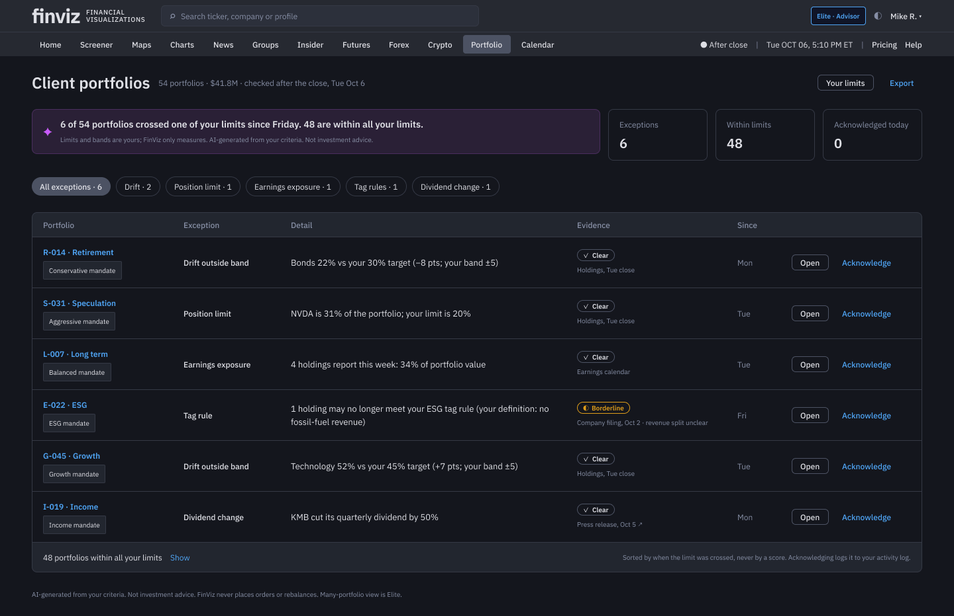
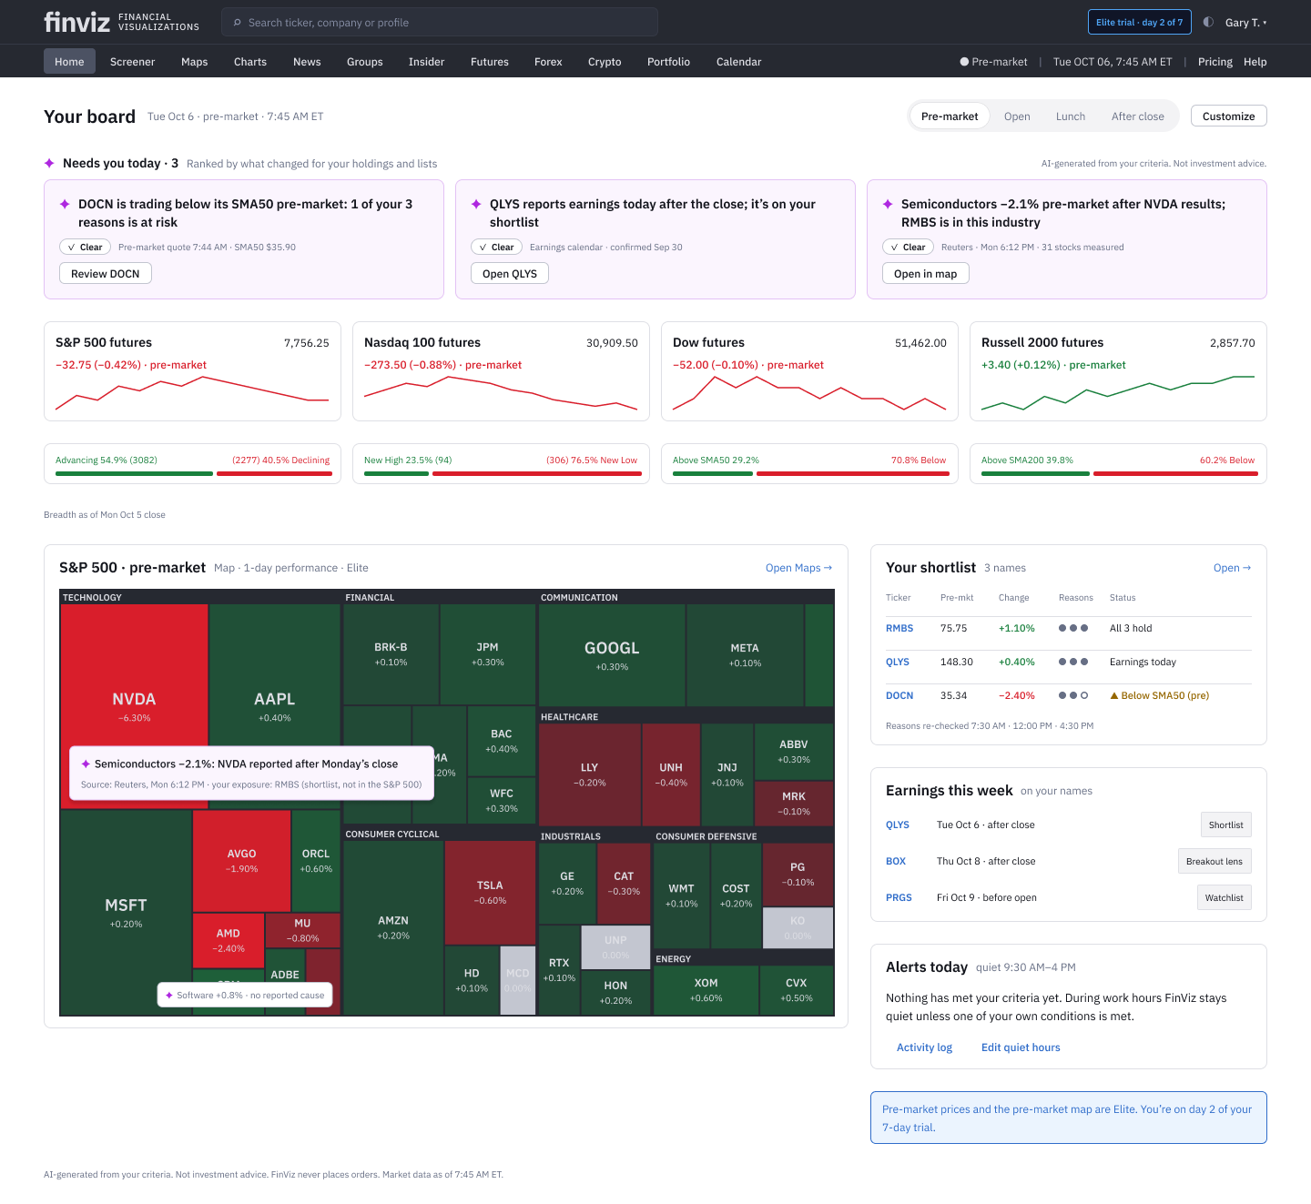
05 · Solution FinViz AI Screener
Beyond Gary: Many portfolios, and both themes
The same components and tokens serve an advisor and the Light theme.
DB4 Multi Mike: 54 client portfolios, only the 6 that crossed one of his limits
DB1 · light Same screen in the Light variable mode; no redrawing
DESIGN SYSTEM Every value is a FinViz token; new IB components (badge, reason dots, session switcher, insight card) live in the library.
Notes:
SCRIPT
[DB4] For an advisor running 54 portfolios, the same idea scales: the 6 that crossed one of his limits, each with evidence. The other 48 are one line.
[close] That's the whole trading day, built mostly on what FinViz already has: the screener, pattern signals, alerts and the earnings calendar. What's new is that FinViz remembers why Gary picked a stock, and watches it on his schedule.
The AI does the watching and the explaining. Gary makes every decision.

Slide 34
06 · Reasoning FinViz AI Screener
Trade-offs and rejected alternatives
The section that matters most: why the AI behaves the way it does.
We chose
We rejected
Why
Examples → editable filter chips
A chat box as the main way in
Real tasks are ambiguous; chips can be inspected, edited and saved
Measurements; clear / borderline / abstain
A confidence % on each detection
A number implies precision we can’t guarantee; measurements can be checked
Verify the trader’s own reasons
AI buy/sell calls, “top picks”, scores
Compliance and trust; only attributed third-party views
One reason-first alert in quiet hours
A live stream of every signal
Alert fatigue kills the habit; replay shows the cost first
Propose rule changes; apply on accept
Silent auto-tuning
He keeps control; every change announced, with Undo
A bounded agent on his names only
An open-ended research agent
Limits cost, hallucination surface and privacy exposure
Neutral “Clear”, amber “Borderline”
Green for “Clear”
Green means price up, nothing else
Desktop first
Mobile in release 1
The screener lives on desktop; mobile deferred, not dropped
ACCURACY VS CONTROL When the model is unsure, the product shows less and asks more. Borderline findings stay visible but never interrupt.

Slide 35
06 · Reasoning FinViz AI Screener
Eight design lead calls that changed the work
Sept 23
Sept 23
Sept 23
Sept 24
Sept 30
Sept 30
Sept 30
Oct 1
1
2
3
4
5
6
7
8
Map today’s onboarding before designing
Desktop only, for now
One design for first-time and repeat users
Remove real frictions with new AI models
Optimize time to first success; no chat box first
Set the advice line, pending compliance
Lead with the swing trader’s trading day
Bring teammates’ screens in line with the rules
Teal marks the team design review

Slide 36
06 · Reasoning FinViz AI Screener
What each call solved (1 of 2)
# | Design lead call | Why it was needed | What it solved
1 | Map today’s onboarding before designing Sept 23 | The docs assumed there was no trial and that slow free quotes were a big pain | A live-site walk found the existing 7-day trial and 1-minute-delayed quotes; the trial now starts from the first saved screen
2 | Desktop only, for now Sept 23 | No native app; two form factors would split the effort | Every screen scoped to 1440px desktop; mobile deferred
3 | One design for first-time and repeat users Sept 23 | Onboarding gates fail repeat users, who keep meeting new filters and decisions | “Onboarding is not a phase”: help fades per concept; no wizard, no tour
4 | Remove real frictions with new AI models Sept 24 | The first concepts were generic AI features | Every mechanic names the friction it removes and the AI advance it uses

Slide 37
06 · Reasoning FinViz AI Screener
What each call solved (2 of 2)
# | Design lead call | Why it was needed | What it solved
5 | Optimize time to first success; no chat box first Sept 30 | Text-to-filters assumed traders can state ambiguous intent precisely | Imports and examples lead; success must be timely, relevant and actionable
6 | Set the advice line, pending compliance Sept 30 | Buy or sell advice is a legal line | AI never originates advice; attributed analyst views behind a flag
7 | Lead with the swing trader’s trading day Sept 30 | Three concepts competed; none followed the real routine | The Trading Day became the lead concept
8 | Bring teammates’ screens in line with the rules Oct 1 | Frames drafted orders, showed confidence % and fit scores | Every flow ends at the trader’s decision and “Open in your broker”

Slide 38
07 · Methodology FinViz AI Screener
Methodology: AI and UX
Kept at the level a product team needs; model choices to confirm with engineering.
AI METHODS (HIGH LEVEL)
Constrained generation
An LLM maps examples or plain English to FinViz’s filter grammar; a validator rejects anything that isn’t a real filter.
Rule-based and statistical detection
Patterns as measurable criteria; support fitted to recent lows; thresholds decide clear vs borderline.
Counterfactual replay
His rule re-run on 30 days of history before he commits or changes it.
Retrieval and summarization
Overnight news and calendar items on his names only, each with source and time.
Learning from corrections
Feedback becomes proposed rule changes he approves, not hidden weights.
VALIDATION AND UX METHODS
Validation of the AI
Labeled chart sets for detection; weekly audits (< 1% wrong among clear); every claim traced to a value or source; A/B on time to first success.
UX research
Live-site audit, competitor review, service blueprint of the trading day, pain register scored by user × business impact.
Synthesis
Synthetic personas (to validate), reviewer feedback R1–R31, KPI tree, AI Solution Canvas.
Design iteration
Concepts → low-fi wireframes (iteration 1) → hi-fi in the design system (iteration 2).
Planned testing
5-user think-aloud on the hi-fi flow; 2-week diary study of alerts.

Slide 39
Discovery
Because of the business goal, gaps in FinViz’s onboarding and what traders do every day, we needed methods that found the real frictions, checked our assumptions against the live product, and opened space for new AI interaction models.
Market and competitor research
Live-site audit of today’s onboarding
Persona development (synthetic, to validate)
Service blueprint of the trading day
Pain register scored by user and business impact
KPI tree and North Star
Problem statement
Swing traders find ideas at night but can’t watch the market at work, so good screens are forgotten and the moment passes. They need a screen they trust in their first session, and a quiet partner that watches it and explains every alert, while every decision stays theirs.

Slide 40
DESIGN LEAD CALL One design for first-time and repeat users
AI UX Principles
Onboarding is not a phase: learnability is a property of every screen; no wizard, no tour.
Judgment stays with the trader: AI explains and verifies; it never recommends, predicts or places orders.
Learn by doing: every explanation is attached to a chip, a row or an alert.
Explain at the moment of doubt: “why it matched” on every row and every alert.
Scaffolds fade: help per concept fades with fluency and returns after 30 days.
Show consequences first: an alert is previewed against the last 30 days before it is saved.
Editable output: AI writes filters, rules and columns, never chat bubbles.
Honest history: base rates with sample sizes, never a confidence % on a trade.
Remembers your why: screens and watches keep the reasons they were created.
Grounded in research: Microsoft HAX guidelines and Google PAIR.

Slide 41
07 · Methodology FinViz AI Screener
The AI UX workflow: AI drafts, the design lead decides
1 · Frame
DESIGN LEAD
Sets the question, audience, scope and rules: desktop only, no advice, purple means AI
2 · Draft
AI AGENTS
Research, docs, FigJam boards and Figma screens, drafted against those rules
3 · Review
LEAD + TEAM
Fact checks on the live site; critique with the team; rule breaks caught
4 · Decide
DESIGN LEAD
What to adopt, rename, cut or lead with, and why
5 · Propagate
AI AGENTS
Each decision applied across every doc, board and screen
Repeated in every phase: research → principles → concepts → screens. Rules set by the lead live in the project brief, so every AI draft starts from them.
Notes:
Crimson = design lead checkpoints; violet = AI. The workflow I ran for this project.

Slide 42
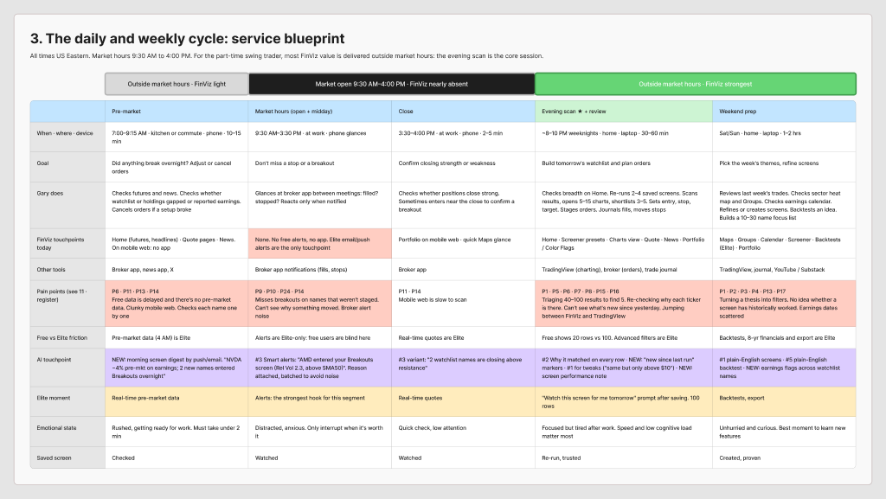
07 · Methodology FinViz AI Screener
The trading day: A service blueprint
Most of FinViz’s value lands outside market hours.
The evening scan is the core session. During the day FinViz is nearly absent: no free alerts and no app. A good screen tonight is forgotten by tomorrow.

Slide 43
08 · Implementation FinViz AI Screener
Implementation and integration
Built mostly on what FinViz already runs; the new pieces are small services around it. Not built; a plan to agree with engineering.
ALREADY IN FINVIZ
• Screener and its URL filter engine
• Rule-based pattern signals
• Elite alerts and the 7-day trial
• Earnings calendar and news feeds
• Portfolio and Maps
NEW SERVICES
• Translation: LLM + filter-schema validator
• Reasons engine: checks at 7:30, 12:00, 4:30
• Replay service for alert previews
• Overnight agent: one batch at 6 AM
• Notification scheduler (quiet hours) + activity log
INTEGRATION CHALLENGES
• LLM latency vs an instant screener: stream chips, cache common screens
• Free (delayed) vs Elite (real-time) data paths
• Cost of the overnight agent per user
• Compliance gate and feature flag for attributed expert views
COLLABORATION One token library (Figma variables matched to FinViz CSS variables), components specified, KPI events defined with analytics, compliance pre-review.

Slide 44
09 · Results & impact FinViz AI Screener
Trust is designed, then measured
< 2%
100%
filter translations wrong (weekly audit)
explanation accuracy: “why it matched” built from real values
< 40%
0
alerts with no action, the biggest driver of trust erosion
compliance incidents: no advice, no forecasts, no orders
Targets from the KPI framework, sitting next to product metrics so a faster screen never comes at the cost of a wrong one.

Slide 45
09 · Results & impact FinViz AI Screener
How success will be measured
42 → 21
3+ days
days from sign-up to Elite
a week re-running a saved screen: the North Star
< 5 min
> 40%
to a first saved screen
of alerts lead to an action
Concept-stage work: these are targets with a plan to baseline them, not results.

Slide 46
10 · Learnings & Next Steps FinViz AI Screener
What leading with AI taught me
The bottleneck moves to judgment
Drafts take minutes. The lead’s value is framing, checking facts and deciding what to keep.
Write the rules down once
Rules in the project brief made every AI draft start compliant.
Check the live product, not the docs
One live-site walk overturned two assumptions.
Reconcile, don’t overwrite
Teammates’ screens kept their best ideas and lost only what broke the rules.
Notes:
My reflection; edit to match how I'd say it in an interview.

Slide 47
10 · Learnings & Next Steps FinViz AI Screener
Before launch: What to validate next
Nothing has launched, so these replace post-launch learnings: the riskiest assumptions, and how to test them.
Will traders trust AI-detected patterns?
Offline audit of 500 labeled charts; track “not a real hammer” rate; test clear vs borderline wording.
Does free AI screen-building speed up Elite or replace it?
A/B the earned Elite moment (step 6) against today’s sign-up trial; measure days to Elite.
Is one alert a day the right amount?
2-week diary study with alerts on; alert-to-action > 40%, muted < 10%.
Can the overnight agent pay for itself?
Cost per user per morning vs conversion lift; batch and cache by ticker.
Is the advice line clear enough for compliance?
Legal review of every AI string; attributed views stay behind a flag until cleared.

Slide 48
Next Steps
Usability test the first-release flow with swing traders in their first 14 days
Baseline time to first success and habit before claiming improvement
Clear the advice line and attributed analyst views with compliance
Clickable hi-fi prototype of the 19-step flow for usability testing

Slide 49
Appendix
How we got here: the concept work, low-fi iterations, the Alerts & Notifications and Chart Lens assignment tracks, and the dashboard concept in low fidelity.

Slide 50
Design
• Three lead concepts, one per property of a first success
• An eight-feature, nine-screen first release
• Nine screens from the team’s early concepts (A · B · C), reconciled with the rules
The Concept
The Trading Day ·
the showcase
Timely. Follows one trade through the day: find at night, check before work, watch during work, review after the close.
Your Playbook
Relevant. Learns how you trade (your setups, your words, your rules) and speaks your language back.
The Decision Board
Actionable. Sourced evidence for and against each candidate; you record the decision and what would change your mind.
Designing the AI
Trust by design: editable output, honest history, no advice, and quality metrics that hold it to account.

Slide 51
Appendix FinViz AI Screener
Pain Points + Business Goals + UX Strategy = Feature Set
Pain Points
Ideas don’t become screens
Blind in market hours
No reason why it matched
Fixed filter buckets
Alert noise
Scattered catalysts
Business Goals
Sign-up → Elite in 21 days
Active Screeners habit
Make Elite’s value obvious
Keep the free tier useful
UX Strategy
Learn by doing
Editable AI output
Timely, relevant, actionable
Judgment stays with the trader
Feature Set
Bring what you have
Living screen sentence
Why it matched
Watch it for me (alerts)
Morning glance
Reasons still hold?
Decision Board
Your Playbook
+
+
=

Slide 52
Appendix FinViz AI Screener
The Trading Day, simplified
Five moments, two roles. FinViz watches and explains; Gary decides.
WHEN
Evening
8–10 PM · Home · laptop
Overnight
while he sleeps · Background
Before work
7:30 AM · Phone · 30 seconds
During work
9:30 AM–4 PM · In meetings
After the close
4:30 PM · Commute
GARY
Reviews what’s new, pins 3–5 names, taps “Watch these for me”
Nothing
Reads one short note
Taps one alert, if it comes
Decides: hold, or exit in his own broker
FINVIZ
✦ Shows what changed since last night and why each stock matched
✦ Checks gaps, earnings and news on his shortlist
✦ Says what changed and whether his reasons still hold
✦ Stays silent unless his own criteria are met; then one alert with the reason
✦ Shows which of his reasons still hold and which exit conditions fired
Gary’s checkpoints: pin the shortlist · tap “watch these” · open an alert · hold or exit. FinViz never drafts, sizes or places orders.
First release: 8 features, 9 screens (next page). The Elite trial starts at “Watch these for me”.
Notes:
Simplified Trading Day workflow. Purple ✦ marks what the AI does; the trader row is every human decision.

Slide 53
Appendix FinViz AI Screener
On Watch: The hero features of The Trading Day
Find it tonight. FinViz keeps watch while you work. You decide.
Today a FinViz screen is something Gary visits: he builds it at night, and by 9:30 the next morning it’s forgotten. On Watch turns a screen into something that keeps watch for him. It remembers why he picked each stock, watches those reasons on his schedule, and hands every decision back to him and his broker. It is built on what FinViz already has: the screener and its 89 filters, pattern signals, Elite alerts, the earnings calendar and the 7-day trial.
WHAT GARY NEEDS TO DO
Job 1
“Turn my idea into a screen that works.”
P1 · P2 · P3
Job 2
“Show me what’s new, and why it’s here.”
P5 · P6 · P8
Job 3
“Remember why I picked it.”
P8 · P16
Job 4
“Tell me when it matters, not all day.”
P9 · P10 · P11
Job 5
“Help me decide: hold or get out.”
P13 · P15 · P16
SEVEN HERO FEATURES
1 · Show It
Evening
2 · Since Last Night
Evening
3 · Reasons Ledger
Evening
4 · Watch These For Me
Evening · Elite trial starts
5 · Morning Glance
7:30 AM
6 · Quiet Hours, One Alert
9:30 AM–4 PM
7 · Reasons Still Hold?
4:30 PM
Notes:
On Watch = the concept name for the seven hero features of The Trading Day. Spec: Design-Specs/On-Watch-Hero-Features.md. Wireframes: Figma page “On Watch · hero wireframes (low-fi)”.

Slide 54
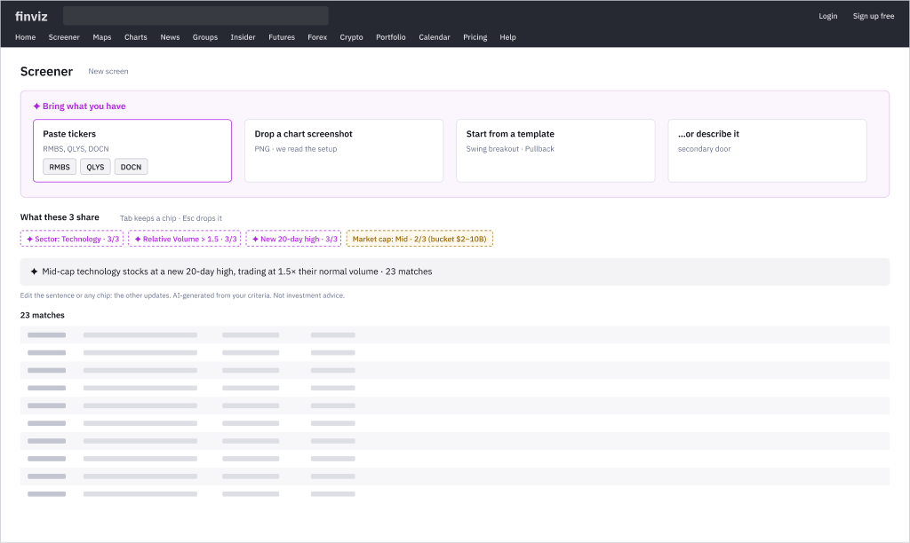
Appendix FinViz AI Screener
Hero feature 1 · Show It
ITERATION 1 · LOW-FI WIREFRAME Evening
JOB 1
“Turn my idea into a screen that works.”
P1 · P2 · P3
WHAT HAPPENS
Gary pastes 3–5 tickers he already likes (or drops a chart screenshot). FinViz shows what they share as editable filter chips with a live count, and a sentence that reads the screen back.
WHAT WE’LL TEST NEXT
Can a first-time user get a working screen from 3 tickers in under 5 minutes, without help? Do they edit the ghost chips or accept them blindly?
NEW INTERACTION
Instead of: Fill in 89 dropdowns, or type a request into a chat box
Drop tickers in; ghost chips appear with coverage (3/3). Tab keeps a chip, Esc drops it; the sentence and chips stay in sync both ways.
✦ WHY IT’S AI-INNOVATIVE
Programming by example plus constrained generation: the output can only be FinViz’s real filters, mapped to buckets on Free and exact values on Elite.
Built on: Screener URL and its 89 filters · Free · F44 F36 F35
Notes:
SCRIPT
[OW1] Gary doesn't start with 89 dropdowns or a chat box. He pastes three stocks he already likes. FinViz's AI works out what they have in common, and the result is real filter chips he can edit, with a live count. AI learns from his examples. It doesn't make him write a query.
— Production notes —
Hero feature 1 of On Watch. Low-fi wireframe OW1 in Figma (page “On Watch · hero wireframes (low-fi)”), with numbered annotations. Iteration 1; next step is the test listed on the page.

Slide 55
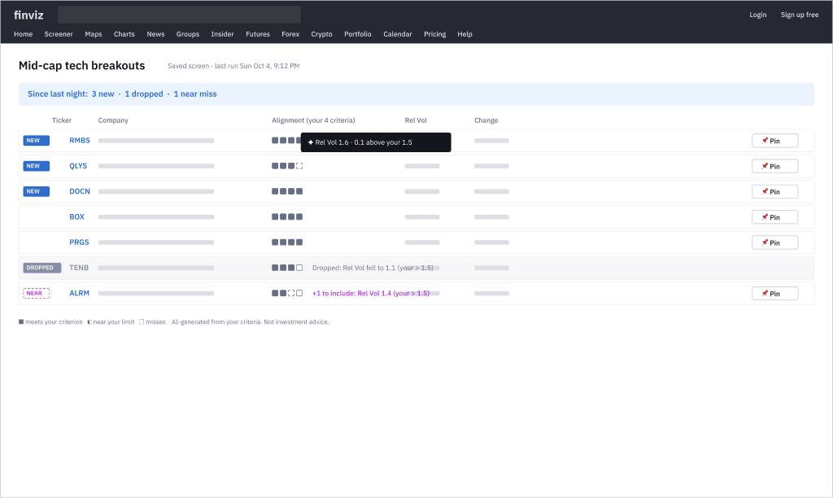
Appendix FinViz AI Screener
Hero feature 2 · Since Last Night
ITERATION 1 · LOW-FI WIREFRAME Evening
JOB 2
“Show me what’s new, and why it’s here.”
P5 · P6 · P8
WHAT HAPPENS
His saved screen opens on what changed: new and dropped names on top, a near miss with the one criterion it misses, and an alignment strip on every row.
WHAT WE’LL TEST NEXT
Do traders stop re-checking every row? Is the alignment strip read as distance from their criteria, not as a rating?
NEW INTERACTION
Instead of: Scroll the whole list A→Z and re-check every name each night
The diff is the default view. Hover a pip for the exact distance to his limit; a near miss offers “+1 to include”; Pin sends a row to the shortlist.
✦ WHY IT’S AI-INNOVATIVE
Grounded “why it matched”, built from real filter values, never generated prose; alignment is distance from his criteria, never a quality score.
Built on: Saved screens and filter values · Free · F4 F3 F34
Notes:
SCRIPT
[OW2] He opens his saved screen. The new names are at the top, and every row shows which of his criteria it meets, or how close it came. The "why it matched" comes from real values, never a score.
— Production notes —
Hero feature 2 of On Watch. Low-fi wireframe OW2 in Figma (page “On Watch · hero wireframes (low-fi)”), with numbered annotations. Iteration 1; next step is the test listed on the page.

Slide 56
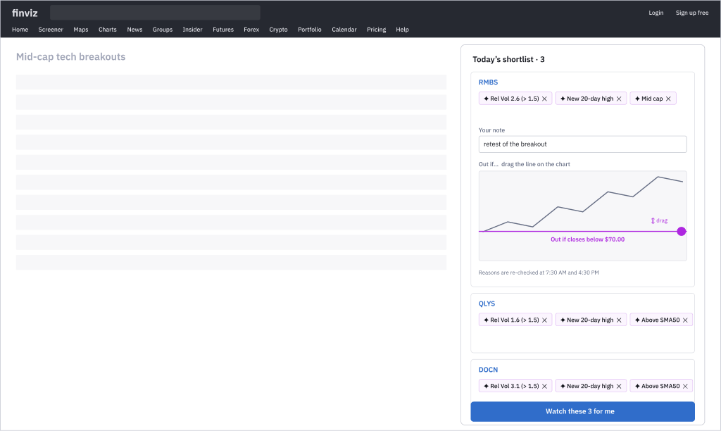
Appendix FinViz AI Screener
Hero feature 3 · Reasons Ledger
ITERATION 1 · LOW-FI WIREFRAME Evening
JOB 3
“Remember why I picked it.”
P8 · P16
WHAT HAPPENS
Pinning a row carries its reasons with it as chips. Gary adds a note in his words and sets an optional exit condition, then watches the shortlist.
WHAT WE’LL TEST NEXT
Do traders keep the auto-captured reasons? Is dragging the exit line faster and clearer than typing a price?
NEW INTERACTION
Instead of: Add a ticker to a watchlist and keep the reason in his head
Pinning captures intent in the gesture: reasons arrive as chips he can strike or edit. “Out if…” is set by dragging a line on the chart, not typing a number.
✦ WHY IT’S AI-INNOVATIVE
Matched criteria become checkable conditions (“Rel Vol > 1.5”, “above SMA50”) that FinViz can re-verify later: transparent, editable memory of the why.
Built on: Watchlists and Portfolio · Free · F60 F54 F58
Notes:
SCRIPT
[OW3] He pins three names. His reasons come with them, his own note too, and he drags an "out if" line straight onto the chart. The product remembers why he picked each one.
— Production notes —
Hero feature 3 of On Watch. Low-fi wireframe OW3 in Figma (page “On Watch · hero wireframes (low-fi)”), with numbered annotations. Iteration 1; next step is the test listed on the page.

Slide 57
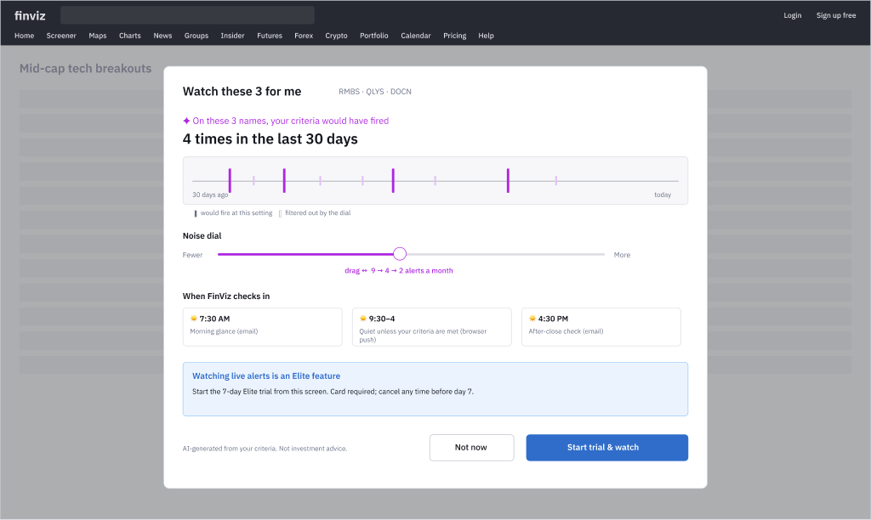
Appendix FinViz AI Screener
Hero feature 4 · Watch These For Me
ITERATION 1 · LOW-FI WIREFRAME Evening · Elite trial starts
JOB 4
“Tell me when it matters, not all day.”
P9 · P10 · P11
WHAT HAPPENS
One tap on the shortlist opens a sheet: on these 3 names his criteria would have fired 4 times in the last 30 days. He sets the noise dial and when FinViz checks in; the 7-day Elite trial starts here.
WHAT WE’LL TEST NEXT
Does the replay change the noise setting traders choose? How many start the trial from this sheet vs from sign-up?
NEW INTERACTION
Instead of: Fill in an alert form blind and discover the noise later
A noise dial that replays the past live: dragging it re-draws the 30-day timeline (fired 9 → 4 → 2) before anything is saved.
✦ WHY IT’S AI-INNOVATIVE
Counterfactual replay of the alert against the last 30 days (simulation before commitment); every future alert carries his reason.
Built on: Elite alerts and the existing 7-day trial · Elite (trial) · F52 F28 F6
Notes:
SCRIPT
[OW4] One tap. Before he commits, FinViz replays the last 30 days: "Your criteria would have fired 4 times." He drags the noise dial and the timeline redraws. He sees what he'll get before he signs up for it. His 7-day Elite trial starts here, because this is the moment the value is obvious.
— Production notes —
Hero feature 4 of On Watch. Low-fi wireframe OW4 in Figma (page “On Watch · hero wireframes (low-fi)”), with numbered annotations. Iteration 1; next step is the test listed on the page.

Slide 58
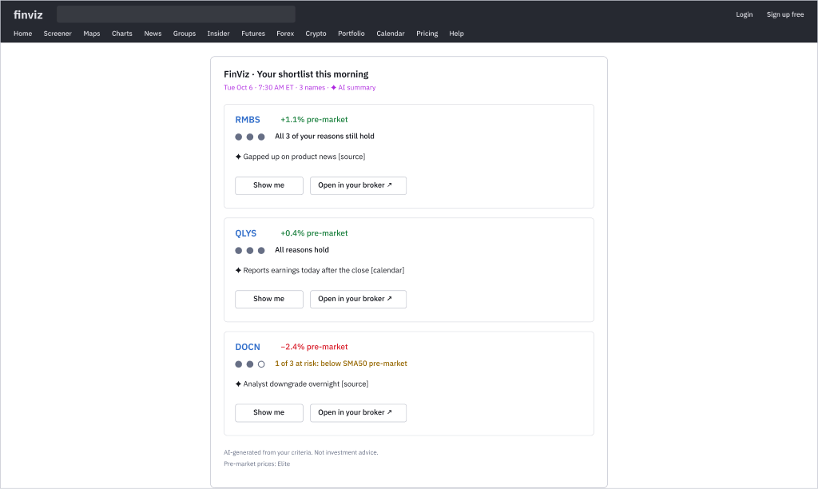
Appendix FinViz AI Screener
Hero feature 5 · Morning Glance
ITERATION 1 · LOW-FI WIREFRAME 7:30 AM
JOB 4
“Tell me when it matters, not all day.”
P9 · P10 · P11
WHAT HAPPENS
At 7:30 AM one short note covers only his names: pre-market move, overnight news with sources, and whether his reasons still hold. A broken reason is named in his words.
WHAT WE’LL TEST NEXT
Can traders read it in under 30 seconds? Do they notice a hollow dot and open “Show me”?
NEW INTERACTION
Instead of: Scan a news feed and look up each ticker
One card per name, readable in 30 seconds. Reason dots go hollow when a reason breaks; “Show me” opens the chart at the exact moment it changed.
✦ WHY IT’S AI-INNOVATIVE
A bounded overnight agent scoped to his shortlist and holdings; every line grounded, sourced and labelled as AI (unlike FinViz’s unlabelled Weekend Brief).
Built on: Earnings calendar (real-time on Free), news, pre-market data · Free / Elite pre-market · F10 F61 F53
Notes:
SCRIPT
[OW5] Gary is asleep, and FinViz watches his three names and nothing else. At 7:30, a note he can read in 30 seconds: RMBS is up before the open on product news, with the source. QLYS reports tonight. DOCN is trading below its 50-day average before the open, so one of his three reasons is at risk. A tightly scoped AI agent, every line sourced.
— Production notes —
Hero feature 5 of On Watch. Low-fi wireframe OW5 in Figma (page “On Watch · hero wireframes (low-fi)”), with numbered annotations. Iteration 1; next step is the test listed on the page.

Slide 59
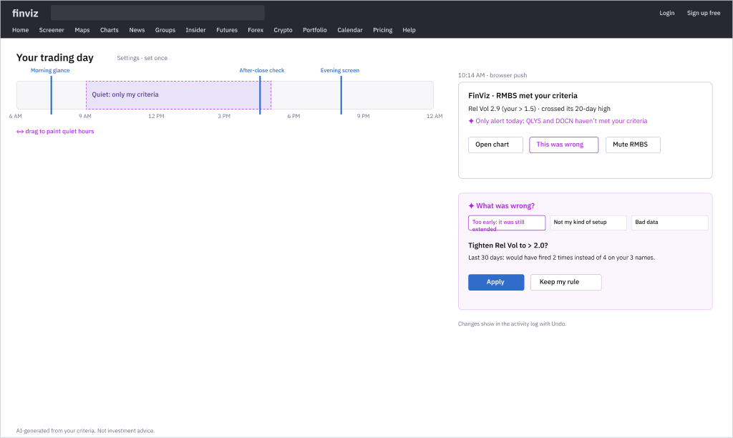
Appendix FinViz AI Screener
Hero feature 6 · Quiet Hours, One Alert
ITERATION 1 · LOW-FI WIREFRAME 9:30 AM–4 PM
JOB 4
“Tell me when it matters, not all day.”
P9 · P10 · P11
WHAT HAPPENS
Gary paints his quiet hours once. During work FinViz stays silent unless his own criteria are met; then one alert with the reason. “This was wrong” proposes a tighter rule with a preview.
WHAT WE’LL TEST NEXT
Do traders feel interrupted at work? Do they use “This was wrong” instead of muting?
NEW INTERACTION
Instead of: Set price alerts one by one, then mute the app when it gets noisy
Paint quiet hours on a day strip. “This was wrong” teaches instead of muting: a tighter rule with a preview of what would have changed, announced and undoable.
✦ WHY IT’S AI-INNOVATIVE
Time-aware batching on his day profile; anomaly detection against the stock’s own normal; feedback tunes the rule, never silently.
Built on: Elite alerts and pattern signals · Elite · F59 F52 Q22
Notes:
SCRIPT
[OW6] Gary is at work, and FinViz stays quiet. At 10:14, one alert: "RMBS met your criteria: Rel Vol 2.9, your threshold 1.5." That's the only interruption all day.
— Production notes —
Hero feature 6 of On Watch. Low-fi wireframe OW6 in Figma (page “On Watch · hero wireframes (low-fi)”), with numbered annotations. Iteration 1; next step is the test listed on the page.

Slide 60
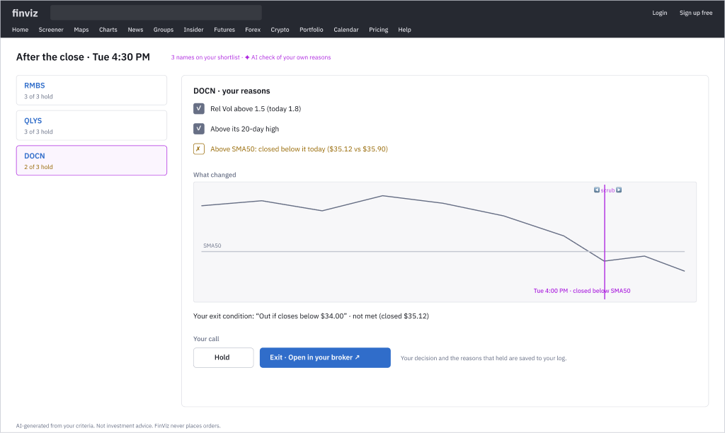
Appendix FinViz AI Screener
Hero feature 7 · Reasons Still Hold?
ITERATION 1 · LOW-FI WIREFRAME 4:30 PM
JOB 5
“Help me decide: hold or get out.”
P13 · P15 · P16
WHAT HAPPENS
After the close, each name’s reasons are re-checked. A broken one shows exactly when it broke; his exit condition shows its status. Hold or Exit is his call.
WHAT WE’LL TEST NEXT
Does the checklist help traders act on exits without reading it as advice?
NEW INTERACTION
Instead of: Re-open charts, decide on gut feel, switch to the broker
A checklist that ticks itself. A broken reason opens a “what changed” scrubber on the chart; Exit hands off to his broker and the decision is logged.
✦ WHY IT’S AI-INNOVATIVE
Re-verifies the trader’s own stated reasons and conditions: a verifier, never an advisor. That is both the ethical and the compliance line.
Built on: Price and indicator data · Free daily / Elite live · F54 F58 F62 F63
Notes:
SCRIPT
[OW7] After the close, a checklist that ticks itself. RMBS and QLYS: all reasons hold. DOCN: two of three. FinViz shows what changed and when. It checks his reasons. It doesn't give advice. Hold or exit is Gary's call, made in his own broker. FinViz never places a trade.
— Production notes —
Hero feature 7 of On Watch. Low-fi wireframe OW7 in Figma (page “On Watch · hero wireframes (low-fi)”), with numbered annotations. Iteration 1; next step is the test listed on the page.

Slide 61
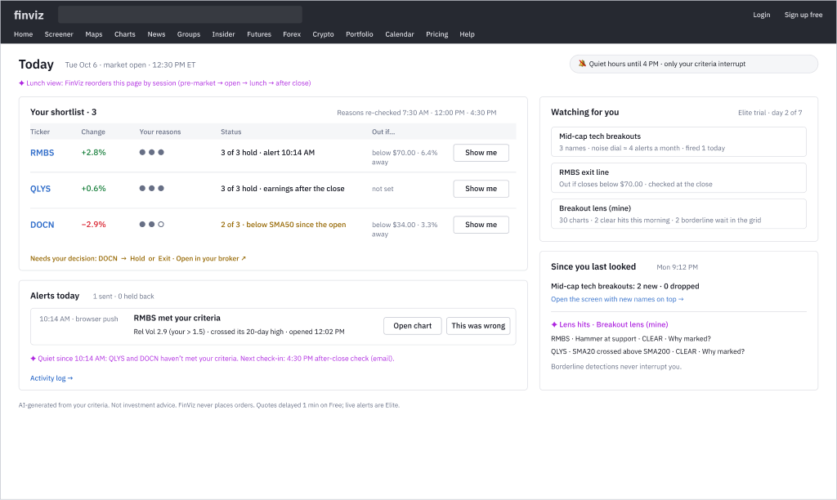
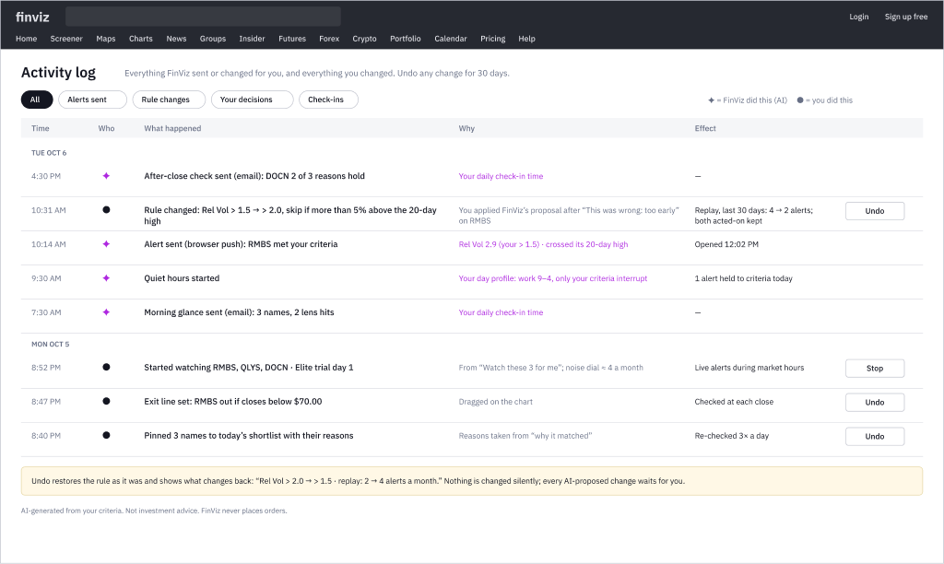
Appendix FinViz AI Screener
Today: One page for the whole trading day
The hero features meet on one dashboard. It reorders by market session, shows what was held back as well as what was sent, and logs every change with Undo.
AN9 · Activity log + Undo
Who did it (✦ FinViz or Gary), why, and the effect. Undo previews before restoring.
WHY A DASHBOARD
Answers “what needs me now?” without visiting Screener, Portfolio and Alerts
Silence reads as “checked”, not “broken”
Reasons are dots, not scores
Purple = AI only; green and red = price only
TD1 · Today Shortlist with reason dots and exit lines, the day’s alerts, watches with their noise level, the night’s changes and lens hits.
Notes:
SCRIPT
[TD1] At lunch, one page: his shortlist, the day's one alert, what was held back, and what needs a decision. Silence means FinViz checked, not that something broke.
[AN9] Everything FinViz sent and changed, and everything Gary changed, all in one log. Purple marks the AI's actions. Every change can be undone.

Slide 62
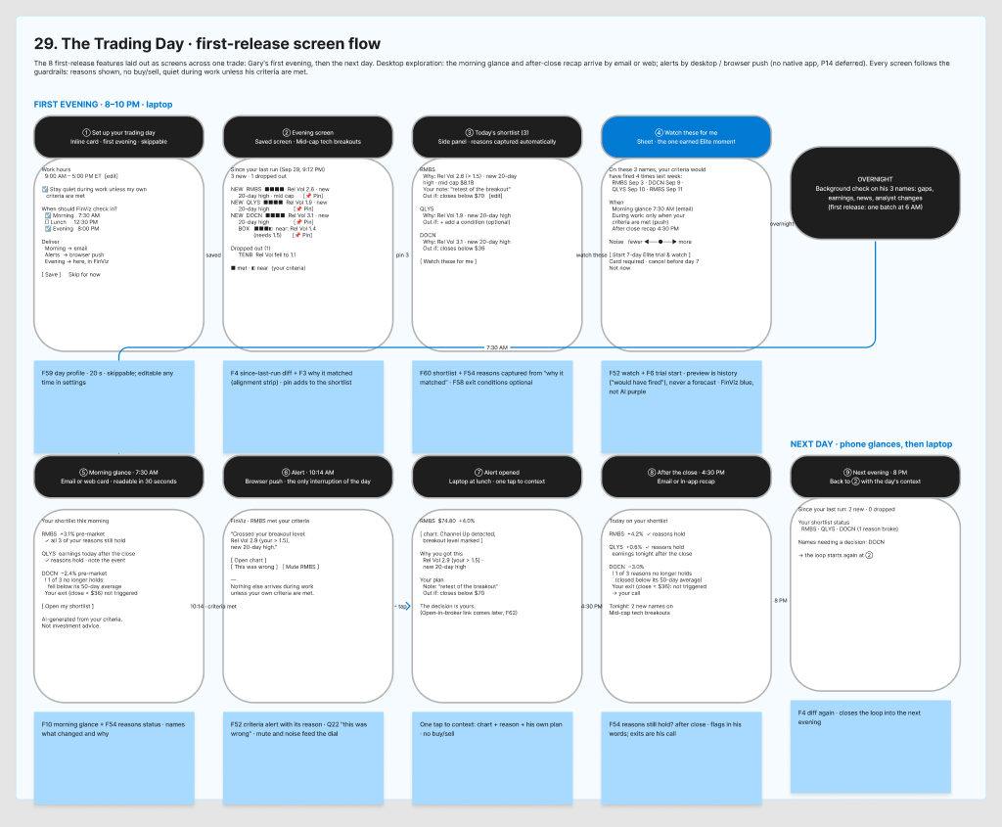
Appendix FinViz AI Screener
DESIGN LEAD CALL Chose the lead concept
The Trading Day concept scenario
8–10 PM
Gary sees what’s new since last night and why each name matched, pins a shortlist and taps “watch these for me”.
7:30 AM
A morning note he reads in 30 seconds: what changed, and what needs him today.
10:14 AM
One alert at work, only because his own criteria were met, with the reason.
4:30 PM
After the close: do his reasons still hold? Exits stay his call, in his own broker.

Slide 63
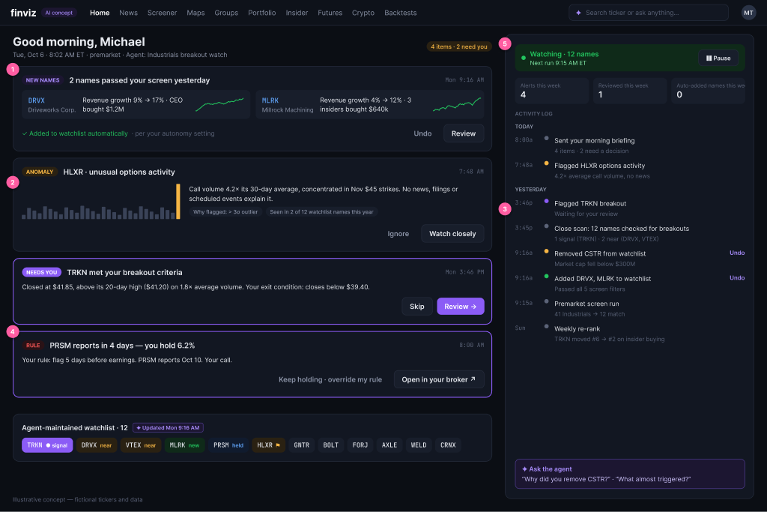
Appendix FinViz AI Screener
Proof of Concept Design 1
Morning briefing
Gary’s 7:30 AM glance: what needs him vs. FYI, the rule nudges he set, and a log of everything FinViz did on its own, each with Undo.
What we learned in the review
Alerts are everything for timeliness
A first success must be timely, relevant and actionable at once
Habit comes from satisfaction, not excitement
The Trading Day · morning briefing and activity log

Slide 64
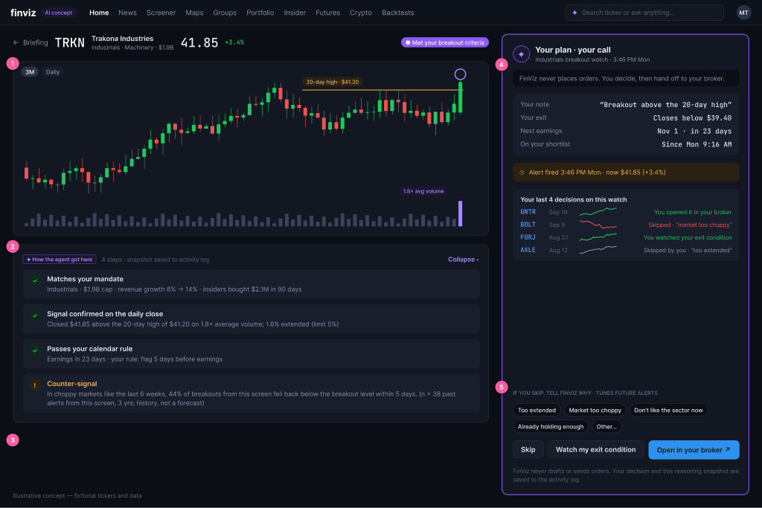
DESIGN LEAD CALL Brought teammates’ screens in line with the rules
Appendix FinViz AI Screener
Proof of Concept Design 2
Alert opened · your plan, your call
Reasoning shown as auditable steps, the case against with its base rate (history, n = 38), and the trader’s own plan. It ends at “Open in your broker”.
What we changed
Removed the order ticket, sizing and confidence %
Kept the counter-signal as history, not a forecast
Skip reasons tune future alerts
The Trading Day · alert opened

Slide 65
Appendix FinViz AI Screener
Three workflows, one trader’s checkpoint each
TIMELY
The Trading Day · the showcase
RELEVANT
Your Playbook
ACTIONABLE
The Decision Board
1 Evening
2 Overnight
3 Before work
4 During work
5 After the close
6 Weekend
1 Seed
2 Notice
3 Own
4 Test
5 Use
6 Reflect
1 Select
2 Assemble
3 Compare & question
4 Decide
5 Hand off & watch
38 features · 8 in the first release · 9 screens
18 features · 6 in the first release · 8 screens
20 features · 5 in the first release · 7 screens
Trader’s checkpoint
Every alert ends at his own call and his broker
Trader’s checkpoint
Nothing enters the playbook until he taps “Add”
Trader’s checkpoint
Every board ends in a decision he writes
Notes:
All three workflows are now specified to the same depth: stages, feature list, first release and a first-release screen flow (FigJam sections 29, 32, 33).

Slide 66
Appendix FinViz AI Screener
Your Playbook workflow
FinViz drafts and asks; the trader owns every entry. The playbook grows from what he already does, never from what FinViz thinks he should do.
1 · Seed
Imports, saved screens and inline answers become draft entries, each showing its source
2 · Notice
A repeated pattern becomes one question: “Add ‘No earnings risk’?” Add, or Not a rule
3 · Own
Every entry visible, editable, versioned and deletable
4 · Test
One-tap backtest: matches and moves with sample size, as history
5 · Use
Screens, alerts and reasons speak the entry’s words
6 · Reflect
Opt-in: his trades vs his own rules, never advice
First-release screen flow
① A suggestion appears after the 6th similar screen
② Name it: editable definition chips
③ Your Playbook page: source and where used
④ Entry detail: version history and Undo
⑤ Test this setup: the earned Elite moment
⑥ Screen from the entry, closest to your setup
⑦ An alert in your words
⑧ Monthly reflection (later)
Notes:
FigJam section 32. First release: drafts from saved screens and answers, pattern noticing with confirm, the playbook page with history, screen from an entry, test this setup, alerts in your words.

Slide 67
Appendix FinViz AI Screener
The Decision Board workflow
From 3 matches at night to a written decision, a broker hand-off and watches the next morning. The AI assembles and compares; the trader decides.
1 · Select
Check 2–8 rows, the whole screen or the shortlist → send to board
2 · Assemble
Sourced evidence cards per stock, including the evidence against his setup
3 · Compare & question
Pin the same card across stocks; ask at a scope; honest gaps
4 · Decide
Take, pass or keep watching; thesis and what would change his mind
5 · Hand off & watch
Open in your broker; conditions become Trading Day watches
First-release screen flow
① Select 3 rows → Send to board
② Assembling: cards stream in, each sourced
③ Evidence stacks, including the case against
④ Compare parts + a scoped question
⑤ Decide: thesis + what would change my mind
⑥ Hand off: broker link + watch my conditions
⑦ Next morning: reasons still hold?
Notes:
FigJam section 33. First release: send to board, evidence cards, part-level compare, decision record with what would change my mind and pass with a reason, broker hand-off and conditions as watches.

Slide 68
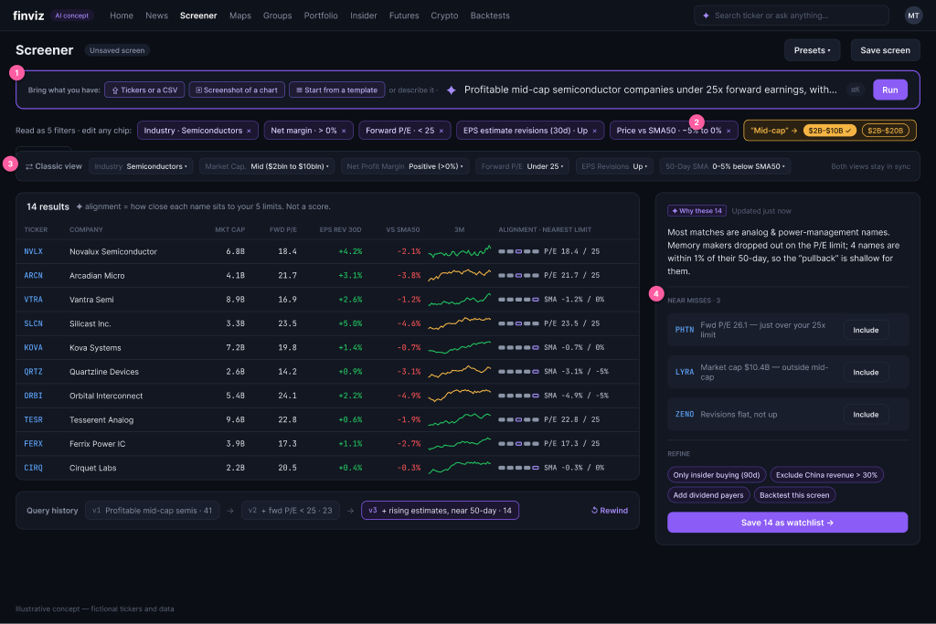
Appendix FinViz AI Screener
Proof of Concept Design 3
Bring what you have
Start from tickers, a chart screenshot or a template instead of a blank box. Each filter becomes an editable chip; matches show how close they sit to your limits, never a fit score.
What we learned in the review
A chat box is not the answer
Pre-fill filters from what users already have
Ask one question about vague terms, never guess
Filtering · screener with alignment strip

Slide 69
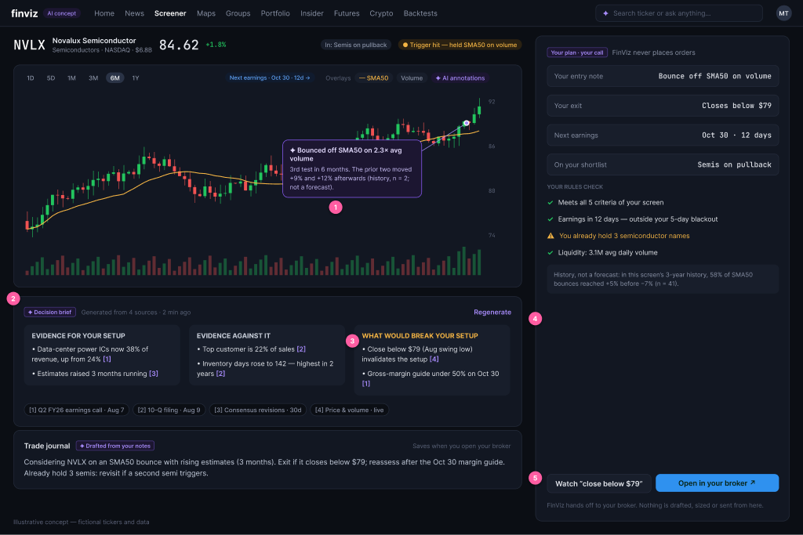
DESIGN LEAD CALL Set the advice line, pending compliance
Appendix FinViz AI Screener
Proof of Concept Design 4
The Decision Board
Sourced evidence for and against your setup, what would break it, and your plan. FinViz never says which stock is best.
Guardrails
No AI verdict, no quality score
Every claim cited to its source
Analyst views behind a flag until compliance clears them
Decision Board · cited evidence and broker hand-off

Slide 70
Alerts &
Notifications
Watching the market is mundane, manual work. Gary does it today by keeping tabs open, re-running screens and setting price alerts one at a time. This track asks how AI, and plain good product, can take that work off him without taking the decision away from him.
• AI Solution Canvas v2 for alerts
• Input, output and refinement journeys
• 18 ideas, AI and non-AI, prioritized by impact
• The sketched AI-powered alerts journey
• Today’s entry point: a bell on the quote page, one rule at a time, Elite only

Slide 71
Appendix FinViz AI Screener
AI Solution Canvas: Alerts & notifications
PROBLEM
Can’t watch the market at work (P9). Alerts are Elite-only, one rule at a time, no reason, noisy (P10)
USERS
Primary: Growth Gary, swing trader with a day job. Conversion lever: Fast Frank, pre-market
VALUE
Your criteria, watched on your schedule, explained when they fire, easy to tune
WHERE AI HELPS
Intent → rules · 30-day replay · reason-first alerts · unusual-for-this-stock · learning from corrections · missed moves
WHERE AI MUST NOT
Originate buy/sell or predictions · place orders · change a rule silently · invent reasons
NON-AI THAT MATTERS
Day profile + quiet hours · channels · grouping · pause · activity log + Undo · broker hand-off
DATA IN
His screens, shortlist, reasons, exit lines, feedback; prices, volume, signals, earnings, news, insider, analyst
OUTPUTS
Watches · previews (“fired 4×”) · alerts with reasons · morning glance · after-close check · weekly review
FEEDBACK LOOPS
This was wrong (+ reason) · noise dial · snooze · retire · I missed one · alert-to-action
RISKS → GUARDRAILS
Fatigue, false triggers, read-as-advice → quiet hours default, reason + source, previewed changes + Undo, AI label
BUSINESS
Build + preview Free; live watching Elite; trial starts at “Watch these for me”
METRICS
Alert-to-action > 40% · no-action < 40%, muted < 10% · alert → chart < 10 min · “wrong” rate ↓
Notes:
AI Solution Canvas v2 for alerts. Supersedes Solution 3 in 05-Solution-Canvas.md. Spec: Design-Specs/Alerts-and-Notifications.md.

Slide 72
Appendix FinViz AI Screener
Input, output and refinement journeys
INPUT
Setting up what to watch
I1
Start from context: “Watch” on a screen, row, chart
I2
State intent: reasons, a dragged exit line, or type
I3
Preview: noise dial redraws 30 days (9 → 4 → 2)
I4
When + how: paint quiet hours once
I5
Commit: Elite trial starts here
OUTPUT
What arrives, and when
O1
7:30 AM morning glance, his names only
O2
One reason-first alert at work; grouped if several
O3
Opened: chart at the trigger bar + his plan
O4
4:30 PM reasons still hold? checklist
O5
Activity log: every send and change, Undo
REFINEMENT
Keeping alerts useful (the hard one)
R1
“This was wrong” → tighter rule, previewed
R2
Noise dial re-ranks what survives
R3
“I missed one” → which condition blocked it
R4
Broken reasons and stale watches: asked, not imposed
R5
Sunday review; every change announced + Undo

Slide 73
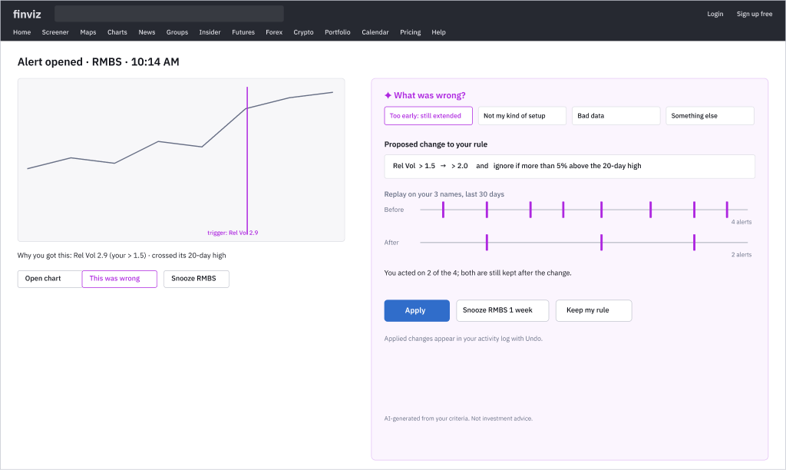
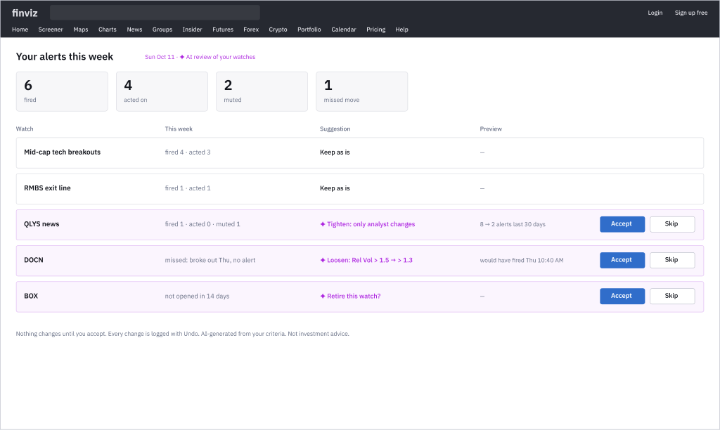
Appendix FinViz AI Screener
Refinement: Making tuning as light as dismissing
Alerts decay: the market changes, reasons break, noise creeps in. Most tools offer only edit, mute or delete. Every refinement here is proposed, previewed and reversible.
AN7 · “This was wrong” → proposed fix A reason, a specific rule change, a before/after replay (4 → 2 alerts, both acted-on kept). Apply, Snooze or Keep.
AN8 · Weekly alert review Fired, acted on, muted, missed; then tighten, loosen or retire, each previewed. Accept or Skip.
REFINEMENT PRINCIPLES
Every suggestion comes with a preview of its effect · nothing changes silently · corrections count as feedback · decay is asked, not imposed · the trader can always see and undo.
Notes:
SCRIPT
[AN7] It came too early, so he taps "This was wrong" and gives the reason. FinViz proposes a tighter rule and shows him the replay: 4 alerts become 2, and the ones he acted on are kept. Nothing changes until he applies it. The AI learns from his corrections, in the open.
[AN8] Six alerts fired and he acted on four. FinViz suggests tightening one, loosening one and retiring one, each with a preview. He accepts or skips.

Slide 74
Appendix FinViz AI Screener
Prioritized ideas: Highest impact first
User impact × business impact (1–5 each); effort S / M / L. Scores are design judgment, to validate with users.
1
30-day replay + noise dial 🤖
25 · M
2
Reason-first alert copy 🤖
20 · S
3
Reasons become rules 🤖
20 · M
4
“This was wrong” → proposed fix 🤖
20 · M
5
Day profile + quiet hours ⚙️
20 · S
6
Morning glance 🤖
16 · M
7
Reasons still hold? 🤖
16 · M
8
Free preview, Elite live ⚙️
15 · S
9
Grouped triggers ⚙️
12 · S
10
Activity log + Undo ⚙️
9 · S
Release 1: the ten above. Release 2: “I missed one” → loosening · weekly alert review · stale-watch retirement · unusual-for-this-stock · plain-language watch (secondary door).

Slide 75
Appendix FinViz AI Screener
The new AI-powered alerts journey
INPUT ① Pin 3 names
INPUT ② Watch these
OUTPUT ③ 7:30 AM glance
OUTPUT ④ One alert
Reasons come along
Replay “fired 4×”, noise dial, trial
His names, sourced
Reason-first, grouped
OUTPUT ⑤ 4:30 PM still hold?
REFINE ⑥ “This was wrong”
REFINE ⑦ Sunday review
THE LOOP
Refinement feeds better watches back into input. AI translates, previews, explains and learns; the trader decides, in his own broker.
Hold / Exit in his broker
Tighter rule, previewed
Tighten, loosen, retire

Slide 76
Appendix FinViz AI Screener
Chart Lens: Let FinViz look at the charts first
Before deciding anything, traders flip through dozens of charts checking the same few things. Each is a check run over a list, every day: exactly what a computer should do, and what the alerts track already watches.
S1
Price at support
Which charts touch the diagonal support line?
FinViz today: Auto trendlines exist; no distance sort or alert
S2
SMA20 × SMA200
Golden / death cross across the list, every day
FinViz today: SMA filters exist; no “about to cross” or history
S3
Pattern in context
Hammer or engulfing, and is it at support?
FinViz today: Candlestick filter exists; location is missing
S4
Linked crosshairs
Same day across charts; volume confirms the breakout?
FinViz today: No linked crosshair found
S5
Templates on a portfolio
One setup, applied to every holding
FinViz today: No “apply to my portfolio and summarize”
THE KEY JOURNEY
SCAN
One grid of his list, ranked by distance to his lens
CONFIRM
Linked crosshair; volume vs each stock’s own norm
WATCH
“Watch this lens” hands off to the alerts track
REVIEW
Drag the line, flag the label; FinViz remembers
Notes:
Chart Lens: assignment scenarios S1–S5 (support, MA crosses, candlestick patterns in context, linked crosshairs/volume, templates on a portfolio). Spec: Design-Specs/Chart-Lens.md. FigJam section 38.

Slide 77
Appendix FinViz AI Screener
Chart Lens: Input, output and refinement
INPUT
Define a lens
I1
Pick a starter lens or his own
I2
Tune chips: “within 1% of support”, “hammer AT support”
I3
Draw a line on one chart → a rule for the list
I4
Save as “Breakout lens (mine)”
OUTPUT
What he sees
O1
Grid ranked by distance to the lens
O2
What happened, marked on the bar
O3
Linked compare; volume vs its norm
O4
Portfolio summary: facts, not scores
REFINEMENT
When the AI’s eyes are wrong
R1
Drag a misdrawn support line; it’s remembered
R2
“Not a real engulfing” + why
R3
Move tolerance with a live count
R4
Weekly lens review; every change + Undo
Pattern names are labels, never advice · distance is to his condition, never a quality score · every marker sourced to the bar.

Slide 78
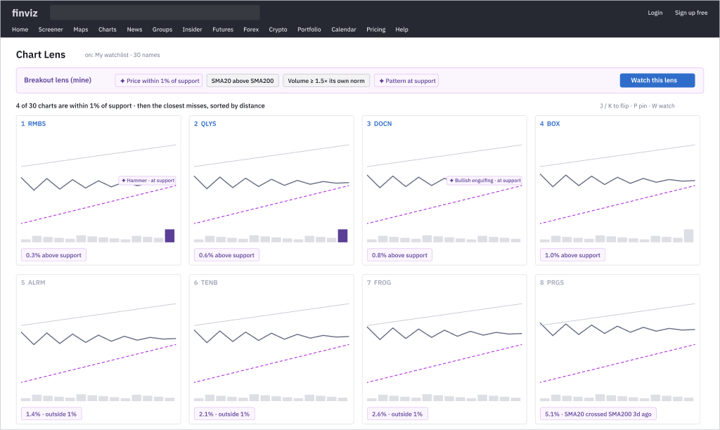
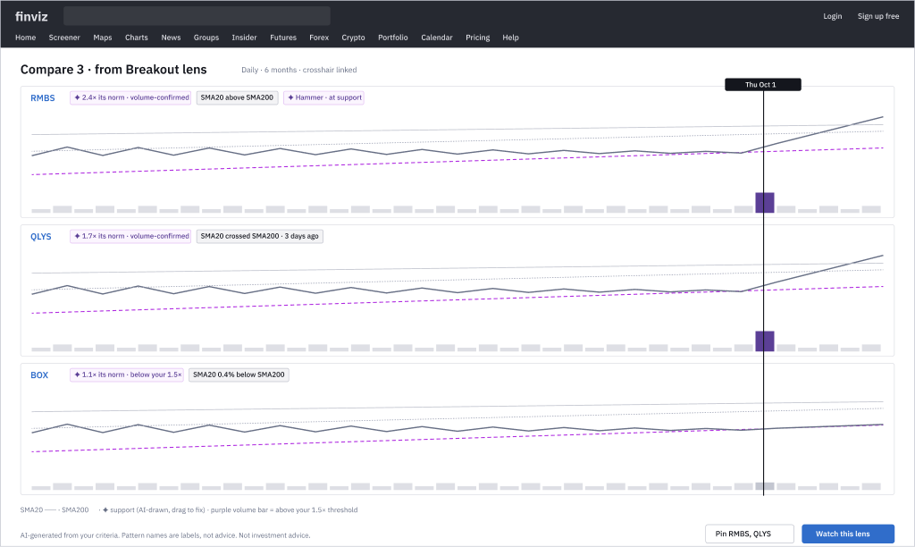
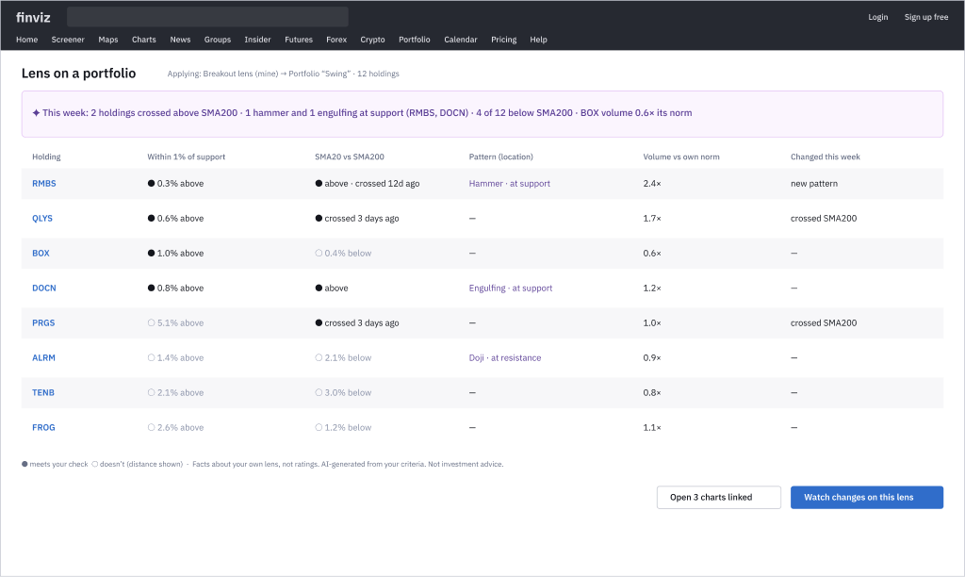
Appendix FinViz AI Screener
Chart Lens: The sketched journey
① Ranked lens grid his 30 names ranked by distance to support; markers on the bar; W to watch
② Linked compare one crosshair across 3 charts; volume 2.4× its norm = volume-confirmed
③ Lens on a portfolio
Apply the lens to 12 holdings: which meet which checks, what changed this week. Facts, not ratings.
PRIORITIZED (RELEASE 1)
1 Distance-to-condition sort
2 Lenses on a list
3 Pattern in context
4 Watch this lens
5 Linked crosshair grid
6 Volume vs its own norm
Notes:
SCRIPT
[CL1] Then the part that used to take an hour. FinViz reads his 30 charts at once and ranks them by how close each one is to his setup: "0.3% above support. Hammer at support." The AI looks at the charts first, so he doesn't have to.
[CL2] He picks three. The crosshairs are linked. Volume is measured against each stock's own normal, so he can see that the breakout has volume behind it.
[CL3] The same chart setup, run across all 12 of his holdings. Facts per holding, and what changed this week. No ratings.

Slide 79
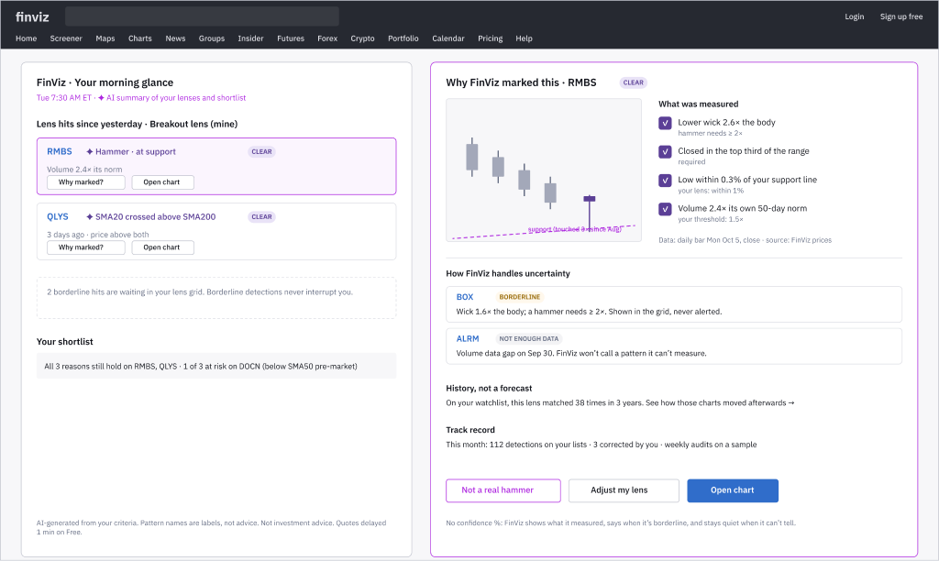
Appendix FinViz AI Screener
Chart Lens: Reliable insights, just in time
Chart detection will sometimes be wrong. The answer is not a confidence %: FinViz shows what it measured, says when it’s borderline, and stays quiet when it can’t tell.
T1 Show the measurement, not a score
“wick 2.6× body · top third · at support”
T2 Clear vs borderline
and the criterion that made it borderline
T3 Abstain when it can’t tell
“Not enough data to call this”
T4 Borderline never interrupts
only clear detections reach alerts
T5 History, with sample size
“matched 38 times in 3 years”
CL4 Clear lens hits arrive in the 7:30 AM glance; “Why marked?” opens the measurements, borderline and abstain examples, history and track record.
T6 Visible track record
“112 detections · 3 corrected by you”
Just in time
clear hits on his lists, before work
Accuracy measures: corrections per 100 detections · weekly audits < 1% wrong among clear detections · abstain rate tracked.
Notes:
SCRIPT
[CL4] His chart setups show up too, but only the clear ones. Tap "Why?" and he sees what FinViz measured: wick 2.6 times the body, at support, volume 2.4 times its norm. When it isn't sure, it says so. Reliable by design: measurements, not confidence scores.
— Production notes —
Week 4: accuracy despite unreliable AI, and insights just in time. Chart-Lens.md sections 5b and 5c.

Slide 80
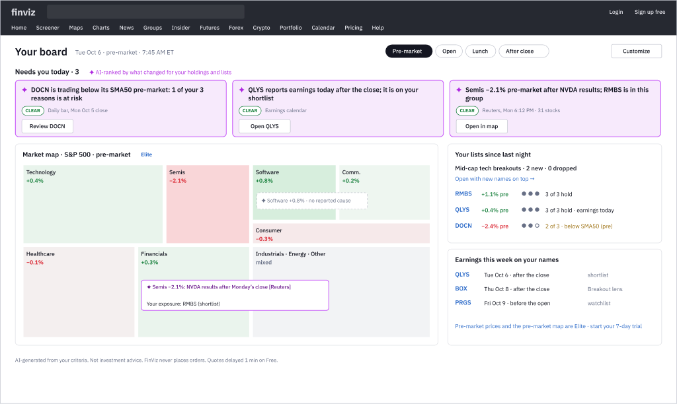
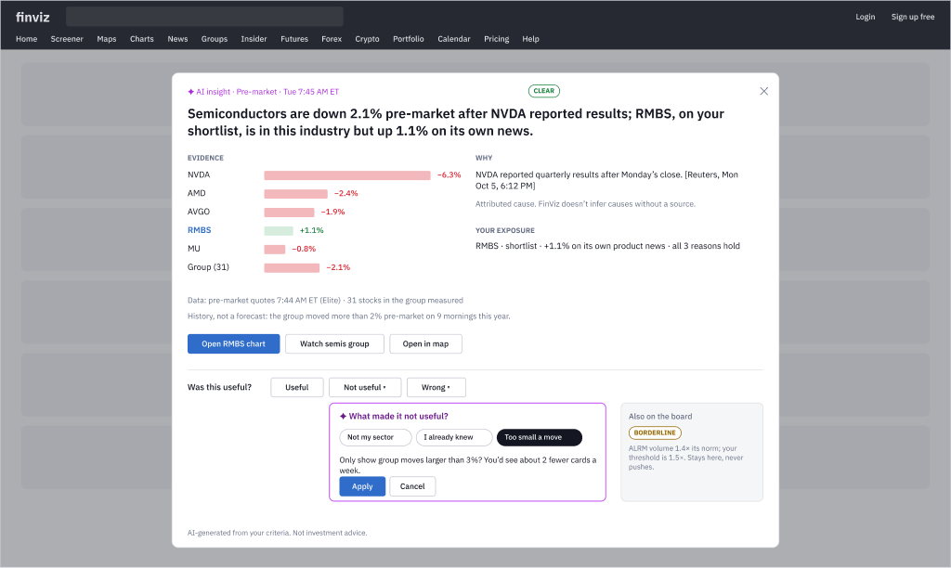
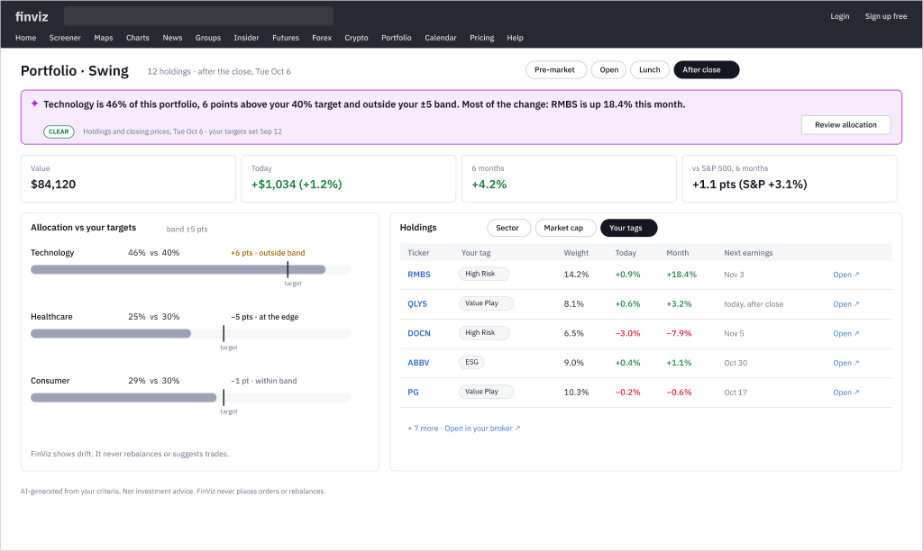
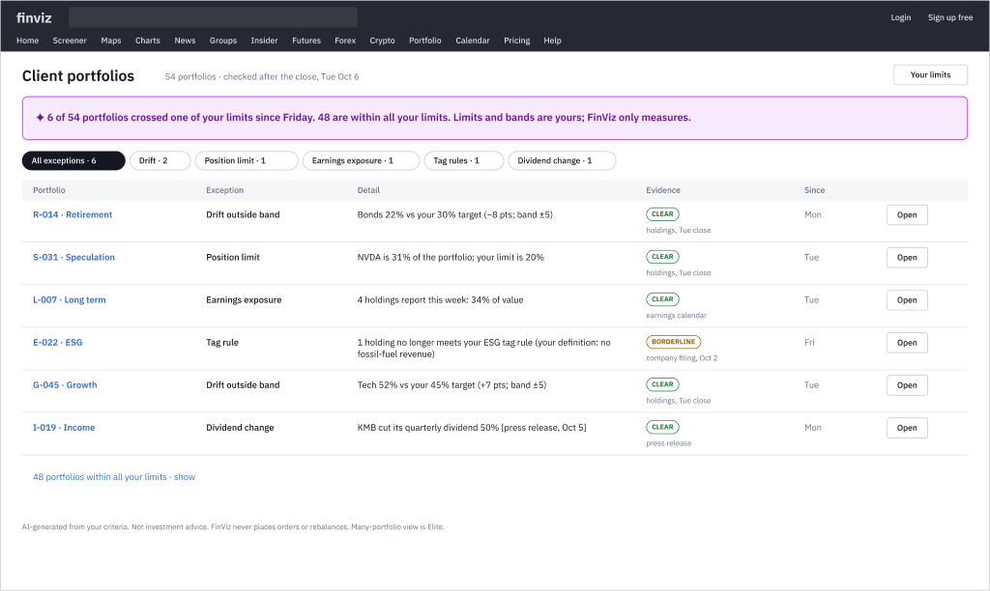
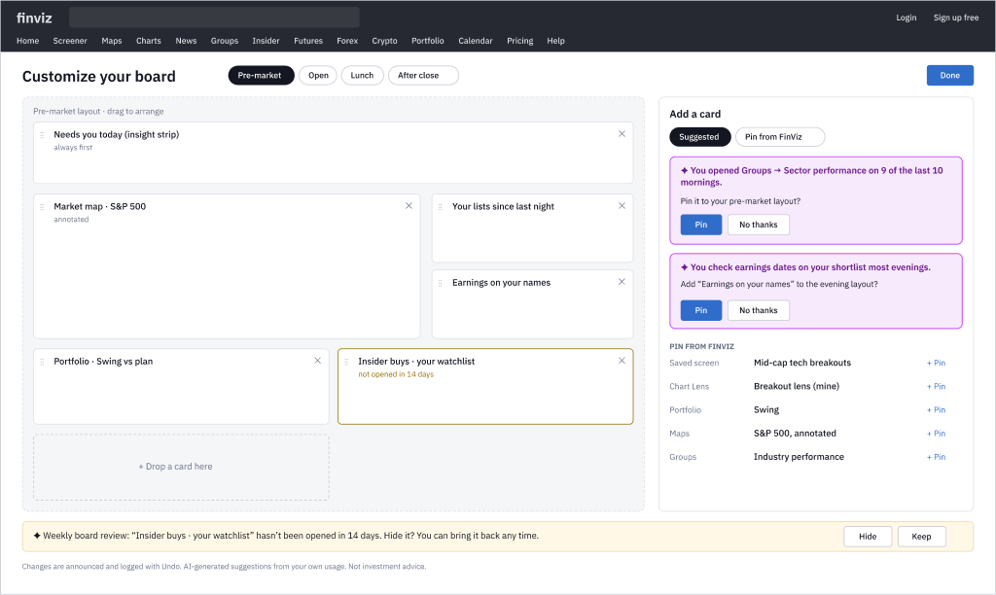
Appendix FinViz AI Screener
Insight Board: Insights, not widgets
Week 4’s dashboard option. The board he keeps open becomes a few findings about his own stocks and portfolios, each with evidence, a reliability label and one next step.
DB2 · Card with its evidence
DB3 · Portfolio vs his plan
DB4 · 54 portfolios, exceptions first
DB5 · Build the board, asked first
GUARDRAILS
Clear findings only reach the top; borderline never pushes
Causes are attributed to a source, or “no reported cause”
Drift is a fact against his targets; FinViz never rebalances
Ranked by what changed for him, never a score
DB1 Pre-market: three sourced findings that need him, annotated map, his lists.
Spec: Design-Specs/Insight-Board.md · FigJam 39 · Figma lo-fi page, part 2
Notes:
SCRIPT
[DB1] When Gary sits down, the board he keeps open isn't a page of data. At the top are three findings that need him, each one sourced: a DOCN reason at risk, QLYS reports tonight, and semis are down after NVDA's results, with RMBS in that group. Insights, not widgets.
[DB2] He opens one: the evidence, the source, the data time, and how sure FinViz is. If it isn't useful he says so, and FinViz shows what that will change before it changes anything.
[DB3] His portfolio, measured against his own plan: tech is 6 points over his target, mostly because RMBS ran 18% this month. A fact, not an instruction. FinViz never rebalances.
[DB4] For an advisor running 54 portfolios, the same idea scales: the 6 that crossed one of his limits, each with evidence. The other 48 are one line.
[DB5] And the board learns what he actually uses. It asks once before adding anything, and every change can be undone.
[close] That's the whole trading day, built mostly on what FinViz already has: the screener, pattern signals, alerts and the earnings calendar. What's new is that FinViz remembers why Gary picked a stock, and watches it on his schedule.
The AI does the watching and the explaining. Gary makes every decision.

Slide 81
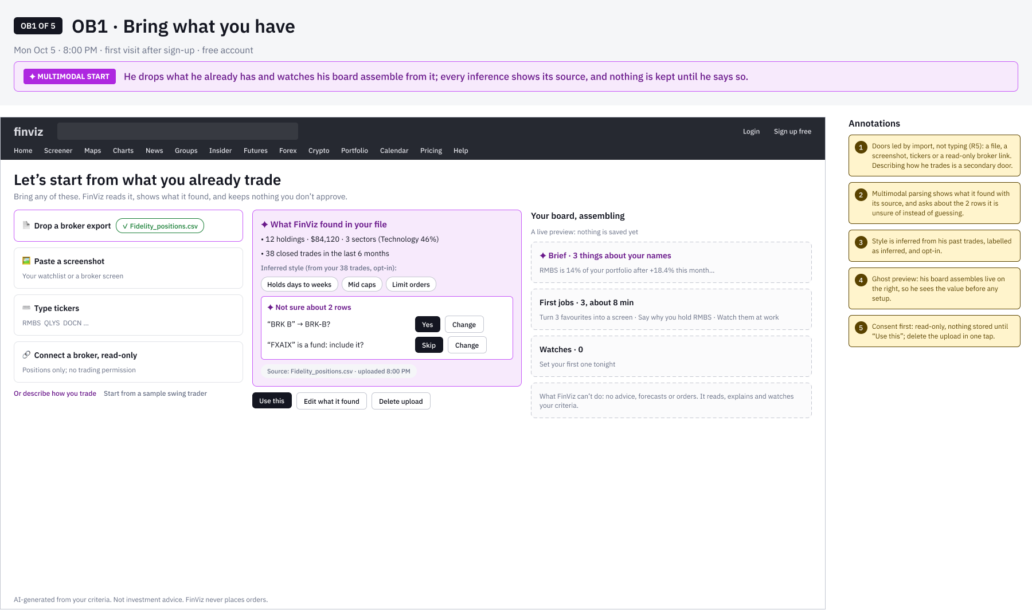
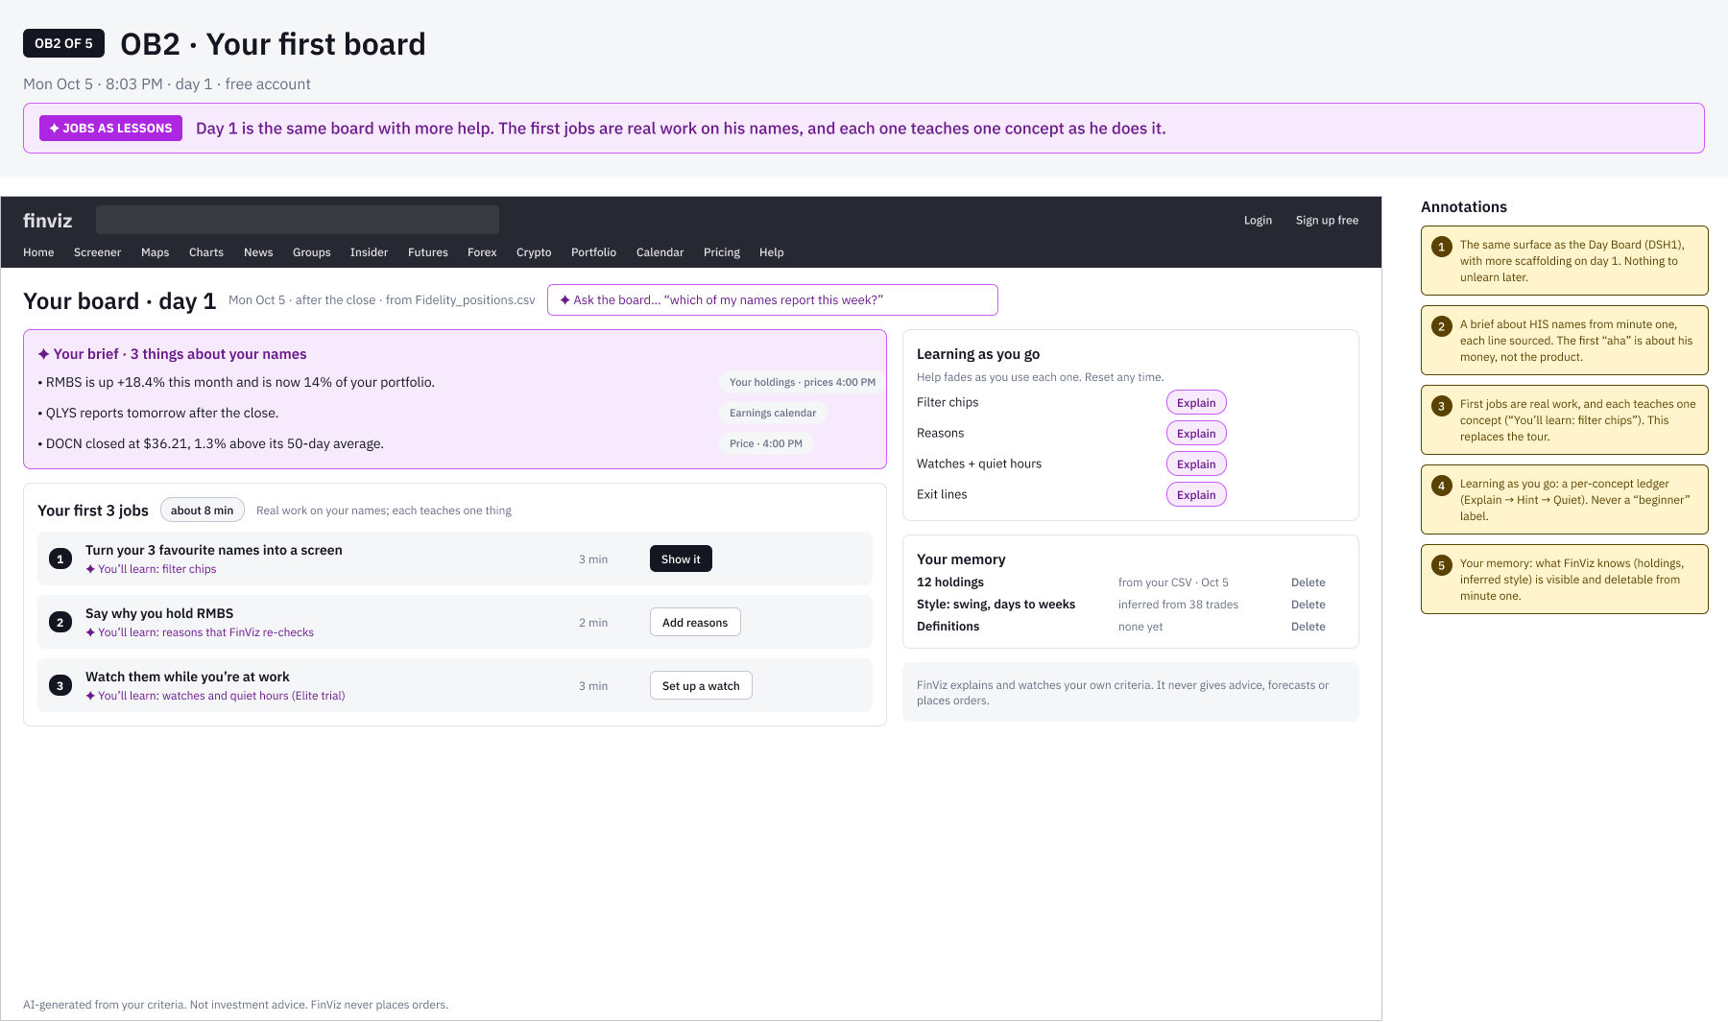
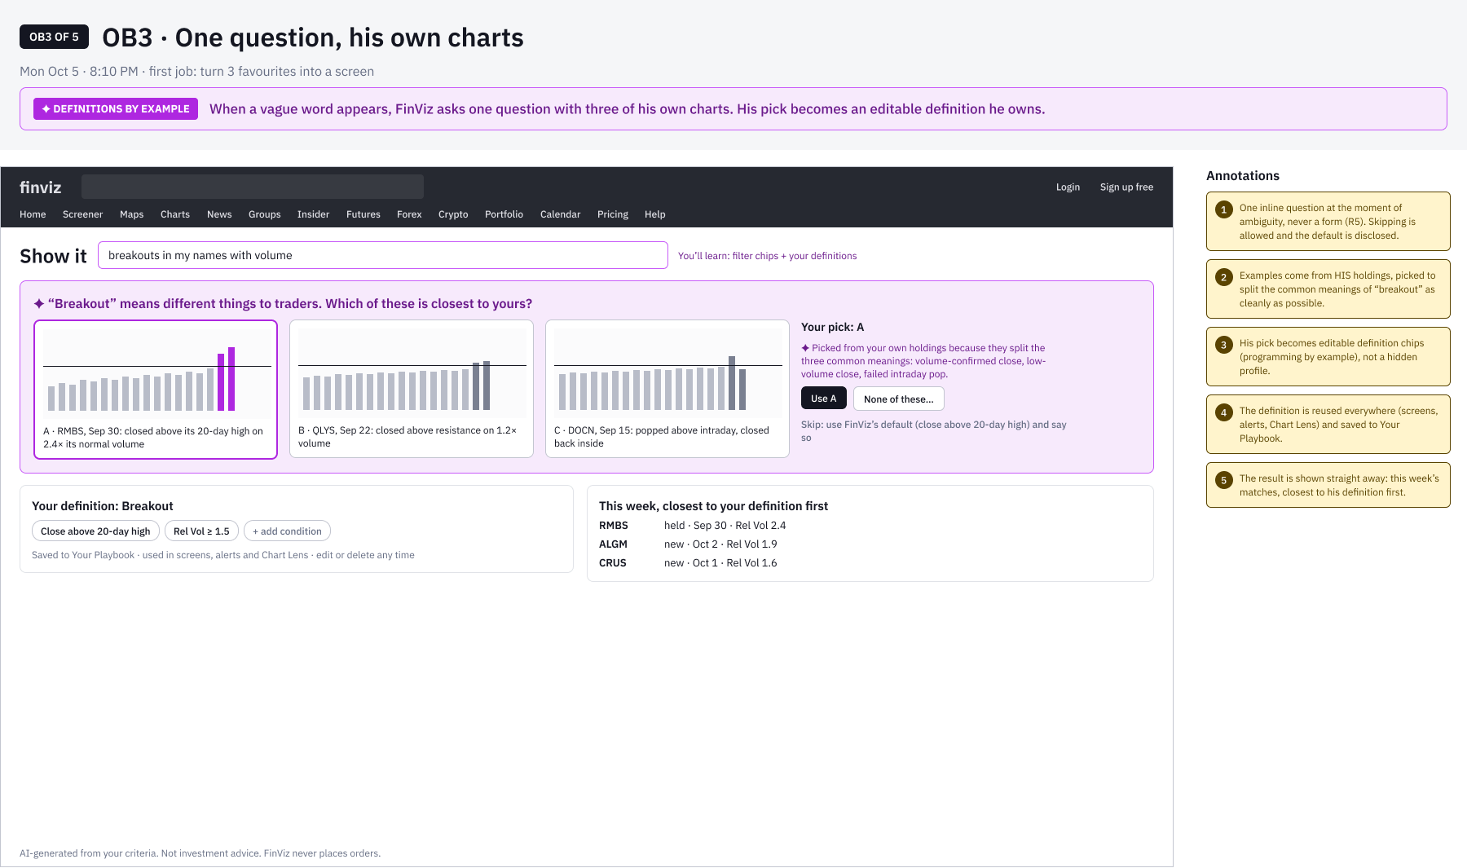
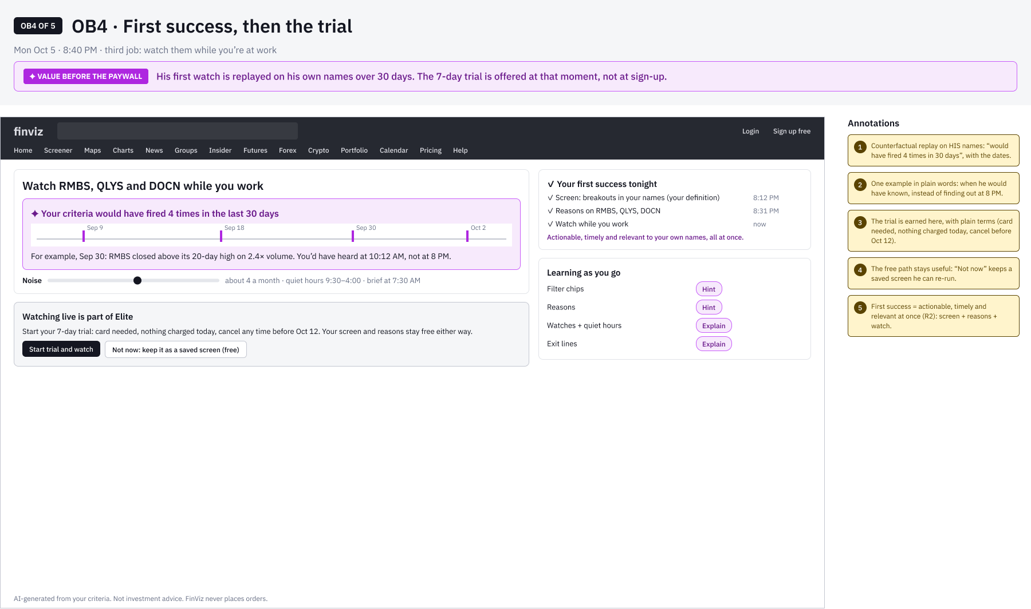
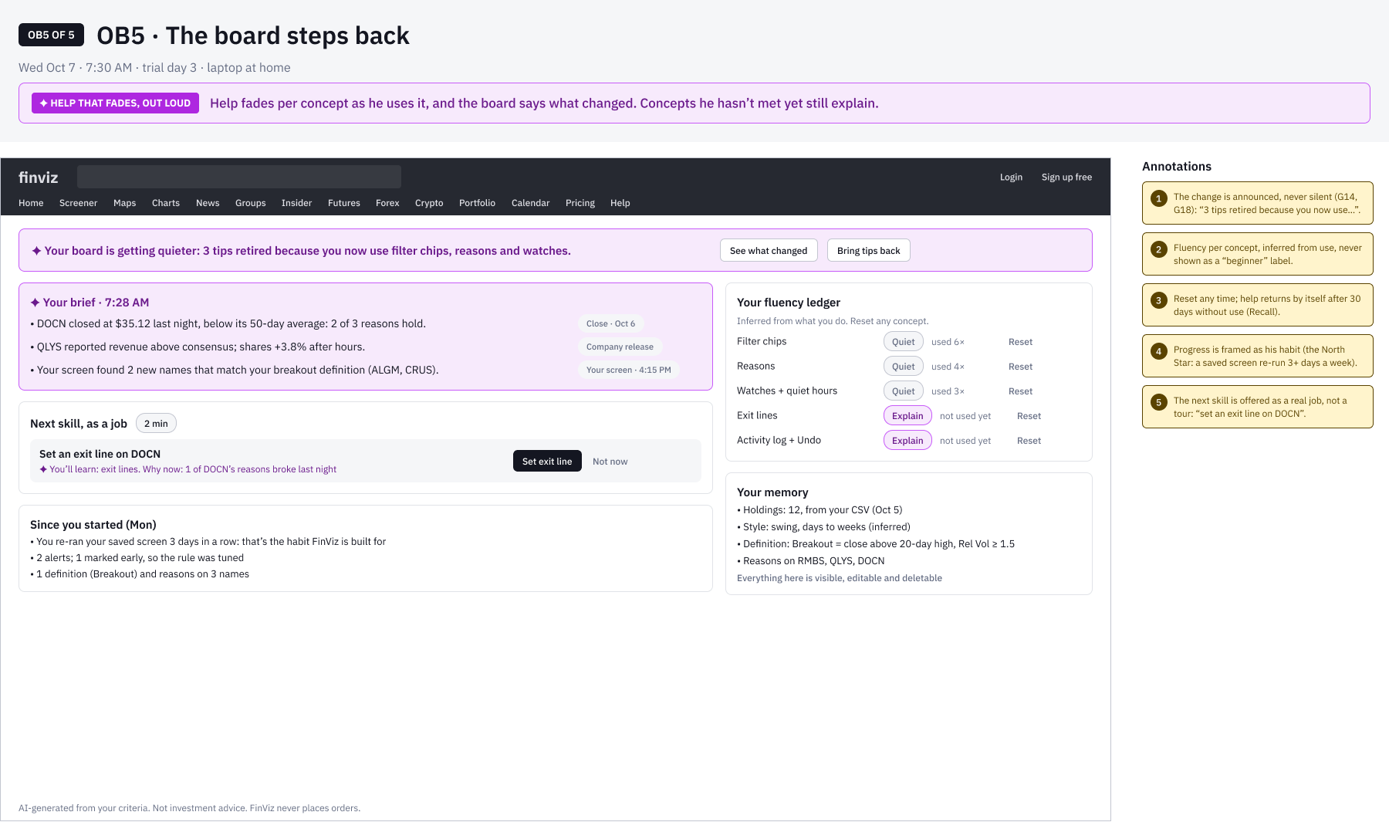
Appendix FinViz AI Screener
Onboarding, Day One: No tour, his first evening
Replaces the tour, the empty screener and a profile form. He brings what he has, the board builds from it, first jobs teach on his own stocks, and the trial comes after his first success.
OB1 · Bring what you have
Broker export → what FinViz found, with source; asks about 2 rows; board previews live
OB2 · Your first board
Cited brief on his names; 3 first jobs, each teaching one concept
OB3 · One question, his charts
“Breakout?” answered with 3 of his own charts; his pick = his definition
SIX AI UX INNOVATIONS
1 Multimodal start + live preview
2 Jobs as lessons
3 Definitions by example (his charts)
4 Value before the paywall (replay)
5 Help that fades, out loud
6 Memory with consent
OB4 · First success, then trial
Watch replayed: “would have fired 4×”; trial offered here
OB5 · The board steps back
Help fades per concept, announced and resettable
Spec: Design-Specs/Onboarding-Day-One.md · Figma: Onboarding · Day One · FigJam 43 · persona and data synthetic
Notes:
Onboarding · Day One (Design-Specs/Onboarding-Day-One.md; Figma page "Onboarding · Day One"; FigJam 43). FinViz onboards Gary by doing his first evening with him. OB1: he brings a broker export and watches his board assemble; FinViz shows what it found and asks about 2 rows. OB2: the first jobs are real work, each teaching one concept. OB3: "breakout" is vague, so one question with three of his own charts; his pick becomes his definition. OB4: his watch replayed on 30 days, then the trial, not at sign-up. OB5: help fades per concept, out loud. Replaces the guided tour, the empty screener, a profile form and the card-at-sign-up trial.

Slide 82
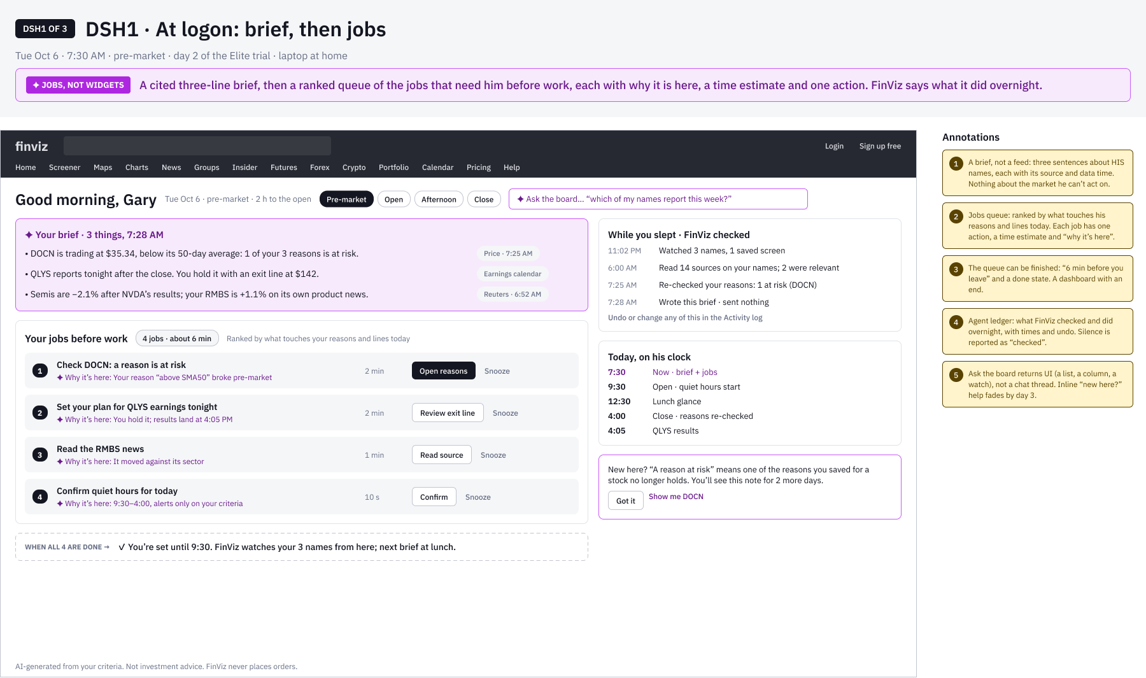
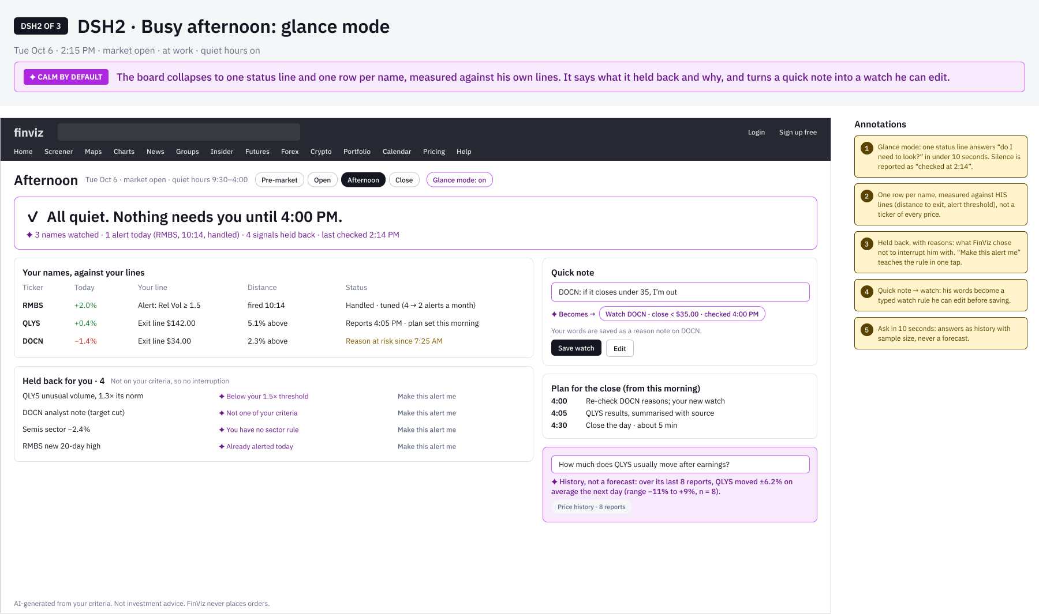
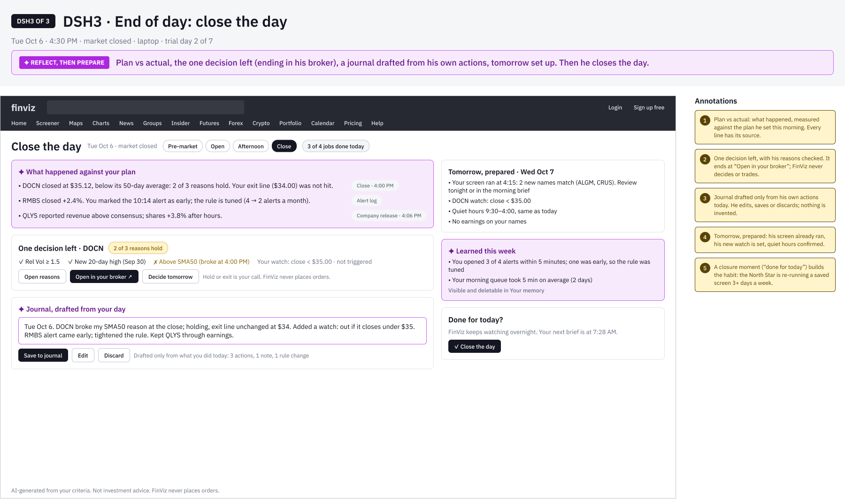
Appendix FinViz AI Screener
The Day Board: A dashboard for three times of day
From widgets to jobs. The same board is a brief at logon, a glance in a busy afternoon and a wrap-up at the close, built around what a swing trader with a day job actually does.
DSH1 · 7:30 AM · At logon
Cited 3-line brief, then 4 jobs (about 6 min), each with why, time and one action; a queue with an end; “while you slept” ledger.
DSH2 · 2:15 PM · Busy afternoon
“All quiet until 4:00.” One row per name against his lines; held back, with reasons; a quick note becomes a watch.
DSH3 · 4:30 PM · End of day
Plan vs actual; one decision ending in his broker; journal drafted from his actions; tomorrow prepared; close the day.
WHERE DASHBOARDS ARE GOING · PATTERNS WE BUILD ON
Jobs, not widgets: a ranked queue with one action each, and an end (next-best-action, inbox triage)
A brief with citations; calm status in work hours (“silence means checked”); an agent ledger with undo
Ask the board returns UI (a list, a column, a watch), not chat; a daily recap and journal close the loop
Guardrails: ranked by his own criteria; no buy/sell or forecasts in the AI’s voice; decisions end at “Open in your broker”
Spec: Design-Specs/Day-Board.md · Figma: Dashboards · The Day Board · FigJam 42 · persona and data synthetic
Notes:
The Day Board (Design-Specs/Day-Board.md; Figma page "Dashboards · The Day Board", first page; FigJam 42). From widgets to jobs: one board that reshapes across Gary’s day. 7:30 AM: a cited brief, then a queue of jobs he can finish. 2:15 PM: glance mode, quiet unless it matters, with what was held back and why. 4:30 PM: plan vs actual, one decision ending in his broker, a journal drafted from his own actions, tomorrow prepared. Industry patterns: next-best-action queues, cited summaries, time-aware layouts, calm status, agent ledgers, generative UI, daily recaps. Case-study guardrails apply. Next: onboarding builds from this board.

Slide 83
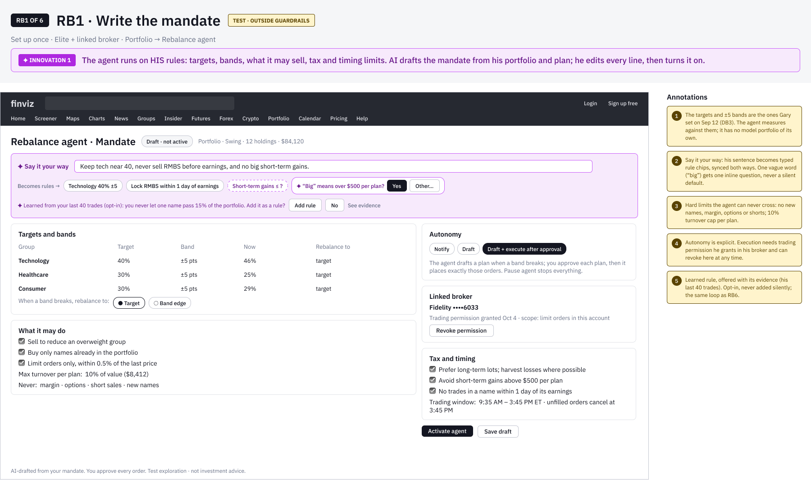
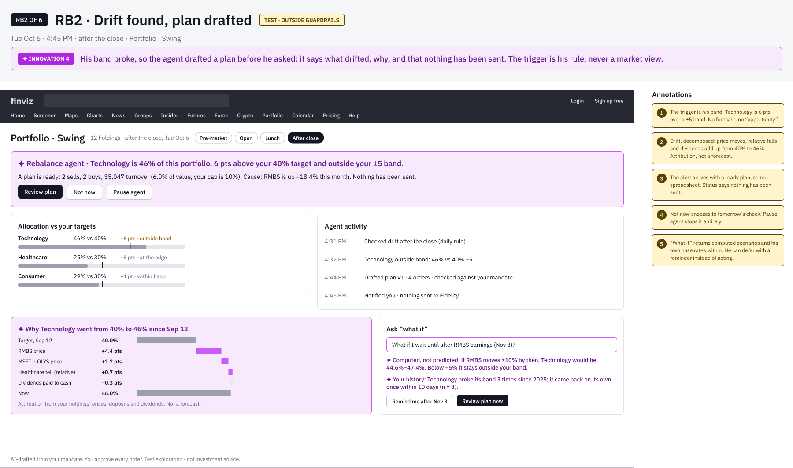
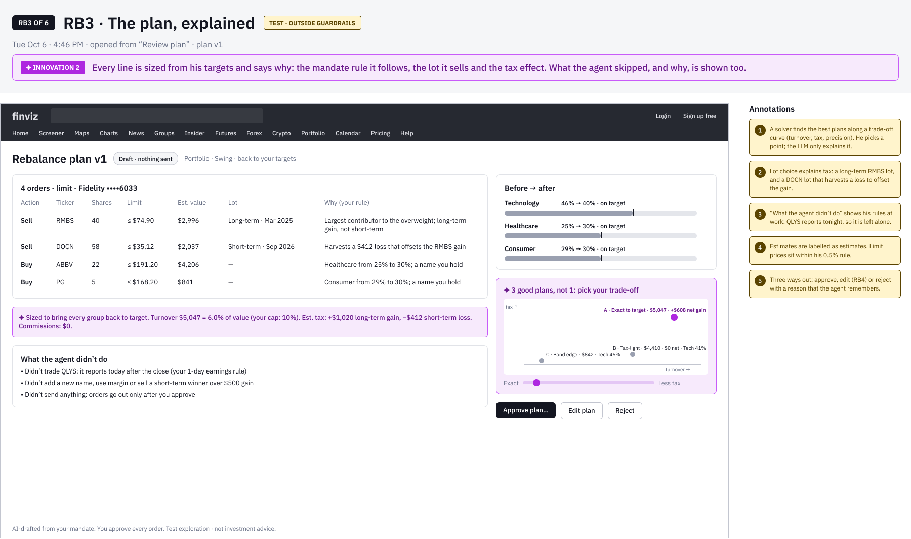
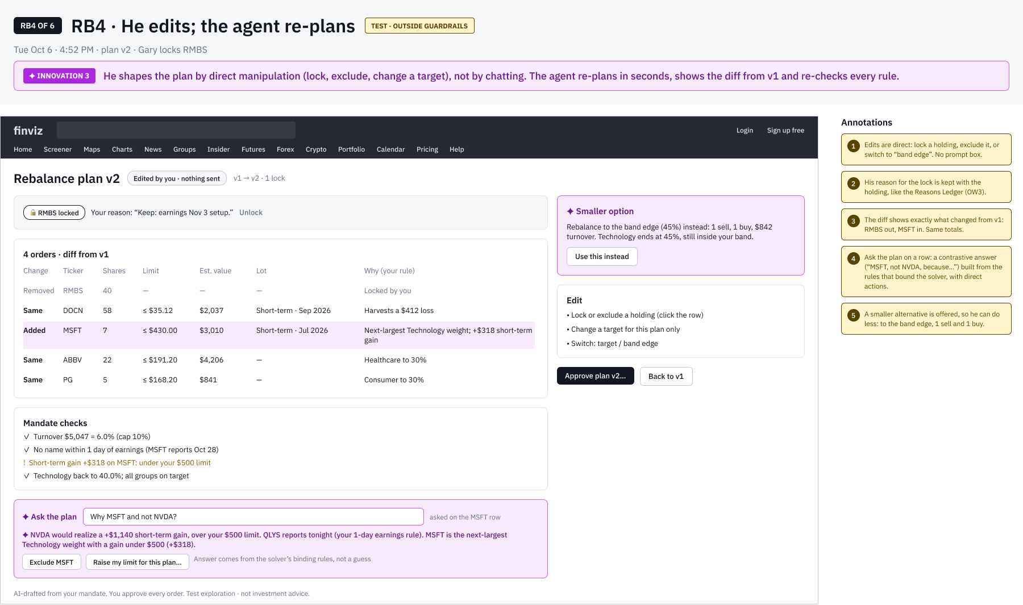
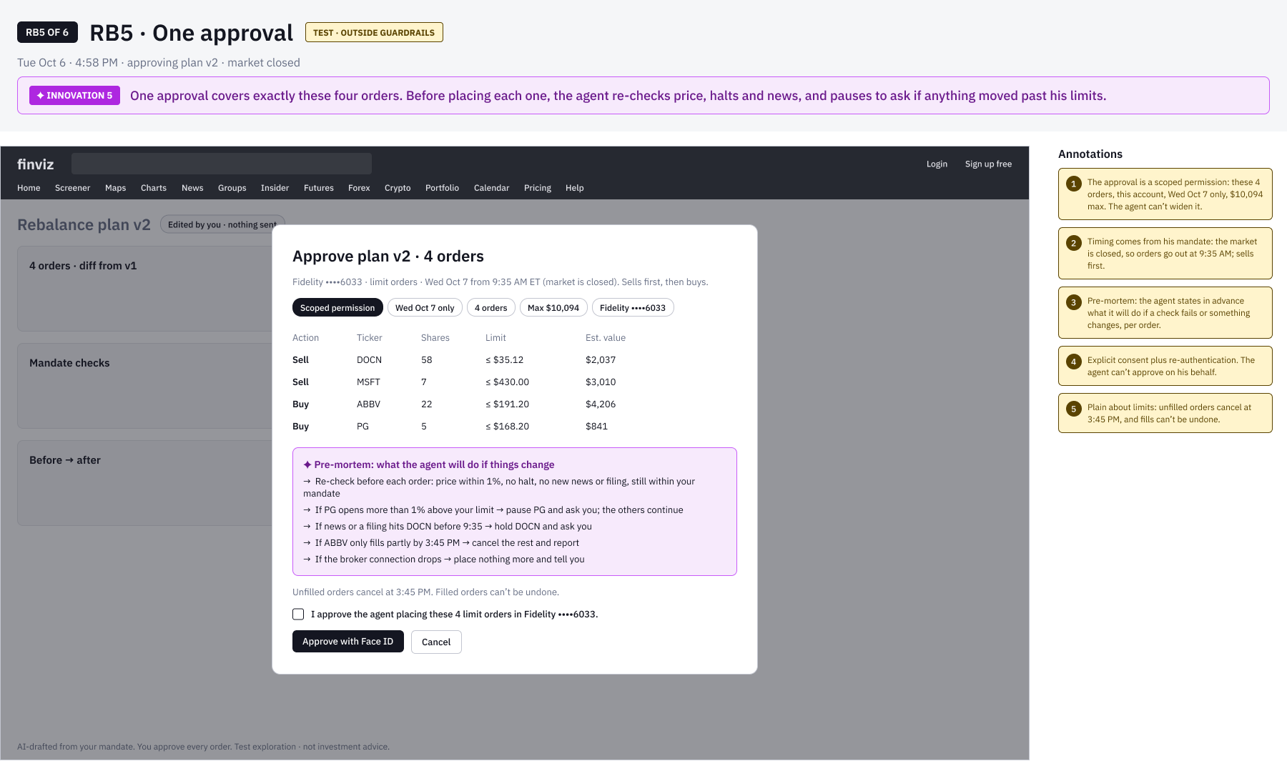
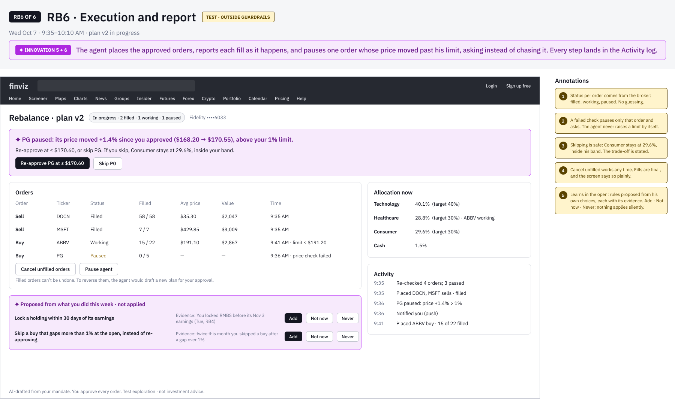
Appendix · Test FinViz AI Screener
Test: A Rebalance Agent, outside the guardrails
TEST EXPLORATION This breaks Principle 5 and F62 on purpose (the agent sizes and places orders after one approval), so it is not part of the case study’s solution.
RB1 · Rules from his own words
RB2 · Why it drifted, decomposed
RB3 · 3 plans on a trade-off curve
RB4 · Edit the plan; ask “why MSFT?”
RB5 · Scoped approval + pre-mortem
RB6 · Pause, report, learn in the open
Beyond pattern recognition: a solver sizes and the LLM explains; counterfactual re-planning with contrastive “why not” answers; drift attribution; a bounded agent with a scoped permission; preference learning shown as editable rules. Main risk: regulatory.
Notes:
Rebalance Agent test (Design-Specs/Rebalance-Agent-Test.md; Figma page "Test · Rebalance Agent (outside guardrails)"; FigJam 41). Deliberately breaks Principle 5 and F62: the agent drafts, sizes and, after one approval, places orders. Kept out of the main story. Six innovations: rules from his own words; a solver sizes and AI explains, with a trade-off curve; re-plan by direct manipulation and ask the plan; drift attribution; a scoped approval with a pre-mortem and pre-trade re-checks; rules learned from his edits, proposed in the open. Main risk: regulatory (adviser and order routing). Test: draft-only vs one-approval execution.

Slide 84
CASE STUDY · AI-ASSISTED TRADING PROTOTYPE
Meridian
Navigator
Retail investors juggle research, orders and monitoring across separate tools. Does AI insight beside the trade help them decide?
A mobile trading prototype: five AI and trading screens, built in SwiftUI and designed in Figma.
Working draft · 2026

Slide 85
How this case study is organized
The final experience first, then the reasoning behind it.
01
02
03
04
05
Overview
Context & constraints
Problem: user and AI
Users
The solution, hi-fi
06
07
08
09
10
Reasoning & trade-offs
Methodology
Implementation
Results & impact
Learnings & next steps

Slide 86
01 · Overview Meridian Navigator
Five screens, one trade, one place for AI
A mobile trading prototype with AI screens beside the order flow.
PRODUCT
An AI layer on a trading app. Users see what needs attention (Insight, Guard), what might fit their plan (Prospect), and whether their mix should change (Adapt), next to the order flow.
Scope
5 core screens · 2 trade flows of 8 steps each · mock data only
My role
Lead UX designer. I framed the problem, designed the trade and AI flows, built the Figma design system, and produced the SwiftUI prototype. AI agents helped with drafting.

Slide 87
02 · Context & constraints Meridian Navigator
Context and constraints
What the prototype has to prove, and what it cannot yet.
BUSINESS CHALLENGE
STAKEHOLDERS
Show one complete loop, from noticing a change to placing an order, in a prototype stakeholders can test.
Active traders, busy investors and first-time investors (draft personas), plus product, design, engineering and compliance.
SUCCESS
CONSTRAINTS
Stakeholders complete a trade and read the AI output without help. Targets are planned, to be set with stakeholders.
Mock data and a mock API only. No live brokerage or market data. Trade and AI copy need compliance review.

Slide 88
02 · Context & constraints Meridian Navigator
How the work was done, and what is still open
1
2
3
4
5
6
Frame
Hypothesize
Map flows
Design system
Design states
Validate
DONE
DRAFTED
DRAFTED
IN PROGRESS
DRAFTED
PLANNED
Problem, scope and assumptions recorded on the FigJam board.
Three draft personas, marked untested.
Share and dollar trade flows, and the AI feature flow, drafted in Figma.
Tokens shared between Figma and SwiftUI. Component library not yet audited.
Empty, loading, error and offline states on 06- Wireframes.
Interviews, usability tests and compliance review. Not started.
Status is a designer’s self-assessment. No interviews or usability tests have run yet.

Slide 89
03 · Problem Meridian Navigator
The user problem and the AI problem, defined separately
1
2
3
User problem
AI problem
Why AI
Research, order entry, watching positions and rebalancing live in different places. The hold-or-exit call gets made in the user’s head.
Summarize what moved and why, with the source. Rank alerts by severity. Show prospects with upside and downside. Propose a rebalance the user reviews first.
Summarizing news and research is a language task. Watching many positions is repetitive. Where a simple rule works, such as sorting or thresholds, the design uses a rule.

Slide 90
Competitive landscape
Competitive landscape: trading apps today, and the gap
From the August 2026 competitive audit. Re-check features before publishing.
Product | Feature today | Limitation
Robinhood | Price alerts that notify when a stock moves. | Passive and user-initiated. No pattern-based guidance.
Schwab | Suitability checks that warn when an order breaks a risk profile. | Compliance-driven. Does not learn from the user.
Wealthfront | Volatility score on positions. | Generic, not based on the user’s own pattern.
Vanguard | Time-based rebalancing reminders. | Tied to the calendar, not to the user’s behavior.
Meridian’s bet: nudges built from the user’s own history, shown next to the order. The audit found no platform doing this.

Slide 91
04 · Users Meridian Navigator
Three draft personas to validate before we rely on them
DRAFT PERSONA
DRAFT PERSONA
DRAFT PERSONA
Maya
Daniel
Priya
Active self-directed trader
Busy professional investor
First-time investor
Trades several times a week from her phone. Uses a brokerage app and a separate news source.
Invests a fixed amount each month and checks his portfolio weekly.
New to investing. Wants to start small and learn while she invests.
Get in and out quickly; spot momentum early
Pain: research is scattered; order entry takes too many taps
Features: Insight, Prospect, Share flow
Grow long-term savings without big mistakes
Pain: no time to research; unsure when to rebalance
Features: Guard, Adapt, Dashboard
Learn by doing; avoid a wrong trade
Pain: jargon; fear of ordering the wrong amount
Features: Dollar flow, Insight explanations
Hypotheses from the FigJam board. Interviews come before any decision rests on them.

Slide 92
The solution
Hi-fi first: one trade through the app, then the AI screens that inform it.

Slide 93
05 · Solution Meridian Navigator
Five screens, each answering one question
Dashboard
Insight
Prospect
Guard
Adapt
What do I own today?
What moved, and why?
What might fit my plan?
What needs my attention?
Should my mix change?

Slide 94
05 · Solution Meridian Navigator
One trade in eight steps, by share quantity or dollar amount
SHARE FLOW
1 Trade Setup
2 Choose Action
3 Enter Share Quantity
4 Confirm Share Quantity
5 Choose Order Type
6 Review and Approve
7 Submission Outcome
8 Return to Dashboard
Setup · Quantity · Review · Outcome
The dollar flow runs the same eight steps, with Enter Dollar Amount and Confirm Dollar Amount in place of the share steps.

Slide 95
05 · Solution Meridian Navigator
Designing for the states that mocked data hides
Dashboard in four states. The other four screens follow the same pattern.
Empty
Loading
Error
Offline
No holdings yet. One clear next step.
Skeleton cards hold the layout while data loads.
Says what failed and offers a retry.
Warns that data is stale and shows the last update.

Slide 96
06 · Reasoning & trade-offs Meridian Navigator
Four calls, and what each one costs
DECISION 1
DECISION 2
Keep both share and dollar entry
Use a mock API with a 0.8-second delay
Why: Unclear which entry model new investors prefer.
Trade-off: Two flows to maintain. Open question for testing.
Why: Lets us test flows and loading states without a backend.
Trade-off: Real timing, errors and data limits stay untested.
DECISION 3
DECISION 4
Adapt suggests buys and sells
Five tabs, one home screen
Why: It is the screen’s job: a rebalance the user can review.
Trade-off: Buy and sell language needs compliance review. It may need to become explanation only.
Why: A scannable set of areas, with trading one tap away.
Trade-off: AI screens compete with trade entry for attention. Test it.

Slide 97
The agent experience
Reconceptualizing the AI from static cards to a bounded agent the user can see and steer.

Slide 98
06 · Agent experience Meridian Navigator
Where the AI experience breaks down today
Five problems, from the current prototype and the competitive audit. Mock data throughout.
1
Outputs without reasoning
Insight shows sentiment with no source, date, or data behind it.
2
All or nothing
Adapt proposes 5 buys and 3 sells. The user can approve or dismiss the batch, nothing else.
3
No learning loop
Dismissing or correcting an insight does not change future output.
4
Advice line in conflict
The design rule says the AI never originates buy or sell advice. Adapt wording does. Compliance review is open.
5
Context lost between screens
Moving from an insight to an order drops the reason, so the user re-enters it.

Slide 99
06 · Agent experience Meridian Navigator
Four concepts for a bounded agent
Each concept answers one of the breakdowns above.
CONCEPT 1
CONCEPT 2
Goal to plan
Autonomy levels
The user states a target, such as "keep technology under 40%." The agent drafts editable steps and shows the impact of each one.
Observe, Suggest, or Act within limits. The current level is always visible, with the user-set limits beside it.
CONCEPT 3
CONCEPT 4
Evidence on every output
Orders with their reason
Each insight links to its source, date, and data. No model-generated confidence percentage.
A trade started from an insight opens with its reason and the user’s own history, and offers a 48-hour pause.

Slide 100
06 · Agent experience Meridian Navigator
Adapt as a plan, not a batch
Set a goal, review the plan, then approve each trade. Nothing runs without approval.
Set a goal
Plan preview
Trade review
The user states a target. The agent drafts a plan.
Each step shows its effect on the allocation.
Each trade shows its reason and source. The user approves, edits, or skips.

Slide 101
06 · Agent experience Meridian Navigator
Evidence on every insight, and orders that carry their reason
The reason travels with the order. Learned rules stay visible and reversible.
Insight with evidence
Order with its reason
Source, date, and the data behind the claim. "What would change this view" is stated.
Opened from Adapt with the reason, and a 48-hour option drawn from the user’s own history (example, mock data).

Slide 102
06 · Agent experience Meridian Navigator
What we would measure (planned, not run)
Hypotheses to test before any claim about the agent. None of these has data yet.
1
Time from insight to decision
Does evidence on the card shorten the decision?
2
Edit and reject rate on plan steps
Do users trust the plan enough to approve it as drafted?
3
Reversal rate of agent actions
Does Act within limits create regret, or stay trusted?
4
Learned rules kept or reversed
Do users value the learning loop, or do they switch it off?

Slide 103
06 · Agent experience Meridian Navigator
The whole experience, end to end
Entry, the five tabs, monitoring, Adapt, the trade flow, the learning loop, and the states. Proposal, mock data.
Nothing trades unless the user approves, or has set Act within limits. Learned rules are visible and reversible.

Slide 104
Build and test
How the AI behaves, how it is built, and how we will check it.

Slide 105
07 · Methodology Meridian Navigator
How the AI behaves, and how we will test it
AI BEHAVIOR · DESIGNED, MOCK DATA
VALIDATION · PLANNED
Insight: sentiment summaries, with the screen as the source
Prospect: opportunity cards with upside and downside
Guard: alerts ranked by severity; mark as read
Adapt: before and after allocation, and a reviewable buy and sell list
Five-person think-aloud on the share and dollar flows
Comprehension check on Insight, Prospect, Guard and Adapt labels
Card sort on the five tabs
Compliance review of trade and AI copy

Slide 106
08 · Implementation Meridian Navigator
Built on SwiftUI, with tokens shared with Figma
WHAT IS BUILT
NEXT TO BUILD · PROPOSED
MVVM: one ViewModel per screen
MockAPIService with realistic data and a delay
DesignTokens.swift: colors, type and spacing
AuthManager: Face ID and Touch ID, Keychain storage
Figma library mirrors the same tokens
Real market data and quotes behind the mock service
Brokerage connection for order placement
Session and authentication with a real backend
Audit log for trade and AI actions

Slide 107
09 · Results & impact Meridian Navigator
What exists today, and what we still need to measure
5
8
3
20
core iOS screens, each with a ViewModel
steps in each trade flow: share and dollar
interactive prototypes published, plus this deck
hi-fi wireframe states on 06- Wireframes
OUTCOMES · NOT YET MEASURED
Time to complete a trade, task success, the share of users who open an AI screen in week one, and a usability score. Targets are planned and will be set with stakeholders before the first test.

Slide 108
10 · Learnings & next steps Meridian Navigator
What building this taught me, and what comes next
LEARNINGS
NEXT STEPS
1
One token source for Figma and Swift keeps the two in step.
Validate the three personas with five to eight interviews
Usability-test the share and dollar flows
Review the 20 wireframe states with stakeholders
Resolve the open questions on the FigJam board
Set metric targets with stakeholders
Schedule the compliance review
2
Settle AI boundaries before more screens. Adapt’s buy and sell wording needs compliance first.
3
Mock data hides timing and error states, so design them explicitly.
4
Keep working documents in one place: the FigJam board.

Slide 109
Working documents and links
FigJam board (working documents)
https://www.figma.com/board/OXpFHEhHcr2ZReOXKKPVxb
Meridian Wires (Figma)
https://www.figma.com/design/W9SuJ8HpznQuY6Fb3H442w
06- Wireframes (hi-fi states)
https://www.figma.com/design/W9SuJ8HpznQuY6Fb3H442w?node-id=5123-3942
New Trading Desk (Figma)
https://www.figma.com/design/w9xAlgyQeXToR54UPbv7wG
Case study deck (web)
https://claude.ai/artifact/TwRA3JxYaMduyLo1MfpcZe
Meridian HTML prototype
https://claude.ai/artifact/QKAHav3ku5fRX5UTnohzsZ
Code and docs (GitHub)
https://github.com/CHUNKY21/trading-platform
Some links need access. Share the FigJam board and prototypes from each tool’s share menu.

Slide 110
End-to-end design process for a risk and compliance system serving Credit Suisse’s Risk and Compliance personnel
Credit Suisse
Outside Business Interests
Helping Credit Suisse save money by reducing friction,
educating employees and removing risk vulnerability in
its risk and compliance efforts.
“It’s too limited in its functionality to be of use for an Approver. Too much time is wasted trying to do more complex tasks”

Slide 111
Introduction Credit Suisse OBI
Target audience
What’s OBI?
Browser-based application that’s part of the Risk & Compliance platform, that gives users pre-clearance for outside activities where requests can be reviewed by first line Reviewers and second line Risk & Compliance Managers.
• Risk and Compliance
managers
• All CS employees
• All CS managers
The problems
• Submission status tracking is not clear
• Lines of responsibility are not transparent
• No ability for reporting
My Role
• I led the project team utilizing the support of 2 UX designers, and a content designer.
• I was responsible for managing the discovery process, including research, strategy and overall hands-on design of the material and artifacts.
• Navigation in the tool is challenging
• Users often don’t know why and when they
should submit
• No Mobile access for Risk & Compliance
• I led the work on all deliverables and artifacts in Sketch and Figma using Lean UX and usability testing, presenting these to the client and key stakeholders.
Managers
• Submission process confusing
• No education available

Slide 112
Discovery & Research Credit Suisse OBI
Original Application

Slide 113
Discovery & Research Credit Suisse OBI
Why redesign OBI?
475
Returned submissions missing required information, per year
22 mins
Average time employees need to resubmit
58%
Approval rating from Process Risk & Compliance Managers
5.4%
Drop-off rate on Outside Business Activities form submissions
6.1%
Drop-off rate on Private Investments form submissions
61%
Approval rating from employees

Slide 114
Because of the KPIs assembled, the assumptions of the business partners, and feedback from users based on help requests we determined we needed to use methods to identify user needs, validate existing assumptions, and generate new ideas.
Discovery
• Interviews
• Reviewers
• Manager Risk & Compliance Managers
• Risk and Compliance Managers
• Contextual interviews
• Persona development
• Research Synthesis
Problem statement
As part of the iComply ecosystem of Employee
Compliance, users need an interactive, web-based pre-clearance application for outside activities where requests flow through an integrated and pre-defined workflow for review by first line Reviewers and second line Risk & Compliance Managers.
• Design Thinking Exercises

Slide 115
Discovery & Research Credit Suisse OBI
Major Themes from Interviews
• Integration with other systems on
platform
• Search
• Reporting
• Shadowing
• All users understanding of the
Pain points we heard from the interviews with Reviewers, Manager Risk & Compliance
Managers, and Risk and Compliance Managers
policies
• Mobile
• Clear navigation
• Clear workflow
• Status awareness

Slide 116
Approver User Journey
Reviewer User Journey
Employee User Journey

Slide 117


Discovery & Research Credit Suisse OBI
Personas
Risk and Compliance Managers
Reviewers of CS Employees

Slide 118
Discovery & Research Credit Suisse OBI
Design Thinking Exercises
Generated concepts for interfaces with 30 participants
5 concepts for dashboard, reporting features and submission processes for all types of end-users
Format:
• Ice breaker
• What would the headlines say?
• How do we?
• Concepts and interfaces
• Voting

Slide 119
Discovery & Research Credit Suisse OBI
Pain Points + Business Goals + UX Strategy = Feature Set
UX Strategy
Pain Points
Business Goals
Feature Set
• Integration with other systems on platform
• Education
• Integrations with other
• Search
• Functionality parity
systems on platform
• Reporting
• Navigation
• Platform parity
• All users understanding
• Shadowing
• Clear workflows
• Mobile
=
+
of the policies
• Proxies
• Status awareness
+
• Access for all in the
• Queries
• Lack of features
platform
• Mobile
• Mobile
• Clear navigation
• Clear workflows

Slide 120

The Delivered Solution
Risk & Compliance Managers, Submitter and Reviewer
Experiences
The main jumping-off point for all 3 user types, the dashboard was the prioritized focus, and went through many iterations based on company goals, line of business goals, UX strategy, legal, risk, and ADA requirements, as well as design system requirements.
• Feature refinement and road map
• 33 Agile-based sprints
• Usability testing on weekly cadence
• Demos and QA

Slide 121
Design Credit Suisse OBI
OBI Experience Design Strategy
What we learned from discovery and design thinking
• For Risk & Compliance Managers a dashboard with ways of understanding and filtering of request statuses
• Reporting and other major functionalities
with ability to share and alert 2nd line of defense managers
• Employees were often confused about
what form they needed.
• They needed education on why, how, when
• They needed their expectations managed
when they returned so they’d have some idea of what to do
• Central space to see all submitted requests
Based on POC 2 from the Design
Thinking process, and thumbnail
sketches.

Slide 122
Design Credit Suisse OBI
Dashboard Design Sprint
The submission form allowed submitters to use a wizard, answering 3 questions to determine the correct form required and get into the submission process immediately.
What we learned in the research
• Submitters responded to a separate dashboard and progressive disclosure forms
• Concepts tried having list view dashboards
or forms based dashboards
Unexpected Challenge
Because of tech debt on mobile platforms,
Mobile Native work was re-prioritized on the
road map, to post MVP release. That required
a responsive experience and refactoring for
new design effort
First iteration

Slide 123
Design Credit Suisse OBI
Dashboard Design Sprint
The first iterations included educational options front and center on the dashboard.
Testing showed us that a segment of newer users needed it, but not all.
What we learned in the testing
• Education was a priority for all users
• Users responded to more friendly copy that
illustrated the scenarios a person might be involved in
• Content geared to Swiss users could be bubbled up based on user ID and location
Second iteration

Slide 124
Design Credit Suisse OBI
Dashboard Design Sprint
Education module positioned to answer users’ questions on when they need to submit a request, but further testing required a new solution.
What we learned in the testing
• Users reacted to educational modules positively, but felt there might be too much information in the guidance.
Unexpected Challenge
• Delays in resourcing for content for translations
required us to reprioritize some of the features
and refactor sprints
Third iteration

Slide 125
Design Credit Suisse OBI
Dashboard Design Sprint
The final dashboard allowed submitters to access a wizard, answering only 2 questions to determine the correct form required.
Final Version
What we learned in the research
• Final solution allowed easy access to
education
• Cleaner interface
• Ability to quickly start

Slide 126
Submitter
Dashboard
Landing Page

Slide 127
Design Credit Suisse OBI
Legacy requests refer to your disclosures
Landing Page Design Sprint
from the previous system, OIRS, that have
been migrated into OBI.
The OBI landing page shows the requester dashboard. By default, the tab
“Your Requests” will be visible.
This has three sections :
1. Drafts Saved
2. Pending Requests
3. Completed Requests

Slide 128
Approver Features
• Proxies
• Reporting
• Queries

Slide 129
Design Credit Suisse OBI
Proxy Request Design Sprint
For situations where individuals cannot access OBI themselves to make the
necessary disclosure submissions, OBI has proxy functions.
With these functions, staff members can name other staff members who can act as proxies. Proxies have the ability to submit requests on behalf of others who have given them this permission.

Slide 130
Reporting

Slide 131
Design Credit Suisse OBI
Reporting Design Sprint
Reporting lets Risk & Compliance Managers search requests by ID, requester, status, type, submission dates, company and office, then download the results as Excel or PDF.

Slide 132


End-to-end design process, including Design Thinking and AI-supported methods, for a trading experience that serves a
wide variety of Wells Fargo customers and gives them an easier way to trade
Wells Fargo
Integrated Trade Ticket
Helping Wells Fargo increase revenue by allowing
users to transact by share or dollar amount
“It’s a confusing interface, the app’s interface
is non-intuitive, making it difficult to navigate
and find specific functions or features. This
extends to both basic banking functions and
the stock trading capabilities.”

Slide 133

Introduction Wells Fargo Integrated Trade Ticket
What’s the Integrated Trade Ticket?
Target audience
An integrated trade platform that simplifies the trading
• Experienced consumer
process, reduces the likelihood of errors, and enhances
traders
overall efficiency, while giving users the ability to trade in
• Novice consumer
shares or dollar amounts and all the needs they have for
traders
self-directed trading.
The problems
My Role
• WIM investors don’t have a way to trade in both shares and
• I led the project team utilizing the support of 2
dollars
UX designers.
• I was responsible for managing the discovery process, including research, strategy and overall hands-on design of the material and artifacts, supported by AI applications.
• Needing a trade ticket that simplifies the current trading process in the native mobile app
• Confusing Interface
• I led the work on all deliverables and artifacts in Figma using Lean UX and usability testing, presenting these to the client and key stakeholders.
• Limited Functionality
• Technical Issues
• Lack of Real-Time Updates
• Poor Customer Support

Slide 134

Discovery & Research Wells Fargo Integrated Trade Ticket
Why redesign the Trade Ticket?
18.3%
of users request
trading both shares and dollars
8.2 mins
Transaction Time: The time taken for a new user to complete their first trade.
1.4%
Error rate on submissions
6.1%
drop-off on trades executed through the mobile app
“The app lacks advanced features like drawing tools or technical indicators. Customer support options are limited, with no chat
support available.”

Slide 135

Because of the KPIs assembled, the assumptions of the business partners, and feedback from users based on help requests we determined we needed to use methods to identify user needs, validate existing assumptions, and generate new ideas.
Discovery
• Interviews with primary external users,
Problem statement
internal stakeholders, and SMEs
As the most important part of the trading experience, experienced and novice users need an integrated trade ticket that simplifies the trading process, reduces the likelihood of errors, and enhances overall efficiency, while giving users the ability to trade in shares or dollar amounts.
• Experienced Traders
• Novice Traders
• Persona development
• Google Design Thinking Exercises
• Competitive Analysis

Slide 136

Design Patterns
Education and NUX: Effective onboarding through upfront and contextual education, using examples like Duolingo and DOT.
Enabling Experimentation: Allowing users to preview, undo, and retrace steps for enhanced control.
Contextual UI: Strategies like inline actions, side panels, and quick actions to offer users more control.
Feedback Mechanisms: Implementing thumbs-up/down ratings and regeneration options for better AI refinement.
Addressing the Cold Start Problem: Solutions like icebreakers, templates, and guided input to help users get started.
Providing Controls: Offering users tools like source verification, image editing, and content manipulation for more control over AI outputs.
Continued Guidance: Providing suggested prompts and contextual assistance to keep users engaged.
Transparency: Ensuring trust by watermarking AI content, labeling generated text, and clarifying data usage.
Personalization: Customizing user experiences through memory, suggestions, and personal input options.
Voice and Streaming: Exploring voice interactions and message streaming patterns to create seamless experiences.

Slide 137
Discovery & Research Wells Fargo Integrated Trade Ticket
Interviews: Experienced and novice traders
I led the interviews of users with more experience trading and less experienced traders. Experienced investors can
average anywhere from 20 to over 1,000 trades per year depending on their trading style; inexperienced investors
typically make fewer trades, ranging from 10 to 100 per year.
Some common complaints include:
Confusing Interface
Many users find the app’s interface non-intuitive, making it difficult to navigate and find specific functions or features.
Lack of Real-Time Updates
Some users have complained about delays in real-time updates for stock prices and portfolio values, which can be critical for making timely trading decisions.
Limited Functionality
Several users have expressed frustration with the limited features available in the trading section of the app. For example, some noted that important functionalities like detailed transaction histories or useful budgeting and spending tools are either buried under unclear tabs or entirely absent.
Poor Customer Support
Dissatisfaction with customer service is another common theme. Users have mentioned that getting support through the app is challenging, and responses to issues are often slow or unhelpful.
Technical Issues
There are reports of the app experiencing technical problems during peak trading times, which can delay access and execution of trades. This unreliability during high-demand periods is a significant drawback for active traders.

Slide 138

Discovery & Research Wells Fargo Integrated Trade Ticket
Pain points we heard from the interviews
1 Can’t trade in both shares and dollar amounts using the mobile platform
2 Several interfaces aren’t intuitive
3 Need more of the right detailed trade information
4 Flexibility needs to be improved
5 More trading options
6 Speed
7 Mobile native
“...the app’s interface is so non-intuitive, it makes
it hard to navigate, find specific functions and
just make a quick trade”

Slide 139
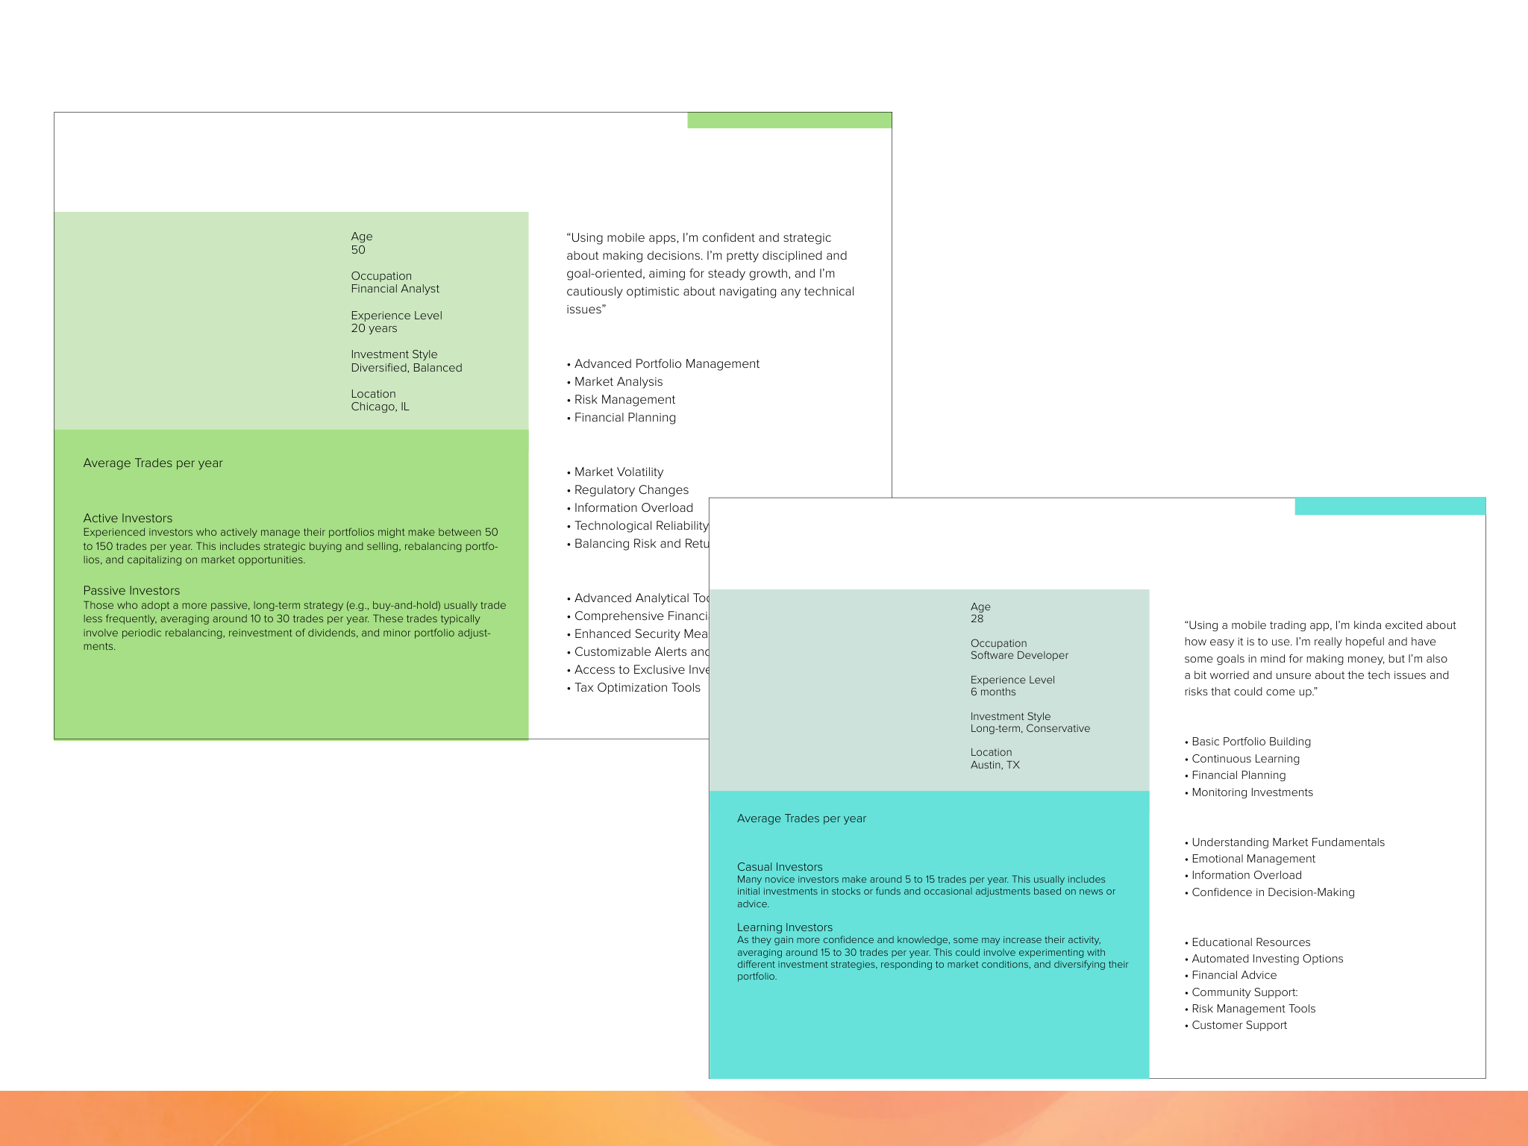


Discovery & Research Wells Fargo Integrated Trade Ticket
Experienced Investor
Jordan
Sentiments
Responsibilities
Key Challenges and Areas of Concern
20 to over 1,000 trades
Novice Investor
Taylor
Wishlist of Features
Sentiments
Responsibilities
10 to 100
Key Challenges and Areas of Concern
Wishlist of Features

Slide 140

Discovery & Research Wells Fargo Integrated Trade Ticket
Pain Points + Business Goals + UX Strategy = Feature Set
UX Strategy
Pain Points
Business Goals
Feature Set
• Can’t trade in both shares
• Speed
• Simplified Interface
• Order Entry
and dollar
• Education
• Dynamic Functionality
• Execution Management
• Interfaces aren’t intuitive
• Platform parity
• Trade speed
• Real-time Monitoring
• Need more of the right detailed trade information
• Integrated systems
• Real-Time Updates
+
• Risk Management
=
+
• Post-trade Processing
• Data
• Integration with Other
• Flexibility
Systems
• More trading options
• Shares vs. dollars
• Transaction speed
• Analytics and Reporting
• Mobile native

Slide 141













Discovery & Research Wells Fargo Integrated Trade Ticket
Competitive Analysis
Robinhood
• Shares and Dollar-Based Trading
Robinhood allows users to trade both whole shares and fractional shares in dollar amounts, making it accessible for investors with varying budget sizes.
• User-Friendly Interface
The app’s interface is simple and intuitive, making it easy to switch between trading shares and dollar amounts. Trade tickets display all necessary details, including stock name, order type, quantity, and estimated cost.
• Instant Notifications
Users receive immediate in-app notifications once a trade is executed, providing details of the trade.
Fidelity Mobile App
• Flexible Trading Options
Fidelity’s mobile app supports trading in both shares and dollar amounts, offering fractional shares for a wide range of stocks and ETFs.
• Comprehensive Trade Tickets
The app provides detailed trade tickets that include the stock symbol, order type, quantity, price, and execution time. Users can easily switch between dollar-based and share-based trades.
• Easy Navigation
The app is designed for ease of use, ensuring that placing trades and reviewing tickets is straightforward.
Charles Schwab Mobile
• Fractional Shares
Charles Schwab’s mobile app allows users to trade fractional shares through its Stock Slices feature, enabling investments in dollar amounts as low as $5.
• Detailed Trade Tickets
The app provides clear and comprehensive trade tickets, showing all necessary information such as stock symbol, order type, quantity, and price.
• Intuitive Design
The app’s interface is user-friendly, making it easy to place trades and review transaction history.

Slide 142

Design
• 6 Agile-based sprints
• Usability testing on weekly cadence
• Demos and QA
The Delivered Solution
Order Entry
Allows traders to enter orders quickly and efficiently, specifying details such as asset type, quantity, price, and order type (market, limit, stop, etc.).
Real-time Monitoring
Provides real-time updates on market conditions, order status, and trade confirmations. This helps traders to make informed decisions and adjust their strategies as needed.
Post-trade Processing
Streamlines the post-trade process by handling settlement, clearing, and reconciliation. This ensures that trades are correctly recorded and settled in a timely manner.
Analytics and Reporting
Provides analytical tools and reporting features to help
traders review performance, analyze trends, and generate reports for regulatory or internal purposes.
Execution Management
Facilitates the execution of trades across various exchanges and trading venues. It ensures that orders are routed correctly and executed at the best possible prices.
Risk Management
Includes tools to assess and manage the risk associated with trades. This might involve setting limits on positions,
monitoring exposure, and ensuring compliance with regulatory requirements.
Integration with Other Systems
Connects with other trading and back-office systems, such as portfolio management systems, compliance tools, and accounting systems. This integration helps in maintaining consistency and accuracy across all stages of the trading process.

Slide 143
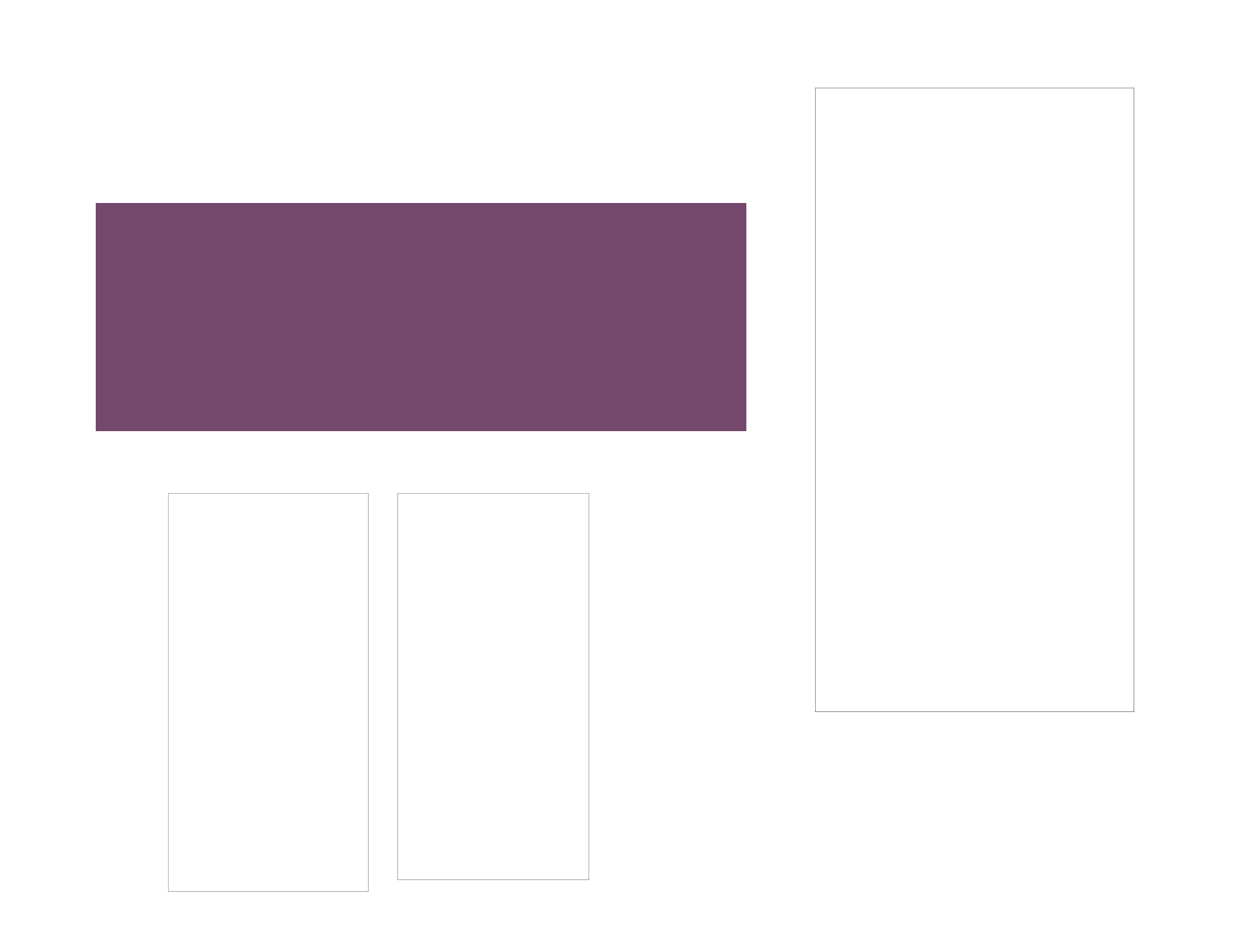
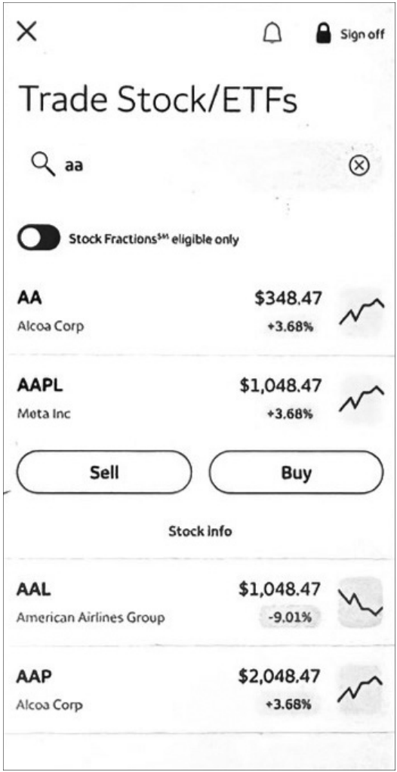
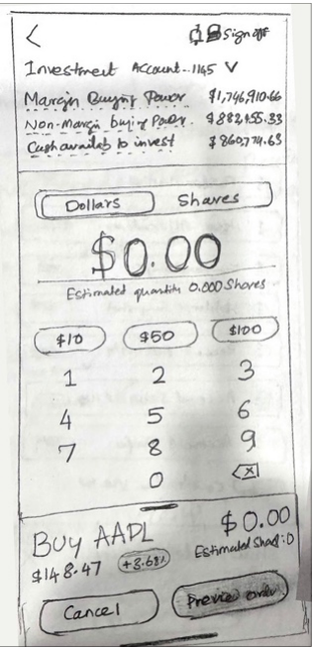
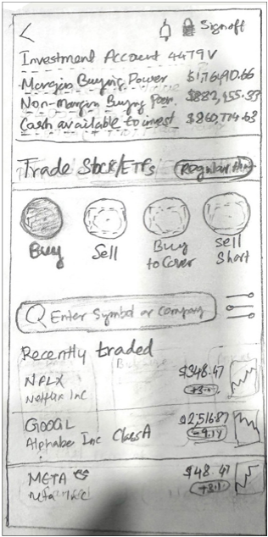
Design Wells Fargo Integrated Trade Ticket
Trade Ticket Experience Design Sprint
• Users can switch accounts
• Users have view of balances and the stock details in a
concise configuration
• If they have a position the system provides their holdings
• Users can switch between shares and dollars
in a centralized place
“While the app is functional for basic trading, it falls short for those seeking more sophisticated
trading tools and resources.”

Slide 144

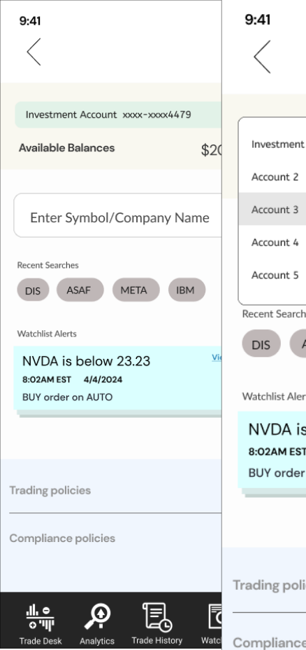


Design Wells Fargo Integrated Trade Ticket
Trade Ticket Experience Design Sprint
What we learned from discovery and design thinking
• Ability to switch accounts would support the
majority of experienced traders and 60% of novice users and support new navigation for mobile native
• Dark mode is important

Slide 145
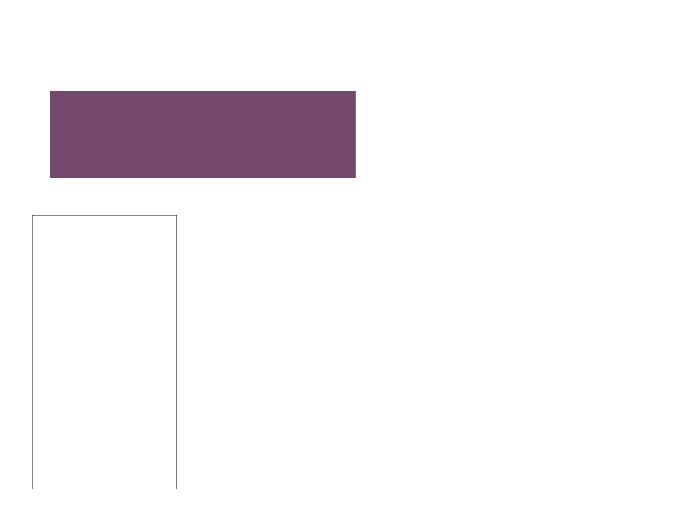


Design Wells Fargo Integrated Trade Ticket
Trade Ticket Experience Design Sprint
• Asset is held already, so the user is driven right
into the funnel
• User can immediately toggle between selling
by dollar amount vs. shares
First iteration
If a user holds an asset they’re
driven right into an interface to buy
or sell. Next to Actions is the icon
to change shares vs. dollars. As
a predictive interface, users are
never burdened with too many
choices, only the appropriate
ones.

Slide 146
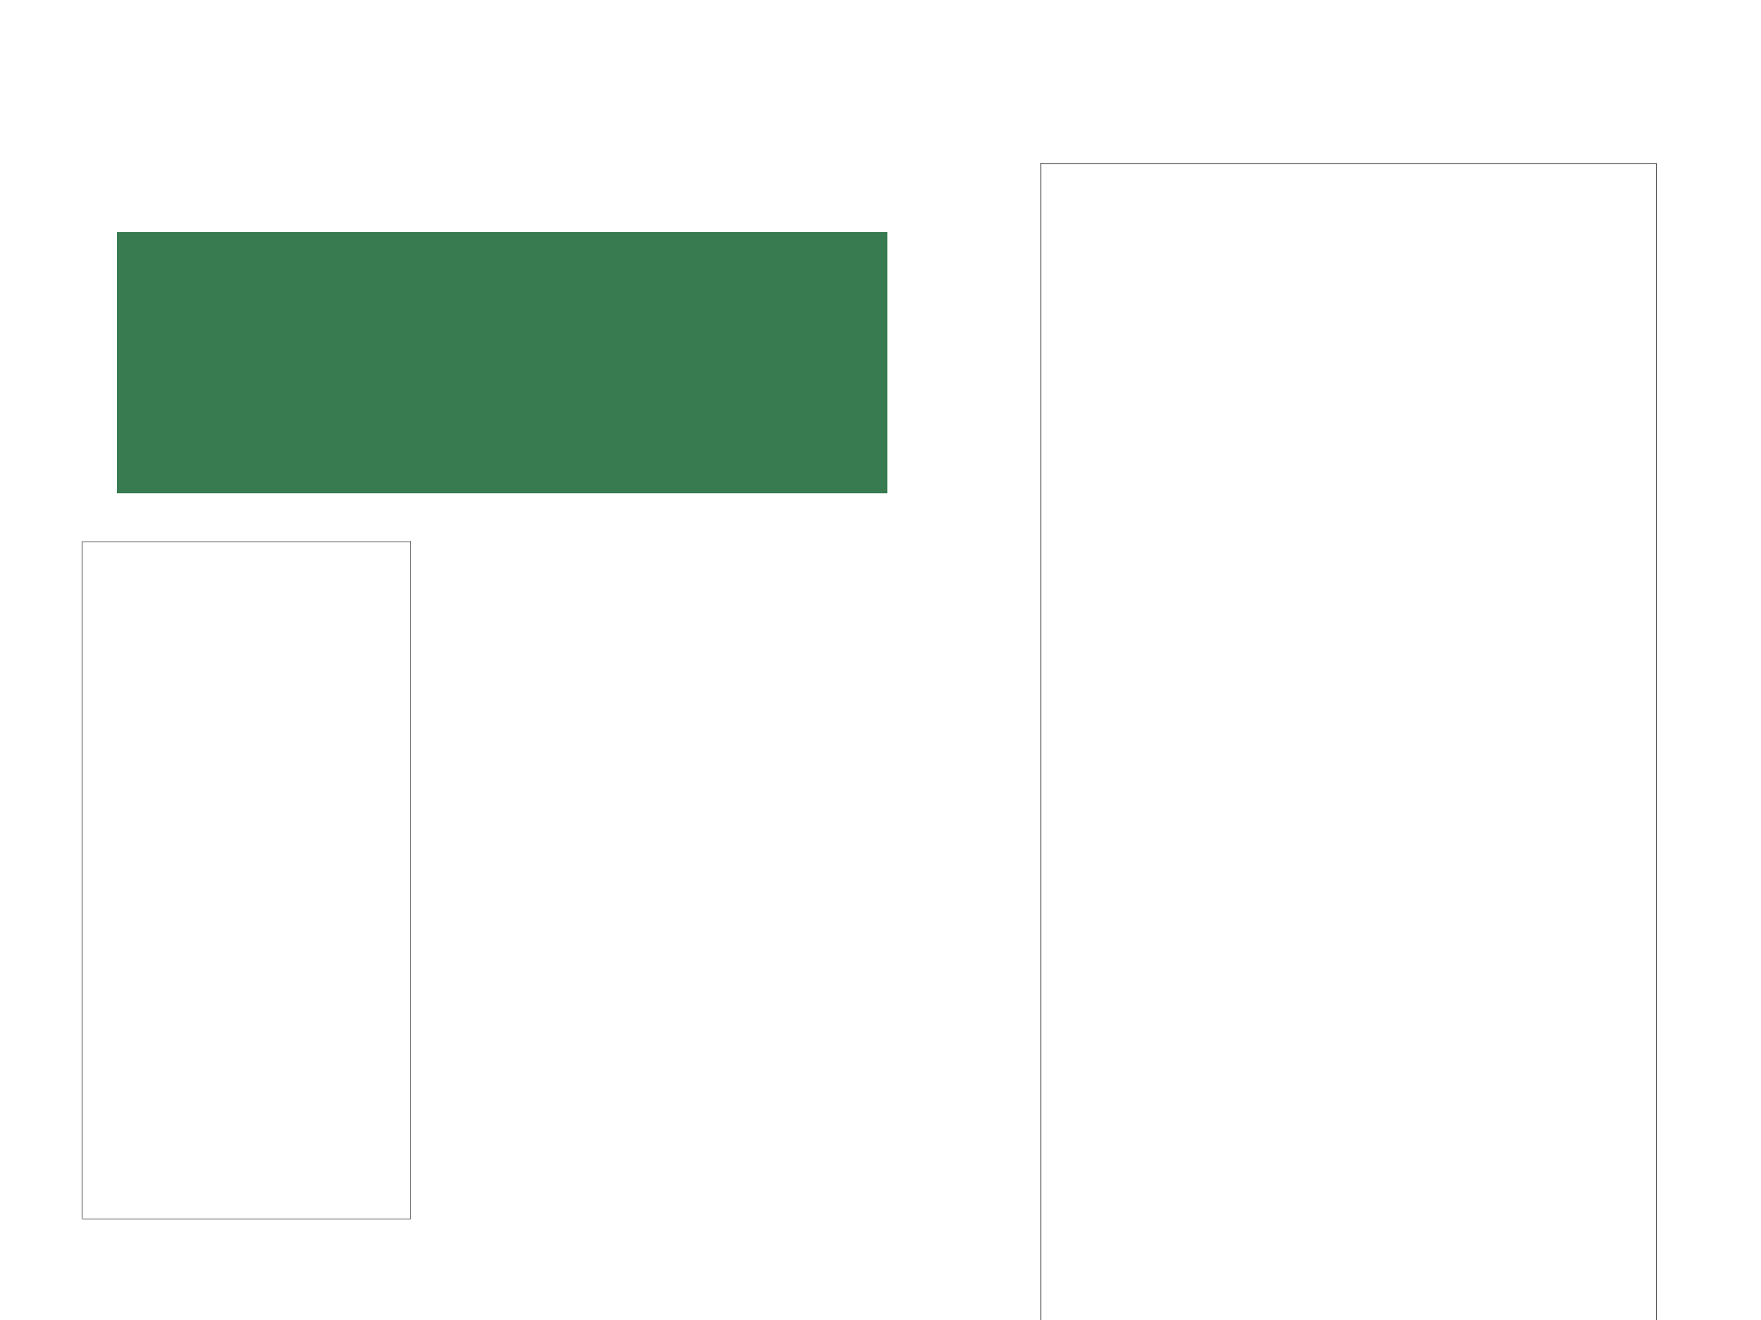


Design Wells Fargo Integrated Trade Ticket
Trade Ticket Experience Design Sprint
What we learned in the testing
• Education was a priority for all users, but
shouldn’t distract nor impede progress
• Trading in quick amounts is good
• Feedback on share amount valuable as well
We designed an interface that was flexible,
allowed vision into details of a stock and
information into the holding itself.
Using a custom keyboard was part of several iterations, but was replaced by the system keyboard.
Second iteration
Third iteration

Slide 147






Design Wells Fargo Integrated Trade Ticket
Trade Ticket Experience Design Sprint
We designed an interface that drove users to be allowed
to see all the variations or Order Types regardless of
shares vs. dollars. We tested 2 variations, one as a list
view and another with tabs.
Test version 1
Test version 2
What we learned in testing
• Tabs vs. list view: people preferred “list view”
• The icon position next to “Action” scored high
• Conditional appearance of Quantity and Order sheets
makes sense to many

Slide 148



Design Wells Fargo Integrated Trade Ticket
Trade Ticket Experience Design Sprint
If a user needs to edit the order ticket all
the fields are available for editing.
What we learned in the testing
• Order types are variable
• Change of color and status give users idea of change in status and process
• Status immediacy is vital
• Cleaner interface
• Ability to quickly transact
• Watchlist alerts actionable
Final delivered solution

Slide 149


End-to-end design process, including Design Thinking for a B2B small business management mobile application
Wells Fargo
mySMALLBUSINESS
Helping Wells Fargo small business owners save money by reducing inefficiency, educating themselves on optimizing their businesses and removing risk vulnerability in their operations
“I have too much to do, and I’m on the road all the time, so a mobile app
would be awesome”

Slide 150

Introduction Wells Fargo mySMALLBUSINESS
Target audience
What’s mySMALLBUSINESS?
• Small Business
Owners
An AI-supported guidance-based application that allows small business owners to monitor and track spending and expenses, optimize business plans and if needed, be educated on the subject of small business finances and business operation.
• Admin support
The problems
My Role
Small business owners who are also bank customers don’t have a dedicated integrated mobile application to better understand their business finances. They need to account for their spending, track business expenses, set budgetary plans and goals, and view their quarterly budgets.
• I led the project team utilizing the support of 2
UX designers.
• I was responsible for managing the discovery process,
including research, strategy and overall hands-on design
of the material and artifacts.
• I led the work on all deliverables and artifacts in Figma
using Lean UX and usability testing, presenting these to
the client and key stakeholders.

Slide 151

How we worked with data scientists using AI
Identifying User Needs and Behavior
Enhancing Data Visualization
• UX Designers: Used AI tools to analyze user behavior,
• UX Designers: Focused on the usability and aesthetic
preferences, and feedback. AI-driven sentiment analysis on user reviews provided insights into user satisfaction and pain points.
aspects of data visualizations, ensuring they were intuitive and engaging for users.
• Data Scientists: Used AI to generate dynamic and
• Data Scientists: Applied machine learning algorithms to
interactive visualizations.
analyze large datasets and uncover patterns or trends that informed UX design.
Improving User Interactions
Designing Personalized Experiences
• UX Designers: Implemented AI-driven virtual assistants
to enhance user interactions and support.
• UX Designers: Worked with AI to create personalized
• Data Scientists: Developed and trained AI models for
user experiences. Used AI to tailor content,
recommendations, interfaces based on individual user preferences.
natural language processing, and other interactive features.
• Data Scientists: Developed personalization models
that feed into UX design. They provided the data and insights necessary for creating these personalized experiences.

Slide 152
Business goals
KPIs
The small business application will see an increase in adoption, use, efficiency of users actions, speed in planning and setting goals, as well as the continual improvement in sales of Wells Fargo for Business products. The increase in usage, education regarding business budgetary planning, increase in sales of supplemental Wells Fargo for Business Products will all add to the net income for the company.
• adoption rate
• usage time
• time on task especially primary tasks
• continual improvement in sales
• increase in use of education regarding business budgetary planning
• increase in sales of supplemental Wells Fargo for Business Products will all add to the net income for the company.

Slide 153
Because of the KPIs assembled, the assumptions of the business partners, and feedback from users based on help requests we determined we needed to use methods to identify user needs, explore new opportunities, validate existing assumptions, and generate new ideas.
Discovery
• Interviews with external users
• Small business owners
• Support staff
• Persona development
• Design Thinking Exercises
Problem statement
Small business owners don’t have a place to monitor their spending, track expenses, set budgetary goals, and view their current budget plans. They will achieve their goal of better understanding of their small business finances through use of this mobile application.

Slide 154

Discovery & Research Wells Fargo mySMALLBUSINESS
Pain points we heard from the interviews
1 Can’t track expenses
2 Limited planning methods
3 Need Photo Receipt and Check Capture functionality
4 Auto bill pay, expense and spending overrun alerts and contingencies
5 No automation of processes
6 Limited status updates
7 Limited up-sell to new Wells Fargo products
“I’d like to have a better understanding of my
spending, and easily be able to track my expenses. Being able to set goals would be even
better, and view my budgets anytime.”

Slide 155






Discovery & Research Wells Fargo mySMALLBUSINESS
Small Business Owner Persona
Small BizOwner Power User
Kunal Power User
General Contractor and Technophile
12 years as a General Contracting small business owner, wants to grow and expand HI-TECH, INC
I spend most of my time trying to understand my finances, trying to track my expenses, I don’t have enough time to plan, or even put out the financial fires, let alone find new ways to save, or connect with other owners and find new products to help me expand.
Pain points in current system
• No spending tracking
Tasks in role
• Find leads, meet leads
• No single place to see current business plans and goals
• No alerts system when a bill is past due or not paid
• Make proposals for new jobs
• Manage crews on jobs
• No place to optimize business budget plan
• Build timelines for projects
• No place for planning and monitoring budgets
• No way to understand and build business for the future
• Budget expenses for work
• Business expenses, general upkeep
• Fractured touch points, no single space for all activities
• Promotion of business
• Research on new opportunities
Expectations of System
• Be able to monitor specific spending
• Get predictive recommendations and alerts
Tools for Tasks
• Optimize current Budgets
• Aid Expansion of business
• Freshbooks
• Square (POS)
• Share, socialize, communicate about the Small Businesses
• MailChimp, SurveyMonkey
• ZipRecruiter
• LegalZoom
• Social Networking sites, i.e., Instagram, Yelp, Facebook
• Squarespace

Slide 156








Discovery & Research Wells Fargo mySMALLBUSINESS
Design Thinking Exercises
Generated concepts for interfaces with 6 participants with 5 concepts for mobile native account views, reporting features and planning processes

Slide 157

Discovery & Research Wells Fargo mySMALLBUSINESS
Pain Points + Business Goals + UX Strategy = Feature Set
UX Strategy
Pain Points
Business Goals
Feature Set
• No way to track spending
• Integrated applications
• Guide
• Expense & Spending
• No workspace for monitoring budgets and planning
• Mobile
• Educate
Tracker
• Functionality Parity
• Optimize
• Budget and Goal Planning Wizard and Workspace
• No place to optimize current business finances
• Optimize customer
• Predict
service experience
=
+
+
• Communicate
• No way to understand and
• Automate
• Business Optimizer and Data Visualization Functionality
build business for the future
• Technology
• Fractured touch points
• Always available to
• No alerts system
help
• Photo Receipt and
Check Capture
• Alert and Predictive
• Tip System
• Multiple Form Factors
• Geared to Users lifestyle
• Chatbot, Voice-based
Customer Support

Slide 158
• Feature refinement and road map
• 22 projected Agile-based sprints
• Usability testing on weekly cadence
• Demos and QA
Design
The Delivered Solution
A predictive, guidance-based application that allows small business owners to monitor and track spending and expenses, optimize Financial Plans and if needed, be educated on the subject of small business finances and business operation. Users will be given guided work-flows when they want to:
• Plan a business budget
• Get status updates, badging and gamification to work
• Track expenses and spending
efficiency and access new Wells Fargo products
• Get recommendations and tips for optimizing their
• Automatically be matched with small business buddies
business
and social network opportunities
• Automate regular business processes
• Optimize business procedures through analytics, and
data visualization
• Set automated procedures, i.e. bill pay, spending overrun
and contingency plans

Slide 159






Discovery & Research Wells Fargo mySMALLBUSINESS
mySMALLBUSINESS Financial Hub Concept Scenario
About an hour later while he is working at a job site, he receives another notification on his mobile phone that his budget goals are in jeopardy. Because he is interested in this plan, he goes on the application and sees the account dashboard.
He needs to investigate deeper into a specific expense. He can view an expense and then see its relationship to a Project and the details the expense was part of.
Kunal Power User is having breakfast at home with his 2 children Preeti and Aziz. While he helps them make their breakfast he gets a notification on his mobile phone that he has an expense that is scheduled to be automatically paid this morning, through his mySMALLBUSINESS application, but that the company’s account is running low on capital.
On the dashboard he gets a visualization of his current mySMALLBUSINESS Financial Plan, the goals, expenses, debts and assets.
He sees the expense and knows it is valid, but he wants to monitor it over time, it is a recurring debt. He goes into the monitoring wizard to set up the preferences to monitor the expense.
During lunch, after overseeing a project, he gets an alert that his yearly budget has issues with employee pay for this quarter. On his mobile he accesses the quarterly view of his current yearly budget for 2023.
When he built his original plan, he used a business budget template that gave him an optimized plan based on his profile and past usage of the application. However, due to an unforeseen increase in business for the quarter, not only did his workload increase, but his expenses did too.

Slide 160





Discovery & Research Wells Fargo mySMALLBUSINESS
mySMALLBUSINESS Financial Hub Concept Scenario
The data visualization feature of the app gives him insight into the increase in activity, expenses and lack of revenue received. The plan gives him real time suggestions and tips to help him run his business better and stay on budget.
Because this has happened several times the app upsells relevant Wells Fargo Small Business products to Kunal, through the Tips and Recommendation engine. Since the quarter is almost ending, he is encouraged to build a new Business Financial Plan. He can use the existing one as a base and adjust, use a suggested Small Business Plan template auto suggested to him, or start from scratch.
By using a Planning Wizard, he decides to use his current plan as a base. The wizard guides him through the process, asking him simple plain-language questions; he could even build it using Siri or other voice-activated technology. He adjusts his plan projecting an increase of 12% in revenue over the next year.
The Wizard algorithmically projects and allocates speculative information and constructs the Plan. He has a new plan to guide him in the new fiscal year. He can also compare past plans to help understand the trends of expenses, debts, spending and revenue.
The interactive data visualizations allow deeper insight of past activity, and help him with his plans for business expansion. He decides to approach Wells Fargo for a new small business loan product, the one that was auto suggested when he was building his budget.

Slide 161

Discovery & Research Wells Fargo mySMALLBUSINESS
mySMALLBUSINESS Information Architecture

Slide 162




Design Wells Fargo mySMALLBUSINESS
Proof of Concept Design 5
mySMALLBUSINESS Dashboard
On the dashboard he gets an AT A GLANCE understanding of his business. From this dashboard he can see his most important and urgent DEBTS and SPENDING. He’d see any INCOME to be expected. A snapshot of TAXES would be seen from a STATE and FEDERAL level.
He can access visualizations of his current FINANCIAL PLANS, the GOALS, EXPENSES, DEBTS,
SPENDING, PAYROLL, and ASSETS. He could
capture any checks for his business as well as
transfer any monies too.
From this dash a user could dive deeper into the
users’ profile, preferences, accounts, security.
They’d be able to set any alerts and monitoring of
spending, accounts, projects, employees, payroll.

Slide 163



Design Wells Fargo mySMALLBUSINESS
Proof of Concept Design 1
Expenses Breakdown
Kunal can view all his SPENDING, then investigate deeper into a specific
EXPENSE. He can view an expense and then see its relationship to a
job and the time frame the expense was part of. He sees the expense
and knows it is valid, but he wants to monitor it over time, as it is a
recurring debt that varies according to the PROJECT it is used on. He
goes into the monitoring wizard to set up the preferences to monitor the
expense.

Slide 164





Design Wells Fargo mySMALLBUSINESS
Proof of Concept Design 4
Budget Plan Wizard
Using his current plan as a base, the
wizard guides him through the process,
asking him simple plain-language
questions. He could even build
it using AI or other voice-activated technology. He adjusts his plan projecting an increase of 12% in revenue over the next year. The Wizard algorithmically projects and allocates speculative information and constructs the Plan. He has a new plan to guide him in the new fiscal year. He can also compare past plans to help understand the trends of expenses, debts, spending and revenue. The interactive data visualizations allow deeper insight of past activity.

Slide 165


Design Wells Fargo mySMALLBUSINESS
Proof of Concept Design 2
Spending Monitoring
When he built his original plan, he used a business budget template that gave him an optimized plan based on his profile and past usage of the application. However, due to an unforeseen increase in business for the quarter, not only did his work load increase, but his expenses did too. The data visualization feature of the app gives him insight.
Year to Date Plan Data vs... Quarterly Plan Data
A BUDGET PLAN gives Kunal real vision to help him run his business better and stay on budget. On a couple occasions he has received alerts and tips. Because this has happened several times the app upsells relevant Wells Fargo Small Business products to Kunal, through the Tips and Recommendation engine. Since the quarter is almost ending, he is encouraged to build a new Business Financial Plan. He can use the existing one as a base and adjust, use a suggested mySMALLBUSINESS Plan template auto suggested to him, or start from scratch.

Slide 166


Design Wells Fargo mySMALLBUSINESS
Proof of Concept Design 3
Spending Monitoring
When he built his original plan, he used a business budget template that gave him an optimized plan based on his profile and past usage of the application. However, due to an unforeseen increase in business for the quarter, not only did his work load increase, but his expenses did too. The data visualization feature of the app gives him insight.

Slide 167
Redesign and UX strategy process for a desktop-based application
AMEX
MOCA
Helping AMEX to increase revenue by aiding
advertisers and marketers in their decisions
about advertising budgets
“Comparing budgets and then optimizing it would allow me to have the confidence,
to increase the budget”

Slide 168
Introduction AMEX MOCA
Target audience
What’s MOCA?
Desktop-based budgeting application that uses algorithmic engines to project a marketer’s potential budget, as well as compare the constructed and optimized budget scenarios.
• American Express
Sales Managers
• American Express
Sales Advisors
The problems
My Role
• AMEX Sales partners don’t have an effective tool for external clients to budget their AMEX Advertising dollars
• By working with data scientists we created more
effective and engaging user experiences. Working
• No way to compare scenarios
together we understood and predicted user needs,
optimizing various aspects of design and data analysis.
• No way to understand effectiveness of investment
• I was responsible for managing the discovery process, including research, strategy and overall hands-on design of the material and artifacts.
• Need a more customizable and predictive application
using nascent AI technology.
• I led the work on all deliverables and artifacts in Sketch and Figma using Lean UX and usability testing, presenting these to the client and key stakeholders.

Slide 169
Discovery & Research AMEX MOCA
Why design MOCA?
$1.34 mil
Average client budget
5.4%
Drop-off rate on the current budget process
12 mins
Average time partners need to complete a budget
58%
Approval rating from internal business partners

Slide 170
How we worked with data scientists using AI
Identifying User Needs and Behavior
Enhancing Data Visualization
• UX Designers: Use AI tools to analyze user behavior,
• UX Designers: Focus on the usability and aesthetic
preferences, and feedback. For example, AI-driven sentiment analysis on user reviews or social media can provide insights into user satisfaction and pain points.
aspects of data visualizations, ensuring they are intuitive and engaging for users.
• Data Scientists: Use AI to generate dynamic and
• Data Scientists: Apply machine learning algorithms to
interactive visualizations. For example, AI can automate the creation of charts and graphs based on user queries or highlight important trends and anomalies in the data.
analyze large datasets and uncover patterns or trends that inform UX design. This might include clustering users into segments or predicting user behavior based on historical data.
Improving User Interactions
Designing Personalized Experiences
• UX Designers: Implement AI-driven features like
chatbots or virtual assistants to enhance user
interactions and support. They design interfaces that integrate these AI tools seamlessly.
• UX Designers: Work with AI to create personalized user
experiences. For instance, using AI to tailor content, recommendations, or interfaces based on individual user preferences or behavior.
• Data Scientists: Develop and train AI models for natural
language processing, speech recognition, or other interactive features. They ensure these models are accurate and effective in real-world applications.
• Data Scientists: Develop and fine-tune recommendation
algorithms or personalization models that feed into UX design. They provide the data and insights necessary for creating these personalized experiences.

Slide 171
Because of the KPIs assembled, the assumptions of the business partners, and feedback from users based on help requests we determined we needed to use methods to identify user needs, validate existing assumptions, and generate new ideas.
Discovery
• Interviews with internal stakeholders,
Problem statement
SMEs, and users
Internal business partners don’t have a tool to help their external clients to budget their AMEX Advertising dollars effectively. Users need an application to effectively allocate marketing budgets through the various AMEX product lines.
• Sales Managers
• Sales Advisors
• Contextual interviews
• Persona development
• Codesign sessions with data scientists

Slide 172
Discovery & Research AMEX MOCA
What we learned from interviews
• Users want to compare different budget scenarios
• Determine through data visualizations the effectiveness between each
• For a deeper understanding of their allocations, users wanted to modulate
each channel and product that make up each channel
• Channels vs. products
• See the effects and modulate
“If I could build a plan down to the product line
and channel, I’d be super happy, but I’d also be
able to customize each quarter”

Slide 173
Discovery & Research AMEX MOCA
Pain Points + Business Goals + UX Strategy = Feature Set
UX Strategy
Pain Points
Business Goals
Feature Set
• Scenario builder
• Education
• Walk through Wizard
• Walk through Wizard
• Data Visualizer
• Platform parity
• Scenario builder
• Scenario builder
• Comparison functionality
• Integrated systems
• Data Visualizer
• Data Visualizer
• Import data sets through
• Import data sets
• Comparison functionality
• Data
=
+
Excel sheets
+
• Channel allocation /
• Import data sets
• Modify each allocation per
product allocation
• Channel allocation /
channel / by product
• Optimization budget tool
product allocation
• Optimization budget tool
• Integration with internal
systems

Slide 174
Discovery & Research AMEX MOCA
The user journey was distilled into a 3-step process to build their investment plans
1 WALK THROUGH WIZARD
The Walk Through Wizard guides users through the process of entering parameters for the budget plan projection. Users import data, set dates, and can manipulate each allocation per channel and by product.
2 SCENARIO BUILDER
A user can build separate scenarios and compare. They will also be able to optimize a selected budget utilizing the tools’ business intelligence and access to big data, to build the most optimal allocated funds.
3 DATA VISUALIZER / SCENARIO COMPARISON
A user can then understand through the data visualizations, how each individual plan is broken down and how they compare to one another.

Slide 175
Discovery & Research AMEX MOCA
User flows for feature sets
Understanding the usage contexts of the application helped us develop a clear vision of the interactive expectations of the users. We developed a set of experience principles woven through the application.

Slide 176
Design
• Feature refinement and road map
• 12 Agile-based sprints
• Usability testing on regular cadence
• Demos and QA
The Delivered Solution
1 WALK THROUGH WIZARD
The Walk Through Wizard guides users through the process of entering parameters for the budget plan projection. Users import data, set dates, and can manipulate each allocation per channel and by product.
2 SCENARIO BUILDER
A user can build separate scenarios and compare. They will also be able to optimize a selected budget utilizing the tools’ business intelligence and access to big data, to build the most optimal allocated funds.
3 DATA VISUALIZER / SCENARIO
COMPARISON
A user can then understand through the data visualizations, how each individual plan is broken down and how they compare to one another.

Slide 177
Design AMEX MOCA
MOCA Experience Design Sprint
What we learned from discovery
Users wanted to import one budget and keep it as a template to build a second budget. Therefore, we built functionality to allow a user to base a new budget on an existing imported budget by duplicating it.

Slide 178
Design AMEX MOCA
Unexpected Challenge
As a desktop app, we needed to account for other applications that sat on the desktop and factor in how this app would connect to them through APIs

Slide 179
Design AMEX MOCA
Plan Builder Design Sprint
What we learned from research
• The navigation bar with tool bar scored high
• Users wanted to see the reset icon as a
separate tool.

Slide 180
Design AMEX MOCA
Scenario Comparison Design Sprint
What we learned from research
• Short term vs. long term was seen as a vital
dynamic
• Selecting a scenario to optimize tested well

Slide 181
Budget Plan Construction
Users want to compare different budget scenarios, and determine, through data visualizations, the differences between each. For a deeper understanding of their allocations, users want to modulate each channel and product that make up each channel.

Slide 182
Design AMEX MOCA
Wizard Design Sprint
As a first-time user experience, users want a friction-free way to get started. Users needed a concise and efficient Wizard to start the process, entering budget details and time frame.
What we learned from research
Through our discussion, we learned that because they only use the application once every 6-12 months, many users needed more structured guidance and hand-holding.

Slide 183
Design AMEX MOCA
Plan Builder Design Sprint
What we learned from research
Users want to be able to allocate, down to the product line OR channel, in order to fine-tune their allocations to see effectiveness.
What we learned from research
Exporting, duplicating and saving functionality seen as vital feedback

Slide 184
Design AMEX MOCA
Plan Builder Design Sprint
What we learned from research
• They like to see the data visualizations comparing plans and the optimization features to help them finish their planning by offering the “best” plan.

Slide 185
Design AMEX MOCA
Scenario Comparison Design Sprint
What we learned from research
• Channel breakdown seen as vital, and a
game changer

Slide 186
Design AMEX MOCA
What we learned from research
Scenario Comparison Design Sprint
• Toggling between chart types was seen as useful
• Visualizing scenarios seen as a vital aspect of the tool, with the correct data metrics

Slide 187
Results AMEX MOCA
Results of the design
Increased approval ratings
88%
Approval rating from internal business partners
Lower submission drop-off
3.4%
Drop-off rate on the new budget tool
Faster comparison
5 mins
Average time spent comparing budgets
Shorter submission time
10 mins
Average time partners need to complete a budget
Higher budget spending
$1.8 mil
Average client budget

Slide 188
michaelthibodea(UX)
646 436 2876 michaelthbd@yahoo.com

