Slide 1

case studies
Portfolio of case studies that show the conceptual
development, design process, artifact construction,
and final released experiences
michaelthibodea(UX)
www.michaeljthibodeau.com

Slide 2

End-to-end design process, including Design Thinking and AI-supported methods, for an AI layer on the FinViz stock screener that guides a swing trader through the trading day
FinViz
Helping FinViz cut the time from sign-up to Elite from 42 to 21 days by getting new traders to a screen they trust, then watching it for them
“Alerts are everything. Once you close FinViz, you get nothing.”
Notes:
Opener in the portfolio format. Concept-stage work; screens are illustrative with fictional tickers. The quote paraphrases reviewer point R3 from the 30 Sept design review.

Slide 3
01 · Overview FinViz AI Screener
How this case study is organized
The final experience first, then the reasoning, data and method behind it. Process artifacts are in the appendix.
01
Overview
Hero and contents
02
Context & constraints
Business goal, stakeholders, success, limits
03
Problem: user and AI
What users struggle with; what the AI must do
04
Data foundation
Sources, volume, quality, labels
05
The solution, hi-fi
One trade through one trading day, 19 screens
06
Reasoning & trade-offs
Chosen vs rejected, accuracy vs control
07
Methodology
AI methods, validation, UX research
08
Implementation
Built on FinViz; new services; collaboration
09
Results & impact
Targets and how they’ll be measured
10
Learnings & Next Steps
What I learned; what to validate before launch

Slide 4
02 · Context & constraints FinViz AI Screener
The brief, and how we answer it
WEEK 1
Domain, needs, pains, AI Solution Canvas
→ Context file, personas, 27 pains scored, KPI tree, canvas
WEEK 2
Onboarding or filters: first success faster
→ First Steps + Filtering → The Trading Day · On Watch (OW1–OW7) → hi-fi flow
WEEK 3
Alerts & notifications: input, output, refinement
→ Canvas v2, three journeys, 18 ideas, AN7–AN8
WEEK 4
Charts UX: insights, accuracy, just in time
→ Chart Lens: lenses over a list, reliability layer (CL1–CL4) · Insight Board dashboard (DB1–DB5)
WHERE WE DELIBERATELY DEPART FROM THE BRIEF
Brief: users are mostly expert day traders and multi-portfolio managers.
We center Growth Gary, a swing trader with a day job: the largest new-user group that can’t watch the market at work, where alerts sell Elite. Day traders stay the conversion lever.
Brief: users want expert recommendations with probability scores.
No AI-originated probabilities or buy/sell. Attributed analyst views are allowed (pending compliance); history is shown as history, with sample sizes.
Brief: mobile is a goal.
Desktop only for this exploration, as Week 2 asks; FinViz has no native app. Mobile is deferred, not dropped.
Notes:
Course brief summarized in Research-Notes/Course-Design-Brief.md (all 🔶 case-brief facts). Live-site facts win for the real product, e.g. 7-day card trial vs the brief’s 30-day money-back.

Slide 5
Competitive landscape
Competitive landscape: where FinViz is strong, and where the AI layer fits
Examples from the FinViz research notes, as of September 2026.
Product | Where it is strong | Where the AI layer fits
TradingView | Charting and community. Ships AI chart analysis and document summaries. | Explains the trader’s own screen. FinViz stays the fastest place to find ideas.
Trade Ideas | Real-time scanning and alerts at tick speed. | FinViz does not compete on tick speed. Push alerts on a saved screen matter more to this user.
Bloomberg Terminal | Market data and news flow for professionals. | Cost and complexity. FinViz’s job is discovery for individual traders.
Source: FinViz research notes. Competitor features change. Re-check before publishing.

Slide 6
03 · Problem FinViz AI Screener
The user problem and the AI problem
Defined separately, so the AI only does what a rule can’t.
USER PROBLEM
Gary can find ideas but can’t hold on to them. 89 filters with no explanation; a list that forgets why he picked each stock; nothing reaches him at work; the decision to hold or exit happens in his head (P1, P5, P8, P9, P13).
AI PROBLEM
Infer a screen from 3 example tickers · explain why each row matched from real values · re-check his own reasons against fresh data 3× a day · detect chart patterns at support with measurable criteria · summarize overnight news on his names only, with sources · turn his corrections into proposed rule changes.
WHY AI IS APPROPRIATE
Translating examples and plain English into 89 filters, and summarizing many sources, are language tasks. Scanning 30 charts for the same setup every day is repetitive perception. Remembering his reasons needs memory. Where a rule is enough we used a rule: the since-last-night diff, exit lines, quiet hours and the activity log are not AI.

Slide 7
03 · Problem FinViz AI Screener
Pain points, scored by user and business impact
1 Ideas can’t become a working, watched screen
2 Blind during market hours
3 Too many results, and no reason why they matched
4 Which metric matters, and what counts as good?
5 Filters in fixed buckets; exact values are Elite
6 Alert noise
7 Catalysts scattered across pages
“Once you close FinViz you get nothing, and setting up alerts today is quirky.”
Design review feedback, Sept 30
Notes:
From the pain register (03c), P1, P9, P5, P3, P2, P10, P13: 27 pains in total, scored urgency × business impact.

Slide 8
05 · Solution FinViz AI Screener
One trade, followed through one trading day
This case study follows Growth Gary, a swing trader with a day job, through a single trade. He finds an idea at night, checks it before work, gets one alert while he’s busy, and decides after the close whether his reasons still hold. FinViz does the watching and explaining at the right moment; Gary makes every decision, in his own broker.
☾ 8–10 PM
☾ while he sleeps
☀ 7:30 AM
☀ 9:30 AM–4 PM
☀ 4:30 PM
1
2
3
4
5
Evening
Overnight
Before work
During work
After the close
Reviews what’s new, pins 3–5 names, taps “Watch these for me”
Nothing
Reads one short note
Taps one alert, if it comes
Decides: hold, or exit in his own broker
Notes:
SCRIPT
[open] Meet Gary. He swing trades, and he has a day job. He finds ideas at night, can't watch the market from 9:30 to 4, and too often misses the moment a stock does exactly what he was waiting for. Today, a FinViz screen is something he visits. By morning, it's forgotten.
This is what changes when FinViz keeps watch for him.
— Production notes —
The one workflow this case study showcases: The Trading Day. Everything else in the deck either explains why (research), how it was led (leadership) or how it works (design).

Slide 9






05 · Solution FinViz AI Screener
The User Journey: From market noise to a focused next step
Six beats on the Insight Board: Gary’s day around work, then Mike, an advisor. The board surfaces what changed; he decides.
1 · Morning DB1 · 7:45 AM
“What needs my attention?”
Three findings about his own names come first: DOCN at risk, QLYS earnings, semis down with RMBS exposed.
2 · Investigating DB2
“Show me the evidence.”
The card shows measured moves, quote time and the Reuters source; RMBS +1.1% on its own news.
3 · Refining DB2 · feedback
“Ask before changing it.”
“Move too small for me” → a previewed threshold change he applies or cancels.
4 · After the close DB3 · 4:45 PM
“How do I compare with my plan?”
Tech 46% vs his 40% target; the cause is RMBS +18.4%. Explained, never rebalanced.
5 · Advisor DB4 · Mike
“Exceptions, not 54 dashboards.”
Mike starts with 6 portfolios that crossed his limits; uncertainty stays visible.
6 · Personalization DB5 · Sunday
“Build the board around my routine.”
Habit-based suggestions he accepts or declines; every change reversible.
Notes:
WALKTHROUGH (5–7 min) · From market noise to a focused next step
Positioning: AI is a contextual research and monitoring assistant, not a chat window. Monitoring and explanation are automatic; changes to preferences or layouts need approval; trading stays outside the agent's role.
[1 Morning · DB1] It's 7:45. Gary doesn't need another feed of headlines; he needs to know what changed for the names he follows. FinViz keeps the familiar context (futures, breadth, heatmap) but puts three findings first: DOCN is trading below its 50-day moving average before the open, so one of his saved reasons is at risk; QLYS reports after the close; semiconductor weakness may matter because RMBS is on his shortlist. Each has a source, a reliability label and somewhere to investigate.
[2 Investigating · DB2] He opens the semiconductor finding: measured moves, number of stocks, quote time, the Reuters report. His exposure is separated from the industry move: RMBS is up 1.1% on its own news while the industry falls 2.1%. FinViz measures the move; it attributes a cause only when a source supports it, otherwise "No reported cause". Research support, not a prediction or a trade recommendation.
[3 Refining · DB2] The move is too small to be useful to him. FinViz asks why and previews a change (only industry moves > 3%; about two fewer cards a week). He applies or cancels. Borderline signals stay on the board without pushing. Reduce interruption, don't manufacture urgency.
[4 After the close · DB3] Technology is 46% of the portfolio, six points above his 40% target and outside his band; the cause is RMBS +18.4% this month. FinViz explains where he differs from his own plan; it doesn't rebalance or turn that into a trade instruction.
[5 Advisor · DB4] Mike manages 54 portfolios: 6 crossed one of his limits, 48 are within them. He starts with an exception queue; each shows evidence and when it appeared; uncertainty stays visible. Acknowledging records review, not resolution.
[6 Personalization · DB5] FinViz notices habits and offers to pin or hide cards, says why, and asks. "No thanks" is remembered; changes are reversible.
[Closing] AI has three jobs: notice relevant changes, explain them with evidence, keep a focused workflow. Sources, timestamps, uncertainty and approval are part of the experience. The user stays in control of criteria, attention and decisions.
Before presenting: conceptual screens with synthetic data; reliability labels describe the evidence, not investment performance; the "Ask about…" entry points are proposed.

Slide 10


05 · Solution FinViz AI Screener
Evening: Turn his idea into a screen he trusts
Mon Oct 5, 8 PM, after Monday’s close. Free account.
STEP 2 · OW2 New, dropped and near-miss rows first, each with which of his criteria it meets
STEP 1 · OW1 Pastes 3 tickers; AI writes what they share as editable filter chips
AI BEHAVIOR Programming by example, constrained to FinViz’s real filters. Decision point: he keeps or drops each chip (Tab / Esc).
Notes:
SCRIPT
[OW1] Gary doesn't start with 89 dropdowns or a chat box. He pastes three stocks he already likes. FinViz's AI works out what they have in common, and the result is real filter chips he can edit, with a live count. AI learns from his examples. It doesn't make him write a query.
[OW2] He opens his saved screen. The new names are at the top, and every row shows which of his criteria it meets, or how close it came. The "why it matched" comes from real values, never a score.

Slide 11


05 · Solution FinViz AI Screener
Evening: Remember why, then watch it for me
Mon 8:32–8:52 PM. The one earned Elite moment.
STEP 5 · OW3 Pinned names keep their reasons as checkable conditions; exit lines dragged on the chart
STEP 6 · OW4 Replay: “would have fired 4 times in the last 30 days”; noise dial; 7-day trial starts here
DECISION POINT He commits only after seeing what watching would have done. History, never a forecast.
Notes:
SCRIPT
[OW3] He pins three names. His reasons come with them, his own note too, and he drags an "out if" line straight onto the chart. The product remembers why he picked each one.
[OW4] One tap. Before he commits, FinViz replays the last 30 days: "Your criteria would have fired 4 times." He drags the noise dial and the timeline redraws. He sees what he'll get before he signs up for it. His 7-day Elite trial starts here, because this is the moment the value is obvious.

Slide 12

05 · Solution FinViz AI Screener
Close-up · Step 8 · CL4 · Why FinViz marked this
Tue 7:40 AM. Opened from “Why marked?” in the morning glance.
AI BEHAVIOR
Measurements, not a confidence score: wick 2.6× body, at support, volume 2.4× its norm
Clear, borderline or not enough data; only clear findings reach his inbox
History with its sample size (38 matches in 3 years) and a visible track record
Notes:
SCRIPT
[CL4] His chart setups show up too, but only the clear ones. Tap "Why?" and he sees what FinViz measured: wick 2.6 times the body, at support, volume 2.4 times its norm. When it isn't sure, it says so. Reliable by design: measurements, not confidence scores.

Slide 13
05 · Solution FinViz AI Screener
Close-up · Step 9 · DB1 · Insight Board, pre-market
Tue 7:45 AM. FinViz Home, upgraded.
AI BEHAVIOR
• Three findings that need him today, each sourced and labelled Clear
• The familiar parts stay: index row, breadth bars, S&P 500 map, now with AI notes
• Pre-market prices on his own names are the Elite moment
Notes:
SCRIPT
[DB1] When Gary sits down, the board he keeps open isn't a page of data. At the top are three findings that need him, each one sourced: a DOCN reason at risk, QLYS reports tonight, and semis are down after NVDA's results, with RMBS in that group. Insights, not widgets.

Slide 14

05 · Solution FinViz AI Screener
Close-up · Step 12 · AN7 · “This was wrong” → proposed fix
Tue 10:31 AM. The alert opened on the RMBS quote page.
DECISION POINT
His reason (“too early”) becomes a specific change to his own rule
Before/after replay: 4 → 2 alerts in 30 days, both acted-on alerts kept
Nothing changes until he applies it; every change is logged with Undo
Notes:
SCRIPT
[AN7] It came too early, so he taps "This was wrong" and gives the reason. FinViz proposes a tighter rule and shows him the replay: 4 alerts become 2, and the ones he acted on are kept. Nothing changes until he applies it. The AI learns from his corrections, in the open.

Slide 15

05 · Solution FinViz AI Screener
Close-up · Step 14 · OW7 · Reasons Still Hold?
Tue 4:30 PM. DOCN closes below its SMA50: a reason breaks.
DECISION POINT
A checklist that ticks itself against today’s close
What changed and when, on the chart; his exit line ($34.00) not met
Hold or exit is his call, in his own broker; FinViz never places orders
Notes:
SCRIPT
[OW7] After the close, a checklist that ticks itself. RMBS and QLYS: all reasons hold. DOCN: two of three. FinViz shows what changed and when. It checks his reasons. It doesn't give advice. Hold or exit is Gary's call, made in his own broker. FinViz never places a trade.

Slide 16
06 · Reasoning FinViz AI Screener
Eight design lead calls that changed the work
Sept 23
Sept 23
Sept 23
Sept 24
Sept 30
Sept 30
Sept 30
Oct 1
1
2
3
4
5
6
7
8
Map today’s onboarding before designing
Desktop only, for now
One design for first-time and repeat users
Remove real frictions with new AI models
Optimize time to first success; no chat box first
Set the advice line, pending compliance
Lead with the swing trader’s trading day
Bring teammates’ screens in line with the rules
Teal marks the team design review

Slide 17
DESIGN LEAD CALL One design for first-time and repeat users
AI UX Principles
Onboarding is not a phase: learnability is a property of every screen; no wizard, no tour.
Judgment stays with the trader: AI explains and verifies; it never recommends, predicts or places orders.
Learn by doing: every explanation is attached to a chip, a row or an alert.
Explain at the moment of doubt: “why it matched” on every row and every alert.
Scaffolds fade: help per concept fades with fluency and returns after 30 days.
Show consequences first: an alert is previewed against the last 30 days before it is saved.
Editable output: AI writes filters, rules and columns, never chat bubbles.
Honest history: base rates with sample sizes, never a confidence % on a trade.
Remembers your why: screens and watches keep the reasons they were created.
Grounded in research: Microsoft HAX guidelines and Google PAIR.

Slide 18
07 · Methodology FinViz AI Screener
The AI UX workflow: AI drafts, the design lead decides
1 · Frame
DESIGN LEAD
Sets the question, audience, scope and rules: desktop only, no advice, purple means AI
2 · Draft
AI AGENTS
Research, docs, FigJam boards and Figma screens, drafted against those rules
3 · Review
LEAD + TEAM
Fact checks on the live site; critique with the team; rule breaks caught
4 · Decide
DESIGN LEAD
What to adopt, rename, cut or lead with, and why
5 · Propagate
AI AGENTS
Each decision applied across every doc, board and screen
Repeated in every phase: research → principles → concepts → screens. Rules set by the lead live in the project brief, so every AI draft starts from them.
Notes:
Crimson = design lead checkpoints; violet = AI. The workflow I ran for this project.

Slide 19
09 · Results & impact FinViz AI Screener
Trust is designed, then measured
< 2%
100%
filter translations wrong (weekly audit)
explanation accuracy: “why it matched” built from real values
< 40%
0
alerts with no action, the biggest driver of trust erosion
compliance incidents: no advice, no forecasts, no orders
Targets from the KPI framework, sitting next to product metrics so a faster screen never comes at the cost of a wrong one.

Slide 20
09 · Results & impact FinViz AI Screener
How success will be measured
42 → 21
3+ days
days from sign-up to Elite
a week re-running a saved screen: the North Star
< 5 min
> 40%
to a first saved screen
of alerts lead to an action
Concept-stage work: these are targets with a plan to baseline them, not results.

Slide 21
10 · Learnings & Next Steps FinViz AI Screener
What leading with AI taught me
The bottleneck moves to judgment
Drafts take minutes. The lead’s value is framing, checking facts and deciding what to keep.
Write the rules down once
Rules in the project brief made every AI draft start compliant.
Check the live product, not the docs
One live-site walk overturned two assumptions.
Reconcile, don’t overwrite
Teammates’ screens kept their best ideas and lost only what broke the rules.
Notes:
My reflection; edit to match how I'd say it in an interview.

Slide 22
Next Steps
Usability test the first-release flow with swing traders in their first 14 days
Baseline time to first success and habit before claiming improvement
Clear the advice line and attributed analyst views with compliance
Clickable hi-fi prototype of the 19-step flow for usability testing

Slide 23
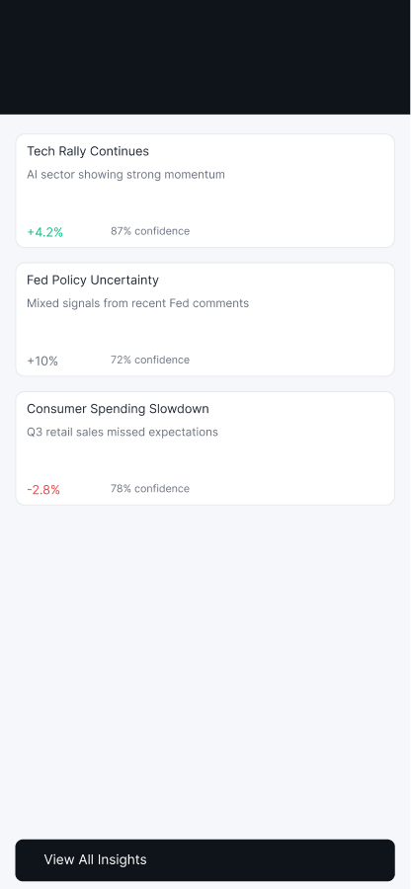
CASE STUDY · AI-ASSISTED TRADING PROTOTYPE
Meridian
Navigator
Retail investors juggle research, orders and monitoring across separate tools. Does AI insight beside the trade help them decide?
A mobile trading prototype: five AI and trading screens, built in SwiftUI and designed in Figma.
Working draft · 2026

Slide 24
How this case study is organized
The final experience first, then the reasoning behind it.
01
02
03
04
05
Overview
Context & constraints
Problem: user and AI
Users
The solution, hi-fi
06
07
08
09
10
Reasoning & trade-offs
Methodology
Implementation
Results & impact
Learnings & next steps

Slide 25
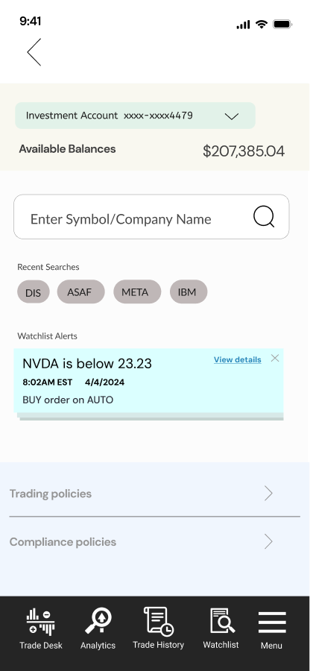
01 · Overview Meridian Navigator
Five screens, one trade, one place for AI
A mobile trading prototype with AI screens beside the order flow.
PRODUCT
An AI layer on a trading app. Users see what needs attention (Insight, Guard), what might fit their plan (Prospect), and whether their mix should change (Adapt), next to the order flow.
Scope
5 core screens · 2 trade flows of 8 steps each · mock data only
My role
Lead UX designer. I framed the problem, designed the trade and AI flows, built the Figma design system, and produced the SwiftUI prototype. AI agents helped with drafting.

Slide 26
02 · Context & constraints Meridian Navigator
Context and constraints
What the prototype has to prove, and what it cannot yet.
BUSINESS CHALLENGE
STAKEHOLDERS
Show one complete loop, from noticing a change to placing an order, in a prototype stakeholders can test.
Active traders, busy investors and first-time investors (draft personas), plus product, design, engineering and compliance.
SUCCESS
CONSTRAINTS
Stakeholders complete a trade and read the AI output without help. Targets are planned, to be set with stakeholders.
Mock data and a mock API only. No live brokerage or market data. Trade and AI copy need compliance review.

Slide 27
02 · Context & constraints Meridian Navigator
How the work was done, and what is still open
1
2
3
4
5
6
Frame
Hypothesize
Map flows
Design system
Design states
Validate
DONE
DRAFTED
DRAFTED
IN PROGRESS
DRAFTED
PLANNED
Problem, scope and assumptions recorded on the FigJam board.
Three draft personas, marked untested.
Share and dollar trade flows, and the AI feature flow, drafted in Figma.
Tokens shared between Figma and SwiftUI. Component library not yet audited.
Empty, loading, error and offline states on 06- Wireframes.
Interviews, usability tests and compliance review. Not started.
Status is a designer’s self-assessment. No interviews or usability tests have run yet.

Slide 28
03 · Problem Meridian Navigator
The user problem and the AI problem, defined separately
1
2
3
User problem
AI problem
Why AI
Research, order entry, watching positions and rebalancing live in different places. The hold-or-exit call gets made in the user’s head.
Summarize what moved and why, with the source. Rank alerts by severity. Show prospects with upside and downside. Propose a rebalance the user reviews first.
Summarizing news and research is a language task. Watching many positions is repetitive. Where a simple rule works, such as sorting or thresholds, the design uses a rule.

Slide 29
Competitive landscape
Competitive landscape: trading apps today, and the gap
From the August 2026 competitive audit. Re-check features before publishing.
Product | Feature today | Limitation
Robinhood | Price alerts that notify when a stock moves. | Passive and user-initiated. No pattern-based guidance.
Schwab | Suitability checks that warn when an order breaks a risk profile. | Compliance-driven. Does not learn from the user.
Wealthfront | Volatility score on positions. | Generic, not based on the user’s own pattern.
Vanguard | Time-based rebalancing reminders. | Tied to the calendar, not to the user’s behavior.
Meridian’s bet: nudges built from the user’s own history, shown next to the order. The audit found no platform doing this.

Slide 30
04 · Users Meridian Navigator
Three draft personas to validate before we rely on them
DRAFT PERSONA
DRAFT PERSONA
DRAFT PERSONA
Maya
Daniel
Priya
Active self-directed trader
Busy professional investor
First-time investor
Trades several times a week from her phone. Uses a brokerage app and a separate news source.
Invests a fixed amount each month and checks his portfolio weekly.
New to investing. Wants to start small and learn while she invests.
Get in and out quickly; spot momentum early
Pain: research is scattered; order entry takes too many taps
Features: Insight, Prospect, Share flow
Grow long-term savings without big mistakes
Pain: no time to research; unsure when to rebalance
Features: Guard, Adapt, Dashboard
Learn by doing; avoid a wrong trade
Pain: jargon; fear of ordering the wrong amount
Features: Dollar flow, Insight explanations
Hypotheses from the FigJam board. Interviews come before any decision rests on them.

Slide 31
The solution
Hi-fi first: one trade through the app, then the AI screens that inform it.

Slide 32
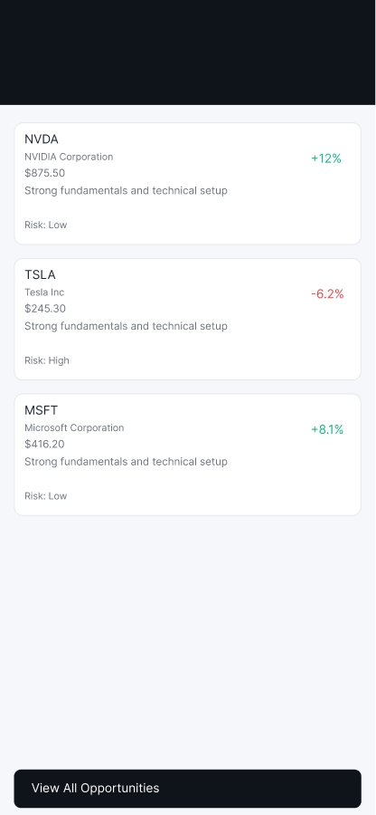
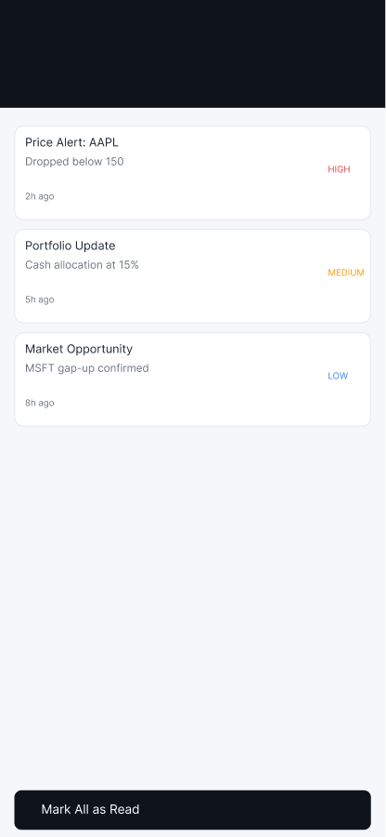
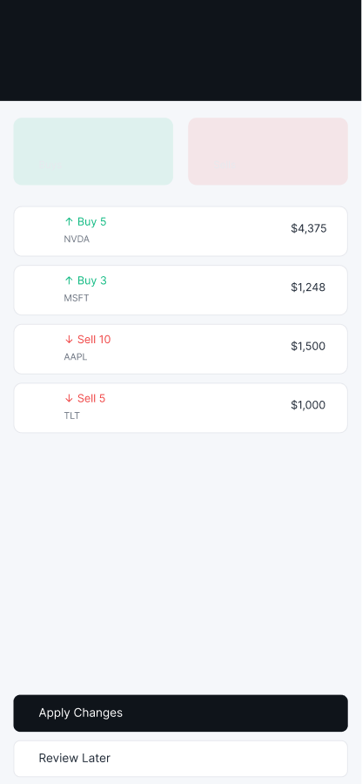
05 · Solution Meridian Navigator
Five screens, each answering one question
Dashboard
Insight
Prospect
Guard
Adapt
What do I own today?
What moved, and why?
What might fit my plan?
What needs my attention?
Should my mix change?

Slide 33
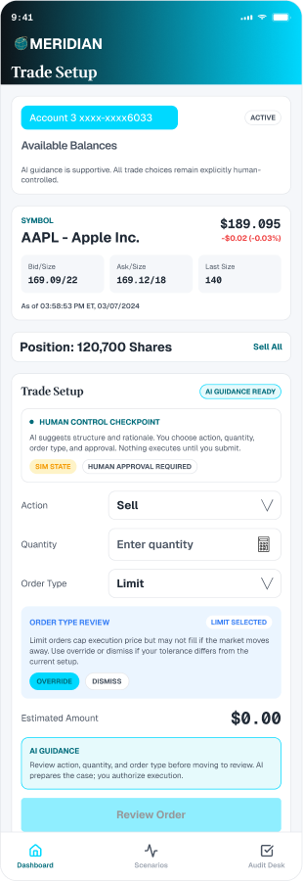
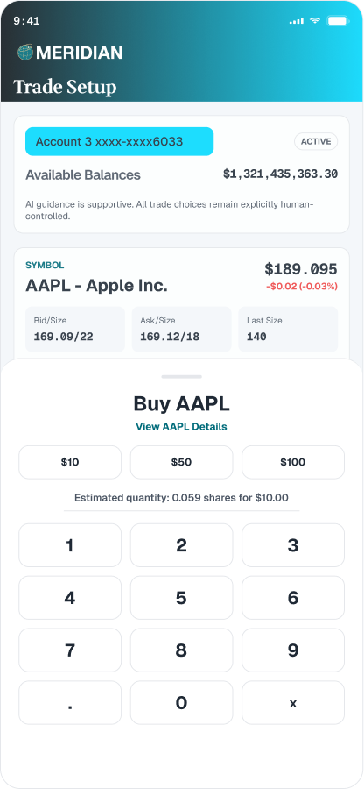
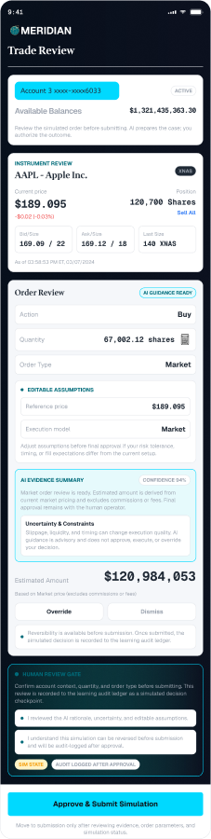
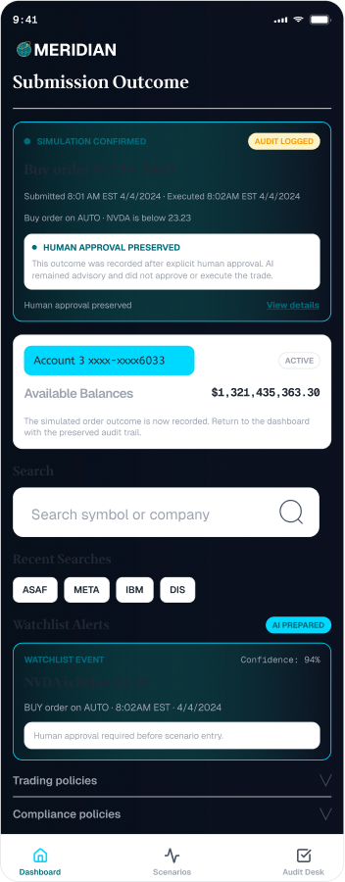
05 · Solution Meridian Navigator
One trade in eight steps, by share quantity or dollar amount
SHARE FLOW
1 Trade Setup
2 Choose Action
3 Enter Share Quantity
4 Confirm Share Quantity
5 Choose Order Type
6 Review and Approve
7 Submission Outcome
8 Return to Dashboard
Setup · Quantity · Review · Outcome
The dollar flow runs the same eight steps, with Enter Dollar Amount and Confirm Dollar Amount in place of the share steps.

Slide 34
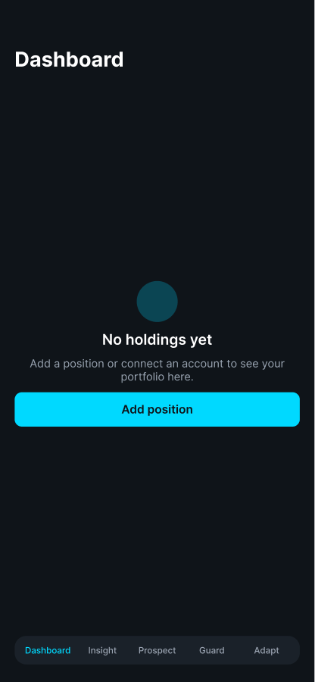
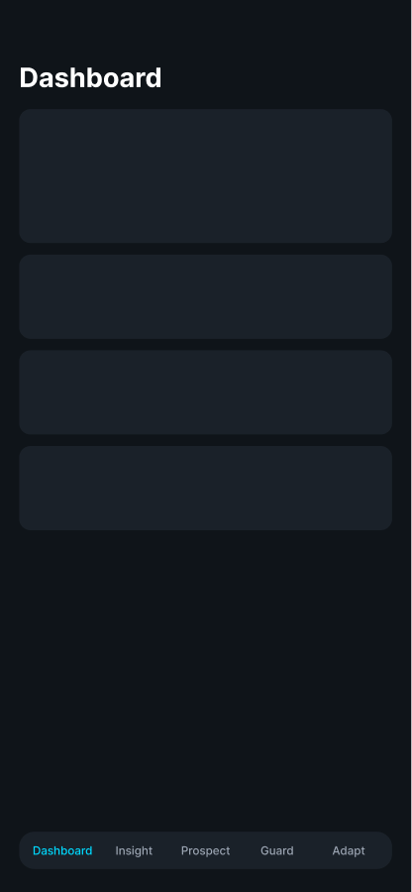
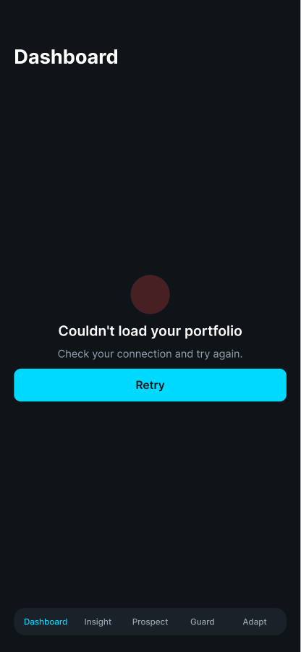
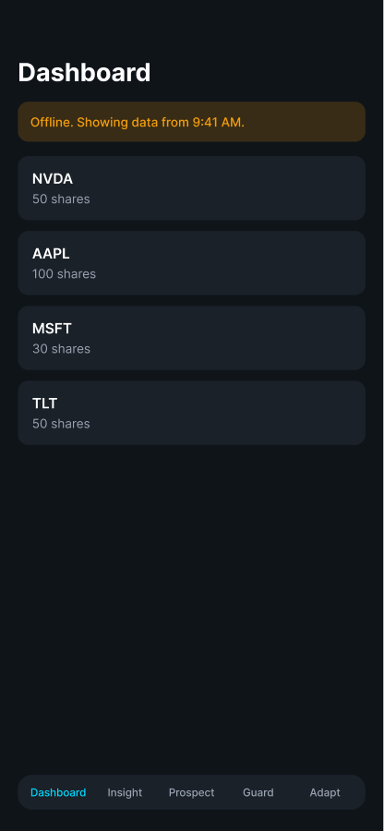
05 · Solution Meridian Navigator
Designing for the states that mocked data hides
Dashboard in four states. The other four screens follow the same pattern.
Empty
Loading
Error
Offline
No holdings yet. One clear next step.
Skeleton cards hold the layout while data loads.
Says what failed and offers a retry.
Warns that data is stale and shows the last update.

Slide 35
06 · Reasoning & trade-offs Meridian Navigator
Four calls, and what each one costs
DECISION 1
DECISION 2
Keep both share and dollar entry
Use a mock API with a 0.8-second delay
Why: Unclear which entry model new investors prefer.
Trade-off: Two flows to maintain. Open question for testing.
Why: Lets us test flows and loading states without a backend.
Trade-off: Real timing, errors and data limits stay untested.
DECISION 3
DECISION 4
Adapt suggests buys and sells
Five tabs, one home screen
Why: It is the screen’s job: a rebalance the user can review.
Trade-off: Buy and sell language needs compliance review. It may need to become explanation only.
Why: A scannable set of areas, with trading one tap away.
Trade-off: AI screens compete with trade entry for attention. Test it.

Slide 36
The agent experience
Reconceptualizing the AI from static cards to a bounded agent the user can see and steer.

Slide 37
06 · Agent experience Meridian Navigator
Where the AI experience breaks down today
Five problems, from the current prototype and the competitive audit. Mock data throughout.
1
Outputs without reasoning
Insight shows sentiment with no source, date, or data behind it.
2
All or nothing
Adapt proposes 5 buys and 3 sells. The user can approve or dismiss the batch, nothing else.
3
No learning loop
Dismissing or correcting an insight does not change future output.
4
Advice line in conflict
The design rule says the AI never originates buy or sell advice. Adapt wording does. Compliance review is open.
5
Context lost between screens
Moving from an insight to an order drops the reason, so the user re-enters it.

Slide 38
06 · Agent experience Meridian Navigator
Four concepts for a bounded agent
Each concept answers one of the breakdowns above.
CONCEPT 1
CONCEPT 2
Goal to plan
Autonomy levels
The user states a target, such as "keep technology under 40%." The agent drafts editable steps and shows the impact of each one.
Observe, Suggest, or Act within limits. The current level is always visible, with the user-set limits beside it.
CONCEPT 3
CONCEPT 4
Evidence on every output
Orders with their reason
Each insight links to its source, date, and data. No model-generated confidence percentage.
A trade started from an insight opens with its reason and the user’s own history, and offers a 48-hour pause.

Slide 39
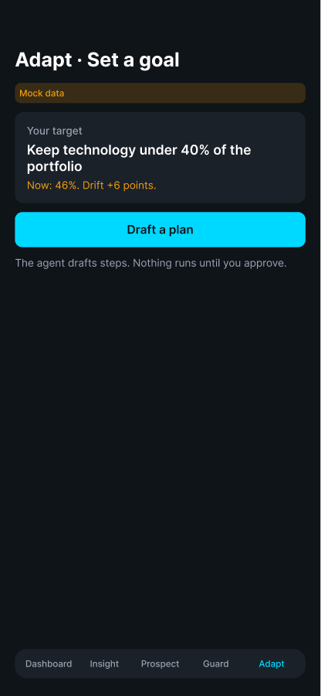
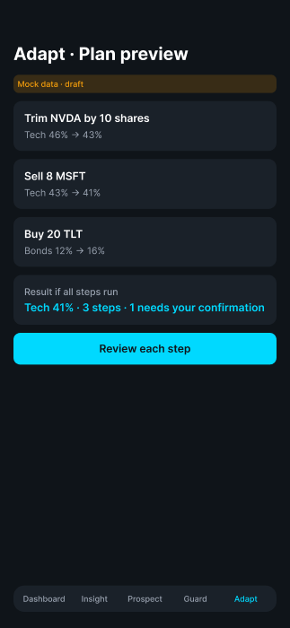
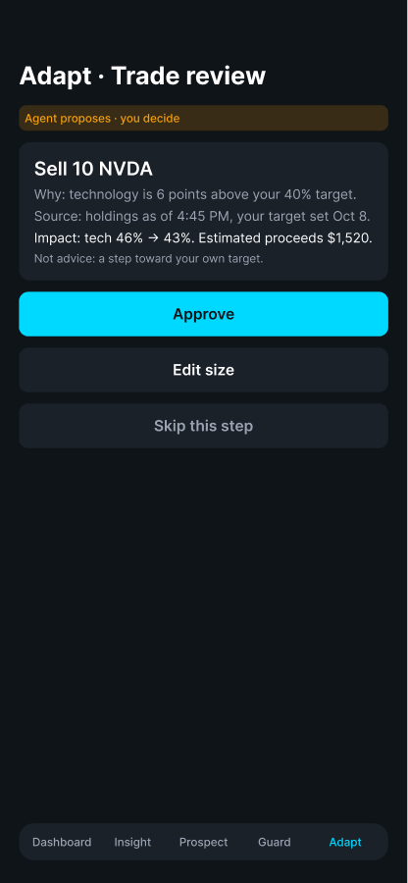
06 · Agent experience Meridian Navigator
Adapt as a plan, not a batch
Set a goal, review the plan, then approve each trade. Nothing runs without approval.
Set a goal
Plan preview
Trade review
The user states a target. The agent drafts a plan.
Each step shows its effect on the allocation.
Each trade shows its reason and source. The user approves, edits, or skips.

Slide 40
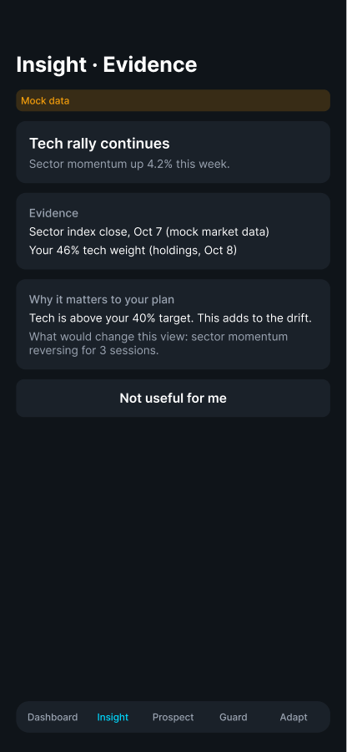
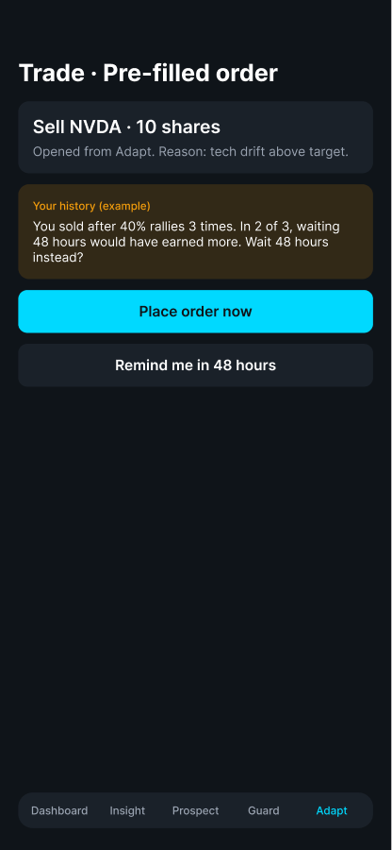
06 · Agent experience Meridian Navigator
Evidence on every insight, and orders that carry their reason
The reason travels with the order. Learned rules stay visible and reversible.
Insight with evidence
Order with its reason
Source, date, and the data behind the claim. "What would change this view" is stated.
Opened from Adapt with the reason, and a 48-hour option drawn from the user’s own history (example, mock data).

Slide 41
06 · Agent experience Meridian Navigator
What we would measure (planned, not run)
Hypotheses to test before any claim about the agent. None of these has data yet.
1
Time from insight to decision
Does evidence on the card shorten the decision?
2
Edit and reject rate on plan steps
Do users trust the plan enough to approve it as drafted?
3
Reversal rate of agent actions
Does Act within limits create regret, or stay trusted?
4
Learned rules kept or reversed
Do users value the learning loop, or do they switch it off?

Slide 42
Build and test
How the AI behaves, how it is built, and how we will check it.

Slide 43
07 · Methodology Meridian Navigator
How the AI behaves, and how we will test it
AI BEHAVIOR · DESIGNED, MOCK DATA
VALIDATION · PLANNED
Insight: sentiment summaries, with the screen as the source
Prospect: opportunity cards with upside and downside
Guard: alerts ranked by severity; mark as read
Adapt: before and after allocation, and a reviewable buy and sell list
Five-person think-aloud on the share and dollar flows
Comprehension check on Insight, Prospect, Guard and Adapt labels
Card sort on the five tabs
Compliance review of trade and AI copy

Slide 44
08 · Implementation Meridian Navigator
Built on SwiftUI, with tokens shared with Figma
WHAT IS BUILT
NEXT TO BUILD · PROPOSED
MVVM: one ViewModel per screen
MockAPIService with realistic data and a delay
DesignTokens.swift: colors, type and spacing
AuthManager: Face ID and Touch ID, Keychain storage
Figma library mirrors the same tokens
Real market data and quotes behind the mock service
Brokerage connection for order placement
Session and authentication with a real backend
Audit log for trade and AI actions

Slide 45
09 · Results & impact Meridian Navigator
What exists today, and what we still need to measure
5
8
3
20
core iOS screens, each with a ViewModel
steps in each trade flow: share and dollar
interactive prototypes published, plus this deck
hi-fi wireframe states on 06- Wireframes
OUTCOMES · NOT YET MEASURED
Time to complete a trade, task success, the share of users who open an AI screen in week one, and a usability score. Targets are planned and will be set with stakeholders before the first test.

Slide 46
10 · Learnings & next steps Meridian Navigator
What building this taught me, and what comes next
LEARNINGS
NEXT STEPS
1
One token source for Figma and Swift keeps the two in step.
Validate the three personas with five to eight interviews
Usability-test the share and dollar flows
Review the 20 wireframe states with stakeholders
Resolve the open questions on the FigJam board
Set metric targets with stakeholders
Schedule the compliance review
2
Settle AI boundaries before more screens. Adapt’s buy and sell wording needs compliance first.
3
Mock data hides timing and error states, so design them explicitly.
4
Keep working documents in one place: the FigJam board.

Slide 47
Working documents and links
FigJam board (working documents)
https://www.figma.com/board/OXpFHEhHcr2ZReOXKKPVxb
Meridian Wires (Figma)
https://www.figma.com/design/W9SuJ8HpznQuY6Fb3H442w
06- Wireframes (hi-fi states)
https://www.figma.com/design/W9SuJ8HpznQuY6Fb3H442w?node-id=5123-3942
New Trading Desk (Figma)
https://www.figma.com/design/w9xAlgyQeXToR54UPbv7wG
Case study deck (web)
https://claude.ai/artifact/TwRA3JxYaMduyLo1MfpcZe
Meridian HTML prototype
https://claude.ai/artifact/QKAHav3ku5fRX5UTnohzsZ
Code and docs (GitHub)
https://github.com/CHUNKY21/trading-platform
Some links need access. Share the FigJam board and prototypes from each tool’s share menu.

Slide 48
Appendix
FinViz case study: full appendix (61 slides)
Concept work, hero features, lo-fi iterations, and the alerts and chart-lens journeys.
Other work: Wells Fargo
Enterprise B2B design work, with discovery, design sprints and results.

