Slide 1

michaelthibodeau(UX) · Shipped work · 2016–2017 (confirm)
AMEX MOCA
Budget planning that partners trust enough to grow
“Comparing budgets and then optimizing it would allow me to have the confidence to increase the budget.”
AMEX sales partner, discovery interview
Lead UX designer
Discovery, strategy and hands-on design; co-design with data scientists; Sketch, Lean UX, usability testing; presented to client stakeholders.

Slide 2
Overview
At a glance
The problem
AMEX sales partners had no tool to help clients budget their advertising spend, compare scenarios, or see what each dollar would do.
The target
Raise partner approval (58% baseline), cut budget drop-off (5.4%) and time to build a budget (12 min), and grow average client budgets ($1.34M).
The decision I made
Turn budgeting into a 3-step flow: a guided wizard, a scenario builder down to channel and product, and a side-by-side comparison with an optimized plan the partner chooses.
What we gave up
One quick, single-plan form. Building and comparing scenarios adds a step (about 5 min of comparison) in exchange for confidence. (confirm)
The result
Partner approval 58% → 88%. Drop-off 5.4% → 3.4%. Time to build a budget 12 → 10 min. Average client budget $1.34M → $1.8M.
My role
Lead UX designer: discovery, strategy and hands-on design, working with data scientists over 12 Agile sprints. Team size (confirm).
michaelthibodeau(UX) · AMEX MOCA · 2

Slide 3
Results
What changed after launch
Measured against the baseline we set in discovery. (confirm the measurement period)
Partner approval
Budget drop-off
58% → 88%
5.4% → 3.4%
+30 pts
−2.0 pts
Time to build a budget
Average client budget
12 min → 10 min
$1.34M → $1.8M
−2 min
+34%
New capability: partners spend about 5 minutes comparing scenarios, a step that did not exist before.
michaelthibodeau(UX) · AMEX MOCA · 3

Slide 4
Context
The product, the people, the constraints
What MOCA is
A desktop budgeting application that uses algorithmic engines to project a marketer’s potential budget, and to compare constructed and optimized budget scenarios.
Who uses it
AMEX sales managers and sales advisors, building advertising budgets with their external clients across AMEX product lines and channels.
Used rarely
Partners build a plan every 6–12 months, so every visit feels like the first.
High stakes
Average client budget of $1.34M at baseline; partners had to defend each allocation.
A desktop app among others
It had to sit beside other desktop tools and connect to them through APIs.
michaelthibodeau(UX) · AMEX MOCA · 4

Slide 5
Discovery
What partners told us
How we learned
Interviews with stakeholders, SMEs and users (sales managers and advisors)
Contextual interviews
Personas
Co-design sessions with data scientists
“If I could build a plan down to the product line and channel, I’d be super happy, but I’d also be able to customize each quarter.”
Sales partner
What we learned
Partners want to compare budget scenarios, not fill in one plan
They need to see, in a chart, how effective each scenario is
They want to adjust each channel, and each product inside a channel
Short term vs long term matters to every decision
Because they plan only every 6–12 months, they need guidance
michaelthibodeau(UX) · AMEX MOCA · 5

Slide 6
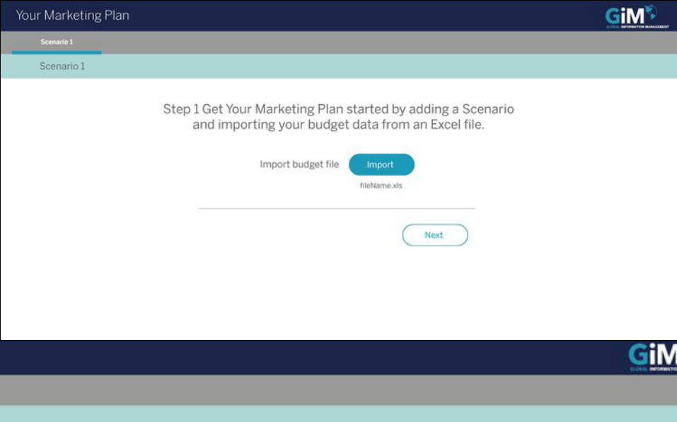
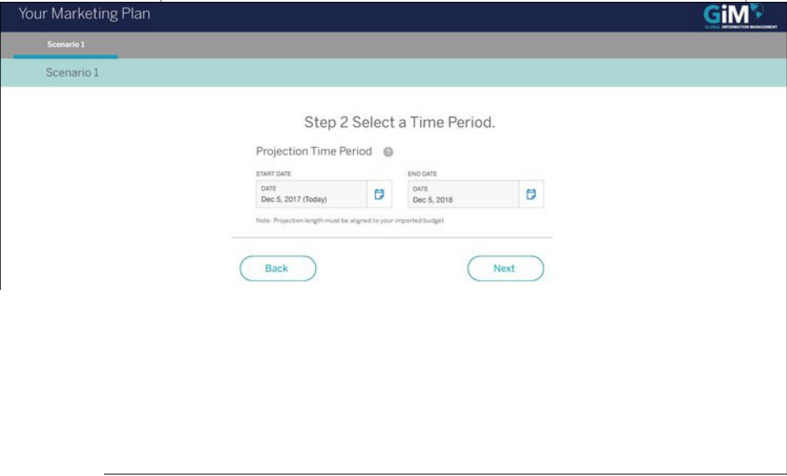
Key decision 1
Guide the first visit with a wizard
Why
Partners plan only every 6–12 months, so each visit feels like the first. A short wizard sets the essentials: import last year’s budget from Excel, then pick the time period.
Trade-off
A few extra steps for the rare expert who knows the tool. We kept them short and skippable once data is imported. (confirm)
michaelthibodeau(UX) · AMEX MOCA · 6

Slide 7
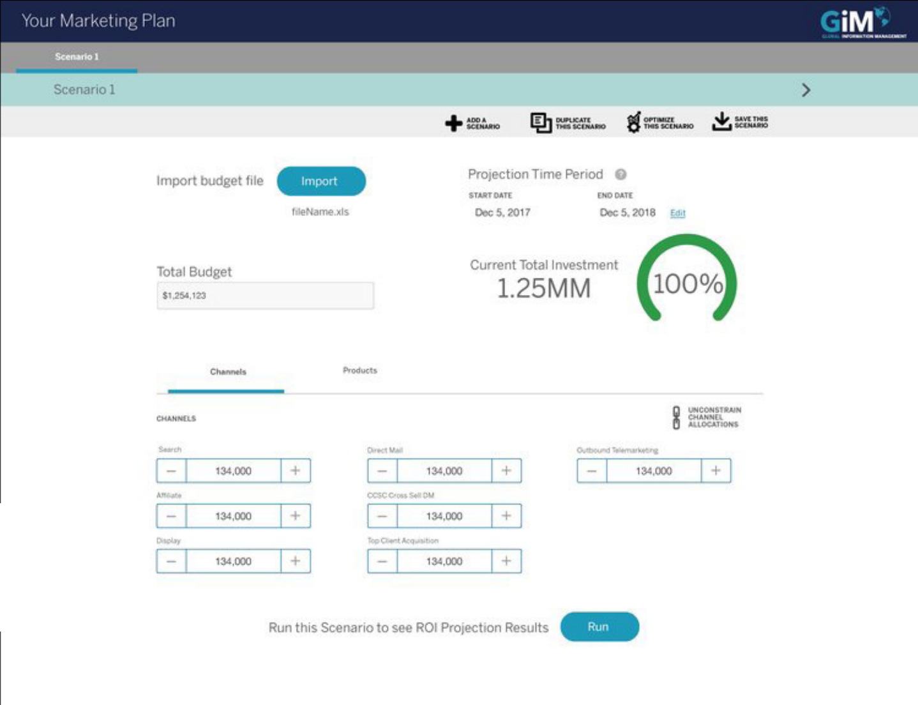
Key decision 2
Build the plan down to channel and product
Why
Partners asked to “build a plan down to the product line and channel”. Each allocation is adjustable, starting from an imported budget kept as a template, so a second plan starts from the first.
Trade-off
More controls on one screen. Channels and products sit on separate tabs, and a running total shows how much is left to allocate.
michaelthibodeau(UX) · AMEX MOCA · 7

Slide 8
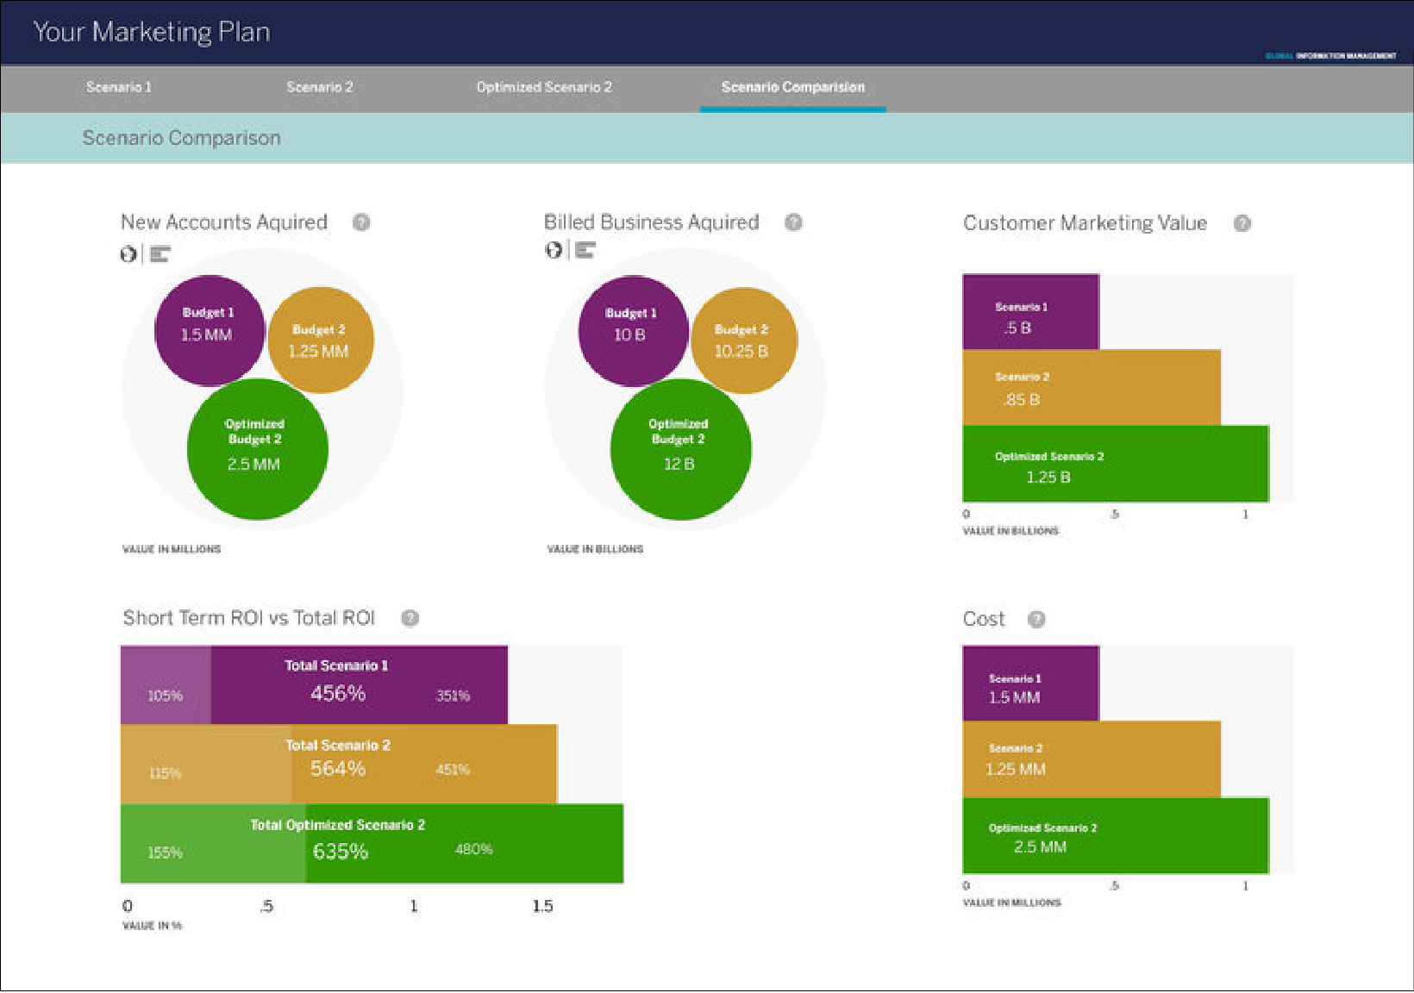
Key decision 3
Compare scenarios; the partner chooses
Why
Confidence came from comparison. Scenarios sit side by side with an optimized plan from the data scientists’ engine, shown with the metrics partners care about: accounts, billed business, ROI, cost.
Trade-off
The optimizer proposes; it does not decide. The partner picks the plan and can see why the optimized one differs, so trust stays with them.
michaelthibodeau(UX) · AMEX MOCA · 8

Slide 9

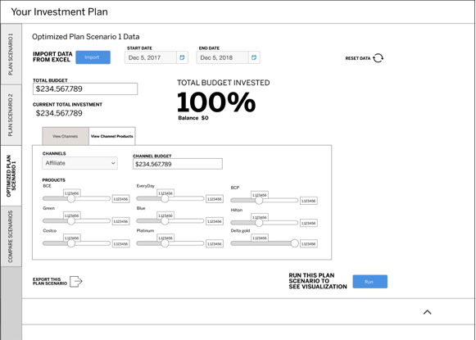
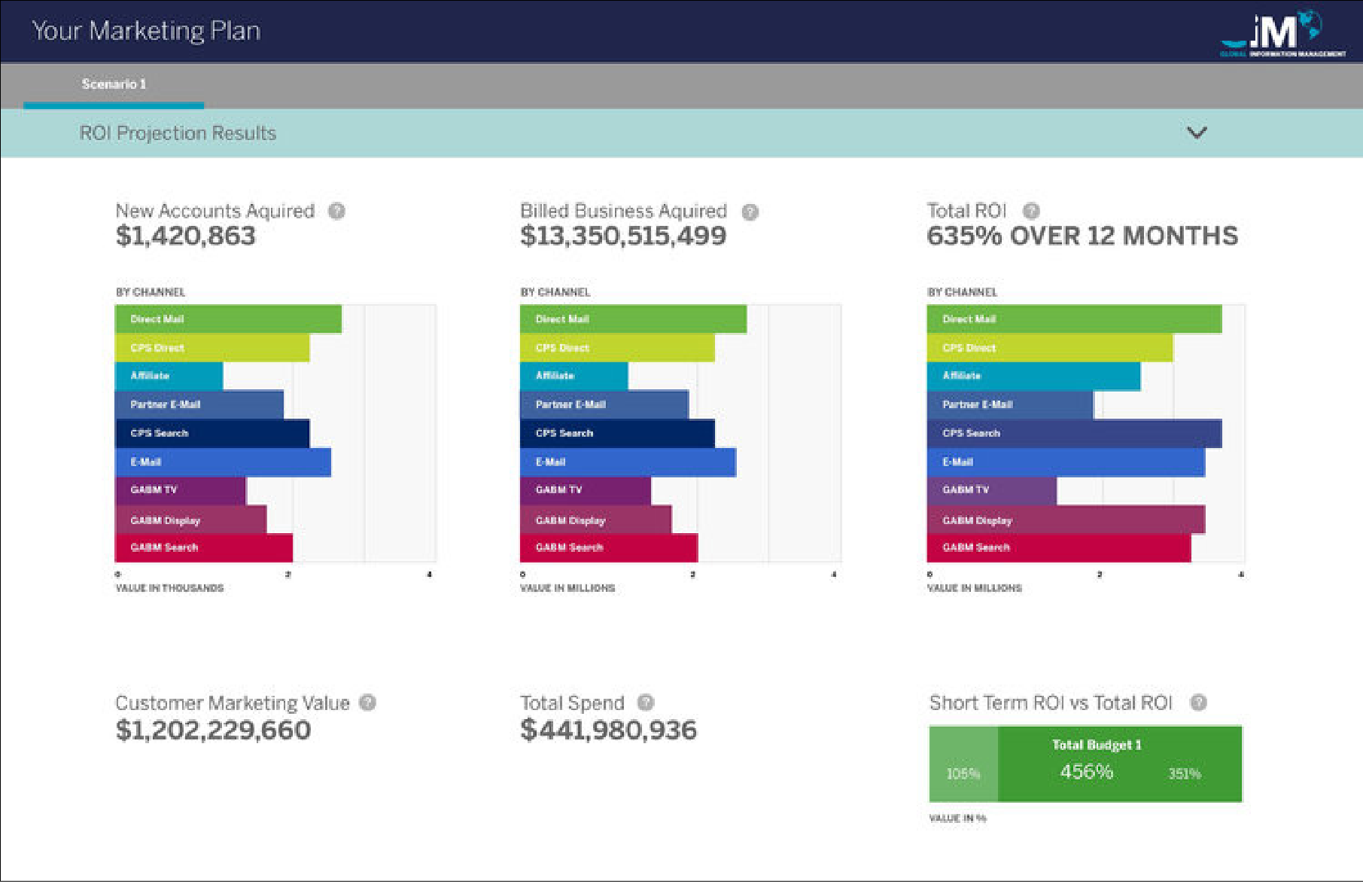
Iteration
From sketch to shipped, and what testing changed
Sketch
Mid-fidelity
Final: ROI projection
What testing changed
Duplicate an imported budget as a template: users wanted to start plan two from plan one
Reset became its own tool, after users kept looking for it
The navigation bar with a toolbar scored high and stayed
Short term vs long term became a first-class view
Exporting, duplicating and saving moved up: partners called them vital
Toggling chart types stayed; channel breakdown was called “a game changer”
michaelthibodeau(UX) · AMEX MOCA · 9

Slide 10

How I led
Leading from the work
My role
Owned discovery, research and UX strategy
Designed the flows and screens myself, from sketches to final
Ran Lean UX and usability testing on a regular cadence
Presented the work to the client and key stakeholders
Working with data scientists
Co-designed with the data scientists who built the projection and optimization engines, so the interface showed what the models could support and nothing more.
Delivery
12 Agile sprints · usability testing every cycle · demos and QA
michaelthibodeau(UX) · AMEX MOCA · 10

Slide 11
Reflection
What I’d do differently today
The fundamentals held up. With today’s tools I would change the level, not the goal.
Explain the optimizer, line by line
Show why the optimized plan moves money between channels, in the partner’s terms, so trust comes from understanding.
Prototype the engine early, in code
Test real projections with partners in week one, instead of after the model was built.
Measure trust, not just completion
Track how often partners pick the optimized plan and why they change it, as a guardrail on the model.
If we can measure it, we can manage it. MOCA set its baseline in discovery and reported against it after launch: the habit I bring to every project.
michaelthibodeau(UX) · AMEX MOCA · 11

Slide 12
Michael Thibodeau
I design AI people can trust with their money, and I lead teams that build it fast.
michaeljthibodeau.com · michaelthbd@yahoo.com · 646-436-2876

