Slide 1
PEIC Final Project Final Presenstation
Group1: 邱于瑄、林均翰、劉展佑、張顥譽
Presenter:張顥譽
Date:2026.05.07

Slide 2
Outline
Topic
Introduction
Design Spec.
Behavior analysis and simulation

Slide 3
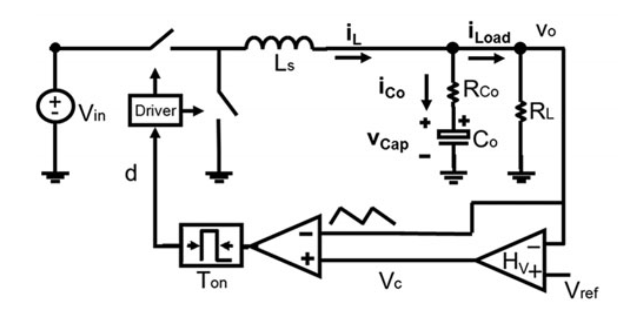
Project plan
V² Constant ON-Time control for point of load (POL) buck
Motivation
Ultrafast Transient Response
Simple Implementation (no current sensing resistor)
Spec & Application:
Vin = 12V, Vo = 1.2V Io = 0.5A to 10A
CPU or GPU in mobile device

Slide 4
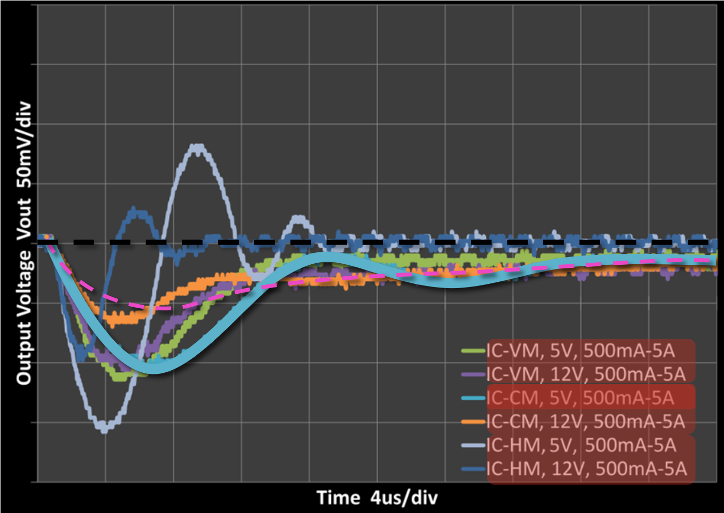
Literature review - comparison among three control modes
Load transient:
Voltage mode with input voltage feedforward(VM):
No VIN difference, no ringing.
Recovery time ~ 15us
Peak Current mode (CM)
Inner current-loop ringing before VOUT recovery.
Recovery time ~ 15us
Hysteretic mode (ripple-based COT, HM)
Ringing and bigger undershoot (less COUT)
Recovery time ~ 5us-10us
https://www.ti.com/content/dam/videos/external-videos/en-us/1/3816841626001/5348922826001.mp4/subassets/Compare-and-Contrast-Fixed-Frequency-vs-Constant-On-Time-Converters.pdf

Slide 5
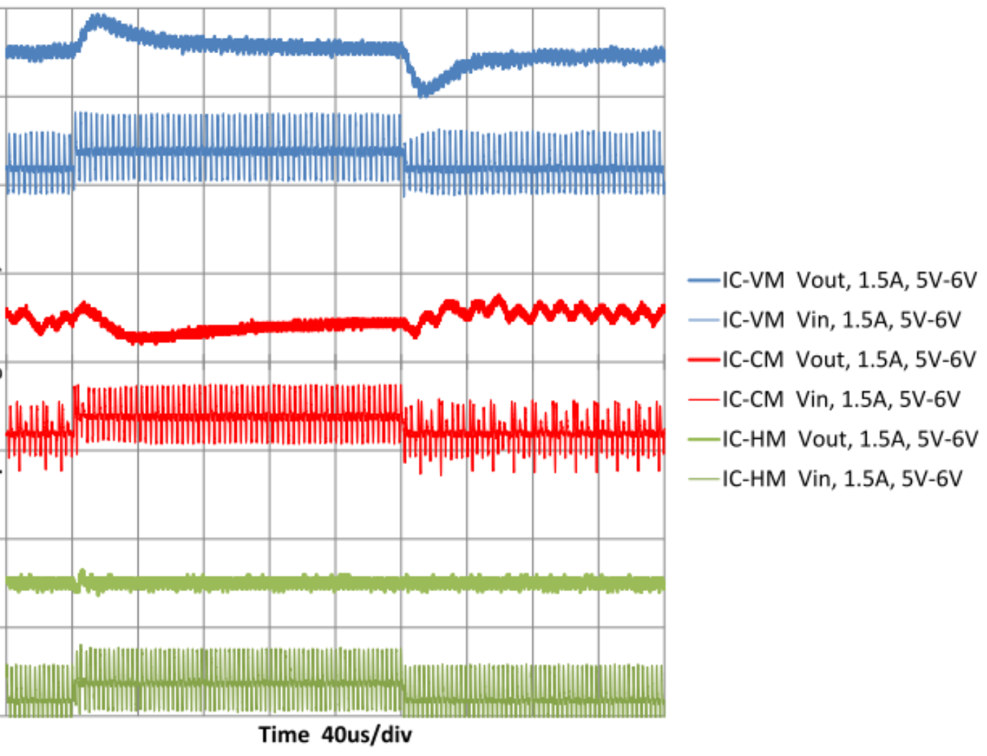
Literature review - comparison among three control modes
Line transient:
Voltage mode with input voltage feedforward(VM):
Smooth waveforms
Recovery time ~ 40us
Peak Current mode (CM)
Edge of stability (0.1uF input cap)
Recovery time ~ 80us
Hysteretic mode (ripple-based COT, HM)
Perfect response
Recovery time (can’t observe glitches)
https://www.ti.com/content/dam/videos/external-videos/en-us/1/3816841626001/5348922826001.mp4/subassets/Compare-and-Contrast-Fixed-Frequency-vs-Constant-On-Time-Converters.pdf

Slide 6
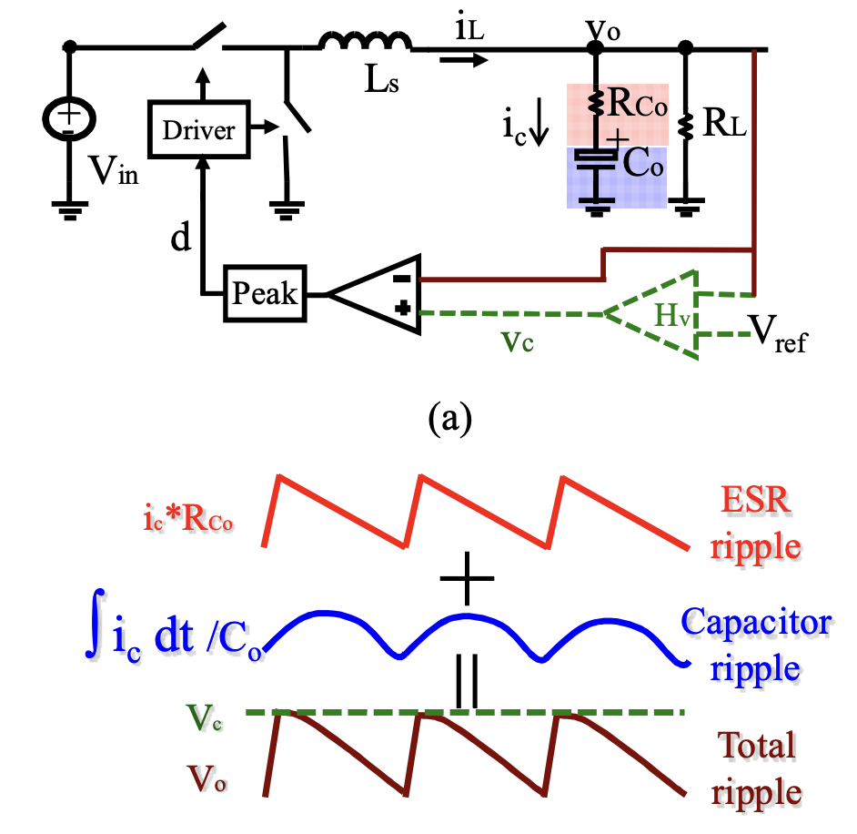
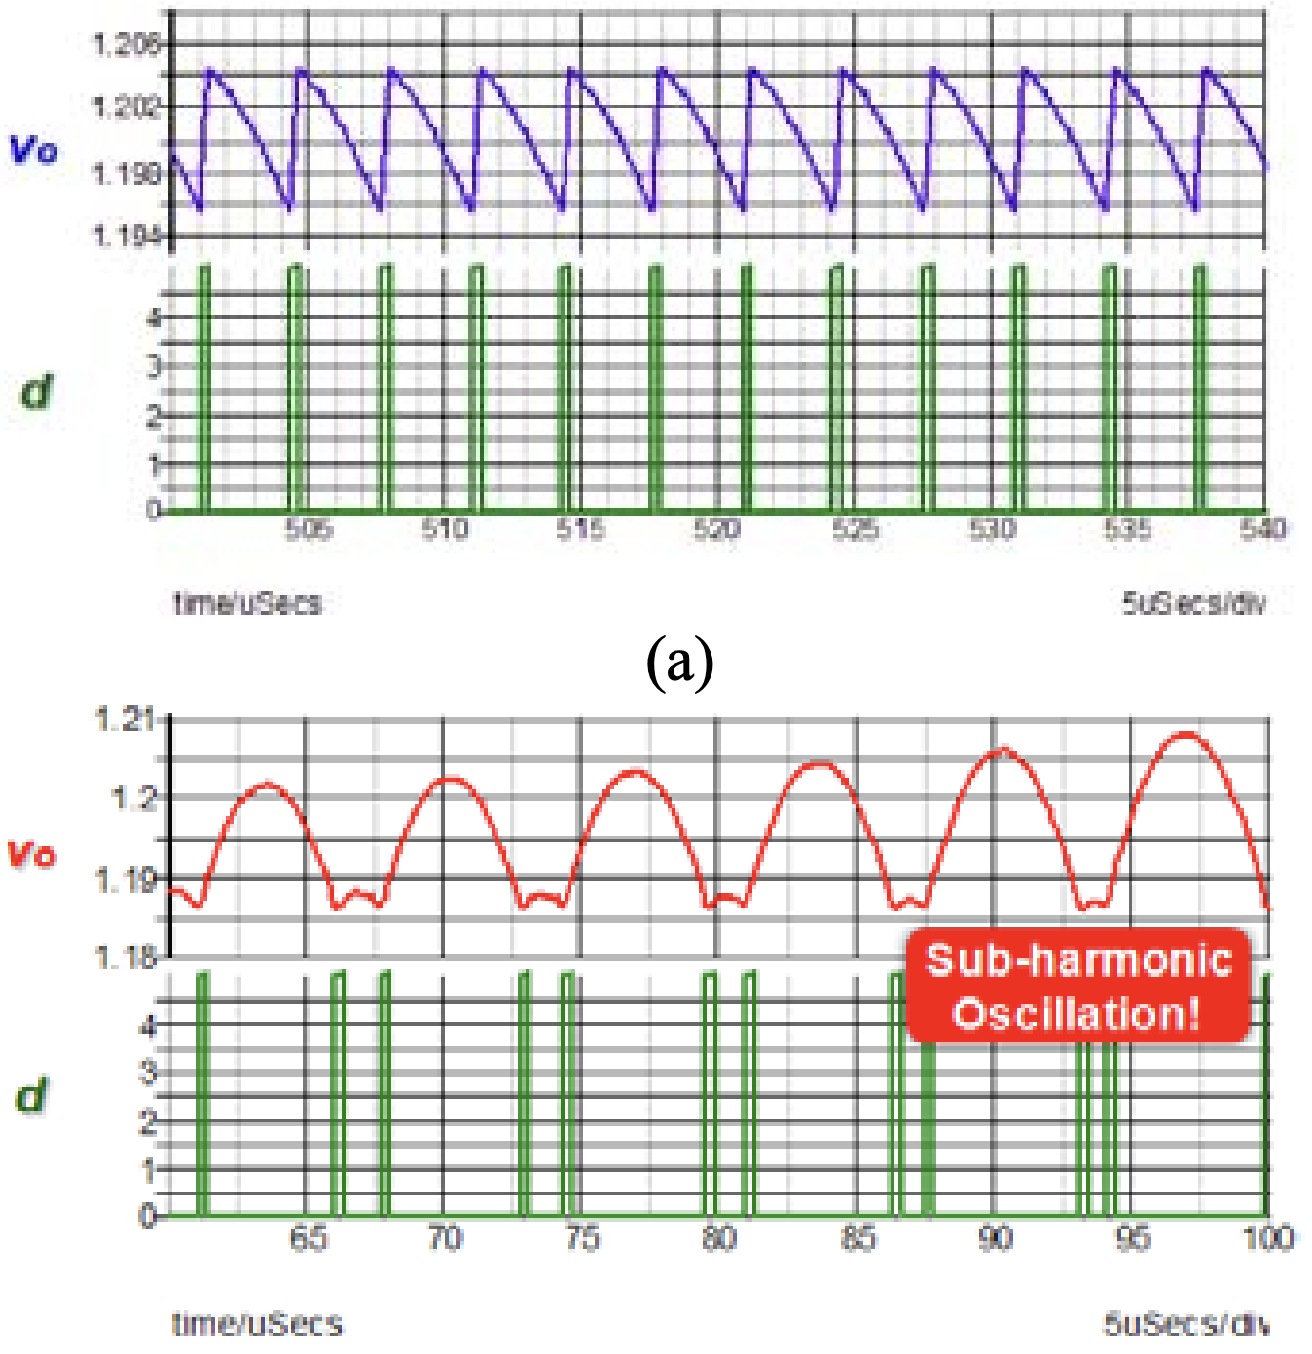
Literature review – Problem of COT
Subharmonic Oscillation:
Both the inductor current and the capacitor voltage ripple information is fed back to the modulator
No subharmonic oscillation in the constant on-time control
Delay due to the capacitor ripple results in sub-harmonic oscillation
System is stable when used with the OSCON capacitor, because the inductor current information dominates the total output voltage ripple
Subharmonic oscillation occurs when the ceramic capacitor is used with the constant on-time control, since the capacitor voltage ripple is relatively too large
Li, Jian, and Fred C. Lee. "Modeling of ${\rm V}^{2} $ Current-Mode Control." IEEE Transactions on Circuits and Systems I: Regular Papers 57.9 (2010): 2552-2563.

Slide 7
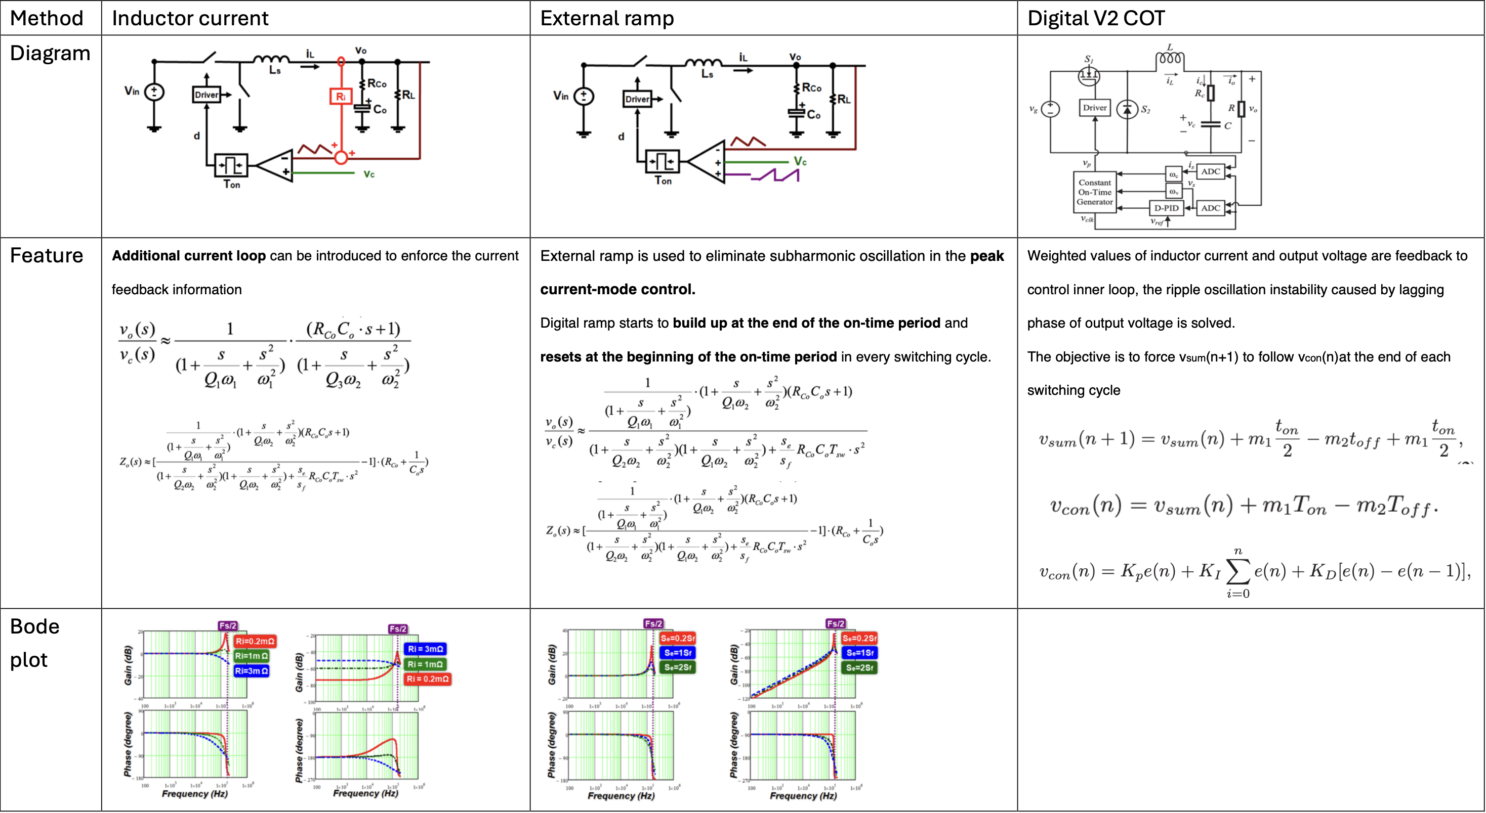
Literature review – Solution to Subharmonic
Hu, Kai-Yu, Chien-Hung Tsai, and Chien-Wu Tsai. "Digital V 2 constant on-time control buck converter with adaptive voltage positioning and automatic calibration mechanism." IEEE Transactions on Power Electronics 36.6 (2020): 7178-7188.
Li, Jian, and Fred C. Lee. "Modeling of ${\rm V}^{2} $ Current-Mode Control." IEEE Transactions on Circuits and Systems I: Regular Papers 57.9 (2010): 2552-2563.

Slide 8
To-do item
Behavior model simulation (SIMPLIS)
Confirm final spec of the power stage

